Slide 1
How many chips do you need? Simulation Studies of Sample Size in Microarray Experiments
Peng Liu¹ and Gregory R. Warnes²
¹Dept of Biological Statistics and Computational Biology,
Cornell University
²Non-Clinical Statistics,
Pfizer Global Research and Development

Slide 2
Biological Background
Monitoring gene expression helps understand the cellular mechanisms for all biological processes.
Microarray technology allows measuring expression levels of thousands of genes simultaneously.
Important applications for pharmaceutical research include:
  Determine regulatory and metabolic pathways
  Identify potential biomarkers and targets
  Determine mechanism of action and toxicity
  Evaluate / predict safety

Slide 3
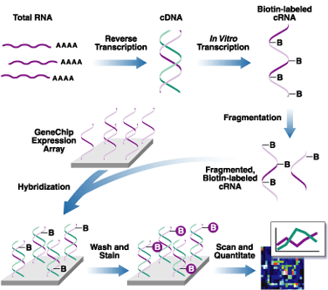
Biological Background
Procedure of Microarray Experiment
Figure source: affymetrix.com

Slide 4


How many chips do you need?
Gene expression experiments are expensive:
  ~ $2,000 per chip for Affymetrix experiments.
  Data analysis takes considerable time.
? How many chips are needed for reliable results without wasting money and time?
➔Estimate sample size before experiments!
  What is a robust and simple statistical method?

Slide 5
Statistical Background
Huge dimension of variables (expressions) and Dependencies between genes for microarray data
Problems for sample size calculation:
  How to handle multiple comparison?
  How to deal with dependencies?
  One effect size or many?
  One power or many?
  Many variables, how to get a single answer?
Traditional methods for calculating sample size do not directly apply.

Slide 6
What are possible approaches?
Two extremes:
Treat each variable (gene) as a separate and independent problem, then summarize
  + easy to set up, understand, explain
  + available data can be used
  - may not be sufficiently realistic, hence accuracy may suffer
Model the entire system, including realistic error structure and interdependencies
  + may be more accurate (if model is good)
  - more initial work to set up / compute
  - may require substantial new data to be realistic
  - may be hard to understand, explain

Slide 7
What approach was chosen and why?
Treat each variable (gene) as a separate and independent problem, then summarize
Why?
  Approximations usually yield a useful information with minimal effort.
  Answers were needed immediately.
  At best, results would only be used for general guidance
  A more realistic error model didn’t work:
  Warnes and Li tried fitting the model from Zien, et al (2002). However, the model appears to be non-identifiable.

Slide 8
Proposed Method by Warnes & Li
Estimate per gene standard deviation from existing studies
Assume standard 2-sample t-tests with pooled variance on each gene
Control multiple-testing error via:
  Bonferroni adjustment (strong control of family-wise Type I error)
Compute sample size separately for each gene
Summarize via cumulative plots

Slide 9
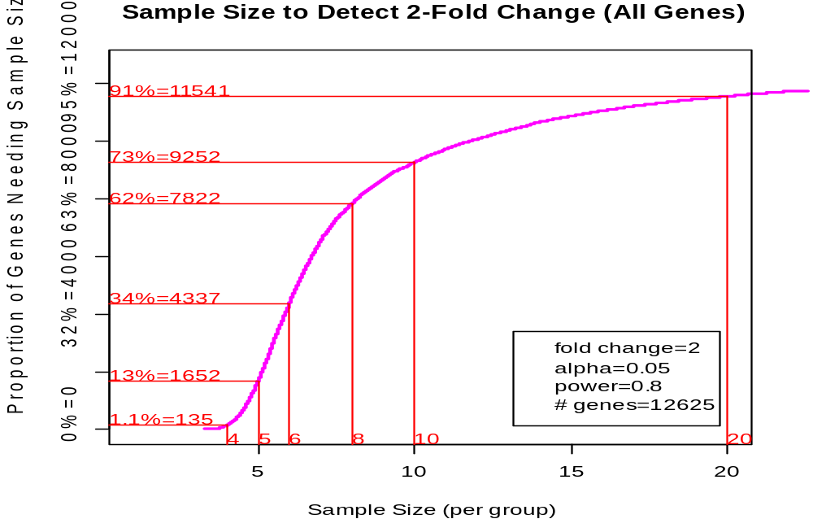
Proposed Method by Warnes & Li
Sample Size to detect 2-fold change
Prop’n of genes needing s.size ≤ n
Sample Size / group

Slide 10
Simulation Study
Check performance of proposed method under
  Violation of assumptions:
    Equal variance
    Independent observations
  Changes to:
    Proportions of genes with true difference
    Minimum effect sizes
    Multiple comparison method
in order to
  Investigate the effects of different influencing factors
  Provide a practical guide for sample size selection.

Slide 11
Simulation Study: Variables
Assumptions (Violations) | Simulation Variable | Tested levels | Description
Independence (Dependence) | fractn.dep | 1, 0.8, 0.5, 0 | Proportion of observations that are dependent
Equal Variance (Unequal Var) | Var.ratio | 1, 3, 10 | Variance ratio between two treatments
Normal Distribution (Not normal) | Not Tested | N/A | Usually data transformation and normalization generate normal data

Slide 12
Simulation Study: Variables
Description | Simulation Variable | Tested levels
Proportion of genes with true differential expression | Fractn.alt | 1, 0.5, 0.1, 0.05
Minimum effect size required for scientific relevance | Delta | 1, 2
Choice of multiple testing procedure | Multiple Testing Procedure | Bonferroni FDR*
FDR (false discovery rate = expected false positives among significant tests)

Slide 13
Simulation Study: Flow Chart
Specify simulation variables; Sample standard deviations and covariance matrices from real data
Generate 1 sample
Generate many samples
Estimate σ²_{g} based on generated sample
Perform t-test for each sample
Estimate sample size based on proposed method
Pool test results to calculate true power
Compare results for cumulative plot of sample size

Slide 14
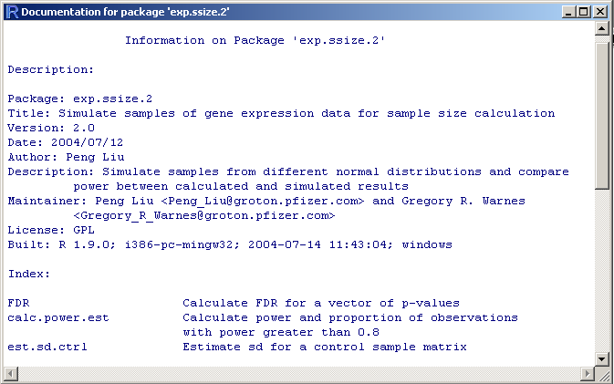
Computer Coding with R
Built a R package for simulation study

Slide 15
Computer Coding with R
18 Functions in exp.ssize package:
Function | Description
sample.genes.dep | Simulate observations given the covariance matrix for normal distribution
sample.genes.ind | Simulate observations from independent normal distribution given sd
calc.power.est | Calculate power and proportion of observations with power greater than 0.8
… | …
tdecision.multiComp | Get the test decision based on FDR procedure or Bonferroni adjustment for a matrix of p-values

Slide 16

Computing Challenges
Simulation needs computations for:
192 set of variables
X 986 set of samples
= 189,312 sample sets, each with
400,000 observations
➔ 120 days of computation with ~895 MHz Intel CPU
Fortunately: Independent sample sets make this an “Embarrassingly parallel” problem
➔ parallel/cluster computers are very efficient

Slide 17
How to speed up the computation?
PVM (Parallel Virtual Machine)
  Tasks are allocated to many abstract computer nodes.
  Dynamic message passing and communication allow the cooperation between different computer nodes.
Time for processes
Computer Nodes

Slide 18
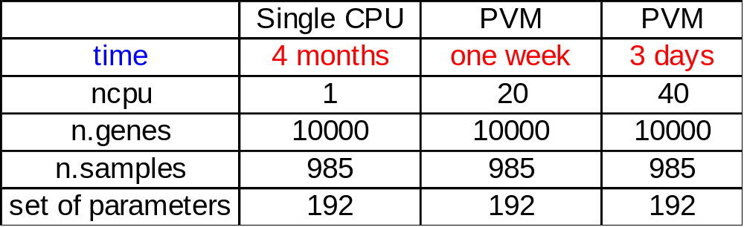

R packages for PVM
rpvm (R interface for PVM)
SNOW (Simple R wrapper for parallel computing)
Reference: http://cran.us.r-project.org/
Comparison of Computation Time
Computation is much faster with PVM!

Slide 19
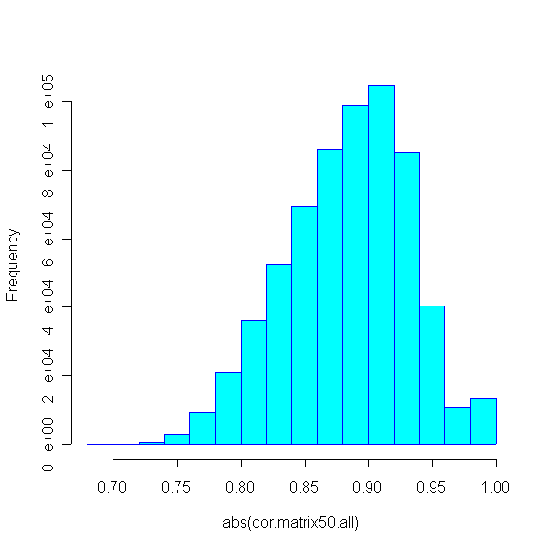
Observations
Gene expression data are highly correlated
  In this data set, each gene is highly correlated with
  at least 50 other genes:
Histogram of top 50 correlation coefficients for each gene
abs(correlation coefficient)

Slide 20
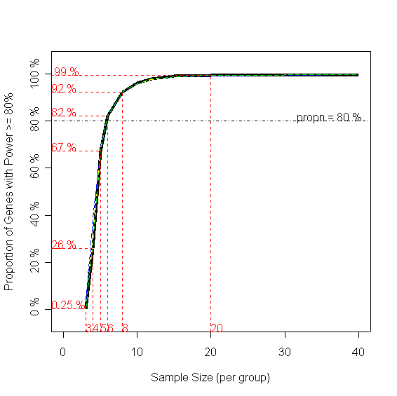
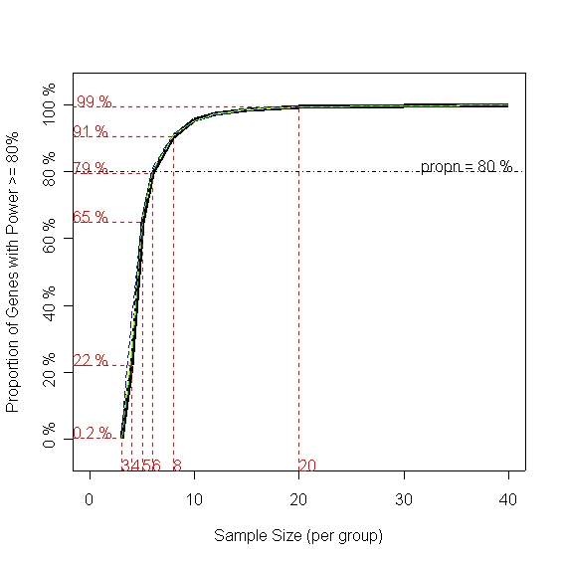
Results: Proportion of dependent observations
Black: Simulation Colors: Estimation
All genes are indep.
All genes are dependent.
Prop’n with power ≥80%
Sample Size / group
Sample Size / group
Sample Size / group
Sample Size / group
→ No effect on estimate quality

Slide 21
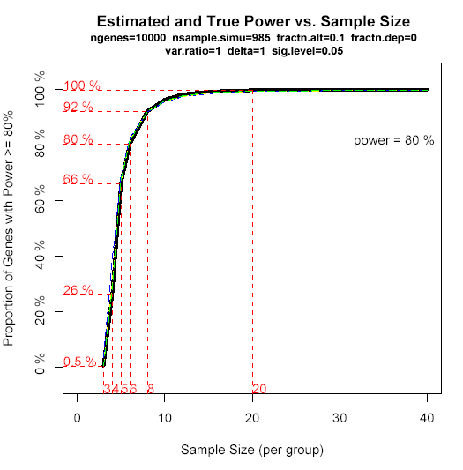

Results: Proportion of truly changed genes
Black: Simulation Colors: Estimation
All genes are diff. expressed.
10% genes are diff. expressed.
Prop’n with power ≥80%
Sample Size / group
Sample Size / group
→ No effect on estimate quality

Slide 22
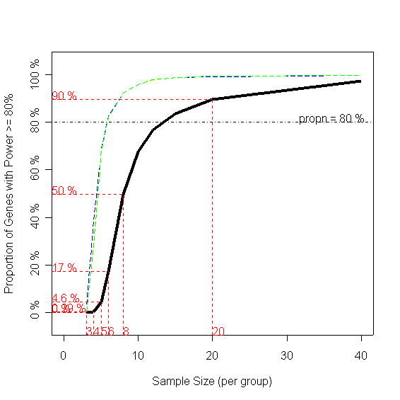
Results: Variance ratio between treatments
Black: Simulation Colors: Estimation
Var ratio = 1
Var ratio = 10
Prop’n with power ≥80%
Sample Size / group
Sample Size / group
→ Large effect on estimate quality

Slide 23
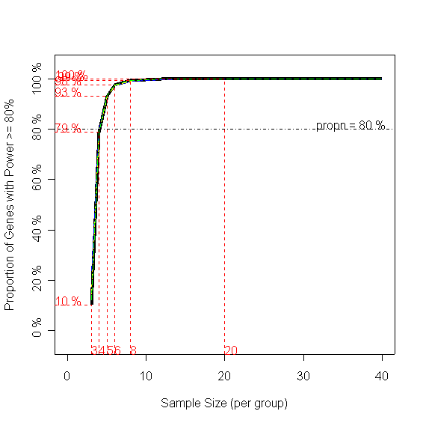
Results: Minimum effect size
Black: Simulation Colors: Estimation
2-fold change
4-fold change
Prop’n with power ≥80%
Sample Size / group
Sample Size / group
→ No effect on estimate quality

Slide 24
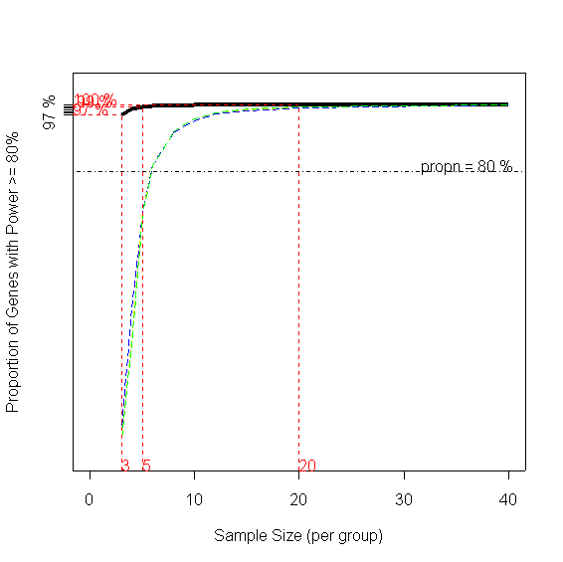
Results: multiple testing procedure
Black: Simulation Colors: Estimation
Bonferroni adjustment
FDR
Prop’n with power ≥80%
Sample Size / group
Sample Size / group
→ Large effect on estimate quality

Slide 25
Summary of Effects
Variable | Effect | Details | Comments
Proportion of dependent observations | little |  | Current method works well here
Var ratio between two treatments | large | Large var.ratio → small power | Sample size estimator needs to account for this
Prop’n of true diff. expressed genes | little |  | Current method works well here
Minimum effect size | mild | Large delta → large power | Current method works well here
Multiple Testing Procedure | large | FDR → large power | Use FDR instead of Bonferroni

Slide 26
Results: Example of Sample Size Guide Table
For minimum effect size = 2-fold, all genes are from dependent groups, using Bonferroni method
True sample size based on simulation
 | Proportion of genes with true differential expression
var. ratio | 1 | 0.5 | 0.1 | 0.05
1 | 6.1 | 5.8 | 6.1 | 6.0
3 | 8.1 | 8.0 | 8.0 | 7.9
10 | 14.1 | 14.1 | 16.6 | 14.2
Estimated sample size = 6.0

Slide 27
Future Research
Apply FDR procedure to control error for multiple testing.
Extend simulations to show power for ANOVA.
Provide a Web page with a general R package for biologists to estimate sample size.

Slide 28
References
Methodology
  Chow SC , Shao J, Wang H (2003). Sample Size Calculation in Clinical Research. Marcel Dekker
  Benjamini Y, and Hochberg Y (1995) Controlling the false discovery rate: a practical and powerful approach to multiple testing. J. Roy. Statist. Soc. B, 57, 289–300.
R Software: www.r-project.org
Parallel Computing with R:
  Rossini AJ, Tierney L, and Li N (2003) Simple Parallel Statistical Computing in R. UW Biostatistics Working Paper series, paper 193 http://www.bepress.com/uwbiostat/paper193/
Me
  Department of Biological Statistics & Computational Biology, Cornell University, Ithaca, NY
  PL61@cornell.edu

Slide 29
Acknowledges
Supervisor:
  Gregory R. Warnes
Computing facilities:
  Nitin Jain, JC Lawrence
  David P. Dean, Gautam Bhola
  CIT Helpdesk Staff
General help:
  Members of Non-Clinical Statistics

Slide 30
Thanks for coming!

