Slide 1
Sample Size Estimation for Omics Experiments
Gregory R. Warnes
Center for Biodefense Immune Modeling
Department of Biostatatistics and Computational Biology
University of Rochester
Peng Liu
Department of Statistics
Iowa State University

Slide 2
Abstract
"Omics" technology is widely applied in biomedical and pharmaceutical research. The huge number of individual measurements for each sample make it difficult to apply traditional sample size calculation techniques and has left most practitioners to rely on rule-of-thumb techniques. In this paper, we describe and demonstrate a simple method for performing and visualizing sample size calculations for ``omics'' experiments. We then summarize simulation results showing that this method performs well, even under a variety of departures from our simplifying assumptions, provided that the underlying formula for computing sample size has been appropriately selected. Although we demonstrate sample size calculation only for the two-sample pooled t-test, it is trivial to substitute an alternative sample size formula appropriate to the problem at hand.

Slide 3
Outline
What is the Context? (Biological Background)
What is the Problem? (Omics Sample Size Calculation)
What Aproaches are Possible?
What is our Approach?
  Description
  Example
How Well Does this Approach Work?
  Simulation Study Design
  Simulation Study Results
Software
Summary & Future Work
References

Slide 4
Biological Background
In order to study cellular biological processes effectively, we need to measure the acting components:
  Understand/model disease processes
  Determine regulatory and metabolic pathways
  Identify potential biomarkers and targets
  Determine chemical or disease agent mechanism of action
  Evaluate/predict effect of agents
There are millions of biological components
  DNA, mRNA, Proteins, Enzymes, Metabolites, …
“Omics” technologies
  Measurement of huge numbers of biological components
  Relatively simple biological assay.

Slide 5
What is the problem?
Omics experiments are expensive:
  Lab processing time
  Materials
    Approx. $1,000 per sample for Affymetrix microarray experiments.
  Data analysis time
Good experimental design is important to avoid wasting resources
  Key issue: How many observations are required

Slide 6
Standard sample size calculation
For a single outcome variable, given
simple design (e.g., two--sample t-test),
effect size δ (ideally, minimum practical significance),
population variance σ²,
significance level α (probability of a false positive when no true effect)
power β (probability of a true positive given the defined effect size),
It is straightforward to compute the required sample size n (see e.g. Cochrain& Cox (1957)

Slide 7
Omics Sample Size
Challenges:
  Huge number of variables (e.g. 72K mRNA expressions)
  Dependencies between variables
Issues:
  How to handle multiple comparison?
  How to deal with dependencies?
  One effect size or many?
  One power or many?
  Many variables, how to get a single answer?
Traditional methods for calculating sample
size do not directly apply.

Slide 8
Possible approaches
Two extremes:
Treat each variable (gene) as a separate and independent problem, then summarize
  + easy to set up, understand, explain
  + available data can be used
  - may not be sufficiently realistic, hence accuracy may suffer
Model the entire system, including realistic error structure and interdependencies
  + may be more accurate (if model is good)
  - more initial work to set up / compute
  - may require substantial new data to be realistic
  - may be hard to understand, explain

Slide 9
What approach was chosen?
Approach:
  Treat each variable (gene) as a separate and independent problem, then summarize
Why?
  Approximations usually yield a useful information with minimal effort.
  Answers were needed immediately.
  At best, results would only be used for general guidance
  A more realistic error model didn’t work: Zien, et al (2002)
    Model is non-identifiable
    Described approach requires “back of envelope” guesses for parameter values

Slide 10
Our Method
Estimate per variable standard deviation from existing studies
Assume standard 2-sample t-tests on log(variable) with pooled variance for each variable
Control multiple-testing error via Bonferroni adjustment (strong control of family-wise Type I error)
Compute sample size separately for each variable
Summarize via cumulative plots

Slide 11
Plots
Generate cumulate plots of # of variables:
  Fixed α, δ, 1-β vs. sample size (e.g. n=5/group,6/group,...)
  Fixed α, δ, n vs. power (eg. 1-β= 60%, 70%, 80%, ...)
  Fixed α, 1-β, n vs. effect size (δ=1.5x, 2.0x, 2.5x, ...)

Slide 12
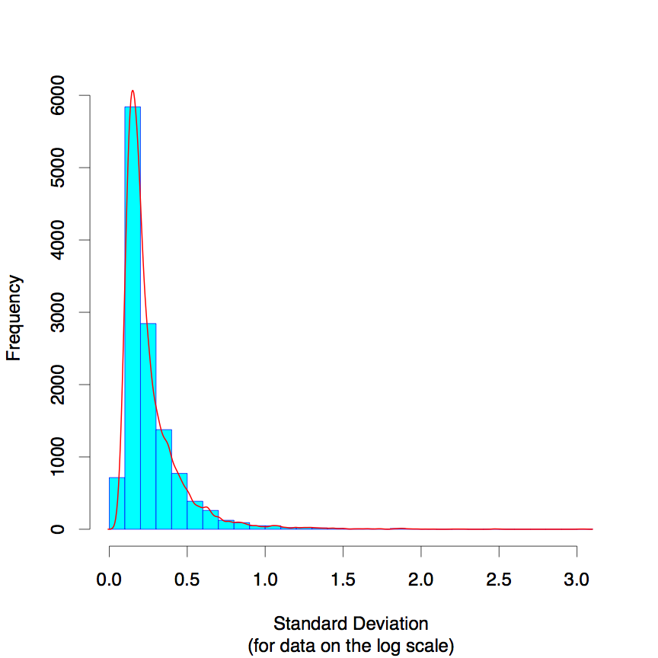
Distribution of Variances

Slide 13
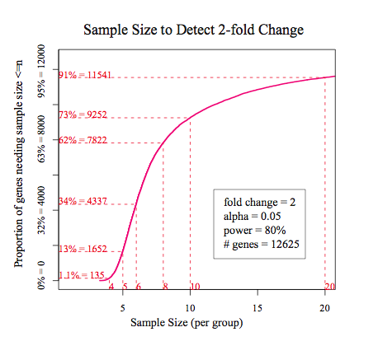
Sample size

Slide 14
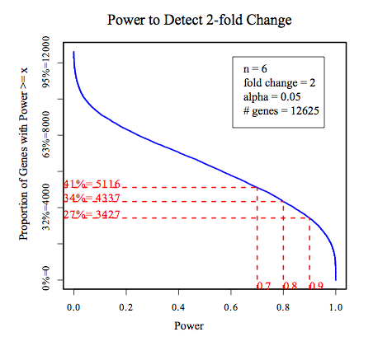
Power

Slide 15
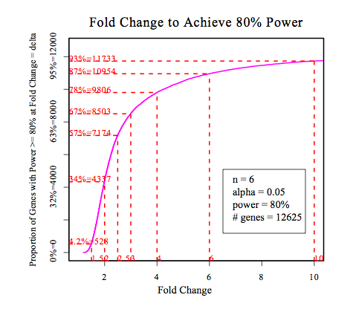
Effect size

Slide 16
Simulation Study
Check performance of proposed method under
  Violation of assumptions:
    Equal variance
    Independent observations
  Changes to:
    Proportions of genes with true difference
    Minimum effect sizes
    Multiple comparison method
in order to
  Investigate the effects of different influencing factors
  Provide a practical guide for sample size selection.

Slide 17
Simulation Study: Variables
Simulation Study: Variables
Assumptions (Violations) | Simulation Variable | Tested levels | Description
Independence (Dependence) | fractn.dep | 1, 0.8, 0.5, 0 | Proportion of observations that are dependent
Equal Variance (Unequal Var) | Var.ratio | 1, 3, 10 | Variance ratio between two treatments
Normal Distribution (Not normal) | Not Tested | N/A | Usually data transformation and normalization generate normal data

Slide 18
Simulation Study: Variables
Simulation Study: Variables
Description | Simulation Variable | Tested levels
Proportion of genes with true differential expression | Fractn.alt | 1, 0.5, 0.1, 0.05
Minimum effect size required for scientific relevance | Delta | 1, 2
Choice of multiple testing procedure | Multiple Testing Procedure | Bonferroni FDR*
FDR (false discovery rate = expected false positives among significant tests)

Slide 19
Simulation Study: Flow Chart
Specify simulation variables; Sample standard deviations and covariance matrices from real data
Generate 1 sample
Generate many samples
Estimate σ²_{g} based on generated sample
Perform t-test for each sample
Estimate sample size based on proposed method
Pool test results to calculate true power
Compare results for cumulative plot of sample size

Slide 20
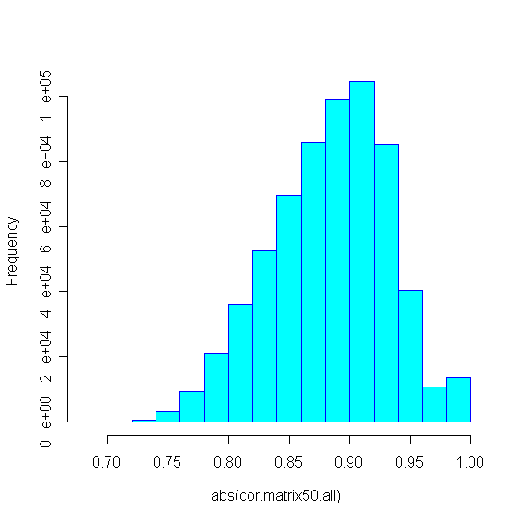
Observations
Gene expression data are highly correlated
  In this data set, each gene is highly correlated with
  at least 50 other genes:
Histogram of top 50 correlation coefficients for each gene
abs(correlation coefficient)

Slide 21
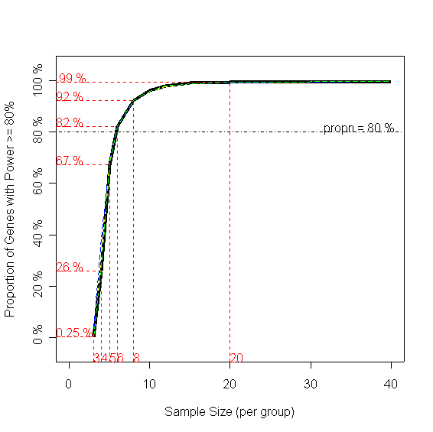
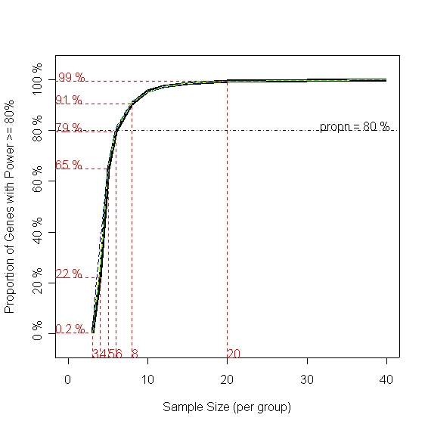
Results: Proportion of Dependent Observations
Black: Simulation Colors: Estimation
All genes are indep.
All genes are dependent.
Prop’n with power ≥80%
Sample Size / group
Sample Size / group
Sample Size / group
Sample Size / group
→ No effect on estimate quality

Slide 22
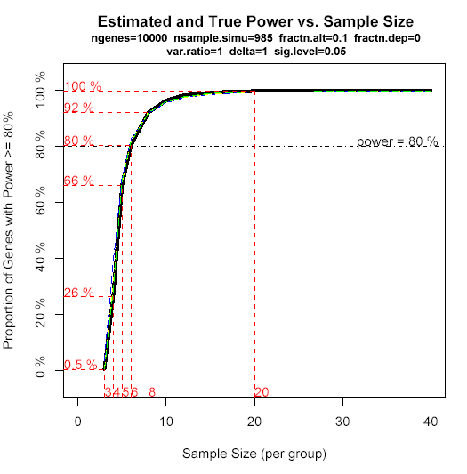

Results: Proportion of True Changes
Black: Simulation Colors: Estimation
All genes are diff. expressed.
10% genes are diff. expressed.
Prop’n with power ≥80%
Sample Size / group
Sample Size / group
→ No effect on estimate quality

Slide 23
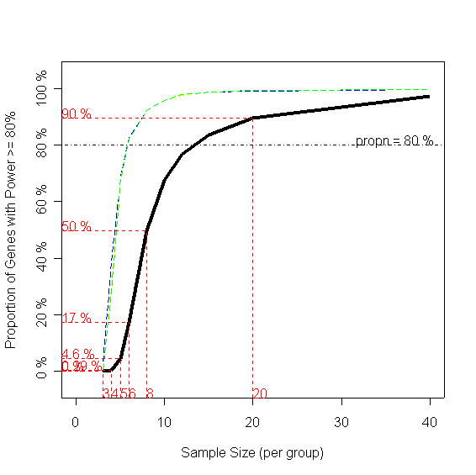
Results: Variance Ratio Between Groups
Black: Simulation Colors: Estimation
Var ratio = 1
Var ratio = 10
Prop’n with power ≥80%
Sample Size / group
Sample Size / group
→ Large effect on estimate quality

Slide 24
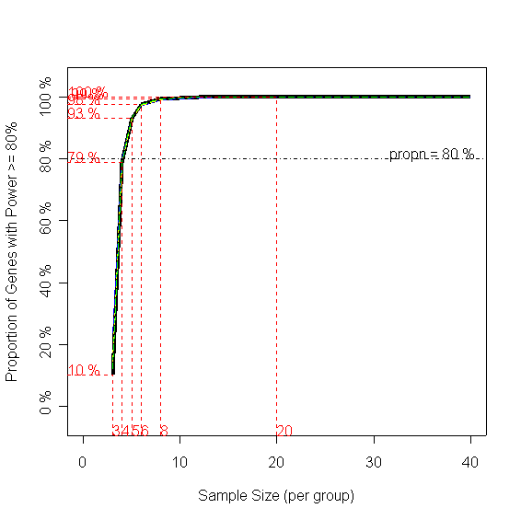
Results: Minimum Effect Size
Black: Simulation Colors: Estimation
2-fold change
4-fold change
Prop’n with power ≥80%
Sample Size / group
Sample Size / group
→ No effect on estimate quality

Slide 25
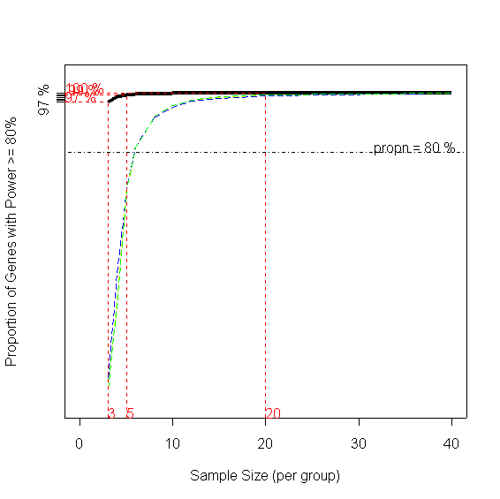
Results: Multiple Testing Procedure
Black: Simulation Colors: Estimation
Bonferroni adjustment
FDR
Prop’n with power ≥80%
Sample Size / group
Sample Size / group
→ Large effect on estimate quality

Slide 26
Simulation Summary
Variable | Effect | Details | Comments
Proportion of dependent observations | small |  | Current method works well here
Var ratio between two treatments | large | Large var.ratio → small power | Sample size estimator needs to account for this
Prop’n of true diff. expressed genes | small |  | Current method works well here
Minimum effect size | medium | Large delta → large power | Current method works well here
Multiple Testing Procedure | large | FDR → large power | Use FDR instead of Bonferroni

Slide 27
Software
R package “ssize”
  Version 1.6.0
  Implements the described computations and graphs
  Available from the BioConductor project: http://www.bioconductor.org
R> source("http://bioconductor.org/biocLite.R")
R> biocLite(“ssize”)

Slide 28
Summary
This simple method works well in practice
  Computation
  Visual Summaries
Usual caveats for sample size estimation apply:
  Model must match data (e.g. common varance)
  Need preliminary variance estimates
  Usually need more samples than the biologists want
Software is available

Slide 29
Future Research
Apply FDR procedure to control error for multiple testing.
Extend simulations to show power for ANOVA.
Provide a Web page with a general R package for biologists to estimate sample size.

Slide 30
References
Two--sample t--test sample size
  Cox GM (1953). Experimental Designs (2ndEd). 17-28. pp
General sample size:
  ChowSC, LiuJP(1998). Design and Analysis of Clinical Trials : Concept and Methodologies. Wiley-Interscience. Chapter 10, 424 -482
  ChowSC , ShaoJ, WangH (2003). Sample Size Calculation in Clinical Research. Marcel Dekker [New, looks interesting]
Gene expression experiments sample size:
  ZienA, FluckJ, Zimmer R, LengauerT (2002). Microarrays: How Many Do You Need? RECOMB02, Meyers G, Hannenhalli S, Istrail S, PevznerP, Waterman M, eds. 321-330.
Statistical analysis software:
  Ihaka R, Gentleman R, et al (2003). http://www.r-project.org[web site]
  Ross Ihaka and Robert Gentleman (1996). R: A Language for Data Analysis and Graphics, Journal of Computational and Graphical Statistics, Vol 5, Number 3: 299-314.
Me:
  http://www.warnes.net
  http://cbim.urmc.rochester.edu
  http://random-technologies-llc.com

