Slide 1
Creating an MVC Web Site …using ASP.NET Core 2.1
David Turton, Professor
Conestoga College
Institute of Technology and Advanced Learning
dturton@conestogac.on.ca
Doon 2A605 519-748-5220 x3610

Slide 2
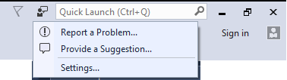
ASP.NET References
Microsoft tutorial:
building your first ASP.NET Core MVC app
Reporting Visual Studio bugs
Use the integrated Report a Problem link on Visual Studio
IDE performance: https://www.techempower.com/benchmarks/#section=data-r15&hw=ph&test=plaintext
Look at the performances of "aspcore" in rounds 15 & 16.
Microsoft didn't appear earlier because it didn't run on Unix/Linux

Slide 3
.NET Core References
.NET Core Guide
https://docs.microsoft.com/en-us/dotnet/core/
.NET Core tutorials
https://docs.microsoft.com/en-us/dotnet/core/tutorials/

Slide 4
Upgrade Visual Studio 2017 & .Net Core
Upgrade Visual Studio 2017 to release 15.7.4 (or higher)
Start Visual Studio 2017
In the menu, click "Tools" → "Extensions And Updates"
On the left column, click "Updates" → "Product Updates"
Download & install .NET Core 2.1
Click the button "Download .NET Core SDK"
This makes ASP.NET Core 2.1 and Entity Framework Core 2.1 available

Slide 5
Visual Studio 2017 setup
By default, Visual Studio doesn’t have ASP.NET web support
On the menu, choose Tools → Get Tools and Features
I would suggest, at a minimum:
Universal Windows Platform development
.NET desktop development
ASP.NET and web development
Data storage and processing
.NET Core cross-platform development
You should have these from Programming Concepts II
These are required for ASP.NET Core

Slide 6
ASP.NET Web Forms
Active Server Pages (ASP)
Microsoft's dynamic web pages
Pages populated using data from a database
Around since late 90's
Originally script-inside-HTML (VB, C++, J++)
.NET 2003 → "web forms"
GUI drag-and-drop design, like Windows forms
Controls: GridView, DetailsView, Master Page
Rendered to XHTML
Code was in a separate file
__ViewState – hidden on web page: server's crib-sheet
… could be quite huge … an impact on large sites

Slide 7
ASP.NET MVC
C
MVC first released 2008
Model-View-Controller
Controller (code)
Reads data through a model (class file)
Selects the appropriate view (web page)
Passes data to the view in ViewData (aka ViewBag)
Single fields or objects instantiated from models
Receives <form> data via HTML POST
Writes to database through a model
Naming convention:
Controller names always end with "Controller"
But, when referring to them, drop the "Controller"
M
V

Slide 8
ASP.NET MVC
C
Model
A set of classes to describe data
Like the Domain Class Model with relations
Also known as Data Access Layer (DAL) classes
Describes properties/relations, what data is valid & how it's displayed
Using validation code & annotations in model
View Model
Used to convey objects that don't exactly match database tables
We'll be using Entity Framework & LINQ (more here)
These generate SQL for us
… and can apply SQL functionality to in-memory objects and collections
M
V

Slide 9
ASP.NET MVC
C
View (web page)
Describes how the page is displayed
Each controller action (method) can have its own view
Uses CSS3 and HTML5
~/Views/_ViewStart.cshtml
Identifies default layout (aka master page) to be used
A framework into which Individual views are inserted
Razor engine merges data & generates some HTML
Saves you having to write repetitive complex HTML
Example: <a asp-action=“Index” asp-controller="Home”>Home</a>
Calls the default (Index) action of the Home controller
Which builds and returns the corresponding View as HTML
M
V

Slide 10
Razor Engine
A templating engine to render HTML
Introduced in MVC 3
Allows you to reference data passed from the controller
Just put "@" followed by C# code or a variable name:
<p>@TempData["message"]</p>
Creates HTML from Tag Helpers (prior releases used HTML Helpers)
<label asp-for="Price" class="col-md-2 control-label"></label>
<div class="col-md-10">
<input asp-for="Price" class="form-control" />
<span asp-validation-for="Price" class="text-danger" ></span>
</div>
Create a label and a datatype-sensitive input field for Price
If a model was provided, pre-load its value for the field Price
If there's an edit error for Price, display that too

Slide 11
Convention Over Configuration
MVC has a lot of assumptions (conventions)
Views are in ~/Views
In a sub-folder named after the controller
Default primary key for a Model:
Field with the model's name followed by "ID" or "Id“ or “id”
If you follow the conventions:
Everything links together without qualifying
Your system is familiar to other programmers
You don't have to follow the conventions
But you become responsible for linking it together
Harder to maintain → constantly re-learning your unique technique

Slide 12
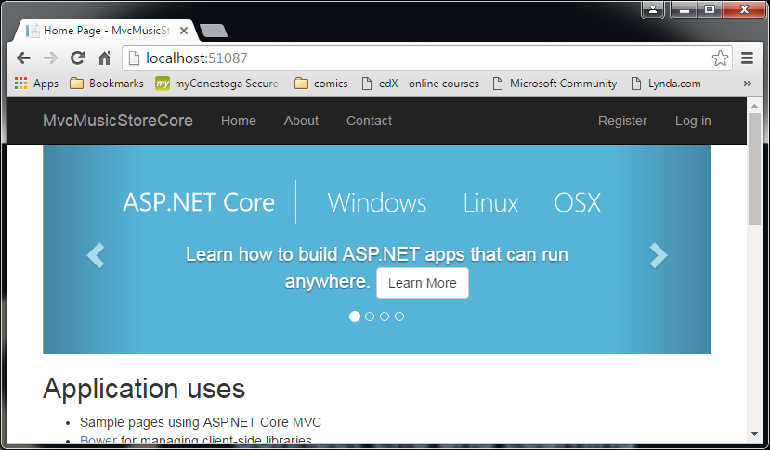
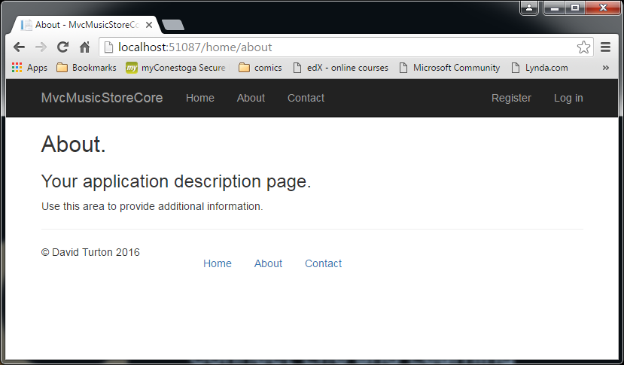
URLs specify controller & action, not page http://site/controller/action/id - no action specified → Index assumed - no controller specified → Home assumed → meaning HomeController.cs

Slide 13
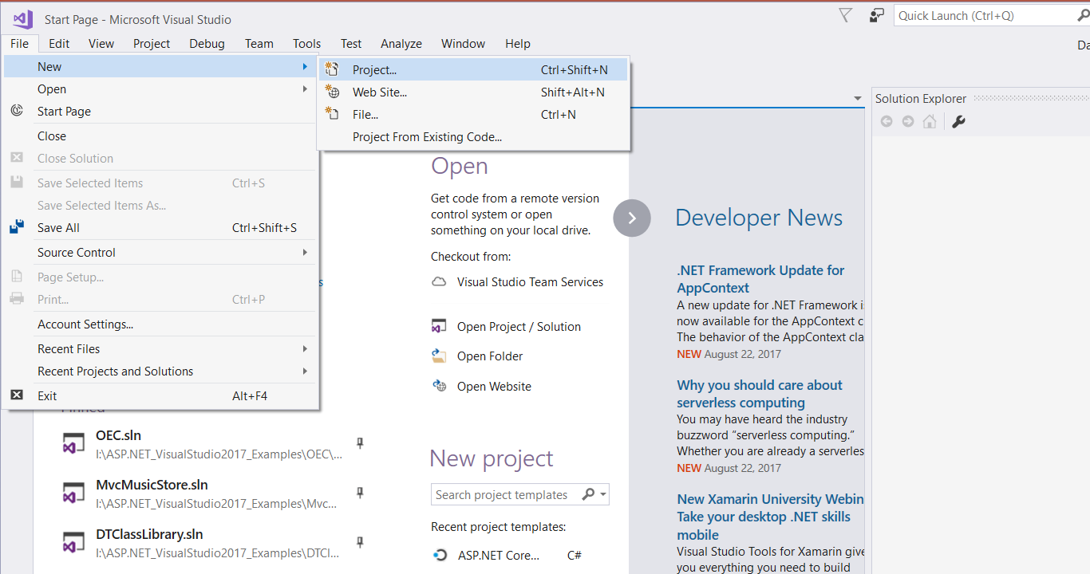
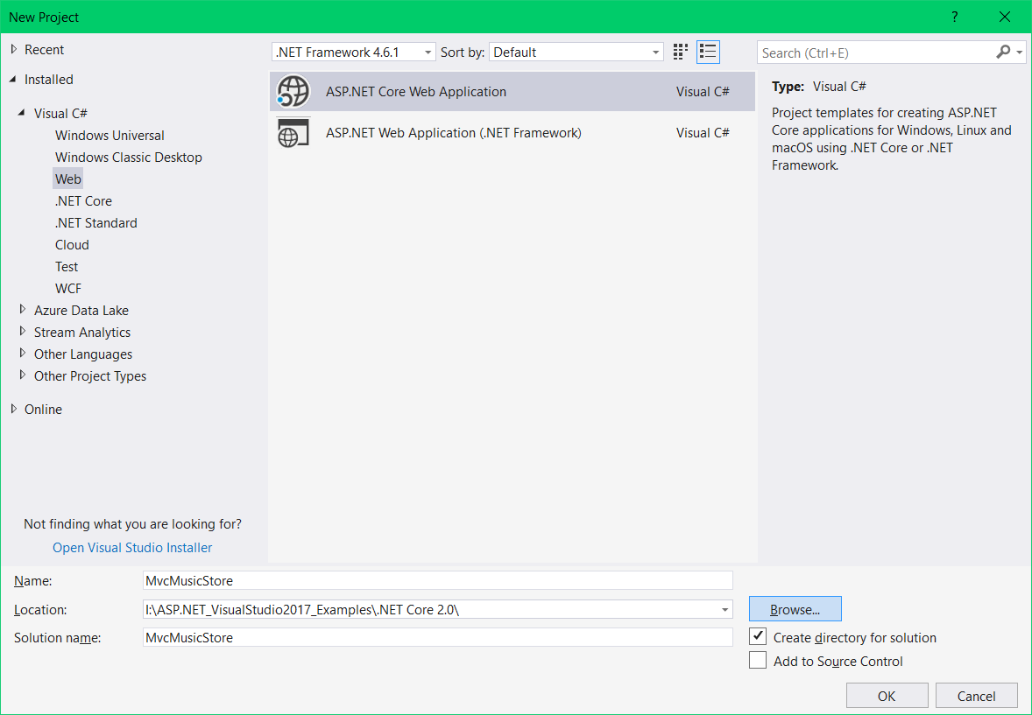
Create a new Project using ASP.NET Core

Slide 14
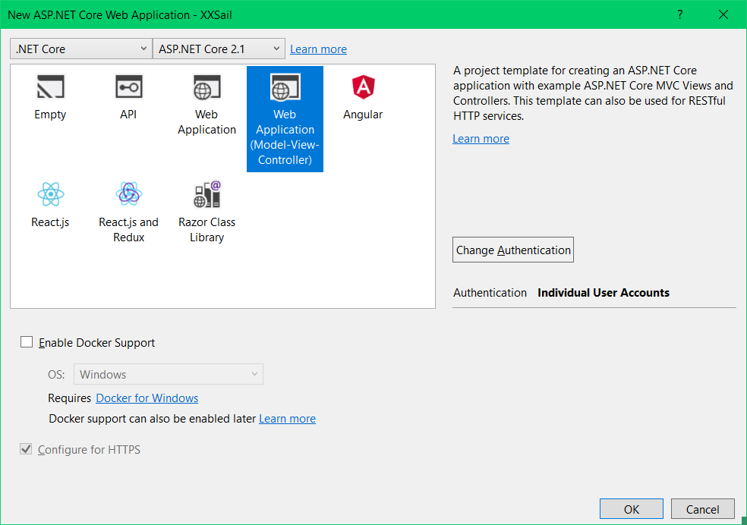
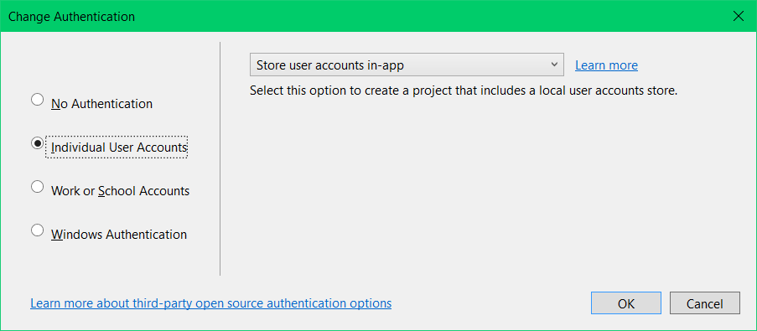
Web Application Model-View-Controller" - this provides the basic MVC structure
If you don't do this, it won't load Entity Framework support, and it's a pain to add later
Individual user accounts
Authenticates using a User/Role database
Work and school accounts
Authenticates using Active Directory, Azure or Office 360 accounts
Windows Authentication
Permit & deny based on Windows username

Slide 15
… add security when you create the site …
If you don’t specify Individual User Accounts:
It won’t link Entity Framework to your project
You can’t create your models
You can’t read your database tables
You can’t create controllers or views
You can probably add the reference later … let me know if you get it to work!

Slide 16
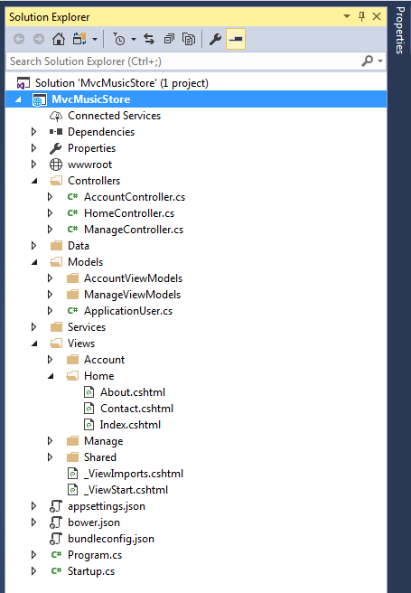
Structure of an MVC Project
A solution can contain multiple projects
Web site, unit-tests, class libraries, etc.
MVC
Controllers (business logic layer)
Code driving web pages
Accesses and maintains database tables
Decides which view to return, passes data to view
Models
Describe data such as database tables
Used by controller to pass data to database & views
Contain data validation code & annotations
Views (presentation layer)
HTML5/CSS3 augmented with Razor code
Conveys data from controller to user
Conveys user input to controller
One sub-folder under Views for each controller
Controllers can have multiple views

Slide 17
Code-First or Data-First Approach?
Code First
You provide the Design Class Models, one model per database table
Creates the database & tables using Migrations under Package Manager
It'll create the context class for you (usually one for whole database, not per table)
Can write "seed" code to initialise table data
If you modify the models or context, site will refuse to use current database:
Must migrate model changes to the database (data is usually retained)
Data First
You provide an existing database
…with existing data
Use Package Manager to generate the models & context
If you modify the database tables:
Delete & re-generate the models

Slide 18
Data-First Approach
Attach or create database in SQL
Start Package Manager console
Scaffold (generate) context & models
Implement dependency injection

Slide 19
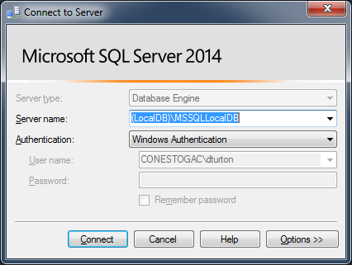
SQL Server Management Studio
SQL Server can be installed multiple times
Each instance has a unique name & its own collection of databases
…all use the same SQL Server program files
Default instance name for SQL Server Express Edition:
(local)\SqlExpress or .\SqlExpress ("." means "local computer")
Checkbox to also install (localDB)\MsSqlLocalDB
…this is Visual Studio’s default instance:
Tools→Options→Database Tools→DataConnections
Instance names are not case sensitive

Slide 20
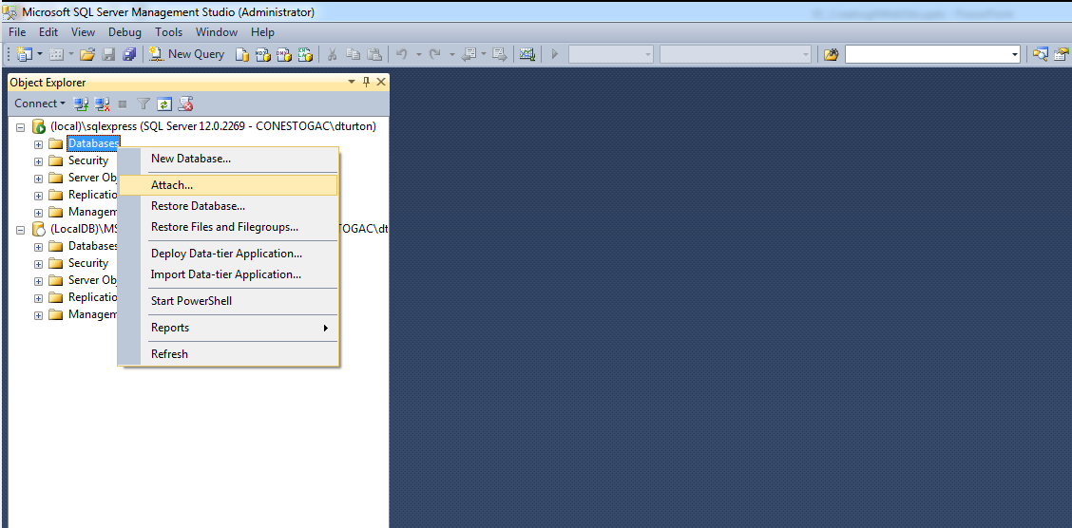
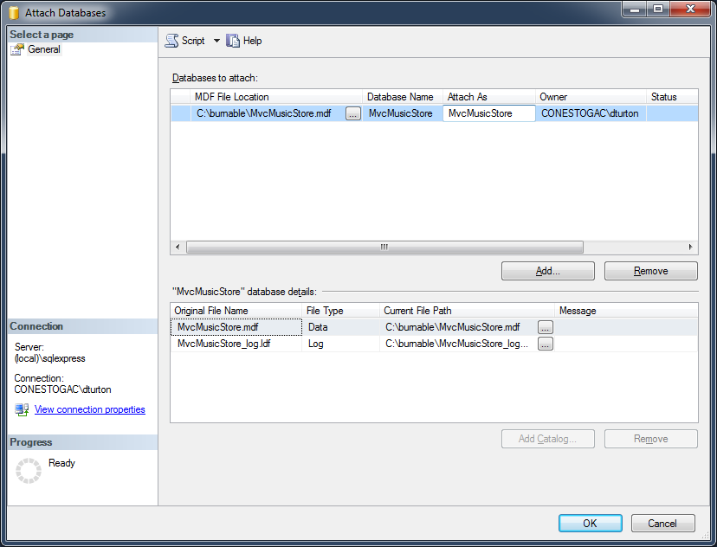
Create Database option 1 – attach an existing database .mdf file
You can change the displayed name
The actual database name is the .mdf file-name
Navigate to .mdf file

Slide 21
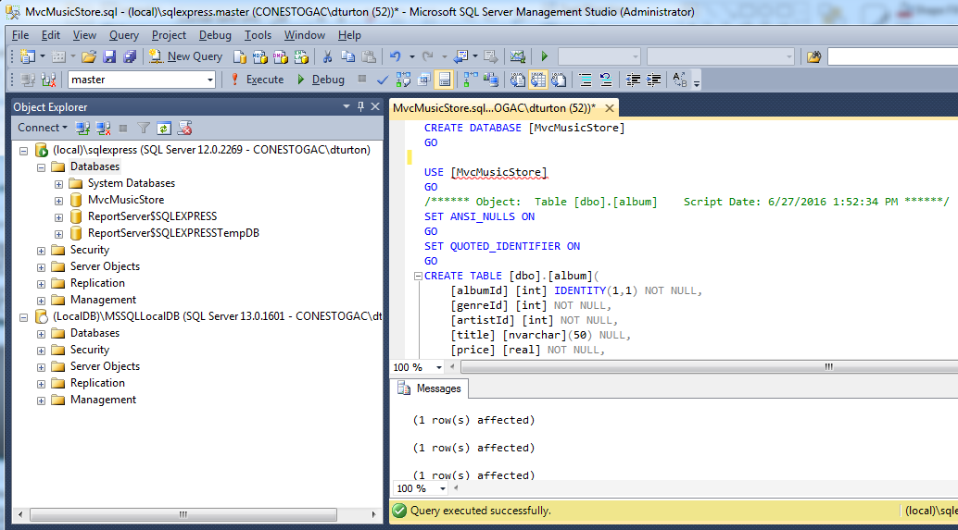
Create Database option 2 – create the database from an .sql script
Select the instance where you want the database
I'm showing 2 instances:
- (local)\SqlExpress
- (localDB)\MsSqlLocalDB
Open or paste the .sql query
Execute the query
huh …
SQL Server 2014: SQL version 12.x.x
SQL Server 2016: SQL version 13.x.x
Refresh…

Slide 22
Create Database option 3 – manually type database & tables
Uh … no … this isn't a database course
Of course, on Visual Paradigm, you could
Generate an ERD from your Detail Class Model
Generate an SQL script from the ERD (targetting SQL Server)
Run the script under SQL Server Management Studio
But … you used Enumerations in your Class Model
… they’re a programming construct, not a database construct
… so SQL doesn’t support Enumerations
… who taught you to use Enumerations?

Slide 23
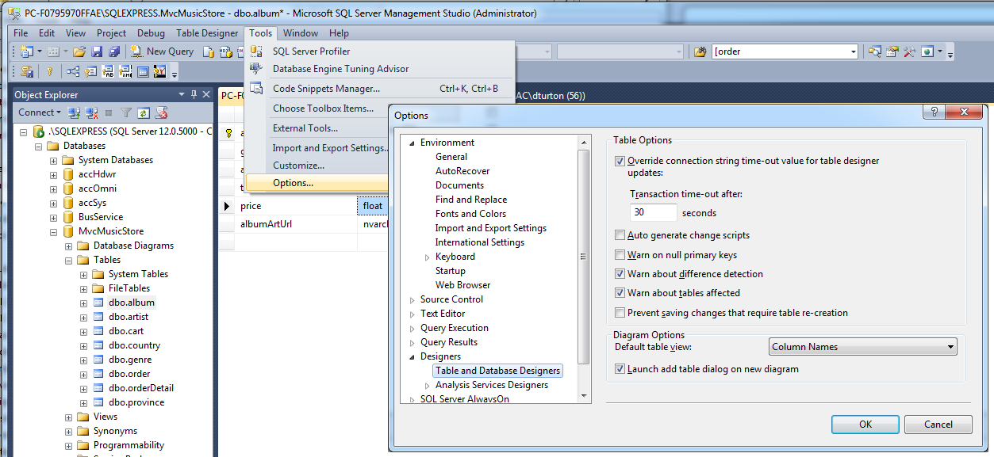
Note … when changing a database schema - default won’t let you change table properties if it has data
Clear this … then can save table changes & retain its data

Slide 24
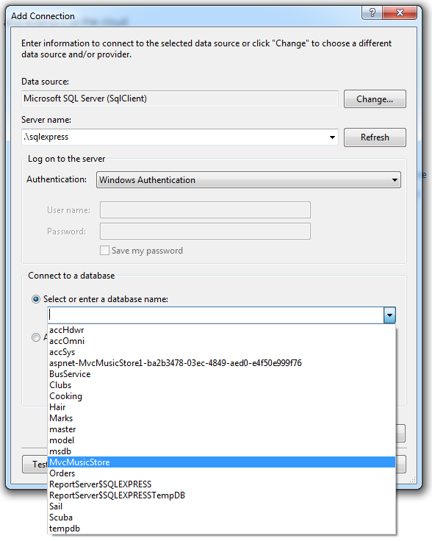
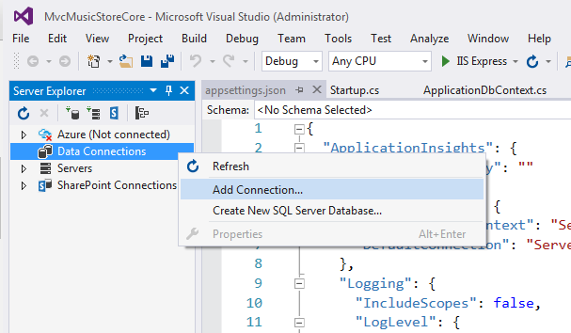
Open Database in Visual Studio (Server Explorer window)
I'd prefer to use .\sqlexpress because it's easier to remember … just ensure the connection string keeps up.

Slide 25
Generate the models
Bring up the package manager console in Visual Studio:
Tools → NuGet Package Manager → Package Manager Console
The starting folder is assumed to be the solution's default project
You can use dir and cd commands to navigate to another folder.
Generate the scripts and context (typed all on one line):
-Connection connection string .\ or .\sqlexpress or (localdb)\mssqllocaldb ?
-Provider database "driver" … for SQL Server or MySql or Oracle …
-OutputDir target directory/namespace of the generated classes (default site root)
-Context name of the context class it'll generate (default dbNameContext)
-Verbose just what it says … in case there are problems
-Force when regenerating the models, this says “overwrite the old ones”
Scaffold-DbContext –Connection "Server=.\sqlexpress;Database=MvcMusicStore;Trusted_Connection=True;" -Provider "Microsoft.EntityFrameworkCore.SqlServer" -OutputDir "Models" –Context "MvcMusicStoreContext" –Verbose -Force
Will request if not provided
don't use default
defaults OK

Slide 26
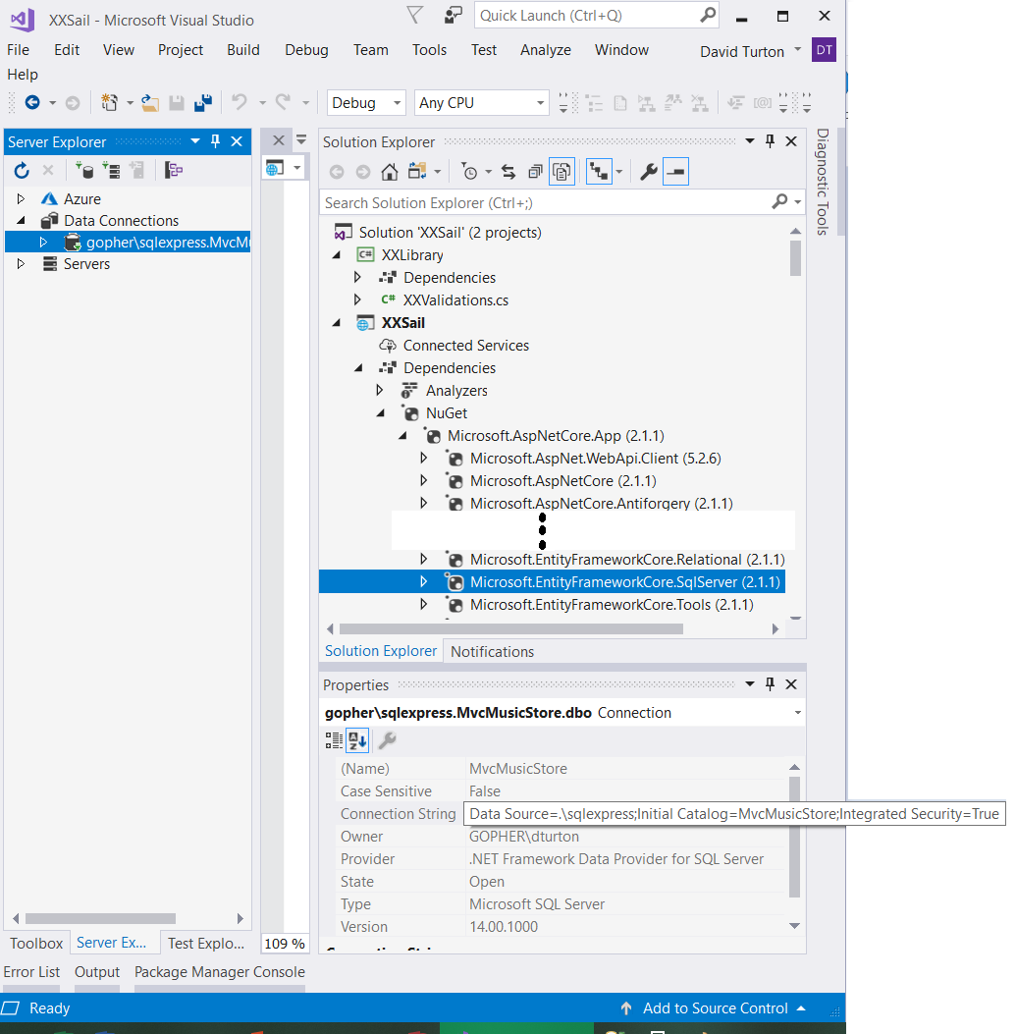
Trick for Connection Strings
Connect to the database using Visual Studio's Server Explorer:
Right-click Data Connections
Add new connection
Follow your nose:
Server: .\sqlexpress
Database: MVCMusicStore
Look at its properties for the connection string
"Initial Catalog" is equivalent to "Database"
…but only works with SQL Server
Provider:
- EntityFrameworkCore.SqlServer
- version irrelevant

Slide 27
Register the Context with Dependency Injection
Dependency
Some components depend on services to work
Dependency Injection
Instantiates, configures & provides service(s) to the component's constructor
Each controller needs a context … a session with the database
…and each context needs a connection string
→ centralise the connection string in appsettings.json
Register the context and its connection string parameter in Startup.cs
A service instantiated & ready to be injected when required

Slide 28
Centralise the connection string
Put this into appsettings.json
… alongside the default connection string
{
"ApplicationInsights": {
"InstrumentationKey": ""
},
"ConnectionStrings": {
"MvcMusicStoreConnection": "Server=.\\sqlexpress;Database=MvcMusicStore;Trusted_Connection=True;",
"DefaultConnection": "Server=(localdb)\\mssqllocaldb;Database=aspnet-MvcMusicStoreCore-9b4191a9-84bc-4996-8…"
},
"Logging": {
"IncludeScopes": false,
"LogLevel": {
"Default": "Debug",
"System": "Information",
"Microsoft": "Information"
}
}
}
This is the default connection used by user/role authentication and, occasionally, for the code-first approach database
… I just use it as a guide

Slide 29
Register a Service to Configure Context in Startup.cs
public void ConfigureServices(IServiceCollection services)
{
// Add framework services.
services.AddDbContext<ApplicationDbContext>(options =>
options.UseSqlServer(Configuration.GetConnectionString("DefaultConnection")));
// enable dependency injection for context of MvcMusicStore database
services.AddDbContext<MvcMusicStoreContext>(options =>
options.UseSqlServer(Configuration.GetConnectionString("MvcMusicStoreConnection")));
services.AddIdentity<ApplicationUser, IdentityRole>()
.AddEntityFrameworkStores<ApplicationDbContext>()
.AddDefaultTokenProviders();
Add a service reference to instantiate the context and provide its connection string

Slide 30
ASP.NET Core 2.1 Remove Connection String from Context
Replace this:
protected override void OnConfiguring(DbContextOptionsBuilder optionsBuilder)
{
… generated code with hard-coded connection string …
}
With this:
// fetch connection string from appsettings.json if not pre-configured by Dependency Injection
protected override void OnConfiguring(DbContextOptionsBuilder optionsBuilder)
{
if (!optionsBuilder.IsConfigured)
{
var builder = new ConfigurationBuilder()
.SetBasePath(Directory.GetCurrentDirectory())
.AddJsonFile("appsettings.json");
IConfiguration Configuration = builder.Build();
optionsBuilder.UseSqlServer(Configuration["ConnectionStrings:MVCMusicStoreConnection"]);
}
}
Connect to appsettings.json with a tool able to find your database connection string

Slide 31
Generated Context Class - used like a database connection
using System;
using Microsoft.EntityFrameworkCore;
using Microsoft.EntityFrameworkCore.Metadata;
namespace MvcMusicStore.Models
{
public partial class MvcMusicStoreContext : DbContext
{
public SailContext()
{ }
public SailContext(DbContextOptions<SailContext> options)
: base(options)
{ }
public DbSet<Album> Album { get; set; }
public DbSet<Artist> Artist { get; set; }
public DbSet<Cart> Cart { get; set; }
public DbSet<Country> Country { get; set; }
public DbSet<Genre> Genre { get; set; }
public DbSet<Order> Order { get; set; }
public DbSet<OrderDetail> OrderDetail { get; set; }
public DbSet<Province> Province { get; set; }
protected override void OnConfiguring(DbContextOptionsBuilder optionsBuilder)
{
if (!optionsBuilder.IsConfigured)
{ #warning To protect potentially sensitive information ….
optionsBuilder.UseSqlServer("Server=.\\sqlexpress;Database=MvcMusicStore;Trusted_Connection=True;");
}
}
protected override void OnModelCreating(ModelBuilder modelBuilder)
{ …bunch of ModelBuilder/Entity<…> stuff }
}
}
These are constructors, used when instantiating a context instance
These properties are the tables in the database & identify the model class that describes each table
I suggested you replace this earlier
… redundant code is never a good thing
This describes the tables and their relationships

Slide 32
Resulting class for Album table
using System;
using System.Collections.Generic;
namespace MvcMusicStore.Models
{
public partial class Album
{
public Album()
{
Cart = new HashSet<Cart>();
OrderDetail = new HashSet<OrderDetail>();
}
public int AlbumId { get; set; }
public int GenreId { get; set; }
public int ArtistId { get; set; }
public string Title { get; set; }
public double Price { get; set; }
public string AlbumArtUrl { get; set; }
public virtual ICollection<Cart> Cart { get; set; }
public virtual ICollection<OrderDetail> OrderDetail { get; set; }
public virtual Artist Artist { get; set; }
public virtual Genre Genre { get; set; }
}
}
Notice the namespace & "partial" class … these become really important when doing validation.
Physical properties of objects instantiated from this class
Relationships to other tables in the database are "virtual" because they are only provided if you ask for them while reading from the table

Slide 33
Generating a Controller & Views

Slide 34
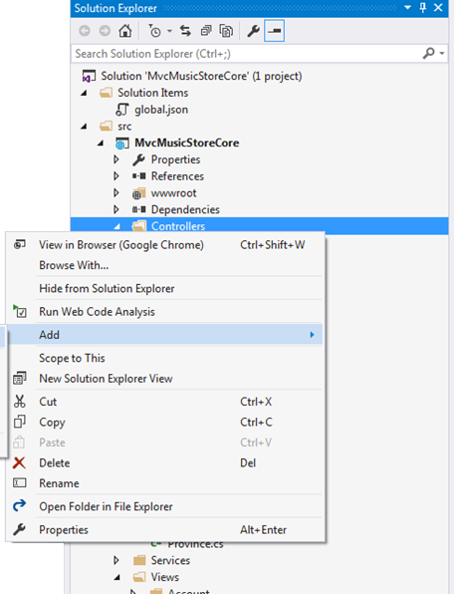
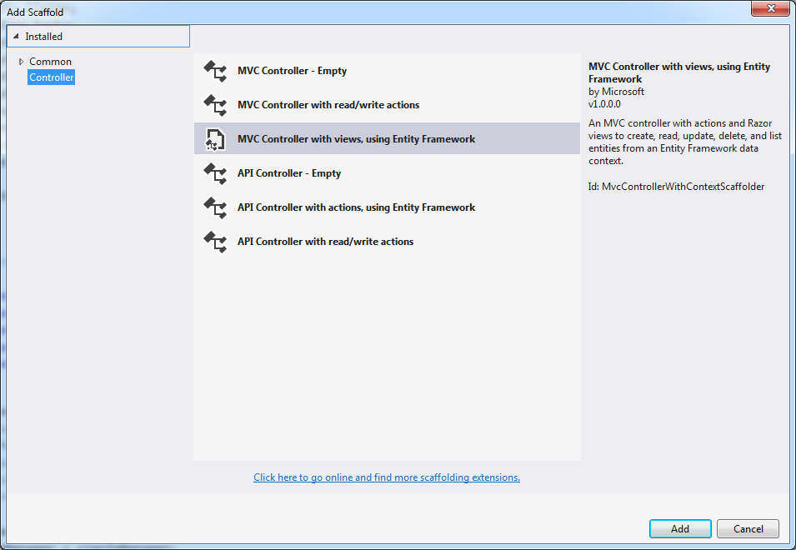
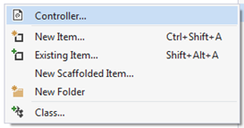
Create a Controller for the Albums Model - decide how much to generate

Slide 35
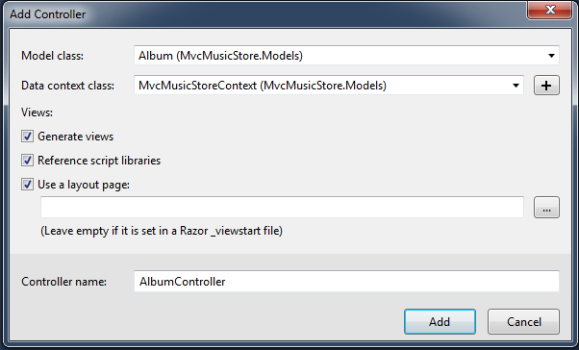
Provide the target class (table) and context if requested
Generate views
Create appropriate view for each action:
Index (list), Detail (single record), Create, Edit, Delete
Reference script libraries
Adds jQuery scripts for data validation on Create & Edit pages
Use a layout page
Views are loaded into a "master page"
To easily provide a consistent look
Default layout is identified in ~\Views\ViewStart.cshtml
I prefer to name the controller with the actual table name, not pluralized like it suggests

Slide 36
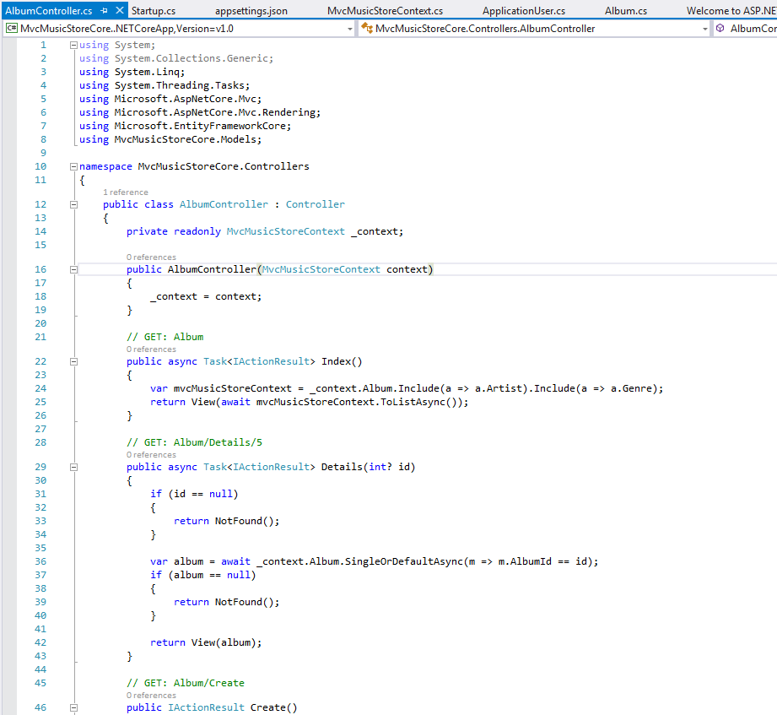
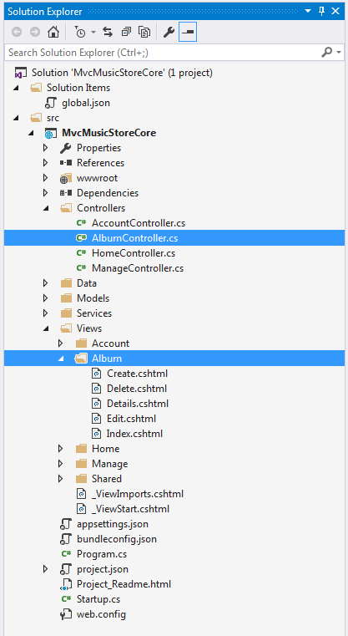
context is provided by Dependency Injection, defined in Startup.cs
Views are named after their action, in sub-folder named after their controller
This tells Razor where the default layout is

Slide 37
Asynchronous Actions in Controllers
IIS has a finite number of process threads
A very active site will either ignore, drop or backlog requests
Users get "Timeout", "Unavailable", "Forbidden" or "Not Found" errors
By default, generated actions fork asynchronous tasks
Releasing resources while waiting on requests to the database server
This allows sites to scale to a very large number of users
// GET: Album
public async Task<IActionResult> Index()
{
var mvcMusicStoreContext = _context.Album.Include(a => a.Artist).Include(a => a.Genre);
return View(await mvcMusicStoreContext.ToListAsync());
}

Slide 38
Controller Actions (cont'd)
Index action
Default is to list all records in the table, ordered by key
Details action
Shows all fields for the selected record (key is passed as "id")
When records have many fields, the index view is often restricted to 5 or 6
Create actions
One to display a blank input page
And set up drop-downs for foreign keys
One, requiring HTTP Post, adds the new record to the table
Differentiated by receiving parameters
The [HttpPost] attribute restricts this to a <form> with action="POST"

Slide 39
Controller Actions (cont'd)
Edit actions
One to display the selected record for update
One, requiring HTTP POST, to save the updated record to the table
Again: differentiated by parameters
Delete actions
One to display the selected record to confirm the delete
One, requiring HTTP POST, to delete the record after confirmation
This has the same parameter as the confirm page
So it has a different name to differentiate it
[HttpPost, ActionName("Delete")] relates it to a Delete post-back request

Slide 40
The setup Create action - similar for Edit
Go to the context and get all records from the Artist table
When user selects an item in the drop-down, return the field "ArtistId"
// GET: Album/Create
public IActionResult Create()
{
ViewData["ArtistId"] = new SelectList(_context.Artist, "ArtistId", "Name");
ViewData["GenreId"] = new SelectList(_context.Genre, "GenreId", "GenreId");
return View();
}
In the drop-down, display the field in Artist called "Name"
Not a good display-field
… is "2" rock or jazz?
Create setup action
Creates two fields in ViewData for drop-downs on the View
One with all artists and one with all genres
& identifying fields from the artist records to:
Display to the user
Return as the value of the drop-down
Calls a view, without passing an album record as the "model"
Input areas on the view will be blank

Slide 41
The post-back Create Action - similar for Edit
Responds only to an HTTP POST request for action Create
[HttpPost]
[ValidateAntiForgeryToken]
public async Task<IActionResult> Create([Bind("AlbumId,GenreId,ArtistId,Title,Price,AlbumArtUrl")] Album album)
{
if (ModelState.IsValid)
{
_context.Add(album);
await _context.SaveChangesAsync();
return RedirectToAction("Index");
}
ViewData["ArtistId"] = new SelectList(_context.Artist, "ArtistId", "Name", album.ArtistId);
ViewData["GenreId"] = new SelectList(_context.Genre, "GenreId", "GenreId", album.GenreId);
return View(album);
}
Checks for a one-time anti-forgery/anti-replay token on the page
May invoke an asynchronous background task, which returns a continuation task
If the data passes the model's validation criteria, then…
Queue it to be added to the database
Then commit/implement the add
Return to the Index page, which lists all records in the table
Happy path
Sad path
Pre-select the entries selected by the user
- This isn't totally necessary: Razor will set it when it pushes the model's value into the control
If the model failed model validation:
Set up the collections again for the drop-downs
Return to the view
…but this time, provide a model with the user's input and error messages, so they can correct it.

Slide 42
About parameters to the post-back action
Create([Bind("AlbumId,AlbumArtUrl,ArtistId,GenreId,Price,Title")] Album album)
[Bind(…)]
Only look for the listed variable names in the flow from the browser
…so nasties don't inject things we're not expecting into the Album object
Album album
Since "album" is a complex object of the Album class:
"Binder" will discover its properties
…and map like-named fields in the browser flow to them
You can have multiple parameters to an action
Including primitives like Int32 and Boolean
If an incoming (string) field can't be converted to the expected primitive datatype…
…you die a horrible death
Binder will map parameters by name to fields in the flow from the browser
Missing fields are null → that's why primitive parameters need Int32? or default values

Slide 43
SSL Warnings
ASP.NET Core 2.0 has SSL encryption turned on by default
It's a Snowden thing
The problem is that Visual Studio generates an encryption certificate itself
Without registering with an recognized authority like VeriSign
Browsers will warn uses that this is a risk
And a few will refuse to load such web site (not IE)
You can turn HTTPS off during development …

Slide 44
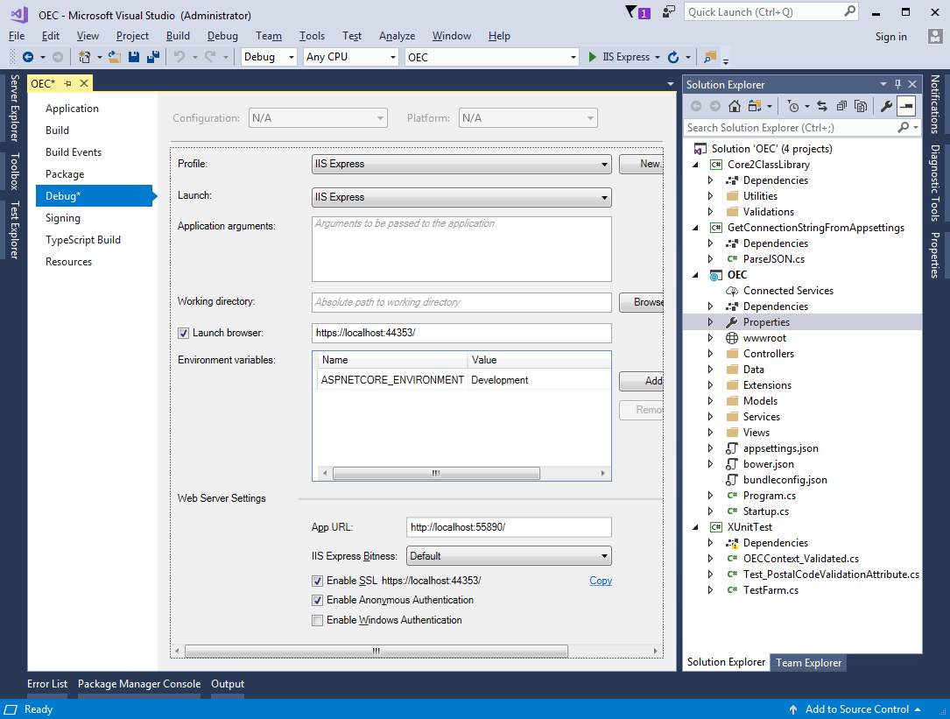
Copy
Clear

