Slide 1
Optimizing Fake News Detection using ML through Parallelization
Review 2 – Parallel and Distributed Computing (CSE4001)
Submitted by:
R. Harini (18BCE1010)
Ria Elizabeth Ranju (18BCE1354)

Slide 2
Objective
Classify a news article as fake or not through the application of suitable ML models.
Using appropriate NLP techniques to extract impactful keywords that can determine the credibility of an article.
Apply parallelization to improve the performance of the normal code.
Evaluate the improvement of the performance in terms of metrics such as execution time.

Slide 3
Application
Fake news and hoaxes have been spreading like wildfire ever since the beginning of the Internet. Fake news, also known as junk news, pseudo-news, alternative facts or hoax news, is “a form of news consisting of deliberate disinformation or hoaxes spread via traditional news media (print and broadcast) or online social media”.
It’s common knowledge that fake news attracts many reads due to its obscure and controversial content. This is exploited by the media on social media platforms to get those clicks which in turn increase their ad revenue. Due to the trend of people relying on social media for news, there are worries that such content could influence audiences unable to distinguish truth from fact or news from propaganda. For example, Fake news is now being used as a means to spread political propaganda during elections which may lead to voters base the choice of their vote on the wrong information. This project aims to classify the fake from real to stop the spread of misinformation.

Slide 4
Procedure
We started with applying some basic Natural Language Processing techniques such as eliminating stop words, lemmatization and POS tagging.
Through the usage of any of the Machine Learning algorithms such as Naive Bayes and Deep Learning algorithms such as LSTMs, we will determine whether the given news is fake or not.
Once we were done creating the model, we trained train the neural network on CPU and GPU which uses multiple threads to parallelise the training.
The final step is to analyse the improvement in the performance of the models prior to and after parallelization.

Slide 5
Parallelization Techniques
Vectorization: One of the most common ways of parallelizing ML models comes from matrix multiplication done during forward and back propagation.
Therefore, we replaced the for loops with matrix multiplication which is faster due to advanced numeric algorithms. We make use of numpy library to achieve this.
Distributing the load in case of Neural networks: This is done by distributing this into number of batches. We can do mini batch gradient descent using N batches in parallel by distributing it amongst the threads.
Frameworks such as Tensorflow and PyTorch along with CUDA libraries do this under the hood without explicit thread programming.
Data Parallelism: We train the neural network on GPU using Tensorflow for distributed training. Once the model is created inside the strategy.scope(), it allows us to create distributed variables which takes care of replicating the model’s training on the GPU.

Slide 6
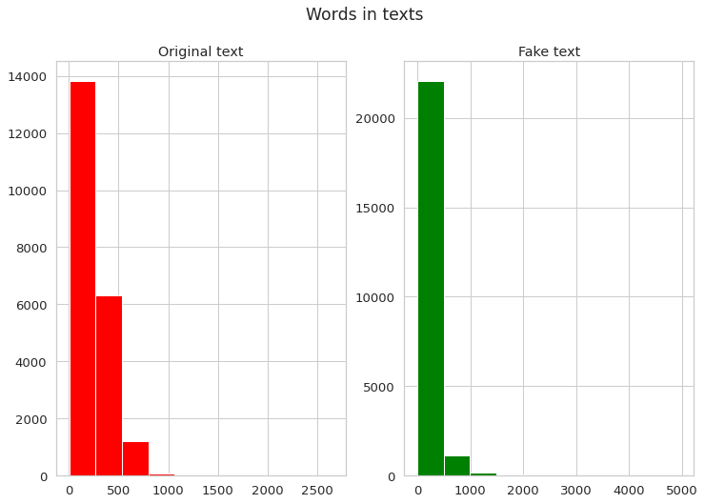
Exploratory Data Analysis

Slide 7
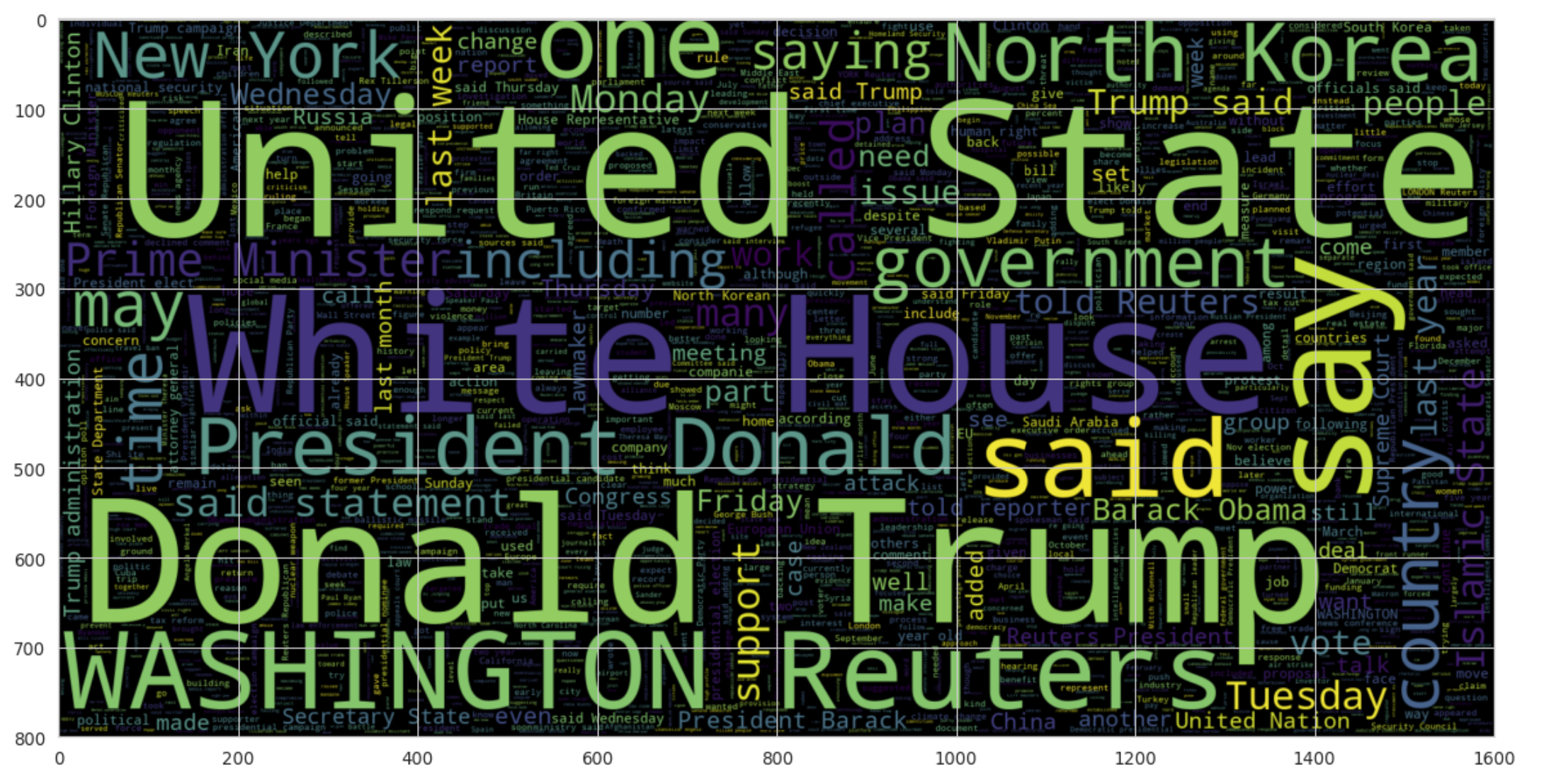
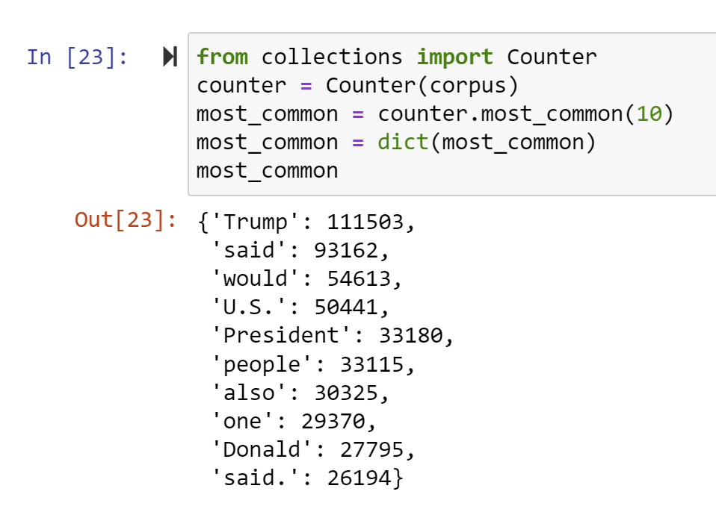
Exploratory Data Analysis

Slide 8
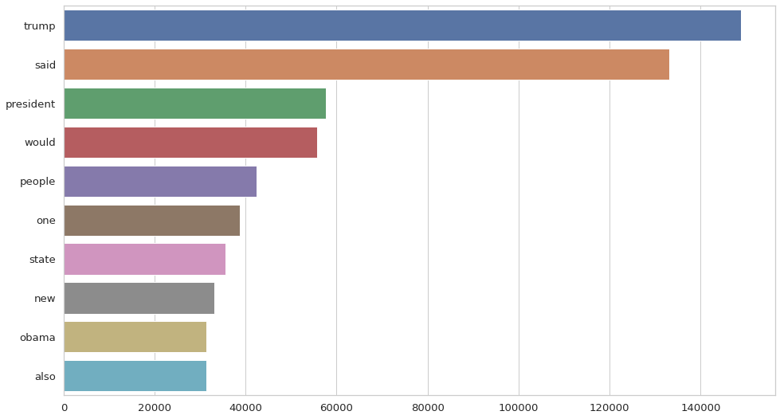
Unigram Analysis

Slide 9
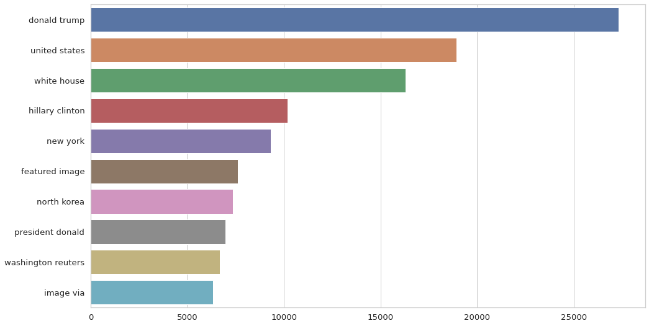
Bigram Analysis

Slide 10
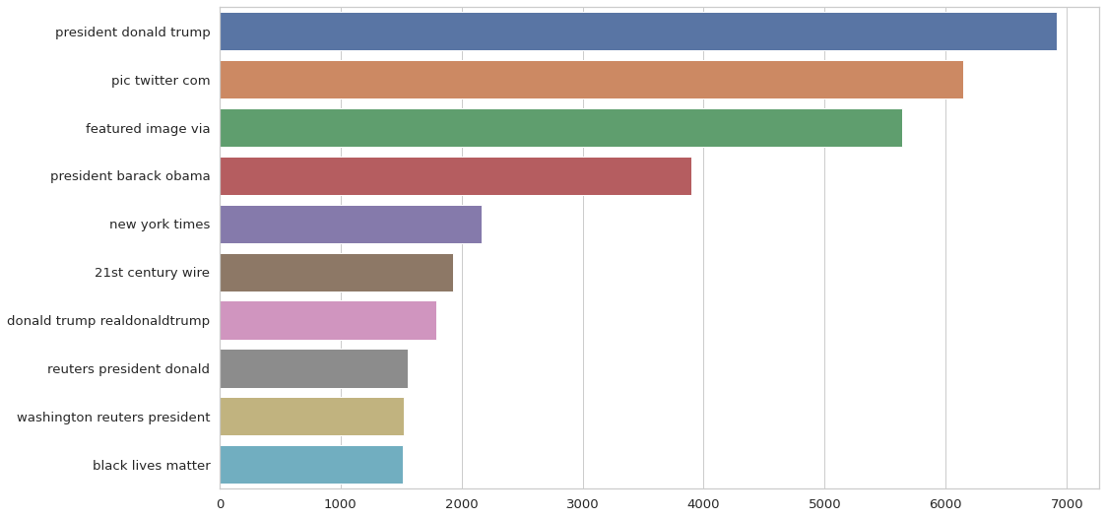
Trigram Analysis

Slide 11
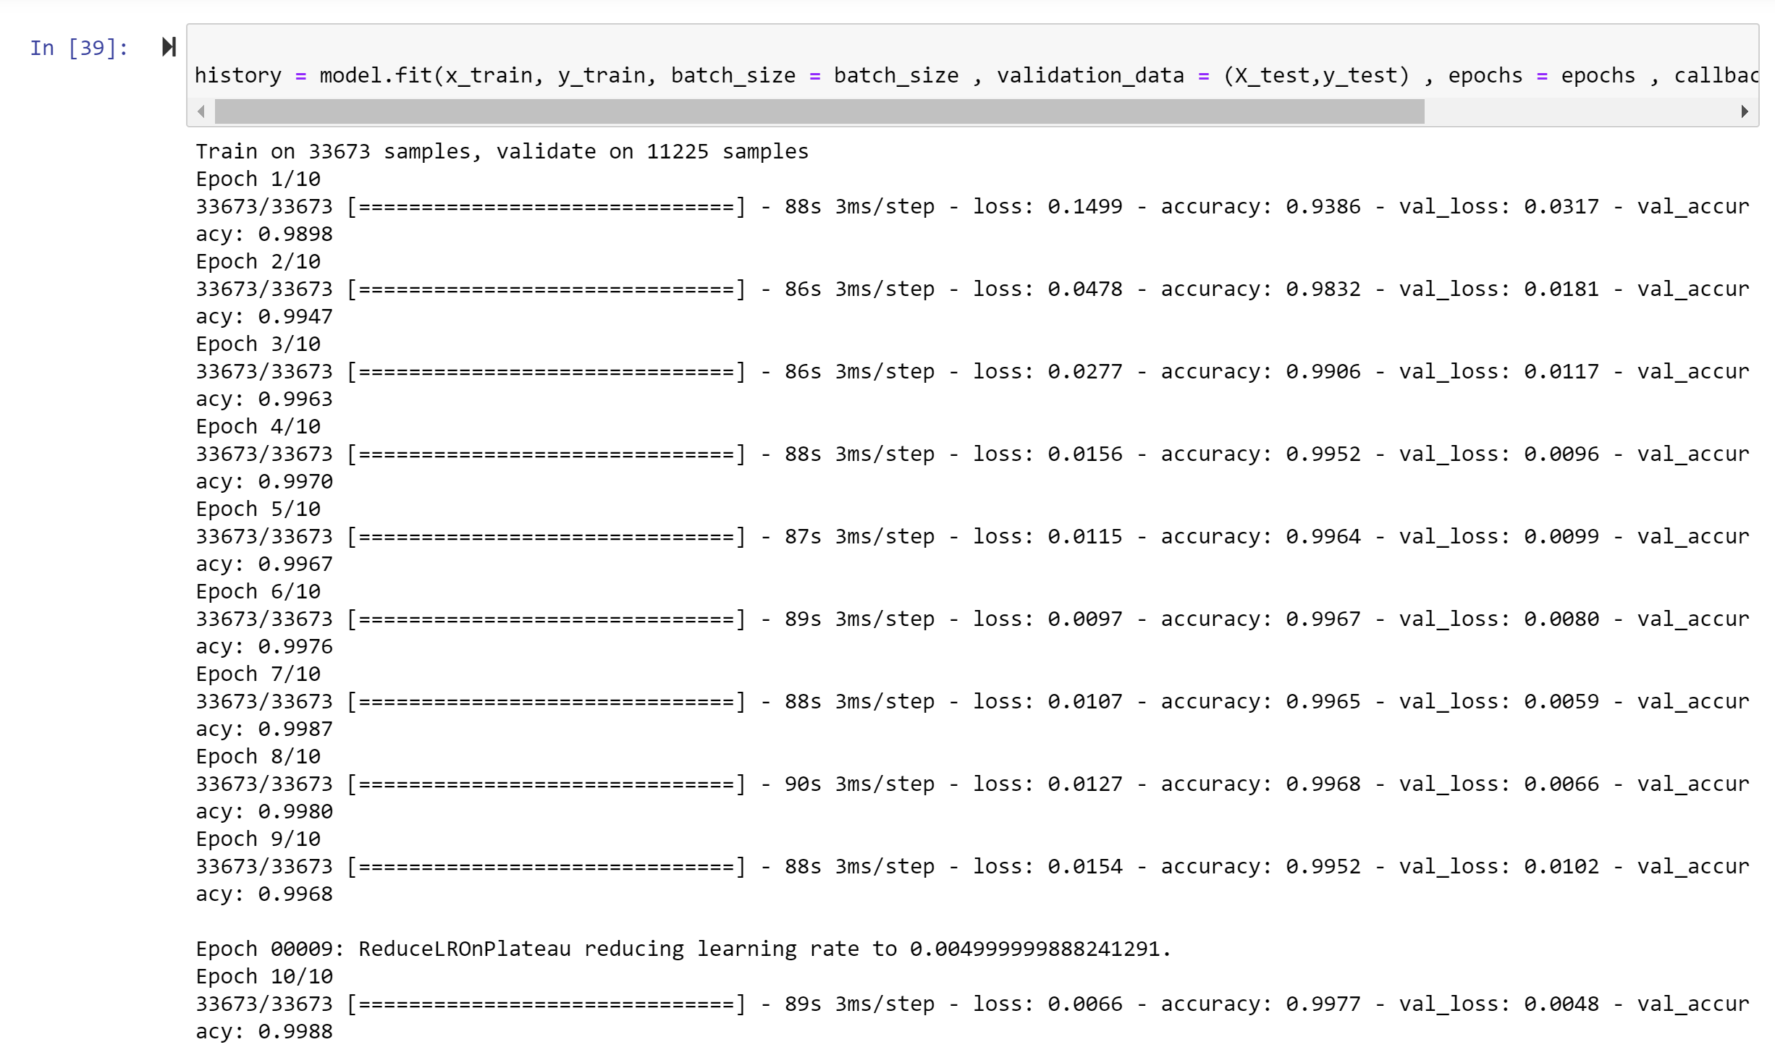
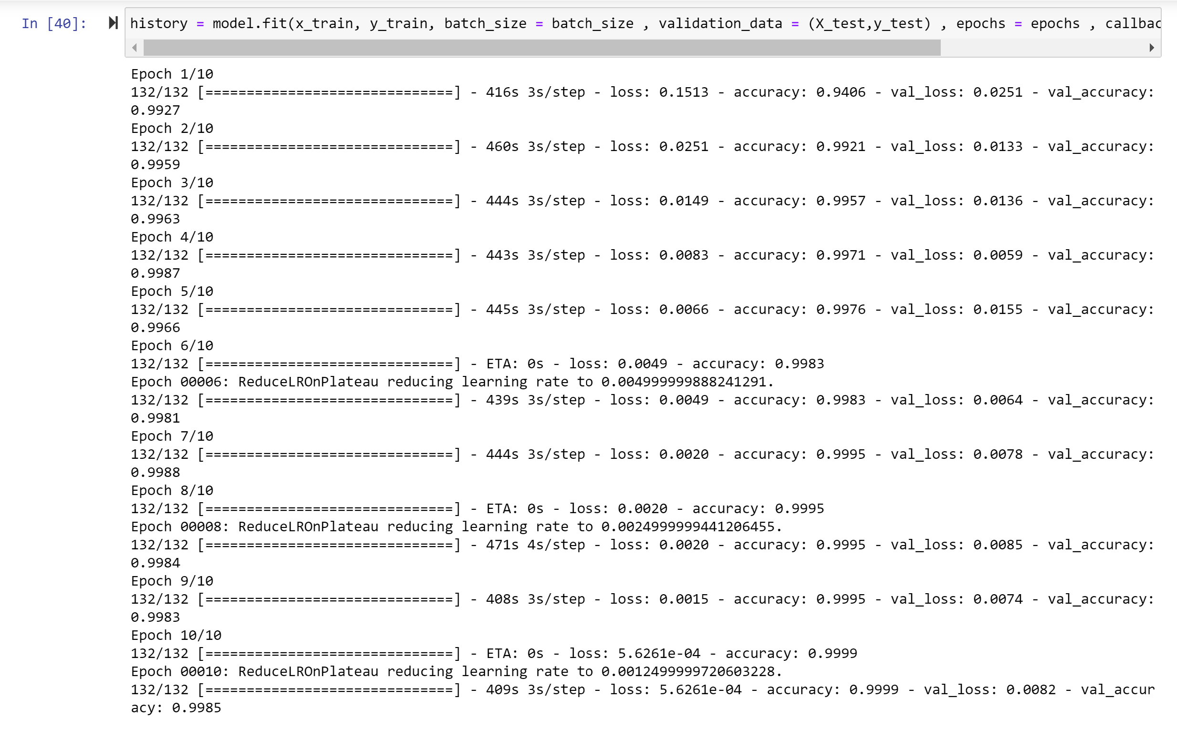
Training the Model
On GPU
On CPU

Slide 12
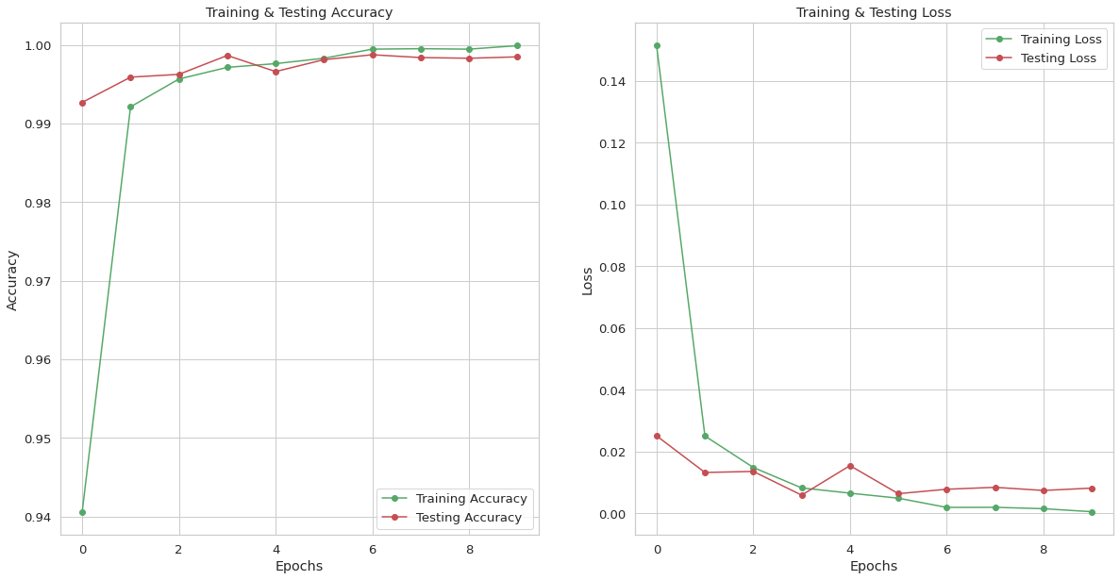
Implementation (Without GPU)

Slide 13
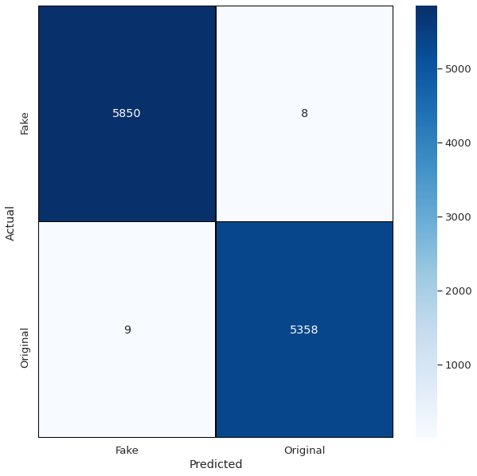
Implementation (Without GPU)

Slide 14
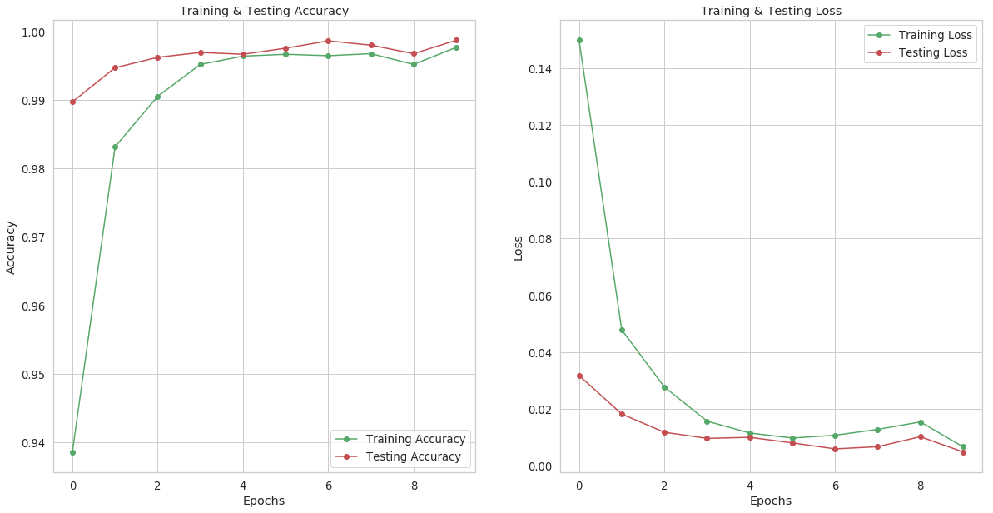
Implementation (With GPU)

Slide 15
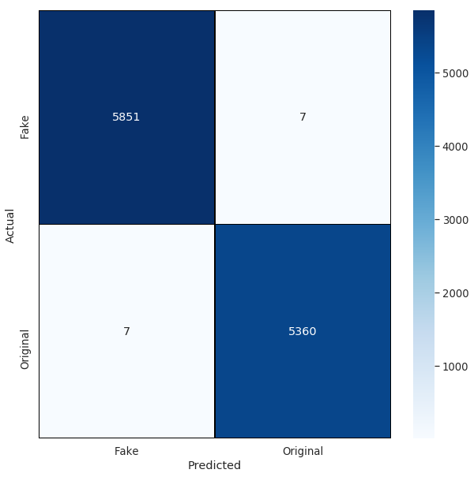
Implementation (With GPU)

Slide 16
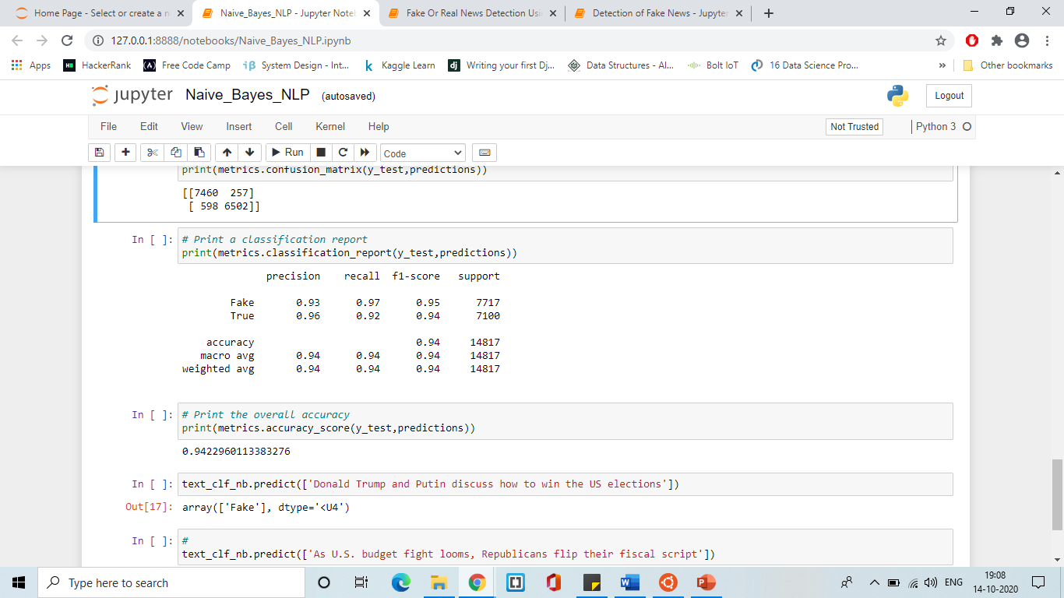
Implementation (Naïve Bayes)

Slide 17
Performance Analysis (CPU vs GPU)
Device Used | Time Taken for Training
GPU (Nvidia GeForce) | 879 seconds (14.65 minutes)
CPU (Intel Core) | 3700 seconds (61.67 minutes)

Slide 18
Accuracy Analysis
Model | Accuracy level
Naïve Bayes Model | 94 %
Neural Network (LSTMs) | 99.87%

Slide 19
Contribution
Development of the elementary code to perform the application, applying the most appropriate NLP and ML techniques – Harini
Applying the most appropriate NLP and ML techniques, parallelizing the code and evaluating performance - Ria

Slide 20
Thank you!

