Slide 1
Finding 2.5Hz

Slide 2
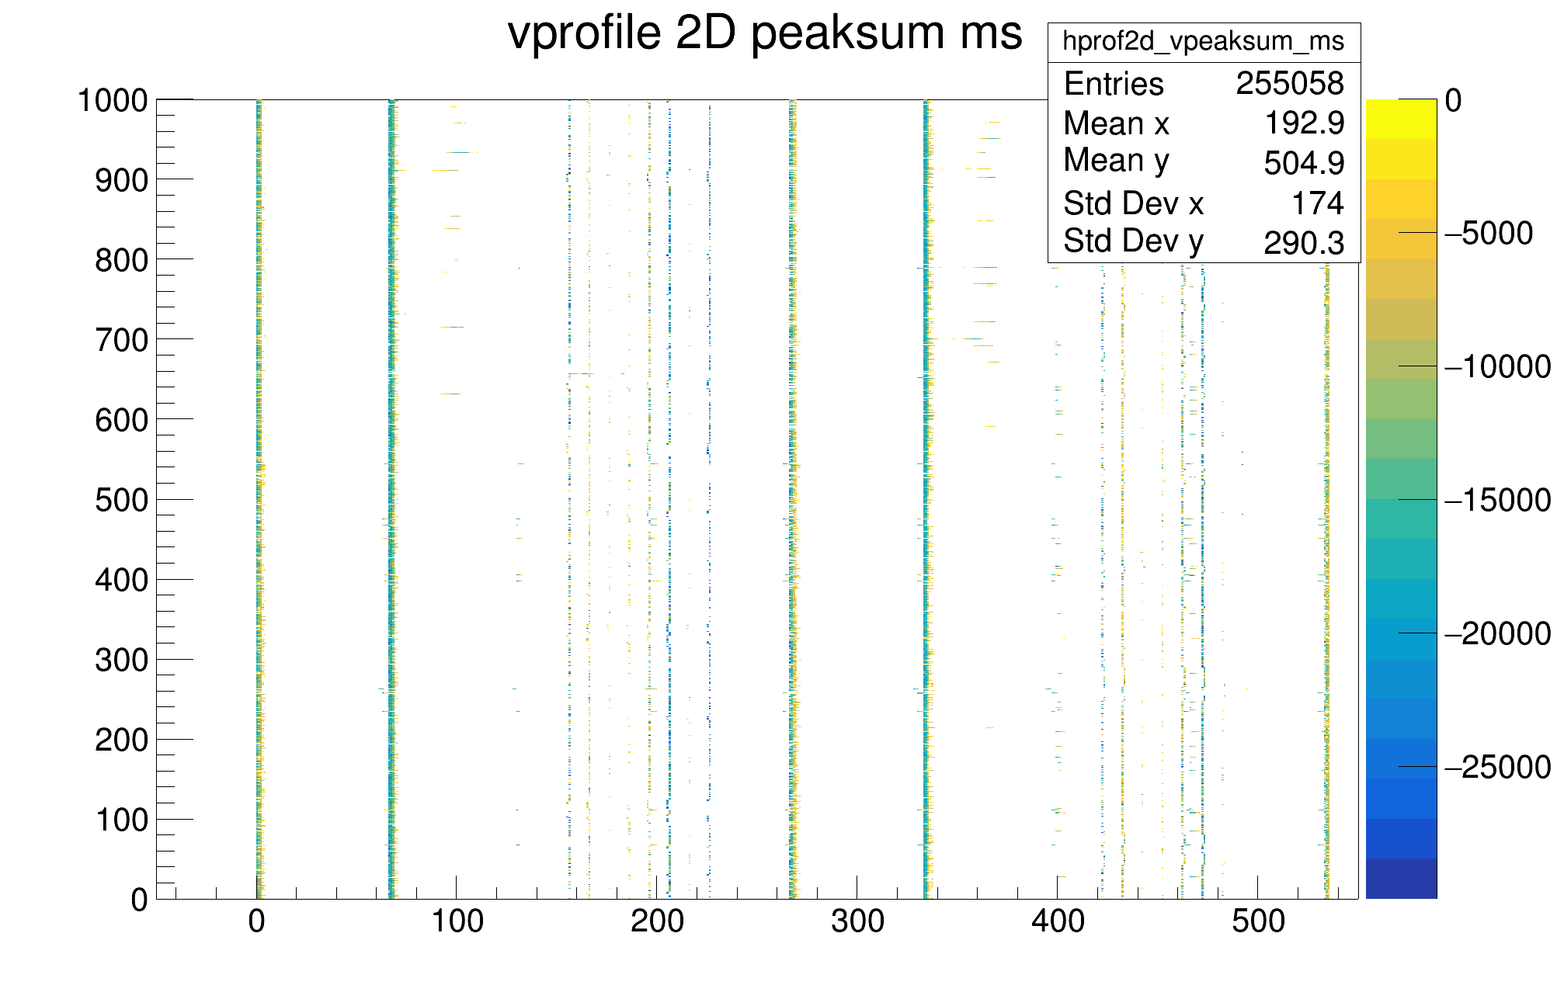
Rebunch 2 bunches into 8
→ Zoom in on these eight bunches

Slide 3
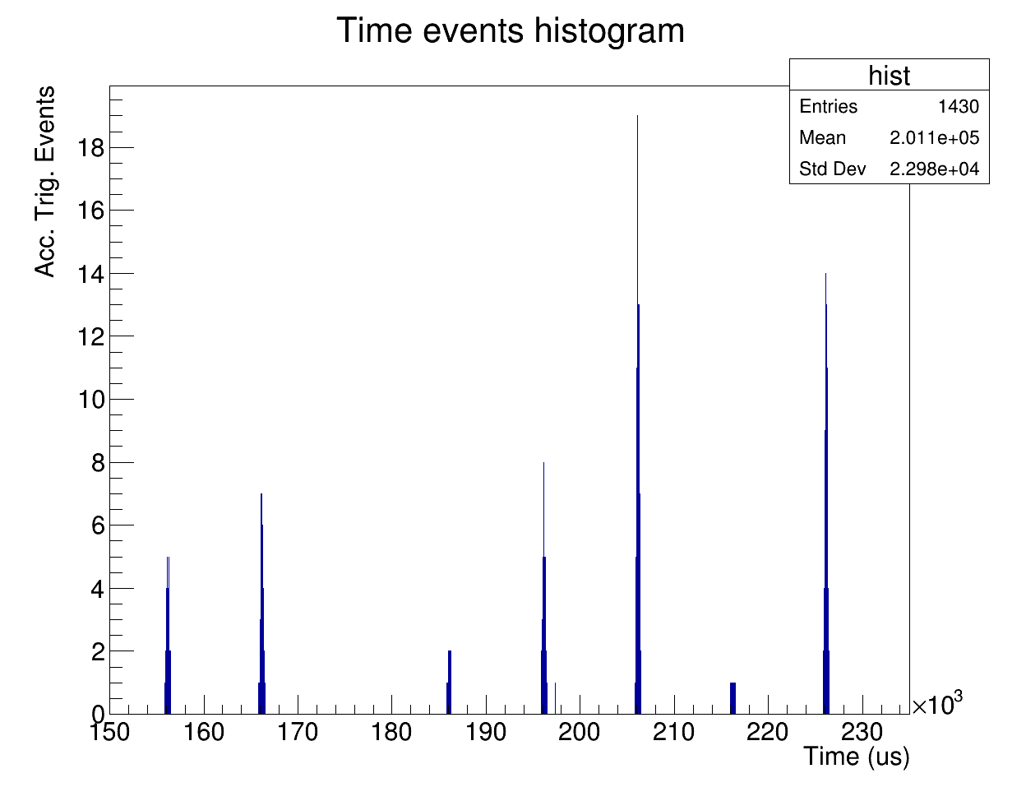
Zoomed view from
previous histogram
(eight bunches)
8 bunches
75 ms
10.7 ms
(93.4 Hz)
Zoom in on one bunch

Slide 4
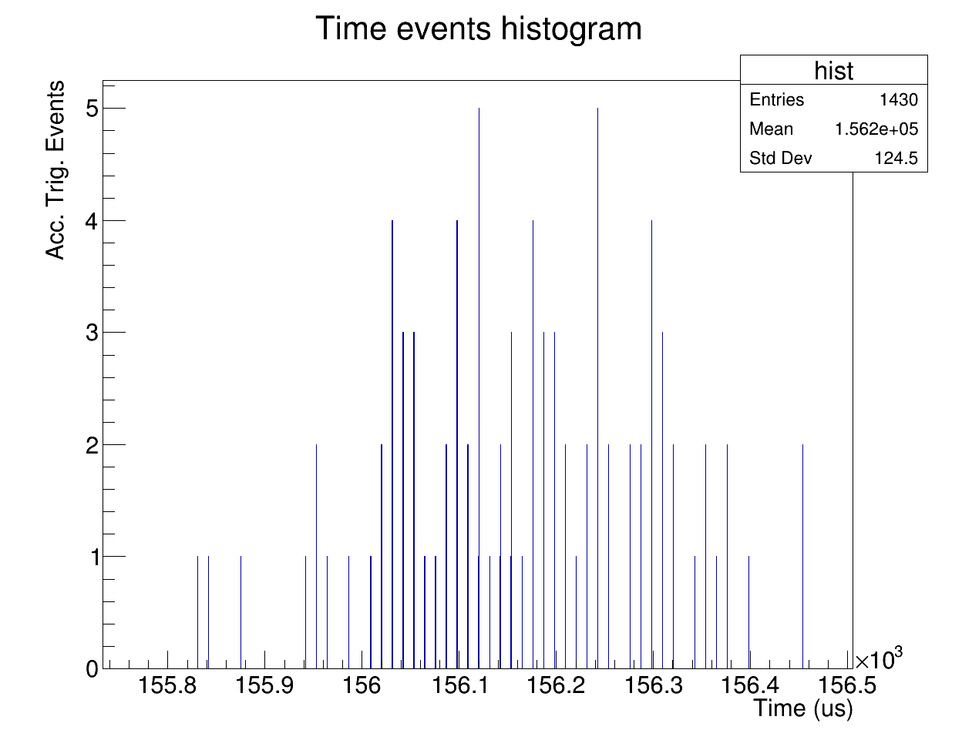
Zoom-in on one
of the eight peaks
11.13us period

