Slide 1

R-Hub
Gábor Csárdi
By the

Slide 2
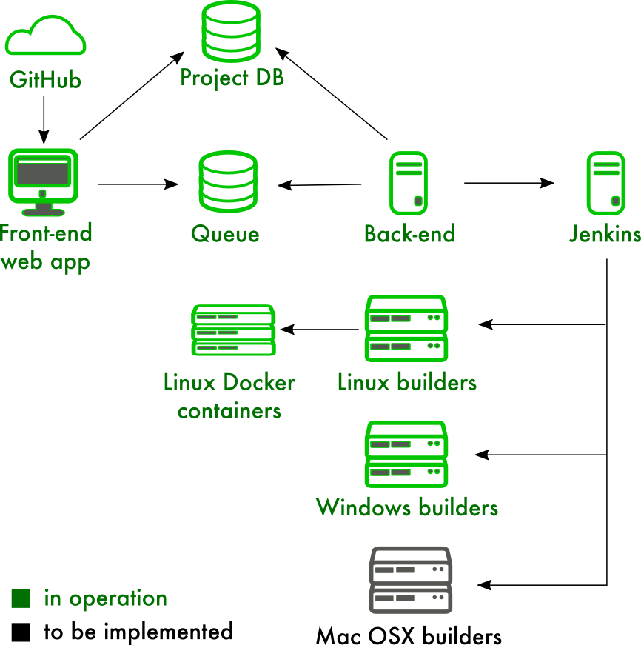
GOALS
R-HUB
Services that ease all steps the R package development process.
Make these services free for all members of the community.
Allow community contributions to
R-hub itself.
Make CRAN maintainers' work easier by pre-testing CRAN package submissions.
$85,000, Jan 2016 — Feb 2017

Slide 3
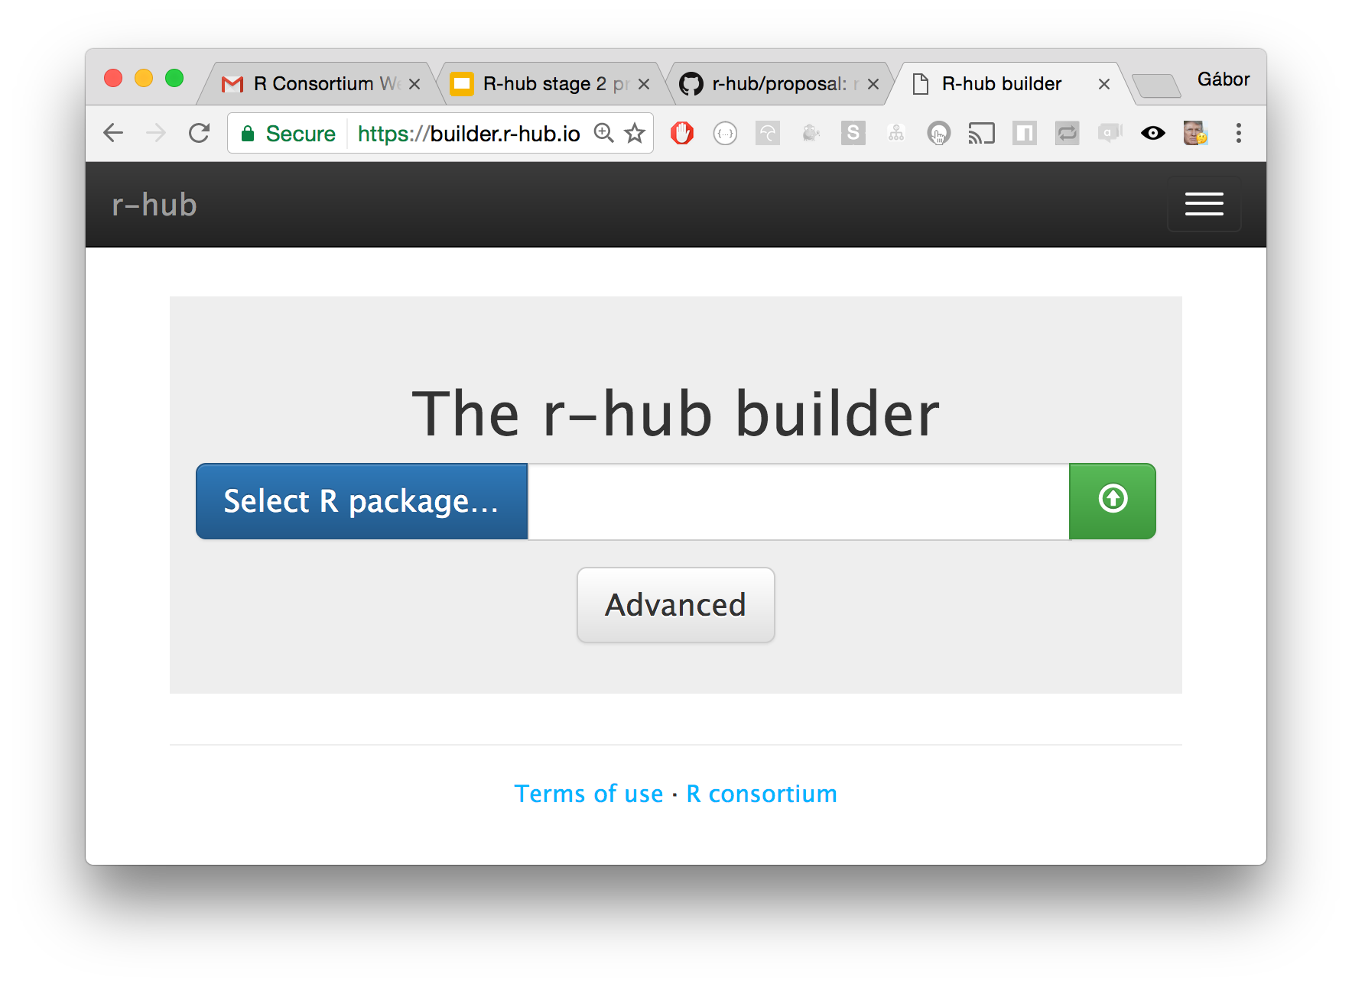
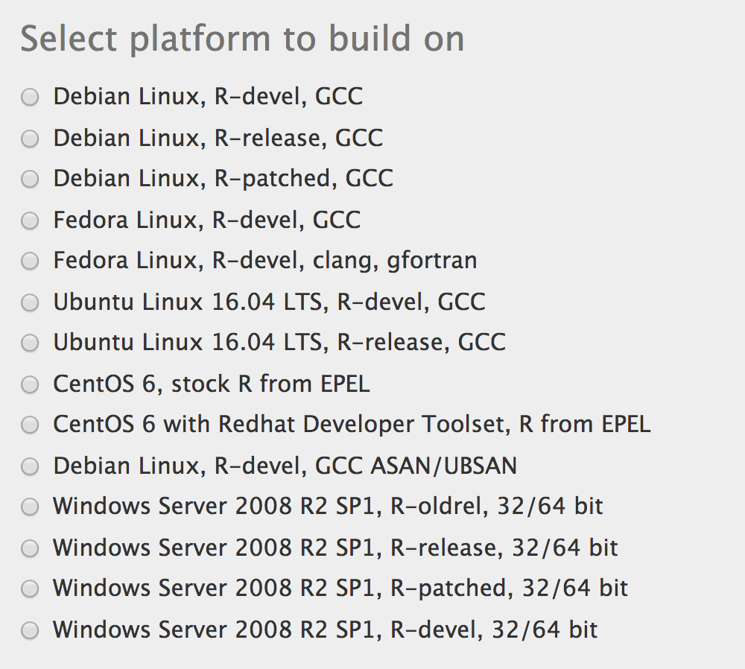
MILESTONES
R-HUB
Linux, Windows, macOS* build servers
Web and command line submission (https://github.com/r-hub/rhub)
Email notifications
Build artifacts
Automated system requirements
Binary Linux packages*

Slide 4
NEXT STEPS
R-hUB
Continuous integration (ongoing)
CRAN pre-check service
Easier deployment
Solaris
Run arbitrary R code, not just R CMD check
https://builder.r-hub.io
https://github.com/r-hub

