Slide 1
Navigating the
Privacy-Robustness-Performance-Trilemma
in Federated Learning
Master Project Seminar Data Protection and Data Security
Hamburg, 20th of July 2026
Jonas Müller, Rebekka Schnoor
20.07.2026

Slide 2
FL-Trilemma: Project Timeline
09.04.2026
Project Kick-off
- Master Project Seminar Data Protection and Data Security begins
09.04.2026
16.04.2026
30.04.2026
21.05.2026
18.06.2026
25.06.2026
09.07.2026
16.07.2026
20.07.2026

Slide 3
FL-Trilemma: Project Timeline
09.04.2026
16.04.2026
30.04.2026
21.05.2026
18.06.2026
25.06.2026
09.07.2026
16.07.2026
20.07.2026
16.04.2026
Schedule & Topic Distribution
- Presentation of project schedule and topic distribution

Slide 4
FL-Trilemma: Project Timeline
30.04.2026
Small Presentations on Potential Topics
- DFL.tex - Security and Privacy Concerns in Federated Learning: An Introduction
- SMPC.tex - Introduction to Secure Multi-Party Computation
09.04.2026
16.04.2026
30.04.2026
21.05.2026
18.06.2026
25.06.2026
09.07.2026
16.07.2026
20.07.2026

Slide 5
FL-Trilemma: Project Timeline
09.04.2026
16.04.2026
30.04.2026
21.05.2026
18.06.2026
25.06.2026
09.07.2026
16.07.2026
20.07.2026
21.05.2026
Lock-in: FL Trilemma
- Theoretical understanding of the problem space
- Robust aggregation landscape reviewed: FLTrust, Krum, Trimmed Mean

Slide 6
FL-Trilemma: Project Timeline
INTERIM PRESENTATION 1 - SLIDES
18.06.2026
Interim Presentation 1
- First code foundation building up (MNIST, Flower)
09.04.2026
16.04.2026
30.04.2026
21.05.2026
18.06.2026
25.06.2026
09.07.2026
16.07.2026
20.07.2026

Slide 7
FL-Trilemma: Project Timeline
09.04.2026
16.04.2026
30.04.2026
21.05.2026
18.06.2026
25.06.2026
09.07.2026
16.07.2026
20.07.2026
INTERIM PRESENTATION 2 - SLIDES
25.06.2026
Interim Presentation 2
- Mechanisms implemented albeit partly flawed (DP, FLTrust, TopK)
- Testing extremely slow due to missing resources

Slide 8
FL-Trilemma: Project Timeline
ACCURACY / RUNTIME CHARTS
09.07.2026
Unlock of Computational Resources
- Larger scale testing unlocked
- GPU access and incrementally stable code foundation allows for CIFAR-10 testing
- First results for large runs are coming through
09.04.2026
16.04.2026
30.04.2026
21.05.2026
18.06.2026
25.06.2026
09.07.2026
16.07.2026
20.07.2026

Slide 9
FL-Trilemma: Project Timeline
09.04.2026
16.04.2026
30.04.2026
21.05.2026
18.06.2026
25.06.2026
09.07.2026
16.07.2026
20.07.2026
16.07.2026
Final Report Submission
- Written report on the Privacy-Robustness-Performance Trilemma due

Slide 10
FL-Trilemma: Project Timeline
FINAL PRESENTATION - SLIDES/RESULTS
20.07.2026
Final Presentation
- Closing presentation of findings
09.04.2026
16.04.2026
30.04.2026
21.05.2026
18.06.2026
25.06.2026
09.07.2026
16.07.2026
20.07.2026

Slide 11
Agenda
Motivation
Background
Threat Model
Research Questions
Experimental Setup
Relevant Findings
Limitations & Future Work

Slide 12
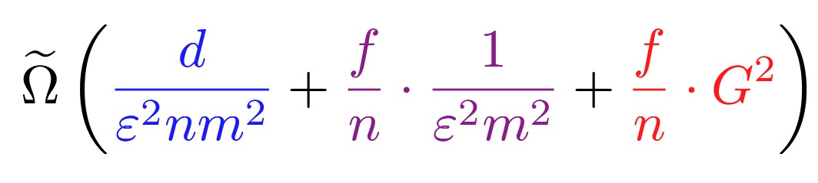
Motivation
Property | Goals | Common drawbacks
Privacy | Limits information leakage, protects client data | Gradient distortion
Robustness | Decreased vulnerability to malicious clients | Disregarding honest updates
Efficiency | Lower communicational cost | Loss of information
f - # malicious clients
n - # total clients
m – dataset size
ε - privacy budget
d– gradient dimension
G – dataset heterogeneity
Lower bound for training error found by Allouah et al. (ICML 2023)

Slide 13
Mechanisms
Background
Differential Privacy SGD
Locally clip per-sample gradients and add calibrated Gaussian noise
Top-k sparsification
Transmit only k largest gradient components
FLTrust
Weigh client contributions based on distance to an anchor update calculated on a root dataset

Slide 14
Method Selection
Axis | Method | Key Parameters | Why do we choose this?
Baseline | FedAvg | - | Commonly used for benchmarking
Privacy | DP-SGD | Privacy budget, failure probability | good standard, tunable privacy budget, Opacus integration with Flower
Robustness | FLTrust | Server root dataset size | Stronger than Krum under heterogeneity
Performance | Top-k sparsification | Sparsification threshold | Simple, compatible with DP and robust agg.; directly controllable

Slide 15
Threat Model
The Server is honest, but curious
Clients are honest
$η\%$ of the clients are malicious
𝜂% of the clients are malicious

Slide 16
Research Questions
Isolation: What is the individual cost of each defense mechanism (DP, Byzantine-robust aggregation, gradient compression) in terms of accuracy, communication overhead, and attack success rate, and do our results reproduce the published baselines?
Combination: How do pairwise and full combinations of the three mechanisms interact? Do the costs compound additively, sub-additively, or super-additively?
Trust and Privacy: How do the trust scores assigned by FLTrust evolve throughout training, and what do they reveal about the interaction between privacy, robustness, and model performance?

Slide 17
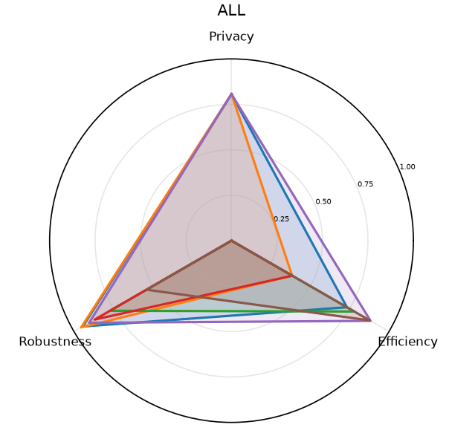
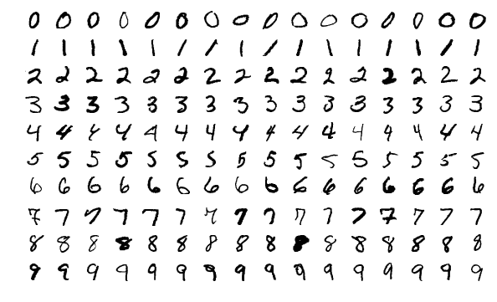
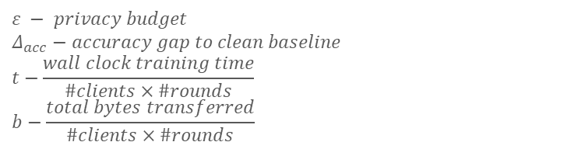

Experimental Setup
$$Reporting metrics$$
$$Privacy: \max\left(0,\frac{ε_{max}−ε}{ε_{max}}\right)$$
$$Robustness: 1−Δ_{acc}$$
$$Efficiency: α×\frac{t_{base}}{t}+\left(1−α\right)×\frac{b_{base}−b}{b_{base}}$$
$$ε − privacy budget$$
$$Δ_{acc}−accuracy gap to clean baseline$$
$$t−\frac{wall clock training time}{\#clients×\#rounds}$$
$$b−\frac{total bytes transferred}{\#clients×\#rounds}$$
Model Architecture: CNN (image classifier)
Dataset: MNIST

Slide 18
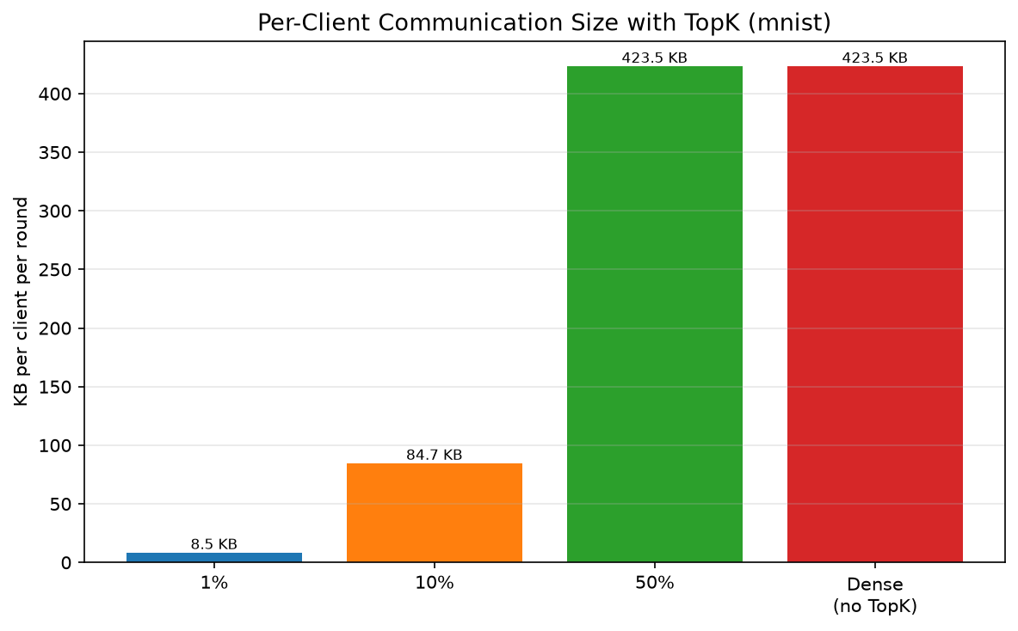
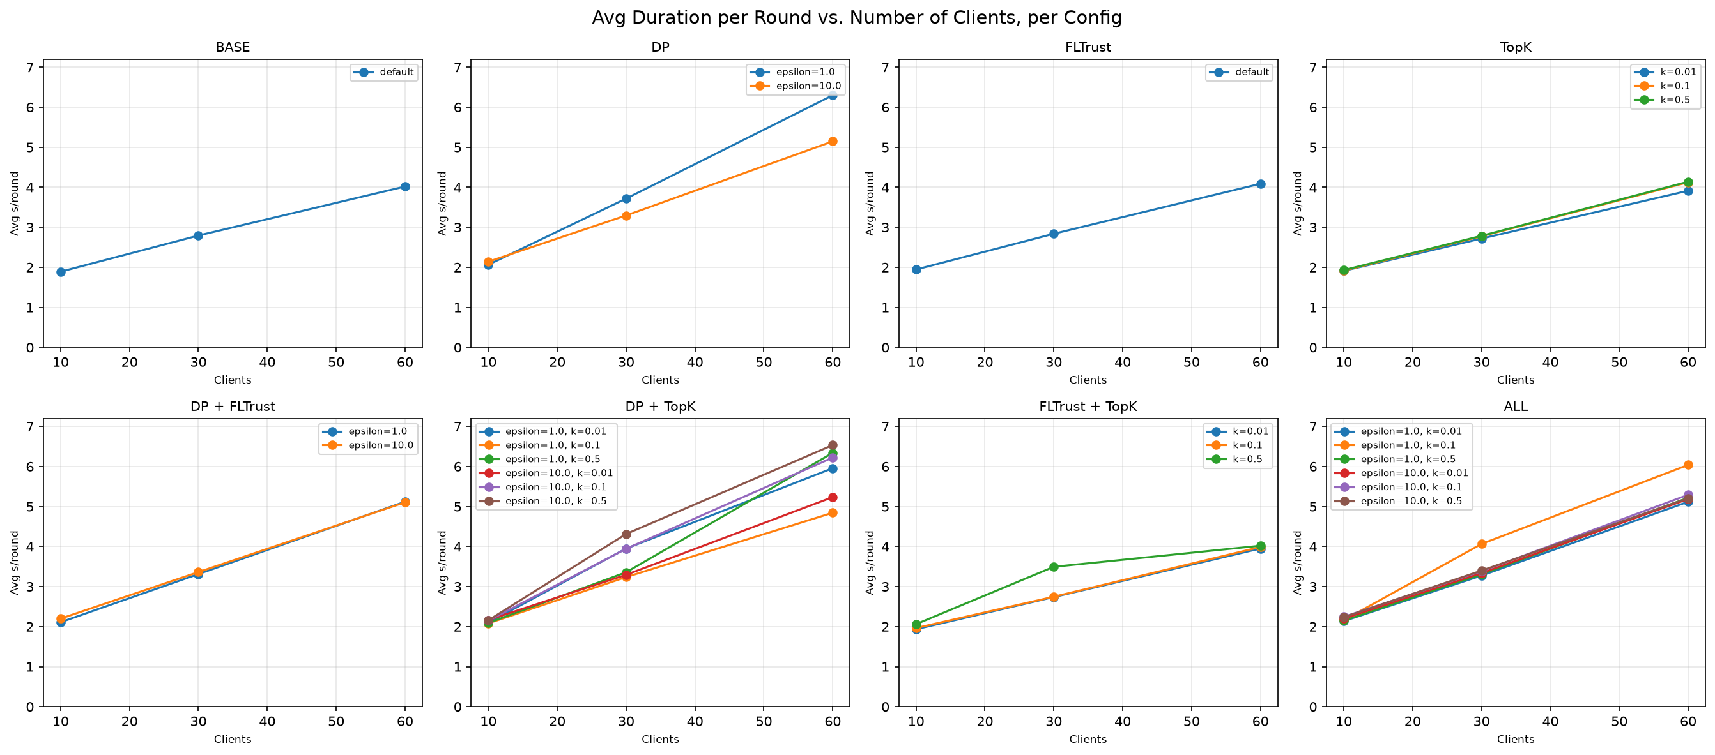
Results
Top-k
Reduces transfered bytes
FLTrust
Mitigates Label-Flipping
Differential Privacy
Increases computation time
Reduces accuracy

Slide 19
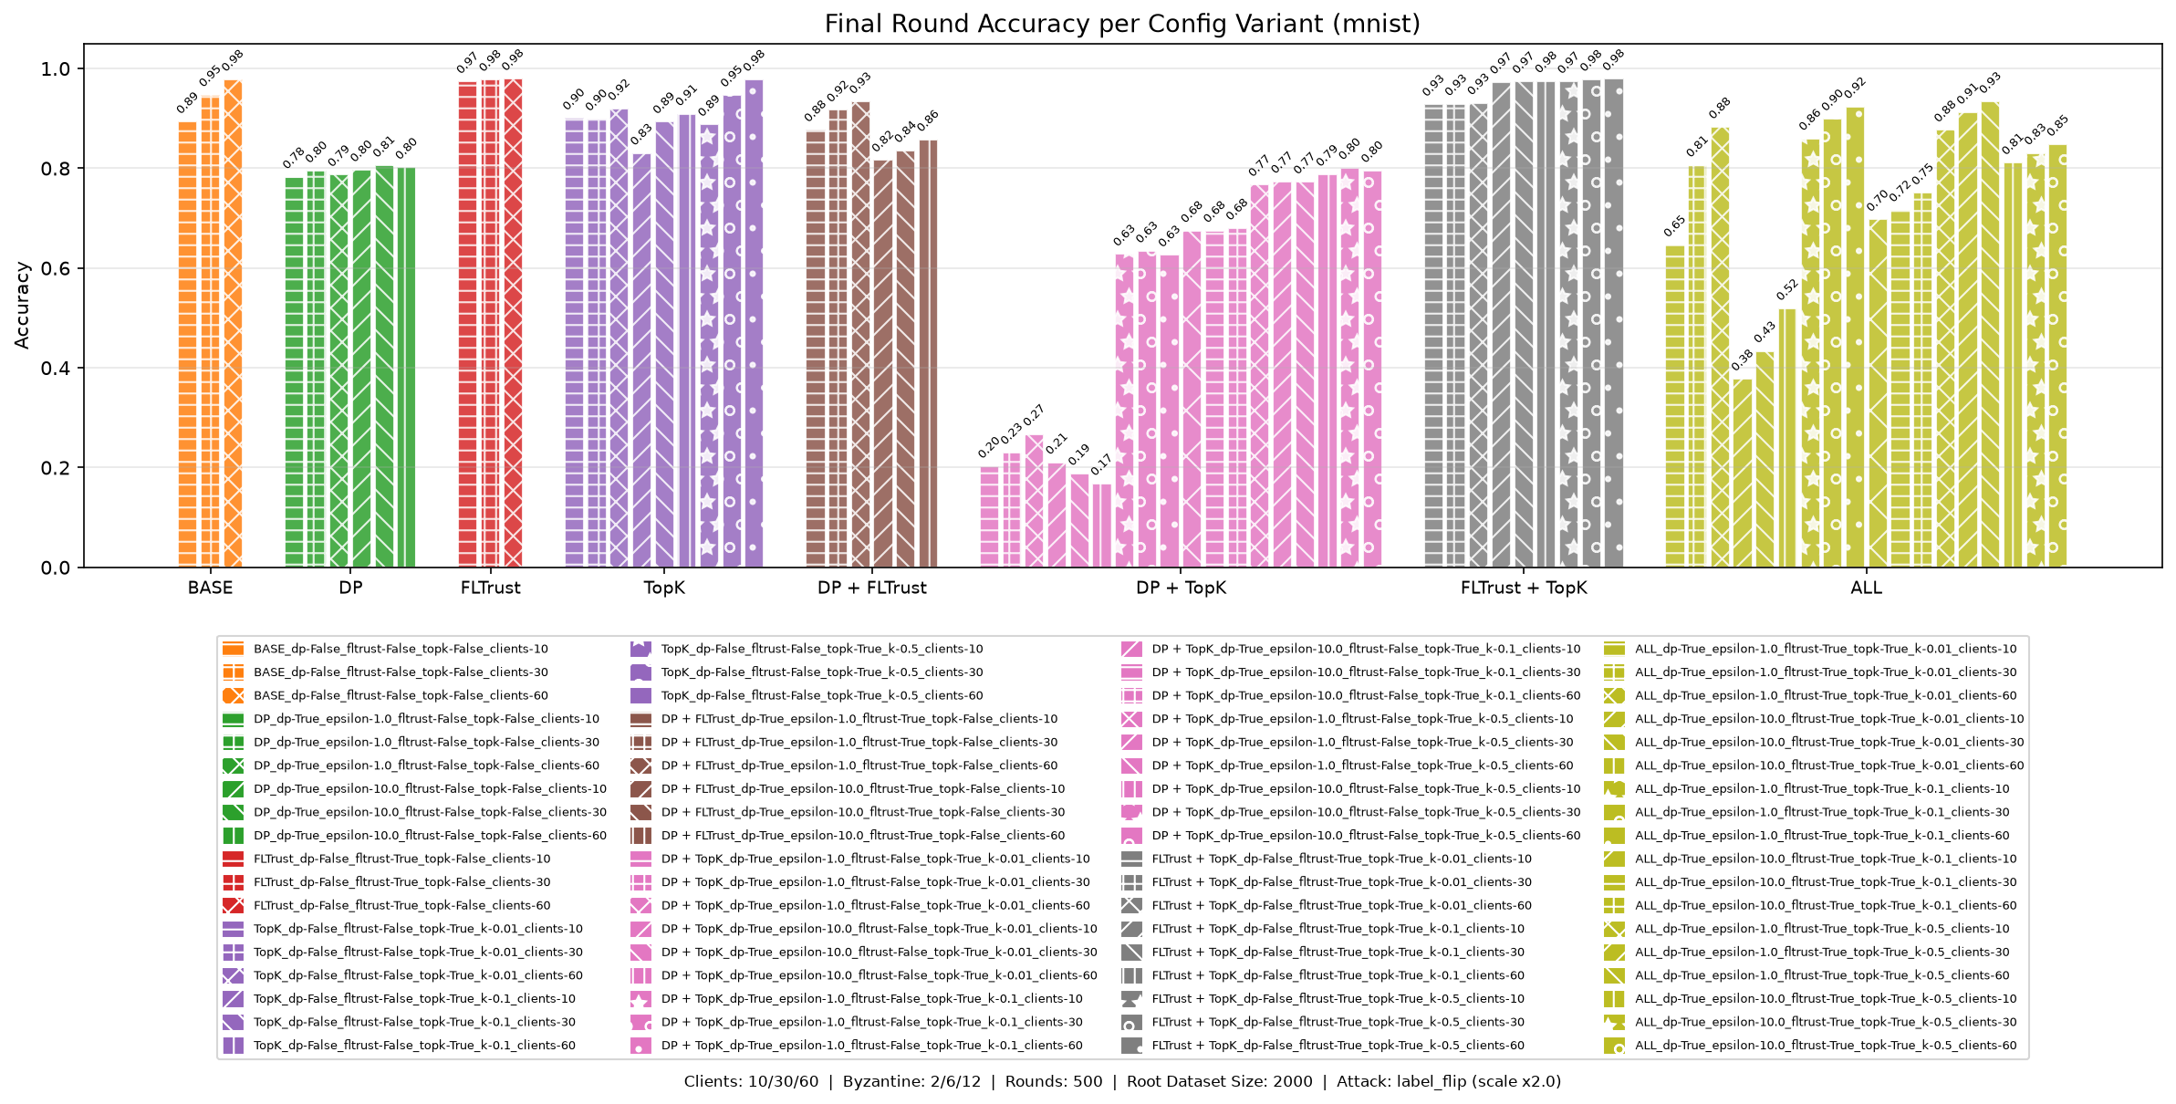
Relevant Findings

Slide 20
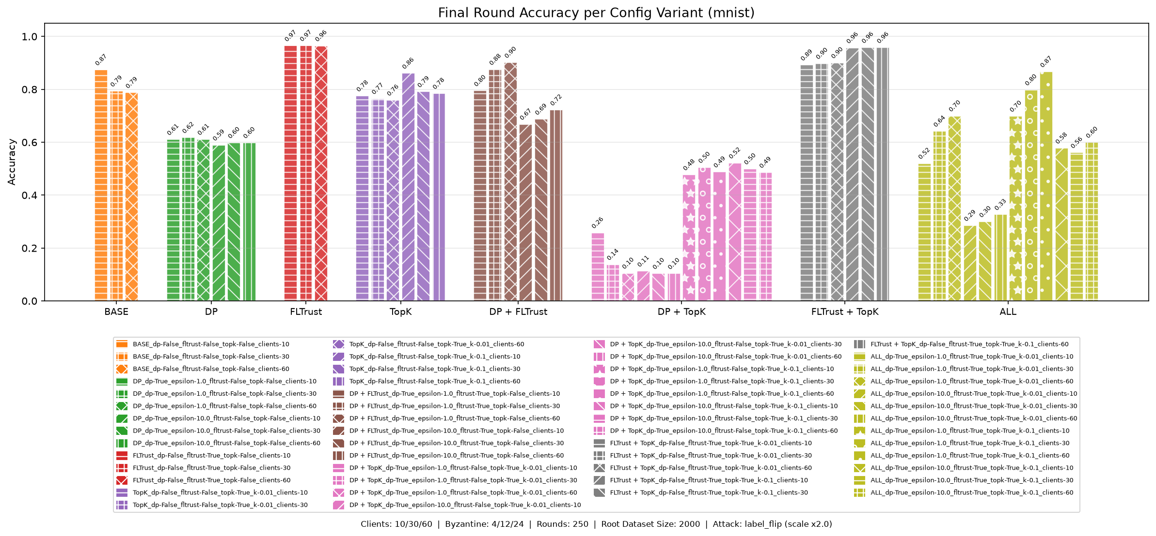
Relevant Findings

Slide 21
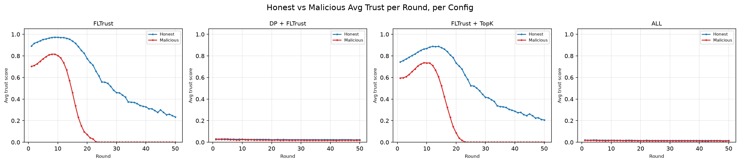
Relevant Findings
Caption: 50 rounds of full epochs trained, n = 50, η = 0.4, attack scale = 2.0
Trustscores decay over time
Malicious converges to 0
Honest stays relevant

Slide 22
Limitations & Future Work
Limitations
Simple models and datasets
Limited method coverage
FLTrust root dataset size
Stateless clients
Privacy budget schedule
Future Work
Investigate the Interaction of DP and FLTrust
Trust Scores as a Regularization Mechanism
Broader Experimental Setup

Slide 23
Limitations & Future Work
Simple models and datasets
Limited method coverage
FLTrust root dataset size
Stateless clients
Privacy budget schedule
Investigate the Interaction of DP and FLTrust
Trust Scores as a Regularization Mechanism
Broader Experimental Setup

Slide 24
References
Y. Allouah, R. Guerraoui, N. Gupta, R. Pinot, and J. Stephan, “On the privacy-robustness-utility trilemma in distributed learning,” in Proceedings of the 40th International Conference on Machine Learning, ser. Proceedings of Machine Learning Research, 2023. [Online]. Available: https://arxiv.org/abs/2302.04787
D. J. Beutel, T. Topal, A. Mathur, X. Qiu, J. Fernandez-Marques, Y. Gao, L. Sani, K. H. Li, T. Parcollet, P. P. de Gusm˜ao, and N. D. Lane, “Flower: A friendly federated learning research framework,” arXiv preprint, vol. arXiv:2007.14390, 2020. [Online]. Available: https://arxiv.org/abs/2007.14390
A. Yousefpour, I. Shilov, A. Sablayrolles, D. Testuggine, K. Prasad, M. Malek, J. Nguyen, S. Ghosh, A. Bharadwaj, J. Zhao, G. Cormode, and I. Mironov, “Opacus: User-friendly differential privacy library in PyTorch,” arXiv preprint, vol. arXiv:2109.12298, 2021. [Online]. Available: https://arxiv.org/abs/2109.12298
X. Cao, M. Fang, J. Liu, and N. Z. Gong, “FLTrust: Byzantine-robust federated learning via trust bootstrapping,” in Network and Distributed System Security Symposium (NDSS), 2021. [Online]. Available: https://arxiv.org/abs/2012.13995
S. Li, E. C.-H. Ngai, F. Ye, L. Ju, T. Zhang, and T. Voigt, “BLADES: A unified benchmark suite for Byzantine attacks and defenses in federated learning,” in Proceedings of the ACM/IEEE International Conference on Internet-of-Things Design and Implementation (IoTDI), 2024.

Slide 25
References
S. Shi, X. Chu, K. C. Cheung, and S. See, “Understanding topk sparsification in distributed deep learning,” 2019. [Online]. Available: https://arxiv.org/abs/1911.08772
R. Guerraoui, N. Gupta, R. Pinot, S. Rouault, and J. Stephan, “Differential privacy and byzantine resilience in sgd: Do they add up?” 2021. [Online]. Available: https://arxiv.org/abs/2102.08166
I. Mironov, “Rényi differential privacy,” in 2017 IEEE 30th Computer Security Foundations Symposium (CSF). IEEE, Aug. 2017, p. 263–275. [Online]. Available: http://dx.doi.org/10.1109/CSF.2017.11
P. Blanchard, E. M. El Mhamdi, R. Guerraoui, and J. Stainer, “Machine learning with adversaries: Byzantine tolerant gradient descent,” in Advances in Neural Information Processing Systems (NeurIPS), vol. 30, 2017.
M. Abadi, A. Chu, I. Goodfellow, H. B. McMahan, I. Mironov, K. Talwar, and L. Zhang, “Deep learning with differential privacy,” in Proceedings of the ACM SIGSAC Conference on Computer and Communications Security (CCS). ACM, 2016, pp. 308–318.

Slide 26
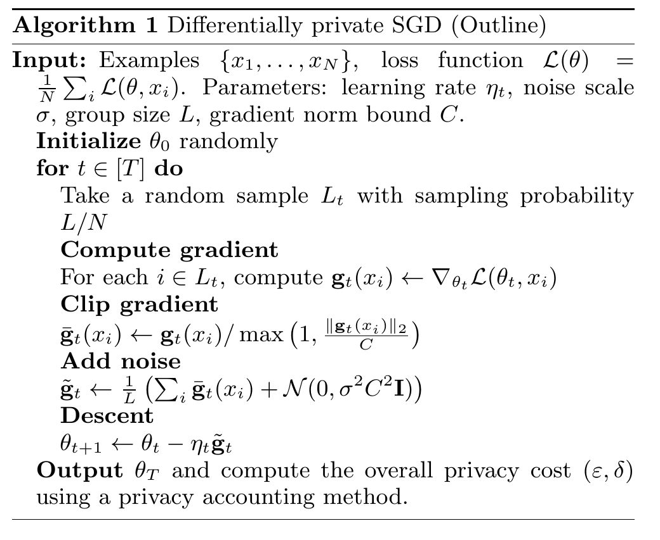
Local Differential Privacy in Deep Learning
Privacy budget ε
Probability, that a perturbed output remains distinguishable whether an individual's data is true or altered
"measure of preserved information"
Controls trade-off between privacy and data utility
Failure Probability δ
Probability that the privacy guarantee is exceeded
Should stay smaller than inverse input dimension |d|⁻¹
M. Abadi, A. Chu, I. Goodfellow, H. B. McMahan, I. Mironov, K. Talwar, and L. Zhang, “Deep learning with differential privacy,”

Slide 27
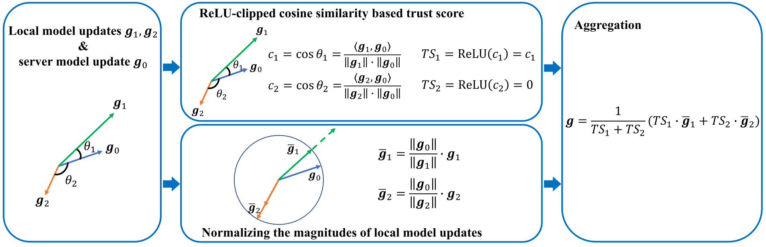
FLTrust update mechanism

Slide 28
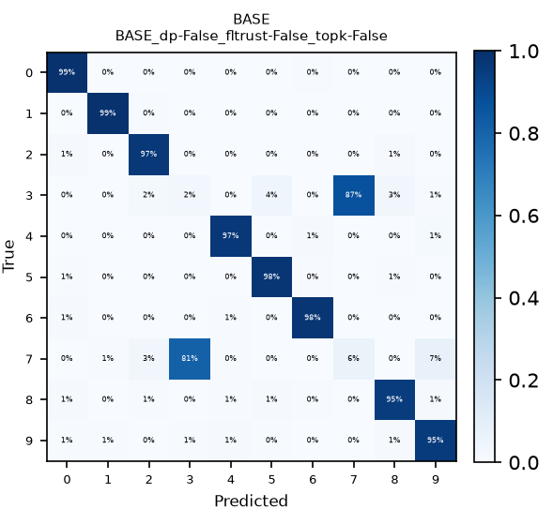
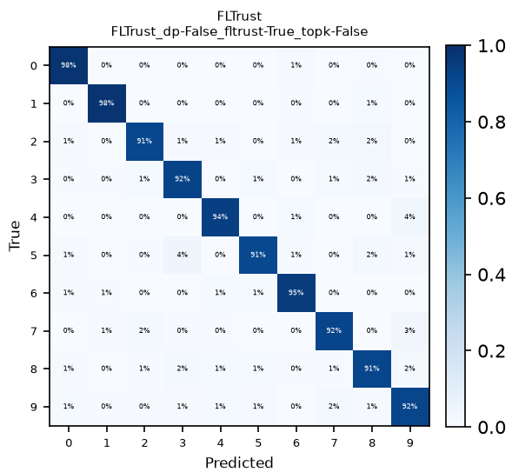
Confusion Matrices

