Slide 1
Intermediate Presentation
Security and Privacy in
Federated Learning
Empirical Study of the Privacy-Robustness-Performance Trilemma
Jonas Müller · Rebekka Schnoor
Master Project Seminar Data Protection and Data Security
Universität Hamburg · 09 July 2026

Slide 2
Outline
01
Accuracy Results
02
Trilemma Overview
Training accuracy across configurations
Triangle visualization of results
03
Milestones
04
Challenges and Next Steps
Achievements and goals​
Current hardships and how to proceed
Security and Privacy in Federated Learning · Jonas Müller, Rebekka Schnoor

Slide 3
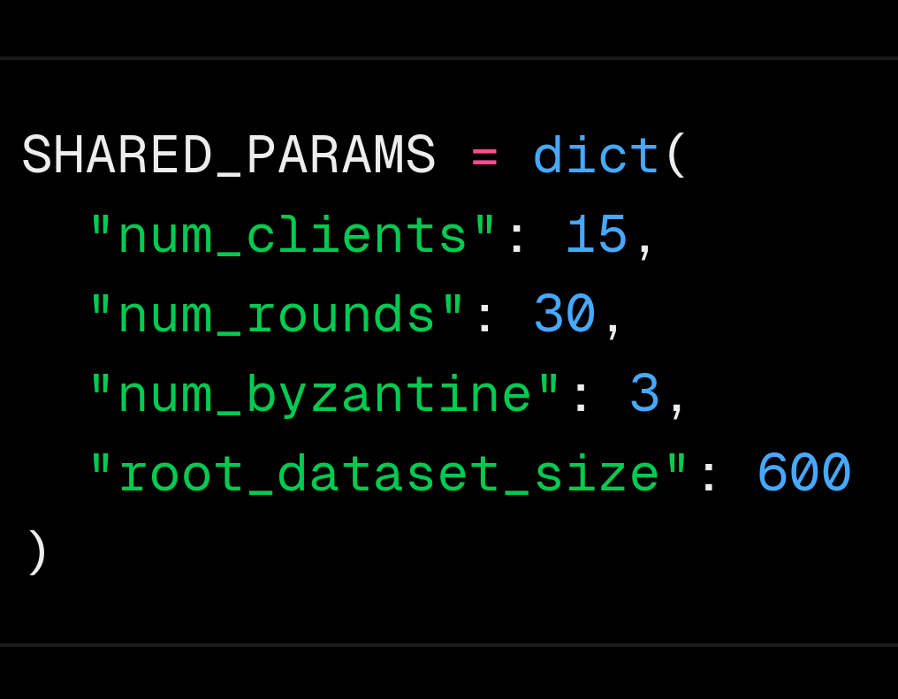
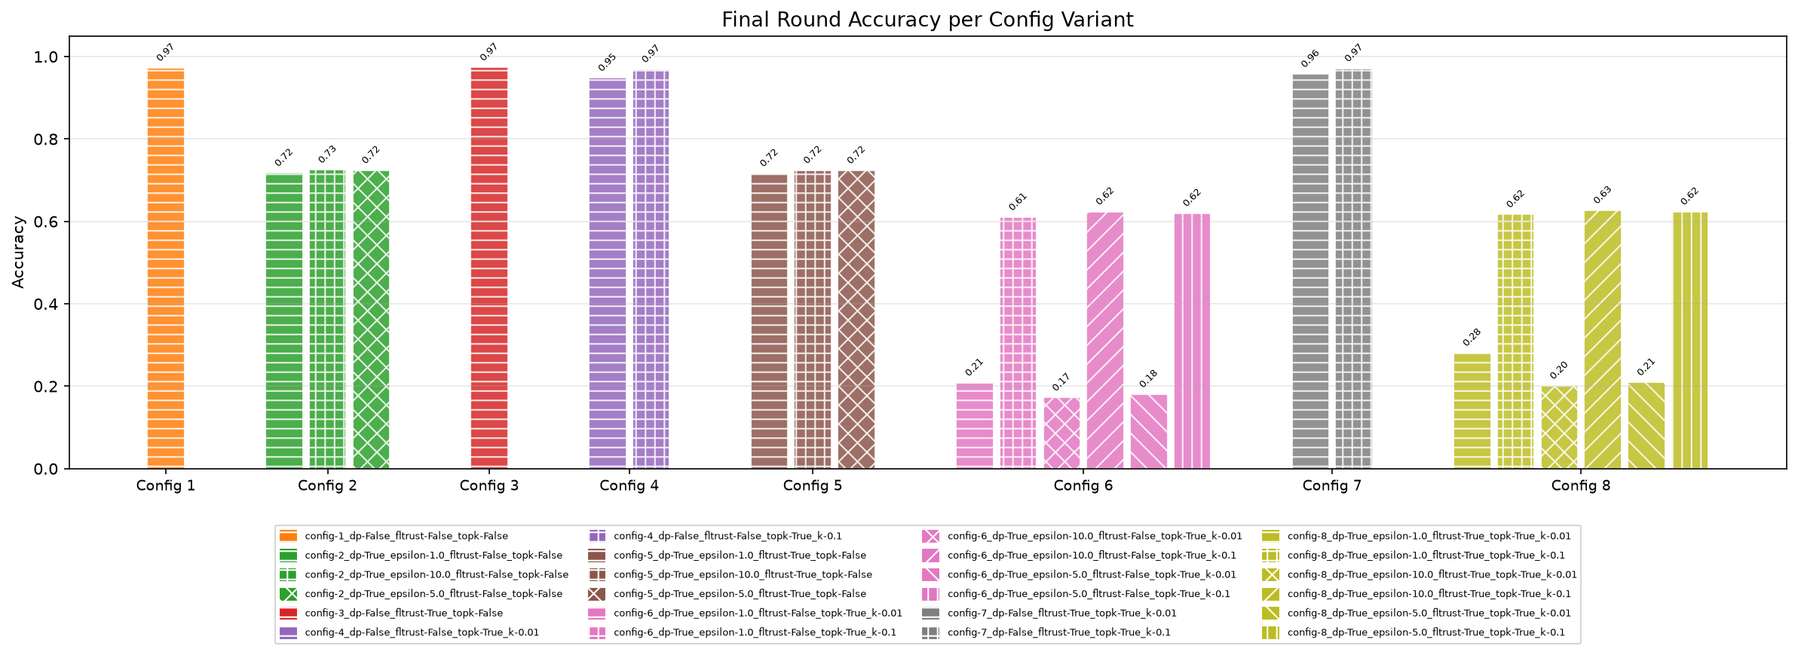
Accuracy Results – Training Convergence
Parameters
Training accuracy for all 8 configurations.
BASE
DP
FLTrust
Top-k
DP + FLTrust
DP+Top-k
FLTrust + Top-k
FULL
Security and Privacy in Federated Learning · Jonas Müller, Rebekka Schnoor

Slide 4
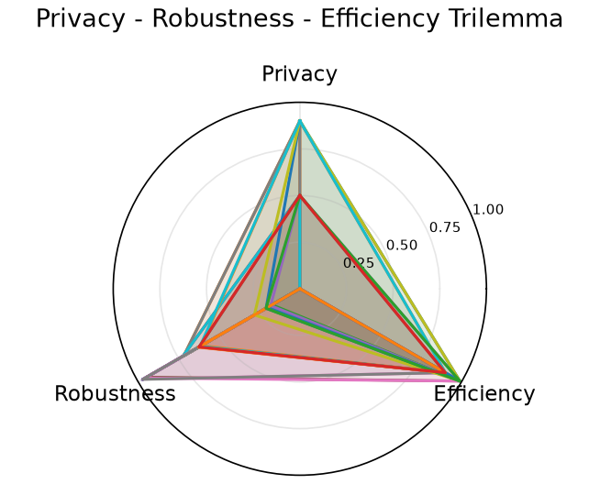

Trilemma Overview – All 8 Configurations
Analysis of Trilemma Radar Chart.
📊
Accuracy: Full vs. Top-k Compressed
Insert plot here
Takeaways
Individual goals achievable
Privacy and Robustness conflict
Privacy + Efficiency difficult to combine
Tradeoff visible: We encounter a maximum size for each triangle
Security and Privacy in Federated Learning · Jonas Müller, Rebekka Schnoor

Slide 5


Milestones
Achievements
Goals
MNIST implementation
Full run of all configs on both datasets
Full operational pipeline integrating all mechanisms
Obtain representative results on performant hardware
Seed control for consistent results
Analyze mitigations
Mitigate initialization randomness
Experiment with alternative designs to mitigate performance break-ins
Confirmation of Trilemma
Evaluation
Results align with expected tradeoffs
Detailed analysis of combinatory effects
Security and Privacy in Federated Learning · Jonas Müller, Rebekka Schnoor

Slide 6
Challenges & Next Steps
Hardships
Next Steps
⚠
Resources
→
CIFAR-10 & ResNet
More Clients might help mitigating the DP effect
Scale experiments to harder dataset and deeper model.
⚠
Stateless Clients (Privacy / Implementation)
→
Increase Client number
Interaction with Top-k computation
More representative results
⚠
Label flipping attack impact
→
Different attack patterns
Experiment with more disruptive attacks
Arbitrary gradients (untargeted performance degradation)
Gradients of large magnitude (strong influence on resulting model)
Security and Privacy in Federated Learning · Jonas Müller, Rebekka Schnoor

