Slide 1
Intermediate Presentation
Security and Privacy in
Federated Learning
Empirical Study of the Privacy-Robustness-Performance Trilemma
Jonas Müller · Rebekka Schnoor
Master Project Seminar Data Protection and Data Security
Universität Hamburg · 25 June 2026

Slide 2
Outline
01
Accuracy Results
02
Privacy–Performance Tradeoff (DP-SGD)
03
Trilemma Overview
Training convergence across configurations
Showing Privacy vs Performance
Overview over the results
04
Intermediate Evaluation
05
Challenges & Next Steps
Some intermediate results explained
Stoppers and TODOs
Security and Privacy in Federated Learning · Jonas Müller, Rebekka Schnoor

Slide 3
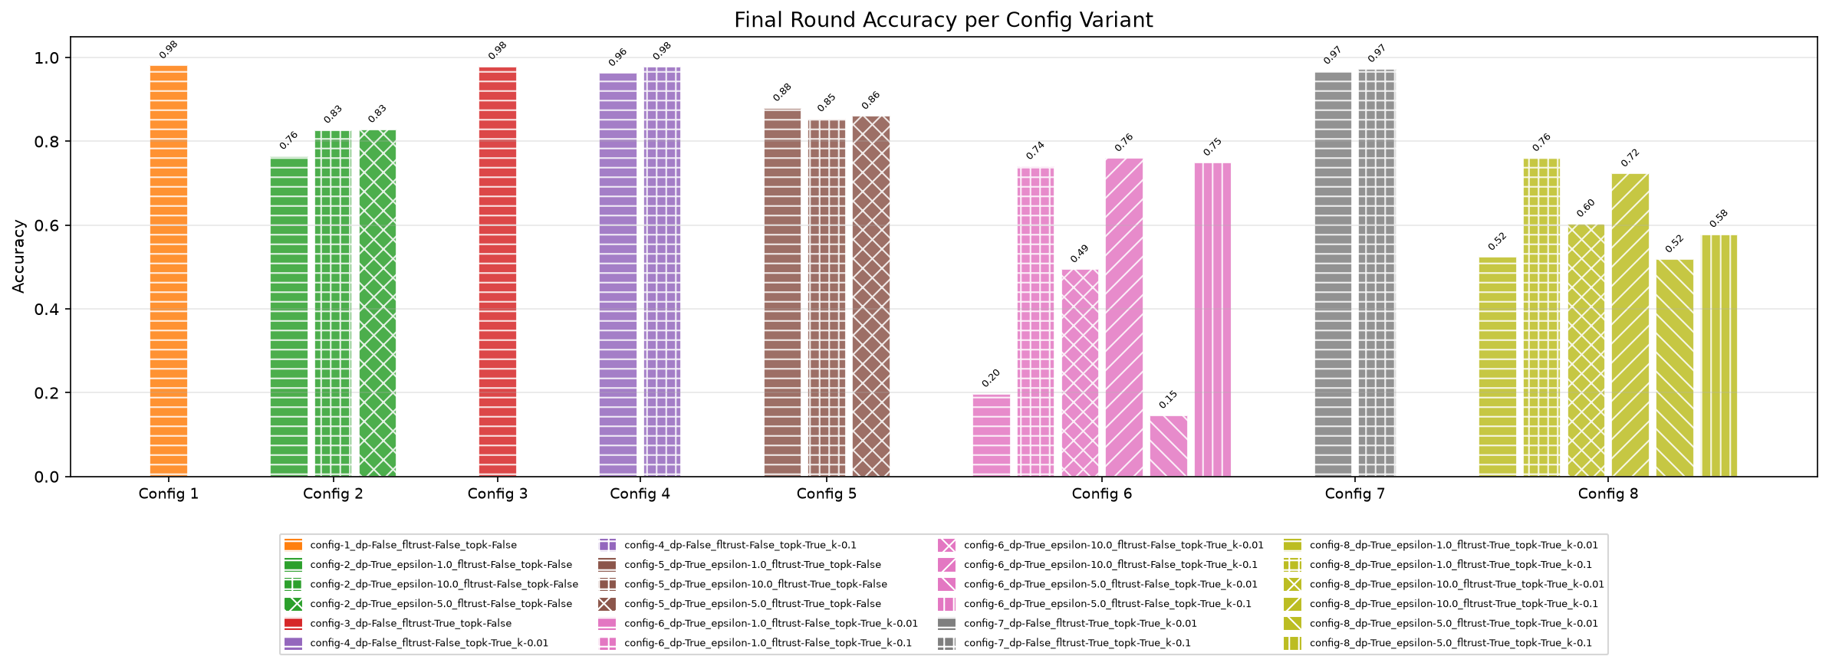
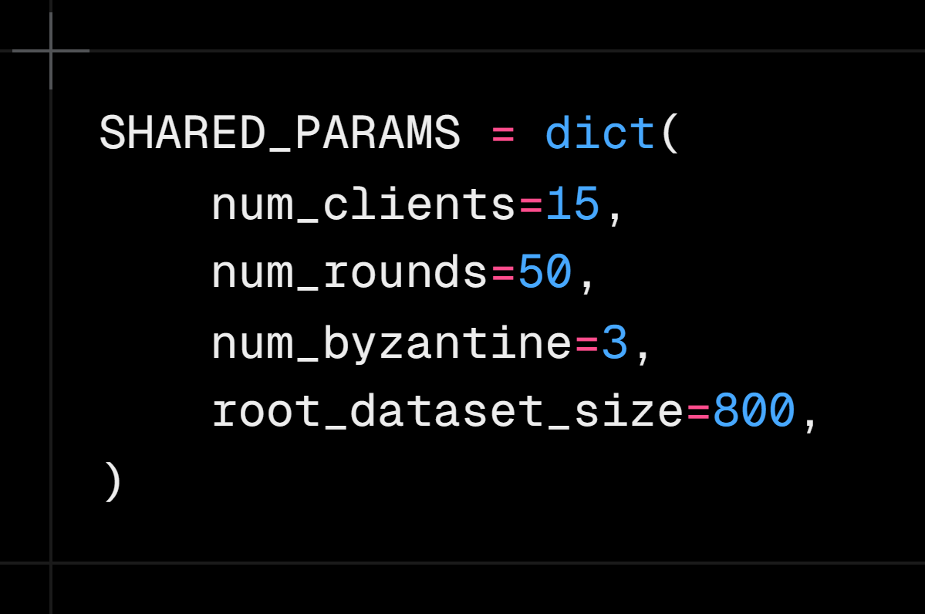
Accuracy Results – Training Convergence
Training accuracy and loss over communication rounds for all 8 configurations.
📊
Accuracy & Loss per Round – All Configs
Insert plot here
Parameters
Configurations
1: Baseline
2: DP only
3: FLTrust only (label-flip)
4: Top-k only
5: DP + FL Trust
6: DP + Top-k
7: FLTrust + Top-k
8: Full
Security and Privacy in Federated Learning · Jonas Müller, Rebekka Schnoor

Slide 4
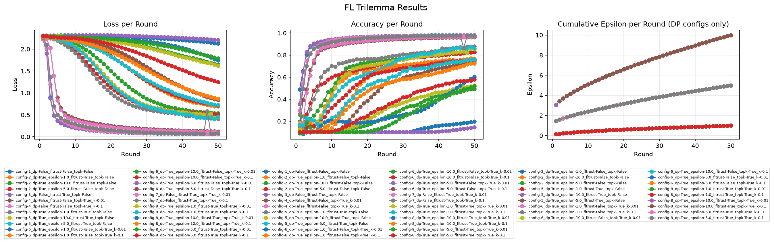
Accuracy Results – Training Convergence
Training accuracy and loss over communication rounds for all 8 configurations.
📊
Accuracy & Loss per Round – All Configs
Insert plot here
Security and Privacy in Federated Learning · Jonas Müller, Rebekka Schnoor

Slide 5
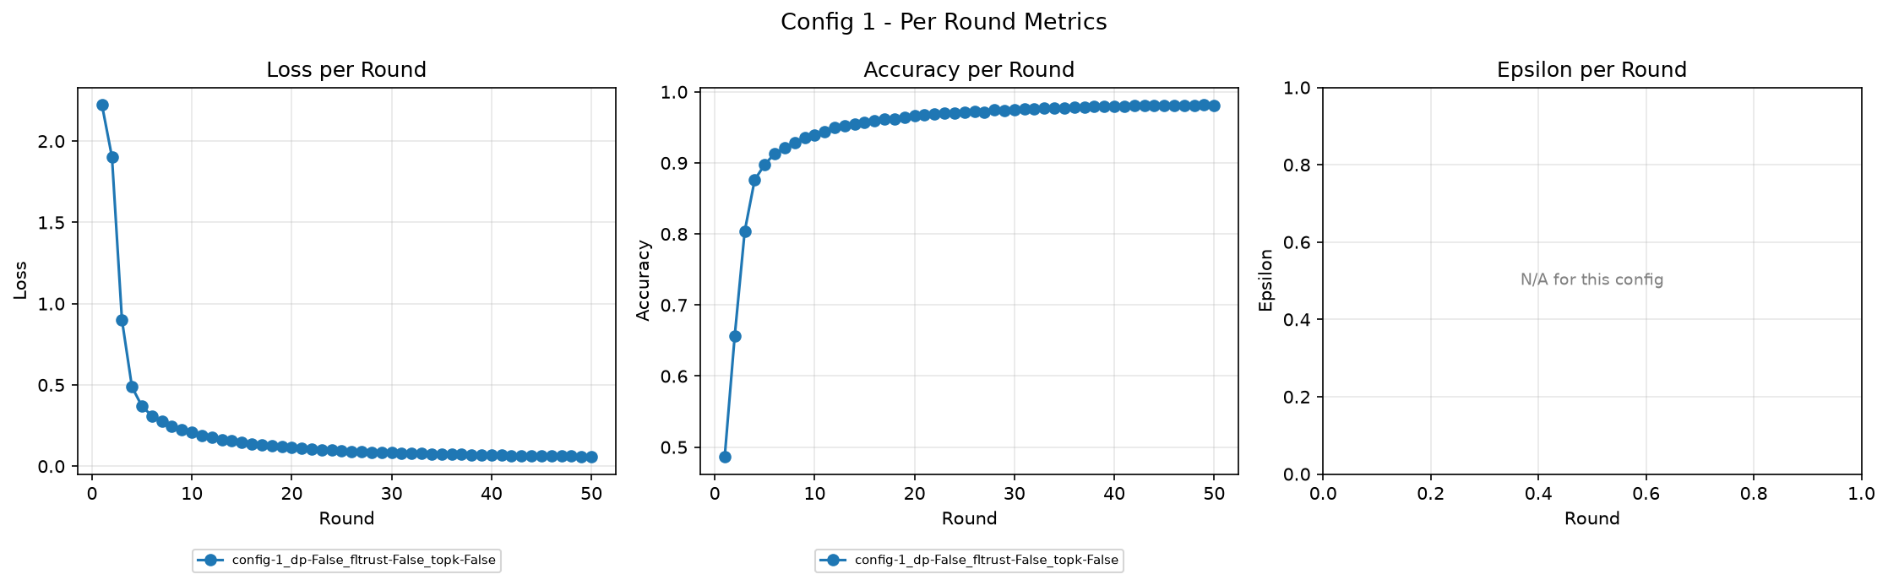
Accuracy Results – Training Convergence
Training accuracy and loss over communication rounds.
📊
Accuracy & Loss per Round – All Configs
Insert plot here
Security and Privacy in Federated Learning · Jonas Müller, Rebekka Schnoor

Slide 6
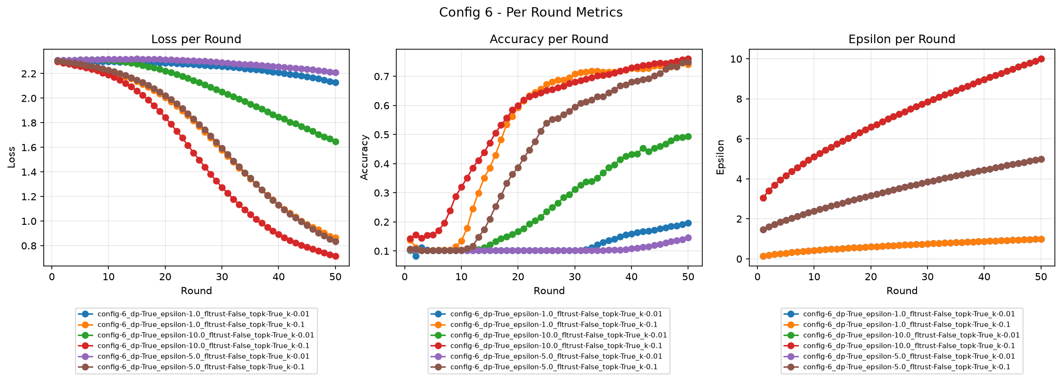
Accuracy Results – Training Convergence
Training accuracy and loss over communication rounds.
📊
Accuracy & Loss per Round – All Configs
Insert plot here
Security and Privacy in Federated Learning · Jonas Müller, Rebekka Schnoor

Slide 7
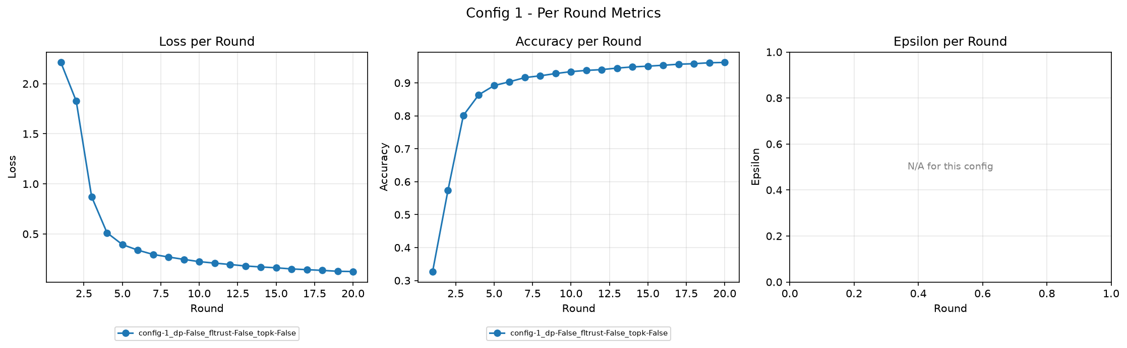
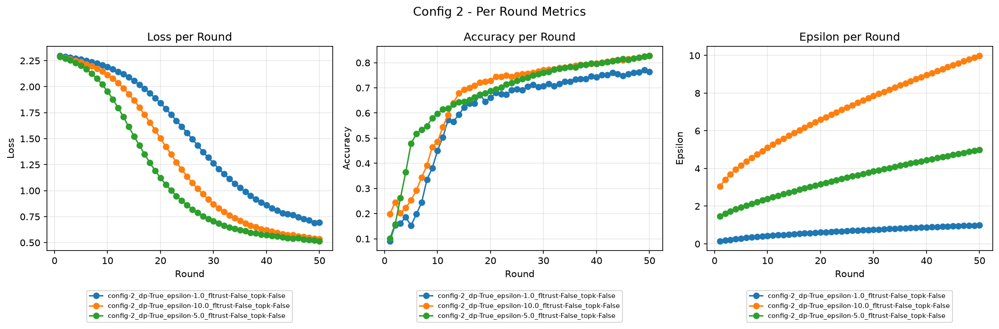
Privacy–Performance Tradeoff (DP-SGD)
Effect of differential privacy (ε budget) on model accuracy across training rounds.
📊
Accuracy & Loss per Round – All Configs
Insert plot here
Security and Privacy in Federated Learning · Jonas Müller, Rebekka Schnoor

Slide 8
Privacy–Performance Tradeoff (DP-SGD)
Effect of differential privacy (ε budget) on model accuracy across training rounds.
📊
DP vs. No-DP: Accuracy over Rounds
Insert plot here
📊
Privacy Budget (ε) Accumulation
Insert plot here
Security and Privacy in Federated Learning · Jonas Müller, Rebekka Schnoor

Slide 9
Robustness Results – FLTrust vs. Label-Flip Attack
FLTrust aggregation defending against malicious clients performing label-flip attacks.
📊
Accuracy: Baseline vs. Attack vs. FLTrust
Insert plot here
📊
Per-Class F1 Score Comparison
Insert plot here
Security and Privacy in Federated Learning · Jonas Müller, Rebekka Schnoor

Slide 10
Compression Results – Top-k Gradient Sparsification
Top-k compression retains only the k% largest gradient values per round.
📊
Accuracy: Full vs. Top-k Compressed
Insert plot here
📊
Loss Convergence Rate Comparison
Insert plot here
Security and Privacy in Federated Learning · Jonas Müller, Rebekka Schnoor

Slide 11
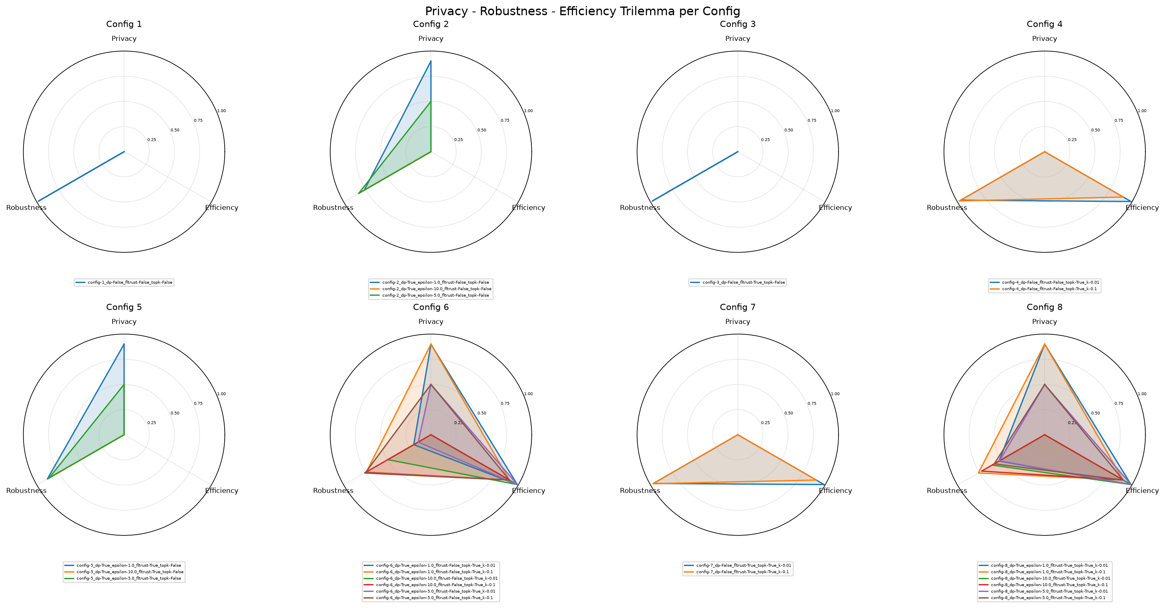
Trilemma Overview – All 8 Configurations
Configurations
Radar charts summarising the privacy–robustness–performance balance per configuration.
📊
Radar Chart – Privacy / Robustness / Performance
Insert plot here
Security and Privacy in Federated Learning · Jonas Müller, Rebekka Schnoor

Slide 12
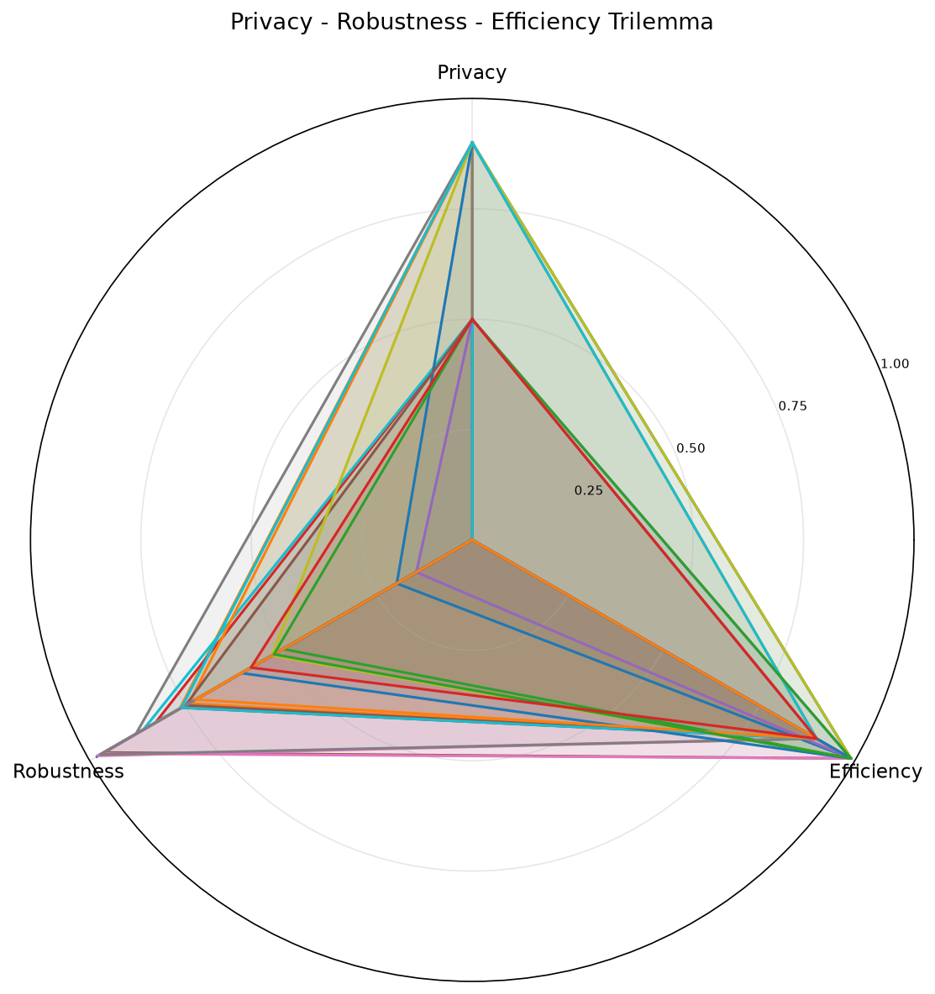
Trilemma Overview – All 8 Configurations
Analysis of Trilemma Radar Chart.
📊
Accuracy: Full vs. Top-k Compressed
Insert plot here
📊
Loss Convergence Rate Comparison
Insert plot here
Some Takeaways
- Overall decent scores
- Tradeoffs visible
- Privacy 100 % is hard (+ FLTrust issue)
Security and Privacy in Federated Learning · Jonas Müller, Rebekka Schnoor

Slide 13
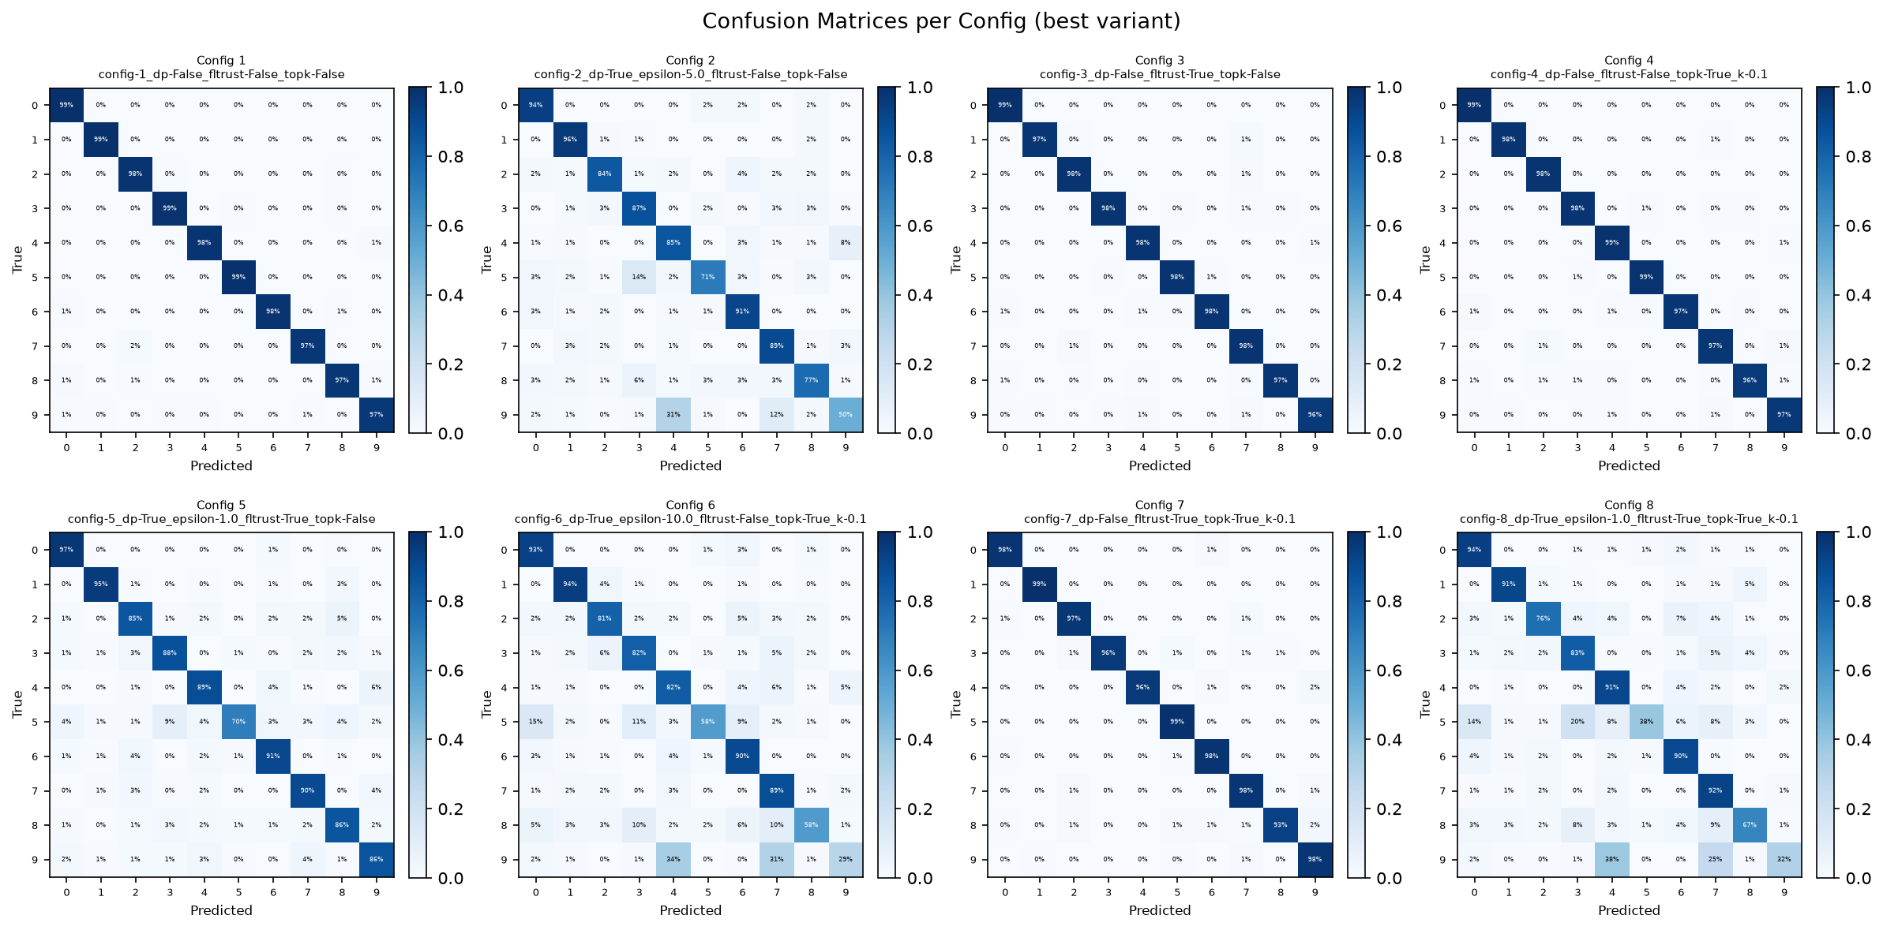
Intermediate Evaluation
Configurations
Security and Privacy in Federated Learning · Jonas Müller, Rebekka Schnoor

Slide 14
Intermediate Evaluation
Configurations
Security and Privacy in Federated Learning · Jonas Müller, Rebekka Schnoor

Slide 15
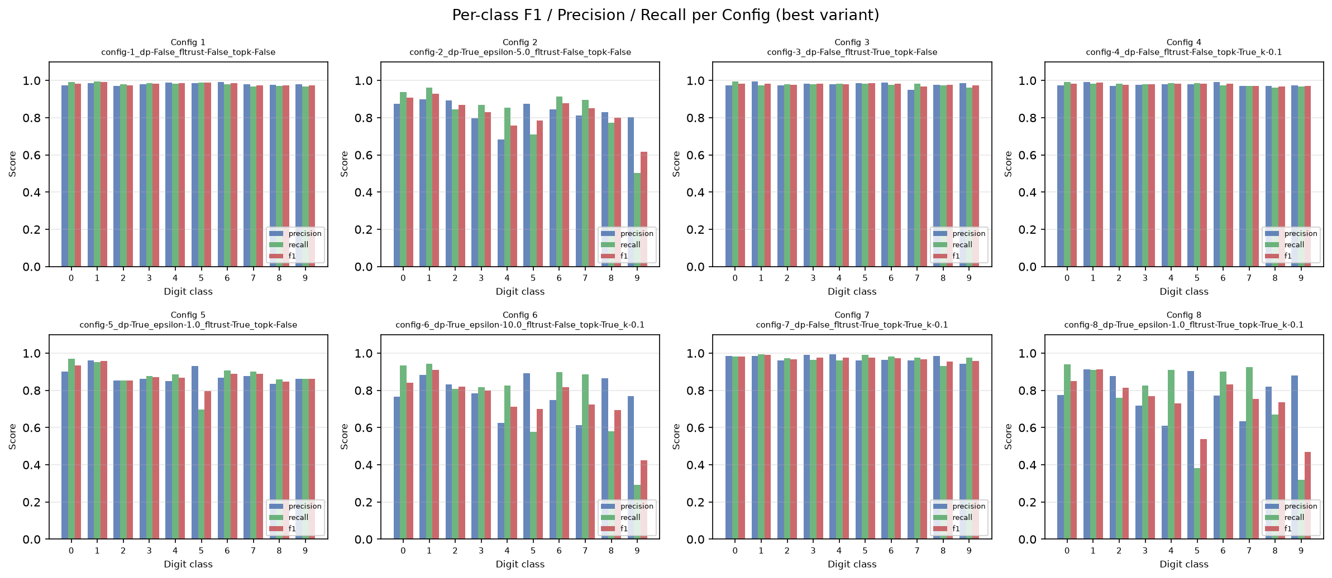
Intermediate Evaluation
Configurations
Security and Privacy in Federated Learning · Jonas Müller, Rebekka Schnoor

Slide 16
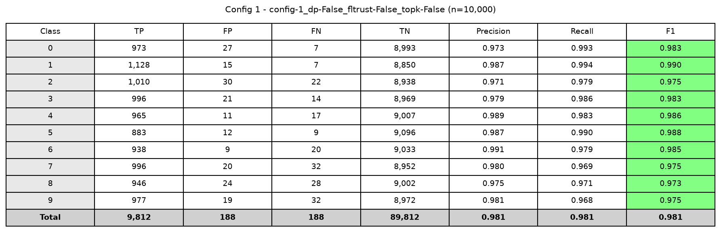
Intermediate Evaluation – Config 1
Configurations
📊
Radar Chart – Privacy / Robustness / Performance
Insert plot here
Security and Privacy in Federated Learning · Jonas Müller, Rebekka Schnoor

Slide 17
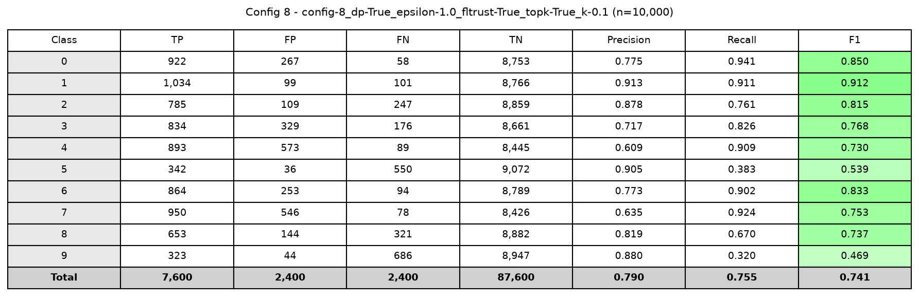
Intermediate Evaluation – Config 8
Configurations
📊
Radar Chart – Privacy / Robustness / Performance
Insert plot here
Security and Privacy in Federated Learning · Jonas Müller, Rebekka Schnoor

Slide 18
Challenges & Next Steps
Hardships
Next Steps
⚠
Resources
→
CIFAR-10 & ResNet
- Laptop is too weak for training
- Desktop struggles
Scale experiments to harder dataset and deeper model.
⚠
Stateless Clients (Privacy / Implementation)
Flower rebuilds clients each round
-> How do we persist privacy budget?
→
Full 8-Config Run
Run complete experiment matrix with meaningful parameters + Plotting
⚠
FLTrust root dataset
The root dataset for FLTrust needs to be representative
→
BLADES Baseline
⚠
FLTrust Trust Scores (Implementation)
Validate results against reference BLADES framework.
-> Potential problem since BLADES might not offer exactly what’s needed.
The FLTrust Trust Scores are too good for malicious clients. Also, mostly too low for honest clients.
Security and Privacy in Federated Learning · Jonas Müller, Rebekka Schnoor

Slide 19
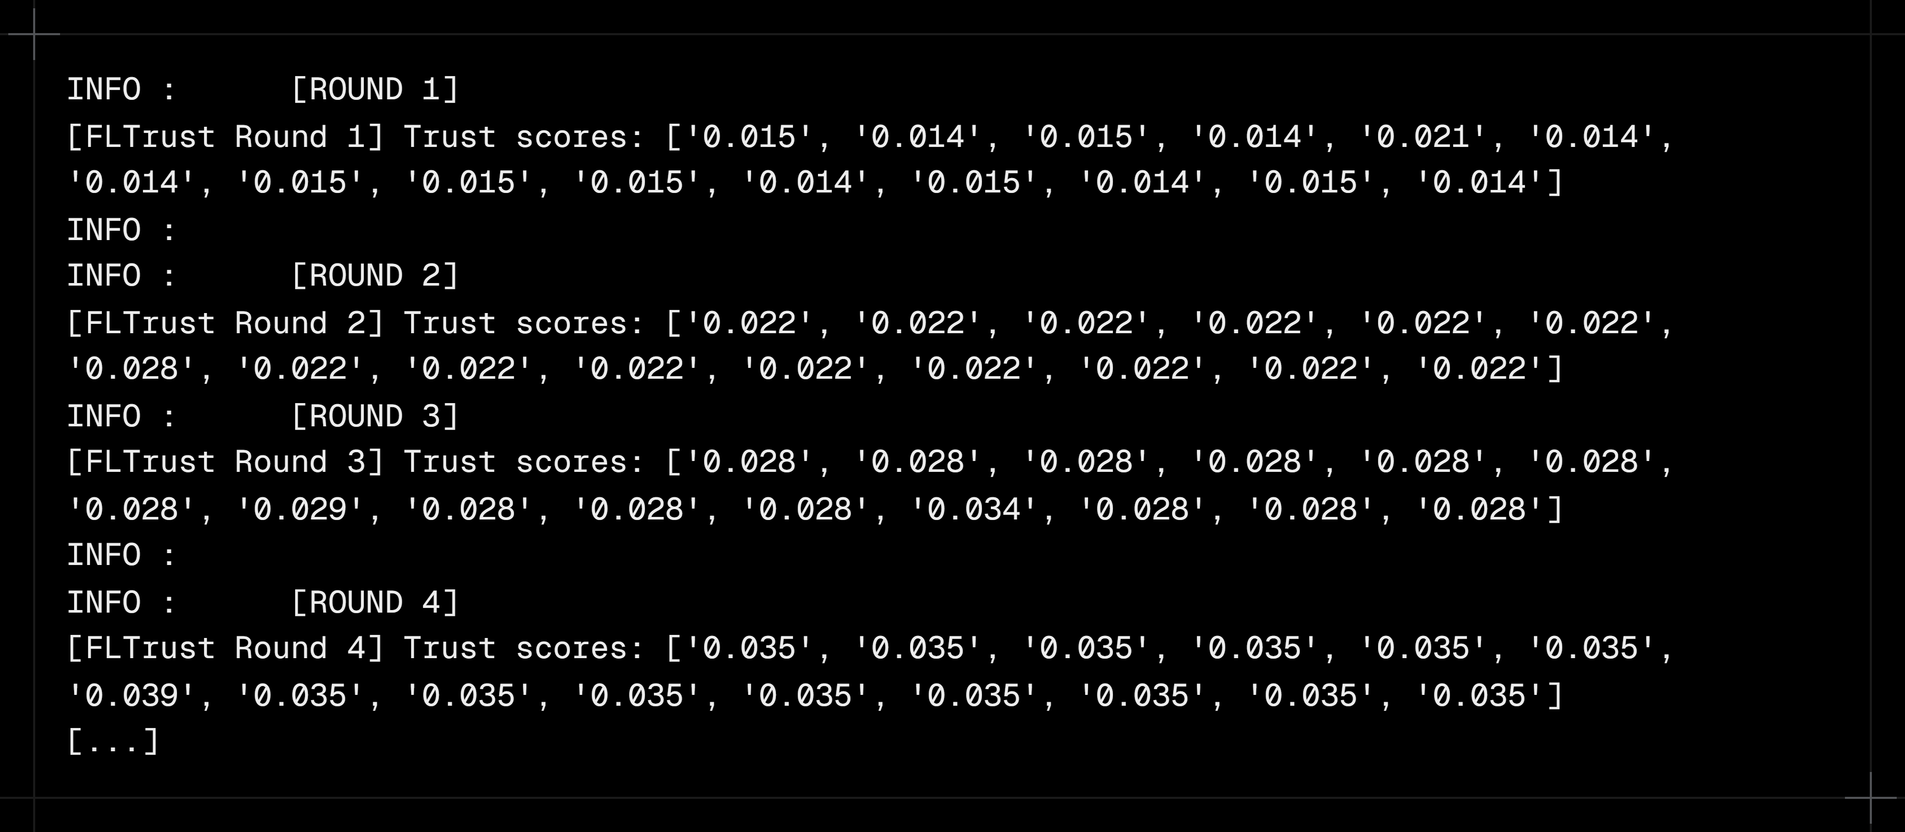
FLTrust Trust Scores
Effect of differential privacy (ε budget) on model accuracy across training rounds.
Security and Privacy in Federated Learning · Jonas Müller, Rebekka Schnoor

