Slide 1
Intermediate Presentation
Security and Privacy in
Federated Learning
Empirical Study of the Privacy-Robustness-Performance Trilemma
Jonas Müller · Rebekka Schnoor
Master Project Seminar Data Protection and Data Security
Universität Hamburg · 09 July 2026

Slide 2
Outline
01
Accuracy Results
02
Trilemma Overview
Training accuracy across configurations
Triangle visualization of results
03
Milestones
04
Challenges and Next Steps
Achievements and goals​
Current hardships and how to proceed
Security and Privacy in Federated Learning · Jonas Müller, Rebekka Schnoor

Slide 3
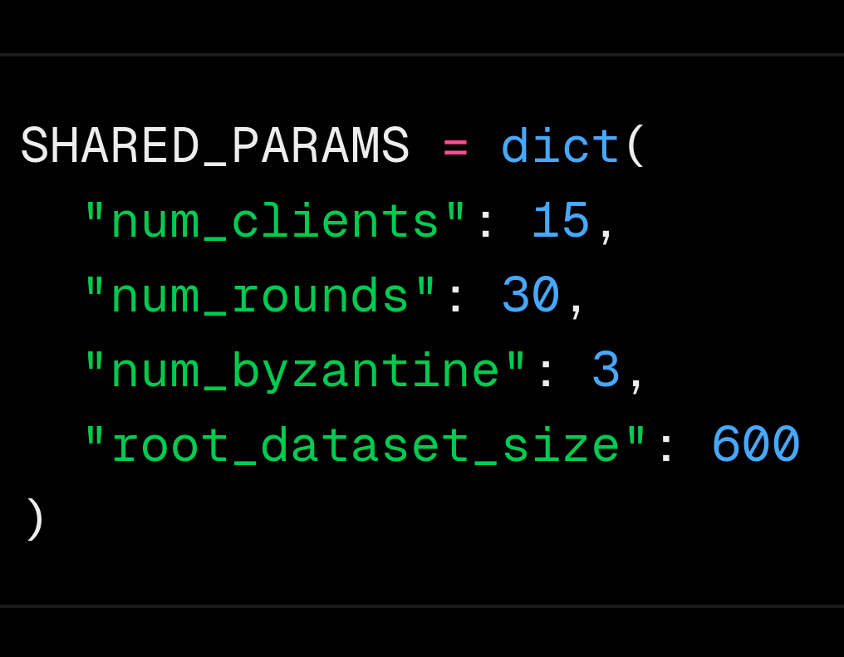
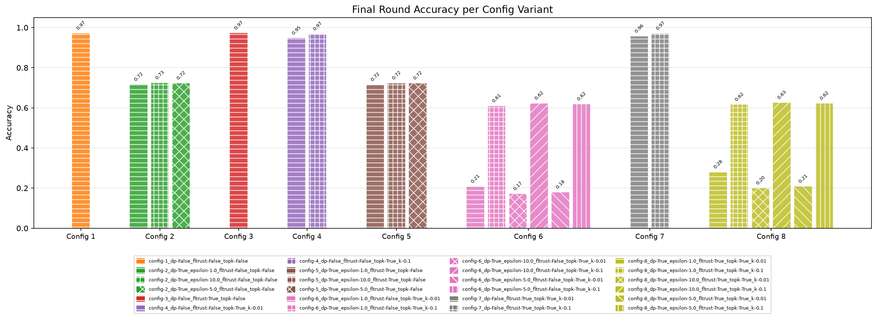
Accuracy Results – Training Convergence
Parameters
Training accuracy for all 8 configurations.
BASE
DP
FLTrust
Top-k
DP + FLTrust
DP+Top-k
FLTrust + Top-k
FULL
Security and Privacy in Federated Learning · Jonas Müller, Rebekka Schnoor

Slide 4
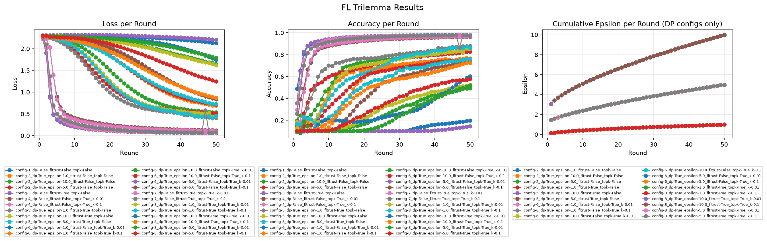
Accuracy Results – Training Convergence
Training accuracy and loss over communication rounds for all 8 configurations.
📊
Accuracy & Loss per Round – All Configs
Insert plot here
Security and Privacy in Federated Learning · Jonas Müller, Rebekka Schnoor

Slide 5
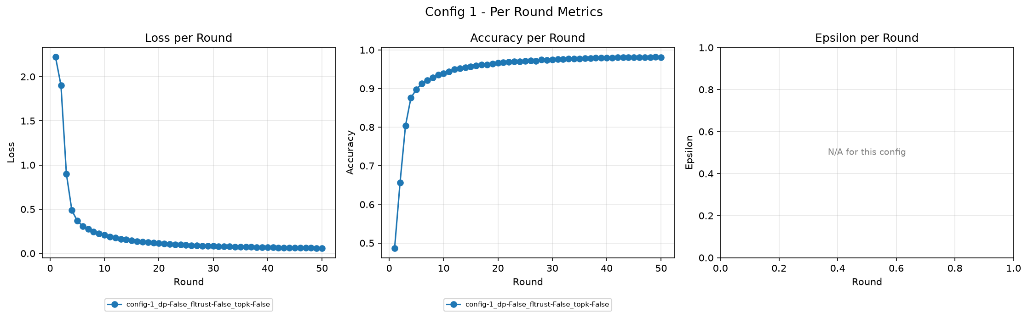
Accuracy Results – Training Convergence
Training accuracy and loss over communication rounds.
📊
Accuracy & Loss per Round – All Configs
Insert plot here
Security and Privacy in Federated Learning · Jonas Müller, Rebekka Schnoor

Slide 6
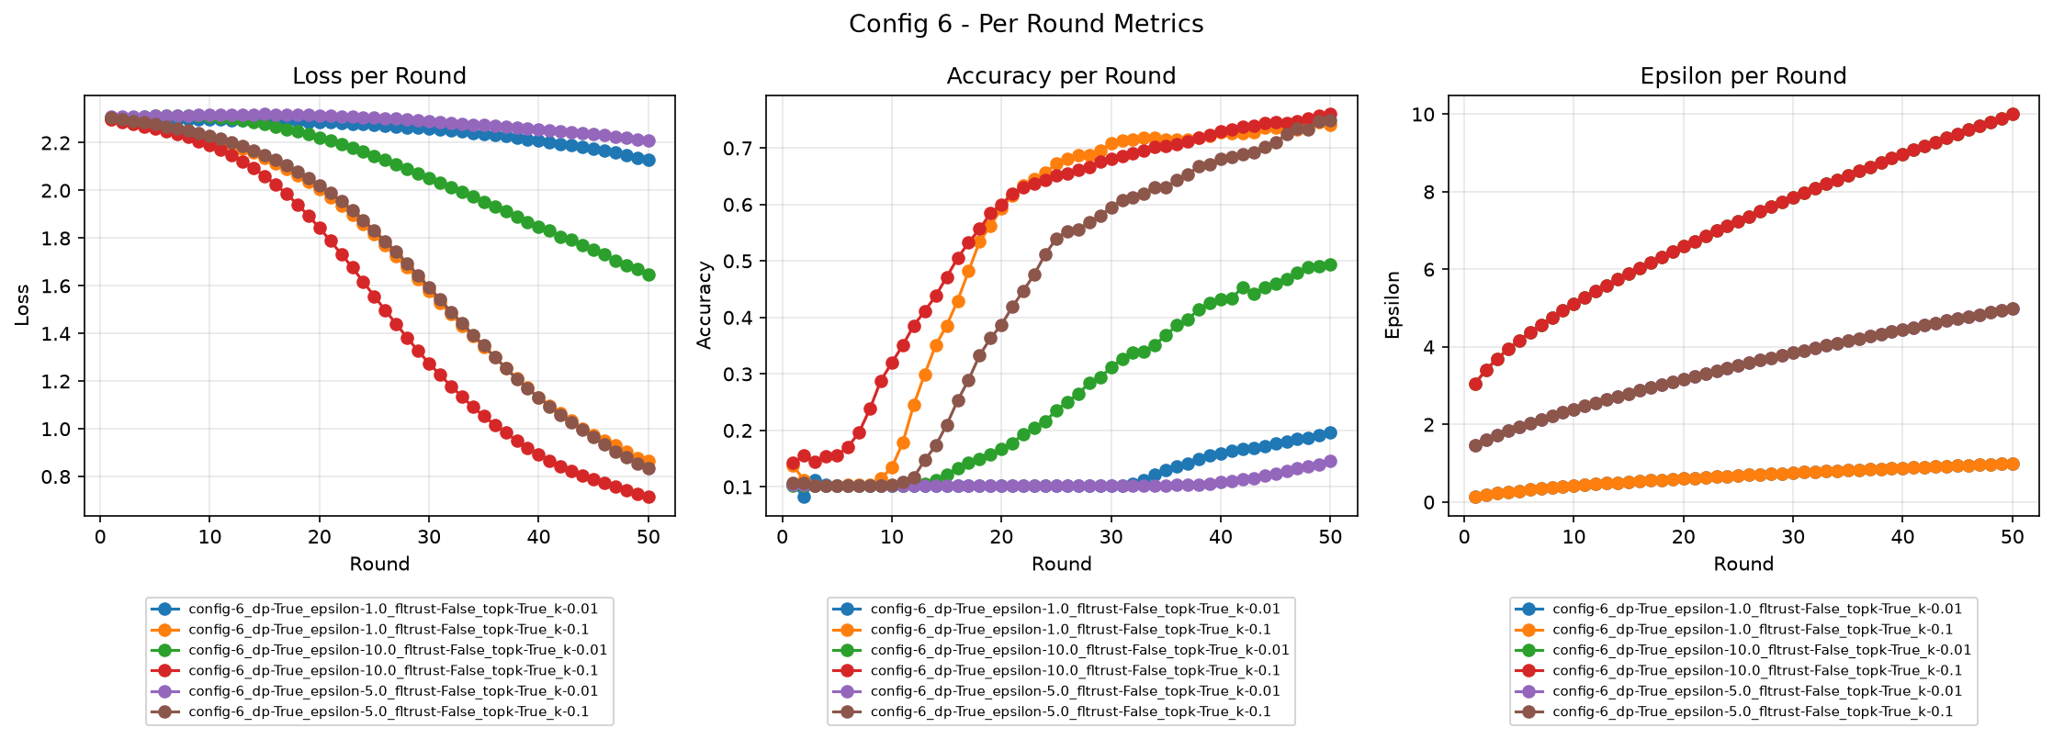
Accuracy Results – Training Convergence
Training accuracy and loss over communication rounds.
📊
Accuracy & Loss per Round – All Configs
Insert plot here
Security and Privacy in Federated Learning · Jonas Müller, Rebekka Schnoor

Slide 7
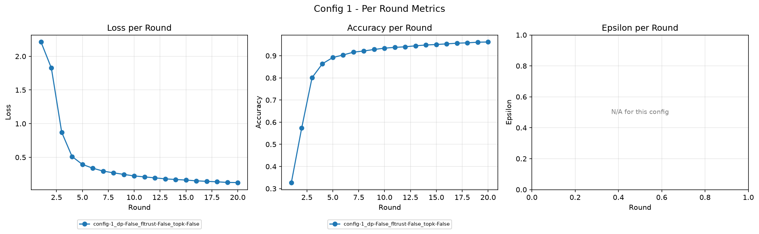
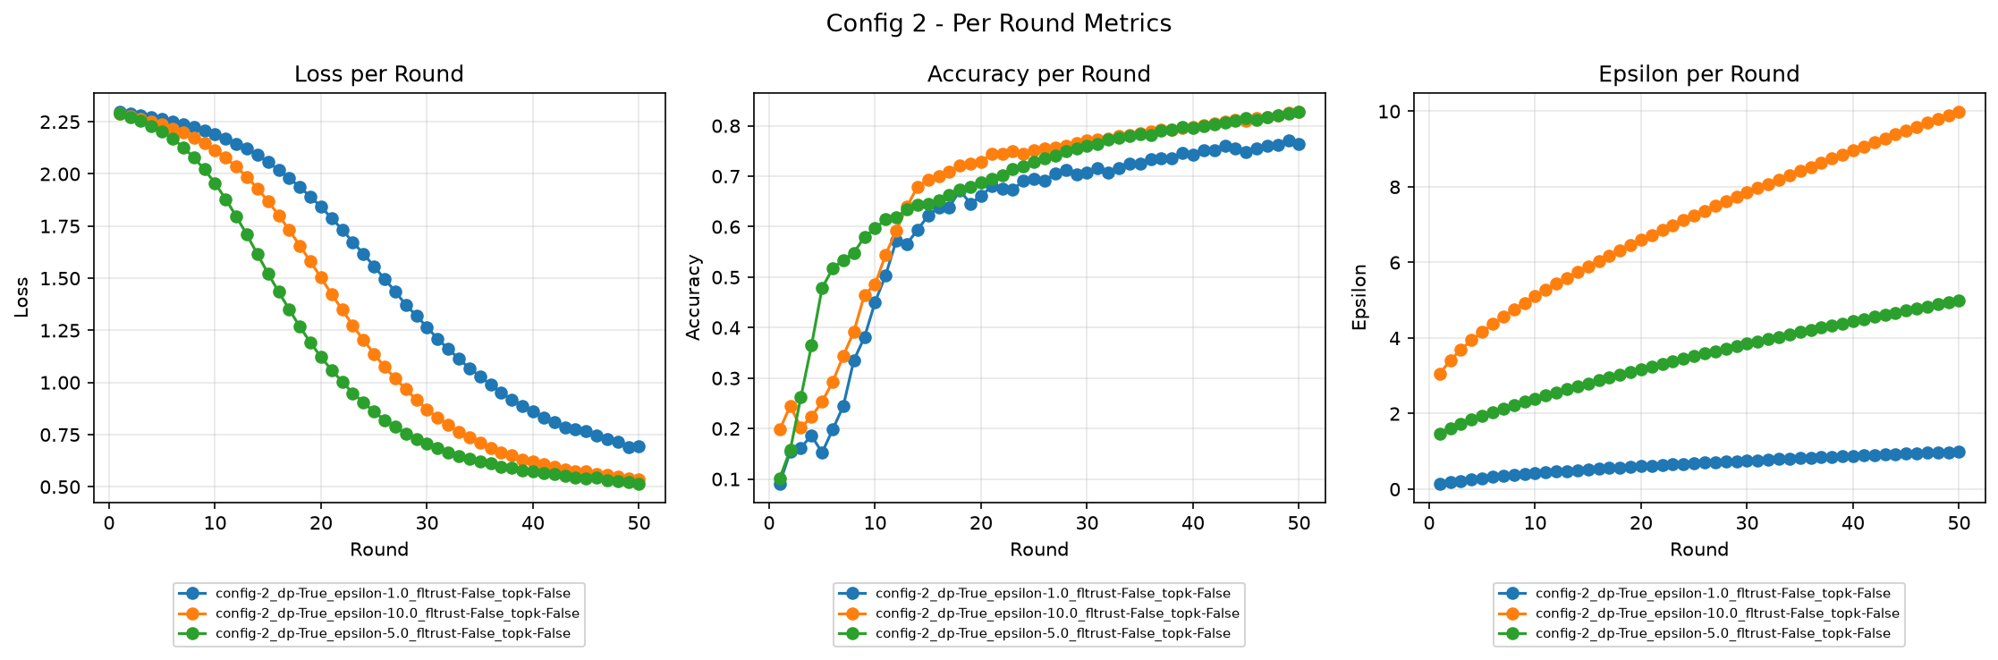
Privacy–Performance Tradeoff (DP-SGD)
Effect of differential privacy (ε budget) on model accuracy across training rounds.
📊
Accuracy & Loss per Round – All Configs
Insert plot here
Security and Privacy in Federated Learning · Jonas Müller, Rebekka Schnoor

Slide 8
Privacy–Performance Tradeoff (DP-SGD)
Effect of differential privacy (ε budget) on model accuracy across training rounds.
📊
DP vs. No-DP: Accuracy over Rounds
Insert plot here
📊
Privacy Budget (ε) Accumulation
Insert plot here
Security and Privacy in Federated Learning · Jonas Müller, Rebekka Schnoor

Slide 9
Robustness Results – FLTrust vs. Label-Flip Attack
FLTrust aggregation defending against malicious clients performing label-flip attacks.
📊
Accuracy: Baseline vs. Attack vs. FLTrust
Insert plot here
📊
Per-Class F1 Score Comparison
Insert plot here
Security and Privacy in Federated Learning · Jonas Müller, Rebekka Schnoor

Slide 10
Compression Results – Top-k Gradient Sparsification
Top-k compression retains only the k% largest gradient values per round.
📊
Accuracy: Full vs. Top-k Compressed
Insert plot here
📊
Loss Convergence Rate Comparison
Insert plot here
Security and Privacy in Federated Learning · Jonas Müller, Rebekka Schnoor

Slide 11
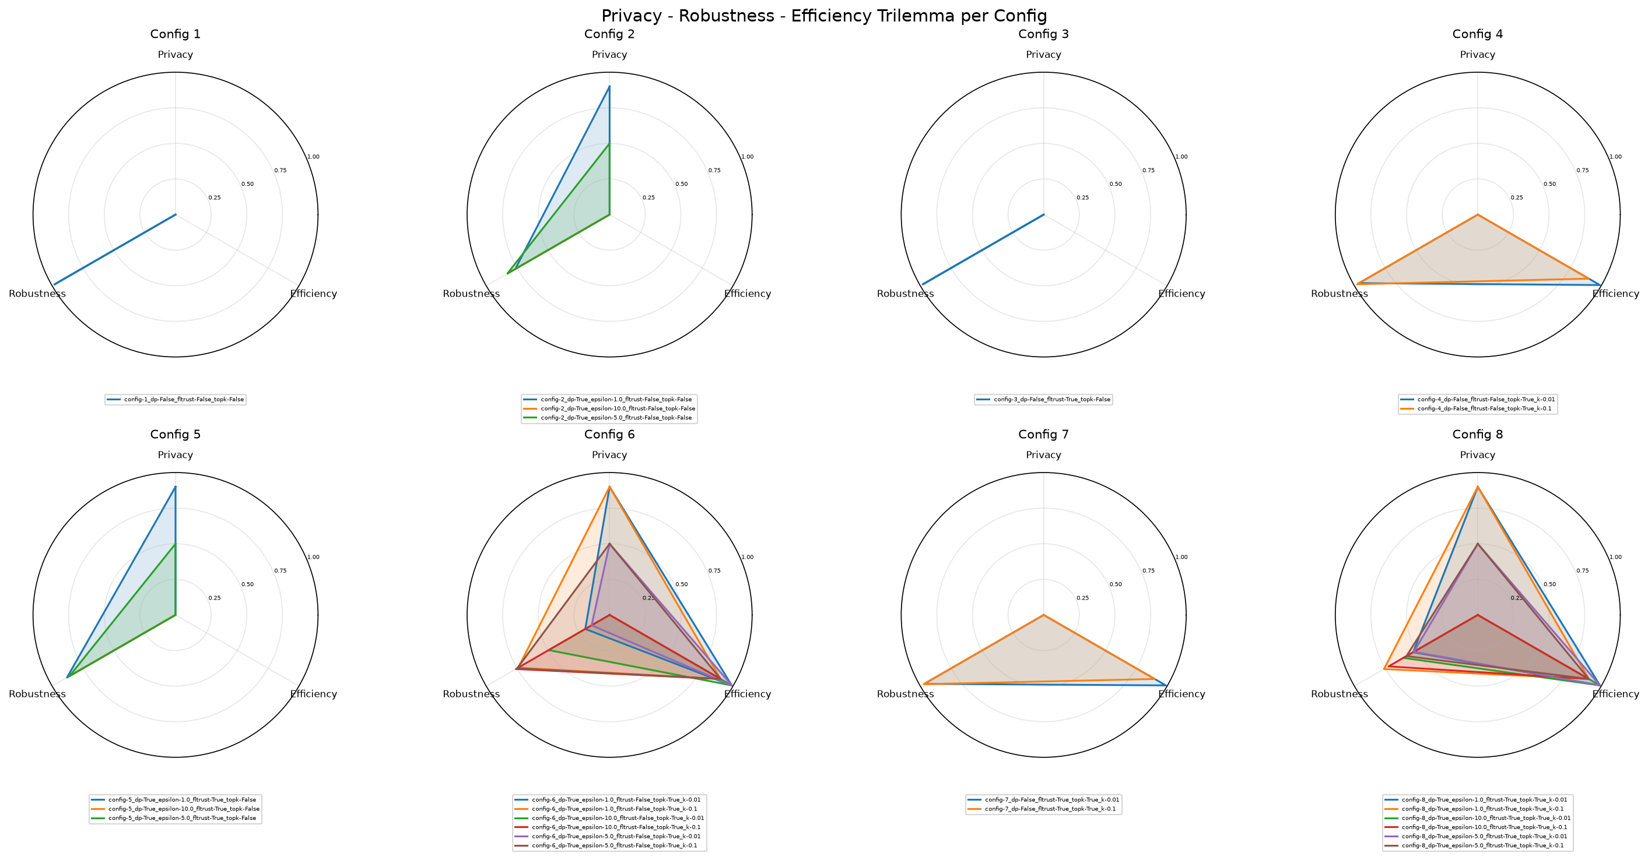
Trilemma Overview – All 8 Configurations
Configurations
Radar charts summarising the privacy–robustness–performance balance per configuration.
📊
Radar Chart – Privacy / Robustness / Performance
Insert plot here
Security and Privacy in Federated Learning · Jonas Müller, Rebekka Schnoor

Slide 12
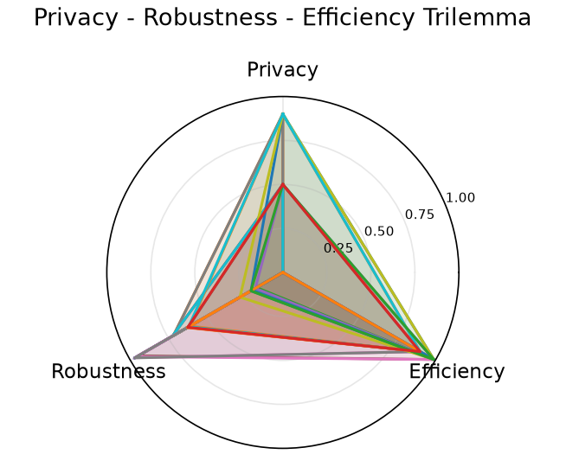
Trilemma Overview – All 8 Configurations
Analysis of Trilemma Radar Chart.
📊
Accuracy: Full vs. Top-k Compressed
Insert plot here
Takeaways
Individual goals achievable
Privacy and Robustness conflict
Privacy + Efficiency difficult to combine
Tradeoff visible: We encounter a maximum size for each triangle
Security and Privacy in Federated Learning · Jonas Müller, Rebekka Schnoor

Slide 13
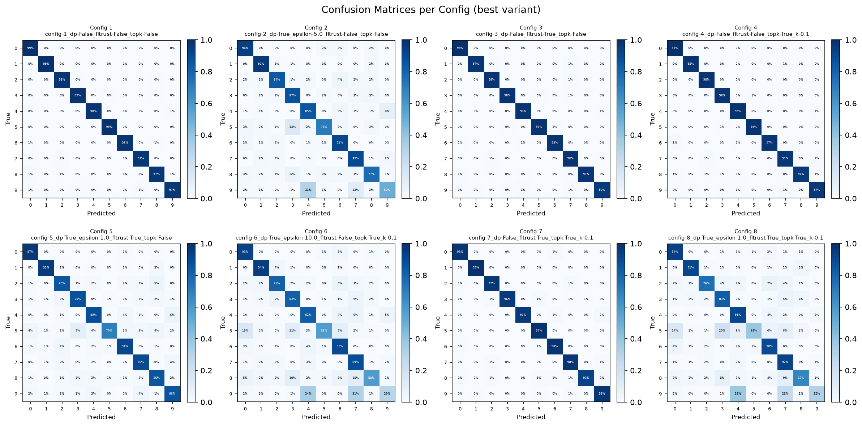
Intermediate Evaluation
Configurations
Security and Privacy in Federated Learning · Jonas Müller, Rebekka Schnoor

Slide 14
Intermediate Evaluation
Configurations
Security and Privacy in Federated Learning · Jonas Müller, Rebekka Schnoor

Slide 15
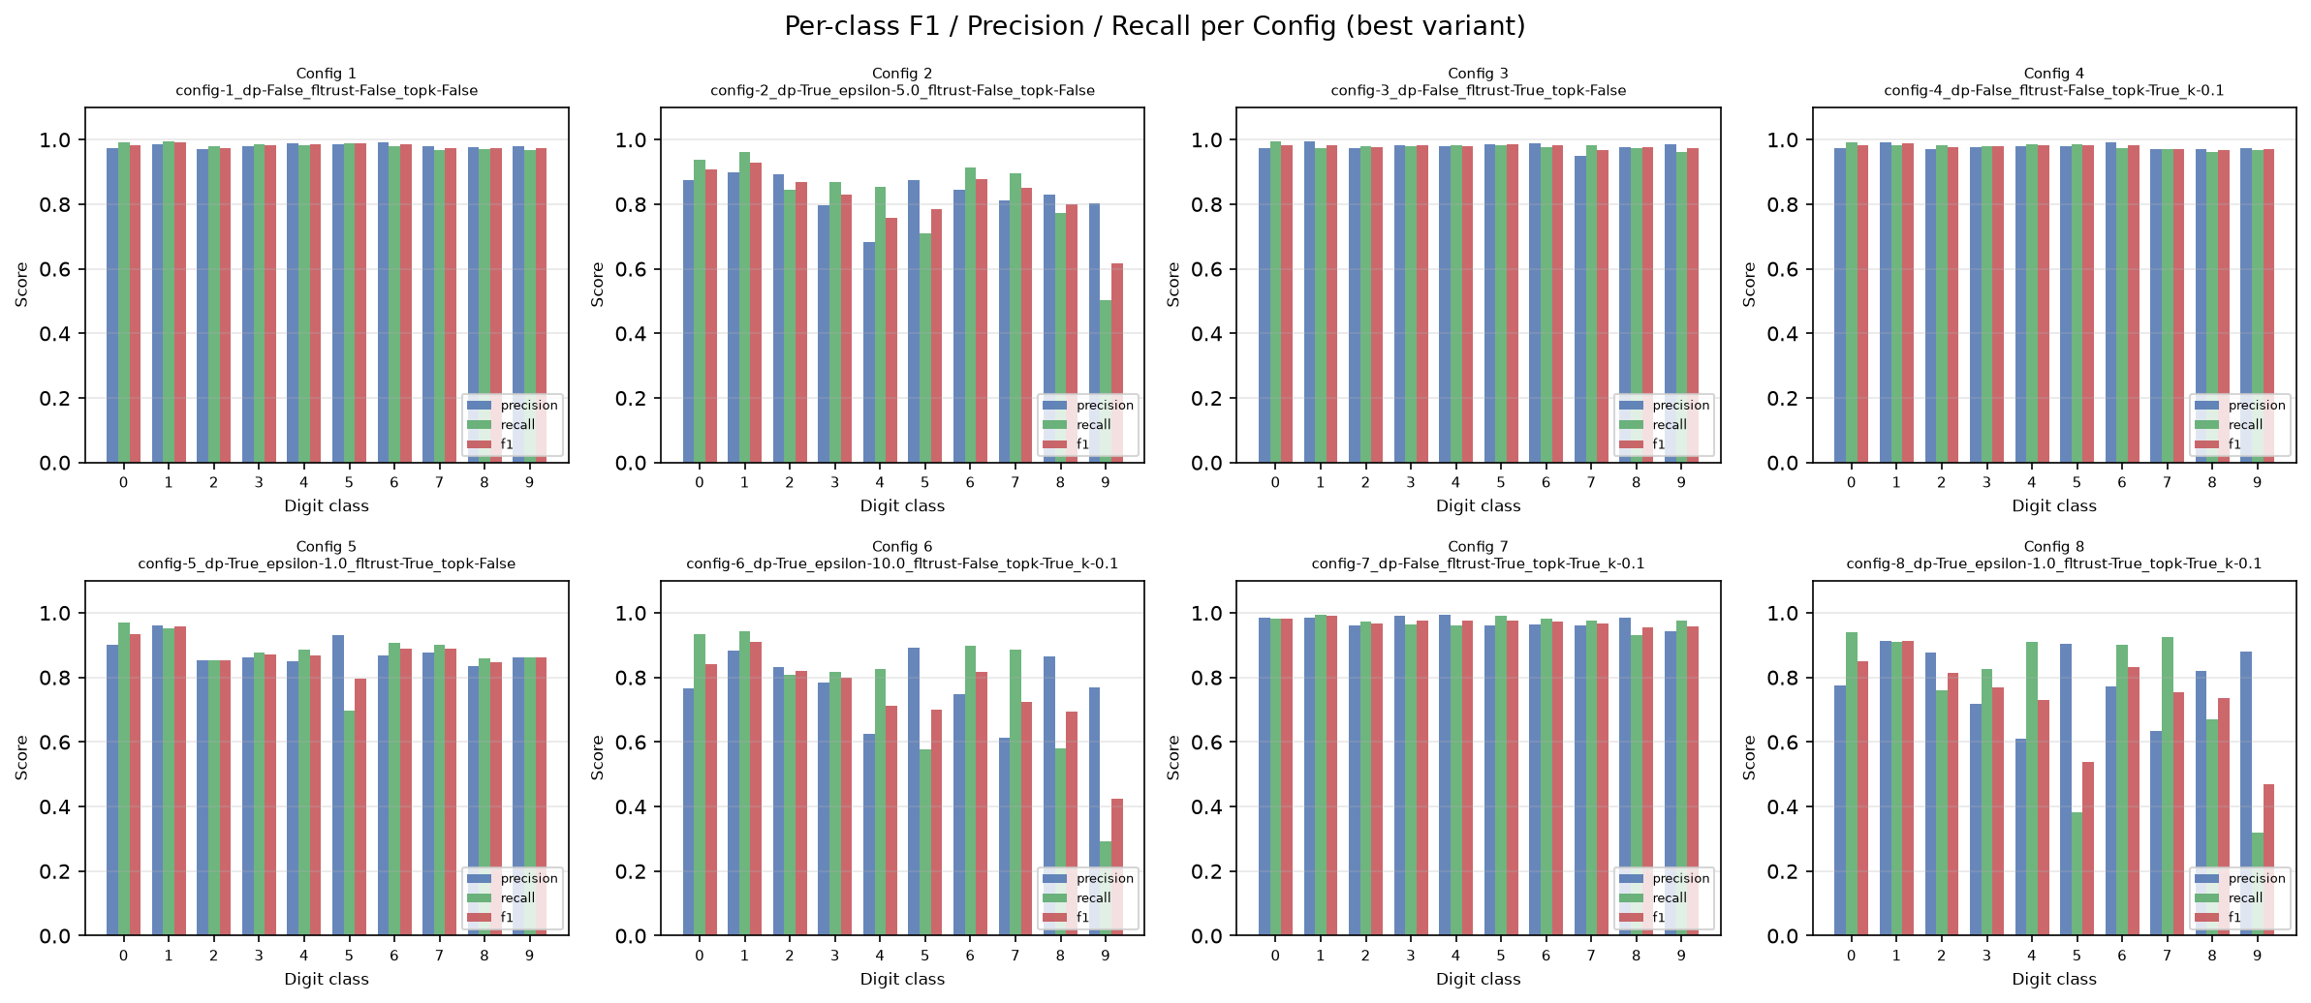
Intermediate Evaluation
Configurations
Security and Privacy in Federated Learning · Jonas Müller, Rebekka Schnoor

Slide 16
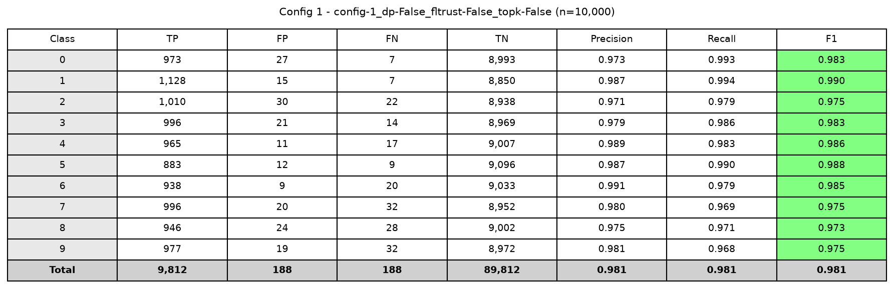
Intermediate Evaluation – Config 1
Configurations
📊
Radar Chart – Privacy / Robustness / Performance
Insert plot here
Security and Privacy in Federated Learning · Jonas Müller, Rebekka Schnoor

Slide 17
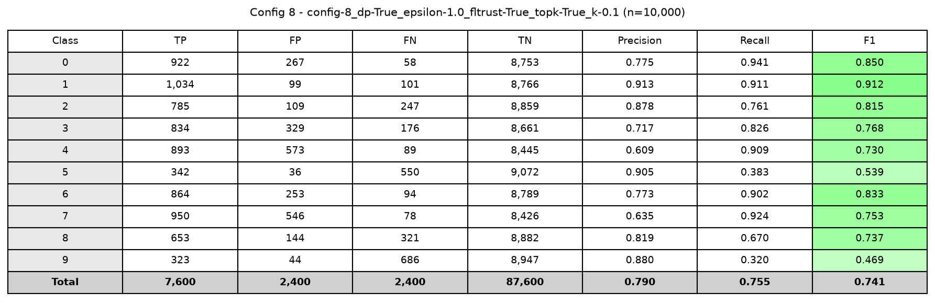
Intermediate Evaluation – Config 8
Configurations
📊
Radar Chart – Privacy / Robustness / Performance
Insert plot here
Security and Privacy in Federated Learning · Jonas Müller, Rebekka Schnoor

Slide 18
Milestones
Achievements
Goals
MNIST implementation
Full run of all configs on both datasets
Full operational pipeline integrating all mechanisms
Obtain representative results on performant hardware
Seed control for consistent results
Analyze mitigations
Mitigate initialization randomness
Experiment with alternative designs to mitigate performance break-ins
Confirmation of Trilemma
Evaluation
Results align with expected tradeoffs
Detailed analysis of combinatory effects
Security and Privacy in Federated Learning · Jonas Müller, Rebekka Schnoor

Slide 19
Challenges & Next Steps
Hardships
Next Steps
⚠
Resources
→
CIFAR-10 & ResNet
More Clients might help mitigating the DP effect
Scale experiments to harder dataset and deeper model.
⚠
Stateless Clients (Privacy / Implementation)
→
Increase Client number
Interaction with Top-k computation
More representative results
⚠
Label flipping attack impact
→
Different attack patterns
Experiment with more disruptive attacks
Arbitrary gradients (untargeted performance degradation)
Gradients of large magnitude (strong influence on resulting model)
Security and Privacy in Federated Learning · Jonas Müller, Rebekka Schnoor

Slide 20
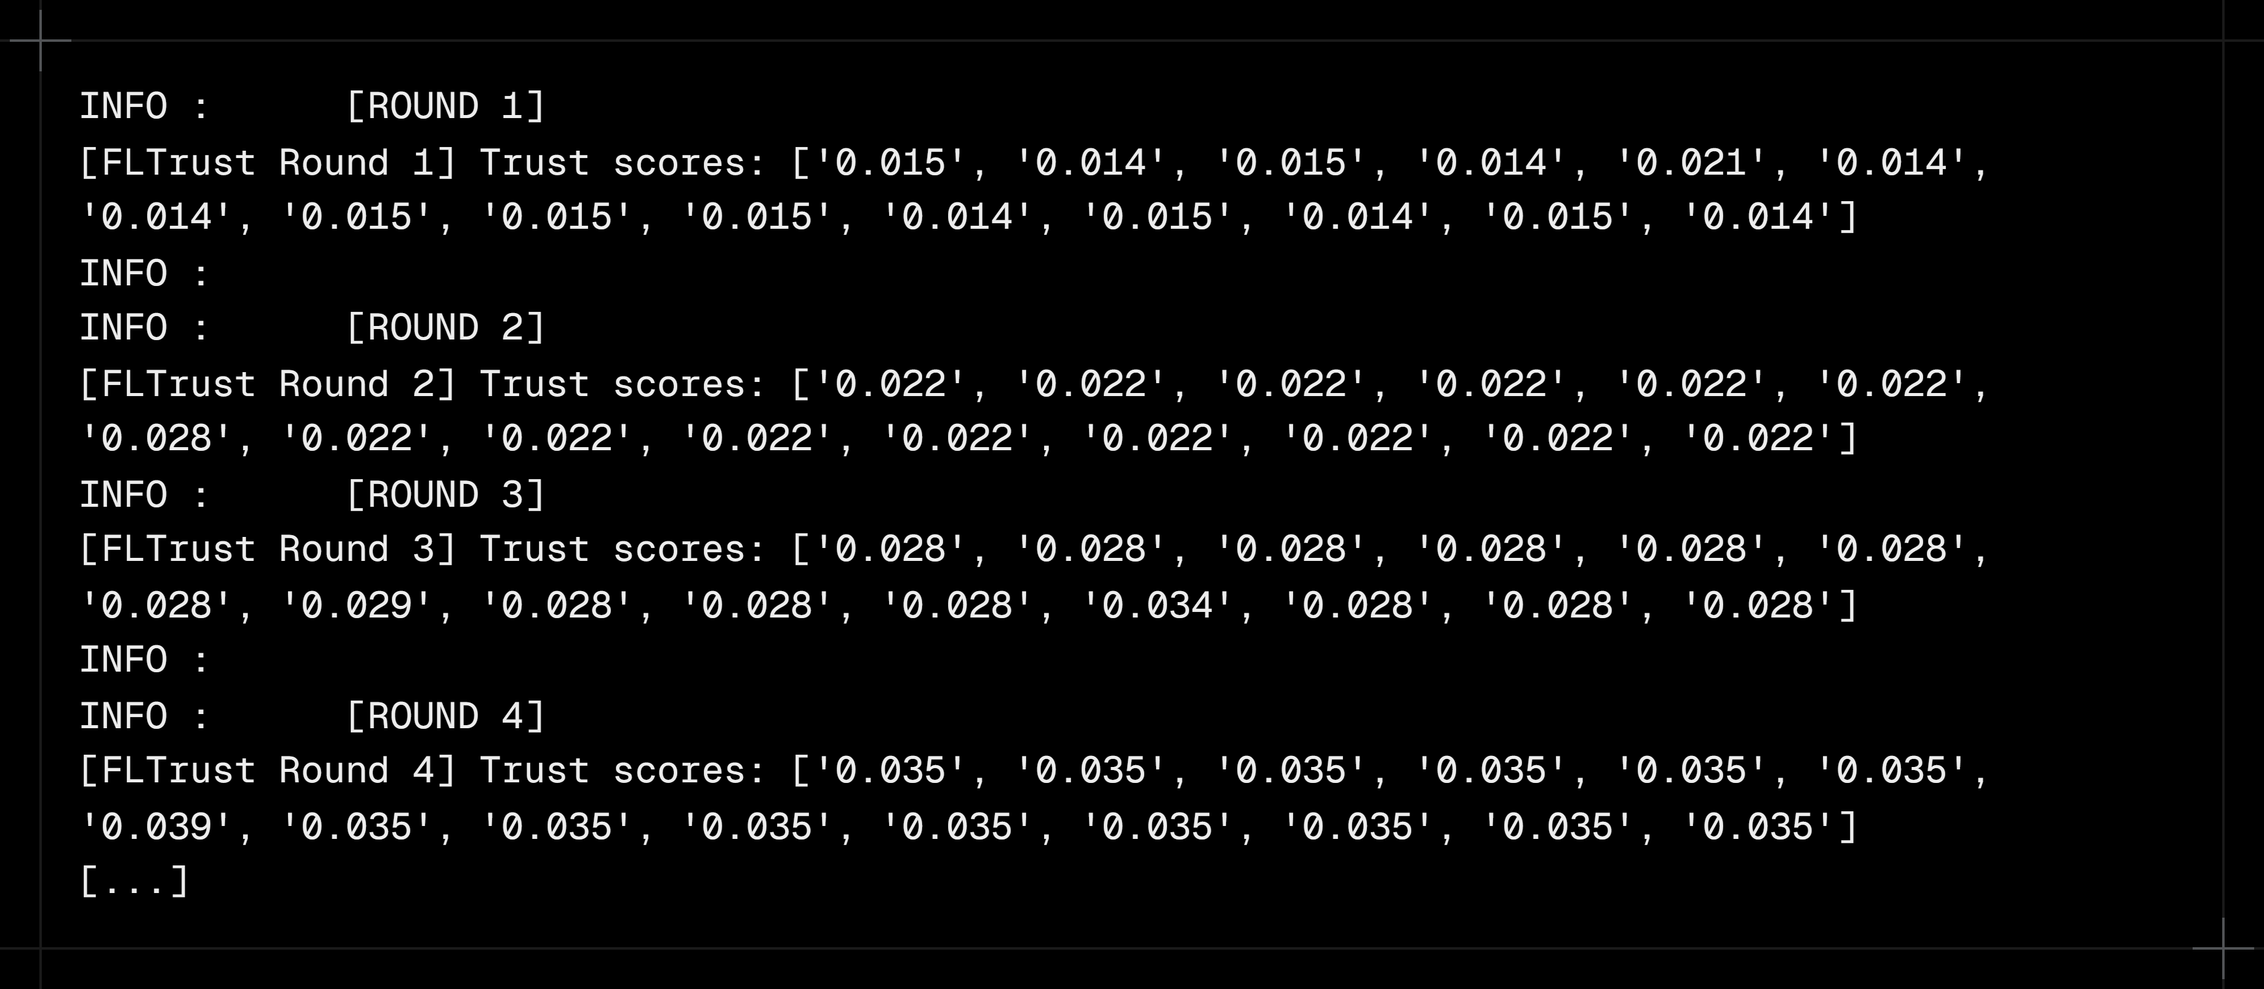
FLTrust Trust Scores
Effect of differential privacy (ε budget) on model accuracy across training rounds.
Security and Privacy in Federated Learning · Jonas Müller, Rebekka Schnoor

