Slide 1



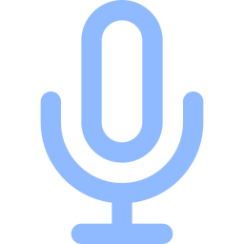
TriLock
Face
FINAL YEAR PROJECT REVIEW
Risk-adaptive multimodal biometric authentication for digital banking
Fingerprint (optional)
Voice
Face | Voice | Fingerprint
Academic prototype. All transactions are simulated.
Notes:
Good morning ma'am. My project is TriLock. It is a biometric authentication system for digital banking, where the amount of proof we ask for depends on how risky the payment is.
Before I start, one thing I want to be clear about: this is an academic prototype. All the transactions are simulated, there is no real money and no real bank behind it. What I want to show you today is how the system makes its decisions, how I tested it, and honestly where it is still weak.

Slide 2


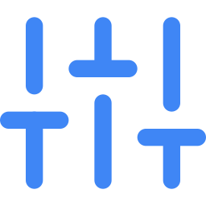
Passwords alone do not prove who you are
Credentials can be taken
Passwords and one-time codes can be guessed, phished or shared. Whoever has them is "you".
The question
How do we verify a person strongly, without making every small payment painful?
One biometric is not enough
A single trait can be faked with a photo or a recording, or fail in bad light and noise.
Every payment gets the same check
A coffee and a large transfer are treated alike, so the check is either too weak or too annoying.
Notes:
The starting point is simple. A password only proves that someone knows a secret, not that they are the person. Passwords and OTPs can be guessed, phished or shared.
Biometrics help, but one biometric on its own can also fail. A photo can fool a face check, a recording can fool a voice check, and honest users get rejected in poor light or a noisy room.
The third problem is what made me choose this topic. Most systems apply the same check to every payment. So the check is either too weak for a big transfer or too annoying for a small one. That is the question on the right: how do we verify strongly without making small payments painful?

Slide 3
The idea: match the check to the risk
More risk, more evidence
Critical
Face and voice, live, higher bar
High
Face and voice, live
Medium
Two biometrics
Low
One biometric is enough
Small payments stay smooth
Large payments get more proof
Missing evidence is never a match
Notes:
So the idea behind TriLock is to match the strictness of the check to the risk of the payment.
For a low-risk payment, one biometric is enough. As the risk goes up, the system asks for more evidence: two biometrics, then face and voice together, and for the highest risk, a higher bar on top of that.
There is one rule I kept everywhere. If a sample is missing, or the camera fails, or the model crashes, the system never treats that as a match. It is just treated as no evidence.

Slide 4





TriLock in one view
Sign in
Payment
Risk score
Evidence
Decision
Password, then live face and voice
Amount, recipient, device
0 to 100, rule based
Face, voice, fingerprint
Approve, reject or ask for more
Multimodal
Risk-adaptive
Liveness-aware
Three traits that fail in different ways, so they cover each other.
The bar rises with the risk of the payment.
High-risk steps need a live head turn and spoken words.
Notes:
This is the whole system on one slide. The user signs in with a password and then a live face and voice check. When they start a payment, the system scores how risky it is. Then it collects whatever biometric evidence the user gives, combines it, and returns one of three outcomes: approved, rejected, or additional verification required.
Three ideas hold it together. It is multimodal, so the traits cover each other's weaknesses. It is risk-adaptive, so the bar rises with the payment. And it checks liveness for the high-risk steps, so a still photo or a recording is not enough.

Slide 5







System architecture
Browser
API
Services
Biometrics
React + Vite
FastAPI
Python
3 modules
Camera and microphone
Dashboard and analytics
Makes no decisions
Routes, validation
Sessions, access control
One error format
Risk engine
Fusion and policy
Sign-in and liveness
Face: YuNet, SFace
Voice: ECAPA-TDNN
Finger: SIFT, RANSAC
SQLite
Templates
Evaluation
users, payments, attempts, audit log
encrypted numbers, never photos
offline scripts, reproducible
Notes:
On the architecture: the browser is a React app that captures the camera and microphone and shows the pages. It makes no decisions. Everything important happens on the server.
The FastAPI backend handles routes, validation, sessions and access control. Behind it are the services: the risk engine, the fusion and decision policy, and the sign-in and liveness logic. Each biometric is its own module with the same interface, so I could test and evaluate them separately.
At the bottom is storage. SQLite for users, payments and every authentication attempt. The biometric templates are stored as encrypted numbers, never as photos or recordings. The evaluation scripts run offline and save their results in the same database, which is what the analytics page reads.

Slide 6
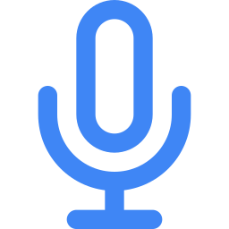

Why face, voice and fingerprint
Face
Voice
Fingerprint
Required
Required
Optional
Every laptop and phone has a camera. It is quick, natural and needs no extra hardware.
Works remotely with only a microphone, and carries different information than the face.
A strong trait, but a browser cannot read a sensor. We work on images, so it is a future enhancement.
Different traits fail in different ways, so combining them covers each other's weak spots.
Notes:
I chose these three because each one has a clear reason. Face is easy: every device has a camera. Voice works remotely with just a microphone, and it gives different information from the face, so one can cover the other.
Fingerprint is the honest one. A normal browser cannot read a fingerprint sensor, so I could only work with fingerprint images, and I could not find a real fingerprint dataset to test on. That is why it is marked optional and is a future enhancement. The system is built so that nothing requires it. Face and voice are the core.
The reason for combining traits is that they fail in different ways. A poor camera image does not affect your voice.

Slide 7
How a face or voice is recognised
1 Sample
2 Quality gate
3 Embedding
4 Compare
5 Confidence
A camera frame or an audio clip
Face found, sharp, lit. Speech present, not clipped
128 numbers for a face, 192 for a voice
Cosine similarity to the enrolled reference
Calibrated to a 0 to 1 match probability
What is stored
Why calibrate
Only the numbers, encrypted. Photos and recordings are processed in memory and never saved.
Face and voice scores mean different things, so each model is mapped to a match probability before we combine them.
Notes:
This slide answers the question of how the system knows it is you and not just capturing a face.
When you enroll, the system checks the sample quality, then a neural network turns your face into 128 numbers, or your voice into 192 numbers. Those numbers describe your features, not the picture. Only the numbers are stored, encrypted.
When you verify, it does the same with the new sample and measures how close the new numbers are to the saved ones. Your own face gives close numbers, someone else's gives clearly different ones. Because the face model and the voice model score on different scales, I calibrate each one into a match probability before combining them. The face model is SFace, the voice model is SpeechBrain's ECAPA-TDNN.

Slide 8
Scoring how risky a payment is
What adds risk (points)
Four risk levels
Amount | 0 to 40
New recipient | +20
International | +12
New device | +10
Unusual amount for this user | +12
Several payments in minutes | +10 / +20
Unusual hour for this user | +8
New account, large amount | +10
Biometrics changed recently | +12
Low
Medium
High
Critical
under 25
25 to 49
50 to 74
75 and up
Rule based and explainable: every point is shown to the user. It is not a trained fraud model.
The time factors learn your usual hours from your approved payments.
Notes:
The risk engine is deliberately simple and explainable. It adds points for things that make a payment riskier: a large amount, a new recipient, an international transfer, a new device, an amount that is unusual for that user.
I also added time-aware factors. Several payments within minutes, an unusual hour for that user, a brand-new account moving real money, or biometrics that were changed recently. The unusual-hour factor learns the user's usual hours from their approved payments.
The total is a score out of 100, grouped into four levels. I want to be clear that this is hand-set rules, not a trained fraud model. I have no fraud data, so I did not claim any accuracy for it. The benefit is that the app shows every factor, so the user can see why.

Slide 9
Combining the evidence into a decision
Evidence
Weigh by quality
Fused score
Risk sets the bar
per modality
poor input counts less
plus coverage
thresholds per level
Risk | Approve at | Evidence needed
Low | 0.60 | any 1 biometric
Medium | 0.70 | any 2 biometrics
High | 0.80 | face and voice
Critical | 0.88 | face and voice
Approved
evidence is strong enough
Rejected
evidence clearly does not match
Ask for more
not enough evidence yet
A missing or failed input is never counted as a match. Fingerprint only adds evidence when present.
Notes:
This is the fusion step, the main technical part. Each modality gives a calibrated match probability and a quality value. Poor-quality input counts for less. The system combines them into one fused score and also measures coverage, which is how much of the required evidence we actually have.
Then the risk level sets the bar. Low risk needs a score of 0.60 from any one biometric. High and critical need both face and voice and a higher score. Fingerprint is optional: if it is there it adds evidence, and if it is missing nothing changes.
The outcome is approved, rejected, or additional verification. The last one matters, because when evidence is missing or unclear I do not want to call the user an attacker. I ask for more. And again, missing or failed input is never counted as a match.

Slide 10
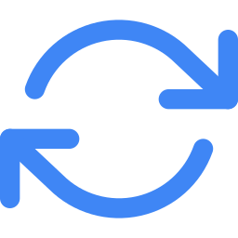



Security and privacy built in
Strong sign-in
Liveness checks
Smart lockouts
Password, then live face and voice.
Head turn and three random spoken words.
An attacker's failures cannot lock you out.
Protected enrollment
Careful recovery
Privacy by default
Changing biometrics needs the password and a matching sample.
Waiting period, admin approval, then probation.
No raw photos or recordings stored. Templates encrypted.
Notes:
Because this is an authentication system, I spent a lot of time on how it could be attacked.
Sign-in needs the password and then a live face and voice. The liveness check asks for a head turn in a random direction and three random words, so a still photo or an old recording does not work. Lockouts are tied to the device and network that failed, so an attacker cannot lock the real owner out of their own account.
Changing biometrics needs your password and fresh samples, so someone with only your password cannot swap in their own face. If you genuinely lose access, there is a recovery flow with a waiting period, admin approval and a probation period.
On privacy, raw photos and recordings are never saved. Only encrypted numbers are, and a user can erase everything. I will be honest about what liveness does not stop in the limitations slide.

Slide 11
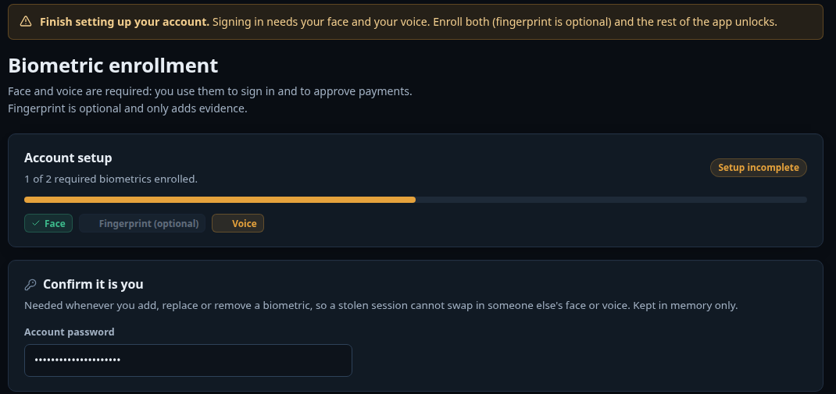
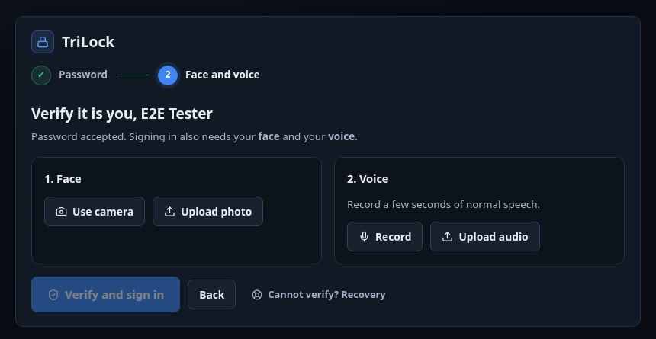
Setting up and signing in
Enrollment
Sign-in
Face and voice are required, fingerprint is optional. A reference only counts once the server has built it.
Password first. Then a live face and voice check, with a recovery option if it cannot be passed.
Notes:
These are real screenshots from the running application.
On the left is enrollment. A new account starts with a limited session that can only see this page. Face and voice are marked required, and fingerprint is marked optional. Each card explains what to do, shows the samples you collected, and only shows Enrolled after the server has actually built a reference from a valid sample. Once face and voice are both enrolled, the rest of the app unlocks.
On the right is sign-in. After the password, the app asks for a live face and voice. The password alone opens nothing. If someone cannot pass this step, for example their face changed, there is a recovery option.

Slide 12
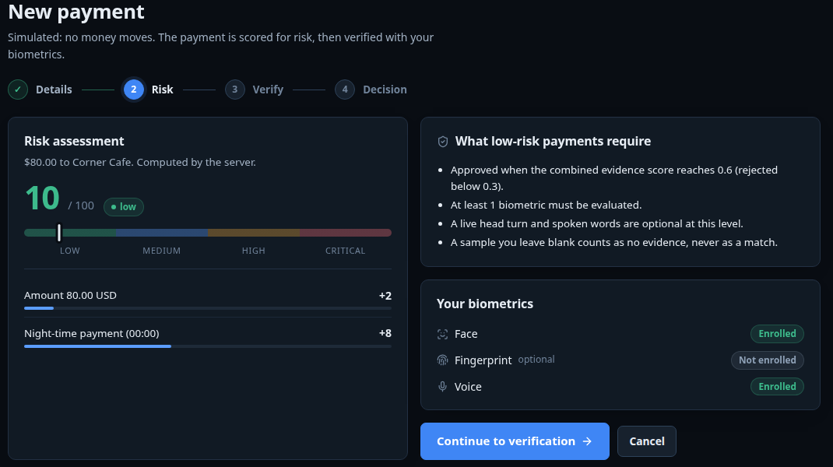
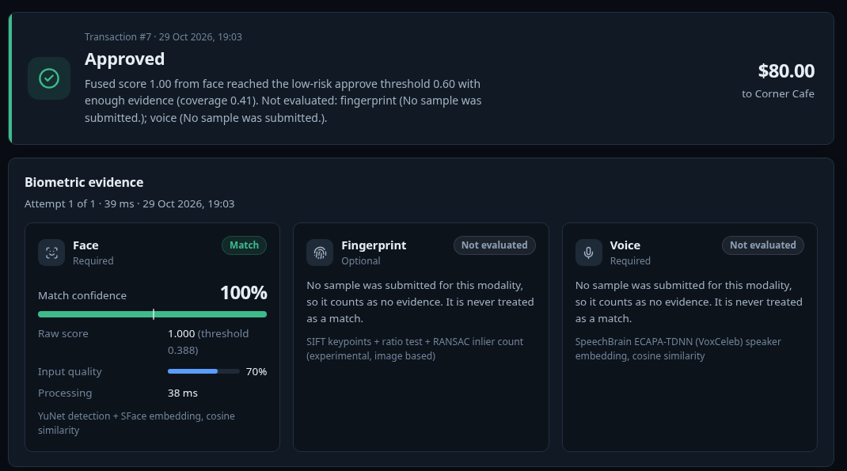
A small payment, start to finish
Risk assessment
Decision with evidence
The server scores the payment, lists every factor, and says what this level requires.
Match confidence, input quality and a plain reason. A blank sample is no evidence, never a match.
Notes:
Here is an ordinary payment. In step one I enter the details and the page shows a live risk estimate with the factors, so the user can see what is adding risk.
In step two the server computes the final risk score and tells the user what this risk level requires. This one is low risk, so one biometric is enough. In step three the user verifies with the camera, and step four is the decision.
The decision page is the part I care about most. It shows the result, the match confidence for each biometric, the input quality, and a plain-language reason. A sample that was not submitted shows as no evidence, never as a match.

Slide 13
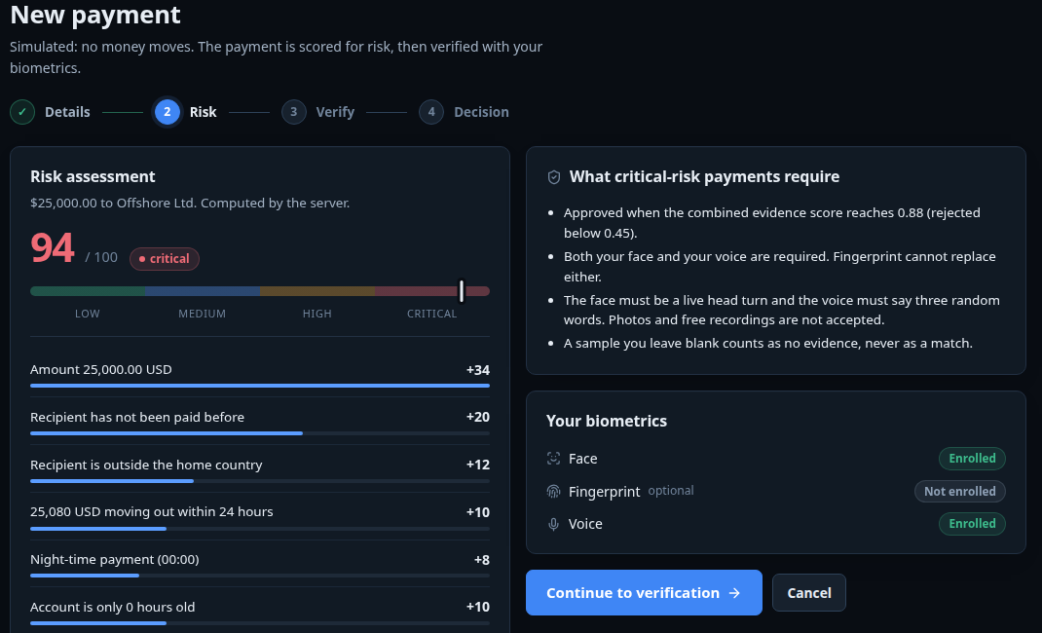
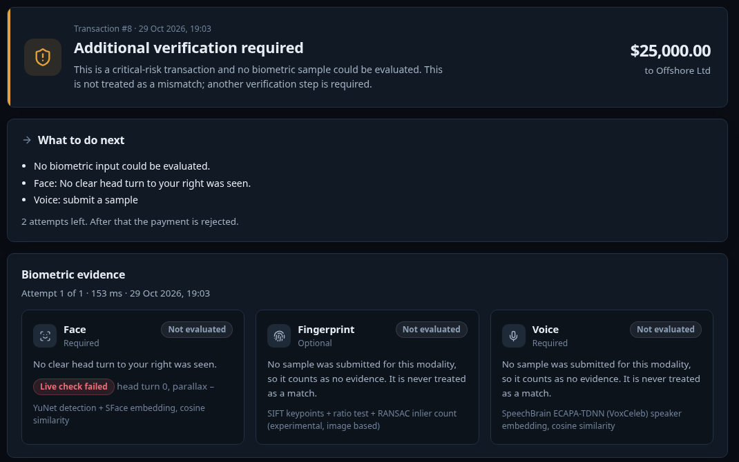
A large payment asks for more
Critical risk
A still camera is refused
Face and voice are both required, and both must be live. Fingerprint cannot replace either.
No head turn was seen, so it asks for more evidence and lists exactly what to do. Three attempts.
Notes:
Now a 25,000 dollar payment to a new international recipient. The risk comes out as critical, and the app tells the user up front that face and voice are both required, and that they must be live.
In the verify step it shows a head-turn instruction and three words to say. In my browser test I used a fake camera that plays a single photo, so it never turns its head. The system correctly refuses it: no clear head turn was seen. The payment is not rejected as an attack. It asks for additional verification and lists exactly what to do next, and the user has three attempts.

Slide 14
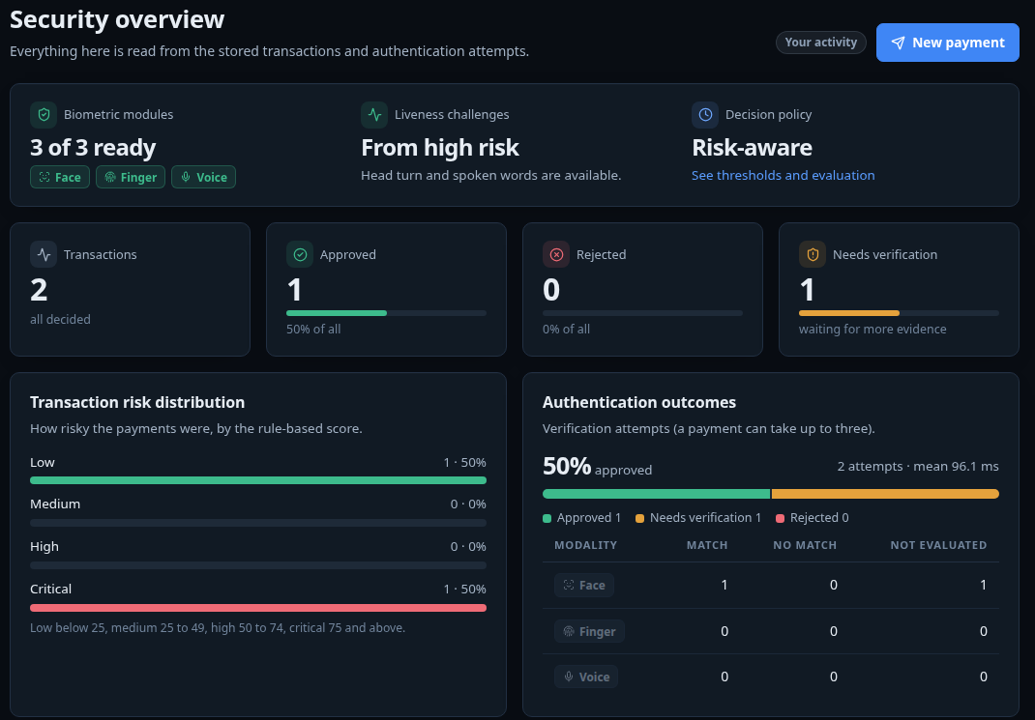
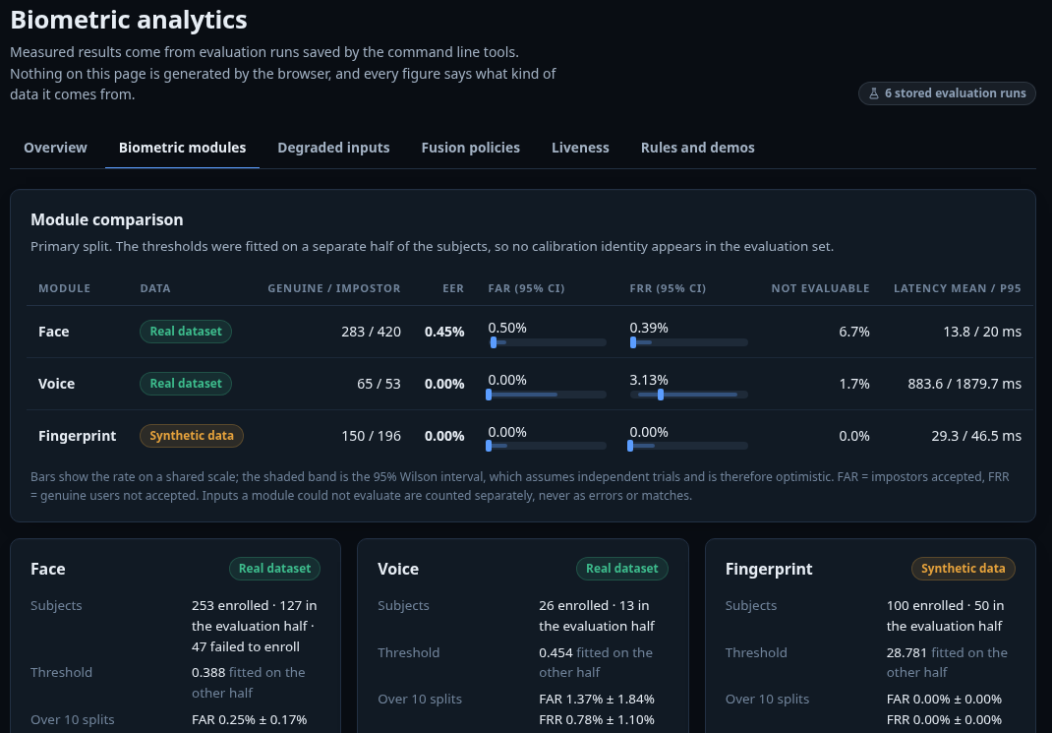
Seeing what happened
Dashboard and history
Analytics
Totals, risk and outcomes from stored data, plus history.
Every figure is labelled real, synthetic or simulated.
Notes:
After payments, the user can see what happened. The dashboard shows totals, the risk distribution, outcomes, activity over time and the status of each biometric module. All of it is read from the stored data, nothing is hard-coded.
The history page lists every payment with its risk, which biometrics were evaluated, and the decision. Opening one gives the full explanation.
The analytics page shows the evaluation results, and every figure is labelled as real dataset, synthetic data or simulated, so nobody mistakes one for the other. I will go through those results shortly.

Slide 15
How it is built and tested
Frontend
React, Vite, Recharts
323
automated tests passing
Backend
FastAPI, SQLAlchemy, SQLite
Face
OpenCV: YuNet + SFace
1
browser test of the whole flow in real Chrome
Voice
SpeechBrain ECAPA-TDNN
Spoken words
faster-whisper (tiny.en)
10
random splits per evaluation
Fingerprint
SIFT keypoints + RANSAC
Models are open source and run on a normal CPU. No paid services.
Notes:
On the implementation: the frontend is React with Vite. The backend is FastAPI with SQLite. Face recognition uses OpenCV's YuNet detector and SFace model. Voice uses SpeechBrain's ECAPA-TDNN speaker model. The spoken-word liveness check uses a small speech recognizer called faster-whisper. The fingerprint matcher uses SIFT keypoints with RANSAC. Everything runs on a normal CPU, with no paid services.
For testing, there are 323 automated tests covering things like the risk rules, the fusion policy, access control, lockouts and privacy. I also wrote a browser test that drives the real interface in Chrome with a fake camera and microphone, and it caught real bugs, for example a camera button that did nothing if you pressed it too early. And the evaluation is reproducible: every run stores its seed and a hash of its trial list.

Slide 16
How we evaluated it
Public datasets
Trials
Split people
Fit on half A
Measure on half B
Repeat
LFW faces, LibriSpeech voices
genuine and impostor
two halves, never mixed
thresholds
FAR, FRR, EER
10 random splits
Real data
Synthetic data
What we report
Faces from LFW and voices from Mini LibriSpeech, public datasets of real people.
Fingerprints are generated. We found no real fingerprint dataset we could download.
FAR, FRR and EER with 95% confidence intervals, plus how many inputs could not be evaluated.
Notes:
Let me explain how I measured it, because the method matters as much as the numbers.
For each biometric I built genuine trials, where the probe is the same person, and impostor trials, where it is a different person. The people are split into two halves. I fit the decision threshold on one half and measure on the other, so the threshold was never tuned on the people it is tested on. I repeat that with ten random splits to see how much the result depends on the split.
I should be upfront about the data. Faces and voices come from public datasets of real people. Fingerprints are synthetic, because I could not find a real fingerprint dataset I could download, so I do not claim anything about real fingerprints. Along the way I found and fixed some flaws in my first evaluation, for example impostor samples leaking across the two halves.

Slide 17
Results: each biometric on its own
 | Data | Trials | EER | FAR (95% CI) | FRR (95% CI) | Time
Face | Real (LFW) | 283 / 420 | 0.45% | 0.50% (0.1 to 1.8) | 0.39% (0.1 to 2.2) | 14 ms
Voice | Real (LibriSpeech) | 65 / 53 | 0.00% | 0.00% (0.0 to 6.9) | 3.13% (0.9 to 10.7) | 884 ms
Fingerprint | Synthetic | 150 / 196 | 0.00% | 0.00% (0.0 to 1.9) | 0.00% (0.0 to 2.5) | 29 ms
Trials are genuine / impostor attempts. EER: false accepts equal false rejects. FAR: impostors accepted. FRR: real users rejected. CI: 95% confidence interval, in %.
0.45%
1.4% ± 1.8%
face equal error rate
voice false accepts over 10 splits
127 people in the evaluation half
only 13 speakers per half
Notes:
These are the results for each biometric on its own. FAR is how often an impostor is accepted, FRR is how often the real user is rejected, and EER is where the two are equal.
Face on real photos has an equal error rate of about 0.45 percent, with a false accept rate of 0.5 percent. Voice on real speech has a 0 percent EER in the main split, but I want to be careful: there are only 13 speakers in each half, so the interval on the false accept rate goes up to almost 7 percent, and across ten splits the false accept rate is 1.4 percent plus or minus 1.8. That variation is the honest picture.
The fingerprint row is synthetic data, so it only shows that the matcher works mechanically. It says nothing about real fingerprints. And all of these datasets are easier than a phone camera in a dim room, so real-world performance will be worse. I did not try to estimate by how much.

Slide 18
When input is poor, and the liveness checks
It refuses to guess
Liveness checks
simulated attacks
Face: mild blur | 35% refused
Face: dim light | 68% refused
Face: strong blur, dark, low resolution | 100% refused
Voice: noise at 10 dB | 14% real users rejected
Voice: noise at 0 dB | 98% refused
Tilted flat photo passes | 1 in 1000
Two-photo swap passes | 0 in 192
Spoken words heard (clean audio) | 95%
Spoken words heard (10 dB noise) | 91%
Unrelated recording passes | 0 in 650
Too-poor input is refused instead of scored. The user is asked to retry.
Face attacks are simulated from photos. The spoken-word test uses real speech.
Notes:
Two things here. On the left, what happens when the input is poor. I blurred, darkened, shrank and added noise to the same test samples. In most cases the system does not guess. It refuses the input as not evaluable and asks the user to retry. That is deliberate: a bad image should not turn into a wrong decision. The one place where real users get rejected is voice at 10 dB noise, about 14 percent.
On the right are the liveness checks. I could not download a real spoofing dataset, so I want to be clear that the face numbers are simulated: I turned real photos into flat tilted sheets and swapped between two real photos. Only 1 in 1000 tilted photos passed and none of the swaps did. For the spoken words, I used real speech: two of three words are heard about 95 percent of the time on clean audio, and none of 650 unrelated recordings passed. These do not cover videos or voice cloning.

Slide 19
Results: fixed threshold vs risk-aware
Plain threshold
Fooled every time when only one trait is submitted.
Always two
Safe, but a good user with one trait is blocked.
Risk-aware
Closes the hole for medium risk and up. Low-risk payments still accept one trait, so 40% get through.
Simulated attempts from measured scores. Fingerprint scores are synthetic.
Notes:
This compares the decision policies using simulated attempts built from the measured scores. The fingerprint scores in it are synthetic, and the risk mix is assumed, so this shows how the policies behave, not real-world accuracy.
The attack I focused on is what I call an omission attack: the attacker has beaten one trait, say the face, and submits only that one, leaving the others blank. A plain fixed threshold averages whatever is present, so it approves that attack every time. My risk-aware policy blocks it for medium risk and above. The 40 percent that still gets through is exactly the low-risk share of my assumed mix, because low-risk payments deliberately accept one biometric.
The honest part: a simple rule that always requires two biometrics is also safe, and when all traits are present it asks honest users for less. The risk-aware policy asks about 6.8 percent of honest users for more, and about 14 to 19 percent on high and critical payments. So it is a different trade-off, not a free win. Whether low-risk single-biometric approval is acceptable is a business decision.

Slide 20
Limitations and what comes next
What we have not proven
What comes next
Fingerprint was only tested on generated prints
Datasets are small and easy, so real-world error will be higher
Liveness does not stop videos, deepfakes or voice cloning, and was never run on a real person turning their head
Prototype: simulated money, no HTTPS, SQLite
Real fingerprint sensor and dataset
Public spoofing datasets to test liveness properly
On-device biometrics (WebAuthn) and HTTPS
Larger multi-session datasets and tuned thresholds
Notes:
I want to be honest about the limits, because I would rather you hear them from me.
Fingerprint was only tested on generated prints, so I make no claim about real fingerprints. The datasets for face and voice are small and easier than real conditions, so the real error rates will be higher. The liveness checks stop still photos and old recordings, but not a video of the user, a deepfake or voice cloning, and the head-turn check has been tested with logic tests and a fake camera but never with a real person turning their head. And it is a prototype: simulated money, no HTTPS, SQLite.
For the next steps, I would get a real fingerprint sensor and dataset, test liveness against public spoofing datasets, move to on-device biometrics with WebAuthn and HTTPS, and run on larger datasets with several sessions per person.

Slide 21
Conclusion
1
The check should match the risk.
TriLock raises the bar for large payments and keeps small ones smooth.
2
Missing evidence is never a match.
Thank you
Failed or missing input asks for more, it does not approve.
Questions?
3
We measured it, and said where it is weak.
Real and synthetic data are labelled, and the limits are listed.
Notes:
To conclude. TriLock shows that the strength of the check can follow the risk of the payment: small payments stay smooth, and larger ones need more proof, with face and voice as the core and fingerprint as an optional extra.
The main rule I kept was that missing or failed evidence is never treated as a match. And I tried to be honest in how I measured it: real data and synthetic data are labelled separately, the simulated results are marked as simulated, and the limitations are written down.
Thank you, ma'am. I am happy to answer questions, and I can show any part of the running application.

