Slide 1

A local search algorithm for the stowage planning problem for pure car carrier ships
Kiyoshi TAKEDA
Yagiura lab

Slide 2
Outline
Background
Problem definition
Proposed model
Summary

Slide 3
Outline
Background
Problem definition
Proposed model
Summary

Slide 4





Background
A carrier ship carries various loads through some ports.
×100
×50
×200

Slide 5

Background
Assignment of vehicles to ship is planned manually.
We aim to make assignment automatically

Slide 6
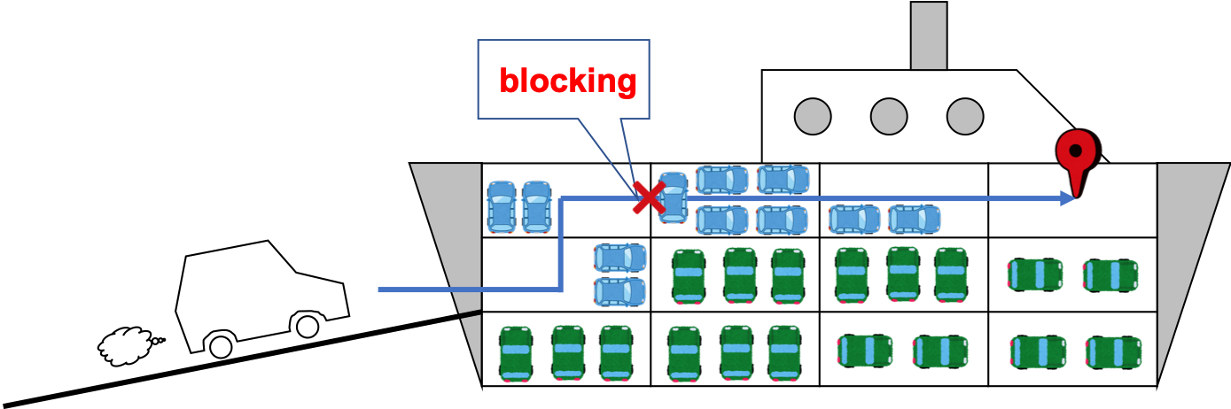
Background
When loading a vehicle, the worker actually drives the vehicle to its assigned location.
If there are too many vehicles parked on the way to the assigned location, it is hard to drive there.

Slide 7
Background
There are a lot of things that has to be considered
Planning assignments that makes it easy to load and unload vehicles is important.
Human error should not happen.
Unbalanced assignments may result in a sinking.

Slide 8
Outline
Background
Problem definition
Proposed model
Summary

Slide 9
Booking information
We are given booking information.
Booking ID
Loading port
Destination port
Number of vehicles
Size of vehicles
etc…

Slide 10
Ship information
We are also given ship information.
How many holds exist.
How large each hold is.
Which holds are connected.
etc…

Slide 11
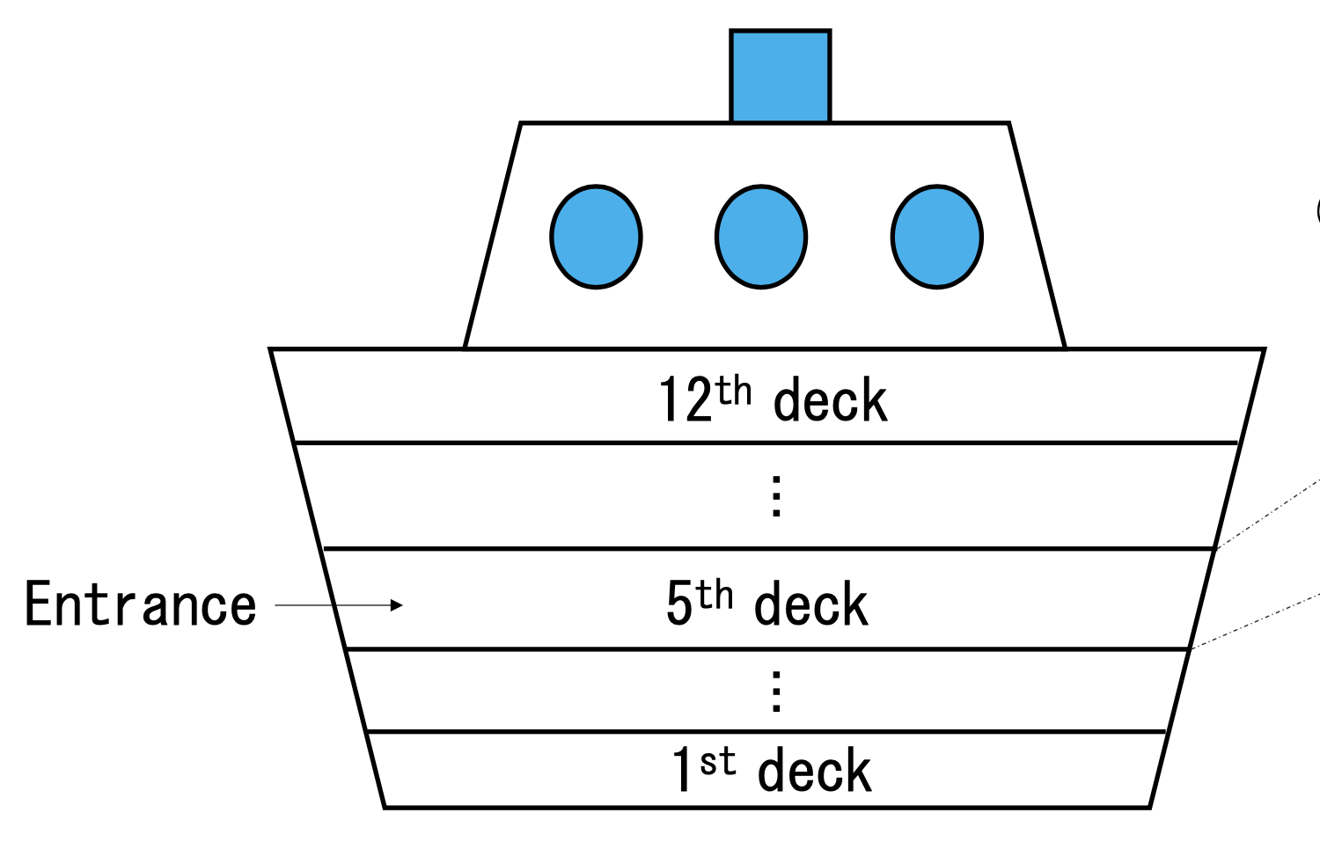
Ship information
In this research, we consider a ship that has 12 floors.
Each floor has up to 4 holds.
４
３
２
１

Slide 12
Stowage Plan
Booking
Stowage Plan
ID | L-Port | D-Port | Number
1 | Port A | Port C | 5
2 | Port A | Port D | 8
2 | Port B | Port D | 5
ID | Floor | Hold | Number
1 | 1st | 1 | 2
1 | 1st | 2 | 3
2 | 2nd | 3 | 4
2 | 2nd | 1 | 5
3 | 3rd | 2 | 2
3 | 3rd | 3 | 3

Slide 13
Mathematical modeling
We conducted multiple interviews with the planners who actually decide the stowage plan.
We model this problem as an assignment problem.
I will explain objective function and constraints one by one.

Slide 14
The objective function
The objective function is the weighted sum of the following five.
Avoiding multiple bookings in one hold
Placing same bookings by port closer together
Securing a path to prevent loss of work efficiency
No dead space
Placing empty space close to the entrance

Slide 15
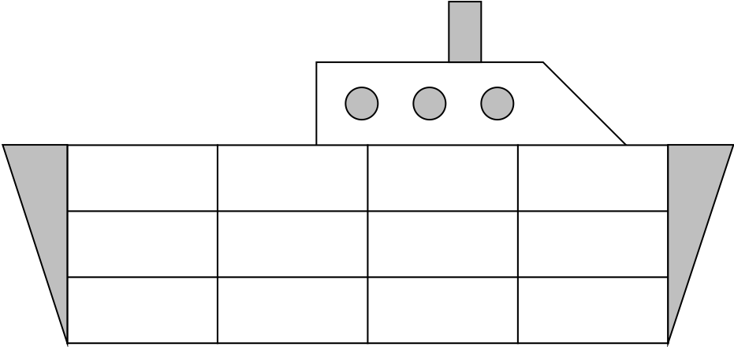
Avoiding multiple bookings in one hold
When a booking is unloaded from a hold at a certain port, if there are several bookings with different destinations in the same hold, human error may occur.
we minimize the number of bookings with different destinations in different loading areas for each hold.
×
○

Slide 16
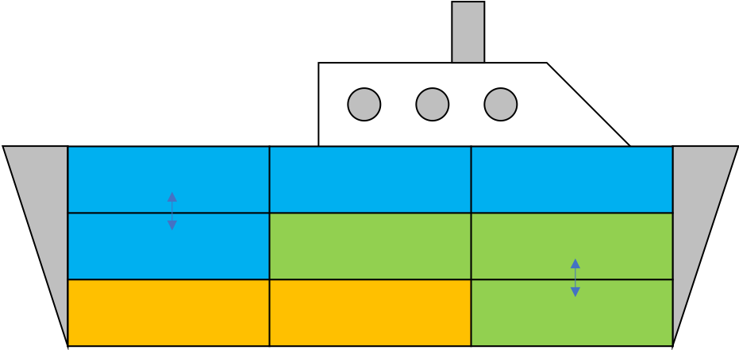
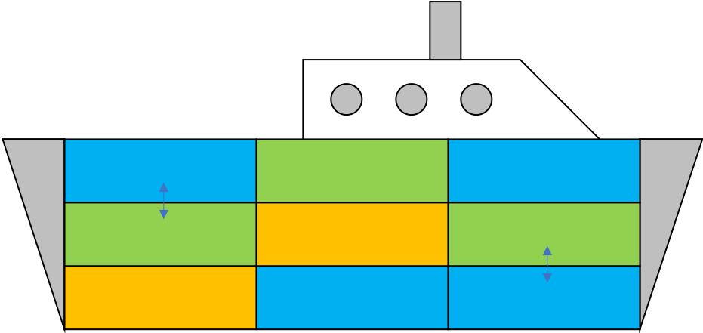
Placing same bookings by port closer together
it is easy to load and unload cars if same bookings by port are placed closer.
we minimize the number of bookings with different ports that exist in adjacent pairs of holds.
○ ×
Port A
Port B
Port C

Slide 17
Securing a path to prevent loss of work efficiency
When a hold is full, it would be harder to pass through that hold.
The crew need to move cars in that hold once and bring them back again.
This leads to a loss of work efficiency.

Slide 18
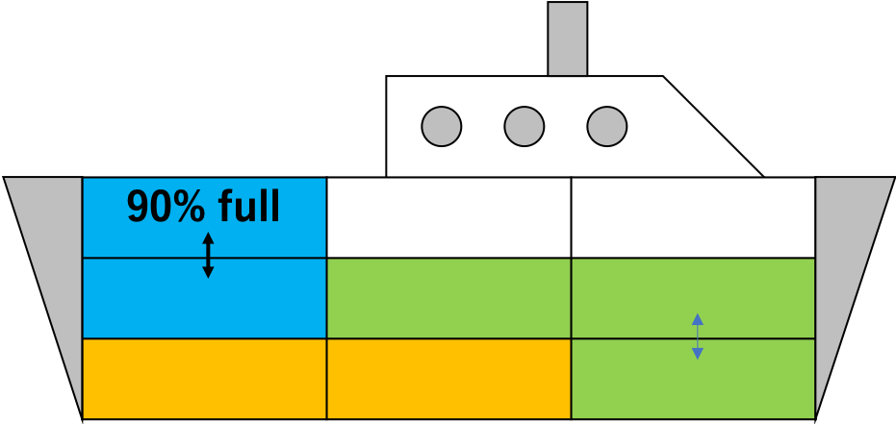
No dead space
There are some holds with a ramp connecting the deck to the deck.
Once these holds are filled to a certain extent, it will be impossible to reach the back holds.
This space is called “dead space”
We minimize the number of dead space.
These space are called dead space

Slide 19
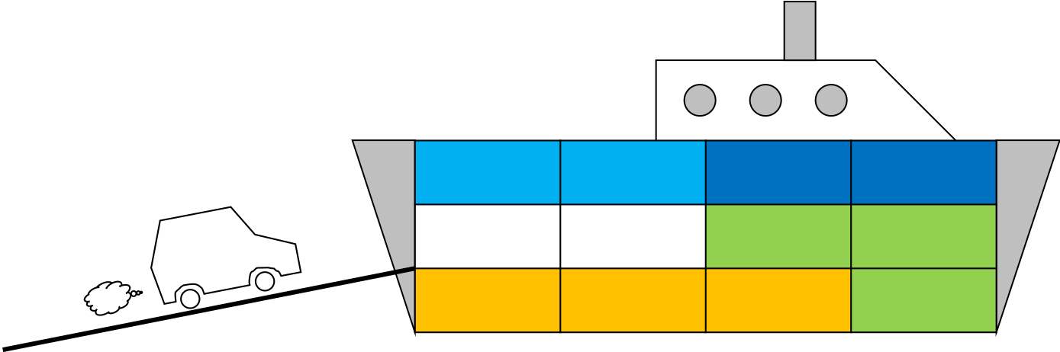
Placing empty space close to the entrance
It often happens that bookings are added just before the voyage.
To handle that situation, we should place empty space close to the entrance

Slide 20
Constraints
There are 3 constraints in making assignment.
Travel routes in the ship
Weight balance of cargo
All vehicles must be loaded.

Slide 21
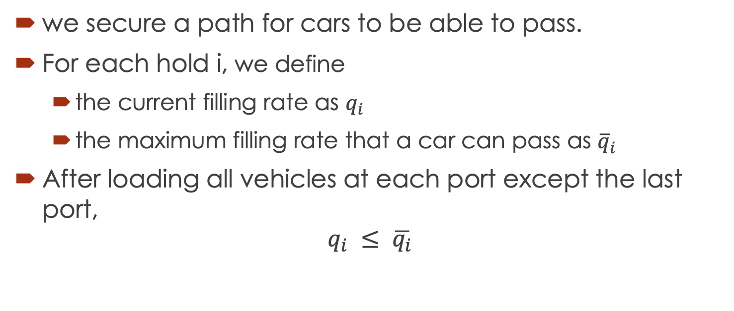
Travel paths in the ship
we secure a path for cars to be able to pass.
For each hold i, we define
the current filling rate as $q_{i}$
the maximum filling rate that a car can pass as ${\overline{q}}_{i}$
After loading all vehicles at each port except the last port,
$$q_{i} ≤ \overline{q_{i}}$$

Slide 22

Weight balance of cargo
When the ship tilts, there is a possibility that the ship will lose its balance and roll over.
We add constraints for balance in two directions
Forward and backward direction
Vertical direction

Slide 23
Outline
Background
Problem definition
Proposed model
Summary

Slide 24
Modeling
We propose mathematical model to this problem.
The basic idea is based on heuristics.
Using the local search, we improve the assignment.

Slide 25
Modeling
We propose model that splits the bookings and assigns them to holds.
As for holds, we think about grouping some holds together and assigning bookings to them.
We call them “segment”.

Slide 26
Segment
The ship has 43 holds.
We divide them into 17 segments.
It is based on the rule that on each floor, planners assign the cars in order from the back hold to the hold with the ramp.
this grouping enable the model to create assignment that is similar to planners'.

Slide 27
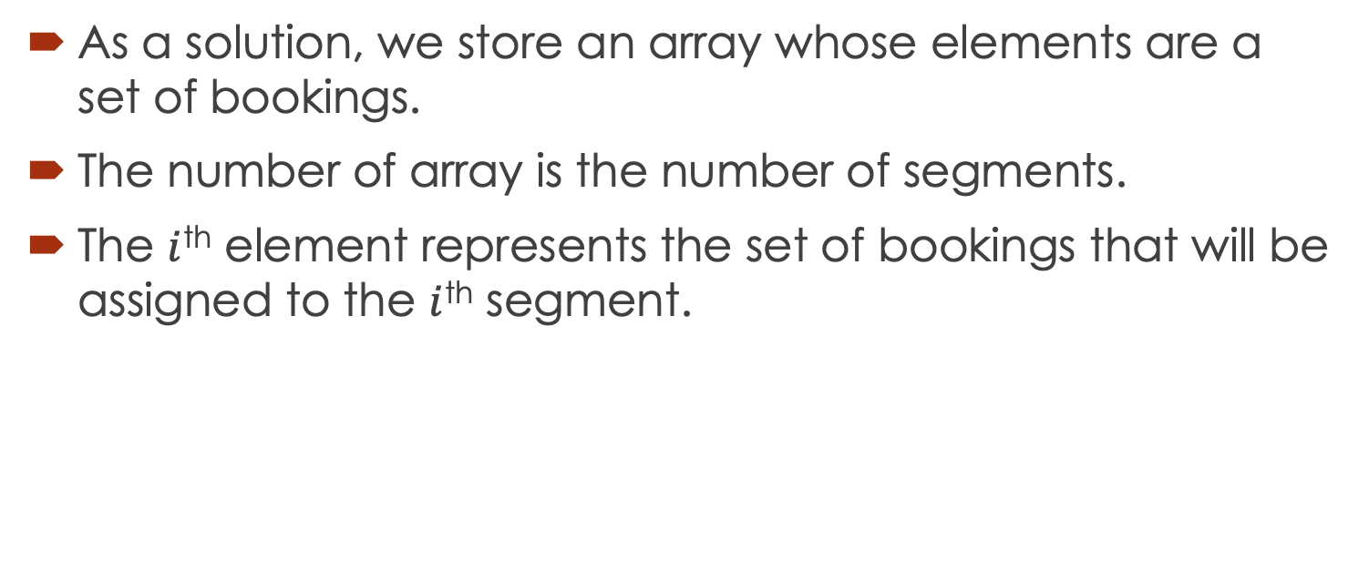
Solution representation
As a solution, we store an array whose elements are a set of bookings.
The number of array is the number of segments.
The $i$^{th} element represents the set of bookings that will be assigned to the $i$^{th} segment.

Slide 28
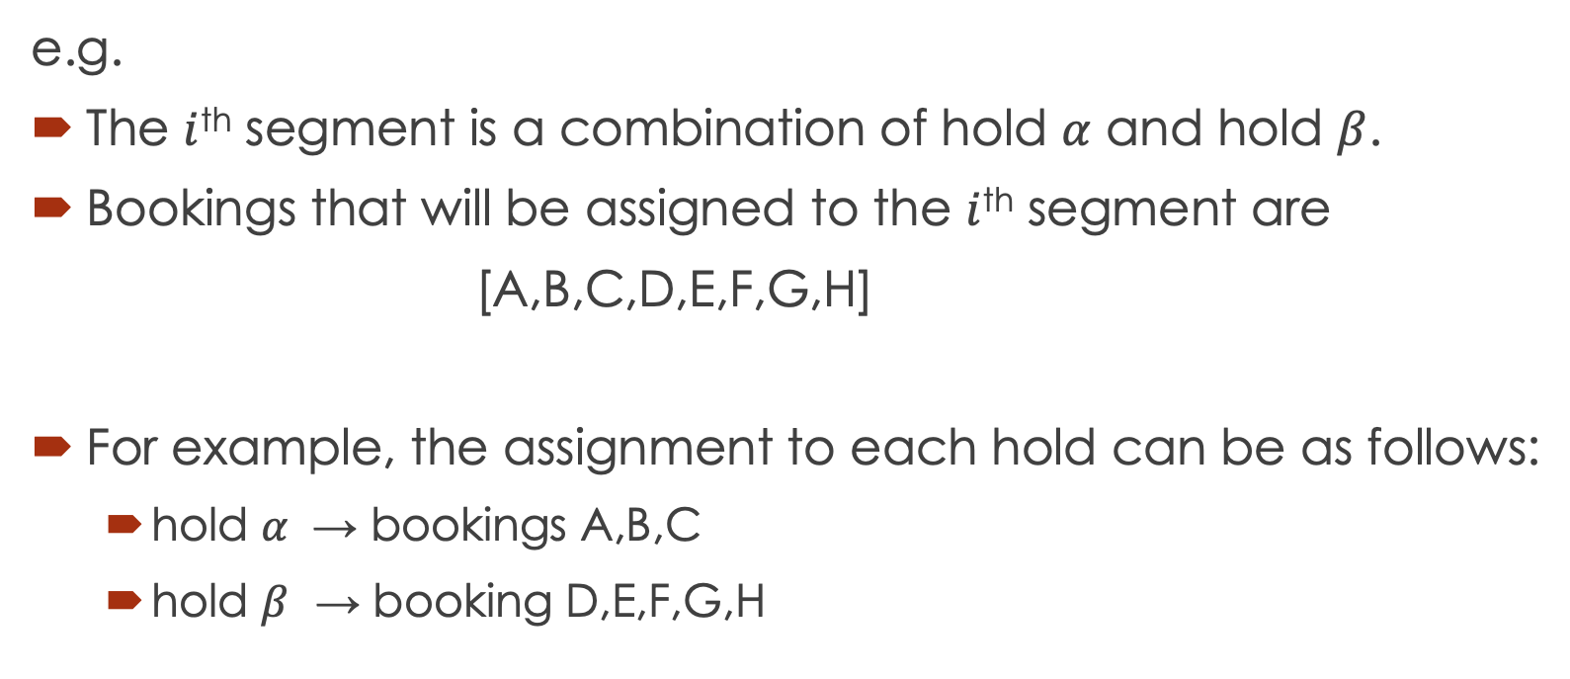
Solution representation
e.g.
The $i$^{th} segment is a combination of hold $α$ and hold $β$.
Bookings that will be assigned to the $i$^{th} segment are
[A,B,C,D,E,F,G,H]
For example, the assignment to each hold can be as follows:
hold $α$ → bookings A,B,C
hold $β$ → booking D,E,F,G,H

Slide 29
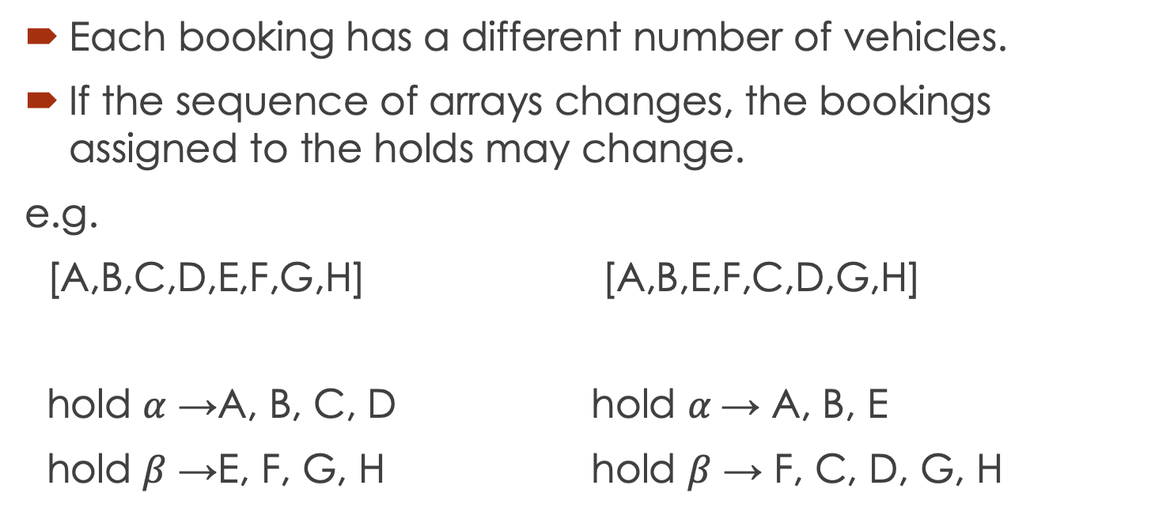
Solution representation
Each booking has a different number of vehicles.
If the sequence of arrays changes, the bookings assigned to the holds may change.
e.g.
[A,B,C,D,E,F,G,H] [A,B,E,F,C,D,G,H]
hold $α$ →A, B, C, D hold $α$→ A, B, E
hold $β$ →E, F, G, H hold $β$ → F, C, D, G, H

Slide 30
Local Search
Local search algorithms move from solution to solution in the space of candidate by applying local changes
We repeat this operation until the termination condition is satisfied
In this research, we use shift neighborhood and swap neighborhood.

Slide 31
Neighborhood
Shift neighborhood
This is obtained by reassigning one booking which was assigned to a segment to another segment.
Swap neighborhood
This is obtained by swapping the allocated segments of two bookings.

Slide 32
Flow of local search
Searching the shift neighborhood until no better solution is found.
Searching the swap neighborhood until no better solution is found.
If better solution is found in step 1 or step 2, return to step 1.

Slide 33
Shift neighborhood
When searching shift neighborhoods, we normally calculate the evaluate function for all possible insertion positions and insert in the best position.
For this problem, there may be a waste of resources.

Slide 34
Waste of resources in the neighborhood
When inserting one booking into another hold, we make a change to the sequence order of the bookings to be inserted.
e.g. inserting booking A
[C,B,D] → [A, C, B, D]
[C, A, B, D]
[C, B, A, D]
[C, B, D, A]
In this case, we try 4 patterns and select the best inserted position.

Slide 35
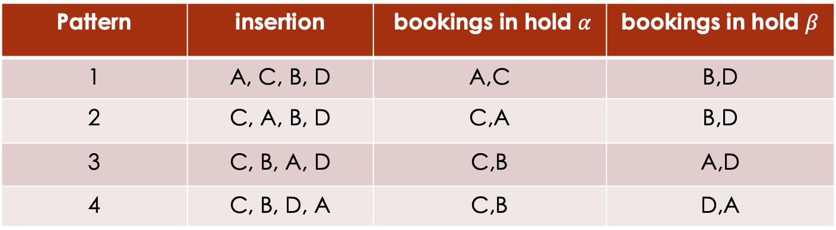

Waste of resources in the neighborhood
Some insertions may result in the exact same assignment.
e.g. when this segment has 2 holds($α,β)$:
In this case, trying 2 patters is enough.
Pattern | insertion | bookings in hold $α$ | bookings in hold $β$
1 | A, C, B, D | A,C | B,D
2 | C, A, B, D | C,A | B,D
3 | C, B, A, D | C,B | A,D
4 | C, B, D, A | C,B | D,A

Slide 36
Our approach to reduce the number of insertions
We propose an approach to reduce the number of insertions.
We insert it at the end of the booking sequence.
We memorize bookings that are split in two.
We insert only in adjacent parts of split bookings.
We select the best insertion position

Slide 37
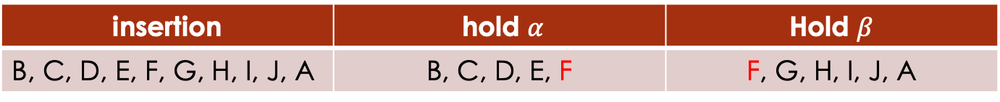
Our approach to reduce the number of insertions
When inserting booking A to segment with the following order sequence:
B, C, D, E, F, G, H, I, J
1. We insert booking A at the end of the sequence.
B, C, D, E, F, G, H, I, J, A
2. We memorize booking that are split in two.
In this case, we insert only before and after booking F, and select the best insertion position.
insertion | hold $α$ | Hold $β$
B, C, D, E, F, G, H, I, J, A | B, C, D, E, F | F, G, H, I, J, A

Slide 38
Our approach to reduce the number of insertions
We compare our approach with inserting all the possible position.
Instance |  |  | Inserting all positions | Our approach
Number of orders | Number of L ports | Number of D ports | Computation time | Computation time
109 | 2 | 3 | 145 | 81
109 | 2 | 5 | 192 | 89
109 | 4 | 3 | 122 | 99
250 | 2 | 3 | 387 | 204
We confirmed that we can reduce the computation time while keeping the quality of solutions

Slide 39
Initial solution
Approaches we propose to create initial solutions:
Generating from solution by relaxation of linear programming
Generating from solution of a problem formulated in MIP with bookings grouped by port

Slide 40
Approach to create initial assignment
Generating from solution by relaxation of linear programming
Generating from solution of a problem formulated in MIP with bookings grouped by port

Slide 41
Relaxation of linear programming
As a preliminary experiment, we compare the solutions to the MIP problem and the relaxation problem.
To compare the properties of the solutions, we use the Manhattan distance.
We performed the comparison and confirmed that the properties of the relaxed solution and the MIP solution are close.

Slide 42
Approach to create initial assignment
Generating from solution by relaxation of linear programming
Generating from solution of a problem formulated in MIP with bookings grouped by port

Slide 43
MIP with bookings grouped by port
We propose using a solution of a model that combines bookings with the same loading port and unloading port into a single booking to create an assignment.
With this approach, we can get a rough solution in a short time.

Slide 44
Comparison by initial solution
instance | randomly generated |  | relaxation solution |  | bookings grouped by port
 | Value | Computation time (seconds) | Value | Computation time (seconds) | Value | Computation time (seconds)
109-2-3 | -2975 | 873 | -2179 | 1641 | -2896 | 776
109-2-5 | -1167 | 938 | -594 | 8057 | -3247 | 2650
109-4-3 | -1378 | 728 | 1840 | 8782 | -1873 | 3009
250-2-3 | -2235 | 3069 | -2755 | 9726 | -3476 | 1605
Instance name:
number of orders- number of loading port- number of unloading port

Slide 45
Computational experiment
We compare the quality and the computation time of the proposed model with that of solving MIP.
For MIP, we show the values of the solution after 1 hour and after 24 hours
For proposed model, we show the value of the solution and the computation time to finish the local search.

Slide 46
Comparison of two models
Instance | Solving MIP |  | Our best approach
 | Value after 3600s | Value after 86400s | Value | Computation time (seconds)
109-2-3 | -508 | -3478 | -2896 | 776
109-2-5 | -2612 | -3354 | -3247 | 2650
109-4-3 | 1240 | -3455 | -1873 | 3009
250-2-3 | infeasible | -2064 | -3476 | 1605
Instance name:
number of orders - number of loading port - number of unloading port

Slide 47
Summary
We formulated the stowage planning problem and proposed model which is based on heuristic.
We propose an approach to reduce computation time in local search.
We propose 2 approach to generate initial solution.
We confirmed that we can get feasible solutions with a certain quality in a relatively short computation time.

Slide 48
supplementary materials

Slide 49
avoiding multiple bookings in one hold
When a booking is unloaded from a hold at a certain port, if there are several bookings with different destinations in the same hold, human error may occur.
we minimize the number of bookings with different destinations in different loading areas for each hold.
e.g. when unloading at port A
Port A
Port B
Port C
We add a penalty of two to the objective function

Slide 50
placing same bookings by port closer together
it is easy to load and unload cars if same bookings by port are placed closer.
we minimize the number of bookings with different ports that exist in adjacent pairs of holds.
○ ×
Port A
Port B
Port C
The penalty is 2
The penalty is 7

Slide 51
Securing a path to prevent loss of work efficiency
For each hold 𝑖, we define a filling rate that does not narrow the aisle of the car.
When loading 10 cars to hold 4:
Red: the hold which the filling rate is exceeded.
Blue: the hold which the filling rate is not exceeded.
Total penalty for this situation is 20 (10 *2)
1
2
3
entrance
4

Slide 52
placing empty space close to the entrance
The ship has 12 floors and the entrance is on the 5th floor.
If there are lots of empty space in the 5th floor’s holds, we get more profit.
We subtract that profit from the objective function.

Slide 53
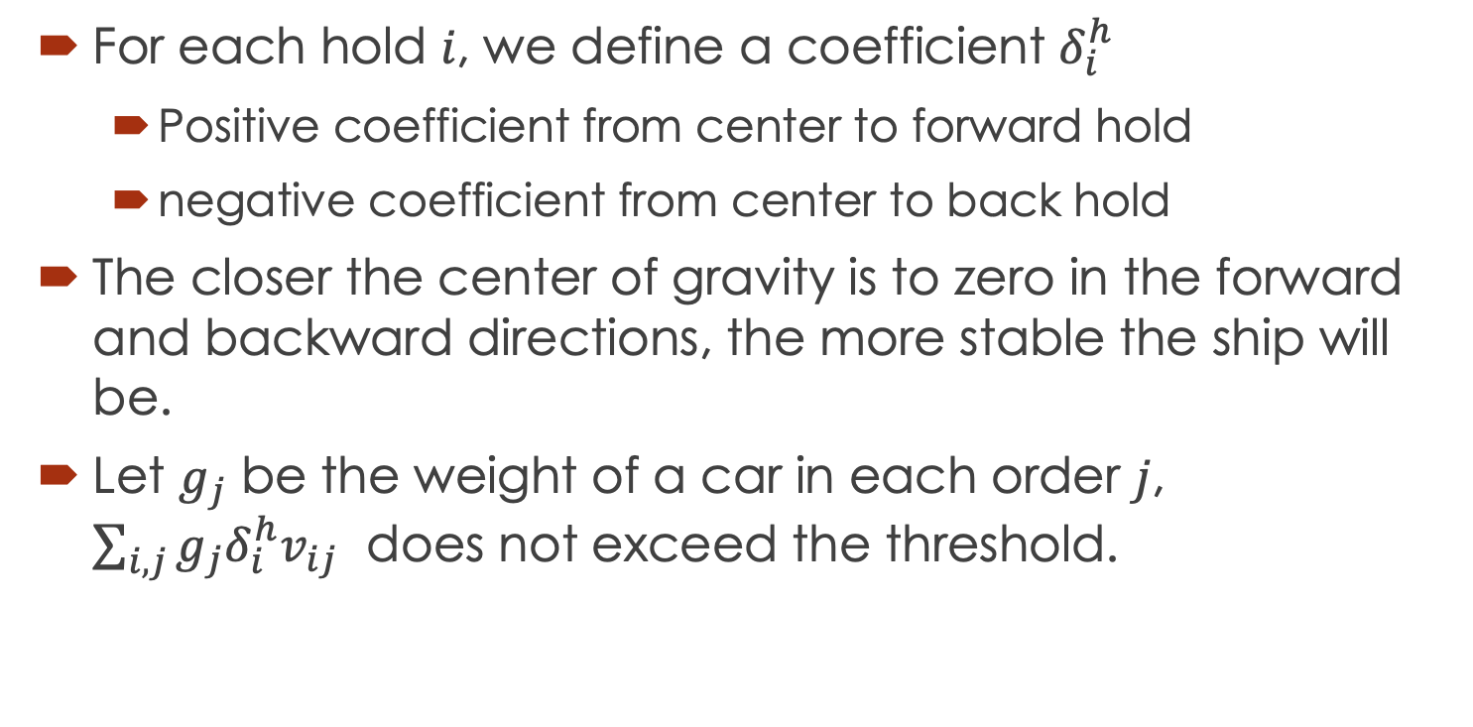
Forward and backward direction
For each hold 𝑖, we define a coefficient $δ_{i}^{h}$
Positive coefficient from center to forward hold
negative coefficient from center to back hold
The closer the center of gravity is to zero in the forward and backward directions, the more stable the ship will be.
Let $g_{j}$ be the weight of a car in each order 𝑗, $\sum_{i,j}{g_{j}δ_{i}^{h}v_{ij}}$ does not exceed the threshold.

Slide 54
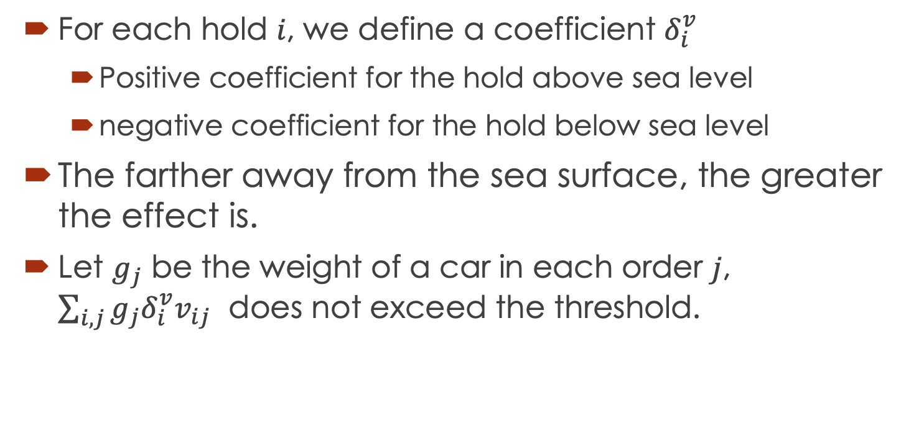
Vertical direction
For each hold 𝑖, we define a coefficient $δ_{i}^{v}$
Positive coefficient for the hold above sea level
negative coefficient for the hold below sea level
The farther away from the sea surface, the greater the effect is.
Let $g_{j}$ be the weight of a car in each order 𝑗, $\sum_{i,j}{g_{j}δ_{i}^{v}v_{ij}}$ does not exceed the threshold.

Slide 55
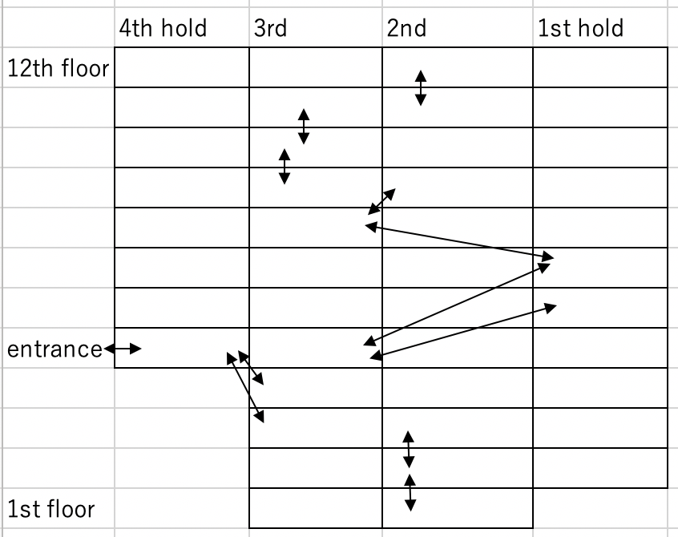
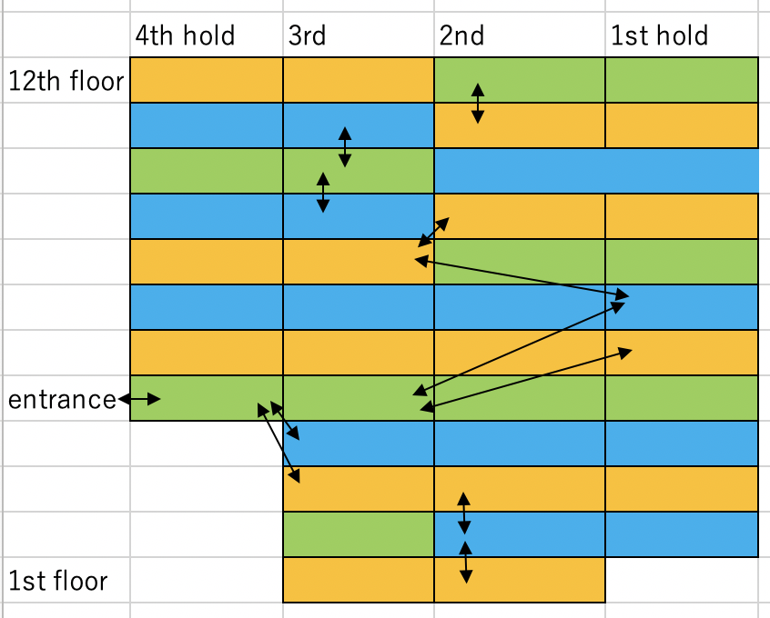
Detailed Segment
→

Slide 56
Assigning to hold
Given an array of booking assigned to segments, we assign the bookings to holds based on the rules.
We load the vehicles from the back hold while satisfying the travel routes constraints.
Other constraints or objectives are calculated in the evaluate function.

Slide 57
Shift neighborhood
We select one order assigned to a segment and reassign it to a different segment.
ex. array of orders in each segment are as follows:
Segment 1 Segment 2
[A,B,C,D] [E,F,G,H]
Segment 1 Segment 2
[A,B,D] [E,F,G,C,H]

Slide 58
Swap neighborhood
We swap the two orders assigned to different segments.
ex. array of orders in each segment are as follows:
Segment 1 segment 2
[A,B,C,D] [E,F,G,H]
Segment 1 segment 2
[A,B,F,D] [E,C,G,H]

Slide 59
Evaluate function
As the evaluation function used to find the solution, we use the weighted sum of the constraint and the objective function.
constraint
Travel routes in the ship
Weight balance of cargo
All vehicles must be loaded.
Objective function
avoiding multiple orders in one hold
placing same orders by port closer together
securing a path
No dead space
placing empty space close to the entrance

Slide 60
Comparison by insertion method
The computation time could be reduced; however, it would take some time.
We have compared the quality and the computation time for the following two cases:
Case that orders are inserted into the optimal position based on our approach
Case that orders are inserted randomly

Slide 61
Our approach to reduce the number of insertions
instance |  |  | inserting to the best position |  | inserting randomly
Num of orders | Num of L ports | Num of D ports | value | Computation time | value | Computation time
109 | 2 | 3 | -2533 | 2244 | -2975 | 873
109 | 2 | 5 | -1492 | 5051 | -1167 | 938
109 | 4 | 3 | -144 | 4965 | -1378 | 728
250 | 2 | 3 | -2925 | 7275 | -2235 | 3069

Slide 62
Comparison by insertion method
Computation time varies greatly.
The quality of the local optimal solution is not very different between the two approaches.
When this algorithm is actually used, it will be checked by a person in the end.
there may be possibilities that obtaining a solution with a certain degree of quality in a short time may be sufficient.

Slide 63
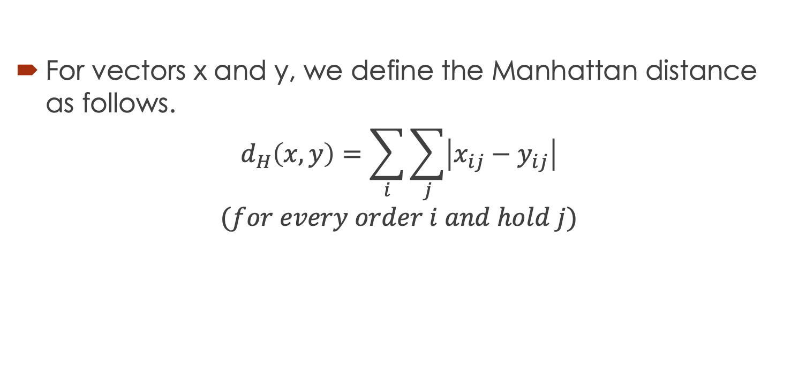
Manhattan distance
For vectors x and y, we define the Manhattan distance as follows.
$$d_{H}\left(x,y\right)=\sum_{i}{\sum_{j}{\left|x_{ij}−y_{ij}\right|}}$$
$$(for every order i and hold j)$$

Slide 64
Example of Manhattan distance
We consider the following conditions
The number of orders is 3 and the number of holds is 4.
Each order contains 100 vehicles.
The values of the vectors take a small number between 0 and 1.
the value is 1 when allocating 100% of the order
the value is 0.5 when allocating 50% of the order

Slide 65
Example of Manhattan distance
we convert the values as shown in this table.
hold
 | 1 | 2 | 3 | 4
A | 30 | 70 | 0 | 0
B | 0 | 0 | 100 | 0
C | 10 | 10 | 0 | 80
 | 1 | 2 | 3 | 4
A | 0.3 | 0.7 | 0 | 0
B | 0 | 0 | 1.0 | 0
C | 0.1 | 0.1 | 0 | 0.8
→
order
We consider the situation that each order contains
100 vehicles.

Slide 66
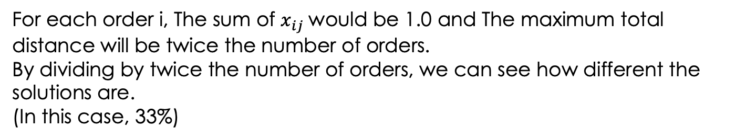
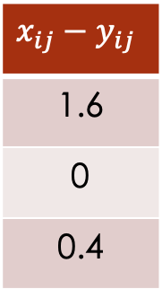
Example of Manhattan distance
|0.3-0.2|+|0.7-0|+|0-0.8|
Pattern 1
Pattern 2
 | 1 | 2 | 3 | 4
A | 0.3 | 0.7 | 0 | 0
B | 0 | 0 | 1.0 | 0
C | 0.1 | 0.1 | 0 | 0.8
$$x_{ij}−y_{ij}$$
1.6
0
0.4
 | 1 | 2 | 3 | 4
A | 0.2 | 0 | 0.8 | 0
B | 0 | 0 | 1.0 | 0
C | 0.2 | 0.2 | 0 | 0.6
Total distance: 2.0
For each order i, The sum of $x_{ij}$would be 1.0 and The maximum total distance will be twice the number of orders.
By dividing by twice the number of orders, we can see how different the solutions are.
(In this case, 33%)

Slide 67
Result of Manhattan distance
We performed the comparison only on instances for which we had the exact best solution.
orders | L ports | D ports | Difference(%)
38 | 2 | 3 | 0.19
63 | 2 | 3 | 3.57
57 | 2 | 5 | 1.07
66 | 4 | 3 | 0.71
We confirmed that the properties of the relaxed solution and the MIP solution are close for all instances.

Slide 68
Rounding the relaxed solution
For every orders, the value of the variable assigned to the hold is used as a probability to randomly determine which hold to assign to.
If the capacity constraint of the hold is not satisfied, we will not assign orders to that hold.
Hold | Value of the relaxed solution.
A | 0.2
B | 0.5
C | 0.3
Hold | Probability that orders are assigned
A | 20%
B | 50%
C | 30%

