Slide 1
Intersectionality in LGBTQ+ health research: Practical analysis in R Using UpSet plots
Prepared and Presented by Chris Battiston, he/him
Chris.Battiston@wchospital.ca

Slide 2
About me….
I work for a hospital in Toronto, Canada that prides itself on improving healthcare for marginalized folks.
With programs like the first out-patient gender confirming surgery program in Canada to revolutionizing HIV and substance use disorder care, our research reflects the broad diversity of this work
I’m the REDCap Administrator for the hospital, so although I don’t have direct involvement in the studies, I support and guide how teams can build their projects in the most effective way.

Slide 3
Why am I doing this talk?
Representing marginalized populations through data equity and justice is something that I strive to bring to my work every single day.
I am developing standardized, inclusive, equitable, and sensitive Demographics questions that will allow more research participants to see themselves in how the questions are asked
Along with better questions, we need to have better methods for analyzing this data. Data visualization has been a passion of mine for many years, so this was a perfect fit for me.
UpSet charts fill the gaps a lot of studies have in their data analysis, so I’m hoping that talks like this expose more people to their usefulness.

Slide 4

…to the point of this talk
…fingers crossed, I’m going to do a demo!

Slide 5
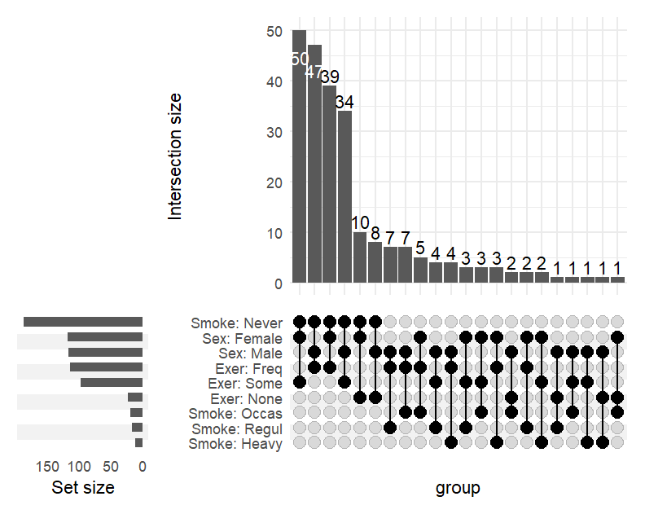
Notes:
Simple example, too much information

Slide 6
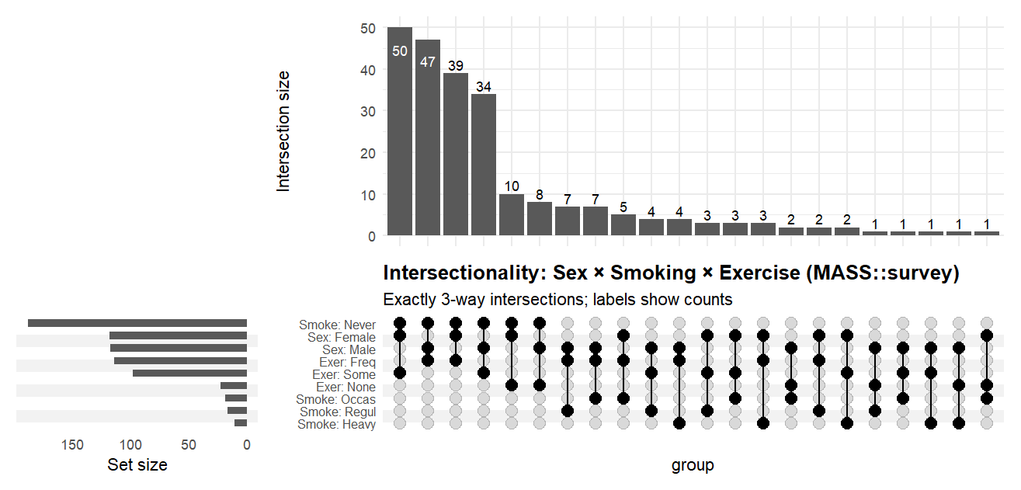
Notes:
Better, but still too wide (N=1 are not really important in this case)

Slide 7


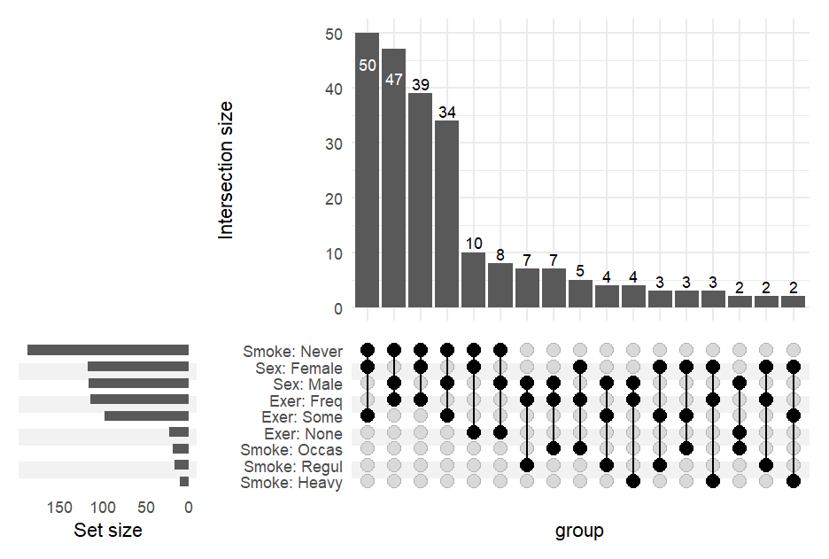



Notes:
Components of the Plot:
Intersection Size (Top Bar Plot):
The vertical bars at the top represent the number of survey respondents in each specific intersection of categories.
The numbers on top of the bars indicate the exact counts.
For example, the tallest bar shows 50 respondents who are in the corresponding combination of Sex, Smoking, and Exercise categories.
Set Size (Left Bar Plot):
The horizontal bars on the left show the total number of respondents in each individual category, regardless of intersections.
For example, “Smoke: Never” has the largest bar, indicating that this category contains the most respondents overall.
Intersection Matrix (Bottom Middle):
Each column corresponds to an intersection. Black dots indicate which categories are included in that intersection, and grey dots indicate categories that are not part of the intersection.
Connected black dots show the specific combination of categories for that intersection.
Example: A column with black dots at “Sex: Female,” “Smoke: Never,” and “Exer: Freq” represents all female respondents who never smoke and exercise frequently.
Variables and Categories:
Sex: Female, Male
Smoke: Never, Occas (occasional), Regul (regular), Heavy
Exer: None, Some, Freq (frequent)
Interpretation:
The plot allows quick identification of which combinations of demographic and lifestyle factors are most common.
In this example, respondents who are female, never smoke, and exercise sometimes make up the largest group.
Less frequent intersections (shorter bars) show rare combinations, which may be important for exploring intersectionality in behaviors and demographics.
Overall Insight:
The UpSet plot clearly separates set-level information (how many people are in each category individually) from intersection-level information (how many people fall into a particular combination of categories).
This is useful for identifying patterns in multi-dimensional categorical data that would be difficult to visualize with a Venn diagram.

Slide 8
Final Thoughts
Clinical research is rapidly becoming more complex, and with the realization that people are not just a bunch of single, isolated variables, new data visualization and analysis tools are needed.
UpSet Plots are a step in the right direction, but more work needs to be done to standardize their use and develop supplemental methods to support them.
Methods shown today are intended for new users; the UpSetR package is the preferred method but is more complex.

Slide 9
References and Reading
Lex, Alexander; Gehlenborg, Nils; Strobelt, Hendrik; Vuillemot, Romain; Pfister, Hanspeter (31 December 2014). "UpSet: Visualization of Intersecting Sets". IEEE Transactions on Visualization and Computer Graphics. 20 (12): 1983–1992. doi:10.1109/TVCG.2014.2346248. PMC 4720993. PMID 26356912.
Lex, Alexander; Gehlenborg, Nils; Strobelt, Hendrik; Vuillemot, Romain; Pfister, Hanspeter. ""UpSet - Visualizing Intersecting Sets"".
Conway, Jake R; Lex, Alexander; Gehlenborg, Nils (15 September 2017). "UpSetR: an R package for the visualization of intersecting sets and their properties". Bioinformatics. 33 (18): 2938–2940. doi:10.1093/bioinformatics/btx364. PMC 5870712. PMID 28645171.

