Slide 1


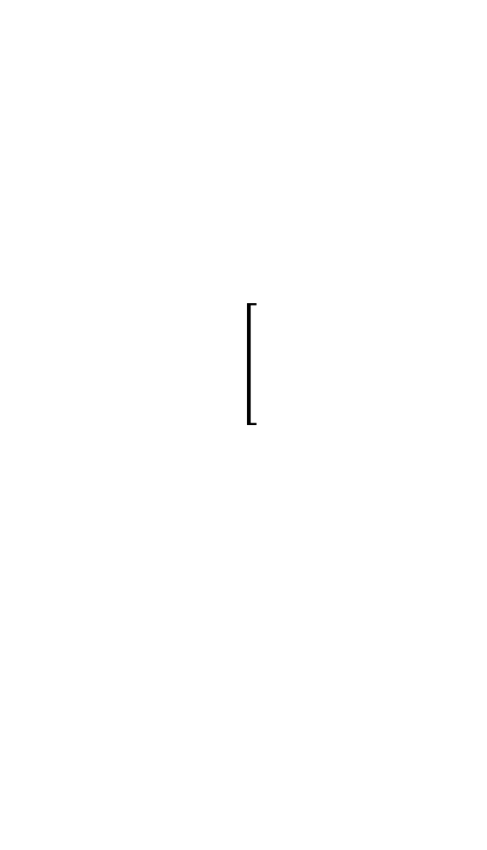

Certainty
$$a∈\left\{True\right\}$$
$$a∈\left\{False\right\}$$
Uncertainty
$$a∈\left\{True, False\right\}$$

