Slide 1
VDERM-X
Submitted by:
Alishba Javed Team Lead, Full Stack Developer
2021-CS-205
Maryam Siddique Backend , Design Developer
2021-CS-180
Muhammad Moaz Frontend , Documentation Developer
2021-CS-101
Fiza Azhar Full Stack, Documentation Developer
2021-CS-193
Supervisor:
Prof. Dr. Shoaib
Co-Supervisor:
Ms. Abqa Javeed
Department of Computer Science UET, LAHORE

Slide 2

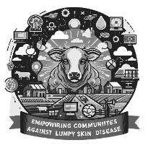

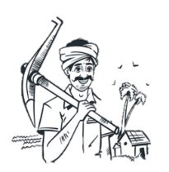
Introduction
Our mobile app combines a chatbot and an AI/DL model tailored for lumpy skin disease detection, offering timely prevention advice and medication guidance
Empowering local practitioners and leveraging technology to bridge gaps in livestock health while raising awareness and combating stigma
Integerate deep learning models InceptionV3 and MobileNetV2 to visually diagnose LSD, your system can help detect early signs of the disease, making treatment more effective and reducing the spread.
Our goal is to deliver quick detection, and easily accessible solutions to Farmers and livestock owners by developing V-DermX that save their animals lives.
V-DermX

Slide 3
Problem Statement
Problem Definition: This project aims to diagnose lumpy skin disease (LSD) in cattle using AI techniques like MobileNetV2 . It develops an offline-capable mobile app for timely detection and diagnosis, along with a chatbot for veterinary consultations, targeting areas with limited veterinary access.
Significance: In rural areas, limited access to veterinary services delays diagnosis and worse cattle health, leading to economic losses. This app enables early LSD detection, offering offline diagnosis and consultation to improve animal well-being and reduce losses.
V-DermX

Slide 4




Objectives
Develop a Deep learning model for image-based detection to enhance diagnostic accuracy and speed.
Building a chatbot
Building a chatbot to help user with symptoms and treatments.
Create an offline-capable mobile app to ensure functionality in areas with limited internet access.
Build a user-friendly interface to ensure accessibility for pet owners with varying levels of expertise.
V-DermX

Slide 5
Literature Review:
Name | Author | Year | Dataset | Features | Model | Result | Pre-Processing
Prediction of Lumpy Skin Disease Using Machine Learning Techniques | Olatayo Olaniyan & Olusogo Julius Adetunji | 2023 | https://data.mendeley.com/datasets/7pyhbzb2n9/1 | Classification | Decision Tree, KNN, Random Forest, SV | 98.89% accuracy | FeatureWiz for feature selection
A deep learning approach optimized with RMSProp and MobileNetV2 | Sheikh M.Saqib M.Iqbal | 2024 | - | Deep learning, MobileNetV2, RMSProp optimization | MobileRMSNet (MobileNetV2, RMSProp) | 95% Accuracy | -
An extensive investigation of CNN designs for the diagnosis of lumpy skin disease in dairy cows | Dip Kumar Saha | 2024 | https://data.mendeley.com/datasets/w36hpf86j2/1 | Image Classification | DenseNet, MobileNetV2, Xception, InceptionResNetV2 | 95% Accuracy | Four CNN models, DenseNet, MobileNetV2, Xception, and InceptionResNetV2 were used to classify the framework
Lumpy skin disease diagnosis in cattle: A deep learning approach optimized with RMSProp and MobileNetV2 | Sheikh Muhammad Saqib, Iqbal M, Tahar Ben Othman M, Shahazad T, Yasin Ghadi Y, Al-Amro S. | 2024 | - | Image Classification | MobileNetV2 | 95% Accuracy | Image processing
V-DermX
Notes:
Visual deep learning model using InceptionV3 can achieve 92.7% accuracy in diagnosing diseases like Lumpy Skin Disease (LSD) through image classification and segmentation. This model allows cattle owners, especially in rural areas, to quickly and reliably identify diseased areas, enabling early intervention and reducing the spread of disease.A Deep Learning Approach to Detect Lumpy Skin Disease in Cows
Integrating chatbot systems with visual deep learning models enables cattle owners to report symptoms and receive immediate advice, like cleaning affected areas and seeking veterinary help. Chatbots collect key information on the animal’s condition, offering basic guidance while connecting farmers with professionals for accurate diagnostics. This AI-driven approach provides accessible support, empowering farmers with timely disease management and intervention.Chatbot usage intention analysis: Veterinary consultation

Slide 6
Literature Review (Cont'd)
Name | Author | Year | Concept
Review: Lumpy Skin Disease | Endalu Mulatu and Abdi Feyisa | 2018 | Medical
Lumpy Skin disease: Review of literature | K. A. Al-Salihi | 2014 | Medical
Lumpy Skin Disease | Hawsar Yasin Abdulqa , Heshu Sulaiman Rahman, Hiewa Othman Dyary1 and Hemn Hasan Othman | 2016 | Medical
Epidemic of lumpy skin disease in Pakistan | Govinda Khatri, Aneesh Rai, Aashish, Shahzaib, Saqlain Hyder, Priya, Mohammad Mehedi Hasan | 2023 | Medical
V-DermX
Notes:
Visual deep learning model using InceptionV3 can achieve 92.7% accuracy in diagnosing diseases like Lumpy Skin Disease (LSD) through image classification and segmentation. This model allows cattle owners, especially in rural areas, to quickly and reliably identify diseased areas, enabling early intervention and reducing the spread of disease.A Deep Learning Approach to Detect Lumpy Skin Disease in Cows
Integrating chatbot systems with visual deep learning models enables cattle owners to report symptoms and receive immediate advice, like cleaning affected areas and seeking veterinary help. Chatbots collect key information on the animal’s condition, offering basic guidance while connecting farmers with professionals for accurate diagnostics. This AI-driven approach provides accessible support, empowering farmers with timely disease management and intervention.Chatbot usage intention analysis: Veterinary consultation

Slide 7
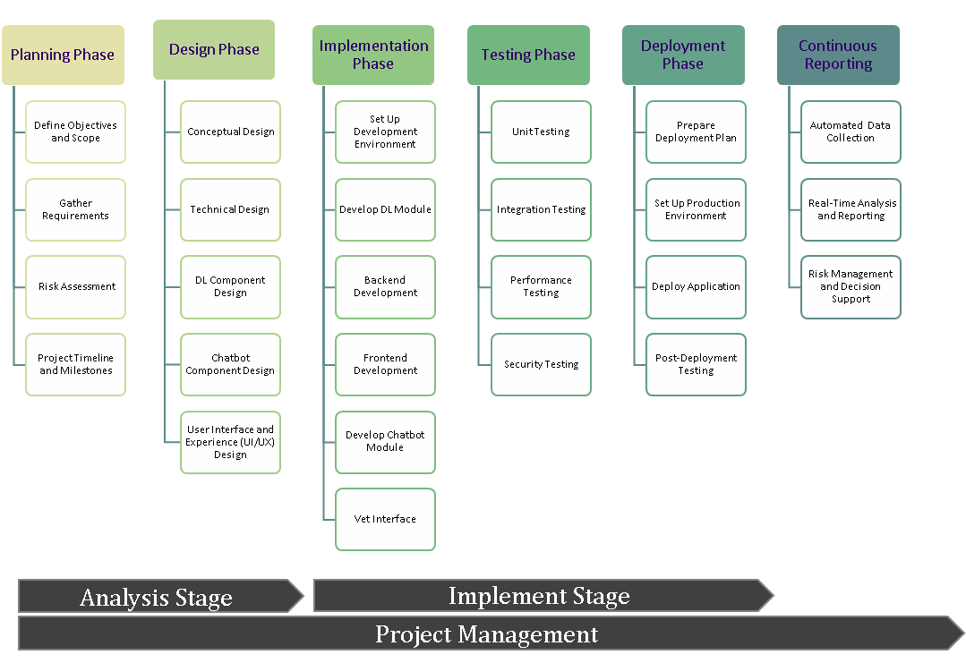
Proposed Solution/Methodology
V-DermX

Slide 8
Software Requirements
1. Frontend Requirements:
Framework: React Native (Cross-platform mobile application development)
Language: TypeScript (Static typing for robust development)
UI Components: React Native's built-in components (e.g., View, Text, Image, Button)
Navigation: React Navigation (Smooth screen transitions and navigation)
State Management: Redux (Centralized state management for recipes, authentication, etc.)
Push Notifications: Socket.IO (Real-time notification delivery)
Offline Storage: AsyncStorage/IndexedDB (Data caching for offline use)
Image Processing: TensorFlow Lite/Expo Image Picker (Model inference and user image processing)
2. Backend Requirements
Framework: Next.js (Efficient RESTful API development)
Language: TypeScript (Ensures consistency with frontend development)
Database: MongoDB and MongoDB Atlas (For secure data storage and scalability)
Authentication: JWT (For secure user sessions and data access control)
Image Storage: Sharp (Compression and optimization of uploaded images)
AI Models:
  TensorFlow/TensorFlow Lite (Inference for InceptionV3 and MobileNetV2 models)
  NLP-powered chatbot for queries and advice
V-DermX

Slide 9
Software Requirements(Cont'd)
3. Machine Learning/Deep Learning:
Frameworks:
  TensorFlow (Training and deploying models for disease detection)
  Fine Tuned gpt 3.5 turbo (Chatbot development and management for FAQs and prevention advice)
Models:
  InceptionV3 and MobileNetV2 (Accurate detection of lumpy skin disease from images)
4. Development & Testing Tools:
Code Linting and Formatting:
  ESLint (Code quality checks)
  Prettier (Enforcing consistent styling)
Unit Testing: Jest (Robust unit testing for backend and frontend)
End-to-End Testing: Cypress (Comprehensive testing of app workflows)
5. Additional Technologies:
Real-time Notifications: Socket.IO
Offline Features: Service Workers (Ensuring app usability without network access)
Cross-Platform Compatibility: React Native enables seamless integration across iOS and Android devices.
V-DermX

Slide 10
Current Progress
Frontend and Backend Development
Implemented frontend using React Native and backend with Nest.js.
Seamlessly integrated frontend and backend for a smooth user experience.
AI Model Implementation
Developed disease detection AI using MobileNetV2.
Trained models to detect lumpy skin disease in livestock.
Chatbot Functionality
Built Fine tuned gpt 3.5 turbo chatbot for real-time guidance on medication, prevention, and precautions.
Backend chatbot ready for integration.
Veterinarian Interface
Developed dedicated vet interface for managing cases and providing diagnosis support.
Features to streamline veterinarians' workflow and decision-making.
V-DermX

Slide 11
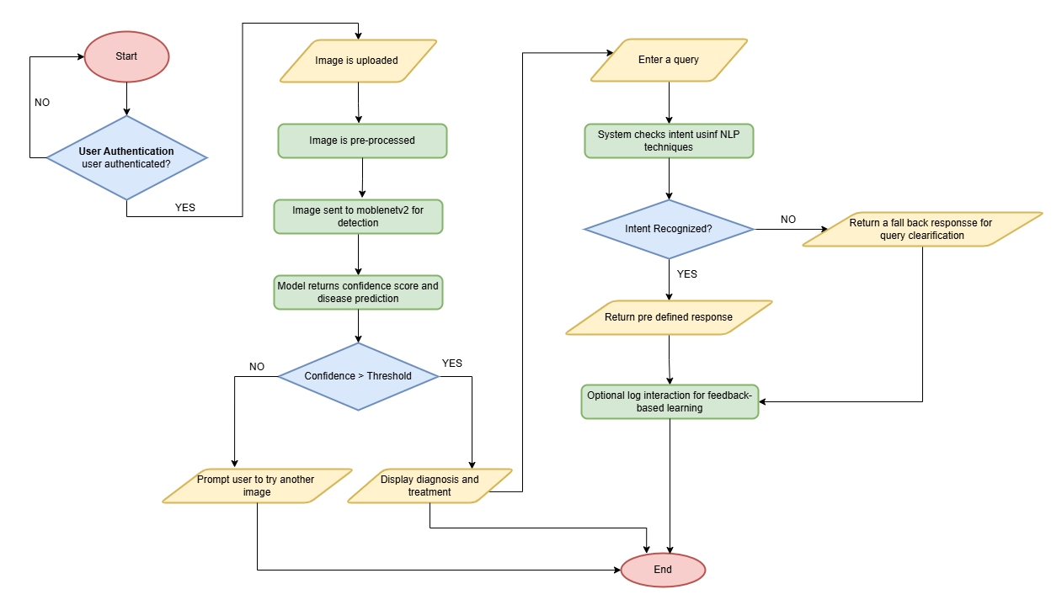
Flow Chart
V-DermX

Slide 12
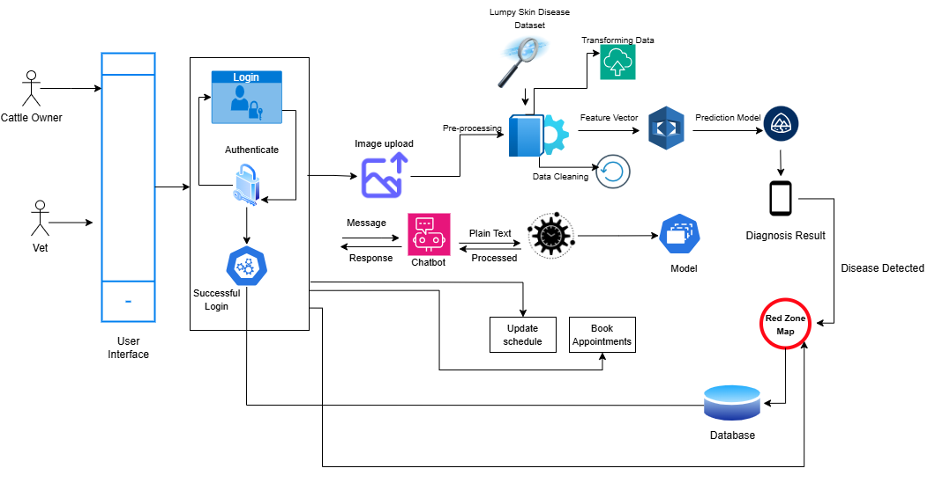
System Design
Architecture Diagram
V-DermX

Slide 13
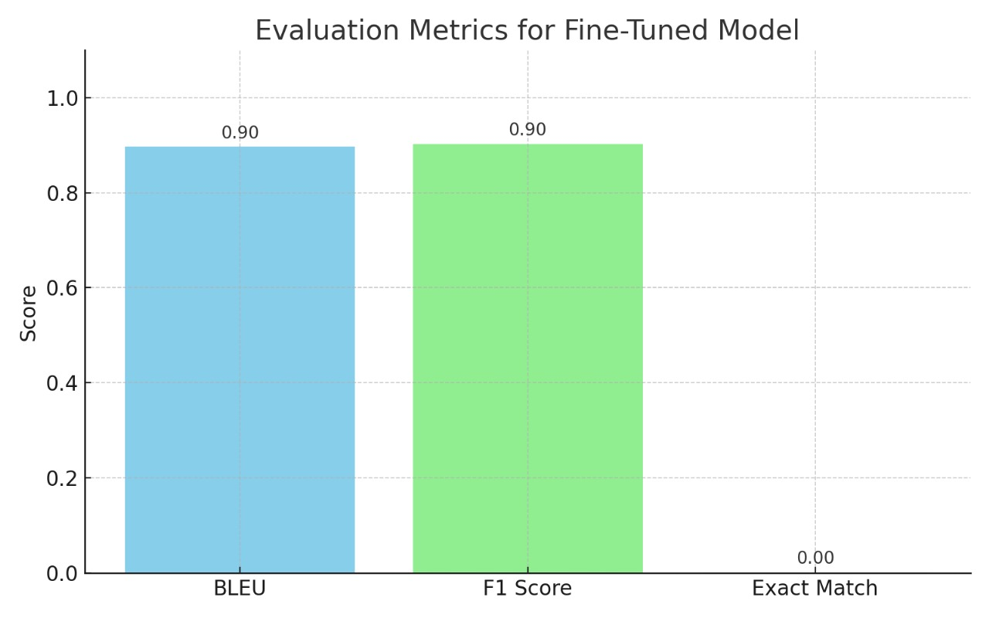
Fine-Tuned Model Evaluation
| Metric | Value | Interpretation |
| ---------------- | -------- | -------------------------------- |
|BLEU | 0.90 | High text similarity |
|F1 Score | 0.90 | Strong semantic match | |Exact Match | 0.0017 | Low due to paraphrasing|
V-DermX

Slide 14
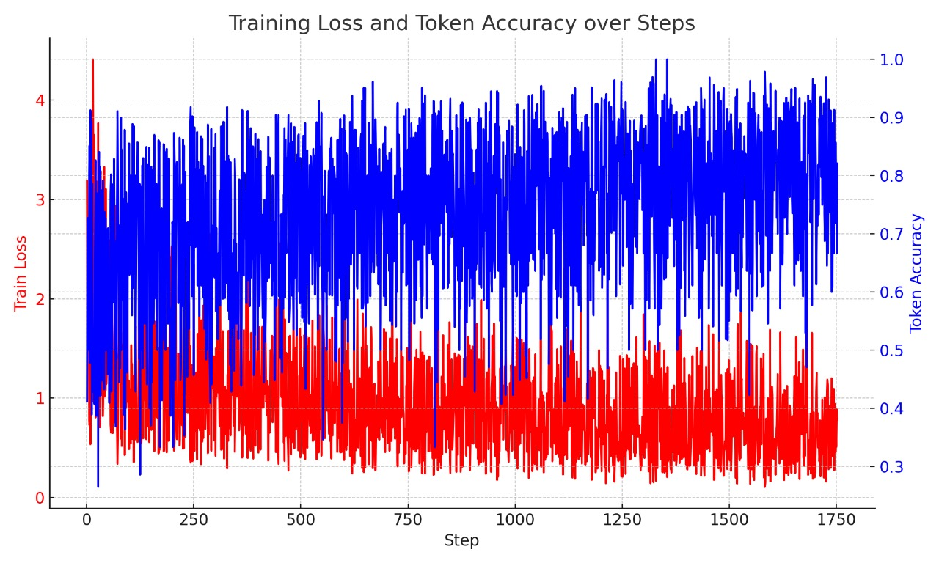
Model Training Behavior
V-DermX

Slide 15
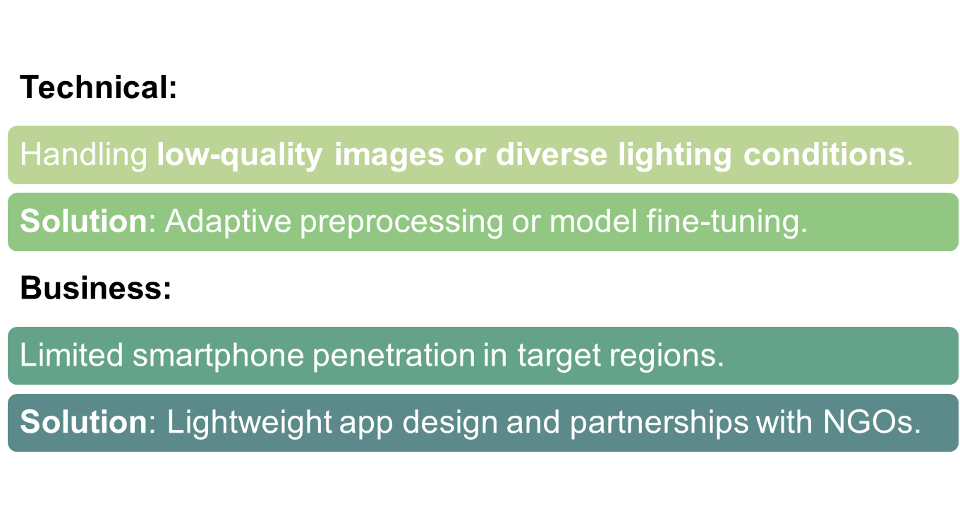
Technical and Business Challenges
V-DermX

Slide 16
Proposed Enhancements
Real-Time Data Feedback:
  Integrate a feedback loop mechanism where the system learns and adapts based on user inputs (e.g., vet confirmation or correction of a diagnosis).
  Enhance the chatbot’s capability to continuously update its database, improving its advice accuracy based on real-world data.
Multimodal Sensor Integration:
  Combine image data with Near-Infrared (NIR) or other sensory input to improve lesion detection accuracy, especially in challenging conditions like low lighting or ambiguous skin patterns.
  Develop a hybrid model using both visual data and sensor data, offering a more comprehensive analysis for better decision-making.
V-DermX

Slide 17
Comparative Study
1. Baseline Accuracy:
The Vet Derm-X system uses a baseline accuracy of approximately 90% for diagnosing lumpy skin disease (LSD) based on current diagnostic models and preliminary research.
Existing diagnostic tools face challenges in accuracy due to variability in skin lesions and the difficulty of capturing clear images under different environmental conditions (lighting, angles, etc.).
2. Goals for Enhanced Accuracy:
Enhance accuracy by leveraging AI models ( MobileNetV2) and continuously improving image data quality.
Integrate real-time data feedback for better training of models, improving the system’s ability to distinguish between similar-looking lesions and other skin conditions.
Minimize errors by incorporating advanced pre-processing techniques for image normalization, ensuring consistent results regardless of environmental and individual variations.
V-DermX

Slide 18
Sustainable Dev. Goals
SDG 3: Good Health and Well-being:
Enhances animal health by enabling early detection of lumpy skin disease, reducing disease spread and mortality.
Provides accessible and effective veterinary support, improving livestock well-being in rural areas.
SDG 9: Industry, Innovation, and Infrastructure:
Utilizes AI technologies like and MobileNetV2 for innovation in veterinary diagnostics.
Contributes to building veterinary tech infrastructure,integrating AI, chatbots, and mobile accessibility.
V-DermX

Slide 19
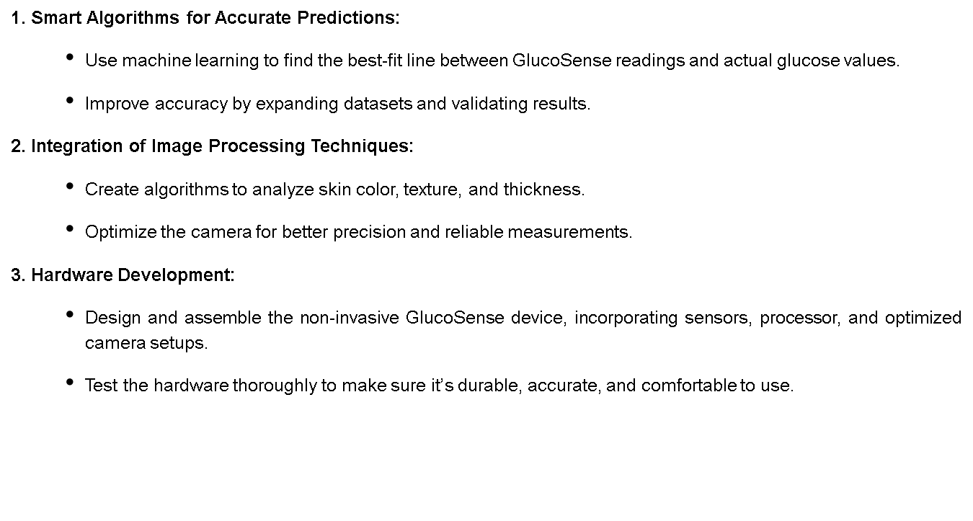
Future Plans
V-DermX

Slide 20
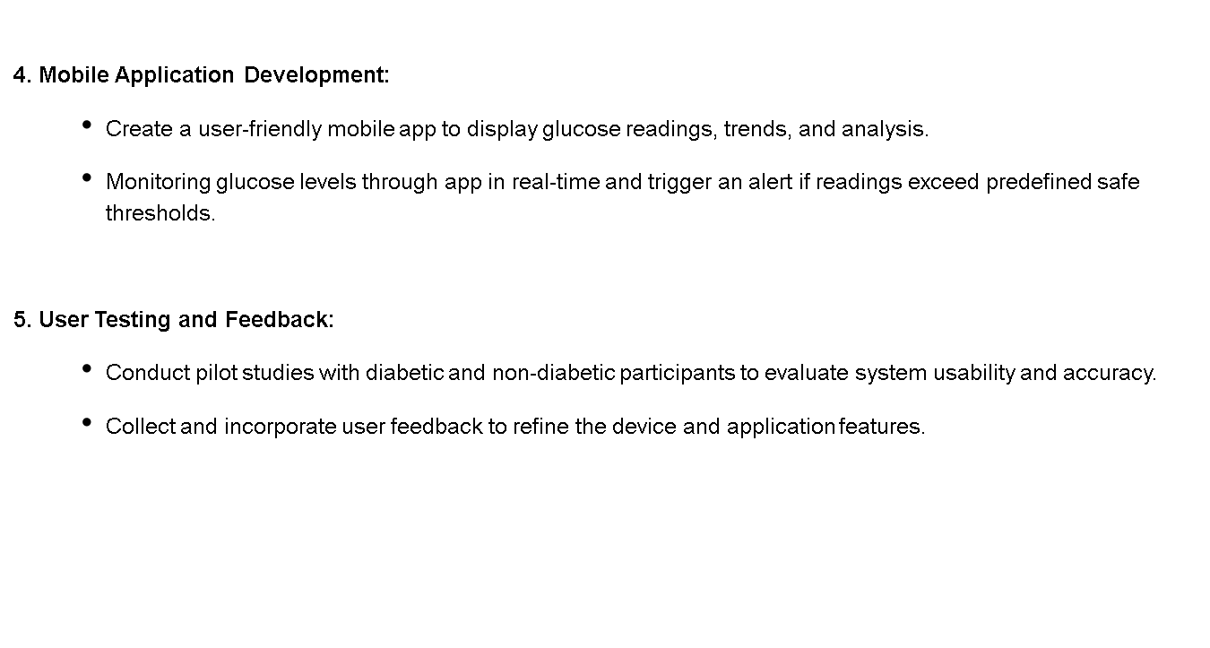
Future Plans (Cont’d)
V-DermX

Slide 21
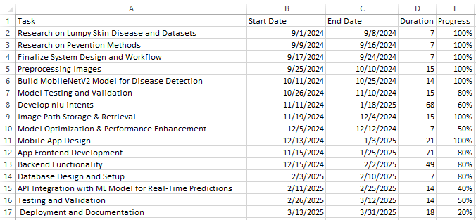
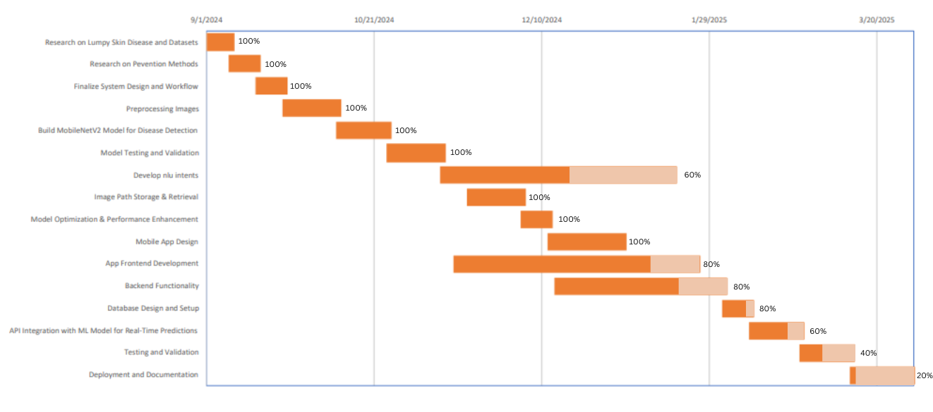
Gantt Chart
V-DermX

Slide 22
Q&A
Open the floor for questions from the audience
V-DermX

