Slide 1
V-DermX
Submitted by:
Alishba Javed Team Lead, Full Stack Developer
2021-CS-205
Maryam Siddique Backend , Design Developer
2021-CS-180
Muhammad Moaz Frontend , Documentation Developer
2021-CS-101
Fiza Azhar Full Stack, Documentation Developer
2021-CS-193
Supervisor:
Prof. Dr. Shoaib
Co-Supervisor:
Ms. Abqa Javeed
Department of Computer Science UET, LAHORE

Slide 2
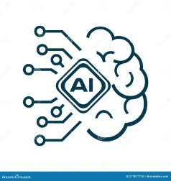
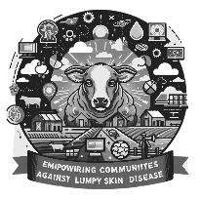

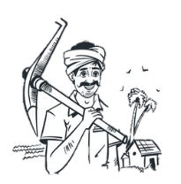
Introduction
Our mobile app combines a chatbot and an AI/DL model tailored for lumpy skin disease detection, offering timely prevention advice and medication guidance
Empowering local practitioners and leveraging technology to bridge gaps in livestock health while raising awareness and combating stigma
Integerate deep learning models InceptionV3 and MobileNetV2 to visually diagnose LSD, your system can help detect early signs of the disease, making treatment more effective and reducing the spread.
Our goal is to deliver quick, detection,
and easily accessible solutions to Farmers and livestock owners by developing V-DermX that save their animals lives.
V-DermX

Slide 3
Problem Statement
Problem Definition: This project aims to diagnose lumpy skin disease (LSD) in cattle using AI techniques like InceptionV3 and MobileNetV2. It develops an offline-capable mobile app for timely detection and diagnosis, along with a chatbot for veterinary consultations, targeting areas with limited veterinary access.
Significance: In rural areas, limited access to veterinary services delays diagnosis and worsens cattle health, leading to economic losses. This app enables early LSD detection, offering offline diagnosis and consultation to improve animal well-being and reduce losses.
V-DermX

Slide 4
Existing Solutions/Limitations
Symptom-based Input
Veterinary Referrals Only
No Visual Diagnosis
Limited Focus on Skin Diseases
Delayed Feedback
User-dependent Accuracy
V-DermX

Slide 5




Objectives
Develop a Deep learning model for image-based detection to enhance diagnostic accuracy and speed.
Provide step-by-step prevention guidance to facilitate effective disease management and intervention.
Create an offline-capable mobile app to ensure functionality in areas with limited internet access.
Build a user-friendly interface to ensure accessibility for pet owners with varying levels of expertise.
V-DermX

Slide 6
Literature Review:
Name | Author | Year | Dataset | Features | Model | Result | Pre-Processing
Prediction of Lumpy Skin Disease Using Machine Learning Techniques | Olatayo Olaniyan & Olusogo Julius Adetunji | 2023 | https://data.mendeley.com/datasets/7pyhbzb2n9/1 | Classification | Decision Tree, KNN, Random Forest, SV | 98.89% accuracy | FeatureWiz for feature selection
A deep learning approach optimized with RMSProp and MobileNetV2 | Sheikh M.Saqib M.Iqbal | 2024 | - | Deep learning, MobileNetV2, RMSProp optimization | MobileRMSNet (MobileNetV2, RMSProp) | 95% Accuracy | -
An extensive investigation of CNN designs for the diagnosis of lumpy skin disease in dairy cows | Dip Kumar Saha | 2024 | https://data.mendeley.com/datasets/w36hpf86j2/1 | Image Classification | DenseNet, MobileNetV2, Xception, InceptionResNetV2 | High Accuracy | Four CNN models, DenseNet, MobileNetV2, Xception, and InceptionResNetV2 were used to classify the framework
Lumpy skin disease diagnosis in cattle: A deep learning approach optimized with RMSProp and MobileNetV2 | Sheikh Muhammad Saqib, Iqbal M, Tahar Ben Othman M, Shahazad T, Yasin Ghadi Y, Al-Amro S. | 2024 |  | Image Classification | MobileNetV2 | 95% Accuracy | Image processing
V-DermX
Notes:
Visual deep learning model using InceptionV3 can achieve 92.7% accuracy in diagnosing diseases like Lumpy Skin Disease (LSD) through image classification and segmentation. This model allows cattle owners, especially in rural areas, to quickly and reliably identify diseased areas, enabling early intervention and reducing the spread of disease.A Deep Learning Approach to Detect Lumpy Skin Disease in Cows
Integrating chatbot systems with visual deep learning models enables cattle owners to report symptoms and receive immediate advice, like cleaning affected areas and seeking veterinary help. Chatbots collect key information on the animal’s condition, offering basic guidance while connecting farmers with professionals for accurate diagnostics. This AI-driven approach provides accessible support, empowering farmers with timely disease management and intervention.Chatbot usage intention analysis: Veterinary consultation

Slide 7
Literature Review:
Name | Author | Year | Concept
Review: Lumpy Skin Disease | Endalu Mulatu and Abdi Feyisa | 2018 | Medical
Lumpy Skin disease: Review of literature | K. A. Al-Salihi | 2014 | Medical
Lumpy Skin Disease | Hawsar Yasin Abdulqa , Heshu Sulaiman Rahman, Hiewa Othman Dyary1 and Hemn Hasan Othman | 2016 | Medical
Epidemic of lumpy skin disease in Pakistan | Govinda Khatri, Aneesh Rai, Aashish, Shahzaib, Saqlain Hyder, Priya, Mohammad Mehedi Hasan | 2023 | Medical
V-DermX
Notes:
Visual deep learning model using InceptionV3 can achieve 92.7% accuracy in diagnosing diseases like Lumpy Skin Disease (LSD) through image classification and segmentation. This model allows cattle owners, especially in rural areas, to quickly and reliably identify diseased areas, enabling early intervention and reducing the spread of disease.A Deep Learning Approach to Detect Lumpy Skin Disease in Cows
Integrating chatbot systems with visual deep learning models enables cattle owners to report symptoms and receive immediate advice, like cleaning affected areas and seeking veterinary help. Chatbots collect key information on the animal’s condition, offering basic guidance while connecting farmers with professionals for accurate diagnostics. This AI-driven approach provides accessible support, empowering farmers with timely disease management and intervention.Chatbot usage intention analysis: Veterinary consultation

Slide 8
Technologies, Frameworks & Tools
Machine Learning & Deep Learning:
  TensorFlow, Keras for model building and training.
  Techniques: Image recognition using CNNs.
Mobile App Development:
  React Native
Natural Language Processing (NLP) For chatbot:
  Entity recognition, intent classification, and query handling for answering user queries related to symptoms and disease.
Backend & APIs :
  Node js
Data Management:
  MongoDB for data storage and management.
Project Management:
  ClickUp for project management.
V-DermX

Slide 9
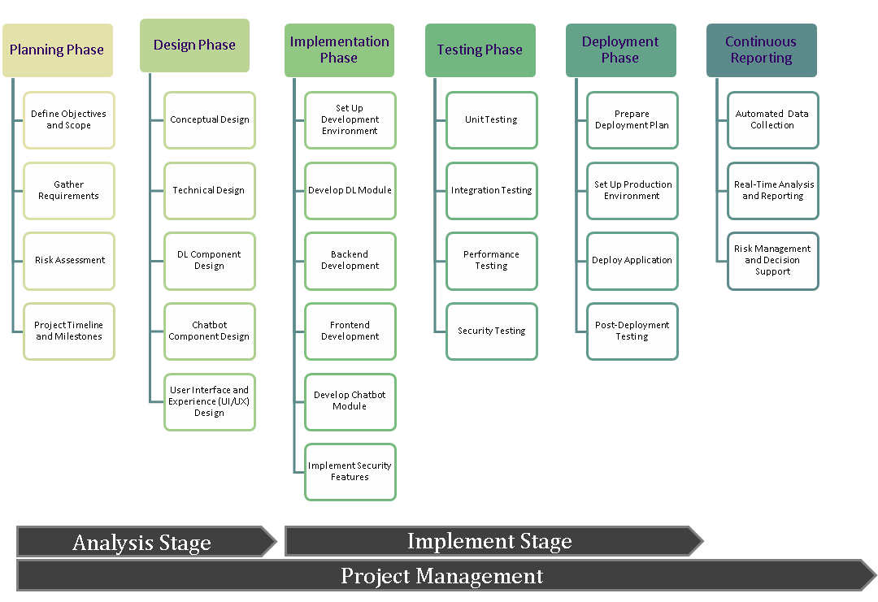
Proposed Solution/Methodology
V-DermX

Slide 10
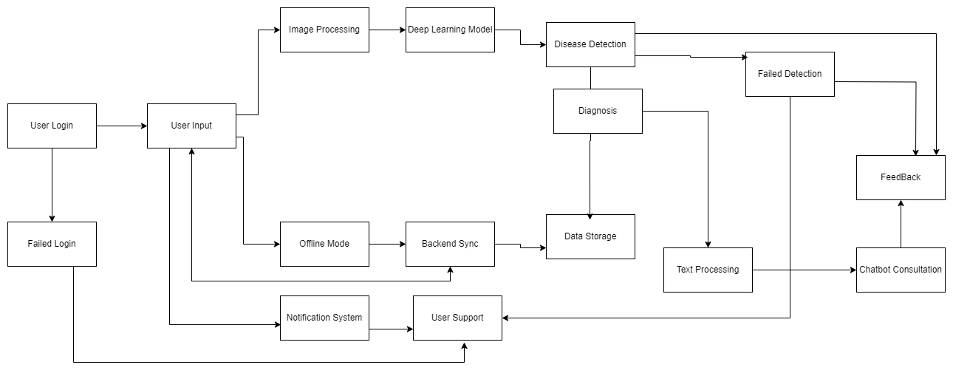
Workflow
V-DermX

Slide 11
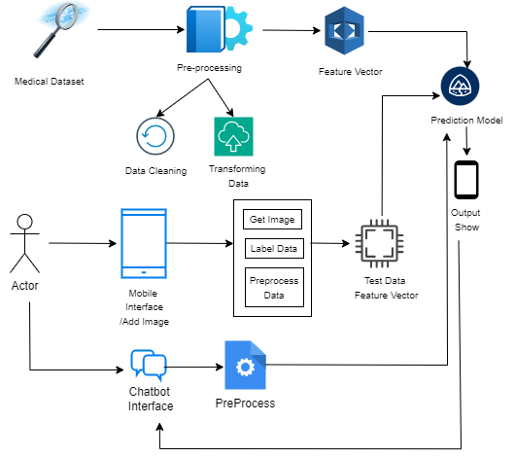
System Design
Architecture Diagram
V-DermX

Slide 12
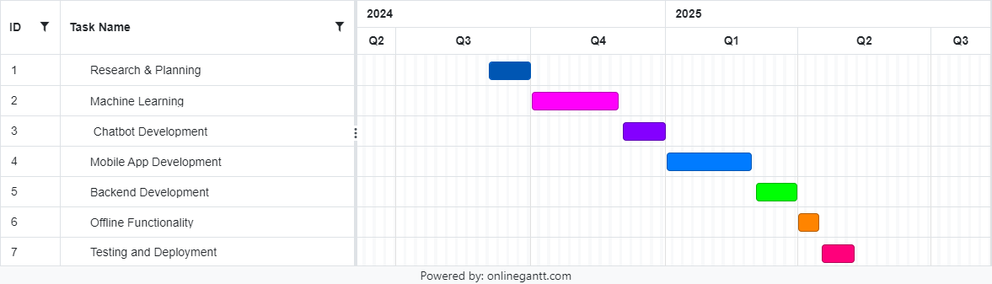
Implementation Plan
Gantt Chart
V-DermX

Slide 13
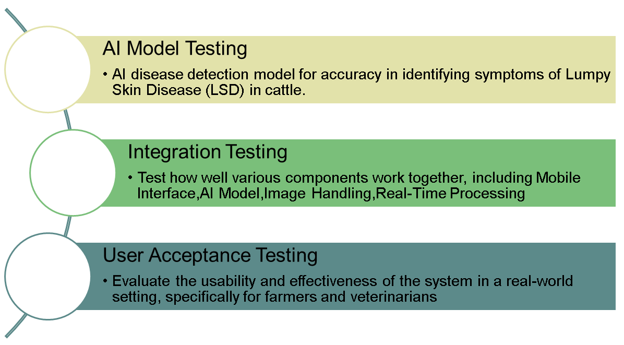
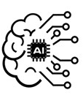


Testing and Evaluation
V-DermX

Slide 14
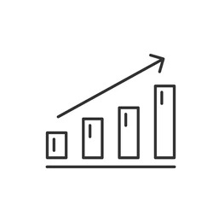

Expected Results
Anticiated Outcomes
  Accurate identification of lumpy skin disease in cattle using ML.
  Easy access to veterinary care for rural areas, reducing the need for physical consultations.
  A user-friendly mobile app for catttle owners to monitor and manage skin diseases.
Potential Impact
  Improved early disease detection and treatment, leading to healthier cattle.
  Increased accessibility to veterinary care in underserved areas.
  Reduction in veterinary service costs and travel time for pet owners.
  Contribution to public health by controlling disease outbreaks in animals.
V-DermX

Slide 15
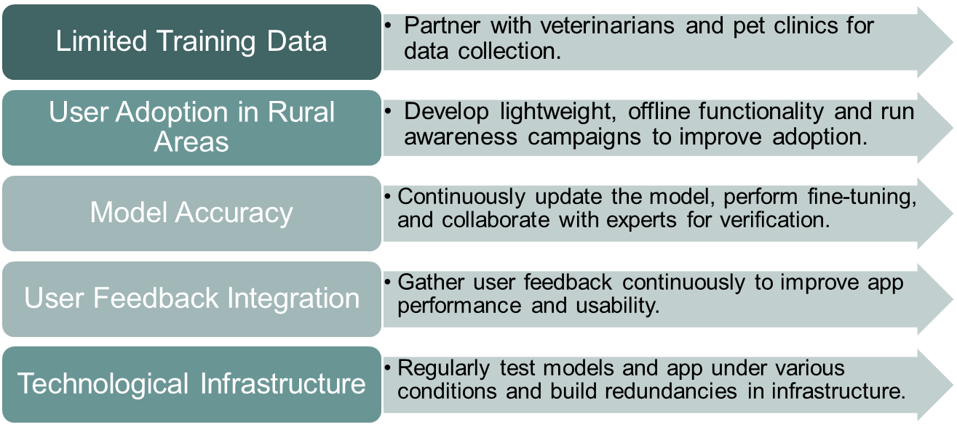
Challenges and Risks
V-DermX

Slide 16
Conclusion
Project Significance & Goals:
  Technologies Leveraged: Machine Learning (ML), Deep Learning.
  Challenges Addressed: Limitations of traditional veterinary services, particularly in rural areas with limited access to specialized care.
  Key Features for Disease Management: Accurate identification, verification, and treatment recommendations.
  Project Objective: To enhance animal welfare and support farmers by providing timely and reliable solutions.
Next Steps
  User Testing: Gather Feedback
  Refinement: Improve Accuracy
  Deployment: Launch & Training
  Support: Ongoing Maintenance
  Expansion: More Diseases, Other Pets
V-DermX

Slide 17
References
https://www.ncbi.nlm.nih.gov/pmc/articles/PMC7364393/
https://www.ncbi.nlm.nih.gov/pmc/articles/PMC7358693/
https://ada.com/
https://emed.com/uk
Dr. Jagreet Kaur Gill (2024, July 2024). Generative AI in Healthcare System and its Uses. Retrieved From
https://www.xenonstack.com/blog/generative-ai-healthcare-system
Etana Fikadu Dinsa (2024, May 16). AI-based disease category prediction model using symptoms from low-resource. Retrieved from
https://www.nature.com/articles/s41598-024-62278-7
V-DermX

Slide 18
Q&A
Open the floor for questions from the audience
V-DermX

