Slide 1
G-32 ANIMAL DISEASE DETECTION SYSTEM
LUMPY SKIN DISEASE DETECTION & PREVENTION
Submitted by:
Alishba Javed 2021-CS-205 Team Lead, Full Stack Developer
Maryam Siddique 2021-CS-180 Backend, Design Developer
Muhammad Moaz 2021-CS-101 Frontend, Documentation Developer
Fiza Azhar 2021-CS-193 Frontend, Documentation Developer
Supervisor:
Prof. Dr. Shoaib
Co-Supervisor:
Mam Abqa
Notes:
Alishba lead, full
maaz, documentation, frontend
Fiza frontend, documentation
Maryam backend, design

Slide 2
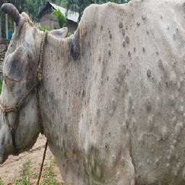
INTRODUCTION
Lumpy Skin Disease (LSD) is a viral infection mainly affecting cattle, transmitted through vectors like mosquitoes and direct contact.
Skin nodules, fever, swollen lymph nodes, and respiratory issues are common signs in infected animals.
LSD leads to economic losses with up to 1-5% mortality rates, reduced milk production, and infertility in cattle.
Motivation:
There is a significant need for accessible veterinary support, particularly in rural areas, to improve animal welfare and prevent suffering.
Relevance to Computer Science:
  Machine Learning for Disease Detection
  Deep Learning for Classification
  Mobile Application Development
  Data Management and Security
  AI-Driven Decision Support
Notes:
-Impact of lumpy skin disease on cattles
Transmission through vectors?
Symptoms
Finalize project name

Slide 3
PROBLEM STATEMENT
The aim of this work is to diagnose lumpy skin disease in animals using advanced AI techniques and develop a mobile application for accurate, timely diagnosis, helping to reduce diagnostic delays and minimize losses.
Why this problem is significant:
Cattle face significant health risks, particularly in areas with limited veterinary access, leading to delays in diagnosis and treatment. This can result in worsened conditions, increased economic impact, and strain on already overburdened clinics. Addressing these challenges is essential for ensuring animal well-being and preventing unnecessary suffering.
Notes:
Lumpy Skin Disease (LSD) in Pets: A growing issue in rural and underserved areas with limited veterinary resources.
Misdiagnosis and Delayed Treatment: Existing methods depend on subjective symptom descriptions from pet owners, leading to potential inaccuracies.
Lack of Immediate Diagnosis: Current pet care apps do not offer visual-based diagnostic tools, leading to delays in identifying and treating skin diseases.
Veterinary Service Accessibility: Rural areas often face overcrowded veterinary clinics, long wait times, and a shortage of qualified professionals.
High Cost of Veterinary Care: Traditional vet services can be expensive, especially for frequent visits due to skin diseases.
Need for Efficient Skin Disease Detection: A lack of tools that provide immediate diagnosis and actionable treatment recommendations for skin-related conditions in pets.
Health risks for pets: Lumpy skin disease and other skin conditions pose significant threats to pets, leading to discomfort, infections, and potentially severe health issues.
Limited veterinary access: Many rural areas lack sufficient veterinary services, making it difficult for pet owners to seek timely care for their pets.
Delays in diagnosis: Early detection of skin diseases is crucial to prevent complications, but current systems often fail to provide quick and accurate diagnoses.
Economic impact: Veterinary visits can be costly, especially for low-income families or those in rural areas, leading to untreated conditions in pets.
Overburdened clinics: Veterinary clinics, especially in underserved areas, are often overcrowded, leading to long waiting times and delayed care.
Animal well-being: Untreated diseases affect both the pet's health and the owner's emotional well-being, as pets are often considered part of the family.

Slide 4
PROBLEM STATEMENT
Limitation of Existing Solutions:
Veterinary Referrals Only
Symptom-based Input
Limited Focus on Skin Diseases
No Visual Diagnosis
User-dependent Accuracy
Delayed Feedback
VETDERMX
Notes:
Symptom-based input: Existing solutions like Joii Petcare and Pawp rely on the pet owner's ability to describe symptoms, which can be inaccurate or misinterpreted.
No visual diagnosis: These platforms lack image-based diagnosis, which is crucial for identifying skin diseases that require visual analysis.
Delayed feedback: The process of entering symptoms and waiting for a diagnosis recommendation can take time, delaying immediate treatment.
Veterinary referrals only: Current apps often recommend seeing a vet without offering actionable treatment advice or self-care options.
Limited focus on skin diseases: Available solutions provide general pet care advice but do not specialize in diagnosing or treating skin diseases.
User-dependent accuracy: Diagnosis in existing apps depends heavily on the pet owner's medical knowledge and ability to describe symptoms, which may lead to variability in the accuracy of recommendations.

Slide 5




PROBLEM STATEMENT
Research and Application Gaps:
Limited research on animal skin diseases
Available solutions provide general pet care advice but do not specialize in diagnosing or treating skin diseases.
Insufficient integration of AI in veterinary diagnostics
Existing solutions like Joii Petcare and Pawp rely on the pet owner's ability to describe symptoms, which can be inaccurate or misinterpreted.
Existing apps lack real-time and offline functionality
An offline-capable app ensures timely diagnosis and treatment of animals in areas with poor internet access, preventing disease progression even without connectivity.
No app focus on detecting animal skin conditions visually
These platforms lack image-based diagnosis, which is crucial for identifying skin diseases that require visual analysis.
VETDERMX
Notes:
Symptom-based input: Existing solutions like Joii Petcare and Pawp rely on the pet owner's ability to describe symptoms, which can be inaccurate or misinterpreted.
No visual diagnosis: These platforms lack image-based diagnosis, which is crucial for identifying skin diseases that require visual analysis.
Delayed feedback: The process of entering symptoms and waiting for a diagnosis recommendation can take time, delaying immediate treatment.
Veterinary referrals only: Current apps often recommend seeing a vet without offering actionable treatment advice or self-care options.
Limited focus on skin diseases: Available solutions provide general pet care advice but do not specialize in diagnosing or treating skin diseases.
User-dependent accuracy: Diagnosis in existing apps depends heavily on the pet owner's medical knowledge and ability to describe symptoms, which may lead to variability in the accuracy of recommendations.

Slide 6




Goals & Objectives
Main goals of your project
Develop a machine learning model for image-based detection to enhance diagnostic accuracy and speed.
Provide step-by-step prevention guidance to facilitate effective disease management and intervention.
Create an offline-capable mobile app to ensure functionality in areas with limited internet access.
Build a user-friendly interface to ensure accessibility for pet owners with varying levels of expertise.
LUMPY SKIN DISEASE DETECTION & PREVENTION
Notes:
Goals:
Early and accurate detection of skin diseases in pets, focusing on lumpy skin disease in dogs.
Provide accessible and affordable veterinary care solutions for pet owners, especially in rural areas.
Empower pet owners with timely, actionable treatment recommendations without needing direct access to veterinary services.
Objectives:
Develop a machine learning model for accurate image-based detection of lumpy skin disease.
Integrate NLP-based diagnostic tools to understand user queries and pet symptoms.
Create an offline-capable mobile app to allow users in remote areas to access diagnosis and treatment suggestions.
Provide clear, step-by-step treatment guidance for detected skin conditions.
Build a user-friendly interface for pet owners with limited technical knowledge.

Slide 7
TECHNOLOGIES, FRAMEWORKS & TOOLS
Machine Learning & Deep Learning:
  TensorFlow, Keras for model building and training.
  Techniques: Image recognition using CNNs.
Mobile App Development:
  React Native
Backend & APIs:
  Node.js
Data Management:
  MongoDB for data storage and management.
Project Management:
  ClickUp for project management.
Communication:
  Slack for team communication.
Notes:
2 slides maximum
Technologies, tools, or frameworks you will use
Workflow or architecture diagram

Slide 8
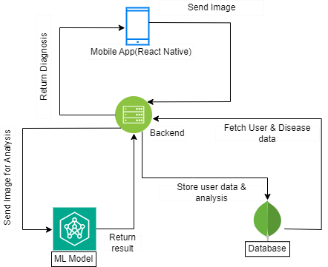
SYSTEM DESIGN
Notes:
High-level system architecture
Key components and their interactions
Data flow diagrams or UML diagrams

Slide 9
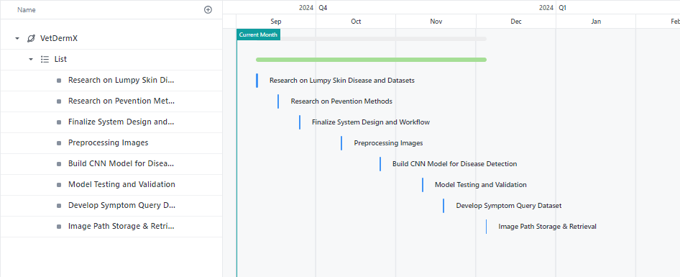
IMPLEMENTATION PLAN
Clickup Link: Clickup Project Management
Notes:
1 slide maximum
Step-by-step breakdown of how you will implement the project
Timeline or Gantt chart showing key milestones

Slide 10
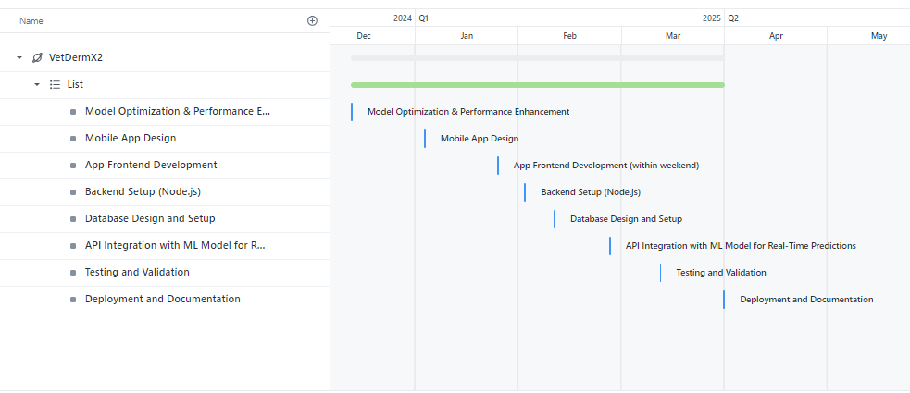
IMPLEMENTATION PLAN
Clickup Link: Clickup Project Management
Notes:
1 slide maximum
Step-by-step breakdown of how you will implement the project
Timeline or Gantt chart showing key milestones

Slide 11
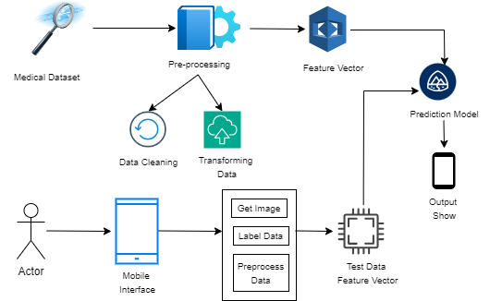
ARCHITECTURAL DIAGRAM
Notes:
2 slides maximum
Technologies, tools, or frameworks you will use
Workflow or architecture diagram

Slide 12
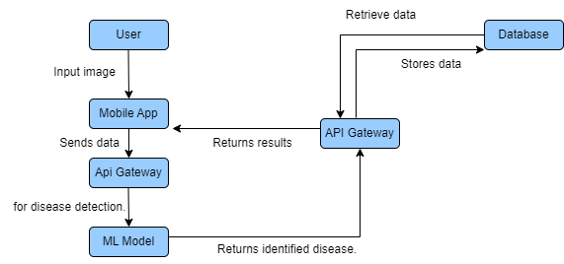
UML DIAGRAM
Notes:
2 slides maximum
Technologies, tools, or frameworks you will use
Workflow or architecture diagram

Slide 13
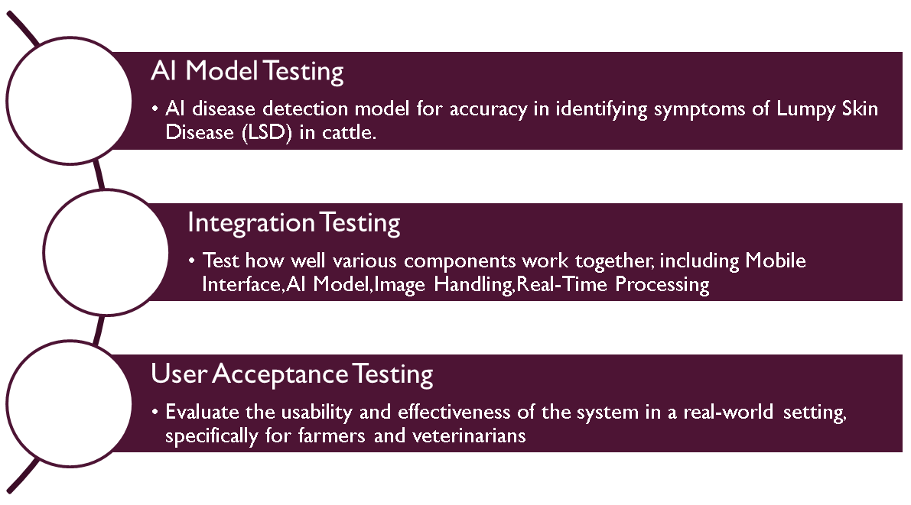
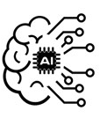


TESTING AND EVALUATION
Testing Methods:
Notes:
Testing methods:
1. Unit testing: Test individual components such as ML model, and API Gateway.
2. Integration testing: Verify interactions between mobile app, backend, and database.
3. End-to-end testing: Simulate real-world user inputs, from image upload to disease detection and treatment suggestions.
4. Performance testing: Ensure the system can handle high load and maintain acceptable response time.
5. User acceptance testing (UAT): Gather feedback from users to confirm the app meets their needs.
Success metrics:
1. Accuracy of disease detection: Target 90%+ accuracy in the ML model.
2. Response time: Ensure responses from the API and ML model are under 2 seconds.
3. User satisfaction: Aim for a 4+ star rating in app reviews.
4. Data retention and storage: Ensure correct storage of disease and user data in the database.
5. Adoption rate: Track the number of active users within 6 months after launch.

Slide 14



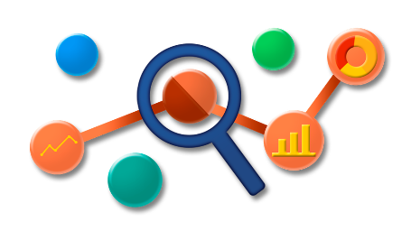
TESTING AND EVALUATION
Success Metrics:
Accuracy:
Target 90%+ accuracy in the ML model.
Data retention and storage:
Ensure correct storage of disease and user data in the database.
Response time:
Ensure responses from the API and ML model are under 2 seconds.
Adoption rate:
Track the number of active users within 6 months after launch.
User satisfaction:
Aim for a 4+ star rating in app reviews.
Notes:
Testing methods:
1. Unit testing: Test individual components such as ML model, and API Gateway.
2. Integration testing: Verify interactions between mobile app, backend, and database.
3. End-to-end testing: Simulate real-world user inputs, from image upload to disease detection and treatment suggestions.
4. Performance testing: Ensure the system can handle high load and maintain acceptable response time.
5. User acceptance testing (UAT): Gather feedback from users to confirm the app meets their needs.
Success metrics:
1. Accuracy of disease detection: Target 90%+ accuracy in the ML model.
2. Response time: Ensure responses from the API and ML model are under 2 seconds.
3. User satisfaction: Aim for a 4+ star rating in app reviews.
4. Data retention and storage: Ensure correct storage of disease and user data in the database.
5. Adoption rate: Track the number of active users within 6 months after launch.

Slide 15


EXPECTED RESULTS
Anticipated outcomes:
  Accurate identification of lumpy skin disease in cattle using ML.
  Easy access to veterinary care for rural areas, reducing the need for physical consultations.
  A user-friendly mobile app for catttle owners to monitor and manage skin diseases.
Potential impact:
  Improved early disease detection and treatment, leading to healthier cattle.
  Increased accessibility to veterinary care in underserved areas.
  Reduction in veterinary service costs and travel time for pet owners.
  Contribution to public health by controlling disease outbreaks in animals.

Slide 16
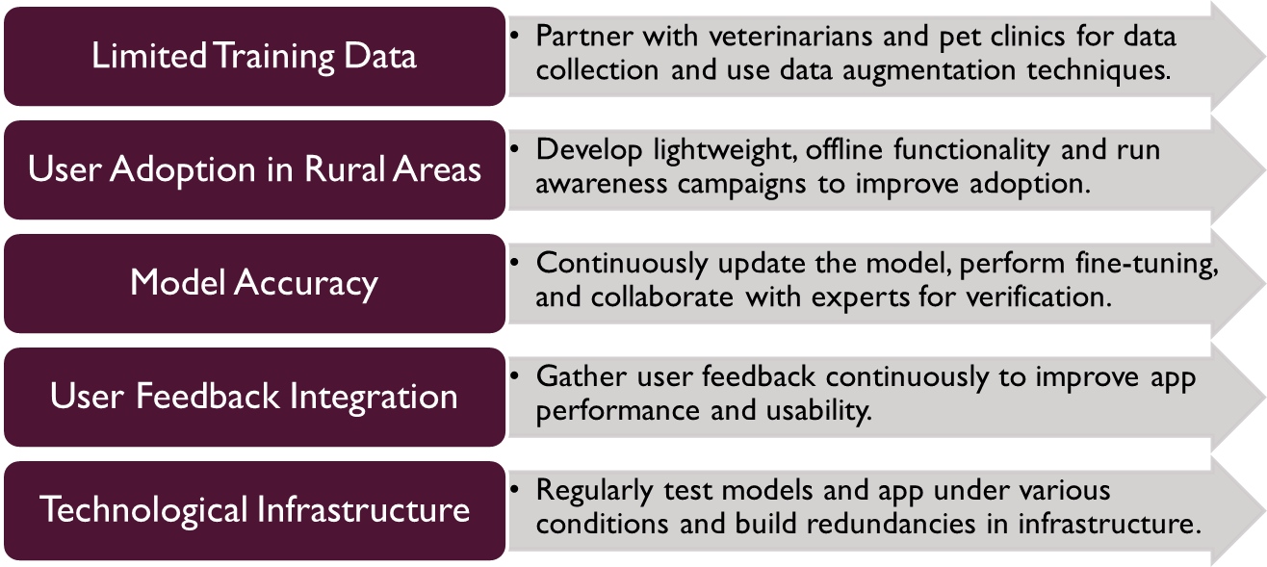
CHALLENGES AND SOLUTIONS
Notes:
Possible Obstacles & Solutions:
Limited Training Data: Difficulty obtaining high-quality, diverse datasets for ML model.
Solution: Partner with veterinarians and pet clinics for data collection, and use data augmentation techniques.
Model Accuracy: ML model may misclassify diseases.
Solution: Continuous model updates, fine-tuning, and collaboration with experts for verification.
User Adoption: Pet owners in rural areas may lack access to smartphones or internet.
Solution: Develop lightweight, offline functionality and create awareness campaigns.
Risk Management Strategies:
Regularly test models and app under various conditions.
Backup data and build redundancies in infrastructure.
Gather user feedback for continuous improvement.

Slide 17
CONCLUSION
Project Significance & Goals:
  Technologies Leveraged: Machine Learning (ML), Deep Learning.
  Challenges Addressed: Limitations of traditional veterinary services, particularly in rural areas with limited access to specialized care.
  Key Features for Disease Management: Accurate identification, verification, and treatment recommendations.
  Project Objective: To enhance animal welfare and support farmers by providing timely and reliable solutions.
Next Steps
  User Testing: Gather Feedback
  Refinement: Improve Accuracy
  Deployment: Launch & Training
  Support: Ongoing Maintenance
  Expansion: More Diseases, Other Pets
Notes:
Recap of the Project’s Significance and Goals:
The "HAPPY PET" mobile application aims to revolutionize veterinary care by leveraging advanced technologies such as machine learning, deep learning, and natural language processing to detect and prevent skin diseases in pets. Specifically targeting lumpy skin disease in dogs, the app provides accurate disease identification, verification, and treatment recommendations. It addresses the challenges faced by traditional veterinary services, especially in rural areas, by offering a reliable, accessible, and user-friendly solution for pet owners and veterinarians.
Next Steps After Project Completion:
User Testing and Feedback: Conduct comprehensive user testing to gather feedback on app performance, usability, and effectiveness in real-world scenarios.
Refinement and Updates: Incorporate feedback to refine features, enhance the app’s accuracy, and improve user experience.
Deployment and Training: Launch the app and provide training resources for users to maximize its potential.
Ongoing Support and Maintenance: Establish a support system for troubleshooting and regular maintenance to ensure the app remains up-to-date with evolving technologies and user needs.
Expansion: Explore opportunities to extend the app’s capabilities to include additional diseases and conditions or to expand its use to other types of pets.

Slide 18
REFERENCES
Risk factors, logistic model, and vulnerability mapping of lumpy skin disease in livestock at the farm level in Indragiri Hulu District, Riau Province, Indonesia, in 2022
Lumpy skin disease: A newly emerging disease in Southeast Asia
To Identify Animal Skin Disease
https://veterinaryworld.org/
https://wvj.science-line.com/aims-and-scope.html
https://pawp.com/
https://www.joiipetcare.com/app/
LUMPY SKIN DISEASE DETECTION & PREVENTION

Slide 19
Q&A
Any Questions?
LUMPY SKIN DISEASE DETECTION & PREVENTION

