Slide 1
AMAZON RDS

Slide 2
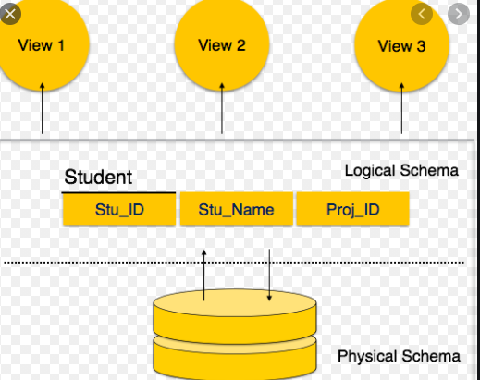
RDS
What is RDS:
Amazon Relational Database Service (Amazon RDS) makes it easy to set up, operate, and scale a relational database in the cloud. It provides cost-efficient and resizable capacity while automating time-consuming administration tasks such as hardware provisioning, database setup, patching and backups.
-Structured and Schema based storage
-Physical & Logical Schema (tables, views, integrity constraints)

Slide 3
RDS
Key Concepts:
Master Replica and Cross-Region Replica
Snapshots
Clustering – Read / Write
Clone
Restore from s3
Reserved instances

Slide 4
RDS
Pre-Defined DBS:
MySQL
PostgreSQL
SQL Server
ORACLE
AMAZON AURORA
MariaDB

Slide 5
RDS
Key Benefits:
Lower administrative burden. Easy to use.
Performance. General Purpose (SSD) Storage.
Scalability. Push-button compute scaling.
Availability and durability. Automated backups.
Security. Encryption at rest and in transit.
Manageability. Monitoring and metrics.
Cost-effectiveness. Pay only for what you use.

Slide 6
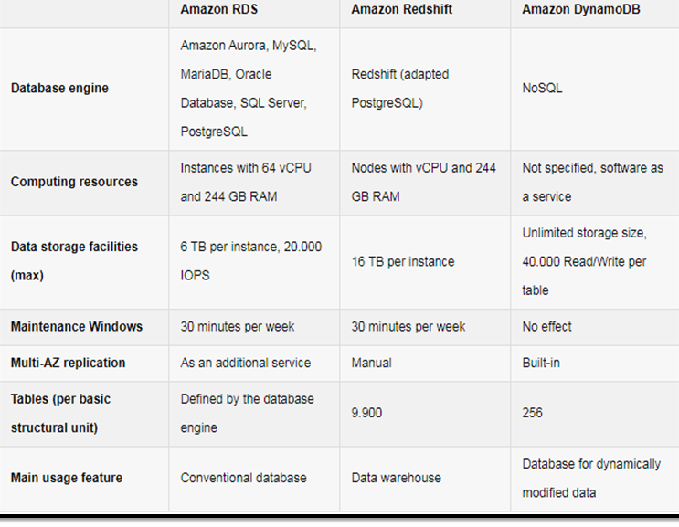
DIFFRENCES BETWEEN DB’S
Types of Databases:
Structured
Unstructured
Semi-Structured

Slide 7
RDS
THANKS

