Slide 1
Welcome
Automated Testing of JPetStore Application
By Ramiz Mostafi

Slide 2
Introduction
JPetStore is a sample e-commerce web application for online pet shopping
User can login by entering username and password.
User Can select pet from pet category and for a particular pet there are multiple types of pet.
User can add product(pet) in cart.
User can fill details of payment address and checkout.

Slide 3
Project Details
1.Implent data driven testing and parallel execution using TestNg
Use POM design principle
3.Need to generate Custom Result Reporting
4.trigger the test from Jenkins
Scenarios:
Navigate to webpage
Login
Click Pet category
Select Product
Add to cart
Checkout
Confirm order
Verify the confirmation message

Slide 4
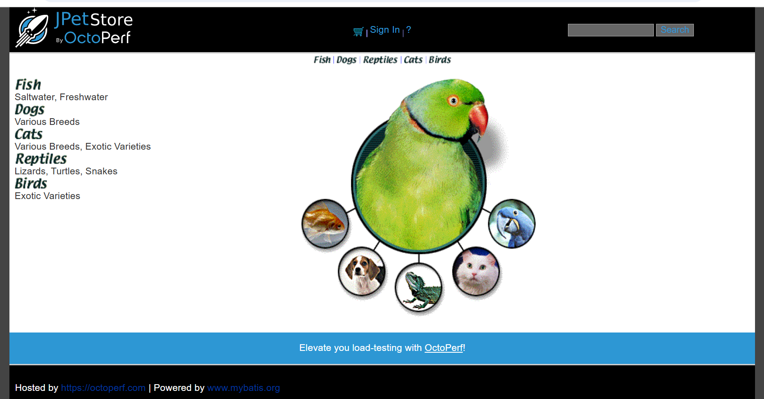

Slide 5
Technologies & Tools Used
Programming Language: Java
Automation: Selenium WebDriver
Test Framework: TestNG
Build Tool: Maven
Reporting: ExtentReports
CI/CD: Jenkins
Data Handling: Excel File
IDE: Eclipse

Slide 6
Page Object Model
The Page Object Model (POM) is a design pattern used in Selenium test automation.
It creates a separate Java class for each web page of the application.
Each class contains locators and methods to interact with page elements.
Test scripts use these page classes to perform actions and assertions.

Slide 7
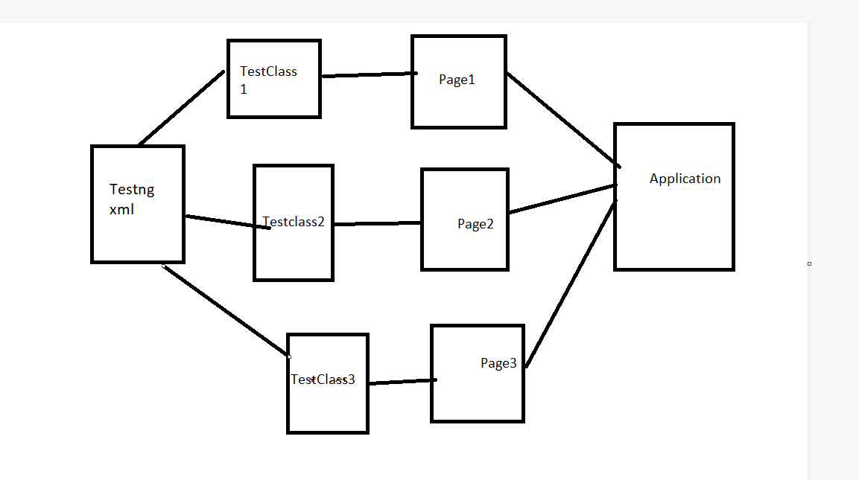
POM Architecture

Slide 8
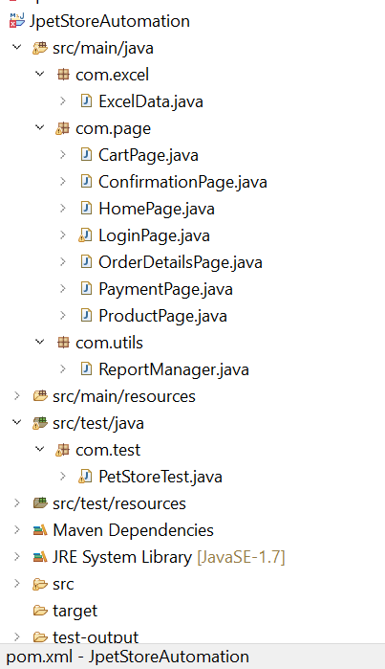
Project Structure
For Data Driven Testing
Page Object Class
For extent Report
Test Class

Slide 9
Maven Project Setup
Created Maven project in Eclipse.-
Managed dependencies in `pom.xml` (Selenium, TestNG, POI, ExtentReports).
Benefits: Easy dependency management, build lifecycle, plugin support.

Slide 10
Selenium WebDriver
Automates browser actions (Chrome, Edge).
Interacts with web elements using locators (id, name, xpath,linkText)
Perform action on webelement

Slide 11
TestNG Framework
Organizes tests using annotations: @BeforeSuite, @BeforeTest, @Test, @AfterTest, @AfterSuite
@DataProvider for multiple test data sets.
Enables assertions for validation.

Slide 12
Data-Driven Testing with Excel
Used Apache POI to read user credentials from Excel.
Implemented TestNG DataProvider for parameterized tests.
Allows easy scaling and management of test data.

Slide 13
Cross Browser
For cross browser Chrome and Edge browser have been used

Slide 14
Extent Reports Integration
Logs Created a custom ReportManager class for ExtentReports.
step-wise test status (pass/fail).
Generates interactive HTML reports for stakeholders.

Slide 15
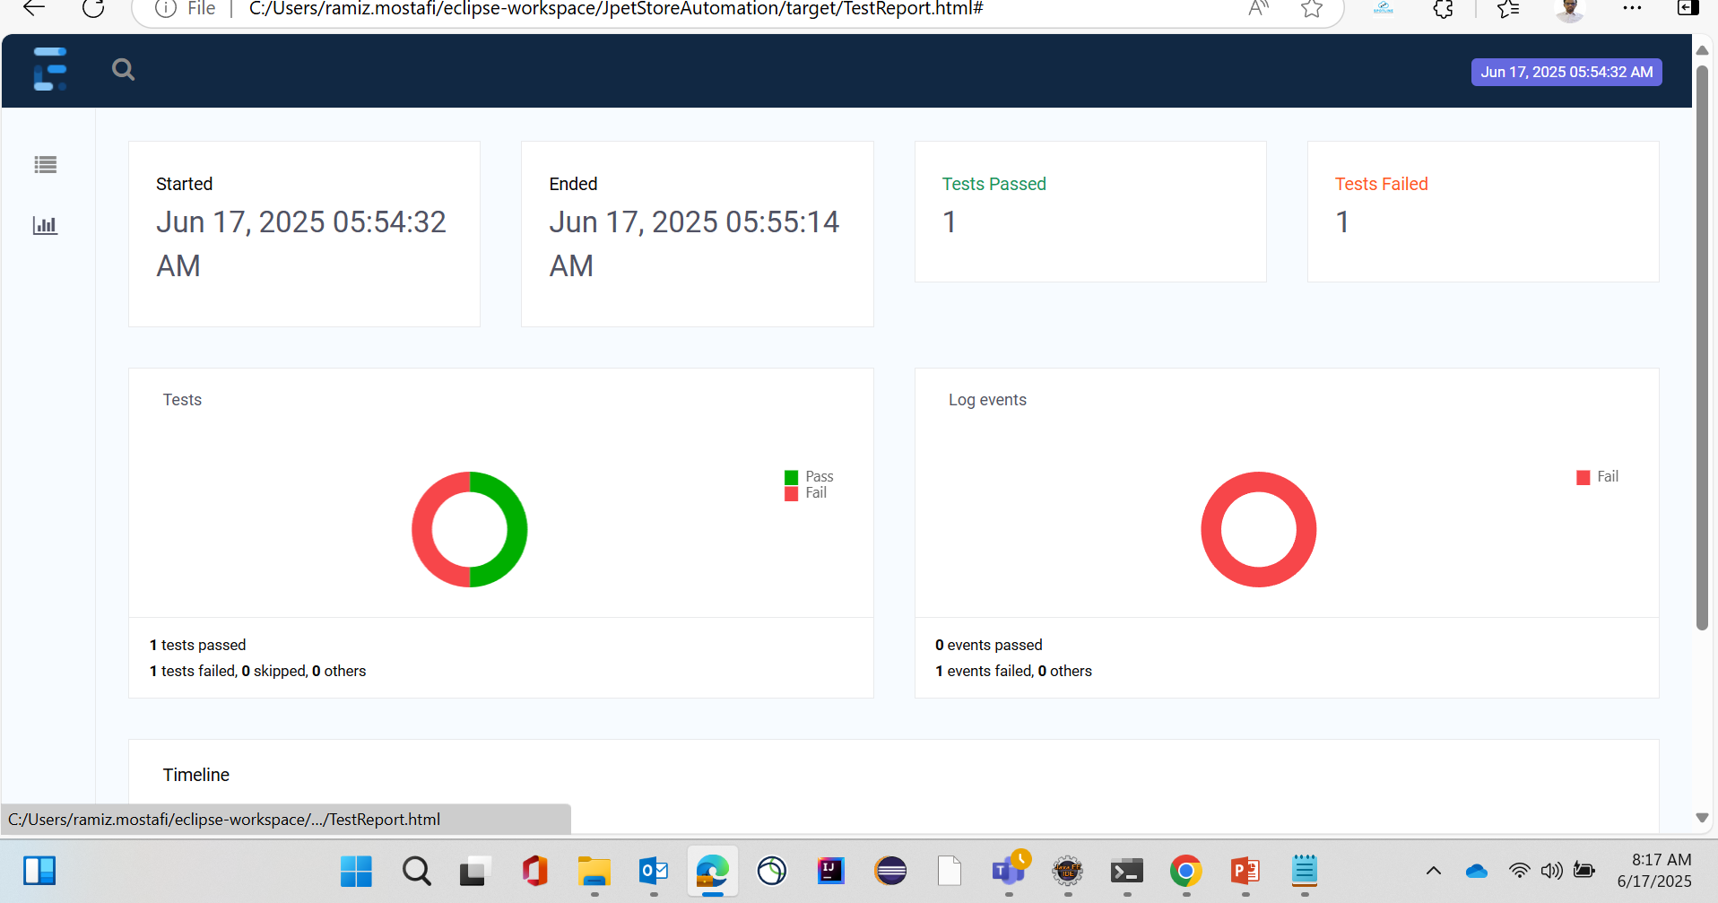
Extent Report

Slide 16
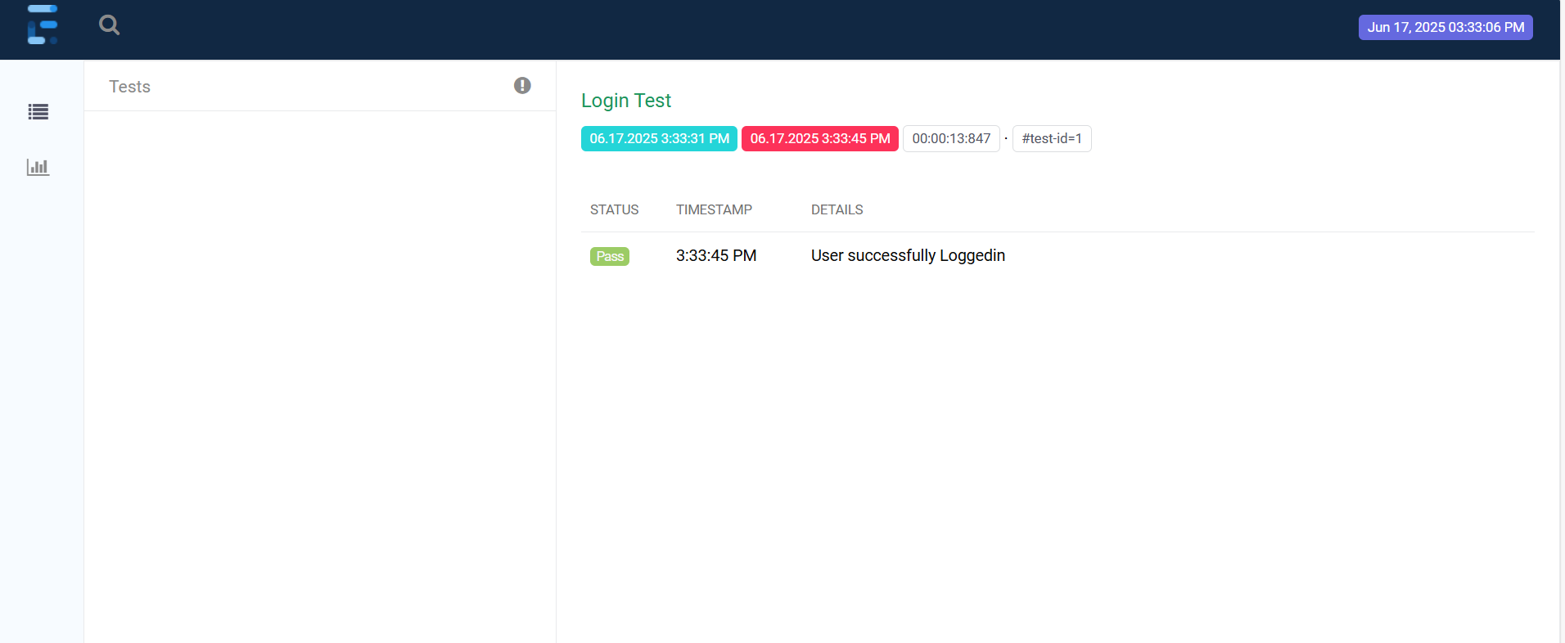
Extent Report

Slide 17
Jenkins Build Pipeline
Configured build steps:
Pull code from SCM
Run Maven goals: clean test
Automated test execution and reporting.
Monitored build and test status through Jenkins dashboard.

Slide 18
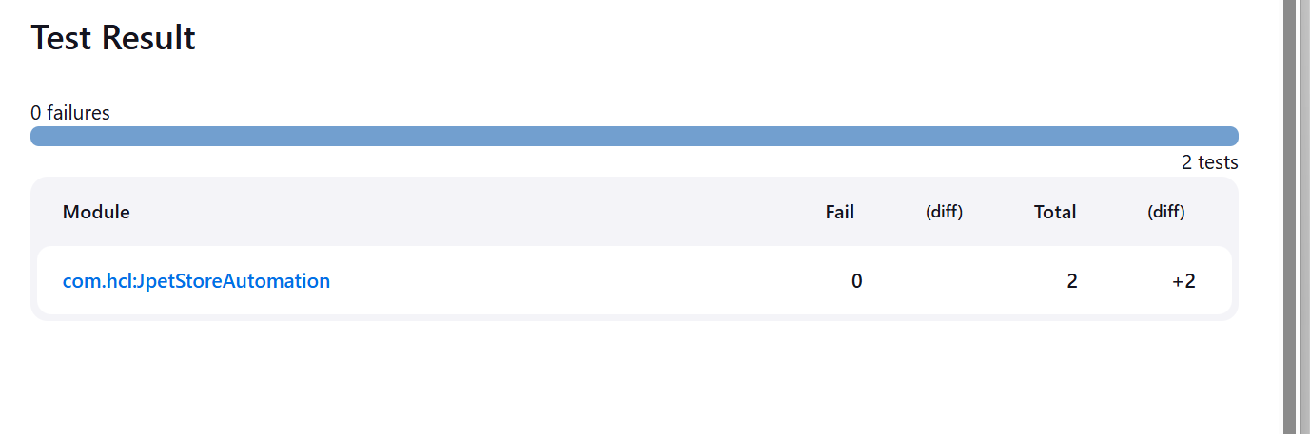
Jenkins Result

Slide 19
Thank You.

