Slide 1

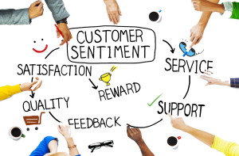
sentiment Analysis
Dr Suresh Chandra Ch

Slide 2
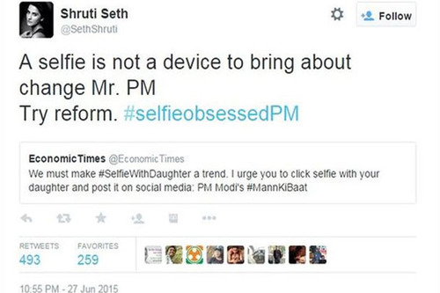
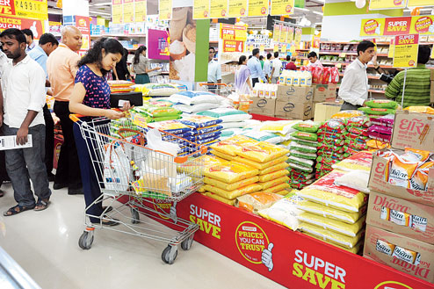

What is a Sentiment?
How can we analyze sentiments?
Dr Suresh Chandra Ch

Slide 3
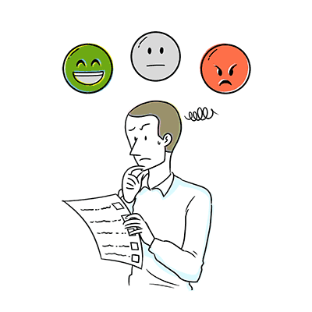
A Sentiment may be a feeling and it is based on of attitude, emotion or a opinion on a person/object/situation
Sentiment is a subjective impression.
The study of sentiments helps to analyze the companies to crack:
Why aren’t customers buying our product/service
What is lacking in customer prefernece
Analyze the subjective data
Perceptions, misperceptions and analysis of tweets/comments
Dr Suresh Chandra Ch

Slide 4

Sentiment Analysis defined…
Sentiment Analysis is the process of analyzing the subjectivity/objectivity of a statement or a comment or a response.
It’s also known as opinion mining, deriving the opinion or attitude of a speaker.
Dr Suresh Chandra Ch

Slide 5
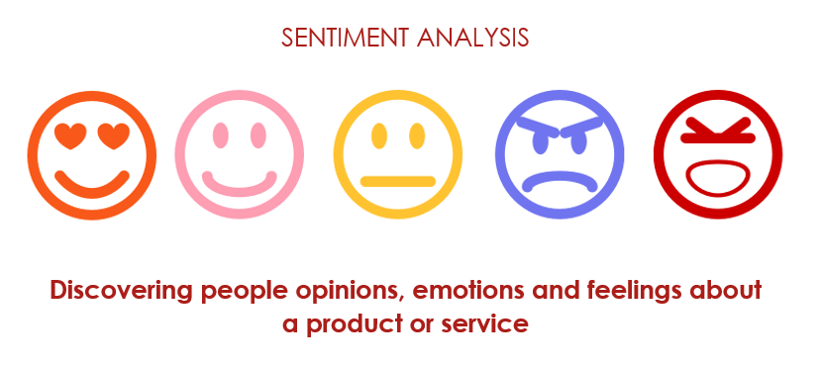
Applications of Sentiment Analysis
To study Open-ended question responses
Customer surveys
Opinion polling surveys
Public feed back and Social trends
Consumer satisfaction analysis
Employee perceptions
Public talks on a product/service/movie
Dr Suresh Chandra Ch

Slide 6




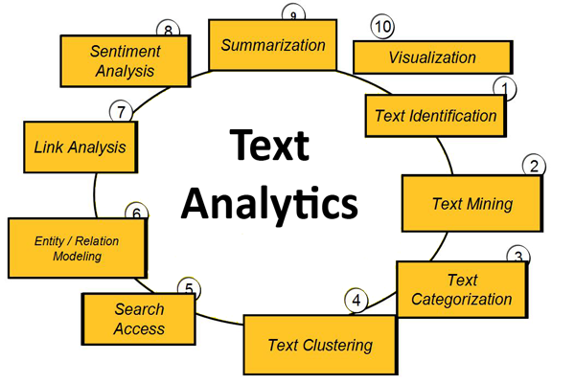
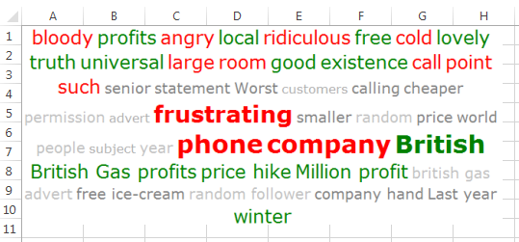
Apps help for the study of sentiment Analysis
Dr Suresh Chandra Ch

Slide 7
Process of Sentiment Analysis
Identify the problem to be analyze
Set the objectives to be revealed through sentiment Analysis
Design the research process to be applied
Do a pilot study
Construct a open-ended question
Collect the responses from the sample respondents
Analyze the responses using Data mining methods/software
Interpret results
Summarize the sentiment
Dr Suresh Chandra Ch

Slide 8
Instructions before analysis
The selection of respondents
Unbiased form of collection of responses
Careful manual entry
Installation of software
Selection of data
Dr Suresh Chandra Ch

Slide 9
The process of installation and using text2data app for sentiment Analysis
Dr Suresh Chandra Ch

Slide 10
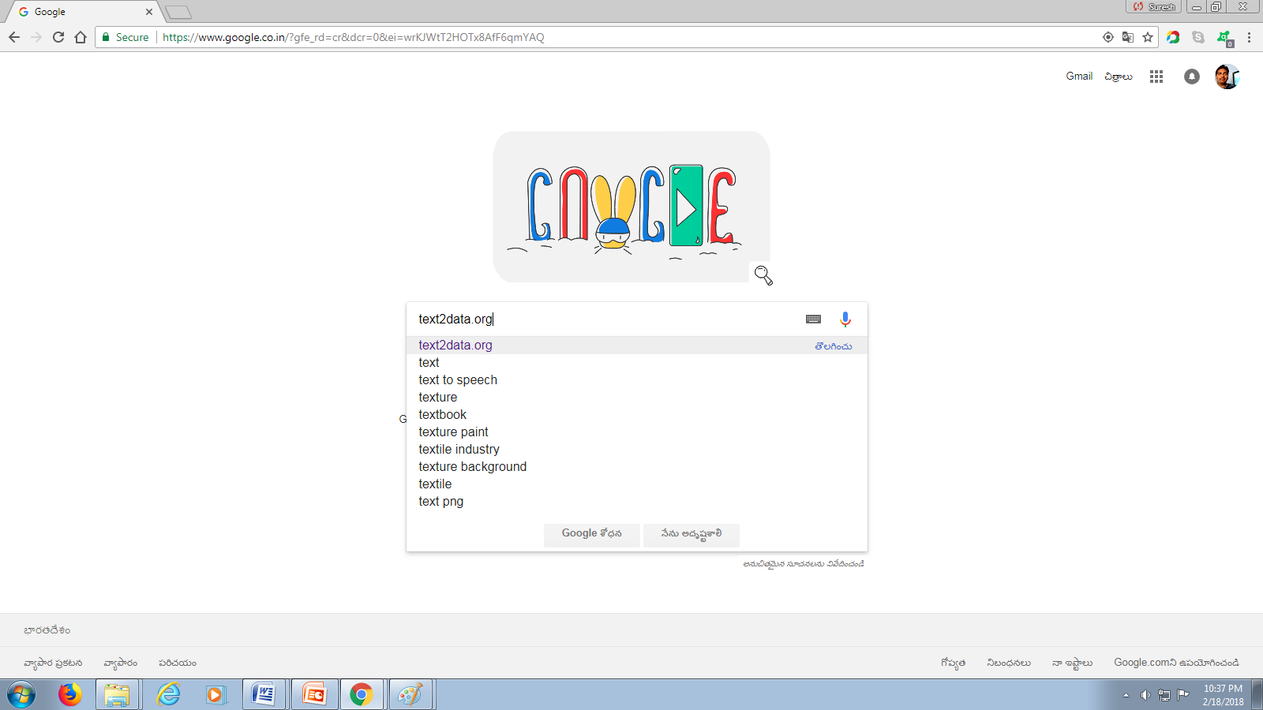

Dr Suresh Chandra Ch

Slide 11
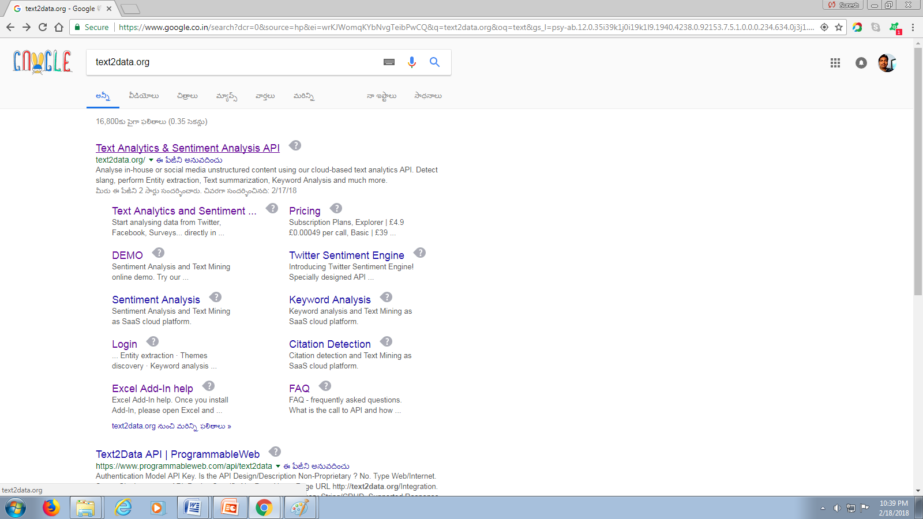
Dr Suresh Chandra Ch

Slide 12
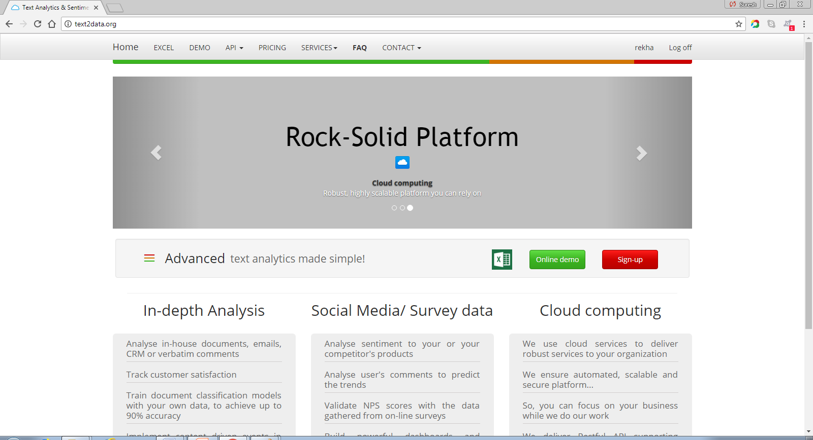
Dr Suresh Chandra Ch

Slide 13
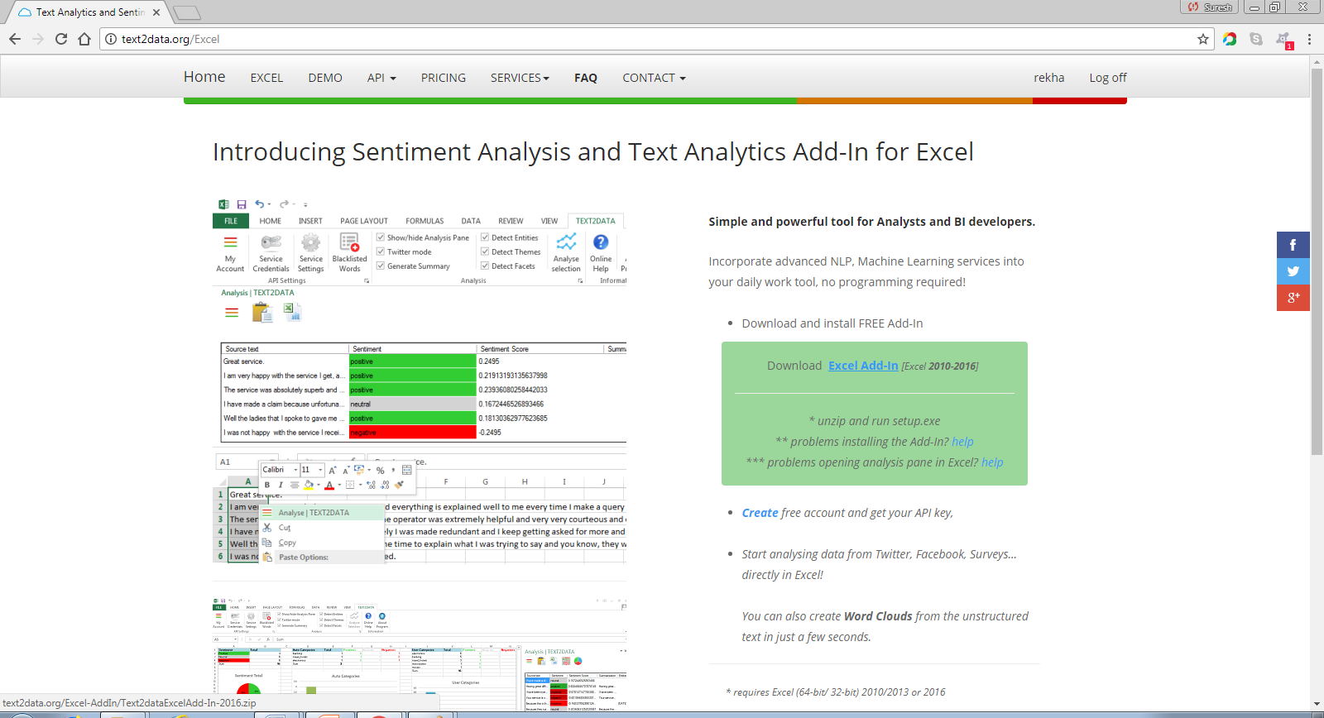
Dr Suresh Chandra Ch

Slide 14
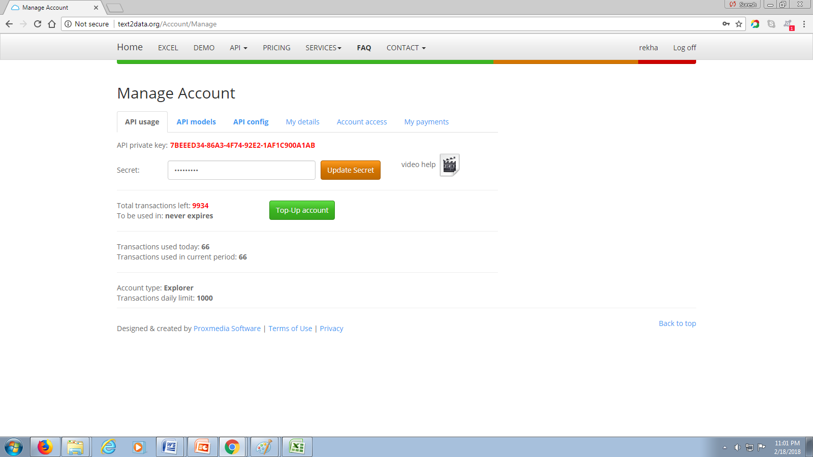
Dr Suresh Chandra Ch

Slide 15
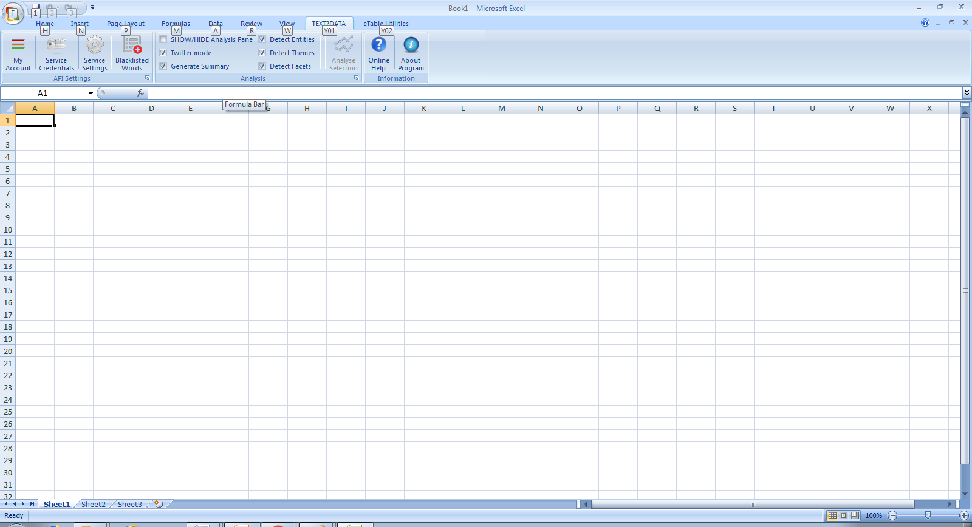
Dr Suresh Chandra Ch

Slide 16
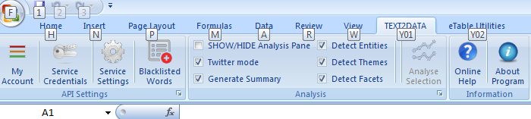
Dr Suresh Chandra Ch

Slide 17
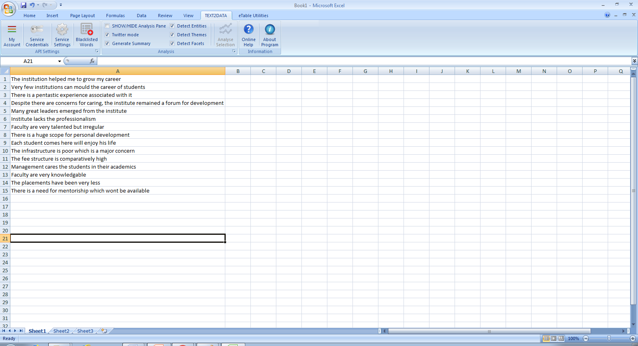
Dr Suresh Chandra Ch

Slide 18
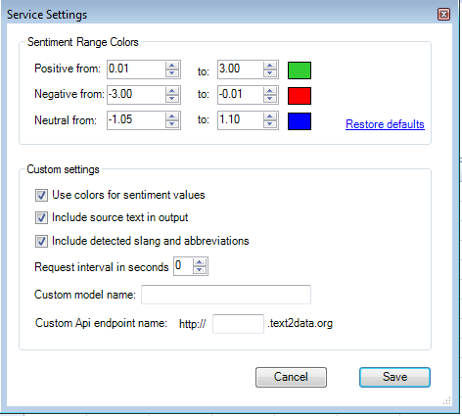
Dr Suresh Chandra Ch

Slide 19
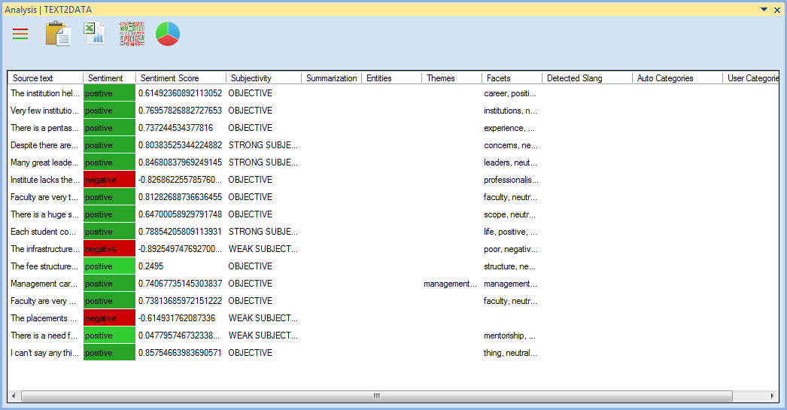
Dr Suresh Chandra Ch

Slide 20
Word Cloud
available poor talented personal high career life concerns enjoy great scope students institution associated grow huge development structure need many thing experience management cares the
Dr Suresh Chandra Ch

Slide 21
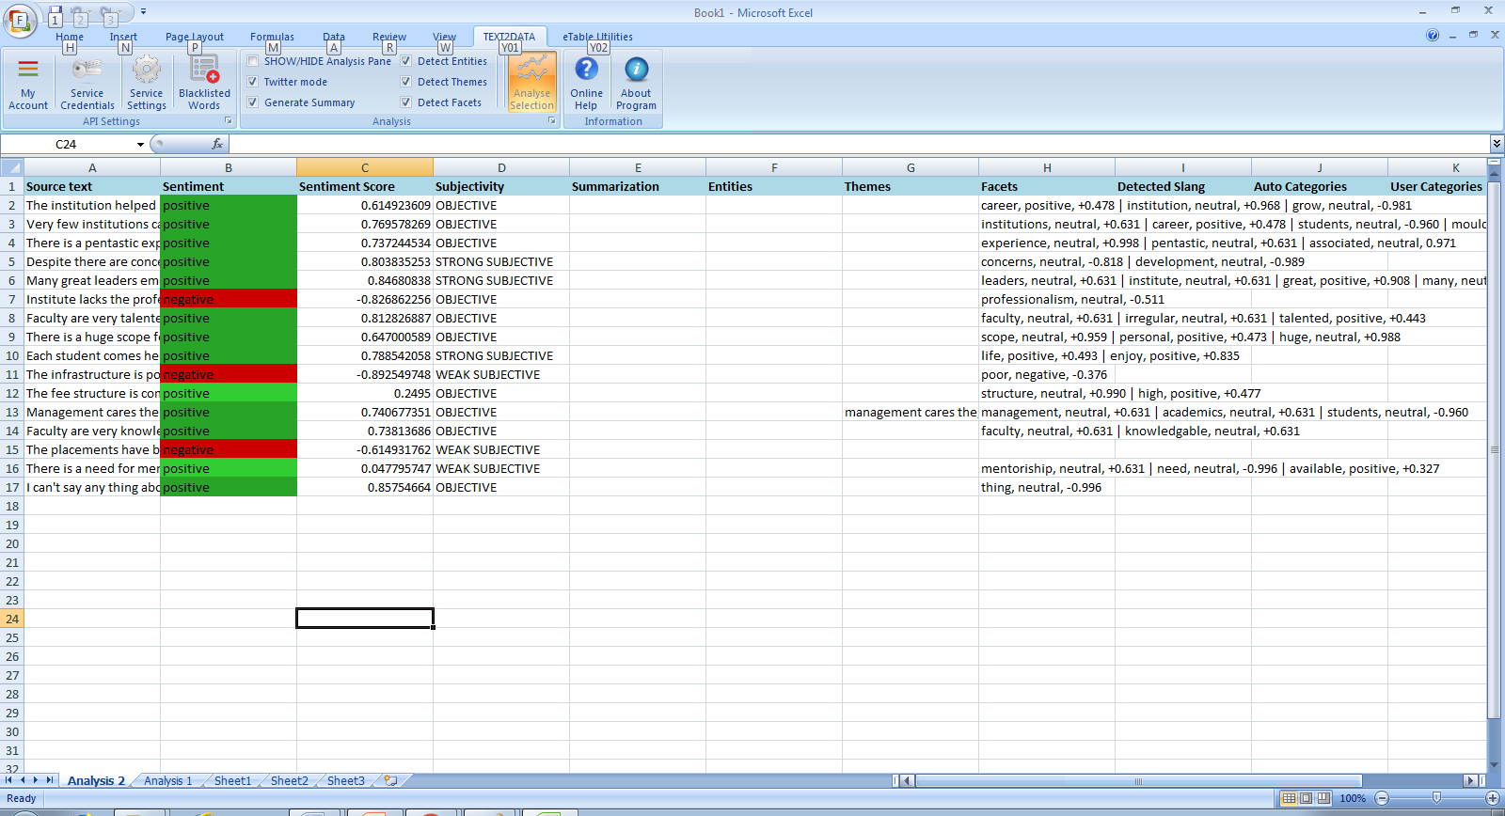
Dr Suresh Chandra Ch

Slide 22
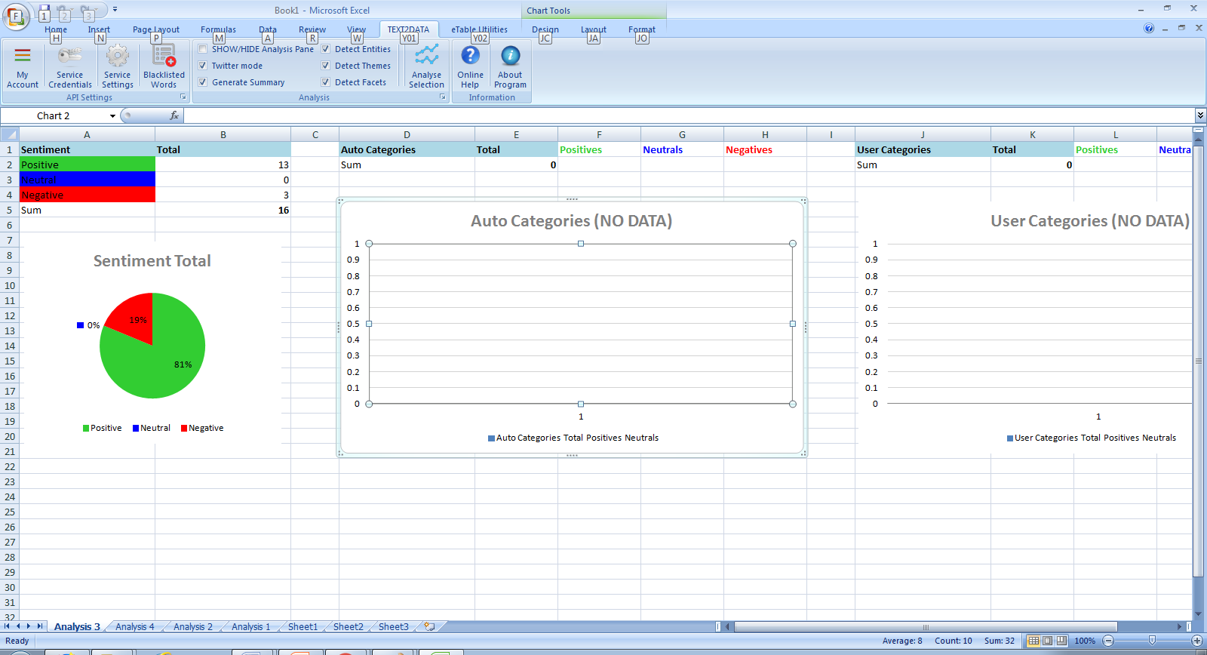
Dr Suresh Chandra Ch

