Slide 1
MNIST CLASSIFIER PROJECT
Rachel Lee

Slide 2
UNDERSTANDING NEURAL NETWORKS
To brush up on my understanding of neural networks, I sought explanations & tutorials online
Using a multitude of resources (listed in Resources slide), I gained an understanding of the following topics, to name a few:
CNNs, RNNs, ANNs, and the advantages and disadvantages of each
The mathematical operations that underlie what neural networks do, such as the calculation and distribution of weights and sigmoid vs. ReLU
Classification vs. Regression problems and the optimal loss functions associated with each
With the information I learned, I had a solid foundation to move onto the next step

Slide 3
IMPLEMENTING LeNet
LeNet consists of two sets of convolutional, activation, and pooling layers, a fully connected layer, a pooling layer, another fully connected layer, and lastly, a softmax classifier
I chose to use the Adam algorithm for the optimizer and CrossEntropyLoss as the loss function, as they perform well for classification problems
The MNIST data came directly from the torchvision library
I had three hyperparameters: batch size, number of epochs, and learning rate, all three of which I adjusted to train the network to perform at a high accuracy

Slide 4
RUNNING INTO DIFFICULTIES
I ran into several difficulties, many of which were very basic, as this was my first time coding a neural network
My first major issue was figuring how to go from the last convolutional/activation/pooling layer to the first fully connected layer. Specifically, I had difficulty determining the input size of the first fc layer. However, after some crude testing, I was finally able to solve this issue.
Another issue I had was with checking the accuracy of the function; however, again, after a lot of trial and error and browsing the internet, I was able to solve this as well.

Slide 5
RESULTS
With a batch size of 32, 11 epochs, and a learning rate of 0.001, I was able to get the network to perform at 99.29% accuracy
I decided to analyze the loss over time for networks trained with two different sets of hyperparameter values as well as analyze the numbers that are incorrectly guessed by the network.
I used matplotlib and seaborn to create the visualizations.

Slide 6
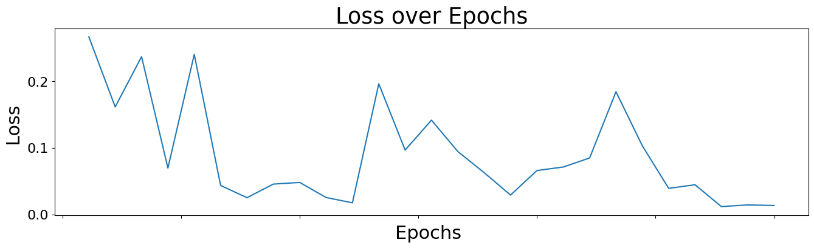
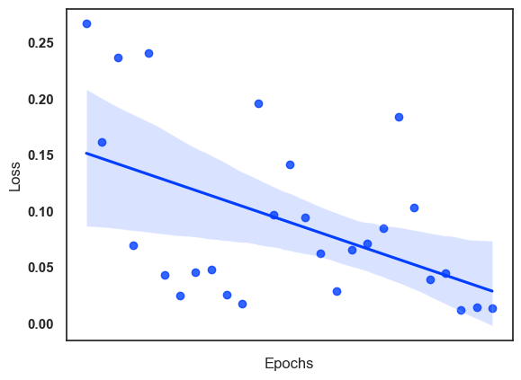
This network was trained with a batch size of 100, 3 epochs, and a learning rate of 0.01. Above is a graph of the loss over the span of three epochs. To the left is a linear regression model fit showing a downward trend.

Slide 7
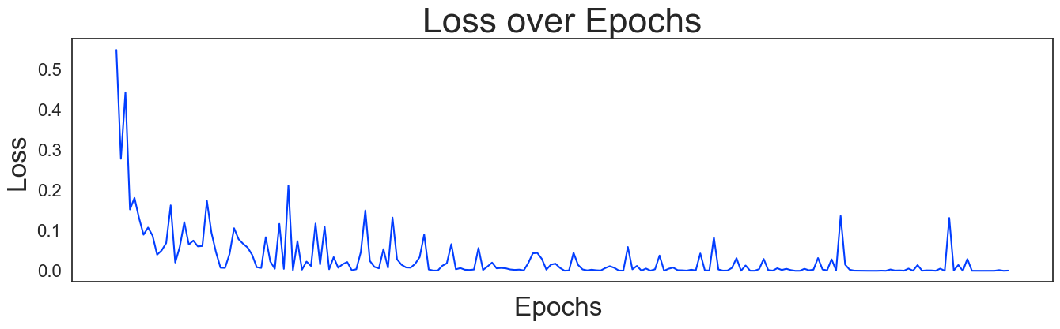
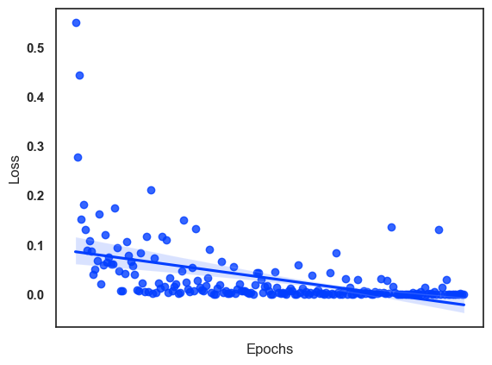
In this network, the batch size was 32, with 11 epochs and a learning rate of 0.001. Above is a graph of the loss over 11 epochs, and to the right is a linear regression model fit again showing a downward trend.

Slide 8
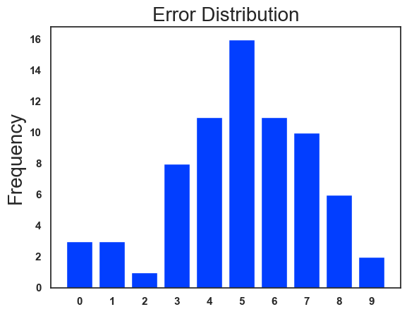
Continuing with the settings listed on the previous slide, I examined the incorrect guesses made by the network. To the left is a distribution of the numbers the network guessed incorrectly.

Slide 9
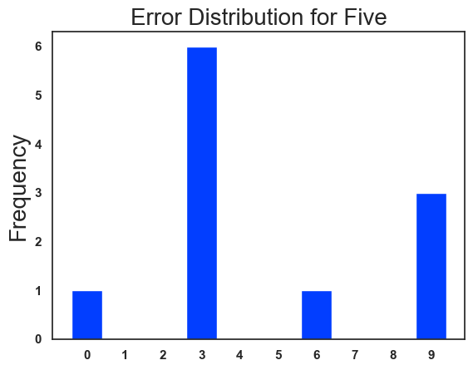
Five, which was most frequently guessed incorrectly, was most often mistaken for a three. To the right is a distribution of the numbers mistaken for a five.

Slide 10
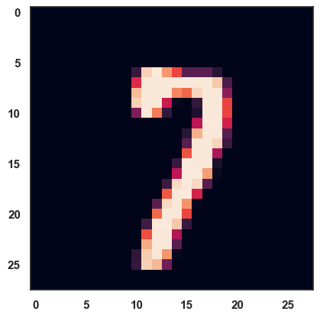
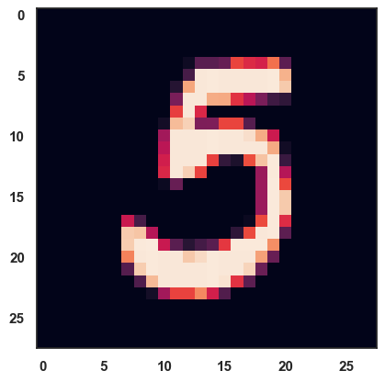
Above are two numbers that were guessed incorrectly by the network. The left number was mistaken for an eight, while the right was mistaken for a zero.

Slide 11
RESOURCES
Pytorch - Deep Learning w/ Python Video Series by sentdex
https://www.youtube.com/playlist?list=PLQVvvaa0QuDdeMyHEYc0gxFpYwHY2Qfdh
3Blue1Brown Video Series on Neural Networks
https://www.3blue1brown.com/topics/neural-networks
https://www.youtube.com/watch?v=Jy4wM2X21u0&t=1022s
https://medium.com/@nutanbhogendrasharma/pytorch-convolutional-neural-network-with-mnist-dataset-4e8a4265e118
https://www.kaggle.com/sdelecourt/cnn-with-pytorch-for-mnist
https://towardsdatascience.com/implementing-yann-lecuns-lenet-5-in-pytorch-5e05a0911320

