Slide 1

Dynamic Operation Of Developmentally-Learned Encoded Sequences (DOODLES)
Group Member: Robbie Schad (schadra@mail.uc.edu)
Project Advisor: Dr. Ali Minai (minaiaa@ucmail.uc.edu)

Slide 2
Project Purposes & Goal Statements
Purposes:
Many modern AI systems will ultimately be learning behavior sequences
Encoding behavior sequences spatially will provide an efficient solution to recalling those behaviors
Goal Statements:
Design an efficient model for encoding sequences of behaviors (in the form of drawing)
Develop the model to retain previously-learned behaviors, while also enabling the capacity for learning new, additional behaviors, as the model scales

Slide 3
Abstract
The Dynamic Operation Of Developmentally-Learned Encoded Sequences (DOODLES) project aims to revolutionize AI systems by addressing the challenges of learning and recalling behavior sequences. By spatially encoding behavior sequences, DOODLES seeks to create an efficient framework for retaining and expanding learned behaviors, primarily in the form of drawings. The project's core objectives include designing an innovative model for behavior sequence encoding and ensuring it can preserve previously-learned behaviors. Simultaneously, DOODLES strives to provide the capacity for the model to adapt and acquire new behaviors as it scales, marking a significant advancement in AI's ability to mimic, remember, and evolve human-like behaviors.

Slide 4
User Stories
As a robotics researcher, I want to be able to create a robot that can doodle, following my desired behaviors, so that I can produce a robot capable of doodling as I desire.
As an art professor, I want to use an AI system to doodle, so that my students can be tasked with determining which doodles are AI generated vs human generated.
As an Intelligent Systems Researcher, I want to be able to ensure that my system is able to recall specific sequences of behaviors given a specific input, so that my system can accomplish complex actions.
As an Intelligent Systems Researcher, I want to be able to encode sequences of behavior spatially, so that my model is much more efficient and has less parameters to learn.
As a Intelligent Systems Researcher, I want to discover an approach to spatially encoding behavior sequences via a unique neural model so that I can build a model suited to my needs that can achieve complex behaviors

Slide 5
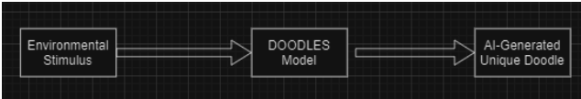
Design Diagram D0

Slide 6
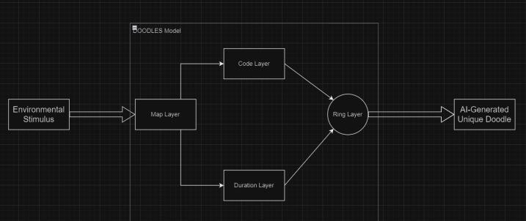
Design Diagram D1

Slide 7
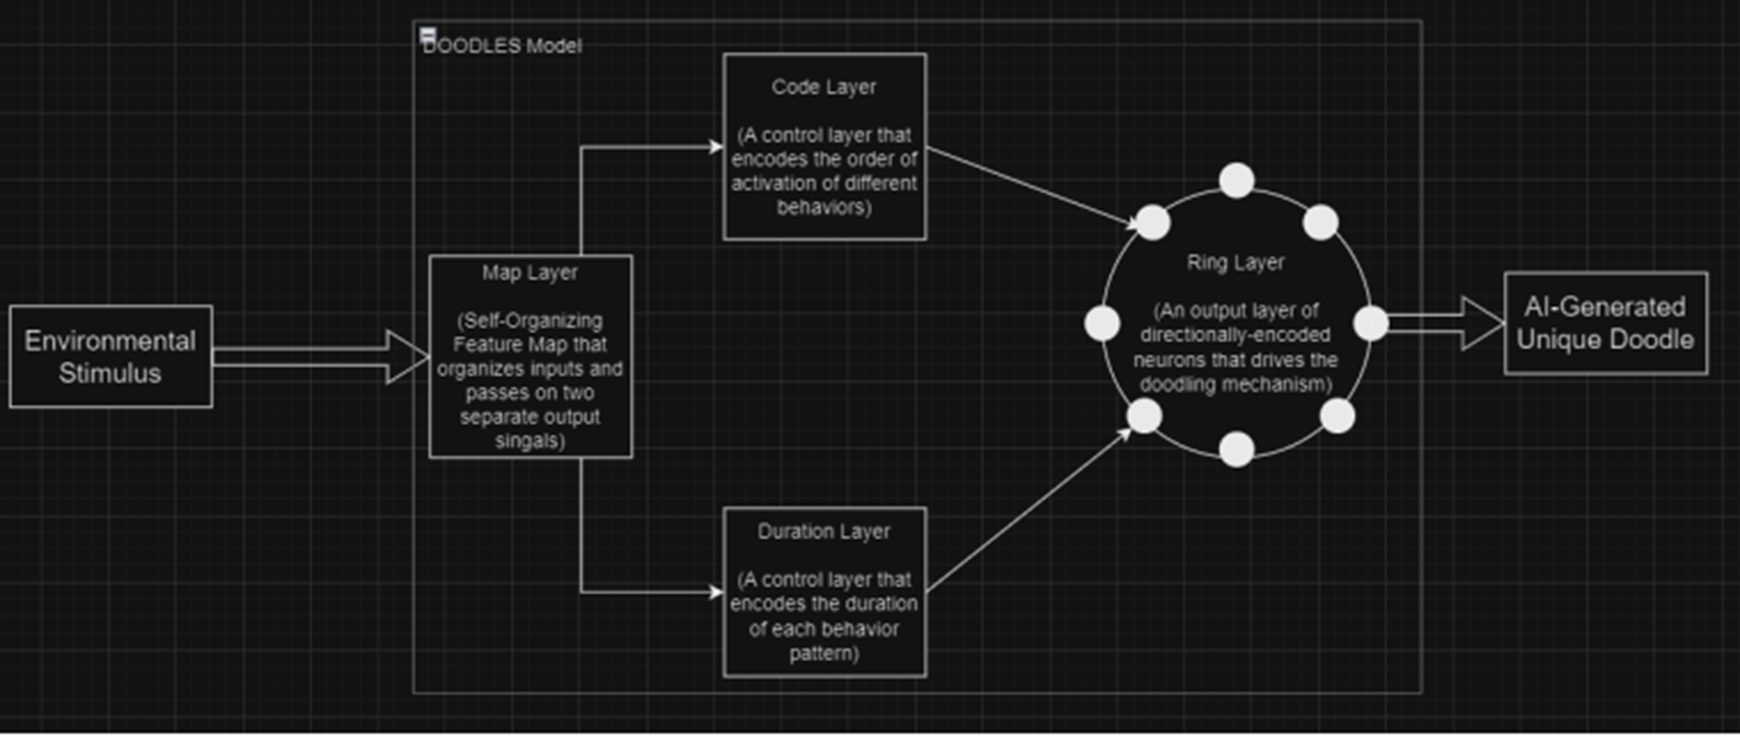
Design Diagram D2

Slide 8
Project Contraints
Economic:
Cost of training model
Processing power/time resources
Security:
Codebase must be secure and safe
Ethical:
Many view AI as “scary” and “potentially damaging”
AI industry can be seen as ethically questionable

Slide 9

Current State of Project
Output system (Ring Layer) implemented
Ring Layer takes in input, applies the input to a dynamical system of differential equations, and maps the dynamics of the output model into a doodle
The system can also display the drawing process in the form of a GIF

Slide 10
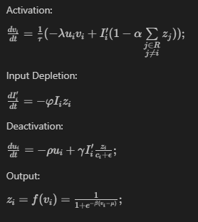
Ring Layer Equations

Slide 11
Example Output
For input array [0.91, 0.9, 0.81, 0.8, 0.5, 0.4, 0.3, 0.2]:

Slide 12
Expected Accomplishments
Create an AI foundation for the model
Train the model to learn to create desired drawings, not just scribbles
Apply developmental learning to the model to increase its learning capacity

Slide 13
Division of Work
All work will be completed by Robbie Schad as the sole member of the project, with support and guidance by Dr. Ali Minai

Slide 14
Expected Demo at EXPO
An interactive display of the system’s operation
Let user apply an environmental stimulus and watch the AI-generated output
Display the learning process of the system over time

