Slide 1
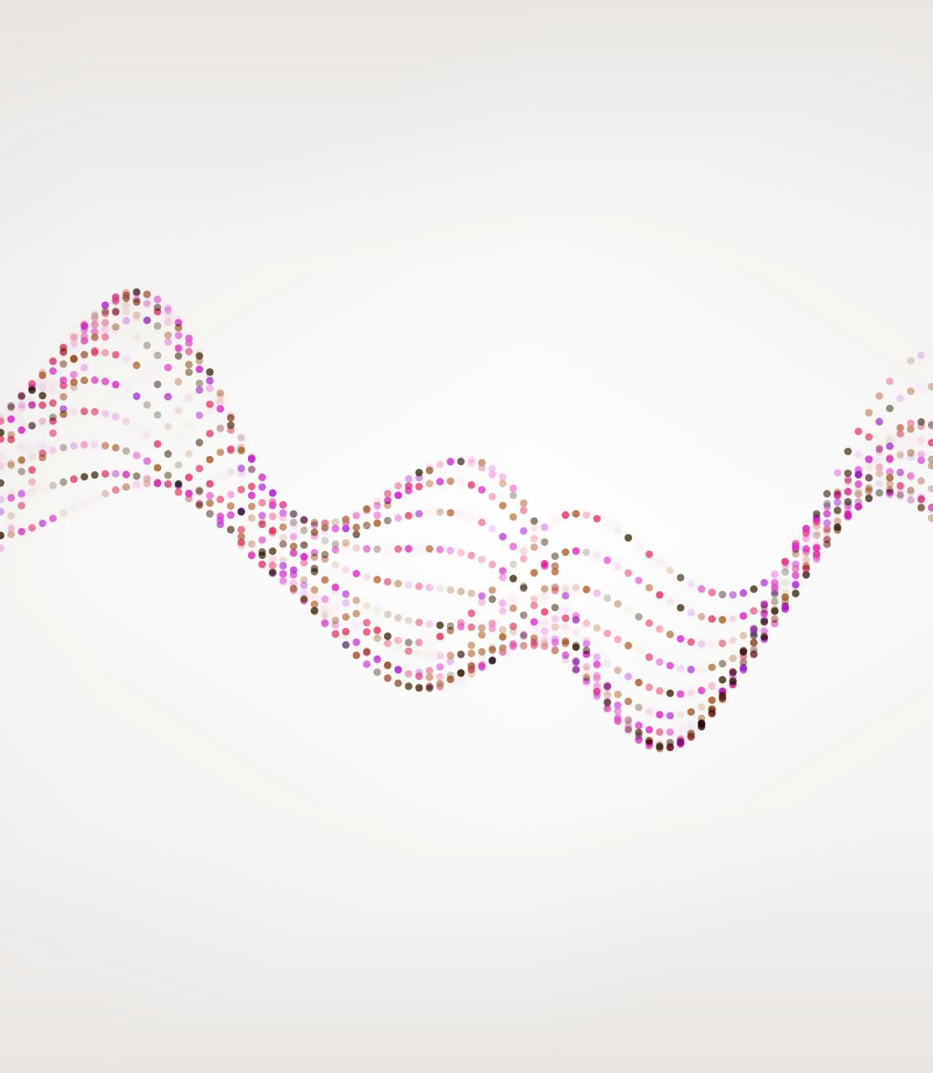
Building Neural Maps of Motor Primitives via Self-Organization and Reinforcement Learning
Group Member: Robbie Schad (schadra@mail.uc.edu)
Project Advisor: Dr. Ali Minai (minaiaa@ucmail.uc.edu)

Slide 2
Project Purposes & Goal Statements
Purposes:
Many modern AI systems learn spatiotemporal behavior sequences
Encoding behavior sequences spatially will provide an efficient solution to recalling those behaviors
Goal Statements:
Design an efficient model for encoding sequences of behaviors (in the form of drawing)
Develop the model to retain previously-learned behaviors, while also enabling the capacity for learning new, additional behaviors, as the model scales

Slide 3
Abstract: Goals/Merits/Impacts
Complex animals are thought to construct complex movements by combining fundamental motor primitives. Learning the primitives and a control hierarchy is a complex task in a high degree-of-freedom (DOF) system. Motor control using a hierarchy of primitives is a promising strategy for use in high-DOF robots. This project presents a simple, biologically-inspired neural network model of how an agent capable of very simple drawing movements can learn to generate good motor primitives through a combination of unsupervised and reinforcement learning. The model produces an ordered self-organized control map that could mediate the triggering of specific learned primitives through simple control signals.

Slide 4
User Stories
As a robotics researcher, I want to be able to create a robot that can doodle, following my desired behaviors, so that I can produce a robot capable of doodling as I desire.
As an art professor, I want to use an AI system to doodle, so that my students can be tasked with determining which doodles are AI generated vs human generated.
As an Intelligent Systems Researcher, I want to be able to ensure that my system is able to recall specific sequences of behaviors given a specific input, so that my system can accomplish complex actions.
As an Intelligent Systems Researcher, I want to be able to encode sequences of behavior spatially, so that my model is much more efficient and has less parameters to learn.
As a Intelligent Systems Researcher, I want to discover an approach to spatially encoding behavior sequences via a unique neural model so that I can build a model suited to my needs that can achieve complex behaviors

Slide 5
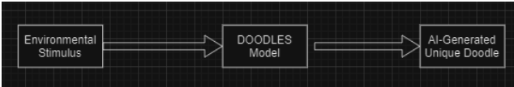
Design Diagram D0

Slide 6
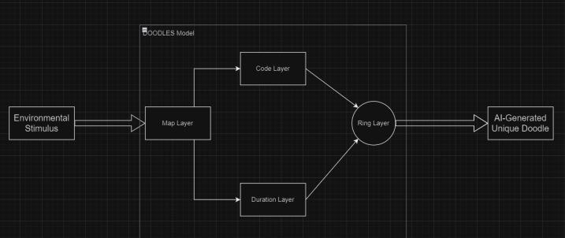
Design Diagram D1

Slide 7
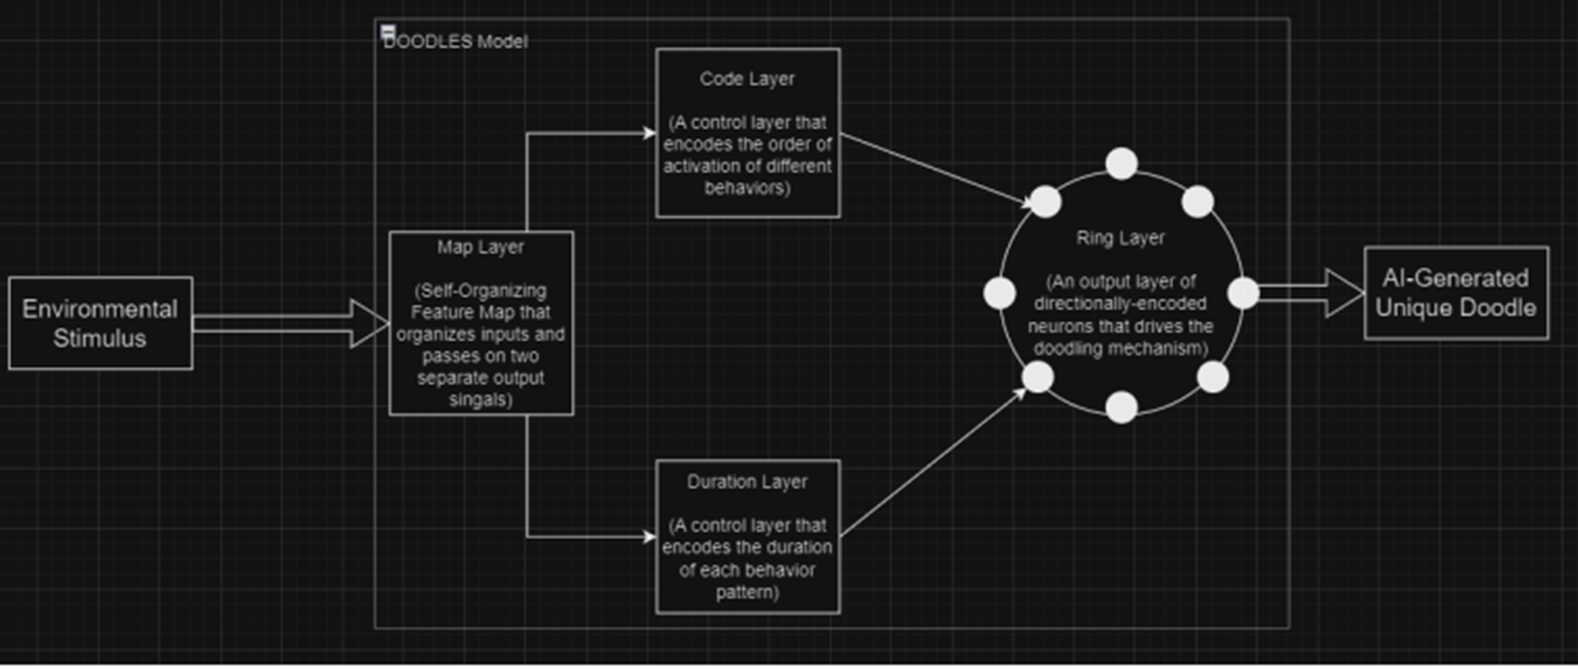
Design Diagram D2

Slide 8
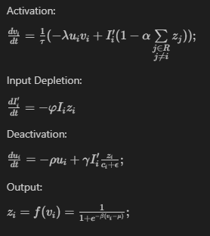
Ring Layer Equations

Slide 9
Example Output
For input array [0.91, 0.9, 0.81, 0.8, 0.5, 0.4, 0.3, 0.2]:

Slide 10
Technologies
Python
Statistical Python packages: numpy, scipy, pandas, matplotlib, seaborn
Jupyter
GitHub
VSCode

Slide 11
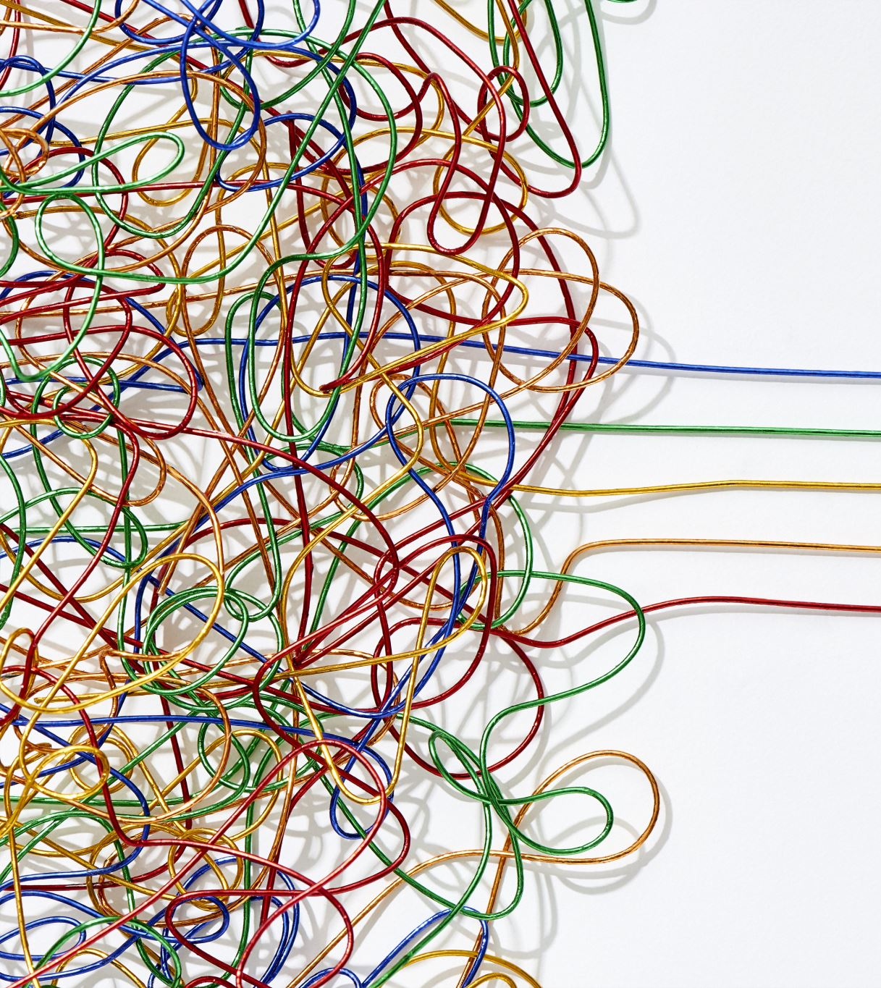
Milestones
Results completed:
Working model implemented
Some decent results found, albeit with some hand-picked inputs
Next:
(4/1) Tune the model to allow more generalization against noisy inputs

Slide 12

Challenges
The most challenging constraint has been the amount of training time required for the model
Also, determining a good metric for evaluating doodles has been a very large struggle

Slide 13

Division of Work
All work will be completed by Robbie Schad as the sole member of the project, with support and guidance by Dr. Ali Minai

