Slide 1
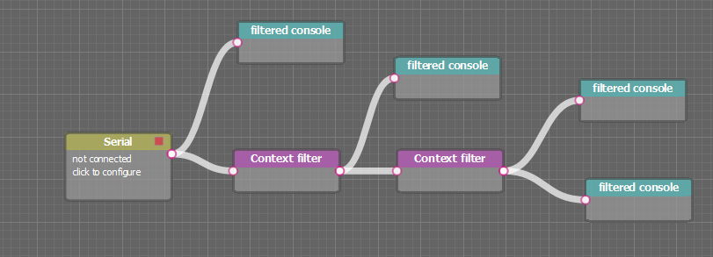
change

Slide 3
No need to reset
Lock, No need to reset
Reset, data invalid
Historical buffer, no need to reset
Reset, on the path
Affected node
Reset, data invalid

Slide 4
reset
change
reset

Slide 5
Reset
Empty buffer
Reset buffer reader
change
Reset

Slide 6
Pause updates
Reset buffer
Empty buffer
Reset buffer reader
change
Reset buffer

Slide 7
Pause updates
Normal update process

Slide 8
Pause updates
If bufferreader->tail == oldTail -> resume paused nodes

