Slide 1






Maximizing energy efficiency in 5G using deep reinforcement algorithm and IOT
Presented by Reyhaneh Shirani
Dr. Ejei
1403/10/03

Slide 2
Overview
Introduction
Problem
Question
Hypotheses
Methodology
Smart Algorithms in Energy Management
IoT-Based optimization
Conclusion
References

Slide 3
Introduction
5th Generation Internet
High Speed
Low Latency
High Capacity

Slide 4

Problems
Problem 1
Problem 2
The increase in the number of base stations and the need for new infrastructure leads to high consumption of 5G
Simultaneous management of diverse network resources to maintain Quality of Service (QoS)

Slide 5

Questions
Question 1
Question 2
What algorithms contribute to energy efficiency in 5G networks?
What architectures enable lower energy consumption and are more cost-effective and easier to implement?

Slide 6


Hypotheses
The integration of smart algorithm within IoT-based architectures will maximize energy efficiency.
The use of smart algorithms in RRHs will contribute to energy efficiency .
1
2
3
IoT-based architectures will reduce energy consumption.

Slide 7

Methodology
Methods based on Smart Algorithms
Deep Reinforcement Learning (DRL)
Methods based on IoT
Cloud Radio Access Network (C-RAN)

Slide 8
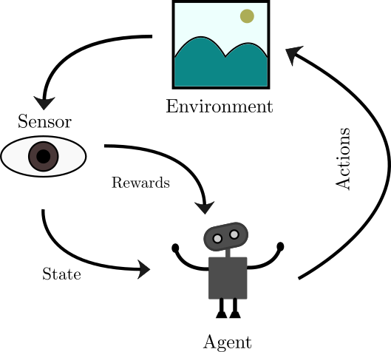
Smart Algorithm
Deep Reinforcement Learning
Main components of the algorithm
Agent
Environment
State
Action
Reward
Policy
Achievements

Slide 9
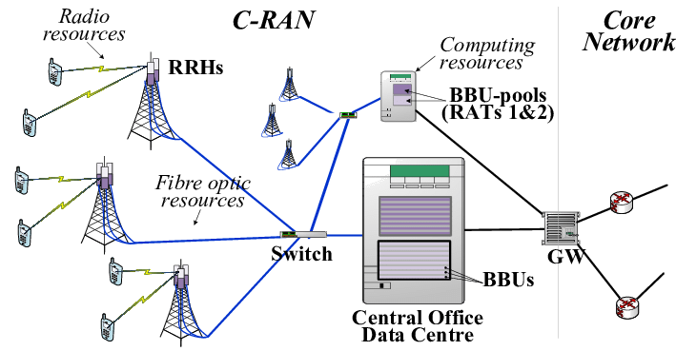
IoT-Based optimization
Cloud Radio Access Network (C-RAN)
Remote Radio Head (RRH)
Base Band Unit (BBU)
Fiber Optic Network
Achievements
Cost and energy reduction
System flexibility enhancement

Slide 10
Conclusion
The combination of the Internet of Things (IoT) and deep Reinforcement (DRL) algorithms can significantly reduce energy consumption in 5G networks.
This synergy optimizes resource utilization while maintaining Quality of Service (QoS), leading to substantial energy efficiency.
Advanced architectures such as Cloud Radio Access Network (C-RAN) play a crucial role in achieving these objectives.

Slide 11
References
Abdallah, Noor Aboueleneen et al. "Deep Reinforcement Learning for Internet of Drones Networks."
Al-Tam, Faroq et al. "Learn to Schedule (Leasch): A Deep Reinforcement Learning Approach."
Hajisami, Abolfazl et al. "Elastic-Net: Boosting Energy Efficiency and Resource Utilization in 5G C-RANs.“
Zuo, Jun et al. "Energy Efficient User Association for Cloud Radio Access Networks."

Slide 12
Thank You So Much
Reyhaneh Shirani | Isfahan University

