Slide 1
Cloud Computing
Ryan Skinner
Tony Duong
Trevor Sawhill

Slide 2
Motivation
Next logical step from our experience in class.
Businesses of any size can benefit from cloud computing.
Ubiquity of cloud computing in everyday tasks.

Slide 3
Description
Definition:
Internet-based computing in which large groups of remote servers are networked so as to allow sharing of data-processing tasks, centralized data storage, and online access to computer services or resources.

Slide 4
Three Main Types
IaaS - Infrastructure as a Service
Previously known as HaaS (Hardware as a Service)
Rackspace, DigitalOcean
SaaS - Software as a Service
Software licensing and distribution by available by the cloud service provider (ie. Dropbox, GoToMeeting, Google Apps)
PaaS - Platform as a Service
An environment for allow developers to build applications and services (i.e. AWS Elastic Beanstalk, Microsoft Azure, Google App Engine))

Slide 5
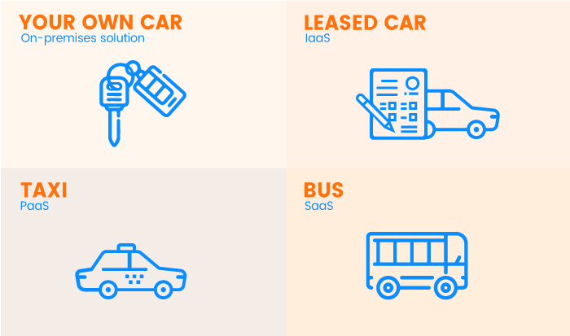
Three Main Types

Slide 6
Relevancy
90% of companies utilize some form of cloud computing in 2019
Estimated 60% of all workloads in the business environment execute in a hosted cloud service
U.S. is the most prominent cloud market with a total expected spending of $124.6 billion in 2019
(Source: Cisco)

Slide 7
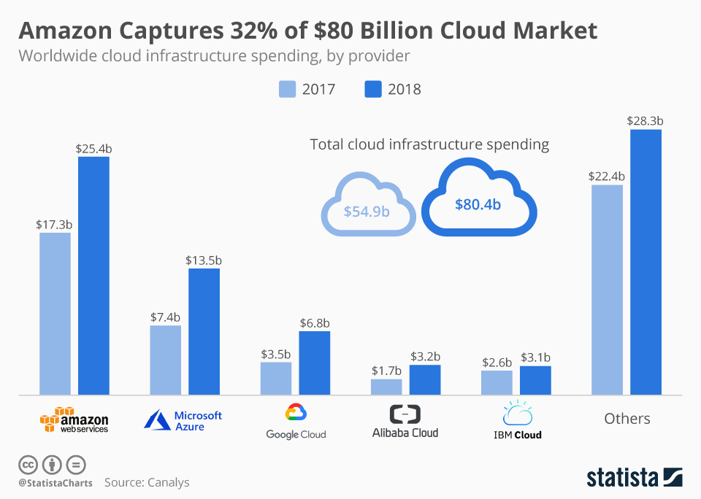

Slide 8
Impact
New utilities
Chromebooks
AI assistants (Siri, Google Assistant, Alexa)
Big data problems became more accessible and thus advancements in fields like machine learning
Improved education and collaboration efforts

Slide 9
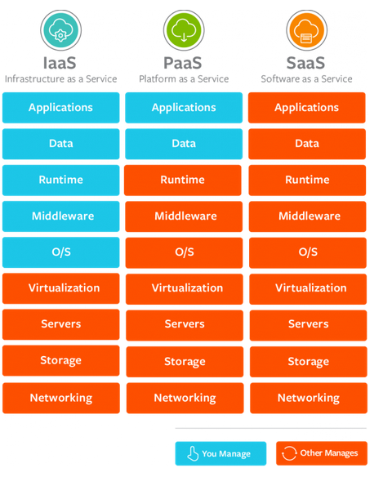
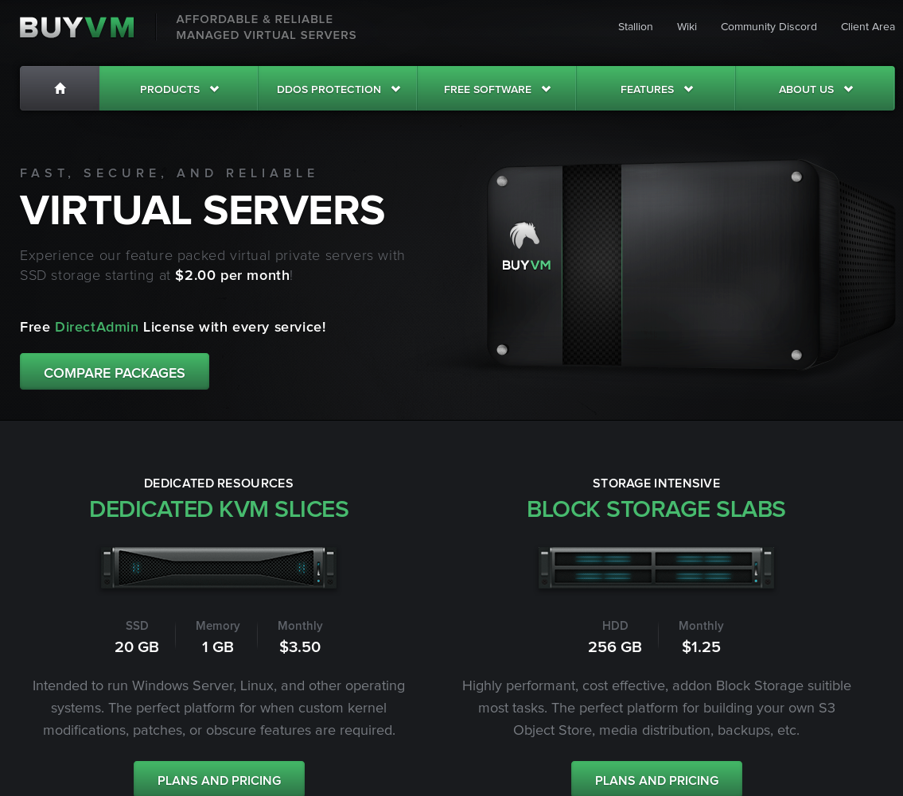
Real world applications - IaaS
Notes:
VPS - host your own servers without shelling out for:
Hardware
Electricity
Business internet plan
Backups, physical security (damage)
Otherwise full control of the OS and above

Slide 10
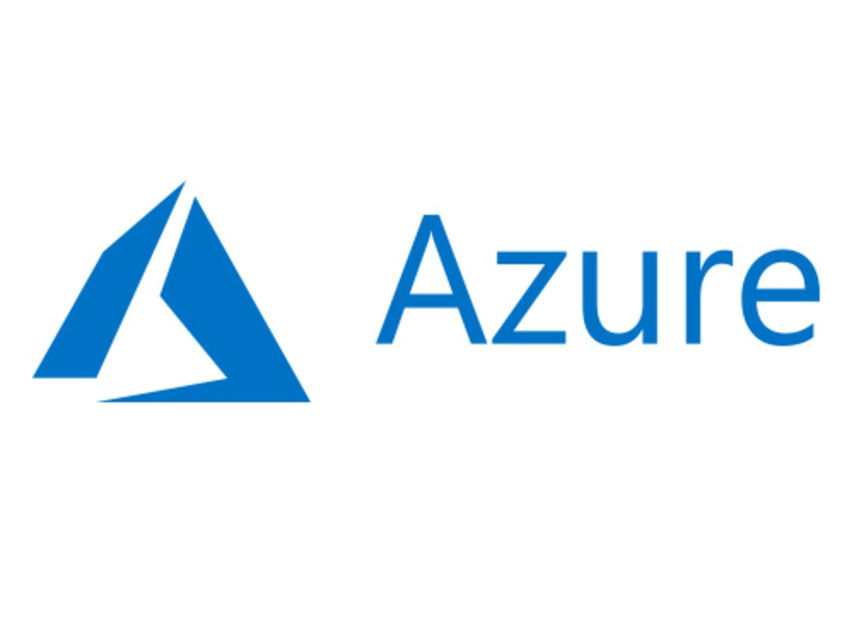
Real world applications - PaaS
Notes:
PaaS -
You only control the applications

Slide 11
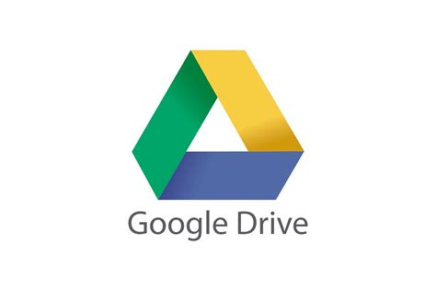
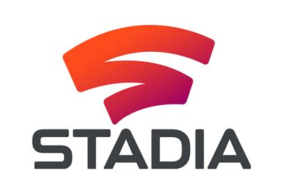
Real world applications - SaaS
Notes:
SaaS -
Everything is given to you, websites with lots of functionality

Slide 12
Performance statistics
 | Google Stadia | Self-built price
CPU | Custom | 200-400
RAM | 16GB | 50-200
GPU | Comparable to Vega 56 | 400
STORAGE | Limitless SSD storage | 50-200 (100/TB)
PRICE | 10/month (or free) | Total: 700-1200
 |  | 70-120 months to break even
Notes:
This doesn't mention the fact that google hardware doesn't break, is more parallel (more threads, multigpu, etc), and will be upgraded to honor its 60 frames at 4k.
Your 6 year old computer won't hold up

Slide 13
Strengths and limitations
Strengths
Flexible
Easy to use
Cost-efficiency
Data security
Limitations
Dependence on network connection
Security
Technical issues
Notes:
Flexible - Upgrade, downgrade, switch providers at the click of a button
Ease of use - Providers try to make their product as user friendly as possible to capture the market
Cost-efficiency - As shown with stadia, renting is way cheaper than buying, faster upgrades, ect.
Network - obvious
Security - Zombieload/Foreshadow attacks, trust the hoster, worry about broken isolation
Technical issues - trust the hoster, deal with tech support to change things

Slide 14
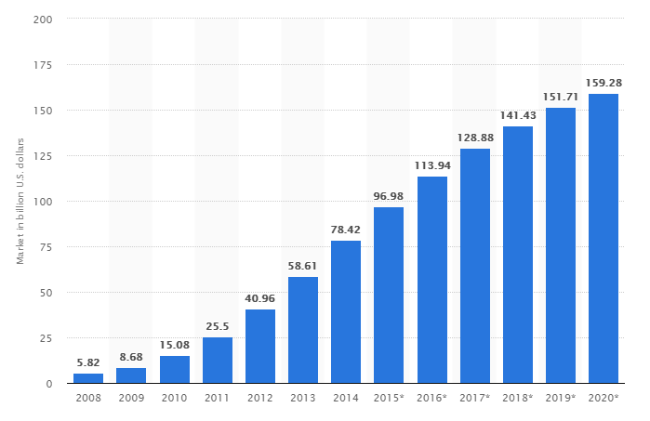
Technology Maturity
Cloud computing is quite mature, with large scale adoption & market.
Since 90% of companies are using cloud computing in some capacity, the technology can be called mature.

Slide 15
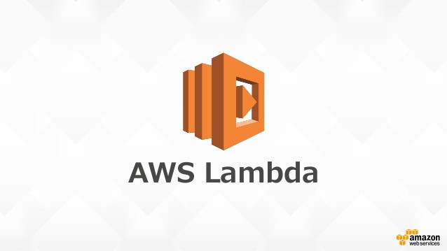
Demo
Multithreaded Monte Carlo pi approximation with Amazon Lambda

