Slide 1

Shootings that Occurred in NYC 2006-2018
BIOS6644 2019 Final Project Presentation
Rachel Weber
MPH Candidate
Colorado School of Public Health
rachel.weber@cuanshutz.edu

Slide 2
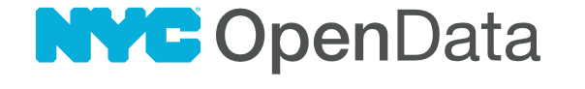
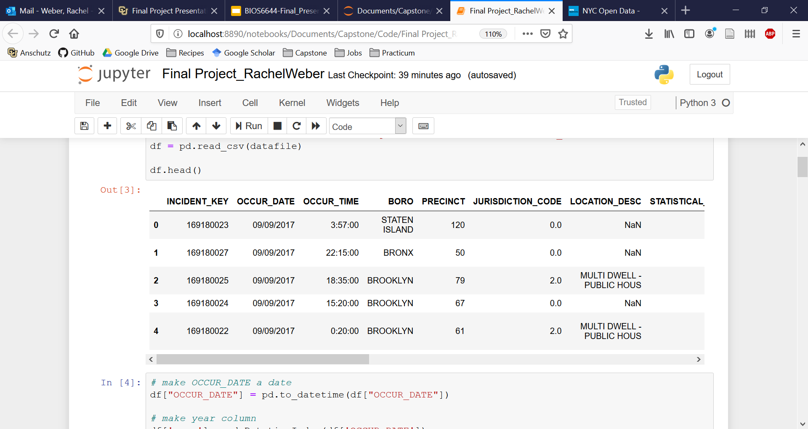
Project Background
In 2018 NYC had their first shooting-free weekend (Fri, Sat, Sun) in decades. It was hailed as ‘remarkable’ and a testament of progress made by the NYPD
My capstone project studies the probability of that happening and secondarily builds a model to predict numbers of shootings that will occur on a given day
Notes:
In October 2018 NYC had their first shooting-free weekend in decades. This was hailed as remarkable and credited to the NYPD but knowing about the law of incredibly large numbers, I wondered if this event was inevitable. The Law of Truly Large Numbers states that with enough repetitions of an experiment, even outlandishly unlikely events become inevitable. It is logical to consider an event that occurs 1 in 1 million times to be extremely rare, but with a population of roughly 329 million people, the United States is expected to see that event happen to 329 people—not a bad sample size. The same concept allows us to view the shooting-free weekend in NYC through a different lens. With enough weekends and enough time, was a shooting-free weekend bound to happen eventually?

Slide 3
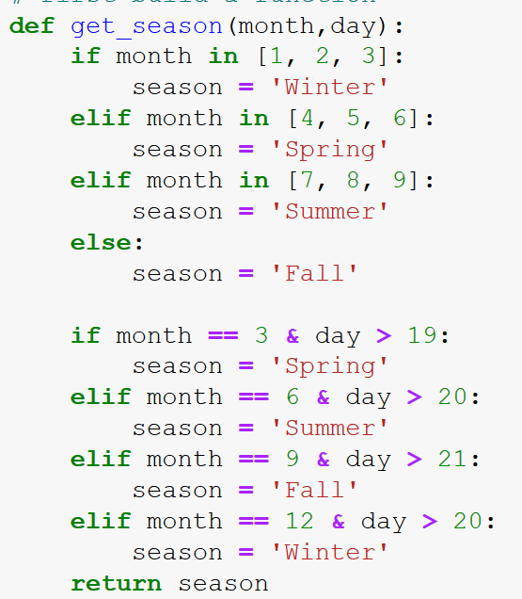
The Data Wrangle
Every shooting that happened between Jan 1, 2006 and Dec. 31, 2018 is recorded, verified then made publicly available.
I used the date to make some new columns:
Month
Year
Season
Day of the Week
Missing dates are days where no shooting occurred. I had to find a way to finding missing dates and add a line for them
Notes:
Data was provided by NYC OpenData in a csv format.
I read in the file, converted the OCCUR_DATE column to a datetime object and then used that to add columns for month, day, day of the week (Monday = 0, Sunday = 6), and year.
From the month and day I wrote a function that determines season. I made season its own column
Dates that were not listed in the dataset were those where no shooting occurred. I had to search for missing dates then create rows for them with all column values--other than date--equal to zero. Having 0 instead of NA will be useful for searching later in analysis

Slide 4
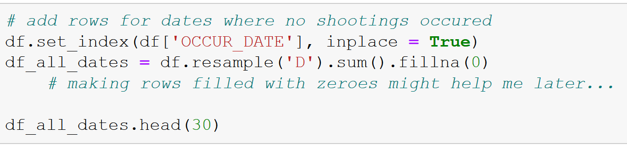
The Data Wrangle
Every shooting that happened between Jan 1, 2006 and Dec. 31, 2018 is recorded, verified then made publicly available.
I used the date to make some new columns:
Month
Year
Season
Missing dates are days where no shooting occurred. I had to find a way to finding missing dates and add a line for them
Notes:
Data was provided by NYC OpenData in a csv format.
I read in the file, converted the OCCUR_DATE column to a datetime object and then used that to add columns for month, day, and year.
From the month and day I wrote a function that determines season. I made season its own column
Dates that were not listed in the dataset were those where no shooting occured. I had to search for missing dates then create rows for them with all column values--other than date--equal to zero. Having 0 instead of NA will be useful for searching later in analysis

Slide 5
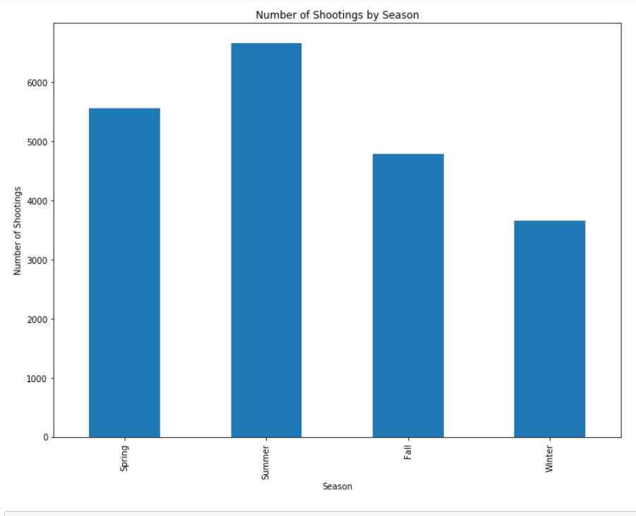
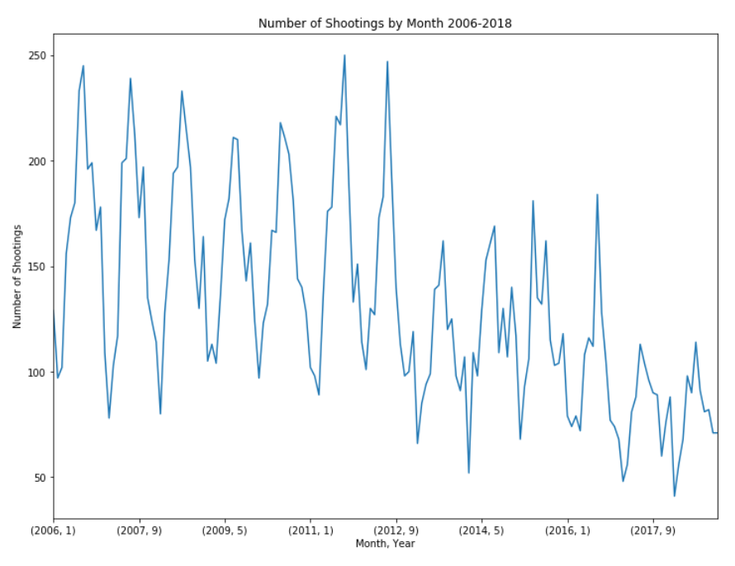
The Demonstration
I did groupby([‘year’, ‘month’]).size() to count the shootings per month over time
I did groupby(‘season’).size() to count the number of shootings
Notes:
While my calculation for the probability of a shooting-free weekend relies just on raw occurence rates and not seasonal or yearly trends, the model I’m building that will predict the number of shootings expected to occur on a given day of the week will account for year and season.
The graph on the left shows what is common knowledge among police departments that shootings go down in the winter time and spike in the summer.
The graph on the right shows the trend in number of shootings per month since 2006. Shootings have steadily been going down so it may be that the number of expected shootings to occur on a given Friday (weekday = 5) this year is different than that from 2006.

