Slide 1
Keeping Your Online Accounts Safe
A hacker’s insight into password security
Notes:
Hello! And welcome to Keeping Your Online Accounts Safe, a hacker’s insight into password security. There have been a few high profile breaches circulating in the news lately, and they’ve shed light on some habits that we as users might have picked up over the years that put us at risk. I was preparing a talk on password security at my office, and after discussing the subject with some friends and family I decided a similar talk would be useful for public consumption as well.

Slide 2
Who the heck am I???
15 years in IT
5 years in information security
Certifications
  OSCP, GCIA, GNFA, GCIH
Security awareness advocate
Offensive security enthusiast
Notes:
But, “wait!” you may be saying, “who the heck is this guy and why does it matter what he thinks?” Well, I’m Derek Rook, a security engineer and sometimes consultant. I’ve been in IT for 15 years, starting as a web developer, and then doing a little of everything from helpdesk to network and system administration. I made the switch to security about 5 years ago, and am certified in intrusion analysis, network forensics, incident response and penetration testing (which is just a fancy term for good guy hacking).
Something a little different about my security awareness talks is that I like to give insight in how the attackers are taking advantage of our security flaws. I think that it’s important to know what we’re protecting against in order to provide the best defense against those attacks. So today, we’re going to talk a little about the subject of cracking passwords.
But first, On to a few house keeping things...

Slide 3
DISCLAIMER:
This will not be an in depth technical talk!
Notes:
Disclaimer, right off the bat, this is not an in depth technical talk. We’re going to be exploring some pretty complex and deep subjects, and in the interest in keeping things moving and being able to appeal to a wider audience, I’m not going to be delving into the minutia of different theories and mathematical formulas and the like. The intention here is to provide insight into the reasoning behind best practices, not to teach password cracking to penetration testers.
On the flip side of that, if something does start to go over your head, please bare with me. We won’t stay in the weeds for long, and I should be providing context for the technicalities shortly after I present them.

Slide 4
Terms
Hashing: Mathematical operation to identify data without knowing it’s actual value. One way.
Credentials: Something used for authentication. Username and password.
Breach: Used to refer to event of a system or website’s security being compromised and data being removed.
Notes:
Alright, in order to talk about password cracking there’s some terms that you’ll need to know.
Hashing: Mathematical operation to identify data without knowing it’s actual value. Basically what that means is that given arbitrary data, let’s say...a password, a hashing algorithm’s goal is to compute that data into a unique string of characters. That means that if I hash the word “dog,” and then hash to the word “cat,” those two hashes will be different. Hashing is a one way operation, meaning that you can hash data into a hash, but you can’t unhash a hash into data. This makes it ideal for passwords because the system doesn’t need to know what the password is in order to check if a password is correct and I’ll be demonstrating how that works in a few minutes.
Credentials: Something used for authentication. Basically it refers to whatever you use to log in to a system. If you have an iPhone or iPad, for instance, your thumb print could be considered credentials as well.
Breach: Used to refer to event of a system or website’s security being compromised and data being removed. It’s a fairly straight forward term, but it’s important to know it’s specific meaning in information security.

Slide 5
The setup
How do attackers get our passwords in the first place?
What happens after the breach?
What is password cracking?
Notes:
Now, let’s give a little background on how password attacks take place. You might here or read about attackers cracking passwords or stealing peoples’ credentials, but how does that even happen? Well, usually when an attacker breaches a company or website, they have various goals in mind, ranging from data destruction to stealing trade secrets. But one thing they usually always try and get is a dump of usernames and passwords that exist on the system.
These lists are valuable as they allow attackers to impersonate the users, either on the system that they breached, or possibly other systems that those users may have accounts on. These lists are so valuable, in fact, that they often get traded or sold on the internet.
The good news is that if the site is using best practices, your passwords should be hashed so that the attackers don’t know what your actual password is, they just have a list of hashes.
Password cracking is the act of using a computer program to try and figure out what your password is based on the hashes they obtained from the breach.

Slide 6
Basic Password Attacks
Notes:
And finally, let’s talk about password cracking.

Slide 7
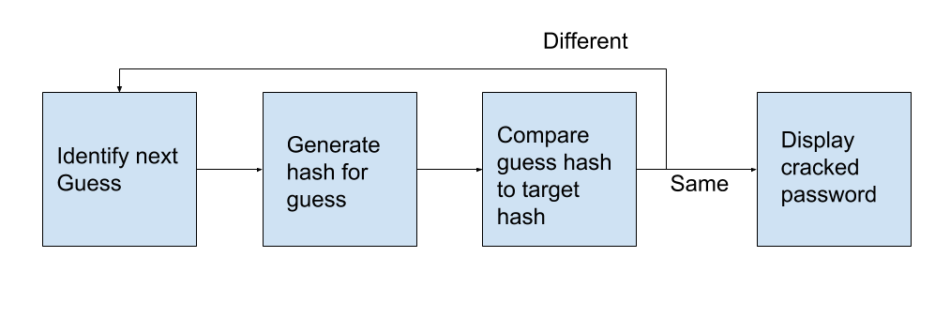
To Crack a Password
Notes:
Generally password cracking works like this. You figure out what your guess is going to be, you hash that guess, and then you compare your guess hash against the hash your trying to crack. If it’s the same, your cracked that password, if it’s different you try a new guess.
If you remember, hashing is a one way operation, so attackers can’t just unhash the list and find the password. That’s why they hash the guess and then compare.
Now, there are two primary methods of determining the guess mentioned in the first box.

Slide 8
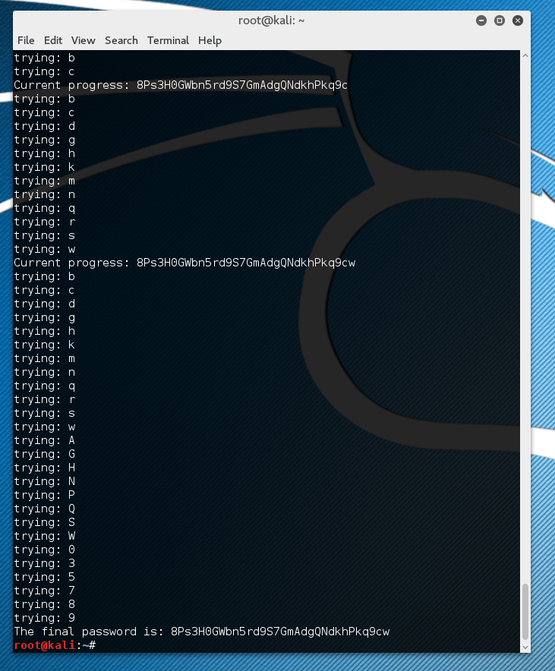
Brute Force Attack
Attempt every possible combination of characters
Will eventually find the password
Success depends on extremely fast computers
Notes:
The first one is called a Brute Force attack. Basically what it does is try and guess ever possible combination of characters until it finds one that matches your password. It will do something like start with a, then aa, aaa, baa, etc. This method will eventually crack any password put in front of it, but it could take a very long time depending on how good the password is and the speed of the computer. We’ll get to just how long in a few slides.

Slide 9
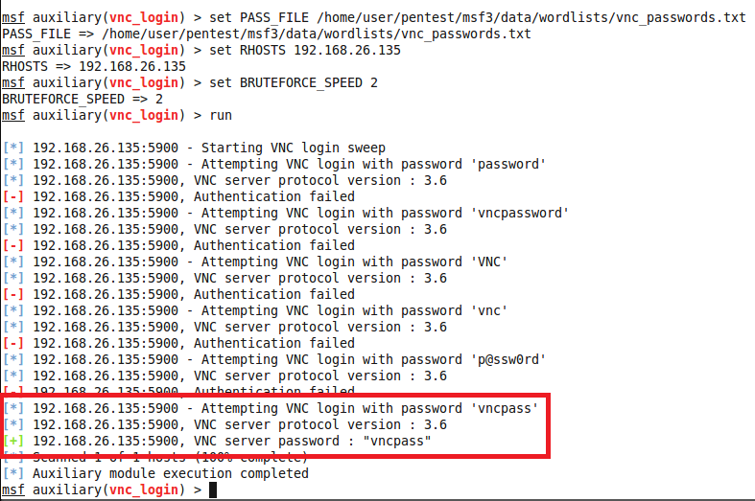
Dictionary Attacks
Runs through list of possible passwords (called wordlists)
Much faster than brute force
Success depends on extremely large or well crafted wordlists
Notes:
The second common method is called a dictionary attack. Basically it uses a list of possible passwords, using each line as a guess for the password until it reaches the end of the list. While this method won’t crack a password that isn’t on the list, if the password IS on the list then it will produce results much faster since it’s not wasting time with random characters in between.
Dictionary attacks live and die based on the quality of that wordlist.

Slide 10
A note on speed
CPU’s are relatively slow at generating hashes
  2014 Macbook Pro averages in the 10’s of millions of hashes generated per second on CPU
GPU’s are extremely good at hashes
  OC’d GTX 680 (2012) clock around 7 billion hashes per second
My 4 year old SLI gaming machine averages ~14 billion attempts per second
Notes:
So let’s talk a minute about speed. When we talk about cracking passwords, it’s important to know how fast this stuff happens. The speed is basically determined by how quickly your computer can complete the mathematical calculations needed to convert a password into a hash. Let’s put this into context.
My laptop is a 2014 Mac Book Pro, which is a fairly respectable machine when it comes to performance. The central processor in that laptop can calculate tens of millions of hashes per second. That means it is capable of making 10’s of millions of guesses every second.
In contrast, video cards, used for computer gaming and a few other applications, are really good at calculating hashes. My 4 year old graphics cards average around 7 billions hashes per second. I have two of those cards in my old gaming computer so it’s capable of generate around 14 billion per second.
There are such a thing as purpose password cracking machines and modern ones are many trillions of guesses per second.

Slide 11
Password Complexity
Notes:
We’ll get back to those numbers and what they actually mean for us as users in a few slides, but first, let’s talk a little bit about password complexity and how IT professionals quantify good passwords.

Slide 12
Beginner’s Guide to Password Complexity
Password complexity can be measured
We’ll boil this down to an “easy” formula
Basic formula: (number of characters in set) ^ (length of passphrase)
Notes:
When we talk about password complexity, there’s various mathematical ways to quantify exactly how complex a password is and how long it will take to crack a password given various methods. All of those methods are extremely complex, beyond the scope of this talk, and quite frankly, most of them are way over my head. To provide some context in this talk, however, there’s a fairly basic formula that we can use. What you do is you take the number of characters in your character set, and raise it to the number of characters in your password.
As an example to illustrate this, imagine a computer trying to brute force our password. Our password is ‘zzzz’, and they are starting at ‘aaaa’. We can calculate the number of possible character combinations there are using an alphabet of 26 lowercase characters for a 4 character long password. That means we take 26, the number of characters in the character set, raised to the power of 4, the length of the password.
In this case, there’s just under 457,000 possible combinations, and the computer will need to calculate each one before it finds our password.
With that sorted, let’s review a couple of tactics that IT guys have used to try and enforce good passwords in our environments.

Slide 13
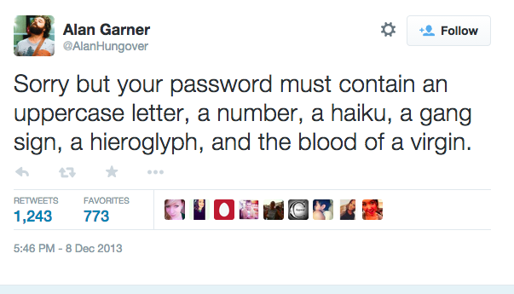
Complex Passwords
a-z + A-Z + 0-9 + punctuation = 95 possible characters
aC 9#<\g
95^8 = 6634204312890625
Notes:
Now, I’m sure that everyone who has used a computer at work sometime in the last 10 years has been the victim of IT guys yelling at them to make ridiculously hard to memorize passwords. And I apologize for that, I really do. We all make mistakes, and I hope you can forgive me for that one. It was just...terrible advice. What we were trying to do was increase the character set, make the computer have to calculate more characters per character slot. It was short sighted of us, as increasing the exponent is a way more efficient way of increasing the end result.
But, we’re here for context, so let’s go ahead and get the number of combinations for this password. Using the formula from the previous slide, the password here is using a character set of 95, which is made up of 26 lower case, 26 upper case letters, 10 numbers, and 33 special characters. The password also happens to be 8 characters long. This gives us a total of around 6.6 quadrillion possible combinations.
Let’s compare that to a newer methodology

Slide 14

Long Passwords
a-z = 26 possible characters
correcthorsebatterystaple
26^25 = 2 with 35 zeros after it
Notes:
Long passwords have become increasingly popular with security departments lately. I’m sure you’ve noticed that the minimum number of characters has been slowly increased on you over the years. As demonstrated by this XKCD comic, it turns out that long passwords are much easier for humans to remember, and much harder for computers to calculate. That’s because we’re increasing the exponent in our formula rather than the base number.
Using just a character set of 26, you can achieve a possible combinations total of 2 with 25 zeroes after it, I think that number is called Septillion. If you start with million, then billion, then trillion, you do that seven times, that’s septillion. It’s a truly monsterous number. To get a clearer picture, let’s see those numbers side by side.

Slide 15
Let’s see those numbers again!
6634204312890625
200000000000000000000000000000000000
aC 9#<\g
  Roughly 5.5 days to crack
correcthorsebatterystaple
  Rough 452 trillion millennia to crack
Notes:
Those numbers are clearly in different leagues.
Using the rough numbers on cracking speed of my gaming computer from a few slides ago, the so-called complex password would be brute forced in 5.5 days, where as the longer, simpler password would take 452 trillion millennia, a millennia being 1000 years. That’s just a staggering amount of time.
So that’s it, we’re done, right? I mean, no one is going to wait that long to get your password, so we’re all secure.

Slide 16
Advanced Credential Attacks
Notes:
Unfortunately it’s not that simple. Attackers are always looking to gain a leg up, and have found ways to craft word lists that get very good at guessing what your password could be. If you recall from the earlier slides, dictionary attacks end up being significantly faster than brute force attacks if your password is on that wordlist. So let’s take a look at a couple methods attackers use to generate powerful wordlists

Slide 17
Common Pitfalls
Movie, book, or song quotes provide easy to remember extremely long passphrases
Substitute letters or numbers with other characters that look similar
Coming up with a single extremely long and complex passphrase and using it in multiple places
Notes:
If you’ll remember, I said that I like to use the attacker’s methods to inform our defenses. The reason is, they are using our defenses to inform their attacks. The attackers look at the things we do to defend ourselves and find the flaws in them. This is as meta as this talk will get, I promise, but let’s look at some things we do, and then we’ll look at how the attackers take advantage of those habits, and we’ll finish it out with how we defend ourselves from those attacks.
As minimum length password requirements have grown, people have been looking to movie, book, and song quotes to provide them with long, easy to memorize pass phrases. Another trick is to use something related to the system we’re logging in to. Something about our work, or something about facebook, whatever helps spark our memory so we can memorize all of these passwords.
Another thing people do is substitute characters with look alike characters. An e becomes a 3, an ‘a’ becomes an @ symbol.
The last thing people do, is once they come up with an incredibly long, complex pass phrase, they use it literally everywhere. We put in the effort to memorize it, we should be rewarded by being safe everywhere we use it.
Well, let’s take a look at some of the ways attackers counter these tactics.

Slide 18
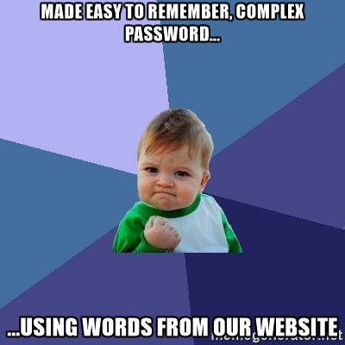
Generating Wordlists with Context
Notes:
Attackers have developed tools that can look through websites, movies scripts, book manuscripts, and song lyrics to generate massive word lists containing phrases and groups of words that we might use as an easy to remember password. If they’re looking to crack passwords obtained in a breach of your company, they may crawl your company’s website to add words that relate directly to you and your job to their wordlists. Have you have tailored your password to the site or service it’s being used for? Well the attackers have thought of that, and are using that habit against you.

Slide 19
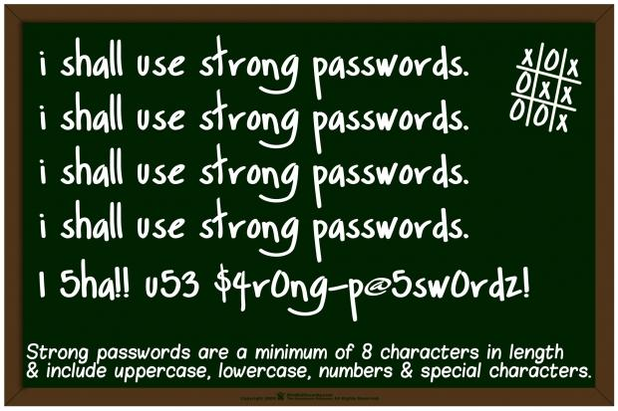
Automated Substitution Rules
Notes:
Well, what about replacing letters with numbers or punctuation that looks similar? Or adding punctuation to the beginning or end of a word. That is clearly not a real word, and won’t be on their word lists, right? Well, attackers have tools for that as well. They have programs that go through their word lists, and use rules to add permutations of every entry. I even have several rules for engagements I work on that adds possible birth years or the current year to the end of all of the words in my list, as those are common things users put on their passwords to make them more complicated.

Slide 20
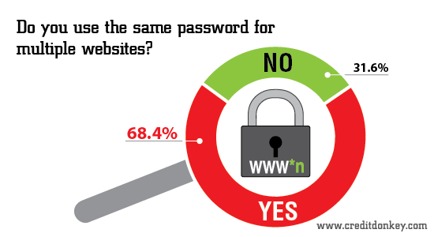
Automated Substitution Rules
Notes:
What about re-using their super secure password? This is actually the worst habit of them all. Everyone does this. Even I was guilty of it for a time. It’s insidious in how convenient it is, how we, as creatures of habit gravitate to this habit. Here’s the problem. Remember when I said credential lists were traded and sold online? You better believe every time a new credential dump gets released, those dumps get cracked and then added to those peoples’ wordlists, making it easy to crack other places.
But worse than that, and the real reason this is bad, is because attackers KNOW that users re-use passwords. You better believe that if they have your username and password, they’re going to try it everywhere. Do you trust linkedin or tumblr with your bank account? If you’re using the same password in all places, then you are trusting them. You’re trusting their security to be as good or better than your bank’s. Your social club’s forum or that review site you frequent may not seem important, until that password that was stolen from there helps the attacker drain your bank account and steal all of your personal photos you store in your cloud account.
I cannot stress enough how important it is to not re-use passwords. It is one of the most concerning things in user security right now.

Slide 21
Making Good Passphrases
Notes:
Well, that was a lot of doom and gloom. The attackers have thought of everything, so we just pack it in, right?
Well, not exactly, there are some things we can do to make their jobs a little more difficult and our online identities a little safer.

Slide 22
Okay, so what do we do?
Make a passphrase describing a character in a book or movie you like (but not your favorite) that is not a quote (or similar to a quote)
Don’t rely on simple substitutions to make an insecure password complex, but do use numbers and punctuation to improve the overall strength of the passphrase
Use passphrases
Enable 2-Factor wherever possible
Never re-use passphrases
Use a credential manager
Notes:
So what are those things?
Make a passphrase describing a character or object in a book, movie, or song. Don’t pick your book or character, just one that you like. Describe it in your own words. This will make it nearly impossible for a program to happen upon the exact combination of words you used.
Don’t rely on simple substitutions to make a secure passphrase. You can use substitutions to help make it secure, but it can’t be the only thing making it so.
Use passphrases, not passwords. Passphrases are long and easier to remember. They also generally contain spaces and punctuation, making them inherently more complex.
Enabling 2 factor authentication can help keep your account secure even during a breach. Most sites allow you to use an app like google authenticator to generate an additional code when logging in, or will send you a text message to confirm it’s you that logged in. Enable that wherever you can.
As mentioned in the last panel, never re-use your passwords. That can get ugly, trying to remember a different password for every site, service, and computer, so the final recommendation is to use a credential manager like LastPass, 1Password, or Keepass. Credential managers could be a webcast all in themselves, and I intend to make one soon, but they are extremely helpful for keeping track of credentials. Find one you like and start using it.

Slide 23
THANKS!
Twitter: @_r00k_
Notes:
Hopefully you learned something from this video. If you did, please share it with your family and friends. The goal here is to help everyone stay safe online.
I have two ideas for follow up webcasts, one on credential managers, and one on two factor authentication, so keep an eye open for those over the coming weeks.
If you have any questions, comments, concerns, or suggestions, feel free to either visit the comment section on youtube, or you can reach out to me on twitter at @_r00k_

