Slide 1
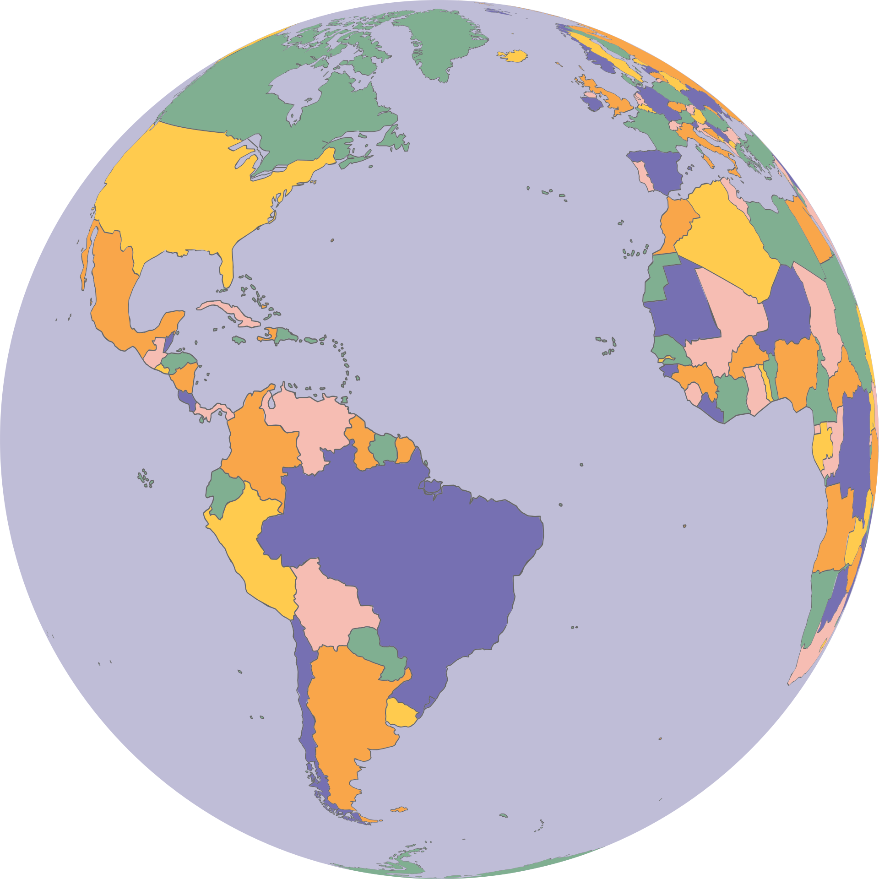

?
Spaß mit
Flaggen

Slide 2



Gliederung
System Kontext
Testkonzept
Statische Code Analyse
Backend
Frontend

Slide 3
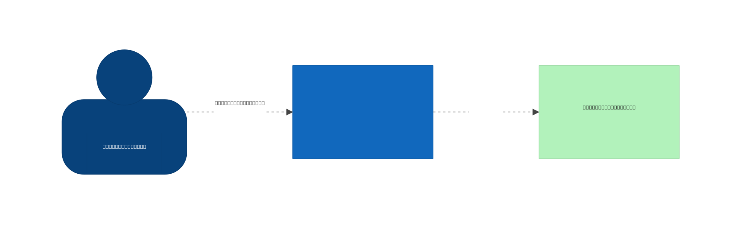
System Context

Slide 4
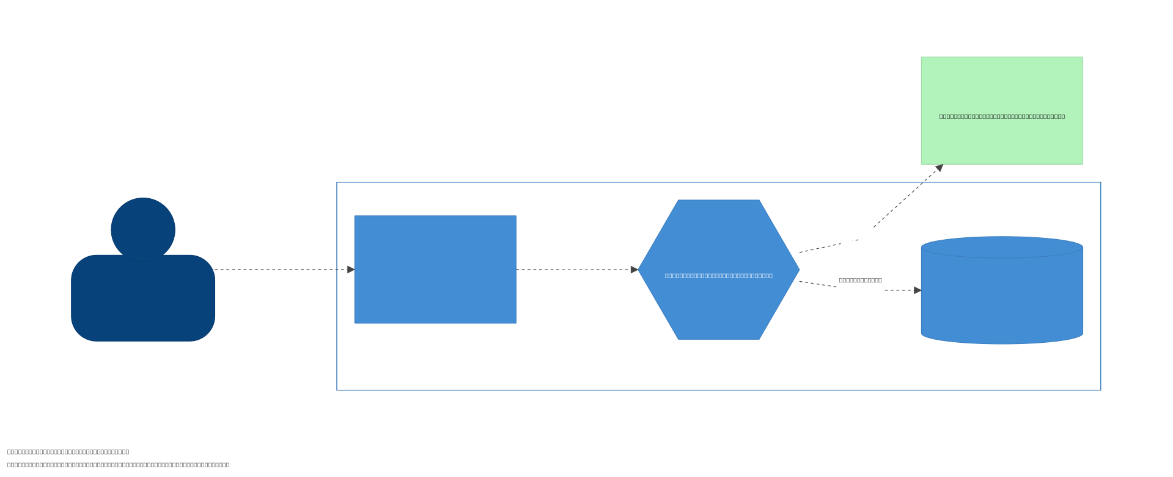
Technical Context

Slide 5
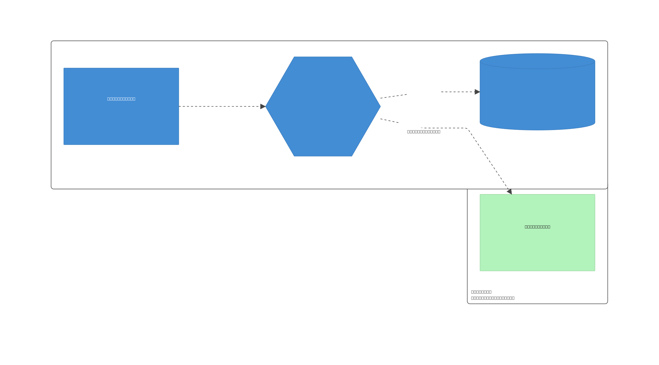
Deployment View

Slide 6
Testkonzept
CI/CD-Pipeline
E2E-Tests
Static Code analysis
Backend
Frontend
Integration
Architektur
Integration
Unit
Unit

Slide 7





Sonarqube
Security
Quality Gates
Code-Qualität
Multi-Language Support
CI/CD-Integration
Reporting

Slide 8
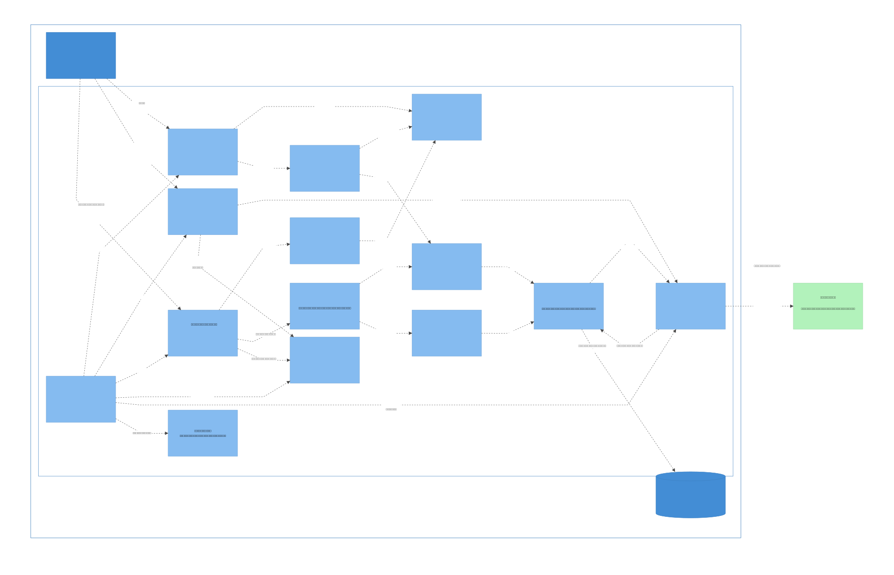

Slide 9
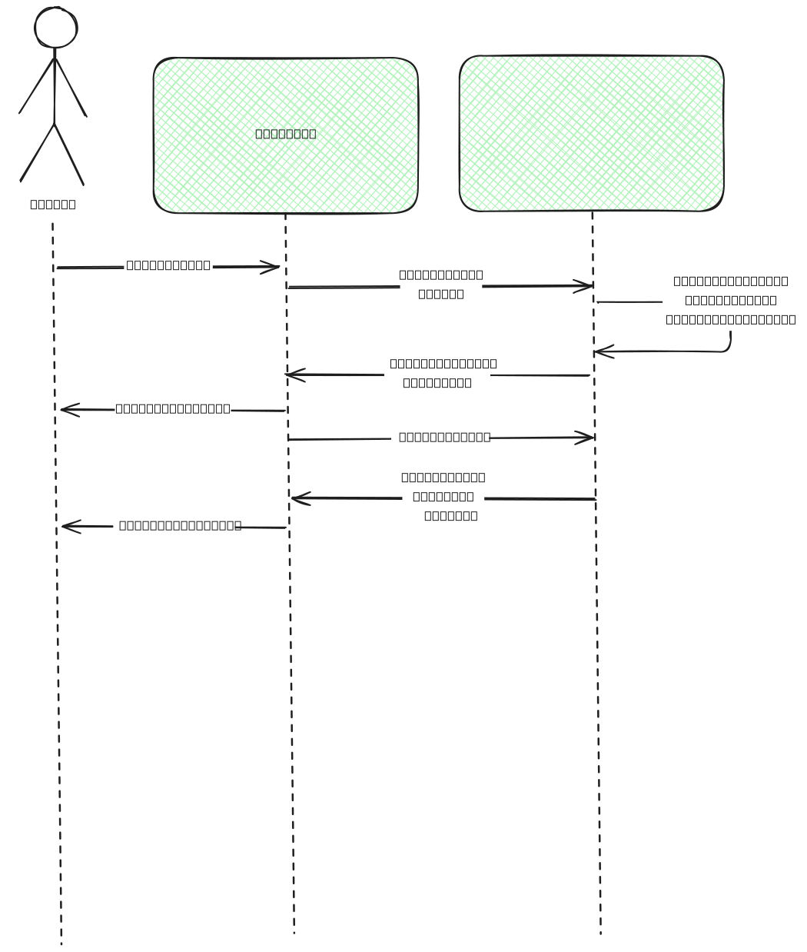
Correct Guess

Slide 10
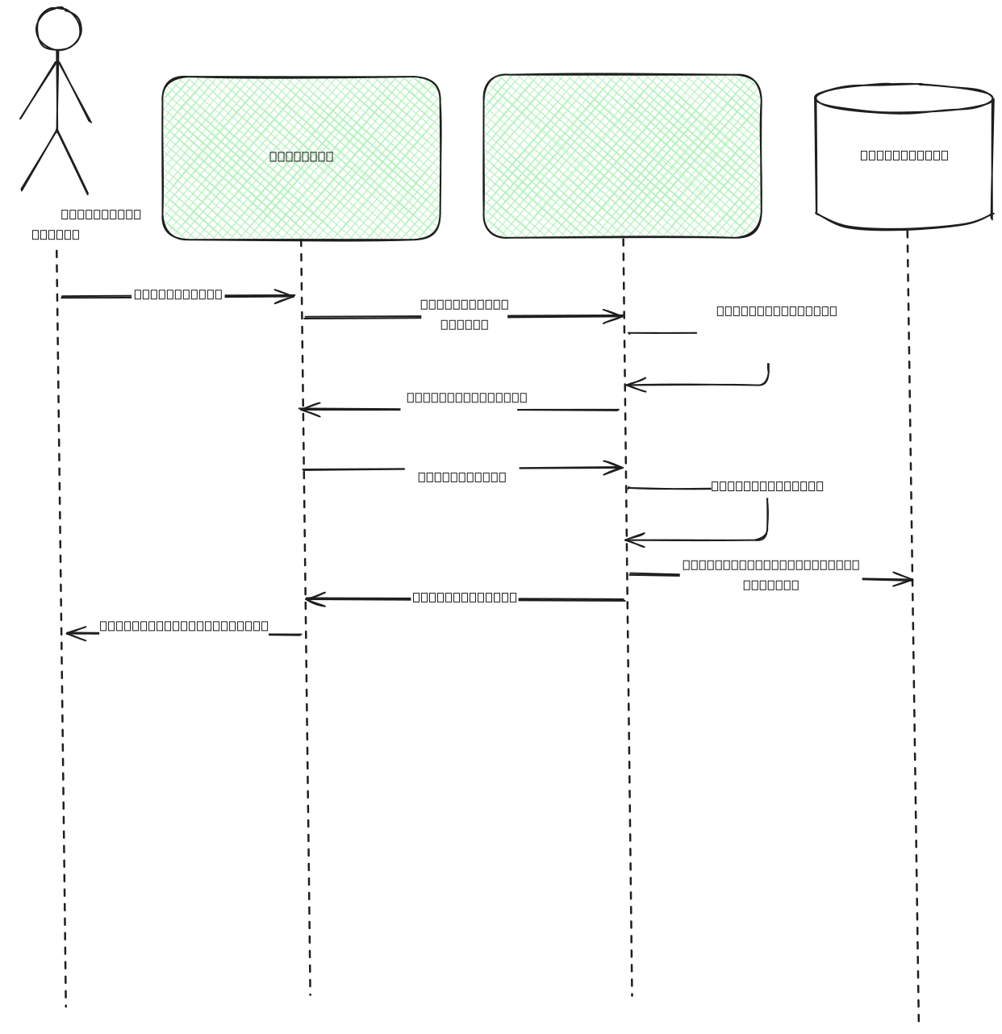
Incorrect Guess

Slide 11
Backend Tests
Unit Tests
Integrationstests
Test Postgres-Container
flag_cache.load Mock
Security: XXS, SQL-Injection, Password + Username, JWT, Session ID
Architekturtests:
pytestarch
Services importieren DB, Routers nicht
DB importiert Router nicht, Router keine DB

Slide 12
Frontend
Vue.js + TypeScript
Vite Dev + Build Tools
nginx + docker
Headless

Slide 13
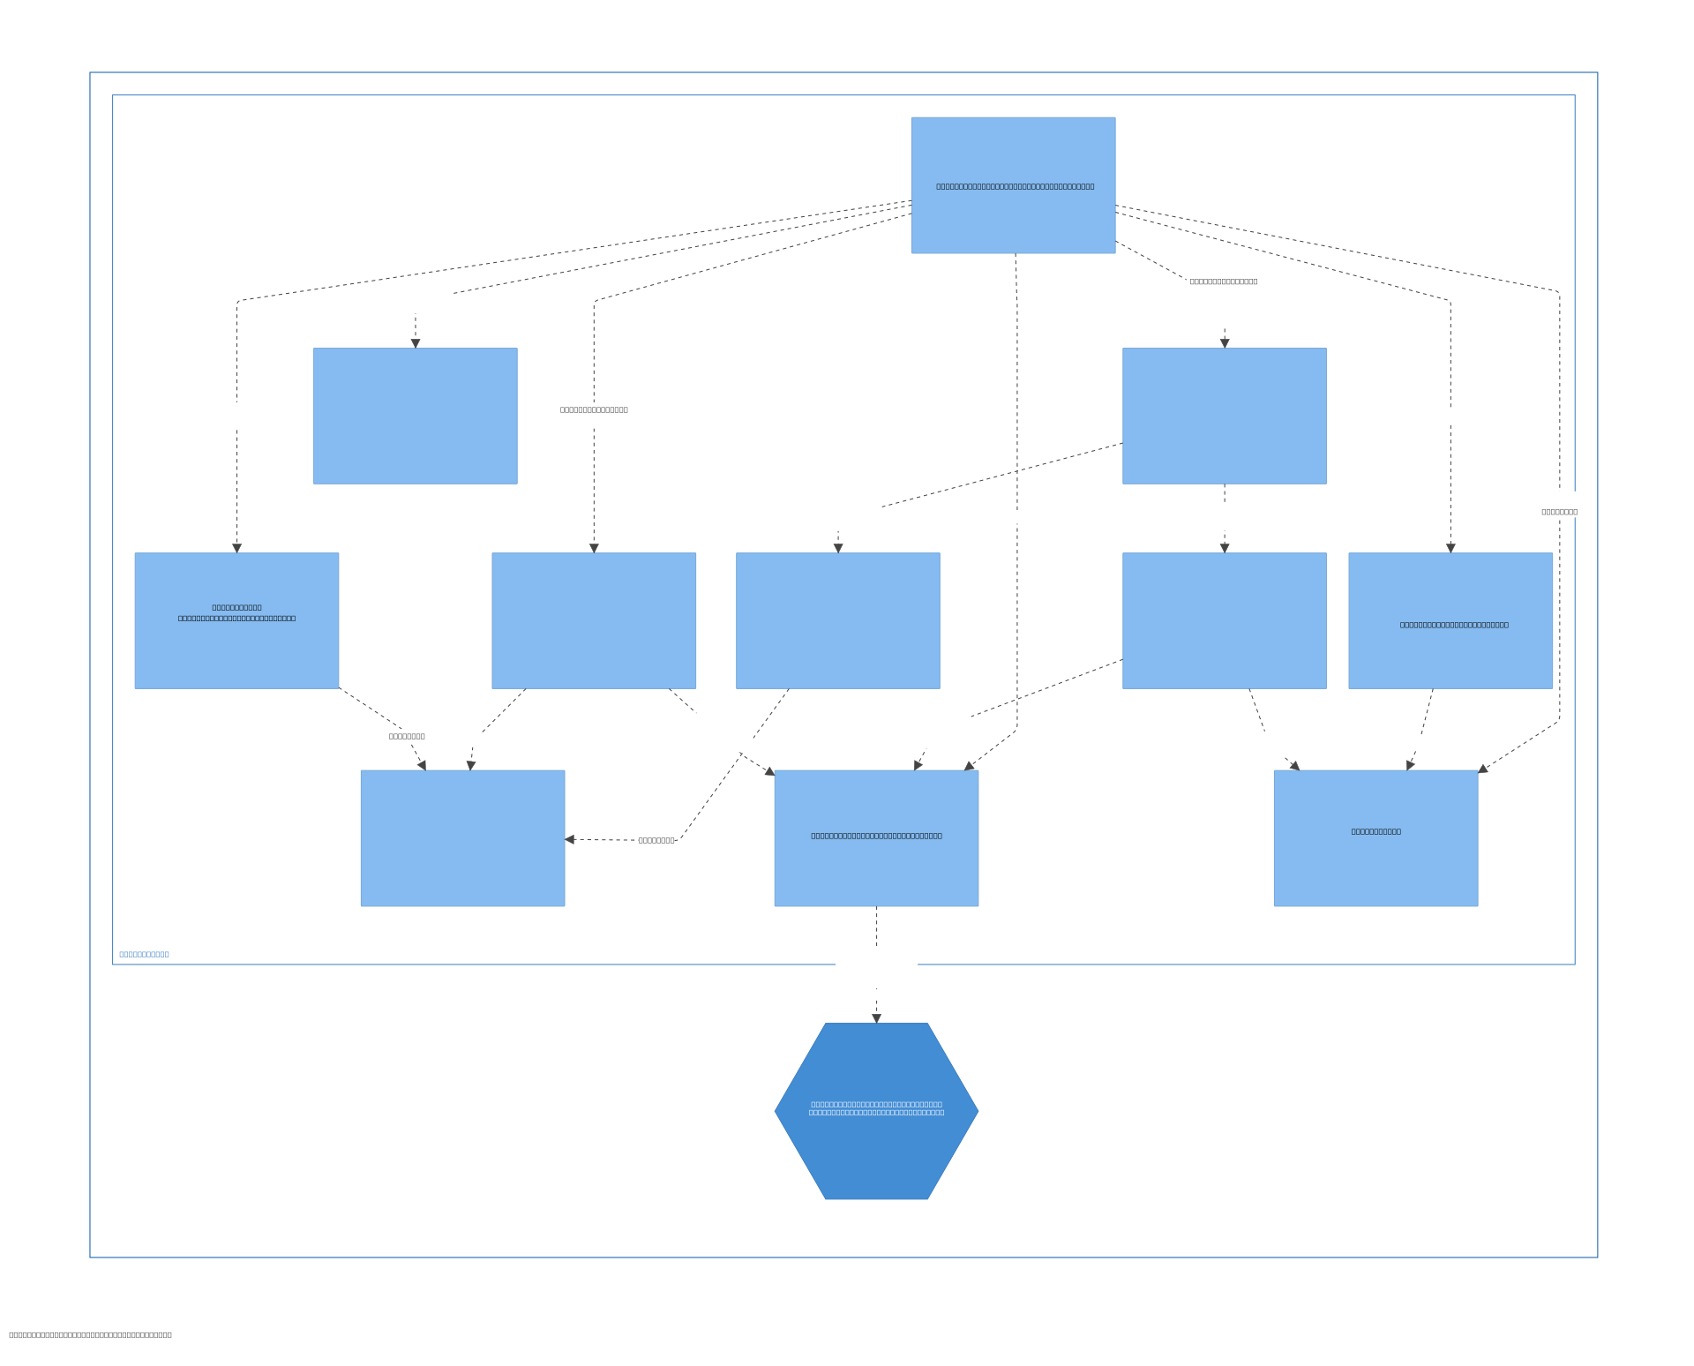

Slide 14
Frontend Tests
Unit/Component/Integration Tests
API mock (fetchMock)
E2E Tests mit Playwright
Game/Auth/Smoke

