Slide 1
Generating and Personalizing Bundle Recommendations on Steam
Apurva Pathak, Kshitiz Gupta, Julian McAuley SIGIR 2017
CSCE 670 Paper Breakdown :: HUNG-YI CHEN

Slide 2
Motivation (1/ 2 slides) Why is this paper interesting?
Recommendations for "bundle" items have some benefits.
Driving sales revenue, lowering inventory level.
A solution to real-world problems with solid business potential.
Recommending "bundle" items to users based on classic method.
An improved BPR method is proposed in this paper.
Generating personalized bundles from existing items.
Normally, existing packages are already fine-tuned by marketing team.
How a generated bundles can outperform the existed ones?
Notes:
[1] When shopping on Amazon, we can found Amazon always "bundle" commodities to customers. In this way, they can:
(1.1) From the business perspective, it can drive sales revenue and lower the inventory level.
(1.2) This research has a strong link to real-world problems, which has solid business potential behind.
[2] Secondly, the algorithms in this paper is based on the BPR model we have learned in class. It is a chance to learn how it works in other problems.
[3] I may think that the bundles are fine-tuned by the marketing team. So how can the authors improve in this field by information retrieval techniques?
<編號>

Slide 3
Motivation (2 / 2 slides) What is the paper trying to do?
A Steam video game dataset with:
Few items (25%) are in bundle, but much purchases (70%) are items in bundles.
Modifying and Personalizing bundles for users is an aspect to drive revenue.
Trying to learn latent features for users and items by BPR.
A customized BPR model to generate bundle rankings by latent features.
A greedy based method is used for personalized bundles generation.
Notes:
[1] The authors adopted a Steam video game dataset with only 25% items in the bundles, but much purchases (70%) are items in bundles.
(1.1) There is a potential here that providing a better personalized bundle for users, if the steam provider hopes to drive revenue.
[2] Firstly, the authors learn latent features between users and items by BPR.
[3] Using a customized BPR model to generate bundle rankings by latent features.
[4] A greedy based method to generate personalized bundles generation for every users.
<編號>

Slide 4
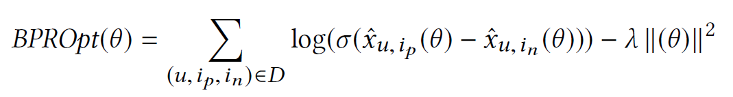
Contributions (1 / 4 slides) Bundle Ranking – Data Sampling and Item BPR
Data Sampling:
to solve power-law problem by graph sampling algorithm, creating Item Data D_{Item} and Bundle Data D_{Bundle} .
Optimization Criterion:
model the ranking by encoding the compatibility between a user and an item using BPTOpt.
Optimization Criterion:
the sigmoid expression represents the probability of purchased item is more preferable than non-purchased one.
Notes:
[1] Firstly, the authors introduce the Data Sampling problem, because the positive ratings of users are too sparse. So they equalize the distribution of negative and positive items to the same scale. The author claims that this would make model to learn richer notion of compatibility, not just predictions based on the distribution of negative/positive population.
[2] The author adopts a BPROpt model as predictors for recommending items and bundles for users.
[3] The sigmoid expression here is to represent the probability of the purchased item is more preferable than non-purchased one.
<編號>

Slide 5
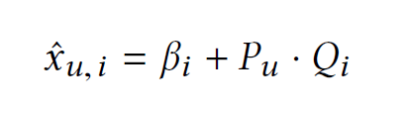

Contributions (2 / 4 slides) Bundle Ranking – Bundle BPR
Item BPR: based on matrix factorization, learned by BPROpt on D_{Item}.
Bundle BPR: the main contribution, learned by BPROpt on D_{Bundle}
β, P, and Q are learned from the item BPR model
This model considers pair-wise Pearson Bundle Correlation c_{b} in the bundle
Notes:
[1] For the item based BPR, the authors set the estimator as x_ui and learned the Pu and Qi, which are k-dimensional latent parameter vectors for user u and item i.
[2] The second part is the main contribution of authors: Bundle BPR.
(2.1) The Bundle BPR estimator uses the latent parameters learned in Item BPR.
(2.2) It also considers Bundle Correlations, which is a pair-wise Pearson Bundle Correlation in the bundle, represented by using item BPR latent features Q.
<編號>

Slide 6
Contributions (3 / 4 slides) Bundle Ranking – Cold Bundle Problem
Definition: a Cold Start Problem in Bundle Ranking
Cold bundles containing at least one item which is not observed in any existing bundles in dataset.
Using the trained Bundle BPR model to rank any bundle.
The authors validated by creating a reduced item set that removing some items and resampling the training data D_{Bundle}.
The proposed results show that it can deal with this cold start problem.
Notes:
Cold start happens when new users or items arrive in a recommendation system, or a old users or items with low feedbacks. If a recommendation
[1] In this paper, the author define cold bundles to be the bundles containing at least one item which is not observed in any existing bundles in dataset.
[2] And it uses the reduced size of item set as training data of cold bundles.
[3] The experimental results show that the proposed algorithm can cope with this cold start recommender problem.
<編號>

Slide 7
Contributions (4 / 4 slides) Bundle Ranking – Personalized Bundle Generation
Greedy based Personalized Bundle Generation
Using the preference score from the Bundle BPR to recommend new bundle for each user.
Selecting the set of items to form bundle greedily, based on the preference scores of each user.
Start with an initial bundle and randomly select neighboring items for add, deletion or replacement of the bundle set.
Converge by a bundle for each user with the best preference score.
The bundle size shall larger than 2, to avoid generating one-item bundles.
Notes:
In this part, the author utilized the proposed Bundle based BPR to generate the personalized bundle for each user.
[1] This is a Greedy based method selecting the best bundle with highest preference score for each user.
[2] The method starts with a initial bundle and implement the add, delete or replace operations to the bundle set.
And when the iterations are converged, it will provide the best bundle for each user.
[3] To prevent generating a one-item bundle, the minimum bundle size shall be 2.
<編號>

Slide 8
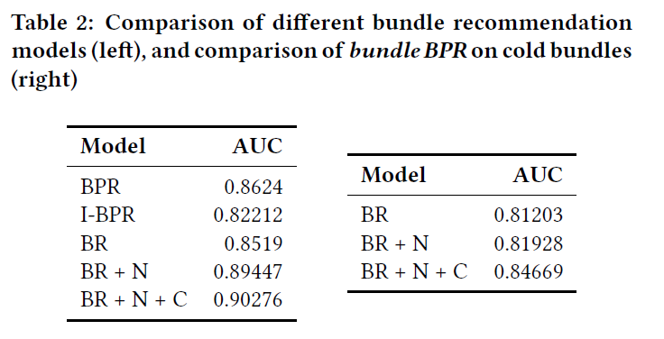
Interesting Experimental Results (1 / 2 slides)
(1) BPR: Regular BPR.
(2) I-BPR: Bundle BPR using item features.
(3) BR: Proposed method without bundle size and bundle correlation.
(4) BR+N: Proposed method with bundle size.
(5) BR+N+C: Proposed method with bundle size and bundle correlation.
β, P and Q in BR are constants learned from the item BPR model.
BR+N+C is a proposed BR with bundle size and bundle correlation.
Proposed model BR+N+C can not only be used for generating new bundles but also outperforms BPR.
Notes:
[1] The authors compare their proposed methods to the previous methods (including BPR and I-BPR). And they also split their methods to three types, they are originally proposed model, the proposed model with bundle size, and introduce the bundle correlation further.
[2] The experimental results show that their method outperforms the previous methods in AUC metric, and the bundle size and bundle correlation are helpful for recommending bundles to users.
[3] Furthermore, the authors also suggest that the bundle size and bundle correlation are helpful when solving the cold bundle problems.
<編號>

Slide 9
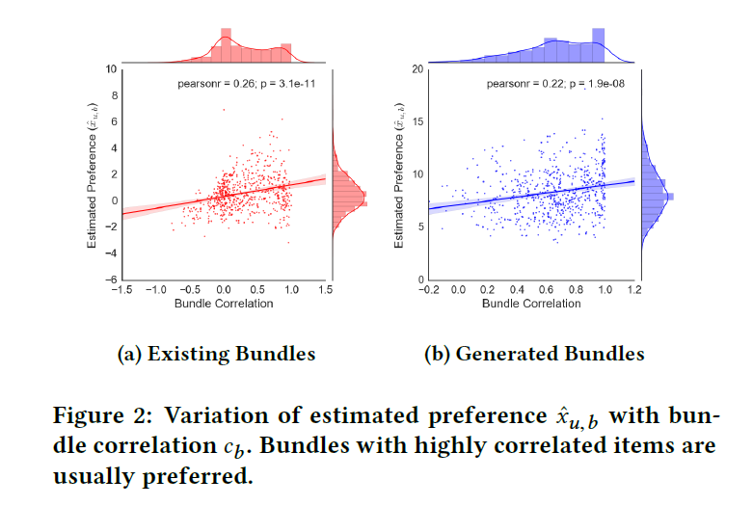
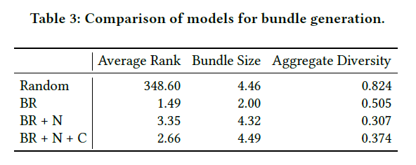

Interesting Experimental Results (2 / 2 slides)
The importance of bundle correlation to Bundle BPR model.
Bundles with higher correlations lead to higher Preference scores.
Aggregate Diversity is to assess the diverse variety of recommended bundles.
Notes:
[1] The author want to emphasize the benefits of incorporating "bundle correlation".
[2] Bundles with higher correlations usually lead to higher preference scores, either in the original bundles in dataset or the generalized bundles based on the authors' work.
[2] The authors also introduce the Aggregate Diversity metric, which is used to prove that their algorithm can access a diverse variety of recommended bundles.
<編號>

Slide 10
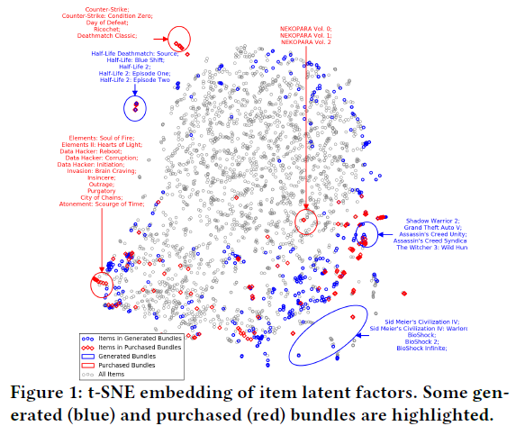
Interesting Experimental Results (3 / 3 slides)
Generated bundles can be catogorized to three types:
All items in a bundle are similar.
Multiple series are collected in a bundle.
Different games with similar types (genre) are collected in the same bundle.
Notes:
The author tried to do some analysis on the properties of the generated bundles with the aid of t-SNE embedding of latent representations, and they conclude three types of bundles will be generated.
[1] All items in a bundle are similar.
[2] Multiple series are collected in the same bundle.
[3] Different games with similar types are collected in the same bundle.
<編號>

Slide 11
My Thoughts (1 / 2 slides) Limitations or Unclarified Parts
Adopting AUC metric only is not enough,
Introducing other criteria (NDCG@5, Precision@5) to be supporting facts.
Some parameters setting are not clarified with enough background information.
EX: initial bundle size = 3, neighbors k = 10 in the Personalized Bundle Generation.
Introducing Cross-Validation procedures would be helpful.
Cross-Validation to prove or find the best hyperparameters
More comparisons with related works.
The authors have cited three related works, and it may be much better to compare with those methods.
Notes:
[1] To support the effect of the proposed algorithm, the authors adopt AUC metric, and it is great. However, I think it may not be enough.
(1.1) Only relying on one metric may have some bias, that why there are many criteria designed for every type of experiments.
(1.2) From my perspective, introducing NDCG@5 or Precision@5 may be a good idea. (Considering the users may not buy too many steam games)
[2] Some parameter settings are not clarified with enough background information.
(2.1) For instance, in the Personalized Bundle Generation part, the initial bundle size and the number of neighbors are confused. Readers may be hard to understand why initial size = 3, neighbors = 10 is the best hyperparameters for this method.
[3] Most Machine Learning based scheme may have a cross-validation step, adding this to the work may be helpful.
(3.1) This step is used in order to prove or find the best parameters for specific model.
[4] The author only compared their work with BPR, which is proposed in 2009. And the authors have cited three related works which are published in 2014 and 2016, I guess the results could be more supporting if it can also be compared with the more recent works.
<編號>

Slide 12
My Thoughts (2 / 2 slides) Benefits and What I can learn from?
Learned pre-processing details and new IR concepts
Tuning negative and positive items to the same degree of distribution.
Using the"Cold Start" cases to evaluate the performance of recommender system.
A research with useful real-world applications.
EX: boosting the shopping desires of customers
The analysis on the generated bundles.
Explain what is "learned" is as critical as the great performance.
The authors analyzed and explained what is contained in the generated bundles.
Notes:
[1] I learned a new concept in pre-processing stage from this paper.
(1.1) I also do some studies that balancing the negative and positive items to the same degree can prevent the biased problem. Also, as the authors claimed, it can learn more information.
(1.2) The cold start problem is also a good aspect to to evaluate the performance of recommender systems. Because there are always new items and new users in the real world. The good recommender system could be resistant to a variant of such problem.
[2] For the authors of many papers, they often focus on a very hard problem and propose a complicated algorithms. In this paper, they start with a common real-world problem and solve it. The most interesting part is that their work can be used in the real-world, because the results outperform the current bundle. (As I stressed, the bundles may be fine-tuned already by the seller)
[3] In this paper, the author did some analysis on what is contained in the generated bundles, I think "Explain what is learned" is as essential as a good performance.
<編號>

