Slide 1
Outline
History
Course
Resources

Slide 2
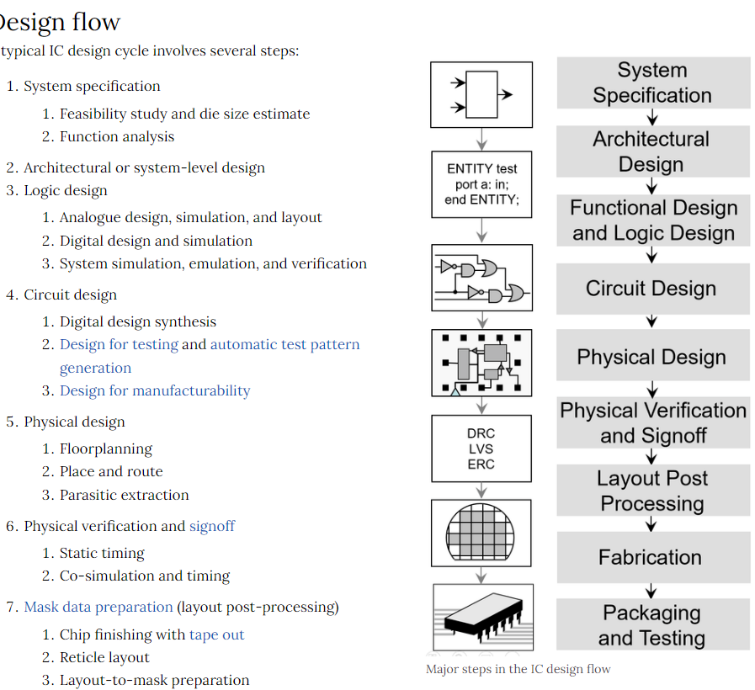
History
hdl, hardware description language
Verilog used in -> (mainstream)
VHDL (optional)
system C (optional)
前段
frontend
後段
backend

Slide 3

History (cont.)
Verilog, IEEE1364
.v
Systemverilog, IEEE1800
.sv
ref
DVCon 2021: A personal perspective on the history of SystemVerilog
https://www.youtube.com/watch?v=NFE9-o11aec

Slide 4
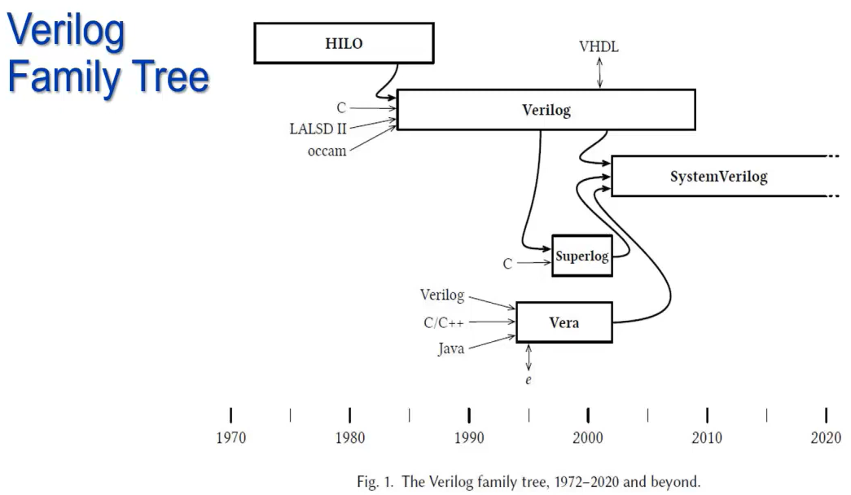

History (cont.)
language war winner: sv

Slide 5
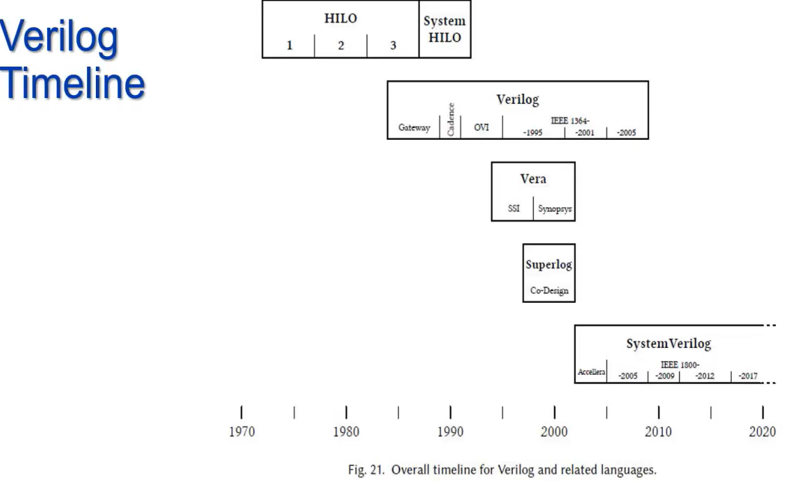
History (cont.)
50 years of hdl development until now

Slide 6
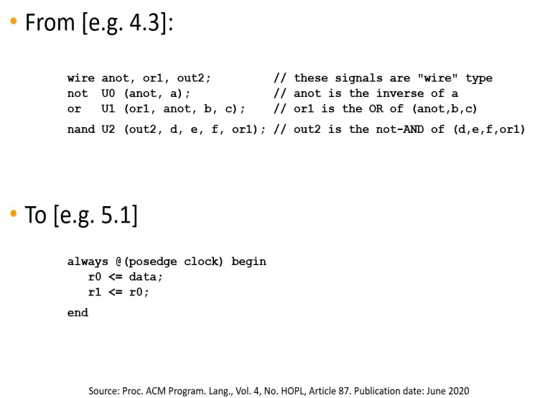
History (cont.)
From netlist to readable code

Slide 7
Course
content
systemverilog design (16 times)
systemverilog verification
assertion sva (4 times)
coverage (2 times) ← skip
universal verification methodology, uvm (10 times)
low power
upf (8 times)
40 times
frequency
every Thursday 21:00 ~ 22:00
fee
600NTD / hr by linepay

Slide 8
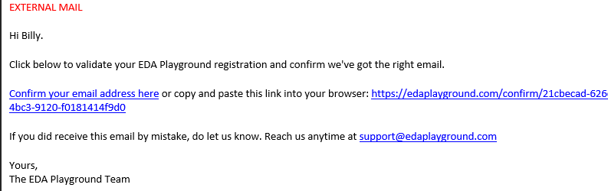

Resources
Simulator 模擬器
https://edaplayground.com/
Need institute account to verify
Verilog .v
https://www.asic-world.com/verilog/first1.html
Systemverilog .sv
https://www.youtube.com/watch?v=y_hEbgWWuQs&list=PLF4DeZAfqGSar69xWgw5TpFuszBd1FSJJ&index=1
testbench, SVA
https://www.youtube.com/watch?v=hMG0dRVjAMk&list=PLYdInKVfi0KYAH0ZfakBOGPQ8kTNj8g_B

