Slide 1
lab??

Slide 2
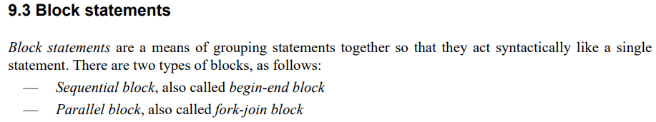
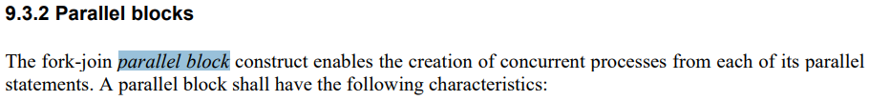
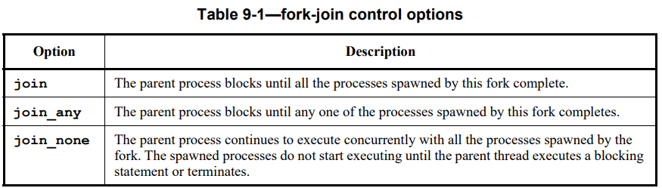
lab14
https://www.asic-world.com/systemverilog/process2.html

Slide 3
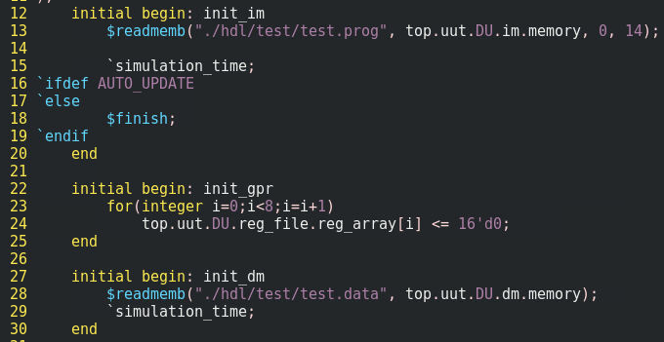
lab14
the problem without fork-join
as the figure, separate begin-end block for memory content initialization
the drawback is that it cannot control the relationship between threads, i.e. no explicit expression among threads

Slide 4
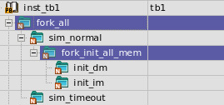
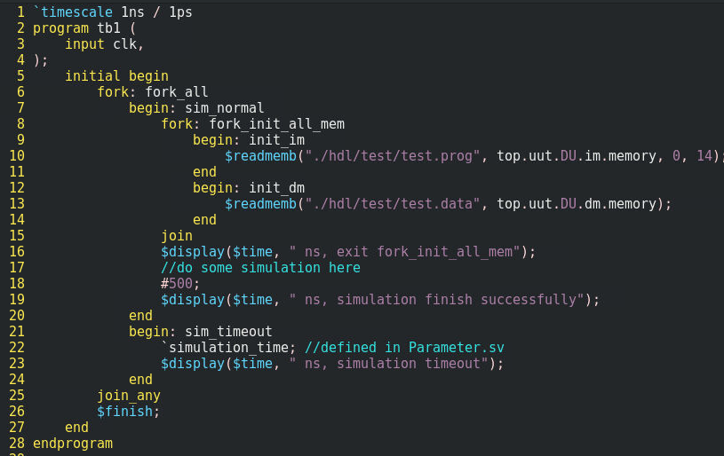
lab14
as the figure shown, with fork-join
organize threads in one initial begin end block
exit the fork-join block when all threads are finish
the purpose of fork-join is to confirm that all the memory are given the initial value in the beginning of simulation
as the figure shown, with fork-join_any
exit the fork-join_any block when either thread finishes
simulation timeout mechanism

Slide 5
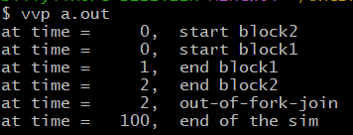
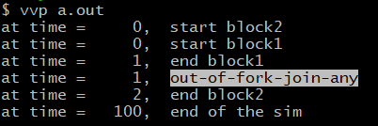
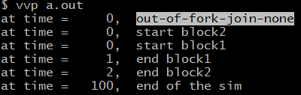
lab14, 15, 16
fork join
fork join-any
fork join-none

Slide 6
lab06
SOC top
module axi_
clkgen
module clkgen(
output clk)
endmodule

Slide 7
lab07
top
tb
dut

Slide 8
lab04
clk T = 10sec
20 clock counts
IDLE
FIRST
200sec
SECOND
100sec
LAST

Slide 9
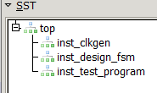
lab04
top
clkgen
design
test_program

Slide 10

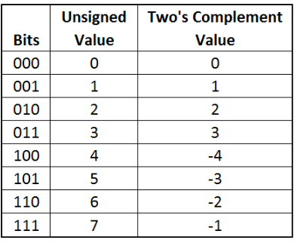
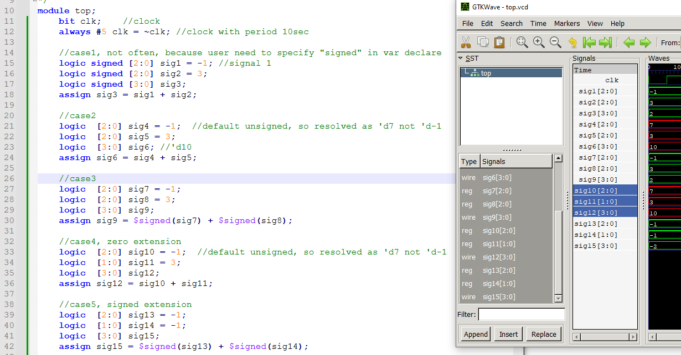
lab12
red = unsigned addition
green = signed addition

Slide 11
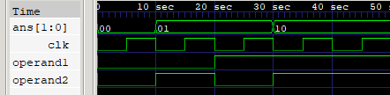
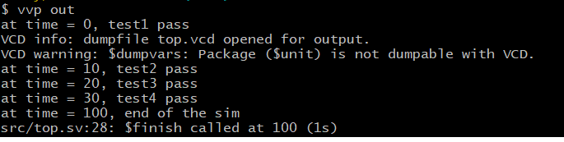

Slide 12
Outline
garage
m1
m2
c1
u1
u2
u1
u2
inst1
inst2
inst3
inst4

Slide 13




archive below
dut[0]
dut[0]
1
2
3
Add Input signals and add marker
1
2
3

