Slide 1
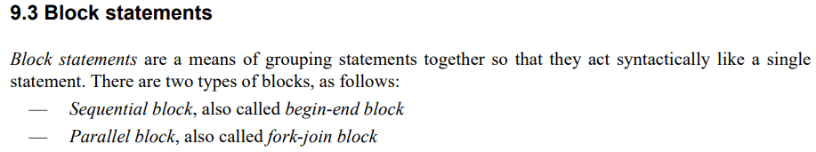
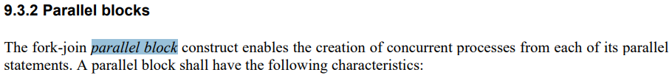
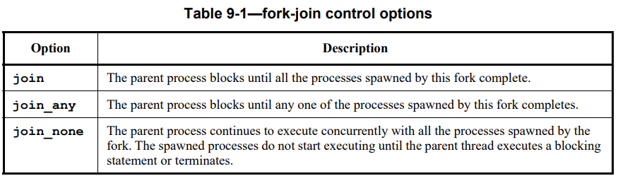
lab14
https://www.asic-world.com/systemverilog/process2.html

Slide 2
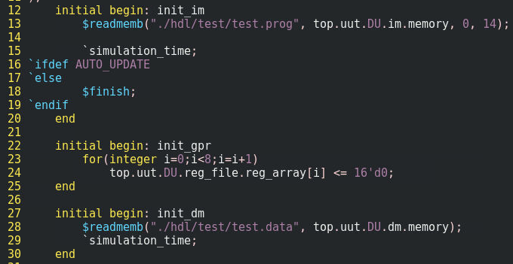
lab14
the problem without fork-join
as the figure, separate begin-end block for memory content initialization
the drawback is that it cannot control the relationship between threads, i.e. no explicit expression among threads

Slide 3
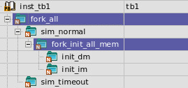
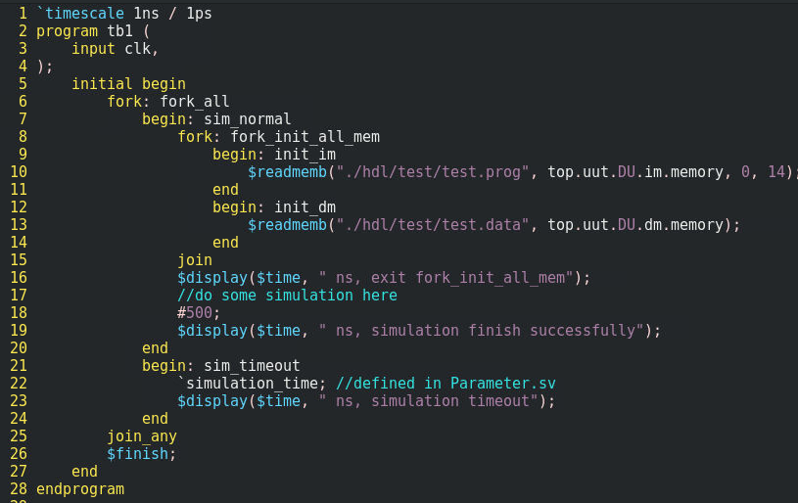
lab14
as the figure shown, with fork-join
organize threads in one initial begin end block
exit the fork-join block when all threads are finish
the purpose of fork-join is to confirm that all the memory are given the initial value in the beginning of simulation
as the figure shown, with fork-join_any
exit the fork-join_any block when either thread finishes
simulation timeout mechanism

Slide 4
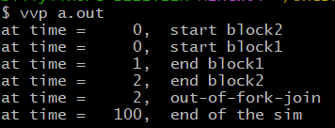
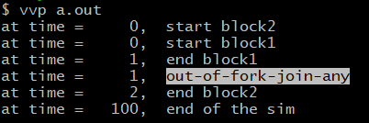
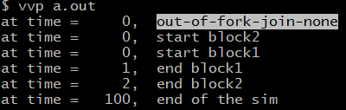
lab14, 15, 16
fork join
fork join-any
fork join-none

Slide 5
lab??
iff
always_ff@(posedge clk iff reset == 0 or negedge reset)
@(A or B)
if reset == 1
@(negedge reset)

Slide 6
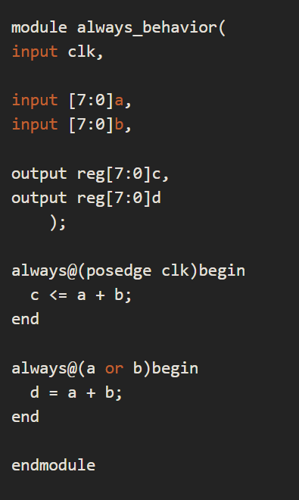
lab09
verilog
systemverilog
always_ff@(posedge clk) begin
…
end
always_comb@(a or b or c) begin
out1 = a & b & c;
end
always_comb@(posedge clk) begin
…
end
=> sim error,

Slide 7
lab07
wire connection by “assign” in generate block
module top;
sub #(.sel(0)) inst1();
sub #(.sel(1)) inst2();
endmodule
module sub;
parameter sel = 1;
logic sig1, sig2, sig3;
generate ←- this is optional
if (sel)
assign sig3 = sig1;
else
assign sig3 = sig2;
endgenerate ←- this is optional
endmodule

Slide 8
lab07
scope
module
endmodule
class
endclass
interface
endinterface
checker
endchecker
program
endprogram
generate
endgenerate
example
module top
c1 inst_c1();
i1 inst_i1;
endmodule
class c1
endclass
interface i1
endinterface
interface i2
endinterface
example2
module top
c1 inst_c1();
i1 inst_i1;
endmodule
class c1
endclass
interface i1();
clocking
endclocking
modport m1;
modport m2;
endinterface
interface i2
endinterface

Slide 9
lab07
module top
testbench (tb)
device under test (dut)

Slide 10
lab06
SOC top
module axi_
clkgen
module clkgen(
output clk)
endmodule

Slide 11
lab04
clk T = 10sec
20 clock counts
IDLE
FIRST
200sec
SECOND
100sec
LAST

Slide 12
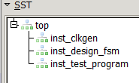
lab04
top
clkgen
design
test_program

Slide 13

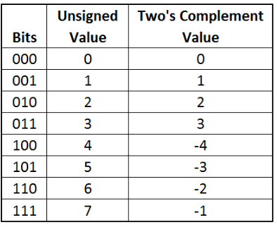
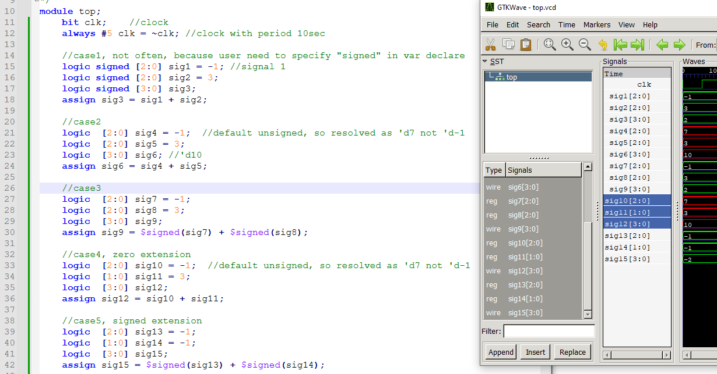
lab12
red = unsigned addition
green = signed addition

Slide 14
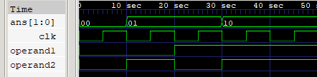
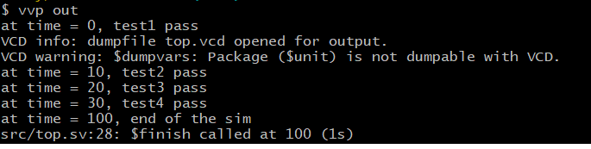

Slide 15
Outline
garage
m1
m2
c1
u1
u2
u1
u2
inst1
inst2
inst3
inst4

Slide 16




archive below
dut[0]
dut[0]
1
2
3
Add Input signals and add marker
1
2
3

