Slide 1




archive below
dut[0]
dut[0]
1
2
3
Add Input signals and add marker
1
2
3

Slide 2
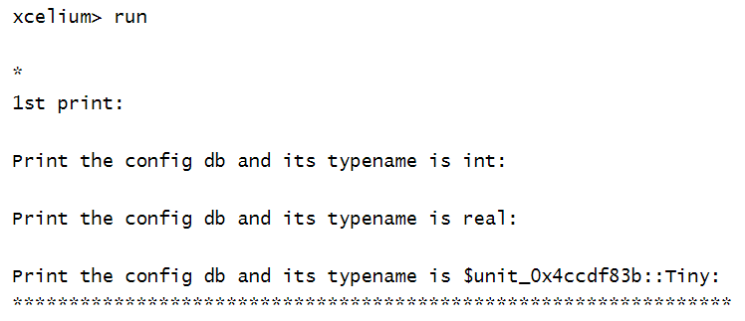
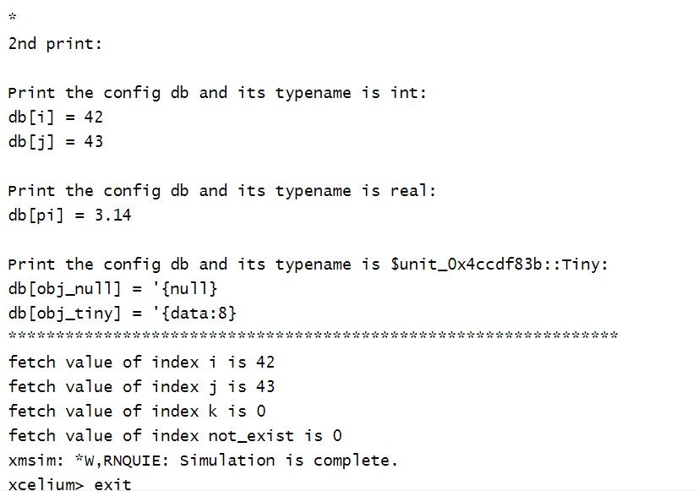
lab60
config_db#(int)
config_db#(real)
config_db#(Tiny)
linked list
data
pointer, point to next entry (node)
m1
i1
$unit
inst2
1
1
1

Slide 4
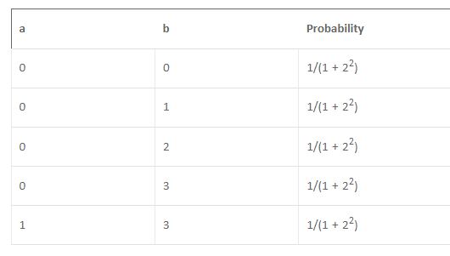
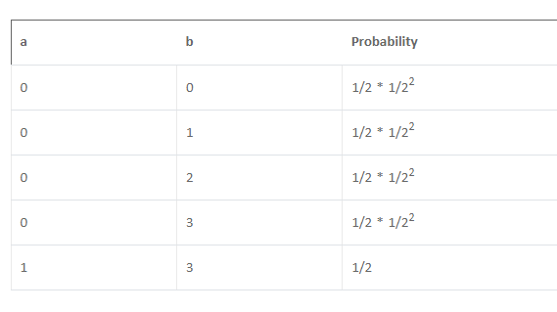
lab29
solve a before b
without solve a before b
solve a
solve b
with solve a before b

Slide 5
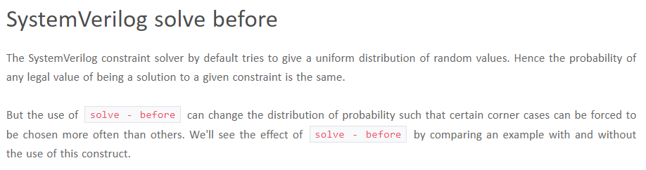
lab29
constraint probablity
ref
https://www.chipverify.com/systemverilog/systemverilog-solve-before

Slide 6
lab25, lab26
https://verificationguide.com/systemverilog/systemverilog-casting/
car is a vehicle (v)
boat is a vehicle (v)
vehicle is boat (x)
parent vehicle
function print_vehicle()
base handle
child1 car
function print_car()
child2 boat
new()
instance
parent p; //base handle
p = new(); //vehicle instance
initial begin
p = child1
<child1 related code>
#100;
p = child2
<child2 related code>
child1 c1; //child1 handle
c1 = new(); //car instance
initial begin
c1 = child1
<child1 related code>
#100;
c1 = child2 boat (x)
<child2 related code>

Slide 7
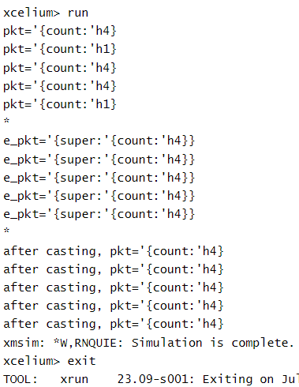
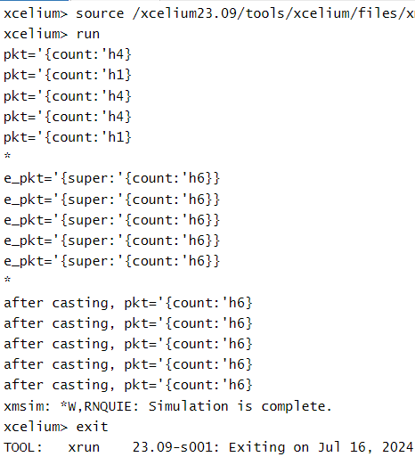
lab25, lab26
lab25
lab26

Slide 8
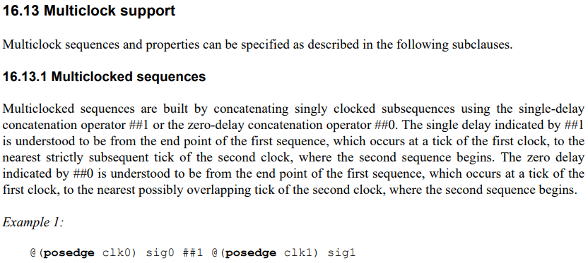
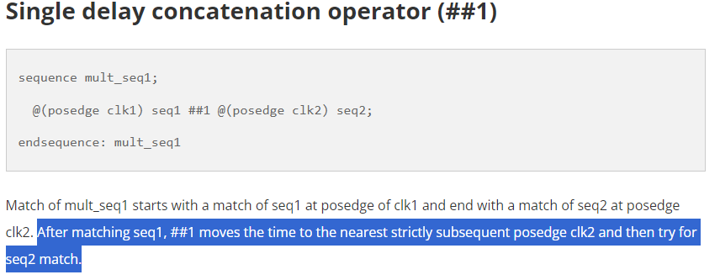

lab40, multi-clk
in multi-clk, both ##0 and ##1 are supported
##2 is not supported
ref
https://vlsi.pro/sva-sequences-iv-multiple-clock-domains-multi-clocked-sequence/#google_vignette

Slide 9
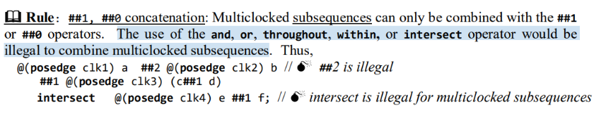
lab40, multi-clk
@(posedge clk1) a ##2 b
@(posedge clk1) a ##2 @(posedge clk2) b

Slide 10
lab40, multi-clk
in the design, signal value of start, x1 and x2 are changed according to clk_slow
in the design, signal value of y1 and y2 are changed according to clk_fast
design1 is composed of start, x1 and y1
design2 is composed of start, x2 and y2
summary
testcase1, diff_clk
description: a system with two clock rates, clk_fast and clk_slow
cannot tell the difference between ##0 and ##1
testcase2, same_clk
description: a system with two clocks, but the clock rates are same
can tell the difference between ##0 and ##1

Slide 11
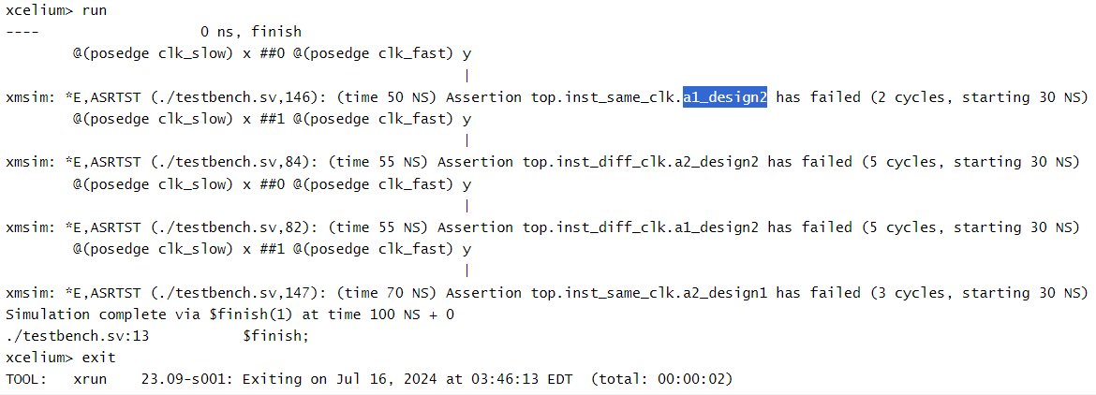
lab40, multi-clk

Slide 12
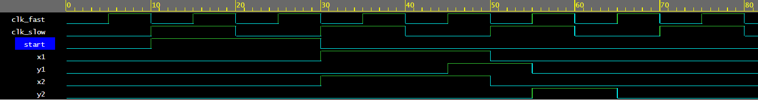
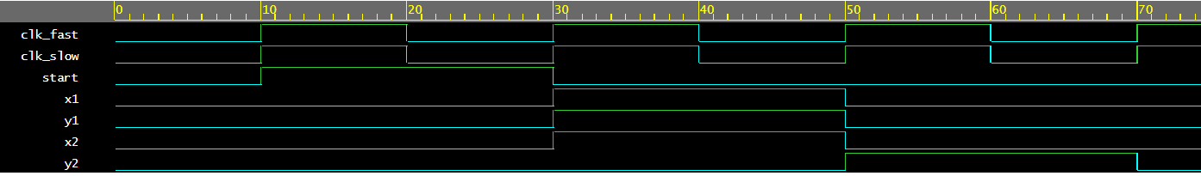
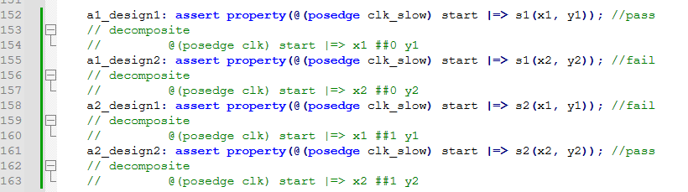
lab40, multi-clk
top.inst_diff_clk
top.inst_same_clk

Slide 14
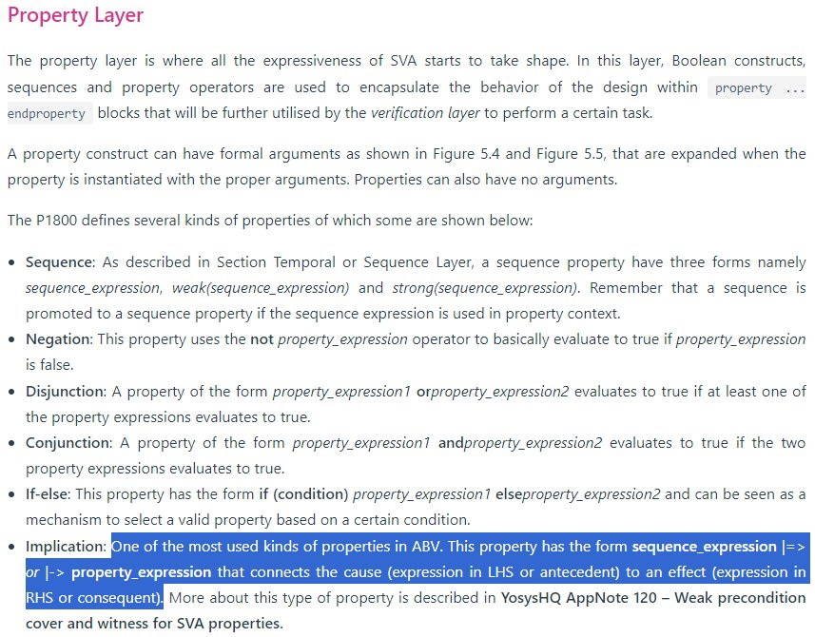
lab39, always

Slide 15
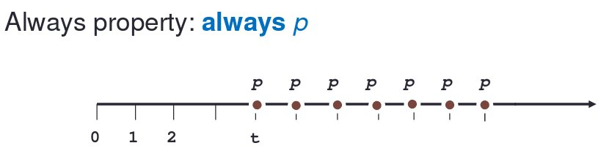
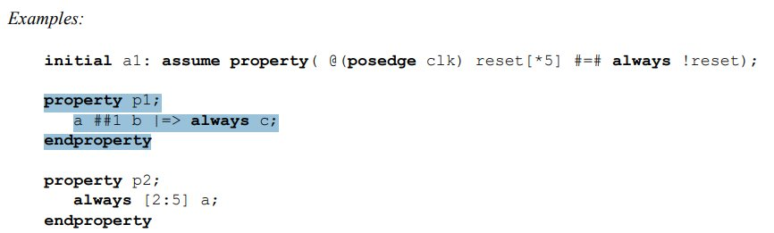
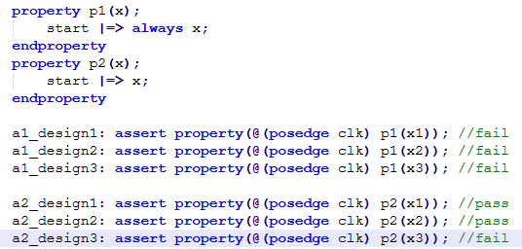
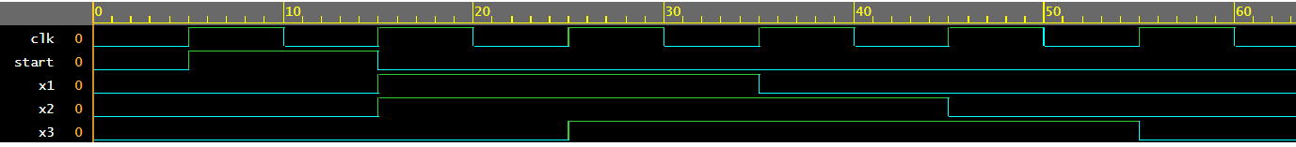
lab39, always
2 or 3 or 4 or 5
property p1;
[2:5] a
endproperty
2 and 3 and 4 and 5
property p1;
always [2:5] a
endproperty

Slide 16

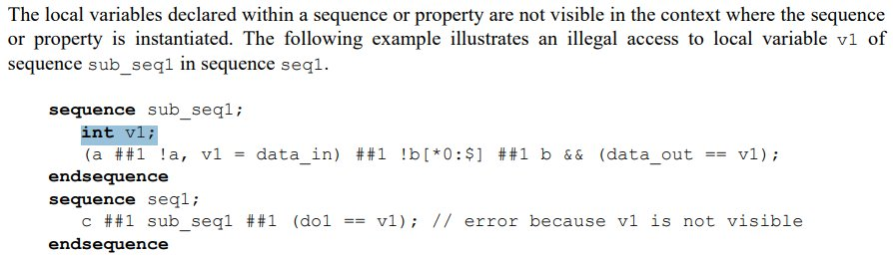
lab38, local
it is possible to declare local variables in the following two blocks
sequence … endsequence
property … endproperty

Slide 17
lab38, local
to assign design data serial_in to a local variable [3:0] val
to check if val[3:0] is equal to expect value at the correct time
time
val[3]
val[2]
val[1]
val[0]
val[3:0]
serial_in
serial_in
serial_in
serial_in
exp_val[3:0]

Slide 18
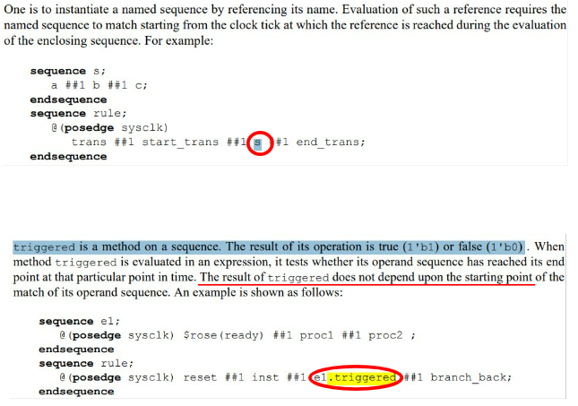
lab37, .triggered

Slide 19
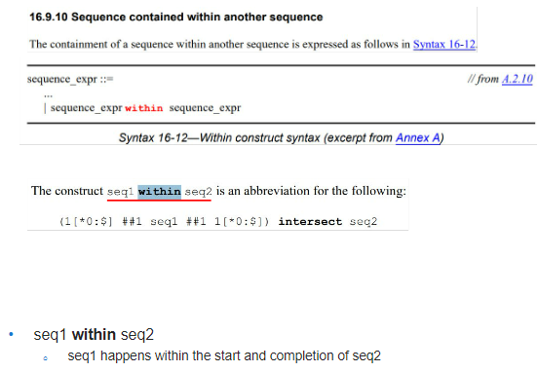
lab36, within

Slide 20
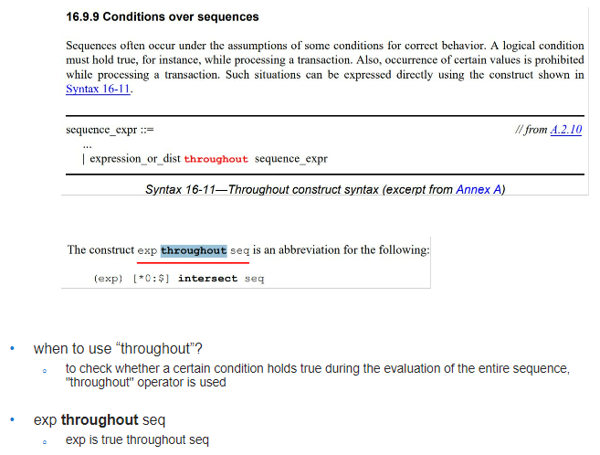
lab35, throughout

Slide 21
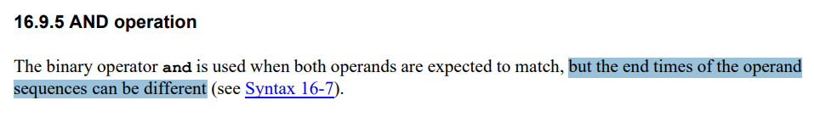
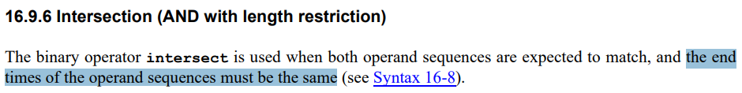
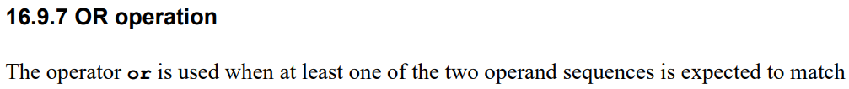
lab34, and, intersect, or
start
finish
reference
https://www.asic-world.com/systemverilog/assertions8.html
3 + 4
operand operator operand
intersect:
s1
s2
and:
s1
s2

Slide 22
module d1;
endmodule
bind d1 asrt inst_d1(<port>);
module d2;
endmodule
bind d2 asrt inst_d1(<port>);
module asrt;
endmodule
design department
rtl design r1 -> synthesis -> gate-level design g1
verification department
assertion module asrt
bind r1 asrt;
bind g1 asrt;

Slide 23
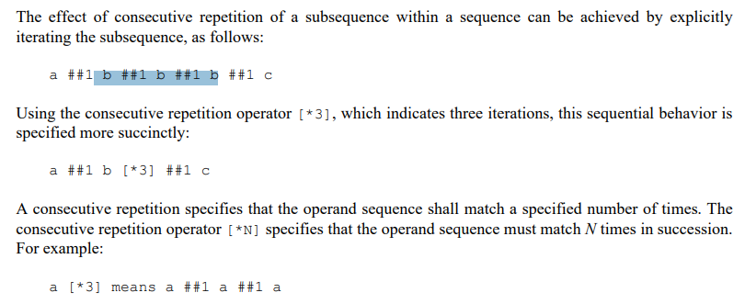
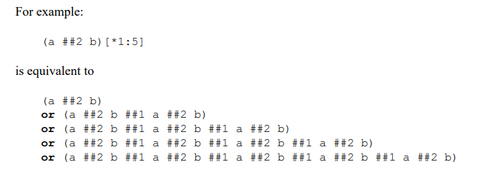
lab33

Slide 24
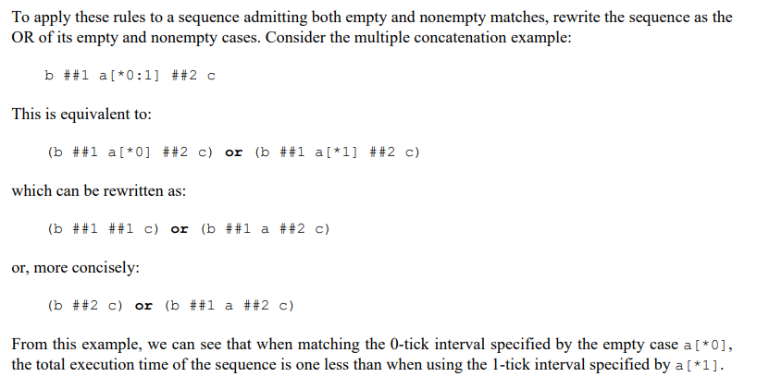
lab33
Rule1
signal_x ##1 (no signal in between) ##1 signal_z → signal_x ##2 signal_z
Rule2
signal[*0] ##2 → reduce 1 clock cycle → ##1

Slide 25


lab33
For example, user apply sequence s2 in the assertion a2_design11
User intent = verify if the design match the waveform pattern described as below
signal x and signal z are consecutive (as the waveform figure below)
allow signal y be inserted between signal x and signal z, but signal y should be less than 2 clock cycles
clk
x
z
The sequence (x ##1 y[*0:2] ##1 z) is decomposed into three parts as below
x ##1 y[*0] ##1 z
x ##1 ##0 z
x ##1 z
evaluated in 2 clock cycles
or
x ##1 y[*1] ##1 z
x ##1 y ##1 z
evaluated in 3 clock cycles
or
x ##1 y[*2] ##1 z
x ##1 y ##1 y ##1 z
evaluated in 4 clock cycles
7/7 = 1
6/6 = 1
0/0 = 1

Slide 26
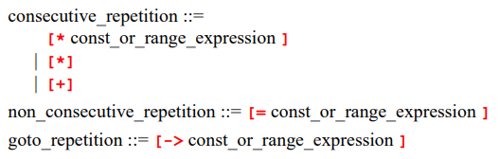
lab32
[=
[->
[*
consecutive repetition
easy to cause assertion fail, the most strict
[*
goto repetition
[->
non-consecutive repetition
[=

Slide 27
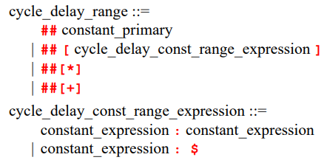
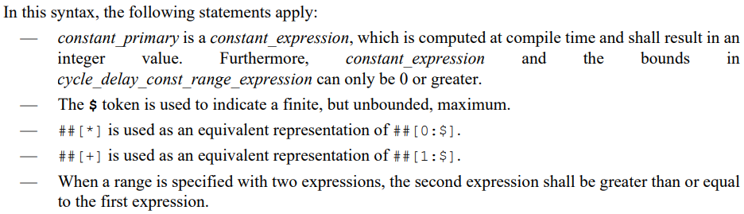
lab31
min value: 0
max value: $

Slide 28

lab31
when dealing with sva seq expression with unbounded range <- use “strong” to modify seq
use “strong” to check its liveness (default is “weak” to check safety)
for example,
##[0:$]
##[+]
https://www.youtube.com/watch?v=OScfnDGFEOg

Slide 29
20240509 below
strong assertion
weak assertion

Slide 30
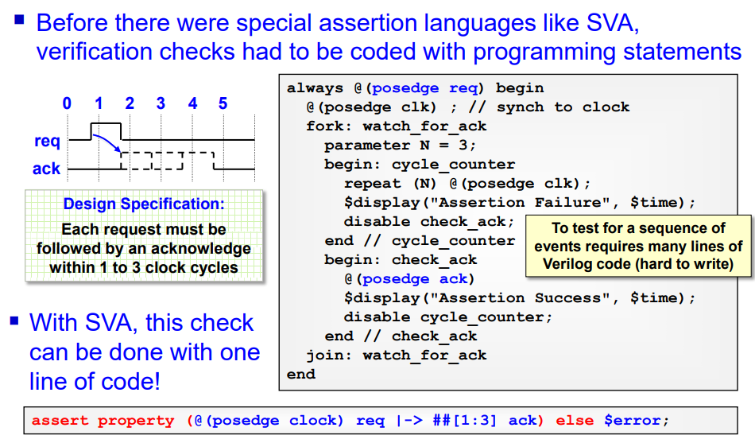
sva introduction
without sva
hard to write
reference
https://www.sutherland-hdl.com/papers/2015-DVClub-Austin_SVA-tutorial_and_SVA-planning.pdf

Slide 31
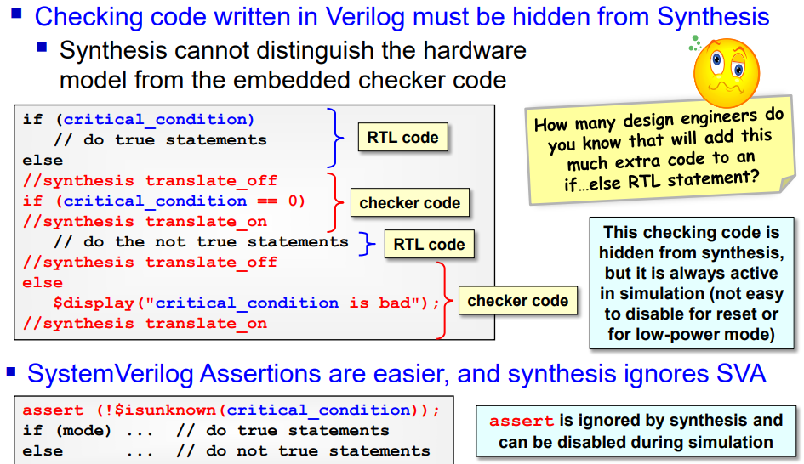
sva introduction
without sva
manually avoid verification hdl in synthesis
reference
https://www.sutherland-hdl.com/papers/2015-DVClub-Austin_SVA-tutorial_and_SVA-planning.pdf

Slide 32
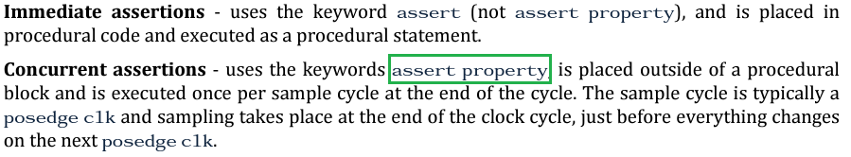
sva introduction
How to distinguish between immediate assertion and concurrent assertion?
The keyword property distinguishes a concurrent assertion from an immediate assertion

Slide 33
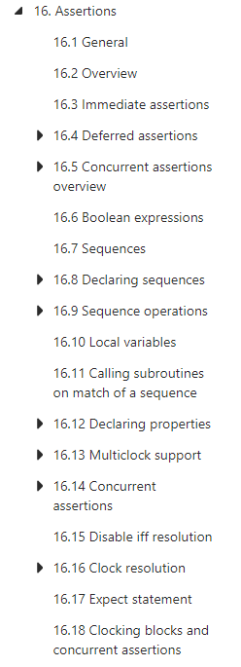
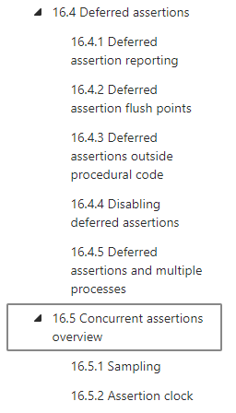
sva introduction

Slide 34
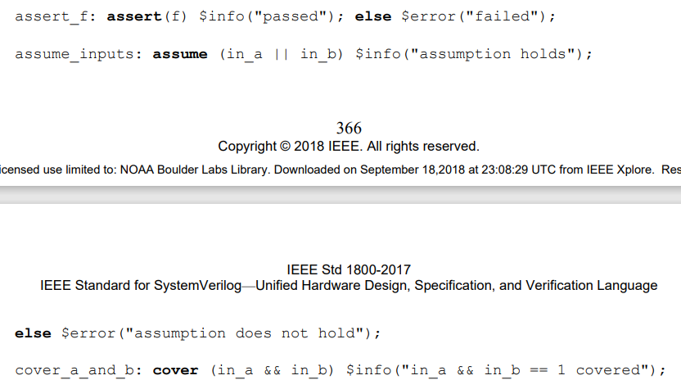
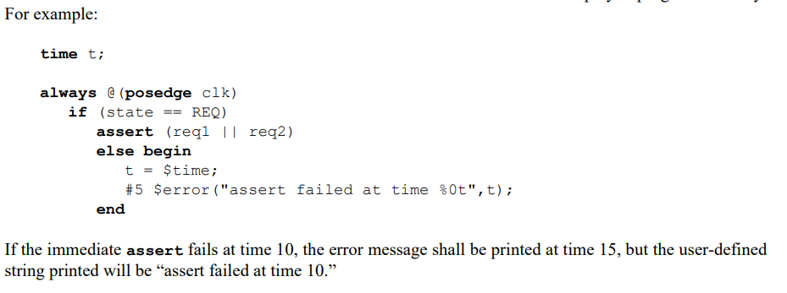
sva introduction
example
example, user can customize the report time of $error

Slide 35
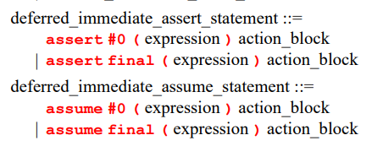
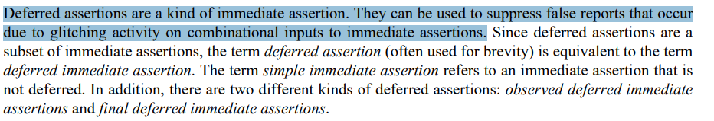
sva introduction
two category as below:
immediate assertion ← to test combinational logic
16.3 simple immediate assertion
16.4 deferred immediate assertion
observed
final
concurrent assertion ← to test sequential logic
16.5 concurrent assertion

Slide 36
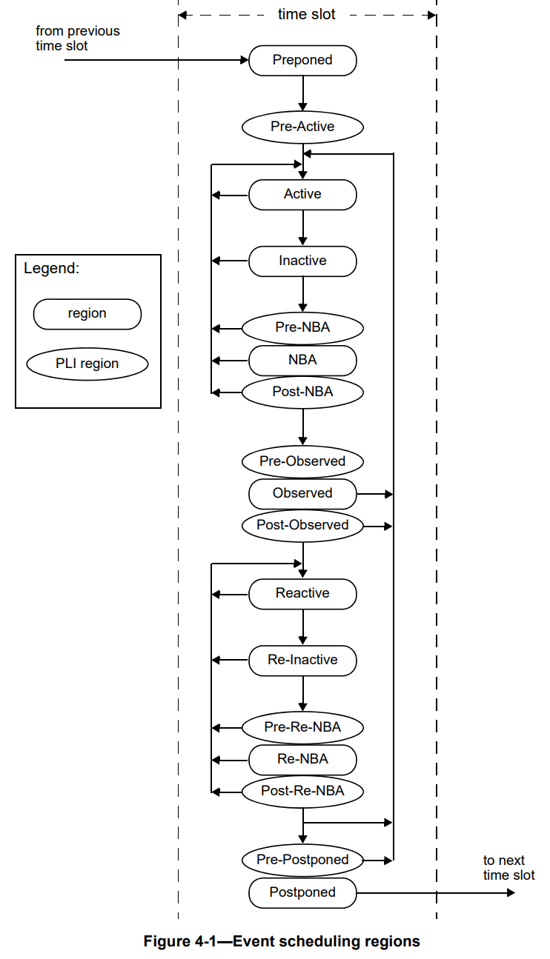
sva introduction
sample
deferred, observed
program block
deferred, final

Slide 37
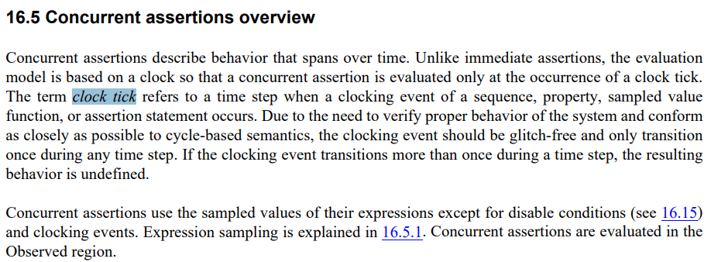
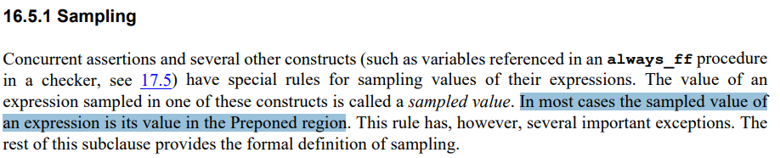
sva introduction

Slide 38
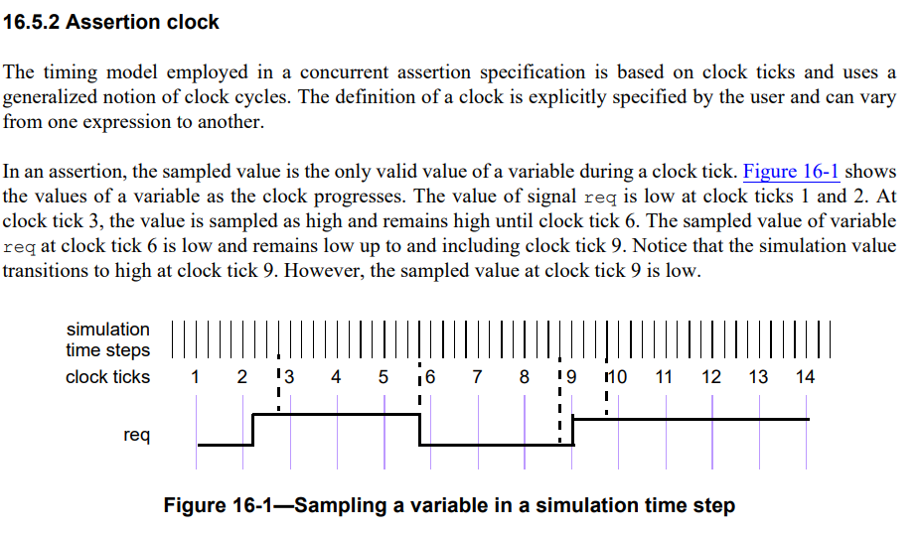
sva introduction

Slide 39
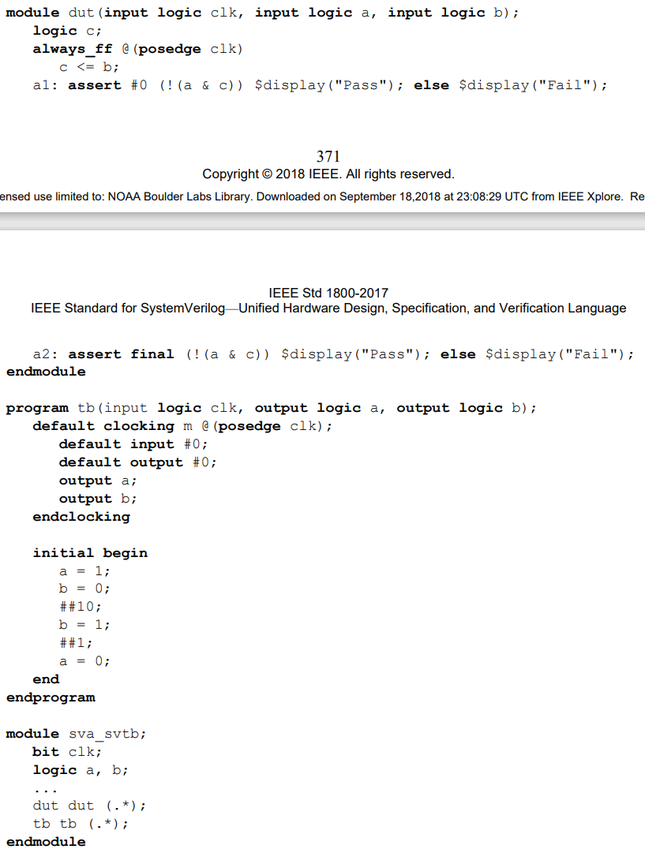
sva introduction
hierarchy:
module sva_svtb
module dut
a1, assert #0
a2, assert final
program tb

Slide 41
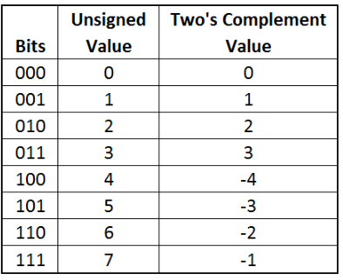

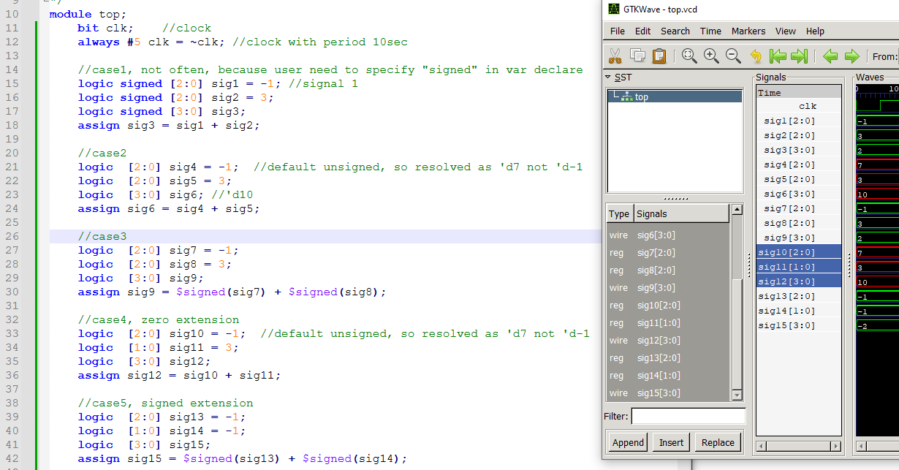
lab12
red = unsigned addition
green = signed addition

Slide 42
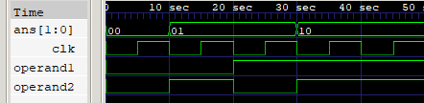
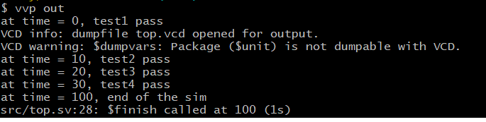

Slide 43



lab14
https://www.asic-world.com/systemverilog/process2.html

Slide 44

lab14
the problem without fork-join
as the figure, separate begin-end block for memory content initialization
the drawback is that it cannot control the relationship between threads, i.e. no explicit expression among threads
cpu
im
instruction memory
dm
data memory
gpr
general purpose register

Slide 45


lab14
as the figure shown, with fork-join
organize threads in one initial begin end block
exit the fork-join block when all threads are finish
the purpose of fork-join is to confirm that all the memory are given the initial value in the beginning of simulation
as the figure shown, with fork-join_any
exit the fork-join_any block when either thread finishes
simulation timeout mechanism

Slide 46



lab14, 15, 16
fork join
fork join-any
fork join-none

Slide 47
lab
iff
always_ff@(posedge clk iff reset == 0 or negedge reset)
@(A or B)
if reset == 1
@(negedge reset)

Slide 48

lab09
verilog
systemverilog
always_ff@(posedge clk) begin
…
end
always_comb@(a or b or c) begin
out1 = a & b & c;
end
always_comb@(posedge clk) begin
…
end
=> sim error,

Slide 49
lab07
wire connection by “assign” in generate block
module top;
sub #(.sel(0)) inst1();
sub #(.sel(1)) inst2();
endmodule
module sub;
parameter sel = 1;
logic sig1, sig2, sig3;
generate ←- this is optional
if (sel)
assign sig3 = sig1;
else
assign sig3 = sig2;
endgenerate ←- this is optional
endmodule

Slide 50
lab07
scope
module
endmodule
class
endclass
interface
endinterface
checker
endchecker
program
endprogram
generate
endgenerate
example
module top
c1 inst_c1();
i1 inst_i1;
endmodule
class c1
endclass
interface i1
endinterface
interface i2
endinterface
example2
module top
c1 inst_c1();
i1 inst_i1;
endmodule
class c1
endclass
interface i1();
clocking
endclocking
modport m1;
modport m2;
endinterface
interface i2
endinterface

Slide 51
lab07
module top
testbench (tb)
device under test (dut)

Slide 52
lab06
SOC top
module axi_
clkgen
module clkgen(
output clk)
endmodule

Slide 53
lab04
clk T = 10sec
20 clock counts
IDLE
FIRST
200sec
SECOND
100sec
LAST

Slide 54

lab04
top
clkgen
design
test_program

Slide 55
Outline
garage
m1
m2
c1
u1
u2
u1
u2
inst1
inst2
inst3
inst4

