Slide 5
lab04
clk T = 10sec
20 clock counts
IDLE
FIRST
200sec
SECOND
100sec
LAST

Slide 6
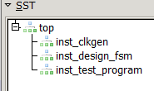
lab04
top
clkgen
design
test_program

Slide 7

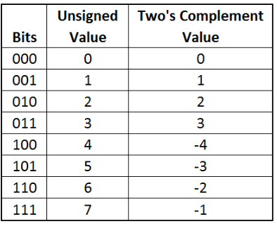
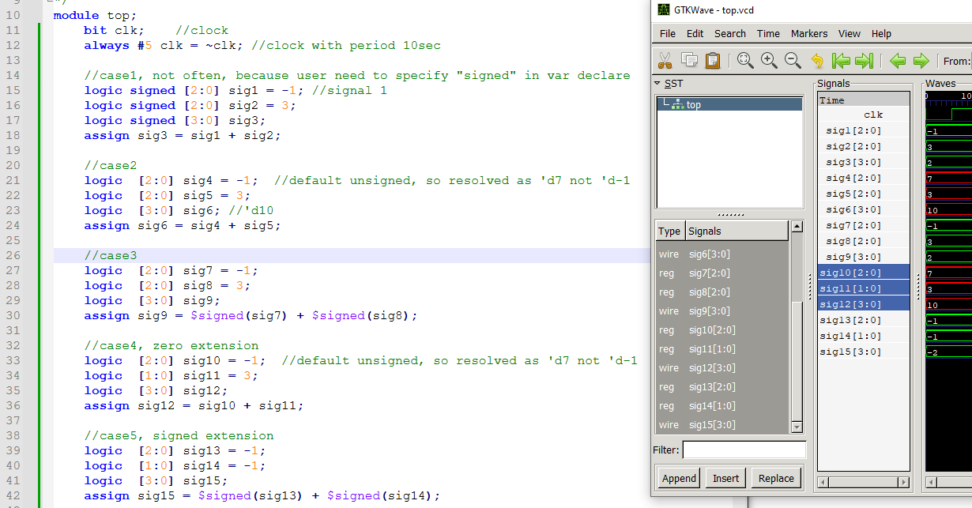
lab12
red = unsigned addition
green = signed addition

Slide 8
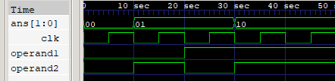
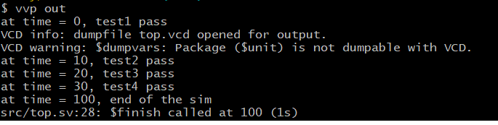

Slide 9
Outline
garage
m1
m2
c1
u1
u2
u1
u2
inst1
inst2
inst3
inst4

Slide 10




archive below
dut[0]
dut[0]
1
2
3
Add Input signals and add marker
1
2
3

