Slide 5
lab04
bit sel

Slide 6
lab04
IDLE
FIRST
SECOND
LAST

Slide 7
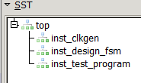
lab04
top
clkgen
design
test_program

Slide 8

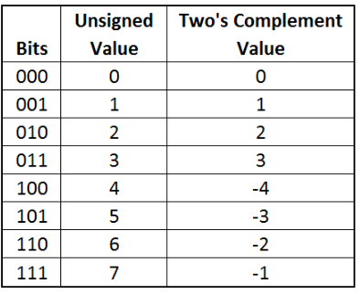
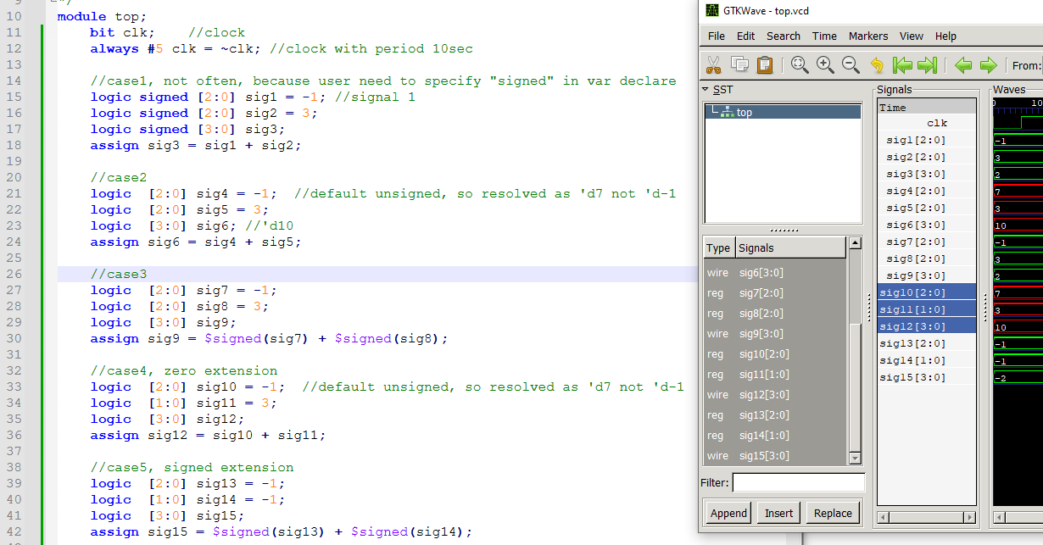
lab12
red = unsigned addition
green = signed addition

Slide 9
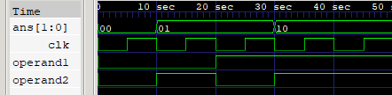
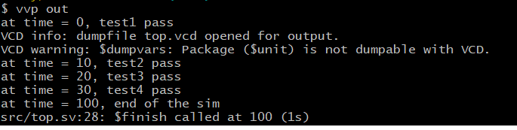

Slide 10
Outline
garage
m1
m2
c1
u1
u2
u1
u2
inst1
inst2
inst3
inst4

Slide 11




archive below
dut[0]
dut[0]
1
2
3
Add Input signals and add marker
1
2
3

