Slide 1

2020·07
以Instagram資料試做一套餐飲評分機制
On the Use of Instagram Data for Building
a Rating System in Catering Industry
指導教授：莊裕澤
學生：林瑋鴻
Notes:
各位口試委員、老師好。我是林瑋鴻，今天要報告的研究主題是”以Instagram資料試做一套餐飲評分機制”

Slide 2
評分與評論機制的普及更可以從各式電子商務平台中看出，如：旅遊類型的TripAdvisor、購物類型的eBay、Amazon、餐廳類型的Yelp，
愈來愈多人會參考他人在網路平台上給出的意見進行購買決策
餐飲評分機制
為何重要？
美國市調公司尼爾森於「2009 年全球網路消費者調查」中早已發現近約七成的消費者都會相信網路上的評論(簡之文，2012)
Notes:
那評分機制的重要性可以從….看出來
換一個角度來看，對於平台方來說，好的推薦系統可以透過降低用戶的流失，帶來以下兩點的好處:
1.透過降低用戶的流失，可以增進現存用戶的終生價值
2.透過降低用戶的流失，可以降低尋找新客戶的成本 (廣告費)
在”The Netflix Recommender System: Algorithms, Business Value, and Innovation”這篇論文中就有提到光是透過改善推薦系統得到以上兩點的好處，每年可以幫助Netflix節省一百萬美元的花費。
因此，我們可以從使用者與平台方的角度得知，設計良好的推薦系統是非常重要的。

Slide 3
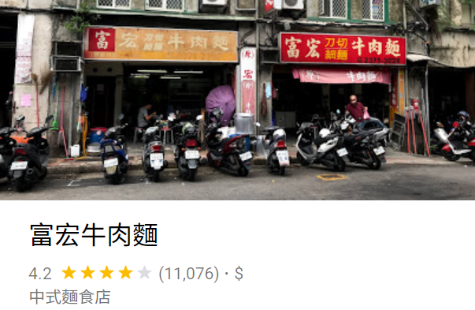
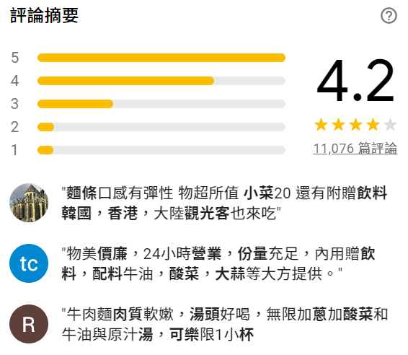
google map評分，任何人都能在任何一個商家地址或是景點位址，根據自己在此地的經驗撰寫評論並加入評分，也因此網路上充斥著愈來愈多使用者原創的評論內容(User Generated Content)。
Google這麼多間店，怎麼挑大眾最推的店家？
餐飲評分機制
為何重要？
Notes:
假設今天我想要找一間很有名的牛肉麵店，大家的第一直覺可能會去Google 評論上找餐廳，或是上網看美食部落客的介紹
menu美食誌介紹(是一款app，用戶都是美食部落客)，他為何是公認準的排名
主要目的：1. 希望隨時都可以依據instagram的大眾評論計算出擬合menu美食誌餐廳排行榜的排名，日後使用者可直接參考本研究計算出的排名，不須再等待menu美食誌不定期公布的餐廳排行，對於menu美食誌而言，日後也不需要再藉助app上美食部落客的資料，才有辦法計算出排名
當我們在周五晚上忙完了一整周的事後，想要好好的窩在家裡的電腦前享受Netflix上的好片時，是否曾經遇過不知道該看什麼片的窘境。
對於使用者來說如果沒有推薦系統或推薦系統的推薦效果不好時，很有可能使用者就會放棄使用該平台。

Slide 4
01
研究主題
02
文獻回顧
Research Topic
Literature Review
03
研究方法
04
研究結果分析
Agenda
Research Method
Result & Analysis
05
結論與未來展望
Conclusion & Future Work
4

Slide 5
Research Topic: Cold start user problem in recommendation system
What’s the difficulty of cold start problem
Apply deep learning to solve cold start problem
5
Notes:
我們的研究主題是專注於推薦系統中的冷啟動問題，會先介紹什麼是冷啟動問題，以及冷啟動問題的難處。接著會介紹我們該使用什麼深度學習模型以及，如何應用深度學習的模型來解決冷啟動問題

Slide 6
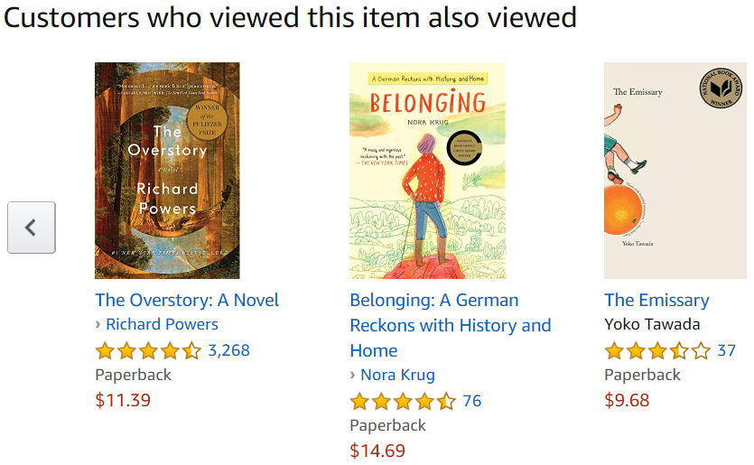
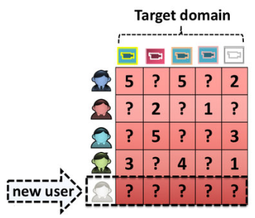
1
Research Topic
What is the difficulty of cold start problem
Non Cold Start User Context
Cold Start User Context
We can use rating similarity between two people
to identify potential items a person would like.
New user do not have ratings overlap with
other people.
6
Notes:
在一般非冷啟動的情境下，我們可以利用用戶彼此之間的共同評分來推薦使用者可能會喜歡的商品。常見的例子有:Amazon網路書店中，購買了此商品的用戶也購買了哪些商品的推薦。
而在冷啟動的情境下，由於使用者大多剛進入平台沒多久，因此與其他使用者在商品的評分上並沒有重疊，而難以推薦商品給使用者

Slide 7
1
Research Topic
Apply deep learning for recommendation system
Why deep learning?
Because deep learning based methods have two major advantages:
Nonlinear relationship simulation
Effective feature extraction
Different kinds of nonlinear activation function
Sigmoid
ReLU
Tanh
Automatically extract feature from
Text
Image
Video / Audio
Application Examples
In the industry
In Academia
Covington, et al., 2016 [6] use deep neuron network to model Youtube recommendation.
ACM RecSys included a deep learning based recommendation system as one of the conference themes since 2016.
Cheng, et al., 2016 [7] apply deep neuron network to model Google Play APP recommendation.
7
Notes:
介紹完冷啟動問題後，接著就是為什麼我們想使用深度學習來解決推薦系統冷啟動問題，原因在於深度學習主要有兩大優點:
可以透過非線性的activation function，模擬資料中複雜的非線性關係
自動且有效的從不同類型的資料中擷取特徵
我們也找出在業界與學界中使用以深度學習為基礎建構推薦系統的例子
Covington, Cheng, ACM RecSys
既然在業界與學界中有愈來愈多的人投入相關的研究，就能得知以深度學習為基礎的推薦顯然是一個無法避免的趨勢。

Slide 8
1
Research Topic
Apply deep learning for recommendation system
使用instagram 資料進行社群聆聽
英國連鎖餐廳Zizzi的調查(2017)，18-35歲的用戶平均一年會花五天的時間瀏覽Instagram上的食物照片，當中3成的用戶會參考這些照片、文章決定是否消費，可見消費者已逐漸將Instagram視為選擇餐廳的媒介之一
Notes:
介紹完冷啟動問題後，接著就是為什麼我們想使用深度學習來解決推薦系統冷啟動問題，原因在於深度學習主要有兩大優點:
可以透過非線性的activation function，模擬資料中複雜的非線性關係
自動且有效的從不同類型的資料中擷取特徵
我們也找出在業界與學界中使用以深度學習為基礎建構推薦系統的例子
Covington, Cheng, ACM RecSys
既然在業界與學界中有愈來愈多的人投入相關的研究，就能得知以深度學習為基礎的推薦顯然是一個無法避免的趨勢。

Slide 9
1
Research Topic
Apply deep learning to solve cold start problem
Which type of deep learning model will we use? And why?
We will use Denoising Autoencoder (DAE), because DAE has two appealing features:
Denoising
Dimension reduction
In the field of image processing, DAE is often used to restore images disturbed by noise
DAE is good at learning top-quality latent representation of data
This feature meets our needs !
What is the relation between cold start user problem and noise?
8
Notes:
不過問題又來了，千百種深度學習模型中，我們又該使用哪一種模型呢?
經過各方的survey後，我們選用了Denoising Autoencoder，原因在於Denoising Autoencoder有兩個很棒的特性:

Slide 10


1
Research Topic
Apply deep learning to solve cold start problem
Relation between cold start problem and noise?
We can regard a cold start user as the user state that comes from a rich user disturbed by noise.
noise
Rich user
noise
noise
Cold start user
9
Notes:
我們可以將一個cold start user視為rich user不斷受到noise覆蓋掉評分的產物，如此一來就可以訓練一個DAE來將cold start user還原回原本的rich user。

Slide 11
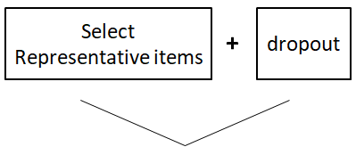
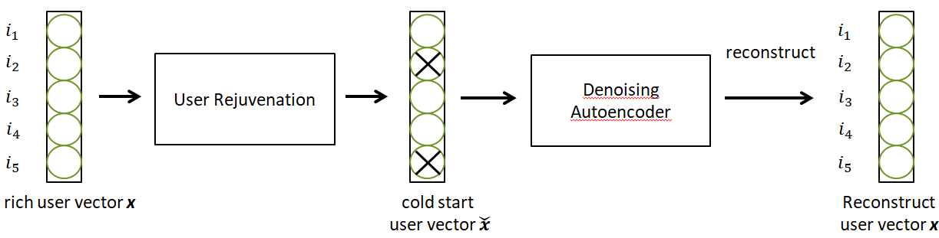
1
Research Topic
Apply deep learning to solve cold start problem
Relation between DAE and cold start problem?
We design a mechanism called “user rejuvenation” which turns rich user back to cold start user state.
After getting cold start users, we can use DAE to recover them back to the rich users’ state.
To the best of our knowledge, we are the first to propose noise generating mechanism
combine with DAE for solving cold start problem in the field of recommendation system
recover
10
Notes:
因此我們設計了一個稱為使用者返老還童的機制來將rich user返還回cold start user，最後再使用DAE來將cold start user還原回rich user的狀態。
其中”使用者返老還童”的分法細節是從所有商品中選取具代表性的商品，並且在將rich user還原成cold start user時給予這些具代表性的商品比較大的機率被保留住。

Slide 12
2. Literature Review
References
Deep learning methods for solving cold start problem (1)
Representative items mining (2)
11
Notes:
在Literature Review中，我會先列出所有相關的reference，然後介紹三篇跟我們方法最相關的論文。

Slide 13
2
Literature Review
References
References
Deep learning methods for recommendation system
Author | Paper | index
Fu,M., et al. | A novel deep learning-based collaborative filtering model for recommendation system | [3]
He, X., et al. | Neural collaborative filtering | [6]
Covington, P., J. Adams, and E. Sargin | Deep neural networks for youtube recommendations | [2]
Autoencoder based methods for recommendation system
Zhuang, F., et al. | Representation learning via Dual-Autoencoder for recommendation | [19]
Vincent, P., et al. | Stacked denoising autoencoders: Learning useful representation in a deep network with a local denoising criterion | [14]
Wu, Y., et al. | Collaborative denoising auto-encoders for top-n recommender systems | [17]
Majumdar, A. and A.Jain | Cold-start, warm-start and everything in between: an autoencoder based approach to recommendation | [9]
Model
Performance
Comparison
12
Notes:
References中的第一部分主要是: 使用Deep learning方法的推薦系統
References中的第二部分主要是: 以Autoencoder為基礎的推薦系統方法

Slide 14
2
Literature Review
References
References
Combine the ideas of these three papers
Deep learning methods for solving cold start problem
Author | Paper | index
Volkovs, M., G.Yu, and T. Poutanen | Dropoutnet: Addressing cold start in recommender systems. | [15]
Shi, S., et al. | Attention-based adaptive model to unify warm and cold starts recommendation | [13]
1
Representative items mining
Author | Paper | index
Liu, N.N., et al. | Wisdom of the better few: cold start recommendation via representative based rating elicitation. | [8]
Shi, L., W.X. Zhao, and Y.-D.J.A.T.o.I.S. Shen | Local representative-based matrix factorization for cold start recommendation | [12]
Georgiou, O. and N. Tsapatsoulis. | The importance of similarity metrics for representative users identification in recommender systems. | [4]
2
3
13
Notes:
References中的第三部分主要是: 著重在於以深度學習的方法來解決cold start問題
References中的第四部份主要是: 如何選出具代表性商品相關的論文
我會在接下來的3張簡報中逐一介紹這三篇論文。

Slide 15
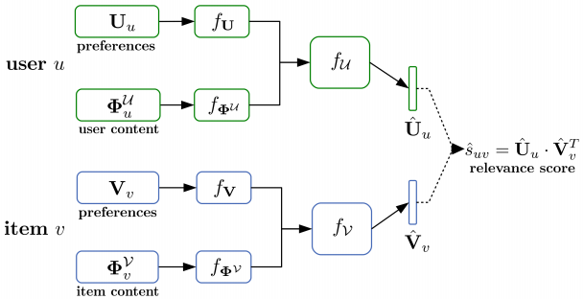
2
Literature Review
Deep learning methods for solving cold start problem
1
DropoutNet: Addressing cold start in recommender systems. [Volkovs, M.,G. Yu,and T. Poutanen]
Combine both preference data and content information as model inputs. While training the model, if the item or user is under cold start scenario, we set the corresponding item preference or user preference to zero vector, called “dropout”.
Inspiration :
We can dropout the unimportant information while training the model !
14
Notes:
首先第一篇是如何用深度學習的方法解決冷啟動問題:
在DropoutNet這篇論文中，提出了一個想法來解決cold start問題。當某個使用者或某個商品處於cold start狀態時，由於我們只有少數關於使用者或商品的評分資訊，因此我們會將對應評分的輸入設定為0，
以利模型用其他完整的content information去學習如何估計使用者對於商品的評分。而這種方法被該論文的作者稱為Dropout。

Slide 16
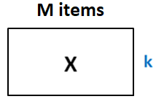


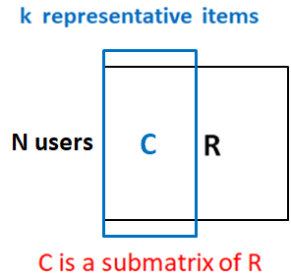
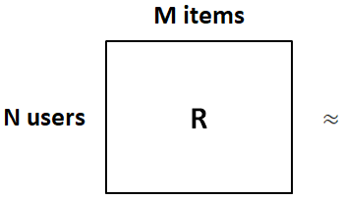
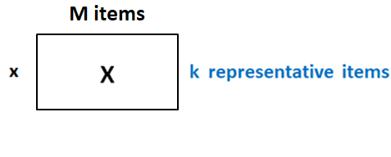
2
Literature Review
Representative items mining
2
Wisdom of the better few: cold start recommendation via representative
based rating elicitation. [Nathan Liu, Xiangrui Meng, Chao Liu, Qiang Yang]
Propose a method called RBMF (representative-based matrix factorization) to find representative items from item set.
=
Cold Start User vector
Inspiration :
We can use RBMF to choose representative items!
15
Notes:
第二篇論文是關於如何用找出具代表性的商品:
這篇論文則提出RBMF來找出具代表性的商品，舉個實例來說:~
* 將user用k個representative items來表示，並且將items也用k個representative items來表示

Slide 17
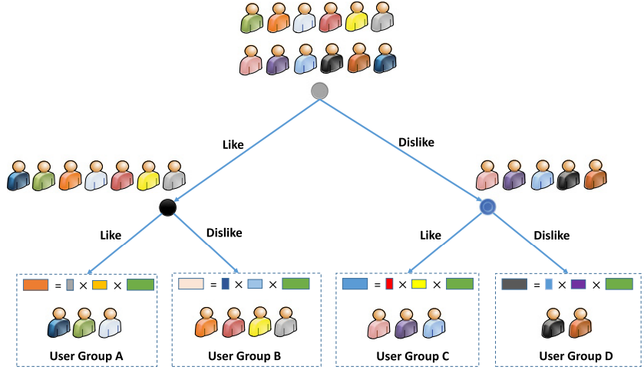
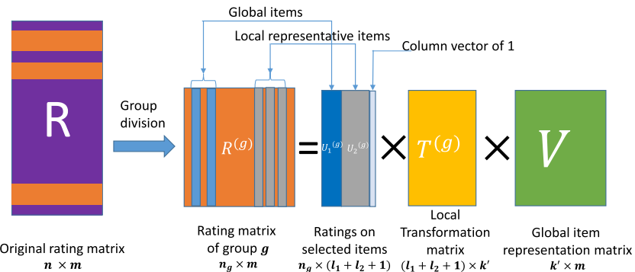
2
Literature Review
Representative items mining
3
Local representative-based matrix factorization for cold-start recommendation.
[Lei Shi, Wayne Xin Zhao, Yi-Dong Shen]
LRBMF tries to improve the RBMF by grouping people and find “global representative items” and “local representative items” respectively for a group of users.
Inspiration :
We can emulate LRBMF to split users into different groups and apply the RBMF.
16
Notes:
而第三篇論文主要是想用來改進前一篇論文RBMF中，所有使用者共用一組具代表性商品這樣的缺點。

Slide 18
3. Research Method
Introduction to DAE
User rejuvenation
Cold start user recommendation
17
Notes:
在論文方法中，首先我們會詳細介紹DAE模型，接著介紹我們提出的返老還童方法，最後則是我們的方法如何進行訓練與推薦。

Slide 19


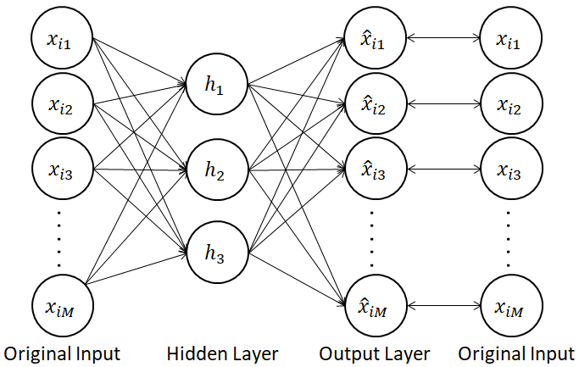

3
Research Method
Introduction to DAE
Autoencoder
Autoencoder is a deep learning model composed of encoder and decoder:
Encoder is used to compress high dimension input vector into low dimension latent vector.
Decoder is used to recover the low dimension latent vector back to input dimension.
The goal of training Autoencoder is to minimize the reconstruction error between input vector and output vector.
Input vector
Output vector
18
Notes:
在介紹Denoising Autoencoder之前，我們要先了解Autoencoder是什麼

Slide 20
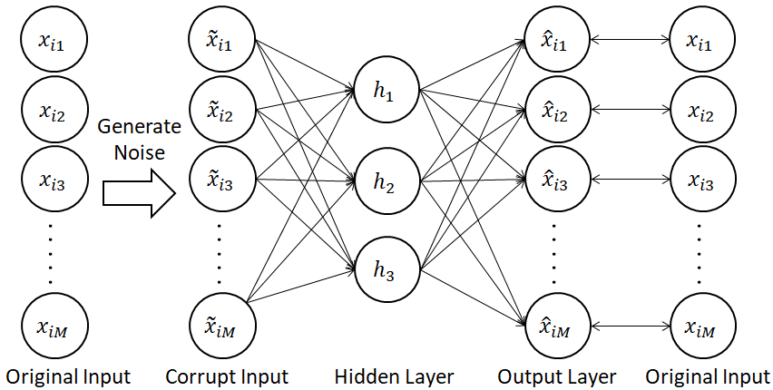
3
Research Method
Introduction to DAE
Denoising Autoencoder
Denoising Autoencoder is a variant of Autoencoder, which generates noise in some dimensions of the input vector before training the following Autoencoder.
The reason behind the noise?
It can make the trained model more robust.
How?
19

Slide 21
3
Research Method
Introduction to DAE
Noise generation methods for Denoising Autoencoder
Gaussian Noise
Generate noise according to normal distribution, and add the noise to the dimensions of input vector.
Masking Noise
Randomly set a part of the dimension value in input vector to zero.
Salt-and-pepper Noise
Randomly set a part of the dimension value in input vector to the maximum or minimum allowable value for the dimension.
They are suitable for the image processing and speech processing.
But may not for recommendation task and low interpretability.
20
Notes:
一般的Denoising Autoencoder主要有三種產生雜訊的方法:
1. 將輸入向量的每一個維度值加上從常態分佈抽樣出的數值

Slide 22
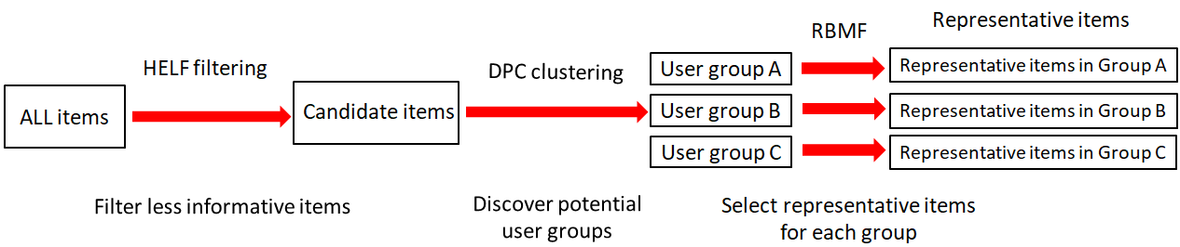
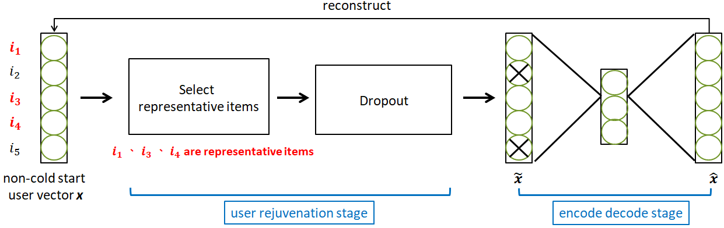
3
Research Method
User rejuvenation
User rejuvenation
We design a noise generation method especially for the cold start users, called “user rejuvenation”, and it is divided into two major steps:
Select representative items
Dropout
21
Notes:
因此我們提出了一個適用於推薦系統而且可解釋性高的雜訊產生方法，稱其為”使用者返老還童”。
使用者返老還童方法主要分成兩個部分，其中選擇具代表性商品又分成好幾個子流程~

Slide 23
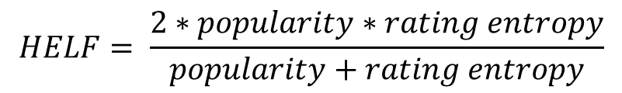
3
Research Method
User rejuvenation
Harmonic mean of Entropy and Logarithm of Frequency (HELF)
When selecting candidate items, we
consider two characteristics of an item:
Item popularity:
If more users rate the item, the item will have higher popularity.
Rating entropy:
If the users’ preference for an item is more inconsistent, the item will have higher rating entropy.
Thus, we can calculate a metric, called HELF, to help us filter out less informative items.
$$HELF= \frac{2∗popularity∗rating entropy}{popularity+rating entropy}$$
22

Slide 24
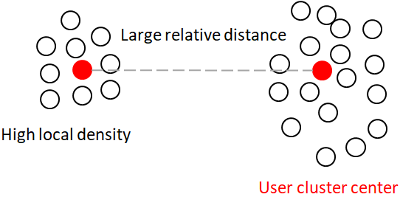
3
Research Method
User rejuvenation
Density Peaks Clustering
After filtering out less informative items by HELF, the remaining items are called “candidate items”.
Each user is represented by candidate items, and we can use DPC to cluster users into groups.
The cluster centers found by the DPC have two characteristics:
High local density
There will be many users near the cluster center.
Large relative distance
The distance between cluster centers are large.
23
Notes:
為何使用DPC?
1. DPC的群中心特性是：需要有夠大的區域密度(群中心周圍必須有很多資料點)，且兩個群中心彼此的距離要夠遠。此兩個特性能使分出的群集更加密集。
2. DPC可以適用於任何資料分布形式的分群任務 (像是如果用k-means只能找出近似球形的群集)
3. DPC演算法的效率高，適合用於大規模資料集 (像是HAC、DBSCAN在大規模的分群效率就比較差)。
4. 不過DPC需要事先定義一個距離範圍(通常需要實驗多次找出適當)，對於分群的影響是：如果太小每個資料會各自形成一個群集，如果太大所以有資料會被分為一群。但是有論文對的選取有一些trick，應該可
以參考。

Slide 25




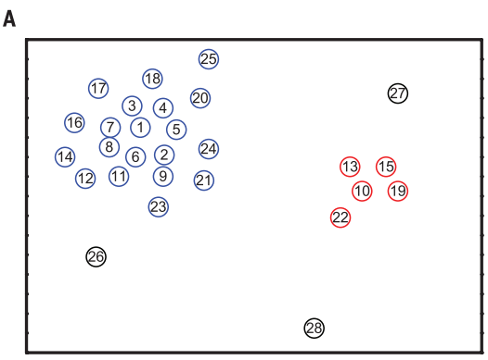
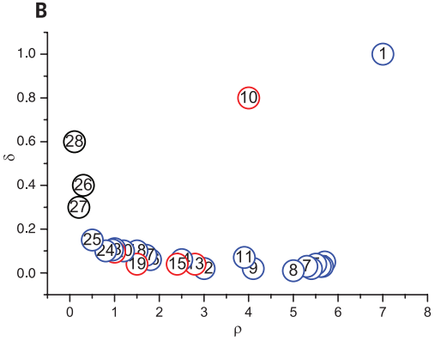

3
Research Method
User rejuvenation
Density Peaks Clustering
Set a pre-define distance $d_{c}$
2. Calculate local density of all users.
3. Calculate relative distance of all users.
4. Plot the decision diagram using local density and relative distance, and select cluster centers.
24

Slide 26
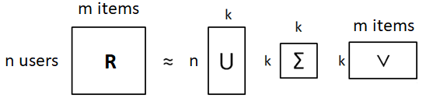




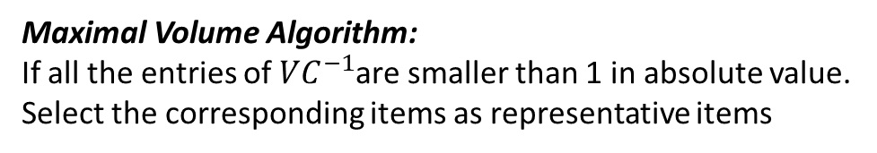
3
Research Method
User rejuvenation
Representative-based matrix factorization
RBMF composed of two steps:
SVD dimension reduction
Group A
2. Basis selection (use maximal volume algorithm)
Maximal Volume Algorithm:
If all the entries of ${VC}^{−1}$are smaller than 1 in absolute value.
Select the corresponding items as representative items
V)
25
Notes:
將使用者分群後，接著我們會使用RBMF為每一組的使用者找出具代表性的商品
如果要讓矩陣C和矩陣X最能還原矩陣V，這時由矩陣V選出的k個column要能讓矩陣C的行列式之值最大，矩陣的行列式之值代表了這k個k維向量在空間中展開的體積。EX:線性相依、線性獨立
而Maximal Volume Algorithm提供了一個性質是~

Slide 27
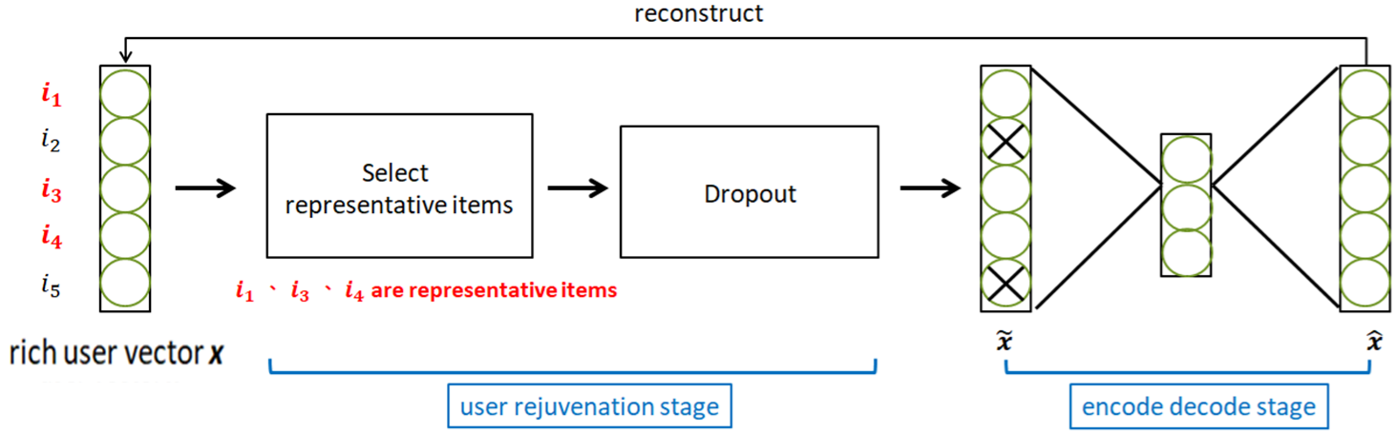
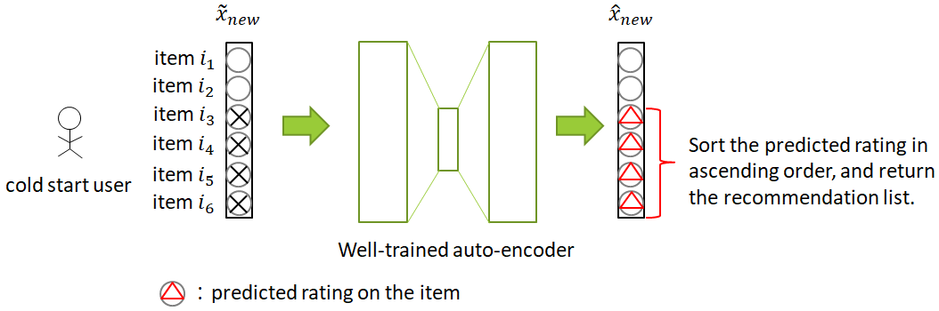
3
Research Method
Cold start user recommendation
We train a DAE for each group of users.
Training Phase for a group:
Cold start user
Recovered user
A test user is assigned to the DAE corresponding to the cluster center closest to him.
Test Phase (Recommendation):
26

Slide 28
4. Result & Analysis
Dataset and Experiment Settings
Evaluation Metrics
Experiment Result Analysis
27

Slide 29

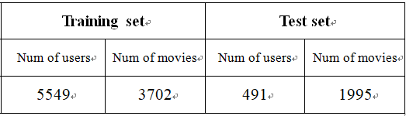
4
Result & Analysis
Dataset and Experiment Settings
Dataset
MovieLens 1M dataset is the movie rating data provided by MovieLens users, and we organize the
ratings information of users in the table below.
Experiment Settings (Train-Test split)
The user with more than 25 user ratings are regarded as training users, and the users with less than
25 ratings are regarded as test users.
28

Slide 30
4
Result & Analysis
Dataset and Experiment Settings
Experiment Settings
When training the model, use the users in the training set to train the parameters of the Autoencoder.
When evaluating the effectiveness trained model, the 20% of the movie ratings that each test user likes are randomly covered to 0, which is regarded as the ground truth to be verified.
For a test user
Randomly mask 20% ratings
Ground Truth
Favorite
Movies
Rated Movies
0
4
Dislike
Movies
0
AE
5
0
5
Unrated
Movies
0
4
29

Slide 31
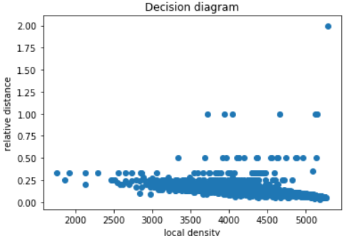
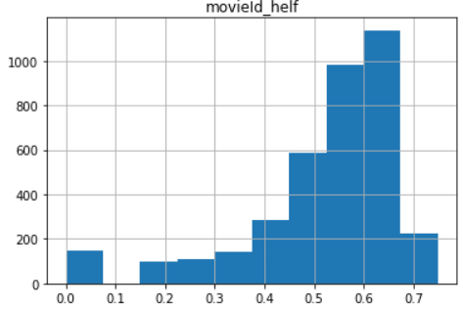
4
Result & Analysis
Dataset and Experiment Settings
Experiment Settings (Hyper-parameters)
Our method has two parts of hyper-parameters to be determined:
We filter out movies with insufficient information, which means movies with small HELF value.
When grouping all users, we will select the appropriate number of groups according to Decision
Diagram.
Set HELF threshold to 0.65
We will choose 4 and 7 clusters in our experiment
30

Slide 32
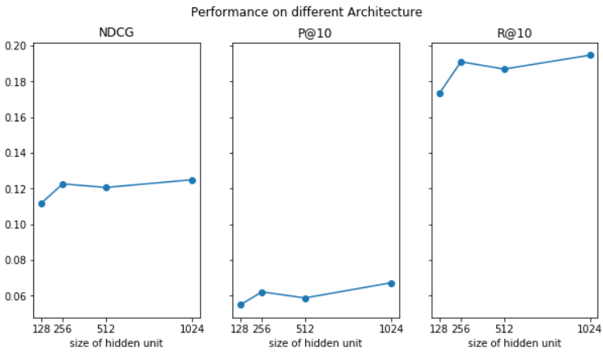
4
Result & Analysis
Dataset and Experiment Settings
Experiment Settings (Hyper-parameters)
Architecture of the Autoencoder model, and the dropout ratio of representative movies and
non-representative dropout ratio. Eventually, we found that the low dropout rate of representative
movies and the high dropout rate of non-representative movies can get better results.
Choose 1024 as our hidden
dimension for Autoencoder
31

Slide 33




4
Result & Analysis
Evaluation Metrics
Evaluation Metrics (NDCG@k)
NDCG is equal to DCG divided by IDCG.
DCG: used to measure the relevance of an item based on its position in the recommendation list.
IDCG: is the maximum DCG score that can be obtained when the recommendation system
can perfectly sort the recommendation results.
Top 3 recommendation:
IDCG Ground Truth: [5,3,1]
$\frac{1}{3}$($\frac{\text{5}}{\log_{2}{(1+1) }}+\frac{\text{3}}{\log_{2}{(1+2) }}$+$\frac{\text{1}}{\log_{2}{(1+3) }})$ = 2.4642
$\frac{1}{3}$($\frac{\text{1}}{\log_{2}{(1+1) }}+\frac{\text{3}}{\log_{2}{(1+2) }}$+$\frac{\text{5}}{\log_{2}{(1+3) }}$) = 1.7975
DCG Recommend: [1,3,5]
32

Slide 34


4
Result & Analysis
Evaluation Metrics
Evaluation Metrics (precision@k & recall@k)
In the context of the recommendation system, we will divide the movie into two categories according
to the rating given by the user. If a movie’s rating is higher than the user’s average rating, we will
regard the movie as the user’s favorite movie; otherwise, we will regard it as a movie the user don’t like.
Then, we can use the below formula to calculate precision@k and recall@k :
33

Slide 35
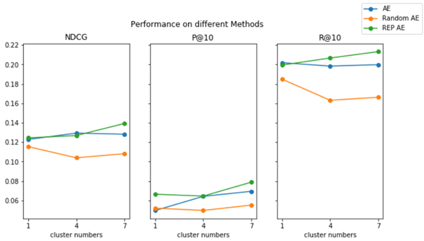
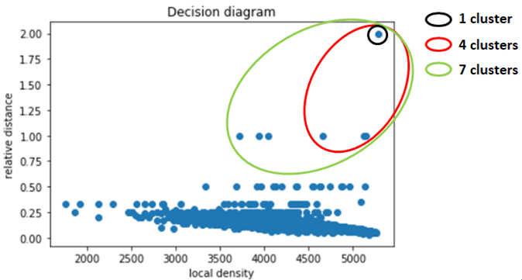
4
Result & Analysis
Experiment Result Analysis
How cluster number affect the performance?
We will select the appropriate number of groups according to the Decision diagram.
According the decision diagram below, we will choose to divide all users into 1, 4, and 7 groups,
because these group centers conform to the characteristics of the group center of the DPC clustering
algorithm.
34

Slide 36
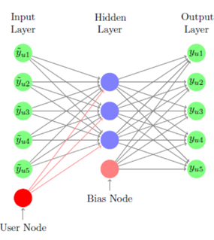
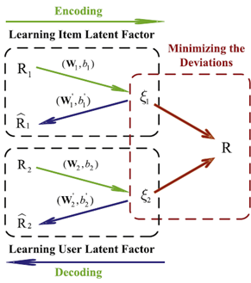
4
Result & Analysis
Experiment Result Analysis
All model performance comparison
Autoencoder
Autoencoder + random masking noise
CDAE
Dual Autoencoder
35
Notes:
CDAE模型的輸入是user對於所有item的評分，並且加上一個額外的User Node，user node這裡是user在資料集中的ID。在訓練模型時，CDAE會隨機的Dropout掉一定比例的input。
Dual Autoencoder的模型架構有兩個Autoencoder同時訓練使用者的低維向量表示法 u 與商品的低維向量表示法v ，最後利用u與v兩個向量內積來預測使用者u對商品v的評分

Slide 37
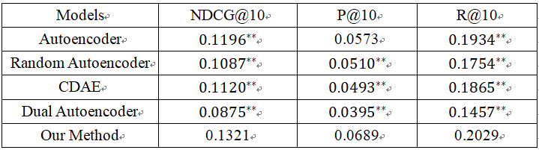
4
Result & Analysis
Experiment Result Analysis
All model performance comparison
Analysis:
It seems that Autoencoders with random masking noise, like Random Autoencoder and CDAE, perform not well.
The reason may be that random masking noise is not suitable for training Autoencoder in the context of recommendation system.
Dual Autoencoder has the worst performance.
The reason may be that the output of the Dual Autoencoder simply do a inner product which cannot effectively capture the non-linear relationship between the user and the item.
36

Slide 38
5. Conclusion & Future Work
Conclusion
Future Work
37

Slide 39
5
Conclusion & Future Work
Our contributions
We are the first to propose the concept that combines noise generation and Denoising Autoencoder to solve the cold start problem in the field of recommendation system.
2. Our “user rejuvenation” is helpful for training the Denoising Autoencoder.
Future Work
Try the more complex model architecture to increase the capacity of the model.
2. Experiment on other dataset, not just on the MovieLen 1M.
38

Slide 40
2020·07
Thanks for listening !

