Slide 1

Identifying and Selecting the Customer Relationship Management System
組員：
403530027 王致淵
403530001 陳子洛
403530045 林瑋鴻
403530056 陳永瀚
403530035 張楷睿

Slide 2
Reporting Objectives
Show an example how information system project is identified, by using Corporate Strategic Planning.
Describe the information identifying process

Slide 3
Guideline
Character introduction
Case Introduction
Corporate Strategic Planning
The Idea for a New System
Formalizing a Project Proposal
Case Summary
Case Questions

Slide 4
Character introduction
Carrie Douglass: Main character, graduated from Stillwater State
University.
Nigel Broad: BEC’s chairman.
Professor Martha Tann: Head of the MIS at Stillwater State
University.
Steve Tettau: Former manager of Centerville store.

Slide 5
Case Introduction
Carrie once worked as a part-time assistant manager at BEC’s store in Centerville.
She was recruited by BEC after graduation.
She got BEC’s Blueprint for the Decade during development program.
She was appointed to be manager of the Centerville store after development program, due to the previous manager was promoted.

Slide 6
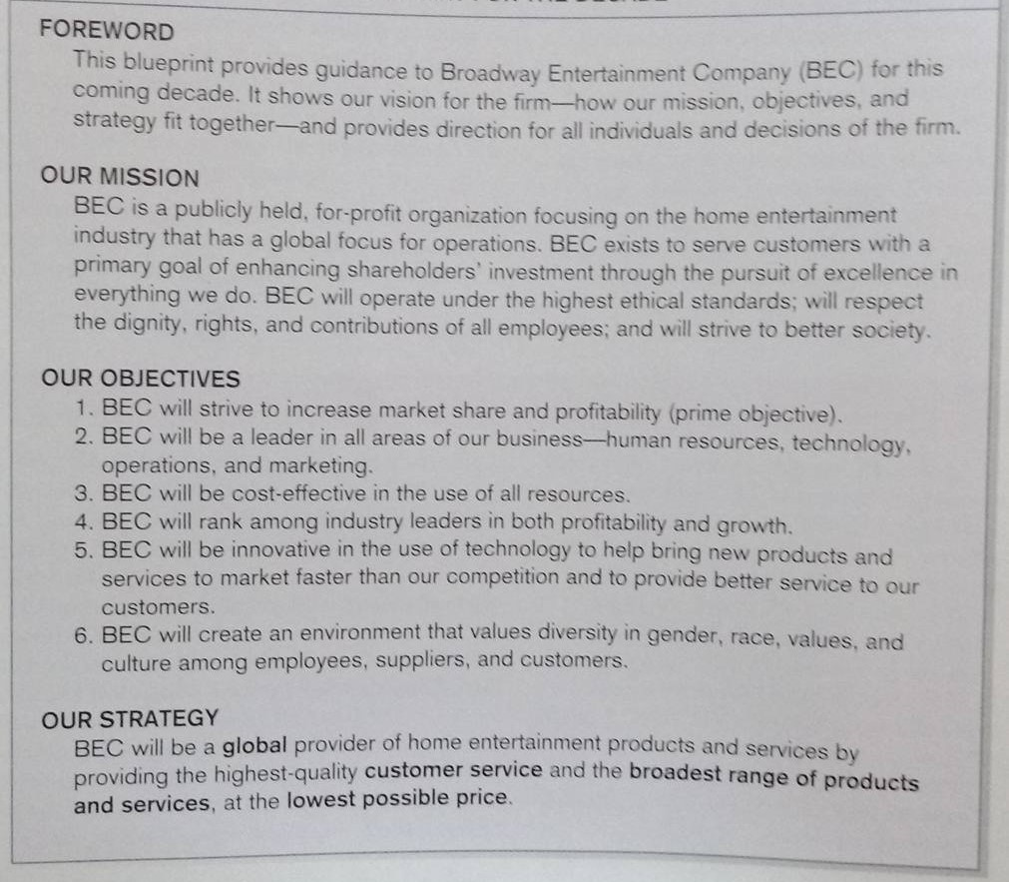
Corporate Strategic Planning
An ongoing process that defines the mission, objectives, and strategies of an organization

Slide 7
The Idea for a New System
Carrie saw that Amazon.com was selling some of the same products BEC sells and rents in its stores.
A frecrent BEC customer wanted BEC to relate to her, not just sell and rent products to her.
Carrie mentioned that the next step for BEC is to launch an online rental subscription service.

Slide 8
The Idea for a New System
She was anxious to do something about her idea.
She needed to make one phone call, and she thought her idea could take shape.

Slide 9
Formalizing a Project Proposal
Systems Service Request(SSR)
Customer relationship management system

Slide 10
Better developing her idea
Professor Martha Tann—head of MIS
Depending on MIS student team
--develop a prototype and sell the concept
Student have right to choose projects from different organizations

Slide 11
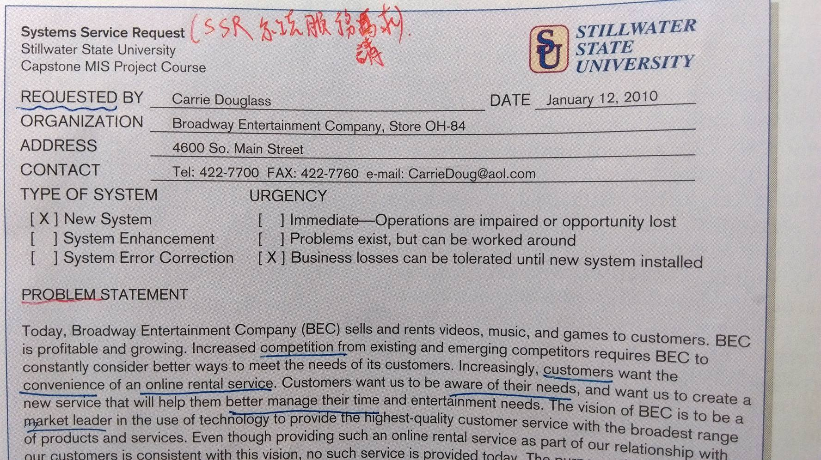
System Service Request
A method of presenting projects to students – SSR (like inside an organization)

Slide 12
Problem Statement
Reason:
Increased competition from existing and emerging competitors
Customers’ need of an online rental service
Solution:
Providing on-line rental service can improve customer satisfaction

Slide 13
Services the proposed system provides
Reviewing a comprehensive library of titles
Specifying preferences in a wish list
Checking status of delivery
Making a rental without a due date or late fees
Movie recommendation from other customers
Promotion of in-store special offers

Slide 14
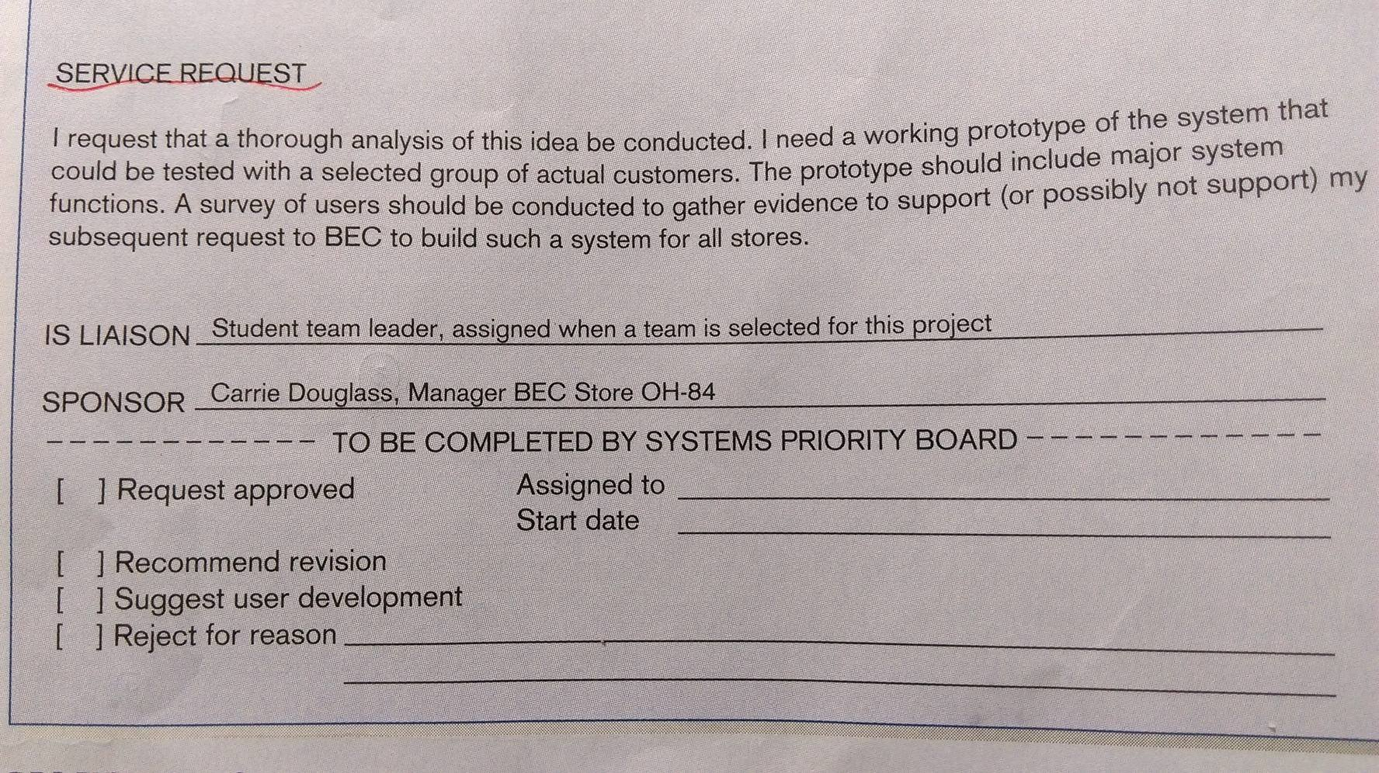
SSR

Slide 15
Why we prepare CRM form?
Professor Tann suggested that students would have many reasons to be motivated to work on submitted projects, including convenience, opportunity to work with interesting technologies , doability, and a sense that their work might make a difference for the organization. Carrie’s project seemed to satisfy the first three reasons, but Professor Tann asked Carrie to think more about the last reason.

Slide 16
The specific IS strategic objectives
Better align IS development with corporate objectives
Deliver global system solutions
Reduce system development backlog
Increase skill level of IS staff

Slide 17
The team leader had Steve that the BEC System Priority Board , which decided which IS projects were funded, would need to see a high-level analysis of how their project, and all other projects competing for limited corporate support, related to corporate and IS strategic plans.

Slide 18
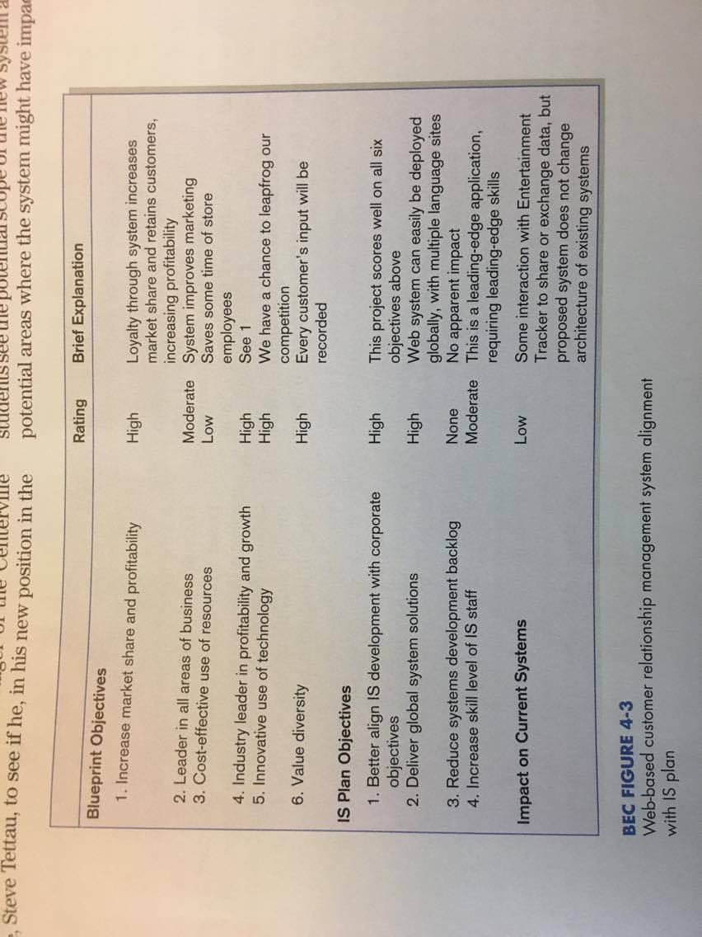
Web-based customer relationship management system alignment with IS plan

Slide 19
Case Summary

Slide 20
Various sources of ideas for improved information systems
The need to fix a broken system
The need to improve the performance of an existing system
Competitive pressure
New government regulations
Requirements generated from top-down organizational initiatives
Creative ideas by individual managers

Slide 21
Case Question

Slide 22
Case Question 1
The SSR submitted by Carrie Douglass has not been reviewed by Professor Tann. If you were Professor Tann, would you ask for any changes to the request as submitted? If no changes, why? Remember, an SSR is a call for a preliminary study, not a thorough problem statement.

Slide 23
Answer of Case Question 1
No changes , because an SSR is a call for a preliminary study, not a thorough problem statement.
The SSR submitted by Carrie is already enough for a comprehensive understanding of system requirements.

Slide 24
Case Question 2
If you were a student in Professor Tann’s class, would you want to work on this project? Why or why not?

Slide 25
Answer of Case Question 2
Yes, I would want to work on this project if I were a student in Professor Tann’s class.
This project might make a difference for the organization and might change the industry of rental business.
It’s exciting & perspective.

Slide 26
Case Question 3
If you were a member of BEC’s steering committee, the Systems Priority Board, what action would you recommend for this project request if you had reveived it? Justify your answer.

Slide 27
Answer of Case Question 3
If I were a member of BEC’s steering committee, the Systems Priority Board, I would need to see a high-level analysis of how their project related to corporate and IS strategic plans.

Slide 28
Case Question 4
Should Carrie have contacted Karen Gardner? Should Carrie have accepted only Steve Tettau’s suggestions, or should she have talked to others at this point? Justify your answer.

Slide 29
Answer of Case Question 4
Yes , I think Carrie should have contacted Karen Gardner because Karen Gardner already had a nice impression of her and it’s a good chance for Carrie to promote her idea.
In case of confidentiality of business, I don’t suggest Carrie talked about it except for crucial members in BEC.

Slide 30
Case Question 5
One of the ideas presented in this chapter is to relate system requests with the competitive strategy of the organization. What is BEC’s competitive strategy and how would you position Carrie’s project request with respect to this competitive strategy?

Slide 31
Answer of Case Question 5
The vision of BEC is to be a market leader in the use of technology to provide the highest-quality customer service with the broadest range of products and services.
Carrie’s project which providing such an online rental service as part of relationship with customers is consistent with this vision.

Slide 32
Case Question 6
If you were a systems analyst in the BEC corporate IS department and you had received a call from Carrie Douglass about her project idea, what would you recommend to Carrie? What do you think Carrie would need to prepare or do, in addition to what she has already prepared, to submit a request to the System Priority Board?

Slide 33
Answer of Case Question 6
More detail about the project inclusive of :
Introduction , Project Overview included.
System Description
Feasibility Analysis
Management Issues

Slide 34
Case Question 7
Consider what other information could further relate the proposed system to corporate and IS strategy or help to motivate the potential worth of the proposed system.

Slide 35
Answer of Case Question 7
The only problem that could raise doubt in the System Priority Board is the fact that the ratings and explanations are highly subjective; they are based on Carrie‘s point of view. It would be more effective if she managed to get a third-party to review her request and ratings in order to provide the board with an accurate objective request that would better represent the objectives and effectiveness of the proposed system. She should add information that reflect the broader needs of the organization in order to attract the attention of top management, in other words try to resemble slightly top-down source. However, she should also try to implement information that would allow functional manager and business units relate with the system. By doing so, she would be able to attract not only top management but also bottom-up initiatives

Slide 36
Case Question 8
If you were an account representative with a small consulting firm that had received a request for proposal from Carrie Douglass to conduct the project she outlines, what would your response be? Is the System Service Request and project alignment document sufficient as a request for proposal? If so , why? If not , what is missing?

Slide 37
Answer of Case Question 8
No, it would include :
Follow-up time-of-day planning, and what parts are expected to be completed before any time and clear planning system development stage.
Attracting information systems development staff, such as providing a working environment, high sponsorship ...

Slide 38
END

