Slide 1
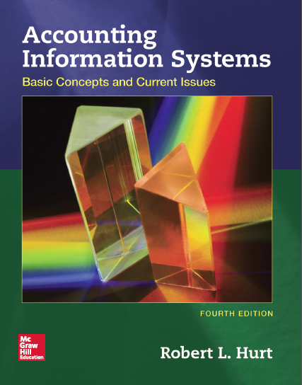
Chapter 10
E-business and Enterprise Resource Planning Systems
Notes:
第一張
9
第二章
如何coding
第三章
43
47,48 echo check nockbox
第四章
如何應付risk 評估後有些舉動 像是接受還是reject
企業流程七步
第五章
兩個model system/ capability
第六章
上課那題p106 只考這題
第七章
123 dataflow 跟flow chating 比較
第八章
Relational data base 括號內數字的意義
第九章
名詞解釋
第十章
Erp成功跟失敗因素
第十一章 佔20分

Slide 2
Outline
Learning objectives
Nature & forms of e-business
Enterprise resource planning systems
Application service providers

Slide 3
Learning objectives
Explain the nature of e-business, comparing and contrasting it with traditional “brick-and-mortar” organizations.
Discuss major forms of e-business.
Describe the basic nature, purpose, and structure of enterprise resource planning systems.
Give examples and analyze the causes of ERP system failures.
List and discuss steps associated with successful ERP implementations.
Discuss the role of application service providers in e-business.

Slide 4
Introductory case
Case: Amazon
Discussion:
What are the defining features, advantages, and disadvantages of the e-business platform?
How does an ERP system provide better, more useful information for decision making in organizations?
How is the modular structure of most ERP systems similar to a relational database?
What internal control issues arise when an organization ventures into e-business? When it installs an ERP system? When it uses application service providers in its operations?
What is SSAE 16?

Slide 5
Definition of E-Business(Commerce)
Def: the exchange of goods and services by means of internet or other computer networks.
Traditional business: in stores and other “brick-and-mortar” buildings, or through mail order catalogs and telephone operators.
E-business: buyers and sellers transact business over networked computers.

Slide 6
Benefits of E-business
Marketing: geographic market expansion, hard-to-reach markets, more targeted marketing
Reduced operating costs: marketing, telecommunications, transaction processing
Streamlined operations(to improve a business, process, etc. by making it more modern or simple )
Quicker, easier product and service delivery.

Slide 7
Costs of E-business
Financial costs associated with setting up networks
Need to develop different, better internal control systems
Potential for customer distrust
Severe consequences for technology breakdowns

Slide 8
Amazon’s marketing strategy
Freely proffers products and services(give related advice)
Uses a customer-friendly interface
Scales easily from small to large
Exploits its affiliate’s products and resources
Uses existing communication systems
Utilizes universal behaviors and mentalities

Slide 9
Something about Amazon
Cost-cutting is the corner-stone of Amazon
It doesn’t suffer the costs of maintaining real-world stores, it has been to charge consumers less.
Able to deliver its products and services very quickly.
Ex: use of drones as product delivery mechanisms.
Notes:
Cost cutting strategy
Benefit/success：短時間內提高市佔率、形成市場障礙
Cost/ problems
成本領導策略之成本問題
使員工達到最大工作量，對待員工如機器人，高強度工作，沒有彈性，員工流動快存在穩定度問題
物流成本高，利用ai監控員工工作效率
無實體店面，需要大量行銷，網路策略，例如促及網路點閱率
假貨氾濫，造成大品牌和消費者卻步

Slide 10
Internal control of E-business
Customer identity authentication via usernames and passwords.
Require customers to input the control number from the back of a credit card.
Billing addresses must match the credit card company’s records as preventive internal control.
Using a secure server
VeriSign logo: an added layer of security for online transactions.

Slide 11
AICPA’s WebTrust and SysTrust
WebTrust is the accounting profession’s answer to concerns relating to electronic commerce.
Using trust service principles and criteria issued by the Assurance Services Executive Committee of the AICPA, CPAs can offer a range of advisory and assurance services to help either clients or employees address security, online privacy, availability, and confidentiality needs.
SysTrust is the accounting profession’s answer to concerns relating to system reliability.
CAPs can offer a range of advisory and assurance services to help either clients or employers address their security, availability, processing integrity, and confidentiality needs.

Slide 12
Other internal mechanism
Data encryption
Segregation of duties designers can restrict access to various parts of the system based on organization level and/or job function

Slide 13

Nature & forms of e-business
Central feature
  Business is transacted over a network.
Forms
  B 2 C
    www.graze.com
  B 2 B
    www.oracle.com
  G 2 C
    www.irs.gov
  G 2 B
    www.sba.gov
  C 2 C
    www.eharmony.com

Slide 14
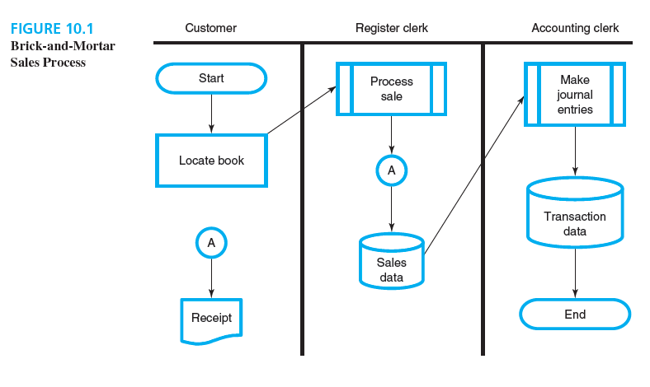
Brick-and-Mortar sales process

Slide 15
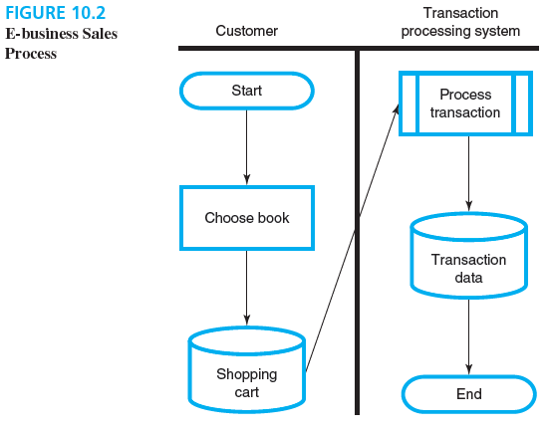
E-Business Sales Process

Slide 16
Case of purchasing airplane tickets
Brick and mortar: most people who wanted to purchase airline tickets would consult a travel agent.
The travel agent would communicate with the airline, then present options to the client.
The client would make a choice; the agent would buy the tickets from the airline, sometimes charging an additional fee for the service.
The process could often take several days.

Slide 17
Buying airline tickets using e-business
Log on to an airline or travel-related Web site.
Then put in the parameters of your travel
The computers searches for tickets and can even compare nearby airports.
You submit your payment information on a secure server, and e-mail arrives in your mailbox confirming the transaction.
When you get to the airport, you don’t need a paper ticket in most cases.

Slide 18
E-business and human intervention
E-business can significantly reduce the need for human intervention in an accounting information system and all the attendant problems that accompany it. (ex: data entry mistakes, billing problems, incorrect journal entries)
From an output perspective, e-business systems facilitate the preparation of general purpose financial statements and other reports.

Slide 19
Def. of ERP systems
ERP: enterprise resource planning system
Definition: a relational database that provides comprehensive information for making decisions in organizations.
Two well-known ERP systems are Oracle’s PeopleSoft and SAP.

Slide 20
Enterprise resource planning systems
Purpose
  Providing comprehensive information for decision making
Nature
  Fundamentally, relational databases
  Modular organization
Major companies
  Oracle (PeopleSoft)
  SAP

Slide 21
Enterprise resource planning systems
Table 10.1 Modular organization of ERP systems
Generic module name | Primary stakeholder group | Module components in SAP
Customer relationship management (CRM) | Customers | Sales and distribution
Human resource management (HRM) | Employees | Human resources
Supply chain management (SCM) | Vendors | Materials management
Financial management | Stockholders | Financial accounting

Slide 22
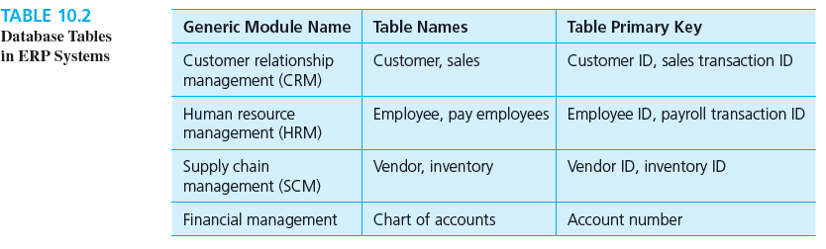
Database tables in ERP sytems

Slide 23
10 major causes of ERP implementation failures
Poor leadership from top management(購入erp系統原本工作的員工會被取代，員工會反抗）
Automating existing redundant or non-value-added processes in the new system
Unrealistic expectations
Poor project management
Inadequate education and training
Trying to maintain the status quo
A bad match ERP software and organizational process
Inaccurate data in the system
ERP implementation viewed as an IT project.
Significant technical difficulties

Slide 24
6 necessary conditions for a successful ERP implementation
Obtain organizational commitment
Communicate strategic goals clearly
View ERP as an enterprise-wide venture
Select a compatible ERP systems
Resolve multisite issues
Ensure data accuracy

Slide 25
Case: Marathon Oil
A successful implementation of SAP ERP software.
Recognizing the goal “the transfer of ownership from the project team that designed and configured the new system and processes to the end users, the internal clients who would employ these tools and processes in their day-to-day operations”
Constant communication via newslettlers, workshops, and hands-on interaction to increase employees’ comfort level with the software.

Slide 26
Enterprise resource planning systems
Selected failure causes
  Poor top management leadership
  Unrealistic expectations
  Inaccurate data in the system
  Significant technical difficulties
Selected conditions for success
  Obtain organizational commitment.
  Communicate strategic goals clearly.
  View ERP as an enterprise-wide venture.
Umble, E., and M. Umble. 2002. “Avoiding ERP Implementation Failure.” Industrial Management, January/February, pp. 25–34.

Slide 27
Application service providers
An organization that provides a contractual service to deploy, host and manage applications for customers remotely from a centralized location.
  Jaruzelski, Ribeiro and Lake (2014)

Slide 28

Application service providers
ASP types
  Enterprise
    ERP systems
  Local / regional
    Payroll services for companies in Denver
  Specialist
    Online diversity compliance training
  Vertical market
    Patient billing for hospitals
  Volume business
    Comprehensive human resource services for mid-range businesses in Nashville

Slide 29
ASPs as a form of risk sharing
Organizations and individuals have used ASPs to:
Process insurance claims
Complete the steps in the accounting cycle
Manage stock market transaction electronically
Provide personal financial planning
Prepare income tax returns

Slide 30
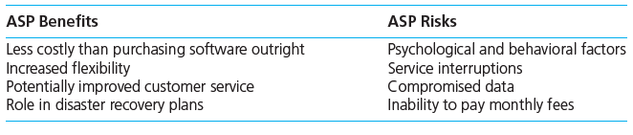
Benefits and risks of ASP

Slide 31
Several internal controls to compensate ASP risks
Establishing a budget for the ASP project
Backing up data on a daily basis
Providing ongoing training for employees using the ASP
Creating firewalls and encryption protocols
Notes:
Asp 短期來說成本較低
長期來說 隨企業成長，資料價值提升，可能還是需要自己的erp系統

Slide 32
Application service providers
Title
  Reporting on Controls at a Service Organization
Three report types
  SOC 1
    Financial reporting
  SOC 2 資訊安全
    Security, confidentiality, privacy and related areas
  SOC 3
    Less detailed version of SOC 2
Using ASPs involves risk.
The risk can complicate a financial statement audit.
The AICPA issued SSAE 16 to help address that risk in the context of an audit.

Slide 34
Instructor feedback
Choose one of this chapter’s main topics:
  E-business
  ERP systems
  ASPs
Form a group of three or four students that has the same topic.
Develop a list of the major points about your chosen topic.
Form a different group of three or four students with different topics.
Discuss each topic’s major points.

Slide 35
Assessment questions
Test your comprehension of this chapter by responding to the questions on the following slides!

Slide 36
E-business
Which of the following statements about B2B e-business is most true?
  B2B companies can benefit from the COSO internal control framework.
  A company engaged in B2B e-business is unlikely to be engaged in B2C e-business.
  Both A and B are true.
  Neither A nor B is true.

Slide 37
ERP systems
Which modules in a company’s ERP system would contain information about cash? (Choose all that apply.)
  CRM
  HRM
  SCM
  Financial management

Slide 38
ASPs
An SSAE 16 SOC 1 report may include information on which of the following internal controls?
  Separation of duties
  Operations of the internal audit department
  Both A and B
  Neither A nor B

