Slide 1


Applicability of a Hardware Accelerator to Combinatorial Optimization Problems in EDA
Presenter: Ting-Yi Wu
Instructor: Jie-Hong Roland Jiang
ALCom Lab
EE Dept./ Grad. Inst. of Electronics Eng.
National Taiwan University

Slide 2
Outline
Background
Proposed technology
Experimental Result

Slide 3
BACKGROUND

Slide 4
Annealing
Annealing
When the object gradually cools down, the temperature will reduce to the lower energy state.
If temperature reduces slowly
Crystal
Quenching
If temperature reduces urgently
Amorphous

Slide 5

Annealing (cont’d)
Start
Energy
Quenching
Stable!!
Amorphous
Annealing
crystal
Temperature

Slide 6
Simulated Annealing (SA)
Metropoils used Monte Carlo simulation to calculate the behavior of cold down
The energy of physical systems is quite similar to optimization problem
The lower energy vs The lower cost
What is the simulated annealing ?
It is simulating the process of cooling a object to crystal

Slide 7
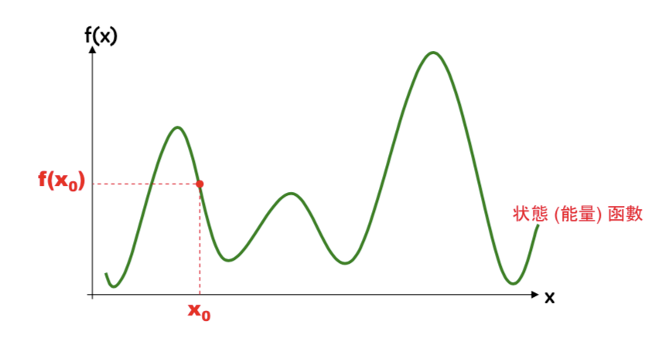
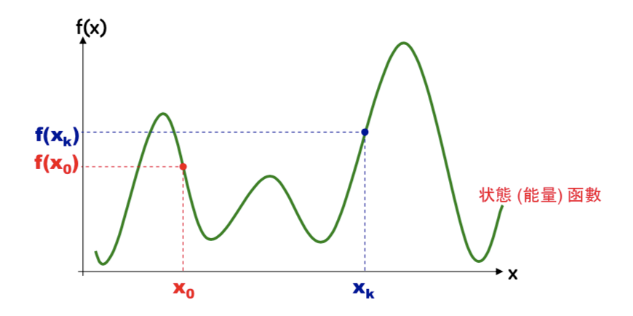
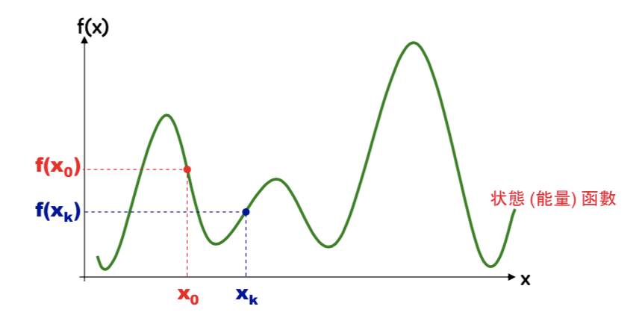


Example
Accept this state?
Notes:
Assume our target is find the smallest state f(x)
We have a initial state x0 and f(x0)
We change this state to get next state, if f(xk) is smaller than f(x0) . We will accept it.
If f(xk) is bigger than f(x0), we will reject this in conventional and find the next better state.
However , it doesn’t mean that the best solution cannot be found after this state.

Slide 8
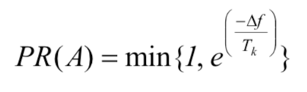
SA Example
Set a probability to accept the bad state
Use Boltzmann function to set probability
If PR is too lower, can’t escape local field
If PR is too higher, can’t convergence
Temperature will reduce when find solution
Important parameter

Slide 9

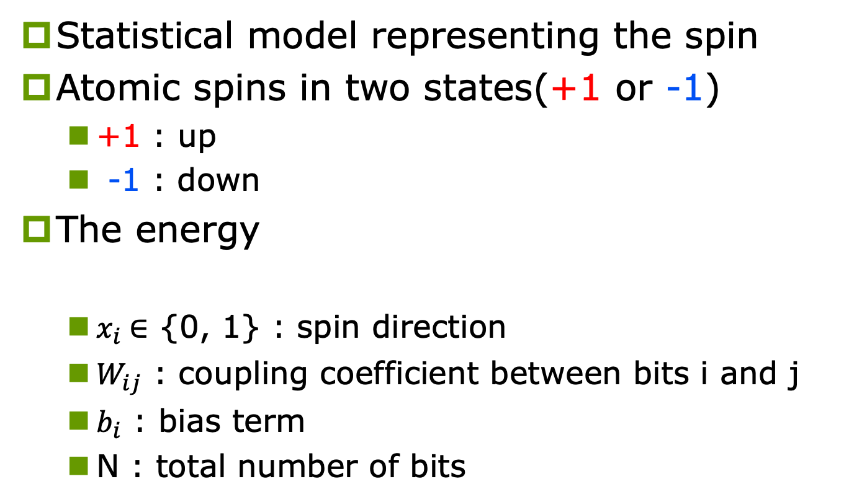
Ising model
Statistical model representing the spin
Atomic spins in two states(+1 or -1)
+1 : up
-1 : down
The energy
${\text{x}}_{i}$∈ {0, 1} : spin direction
${\text{W}}_{ij}$ : coupling coefficient between bits i and j
$b_{i}$ : bias term
N : total number of bits

Slide 10
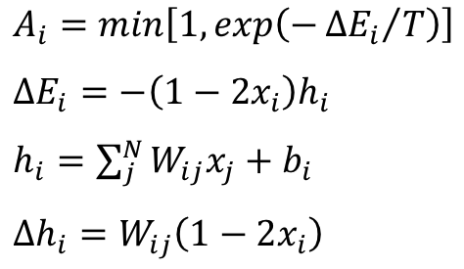
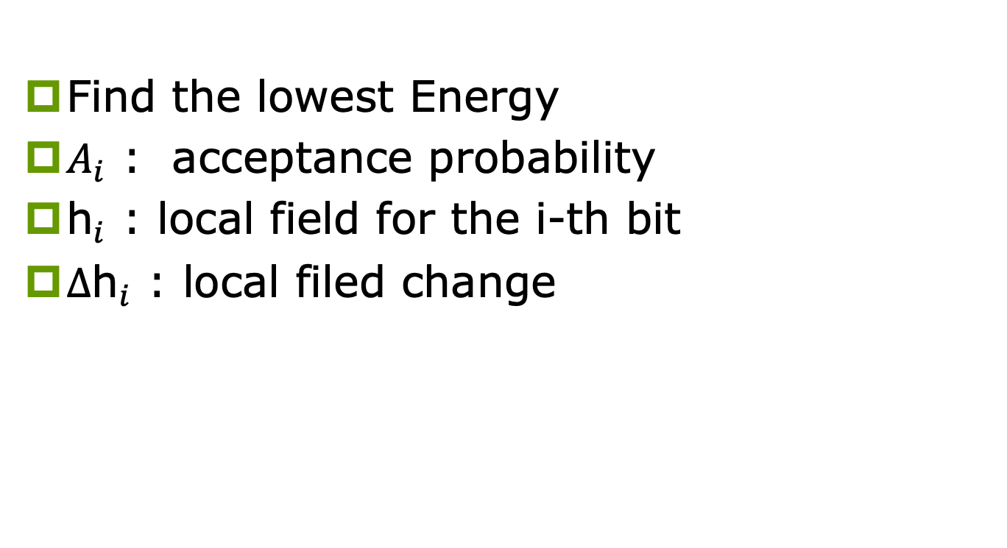
SA for Ising model
Find the lowest Energy
${\text{A}}_{i}$ : acceptance probability
${\text{h}}_{i}$ : local field for the i-th bit
$∆{\text{h}}_{i}$ : local filed change

Slide 11
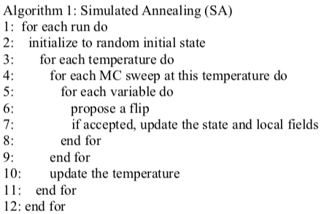
SA algorithm

Slide 12
SA challenges for solving combinatorial optimization problems
Slow convergence when trapped at local minimum
Solution is sensitive to parameters
If a parameter is slightly shifted, the quality will greatly deteriorate

Slide 13
Proposed technology

Slide 14
Hardware accelerator
To alleviate two problems in SA
Slow convergence problem
Solution’s sensitivity to parameters
Applying the following techniques
Parallel search architecture
Replica exchange scheme

Slide 15
Parallel search architecture
In the conventional SA algorithm, it executed bit by bit
The proposed hardware accelerator executes all the bits in parallel
If limits the number of flip bits to one, the accelerator is guaranteed to reach the optimum solution like SA

Slide 16

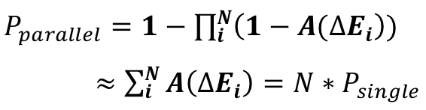
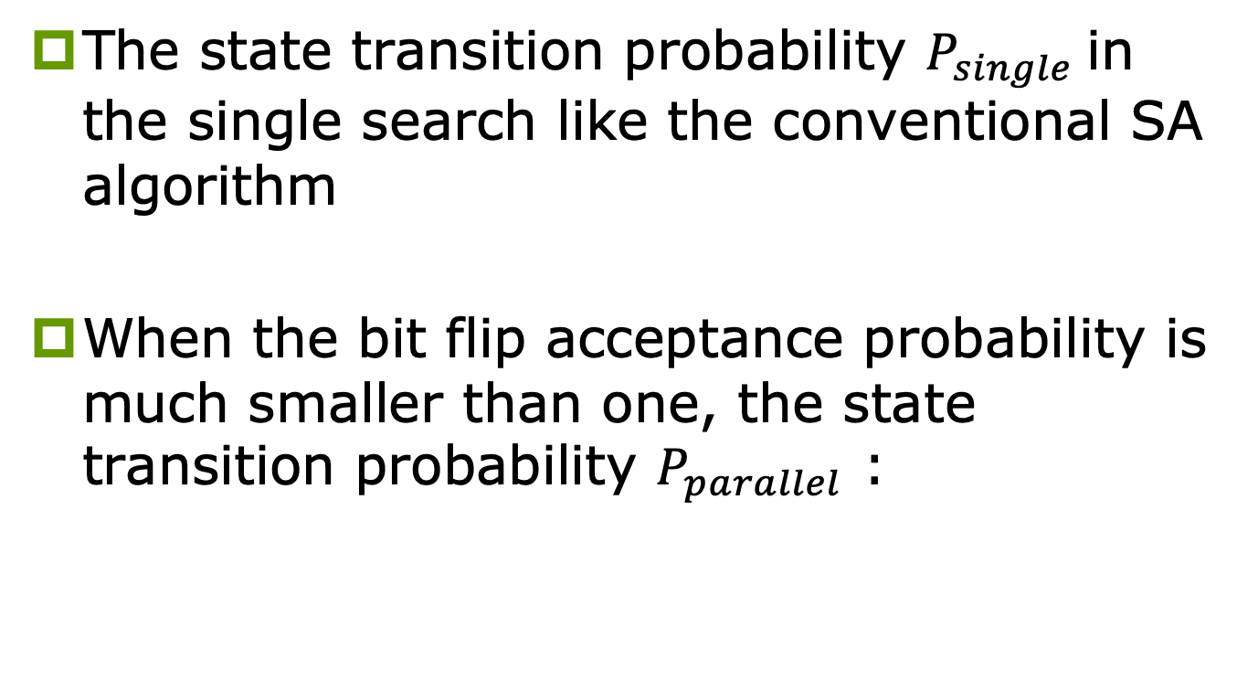
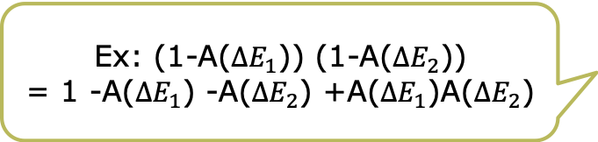
Parallel search architecture (cont’d)
The state transition probability $P_{single}$in the single search like the conventional SA algorithm
When the bit flip acceptance probability is much smaller than one, the state transition probability $P_{parallel}$ :
Subtract nonacceptance probability from 1
Ex: (1-A($ΔE_{1}$)) (1-A($ΔE_{2}$))
= 1 -A($ΔE_{1}$) -A($ΔE_{2}$) +A($ΔE_{1}$)A($ΔE_{2}$)
Speedup
N times

Slide 17
Replica exchange scheme (cont’d)
Find the optimum scheduling for changing the temperature can be tricky
Proposed hardware accelerator provides a replica exchange scheme
Mitigate the solution’s sensitivity
Alleviate the slow convergence problem

Slide 18
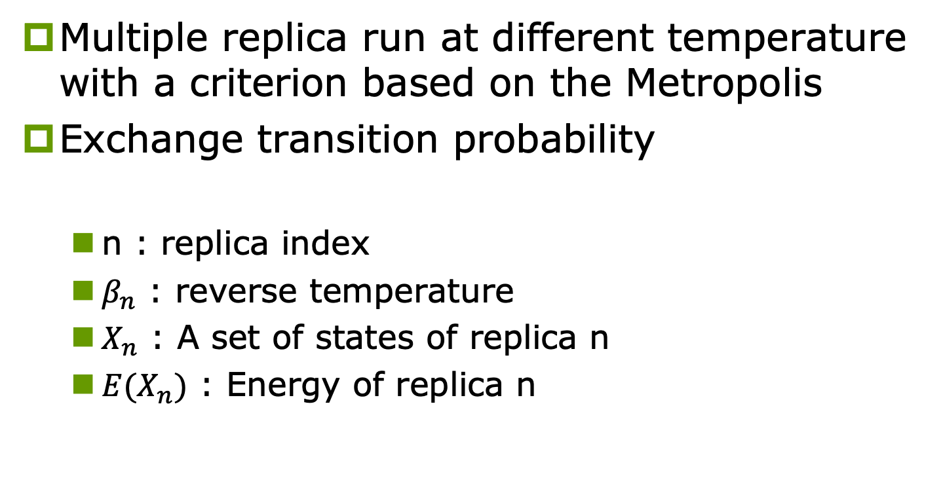
Replica exchange scheme (cont’d)
Multiple replica run at different temperature with a criterion based on the Metropolis
Exchange transition probability
n : replica index
$β_{n}$ : reverse temperature
$X_{n}$ : A set of states of replica n
${E(X}_{n})$ : Energy of replica n

Slide 19
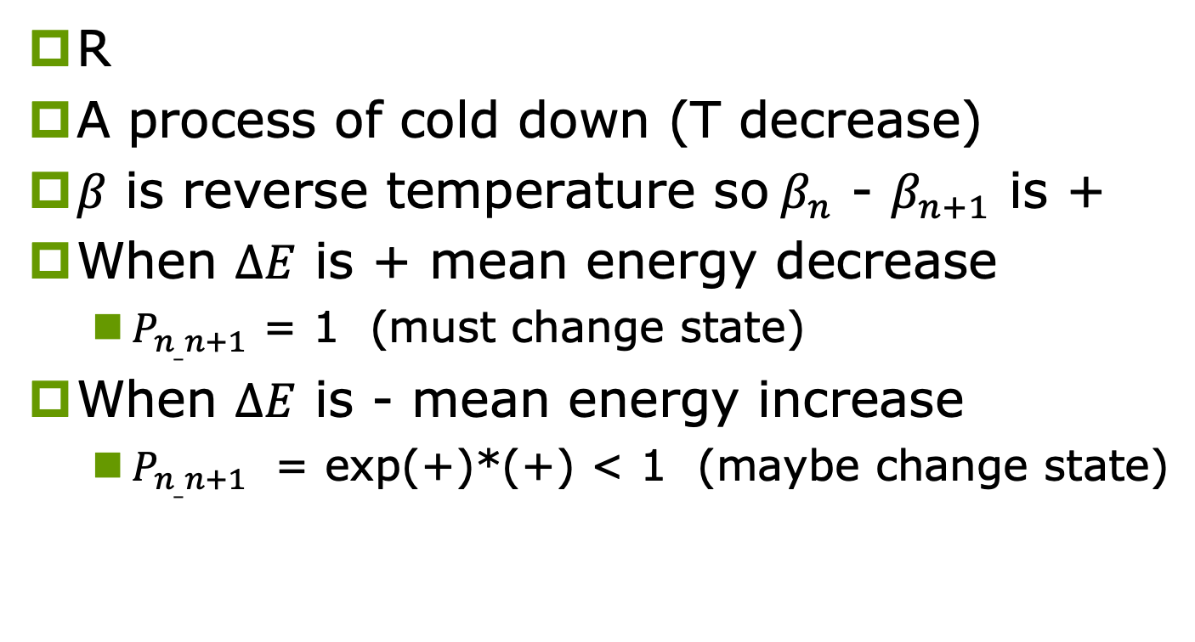
Replica exchange scheme (cont’d)
R
A process of cold down (T decrease)
$β$ is reverse temperature so$β_{n}$ - $β_{n+1}$ is +
When $∆E$ is + mean energy decrease
$P_{n_{_}n+1}$ = 1 (must change state)
When $∆E$ is - mean energy increase
$P_{n_{_}n+1}$ = exp(+)*(+) < 1 (maybe change state)

Slide 20



Replica exchange scheme (cont’d)
E(T)
R3
R8
R6
R2
R4
R7
R5
R1
T
Don’t need to find T
Find T is tricky

Slide 21
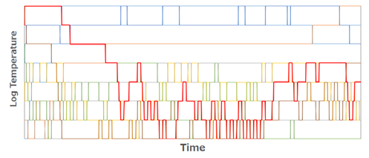
Replica exchange scheme (cont’d)
When the state is trapped at local minmum, it temperature can rise because state change
Shorten time & improved solution quality

Slide 22
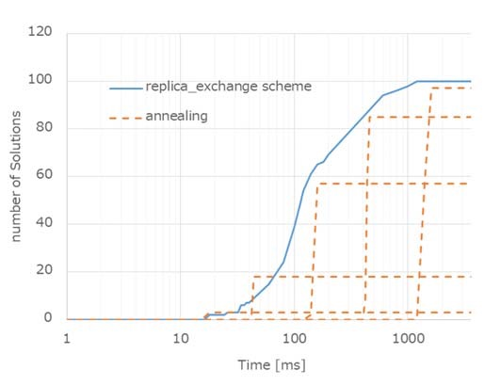
Replica exchange scheme (cont’d)
Annealing method
Number of optimal solutions remained zero for a long time and increased rapidly from a certain temperature.
Replica exchange scheme
Despite the temperature not being adjusted, it always found optimal solutions equivalent to the peak performance in the annealing method.
Five different ways

Slide 23
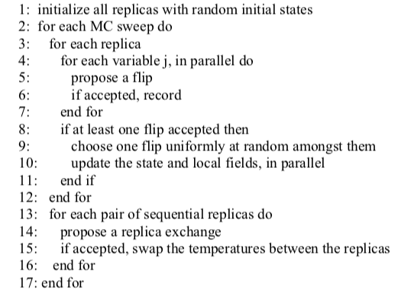
Replica Exchange Algorithm in the proposed hardware accelerator

Slide 24
Experimental results

Slide 25
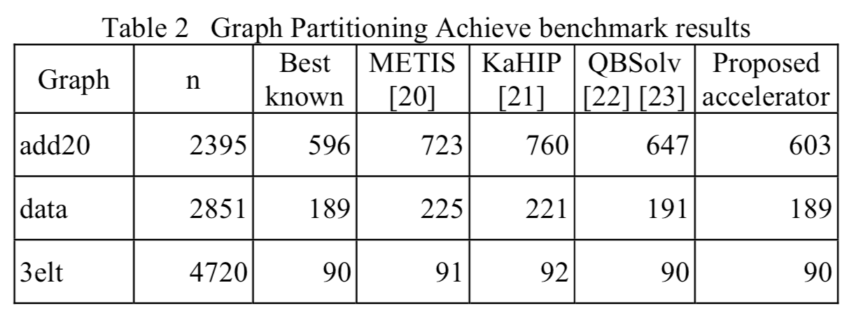
Minmum cut problem benchmarks
Evaluation with Test graphs in Graph Partitioning Archive

Slide 26
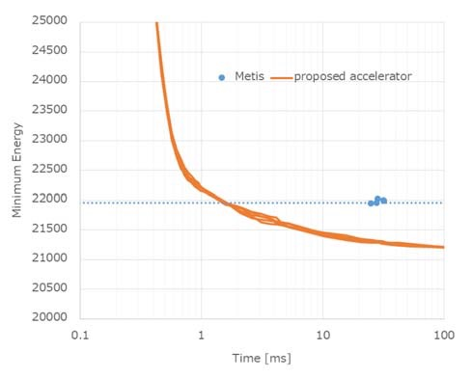
Evaluation with tree graphs for EDA
Compare proposed accelerator and METIS which is a set of highly evaluated serial programs for partitioning graphs
Minmum Energy
Faster than METIS
Lower than METIS

Slide 27
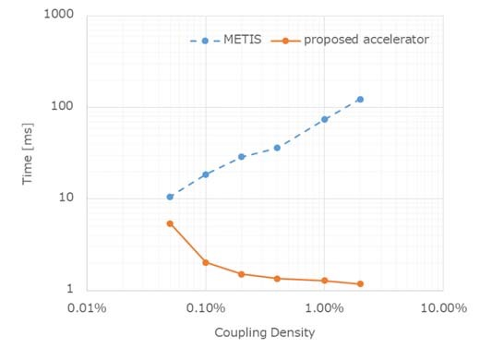
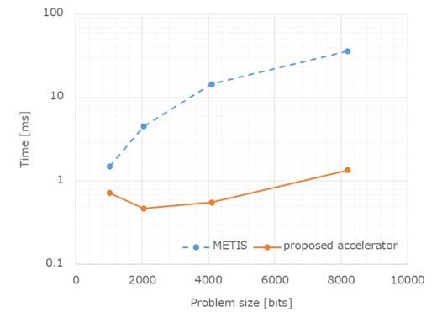
Evaluation with tree graphs for EDA
Coupling density
Short time to reach
Problem size
Short time to handle
Based on parallel

Slide 28
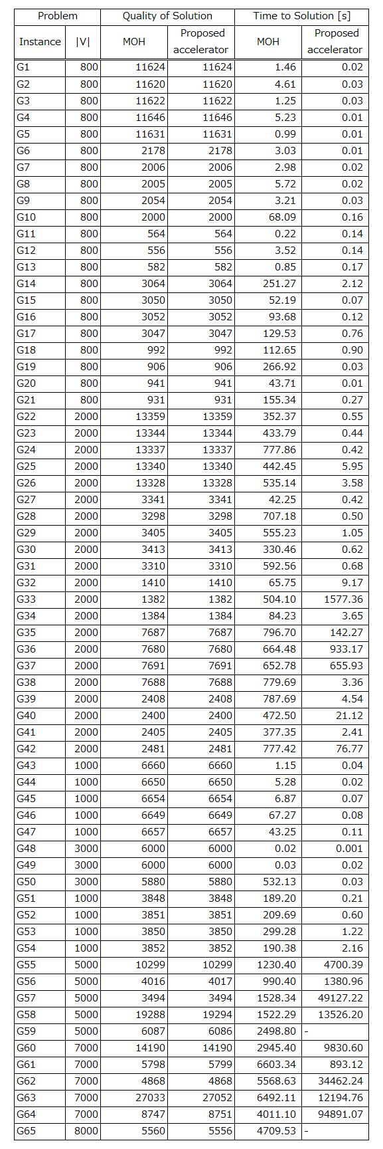
Maximum cut problem benchmarks
The accelerator and MOH(Multiple operator heuristic)
Same solutions in 58 out of 65 instance
Better solution
The accelerator : G56, G58, G61, G63, and G64
MOH : G59 and G65
Speed faster :
The accelerator : 51 instances
MOH : 8 instances

Slide 29
THANK YOU

