Slide 1


Digital Annealer and Its Applications
Presenter: Ting-Yi Wu
Instructor: Jie-Hong Roland Jiang
Team 28

Slide 2
Outline
Introduction
Ising model
DA Operating principle
Application Example
TSP
Routing with Cell Movement(Problem B, ICCAD 2020)
Conclusion
Q&A

Slide 3
Introduction

Slide 4
Introduction
A Digital Annealer (DA) is a dedicated architecture for high-speed solving of combinatorial optimization problems mapped to an Ising model.
Fully coupled bit connectivity
High coupling resolution
Uses Markov Chain Monte Carlo as a basic search mechanism
Accelerated by the hardware implementation of multiple speed-enhancement techniques
Parallel search
Escape from a local solution
Replica exchange

Slide 5
Introduction (cond.)
As Moore's Law, the performance improvement of general- purpose processors is slowing down
Specific computing that improves the performance by applying dedicated hardware and algorithms to specific application domains is gaining attention.
However, even the slightest change in the application could lead to a system needing to be redesigned.
Having a compelling range of applications
Allowing specialization to achieve significant performance gain
Combinatorial optimization problem
Ising model
The Energy Function equal to the QUBO form of problem

Slide 6
Ising model
Statistical model representing the spin
Atomic spins in two states(+1 or -1)
+1 : up
-1 : down
Two procedures:
Anneling:
State transition that lowers the local energy by the interaction with adjacent spins
Random flip:
A stochastic state transition to help escape from local minima

Slide 7
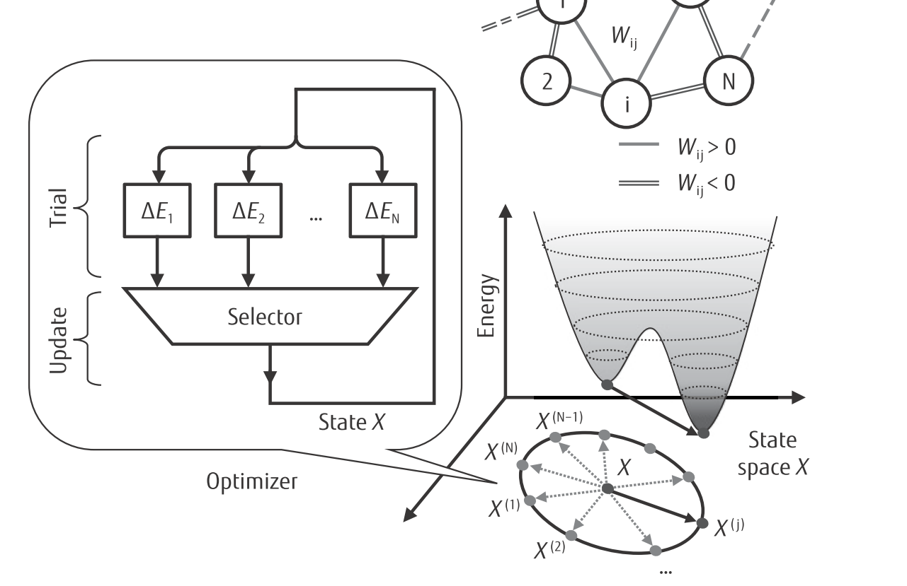
DA Operating steps
Two phases
Trial phase
state-variable change that meets an acceptance criterion is selected
Update phase
selected variable is flipped and relevant signals that depend on the variable are updated accordingly
Notes:
選擇滿足驗收標準的狀態變量更改

Slide 8
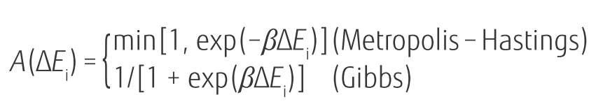

Trial phase
The criterion used in the trial phase is selectable from either Metropolis-Hastings or Gibbs ones:
is the acceptance probability of x_{i} flipping to 1−x_{i}

Slide 9
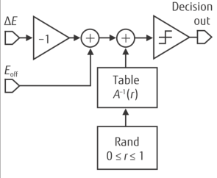
Acceptance Decision Block(ADB)
Each neuron compares the value of ΔE_{i} with a numerical noise value to produce a binary flag that becomes “1” with the probability given by
The numerical noise is generated by a table lookup from a random number r_{i} uniformly distributed between 0 and 1 so that the table outcome is A⁻¹ (r_{i})
The resulting flag bit indicates whether the corresponding state variable is a candidate.

Slide 10

Update phase
At most one state variable changes its value during the update phase, and local field values h_{i} (i=1,2,···,N) are stored in registers
When a state variable is updated, each local field is updated accordingly by adding its increment δh_{i} to its current value

Slide 11
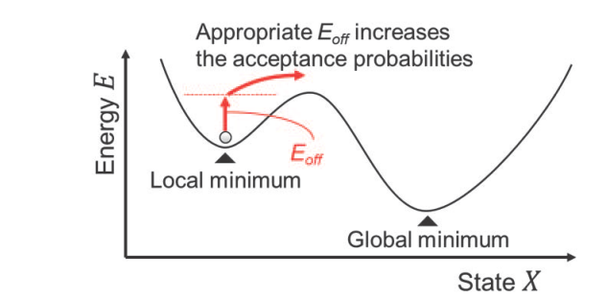
Escape from a local solution
When the state is at a local minimum of the Ising energy function, the probability of moving to a new state is small.
Slows convergence

Slide 12
Replica exchange
In stochastic search, there are various speedup methods using multiple replicas defined as MCMC search processes specified by state variables and temperature.
One of the simplest methods is a simple parallel annealing
When the lowest energy state obtained by multiple replicas is used as a solution, the target accuracy rate of each search may be small. Therefore, the time required to obtain the lowest energy state can be expected to be shortened.

Slide 13
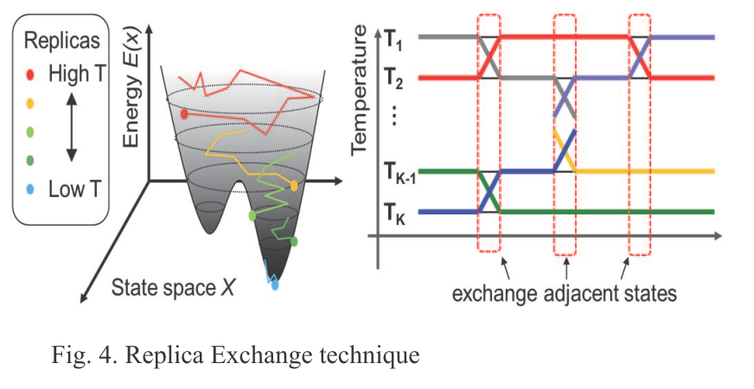
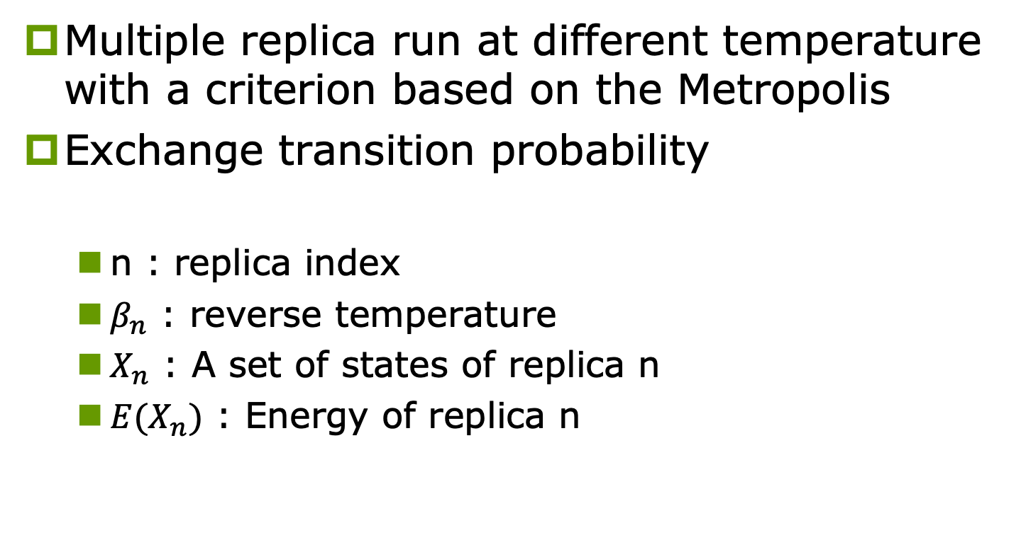
Replica exchange (cont.)
Multiple replica run at different temperature with a criterion based on the Metropolis
Exchange transition probability
n : replica index
$β_{n}$ : reverse temperature
$X_{n}$ : A set of states of replica n
${E(X}_{n})$ : Energy of replica n

Slide 14

DA Operation Review
Given an problem: 4 city TSP
Convert to ising model
$$\left[\begin{matrix}0 & 0 & 0 & 0 \\ 0 & 0 & 0 & 0 \\ 0 & 0 & 0 & 0 \\ 0 & 0 & 0 & 0\end{matrix}\right]$$
Assume this is initial state

Slide 15









DA Operation Review (cont.)
Trial phase (Parallel)
16 spins need trial
Candidates
$$\left[\begin{matrix}1 & 0 & 0 & 0 \\ 0 & 0 & 0 & 0 \\ 0 & 0 & 0 & 0 \\ 0 & 0 & 0 & 0\end{matrix}\right]$$
Random choose and update phase
(if at local minimum add Eoff)
$$ΔE$$
ADB
$$\left[\begin{matrix}0 & 0 & 0 & 0 \\ 0 & 0 & 0 & 0 \\ 0 & 0 & 0 & 0 \\ 0 & 0 & 0 & 0\end{matrix}\right]$$
$$\left[\begin{matrix}0 & 1 & 0 & 0 \\ 0 & 0 & 0 & 0 \\ 0 & 0 & 0 & 0 \\ 0 & 0 & 0 & 0\end{matrix}\right]$$
$$ΔE$$
ADB
$$\left[\begin{matrix}0 & 0 & 1 & 0 \\ 0 & 0 & 0 & 0 \\ 0 & 0 & 0 & 0 \\ 0 & 0 & 0 & 0\end{matrix}\right]$$
$$ΔE$$
ADB
………….
$$\left[\begin{matrix}0 & 0 & 0 & 0 \\ 0 & 0 & 0 & 0 \\ 0 & 0 & 0 & 0 \\ 0 & 0 & 0 & 1\end{matrix}\right]$$
$$ΔE$$
ADB

Slide 16
DA Operation Review (cont.)
Replica exchange
Above operations will parallel run with different temperature
After one update, exchanging replica with probability

Slide 17
Application Example 1: TSP

Slide 18
TSP
n-cities are modeled by a lattice-like graph that uses n²
City number
Visit order
The objective function is formulated as the summation of the distances along the route and the number of constraint violations.

Slide 19
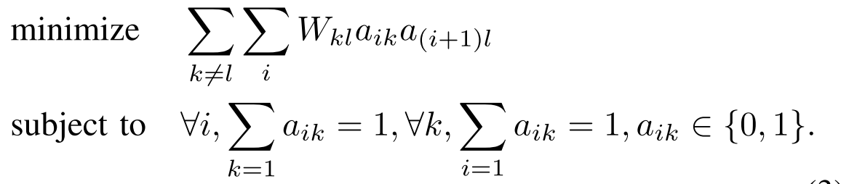
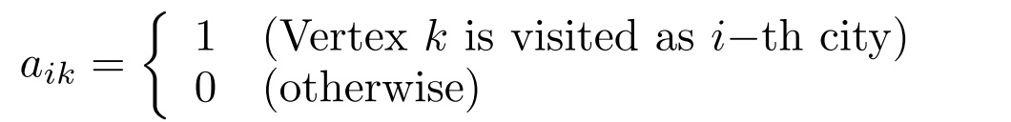
TSP(cont.)
A n-vertices TSP is formulated as:
a_{ik} : vertex k is (is not) visited as the i-th city when a_{ik} = 1(0)
W_{kl} : the weight (or distance) between vertices k and l
Possible routes is (n - 1)! / 2
Difﬁcult to obtain its optimal solution by brute force methods as n becomes larger.

Slide 20
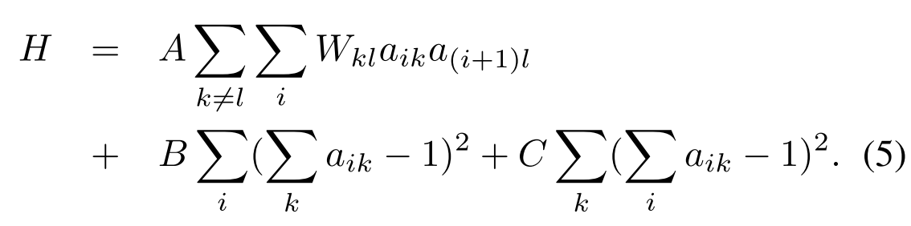
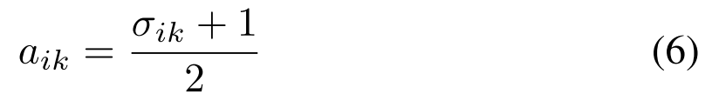
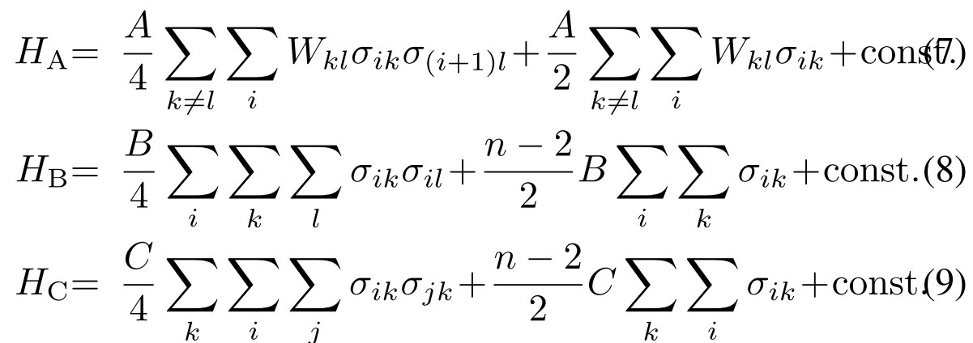
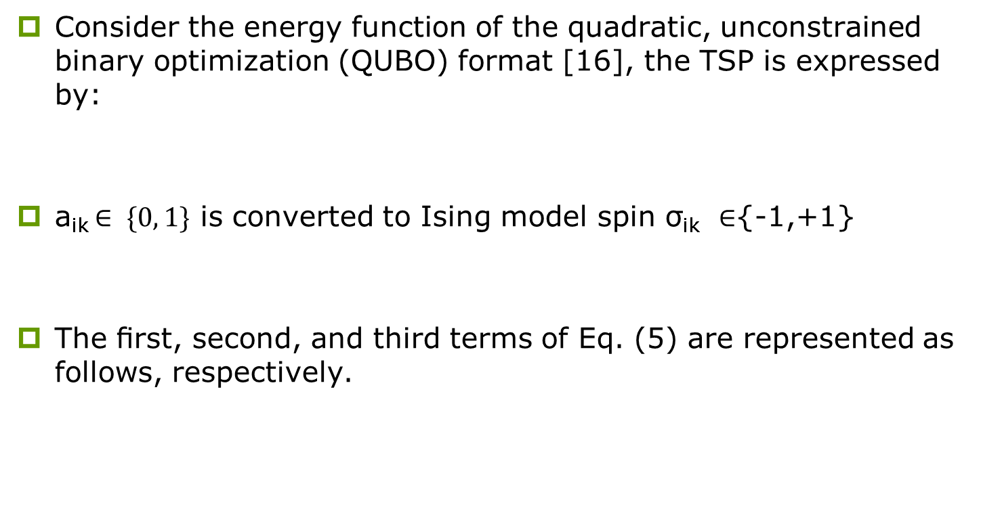
Step1: Mapping
Consider the energy function of the quadratic, unconstrained binary optimization (QUBO) format [16], the TSP is expressed by:
a_{ik} $∈ \{0, 1\}$ is converted to Ising model spin σ_{ik} ∈{-1,+1}
The ﬁrst, second, and third terms of Eq. (5) are represented as follows, respectively.
penalty(visit vertex i twice or more )
objective function penalty(visit several at the same time)

Slide 21
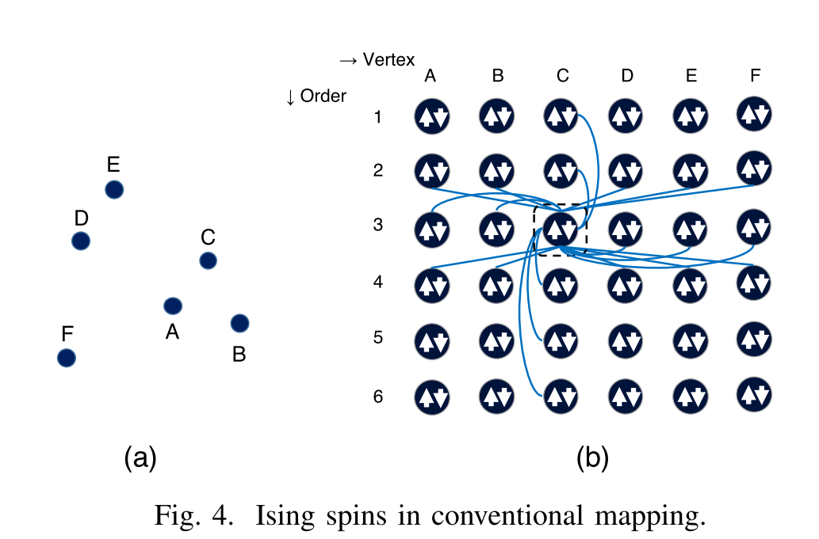
Step1: Mapping (cont.)
Typically, for hardware-based Ising model-based solvers, the number of interactions that can be coupled to a spin is limited due to routing congestion.
As shown in Fig.4, σ_{ik} is fully connected by:
σ_{i*}
σ_{*k}
σ_{i-1,*,} σ_{i+1,*} (the row numbers are wrapped around for the circuit to close)
Mapping using hardware becomes very difﬁcult as n becomes larger

Slide 22
Step2: Random ﬂip for TSP
During the procedures, random ﬂips bring the spins to a state that does not satisfy the constraints in Eqs. (8) and (9)
In order to cause the spins to satisfy the constraints, we assign heavier weights for H_{B} and H_{C} .
The constraints may be satisﬁed but the solution obtained deteriorates.
If the hyperparameters for the constraints are weakened, we may end up with no solution that satisﬁes the constraints.

Slide 23
Step3: Interpretation
After repeating annealing with random ﬂips, the spin states will be interpreted as the solution for the TSP.
Legal solution:
All rows and all columns, there is only one spin that is valued at 1, and those of other spins are all -1.
Illegal solutions are practically useless.
Good hyperparameter set is difﬁcult
Satisfy vs Quality

Slide 24
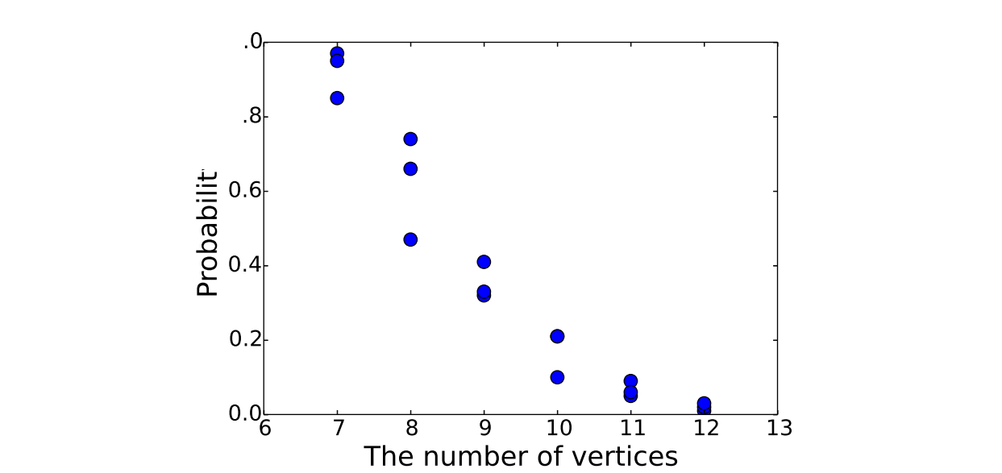
Issues discussion
The graph becomes quadratically large
Solutions fail to satisfy the constraints with quality
If the constraint term is emphasized, the solution quality will signiﬁcantly deteriorate
Naïve Ising model solvers are used, the probability of obtaining an optimal solution is very low for TSPs of any useful size.

Slide 25
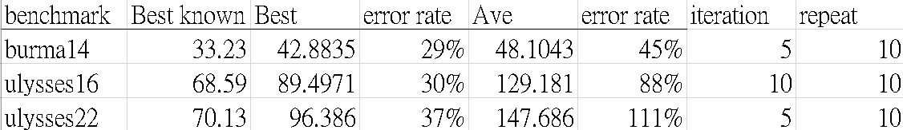
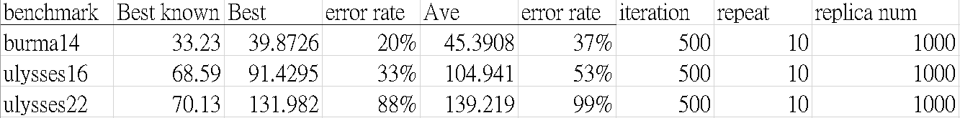
Evaluation Results (TSP LIB)
Serial(cooling rate = 0.99, B=C = W_{max}+1)
Each temperature has k-iteration, records E_{best} and solves by next temperature
Replica scheme(cooling rate = 0.9 ,B =C = W_{max}+1)

Slide 26
Application Example 2: Routing with Cell Movement (Problem B, ICCAD 2020)

Slide 27
Problem Statement
Given a design whose placement and routing on a chip is decided, the objective is to improve the current routing result by moving limited number of cells. The design implementation must be done on a given chip.
A chip consists of multiple layers with alternating routing direction on adjacent layers. A layer is formed by rows and columns of gGrids. A gGrid provides resources, namely supply, for cell placement and net routing. Supply of gGrids on each layer are specified.

Slide 28
Problem Statement(cont.)
Reduce the total wire length under the following constraints:
The maximum number of cells to move is limited.
For any gGrid, demand is no larger than supply.
All cells are placed on the chip.
For each net, no pin is left open.
For each net, the route must obey the routing directions on each layer.

Slide 29
Overall Algorithm Flow

Slide 30
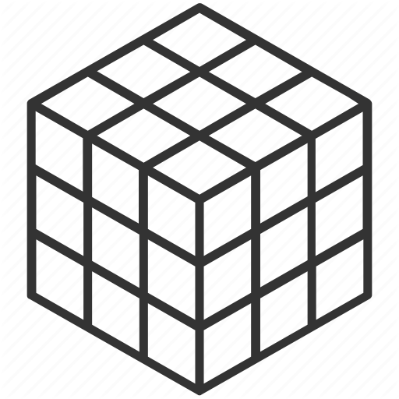
Global Route: Steiner tree
Net-Ordering
steiner point
Hanan’s Thm
Notes:
我們將繞線的問題分為global routing跟detail routing兩個階段
我們在routing開始前 會對netlist進行排序
排序依據為每一條net上面所有pin的HPWL
global routing的目標是要為netlist中的每一條net找到一個steiner tree
建立steiner tree分兩個階段
首先會根據目前pin的位置 由Hanan's Theorem找出可能的steiner point
原本的理論是 任兩個pin在座標上水平與鉛質線的交會點 就是可能的Steiner point 由於我們是再3D空間尋找 因此Steiner point必須符合兩個條件
Steiner point會出現在兩個pin的共同平面上
若兩個pin共線 就不會有steiner point
(就不會有對減少wire length有幫助的steiner point

Slide 31
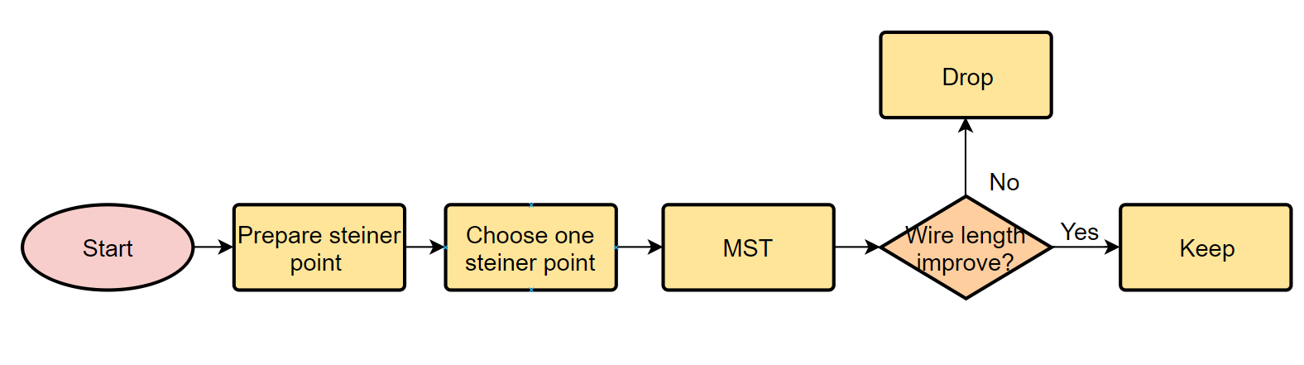
Global Route: Steiner tree (cont.)
Keep or drop?
Iterated 1-Steiner Heuristic
Notes:
global route第二個階段是根據剛剛蒐集的steiner point 建立出最後的steiner tree
我們使用上課教的Iterated 1-Steiner Heuristeic
如果一個steiner point建出來的MST對減少wire length有幫助 就保留 沒幫助就刪除

Slide 32
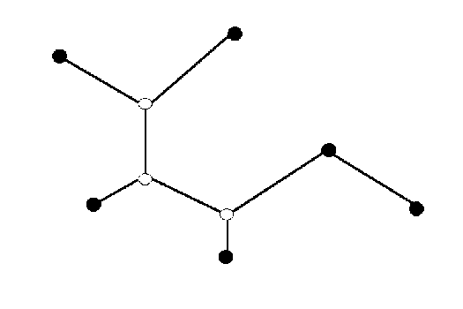
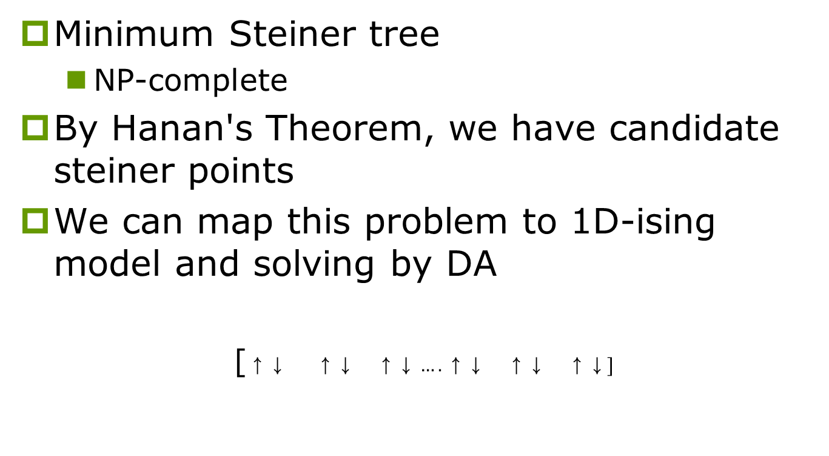

Global Route: DA for Steiner tree
Minimum Steiner tree
NP-complete
By Hanan's Theorem, we have candidate steiner points
We can map this problem to 1D-ising model and solving by DA
[$\begin{matrix}\text{↑↓ } & \text{↑↓} & \text{↑↓}\end{matrix}….\begin{matrix}\text{↑↓} & \text{↑↓} & \text{↑↓}\end{matrix}]$
sp₁
sp₁
$$\text{sp}\text{2}$$
sp₃
sp_{n}
sp₂
sp₃

Slide 33
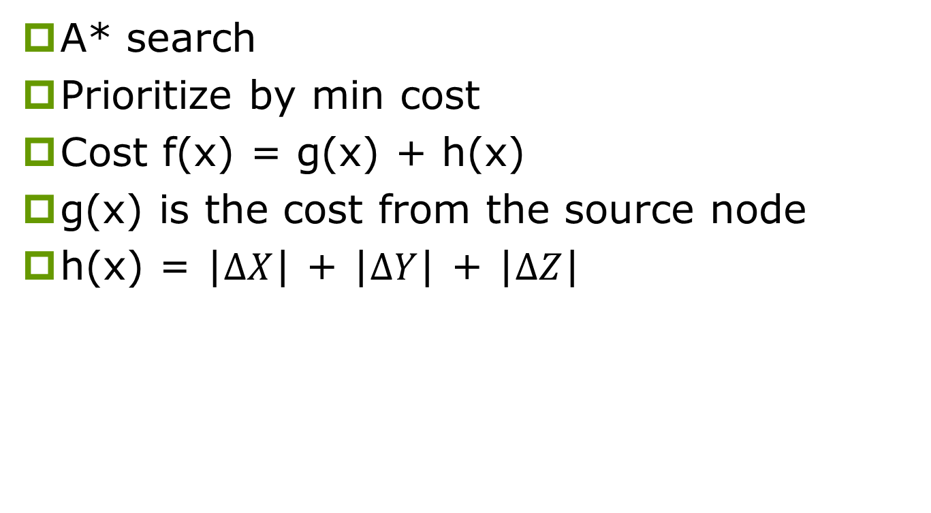
Detail route
A* search
Prioritize by min cost
Cost f(x) = g(x) + h(x)
g(x) is the cost from the source node
h(x) = |$∆X$| + |$∆Y$| + |$∆Z$|
Notes:
對所有net建出個別的Steiner tree後 會進入detail routing階段
detail route目的是根據建立的steiner tree上的每個edge 在chip上面找到由grid組成的確切路徑
我們使用A*Search演算法來達成這件事 他的cost function定義為目前的route佔用的grid數量 加上目前route的新起點距離目標的Manhattan distance

Slide 34
Set HPWL for Nets and Cells
Nets
Grid position(layer, row, column)
HPWL_{net} = (layer_{max} - layer_{min}) +(row_{max} - row_{min}) + (col_{max} - col_{min})
Cells
HPWL_{cell} =
Ex: HPWL_{cell1} = HPWL_{N1} +HPWL_{N2} + HPWL_{N3}
Cell2
Cell5
N₂
Cell2
Cell1
P₂(layer₂,row₂,column₂)
Cell1
N₁
N₃
P₁(layer₁,row₁,column₁)
P₃(layer₃,row₃,column₃)
Cell3
Cell4
Cell3

Slide 35
Placement
Algorithm Flow

Slide 36
Zero forced-directed Method
Take Cell from cell list with Max cost
New position:
1
Cell5
N₃
(row₂,col₂)
Cell2
(row₅,col₅)
Cell1
N₁
1
N₂
2
(row₄,col₄)
(row₃,col₃)
Cell4
Cell3
This Ggrid is valid?
Yes: Moving this cell
No: Another Grid Moving

Slide 37
Another Grid Moving
If the position is invalid, we consider the adjacent grid (Jiugongge)
After moving, choose grid with remain max supply
If these 8 grids are invalid
Give up moving this cell
Choose the 2nd cell in the cell list and recalculate
 | Zero forced
One of the grids valid?
Yes: Moving the cell with max remain supply
No: Choose another cell

Slide 38
Evaluation Results

Slide 39
Conclusion

Slide 40
Conclusion and Future Work
This project implements “Digital Annealer” for two applications
1) TSP
2) Routing with Cell Movement (Steiner tree)
According to evaluation results, this digital annealer has poor performance in TSP
Issue Discussion:
Temperate interval and cooling rate setting
ADB adjust

Slide 41
THE END AND Q&A

