Slide 1
TEAM PROJECT
Business case – Supermarket
Group 7 - Carolina, Filipe and Robertson

Slide 2
decisions
Website and internal system
Website using PHP and Java Script
Internal system using Java
Repository link: https://bitbucket.org/teamprojectgroup7/teamprojectg7

Slide 3
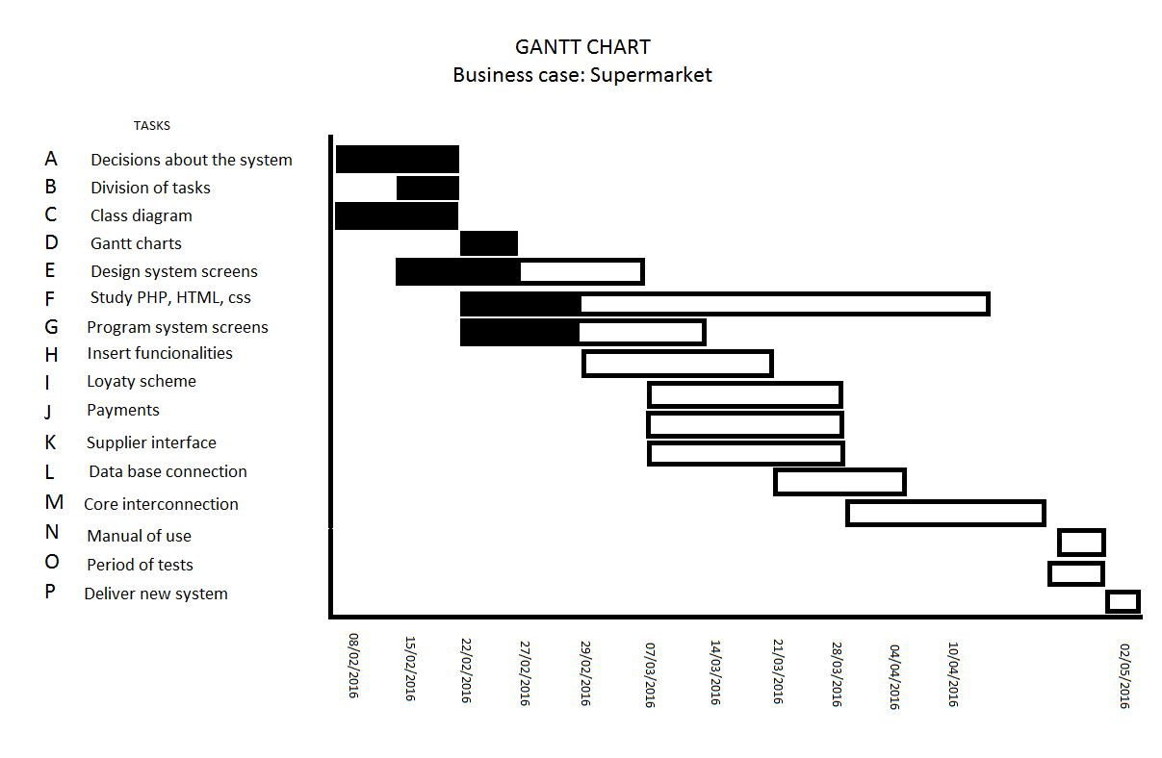
Planning

Slide 4
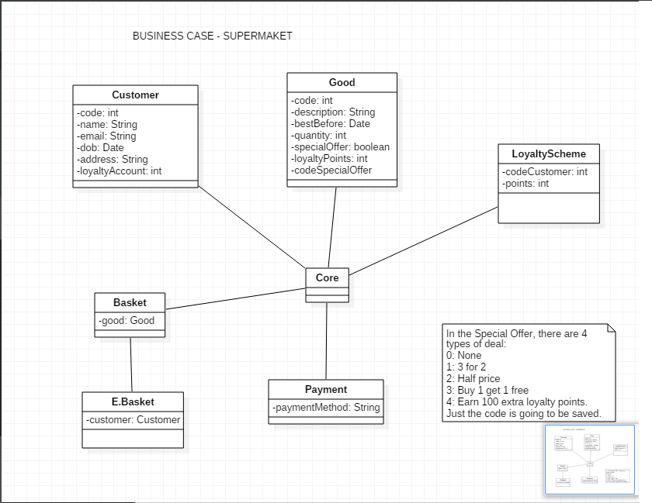

Class diagram

Slide 5
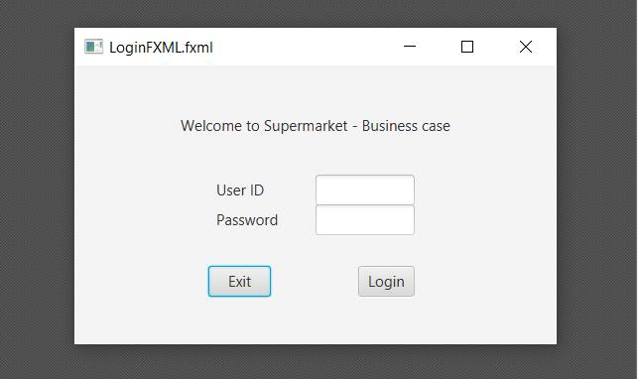
Screens

Slide 6
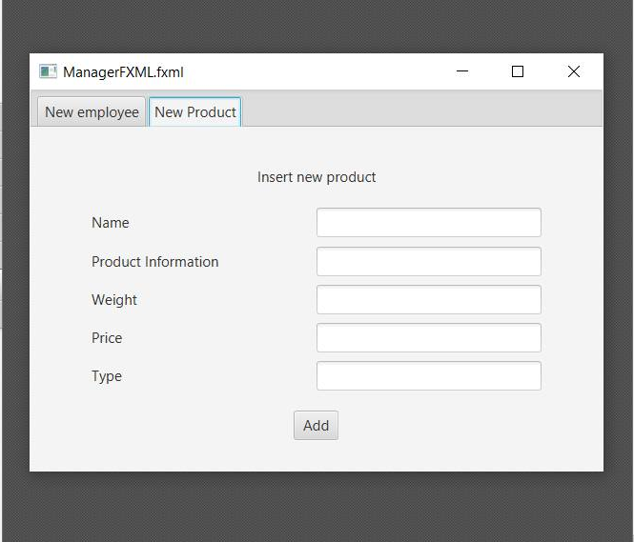

Slide 7
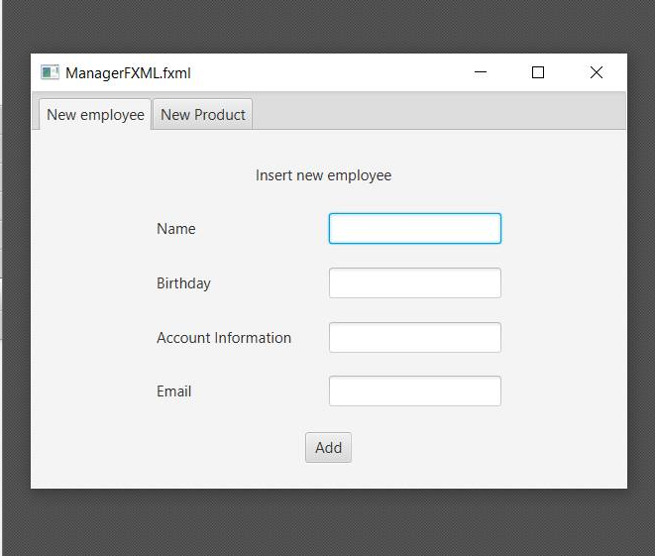

Slide 8
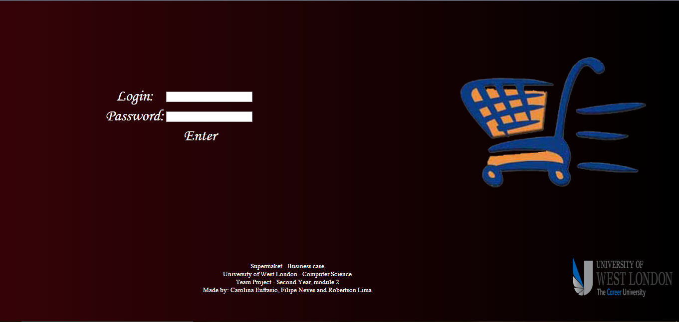

Slide 9
Payments
Two different types of payments:
Presential, at the supermarket
(credit/debit card, cash)
In the website
(credit/debit card, Paypal)

Slide 10
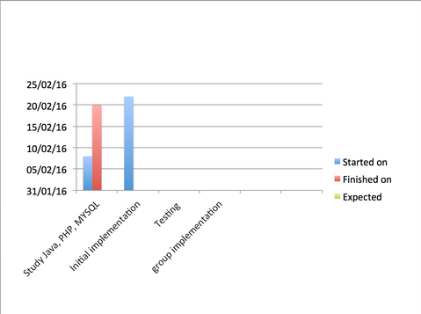
PLANNING

Slide 11
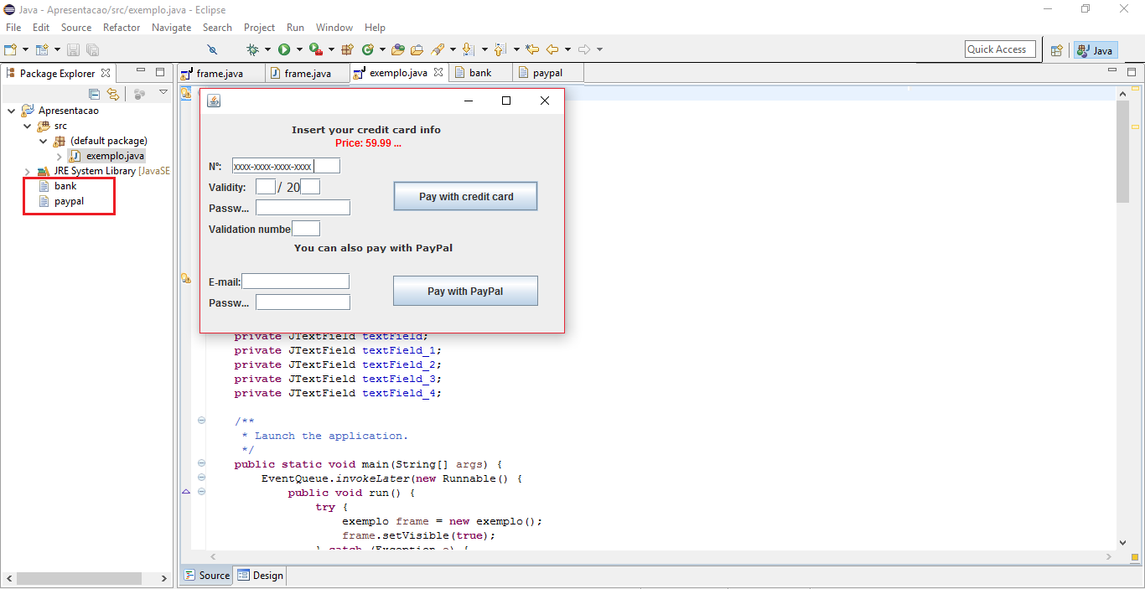

Slide 12
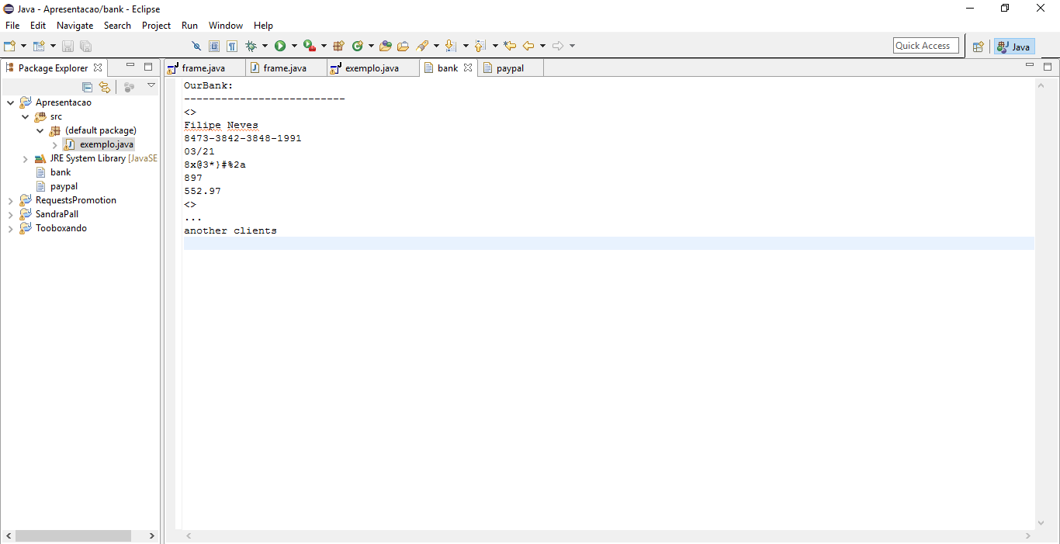

Slide 13
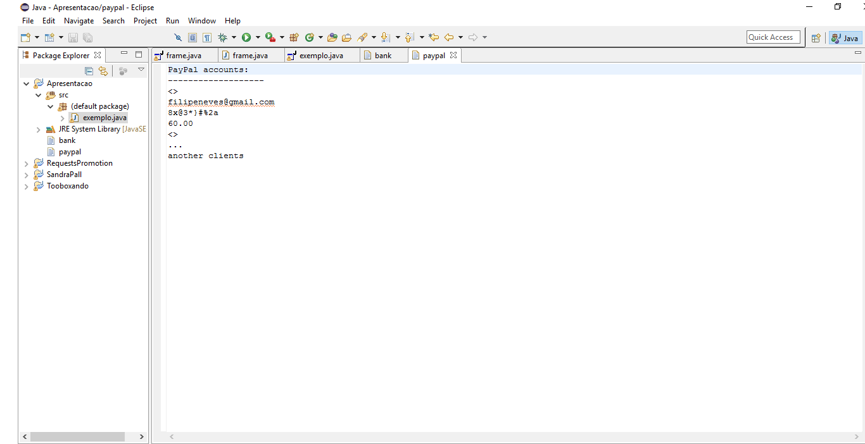

Slide 14
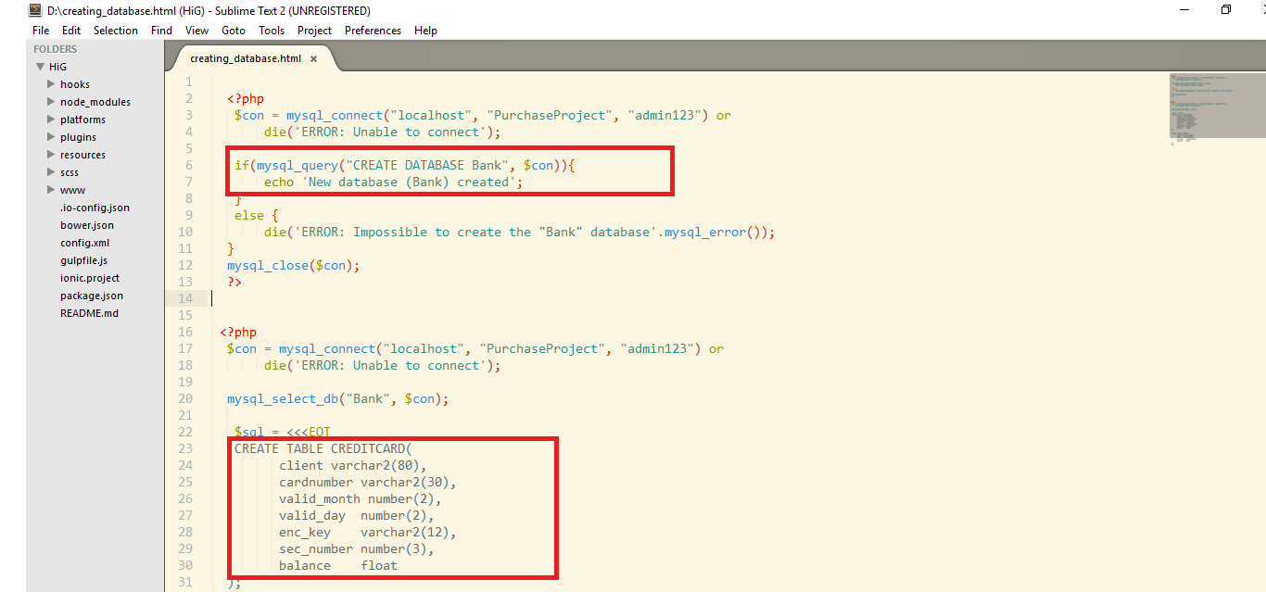

Slide 15
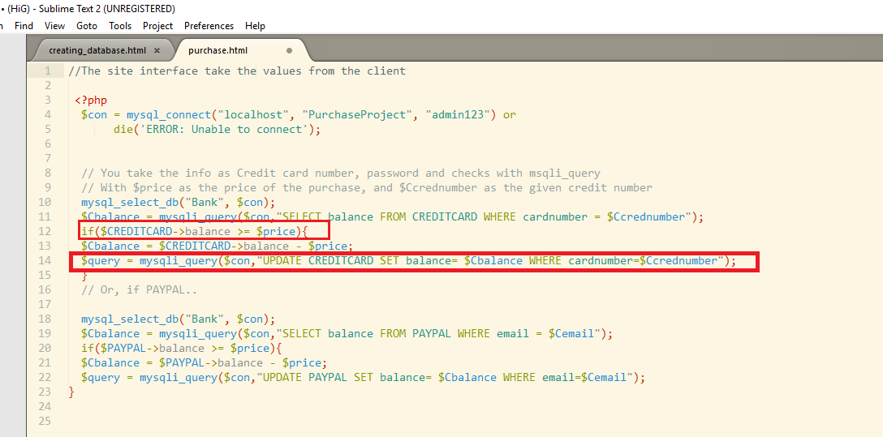

Slide 16
Loyalty Scheme
Different company
Independent website
Account number

Slide 17
Website
Independent database
Register and login areas
PHP HTML CSS AND MYSQL
Webserver attending requests

Slide 18
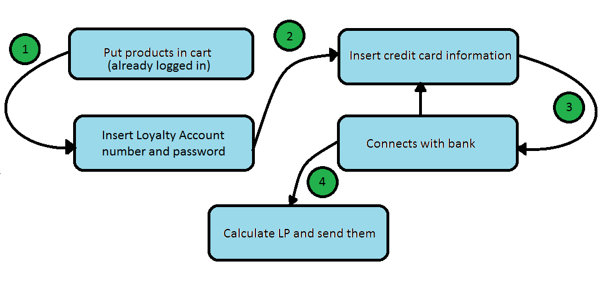
Flowchart

Slide 19
Individual tasks
Supermarket screens
Develop the Loyalty Scheme system
Test
Connect it with the supermarket system
Give support to the group members, search for bugs and fix them (Quality assurance).

Slide 20
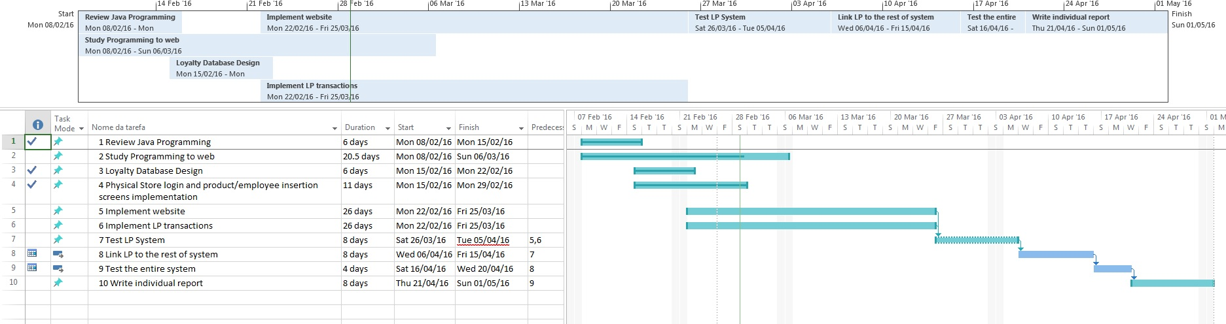
Schedule

Slide 21
Supplier scheme
After all the others actions
New table Replacements
System contacts the suppliers

Slide 22
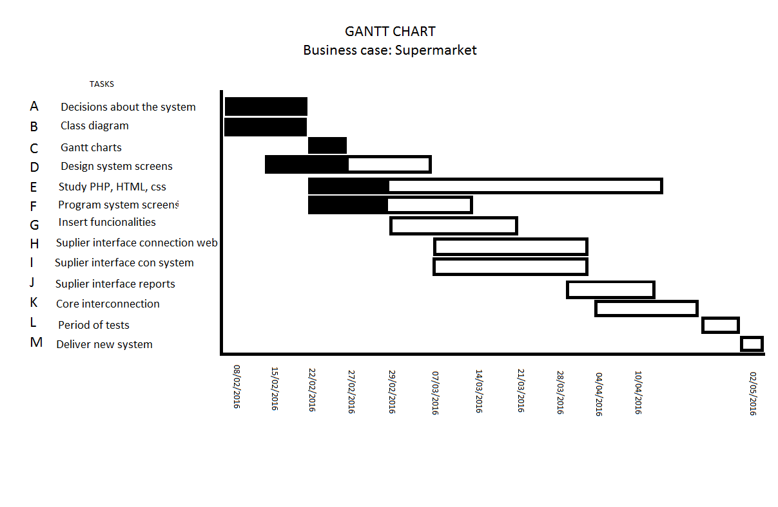
Schedule

Slide 23
Individual tasks
Web site screens
Connection to the database
Develop the Supplier Scheme
Test
Project manager

Slide 24
QUESTIONS?

