Slide 1



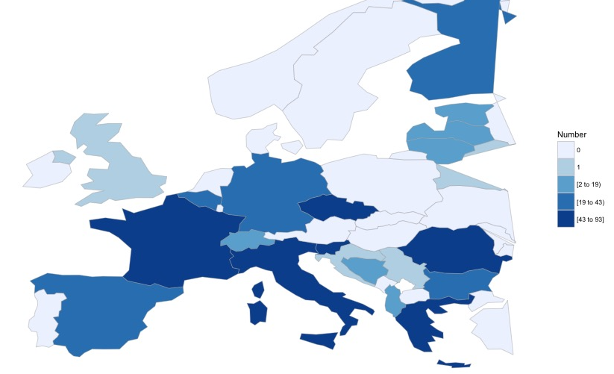
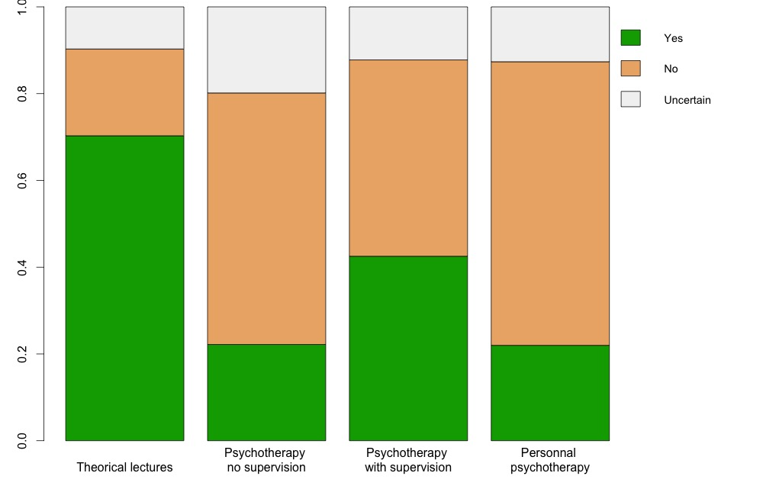
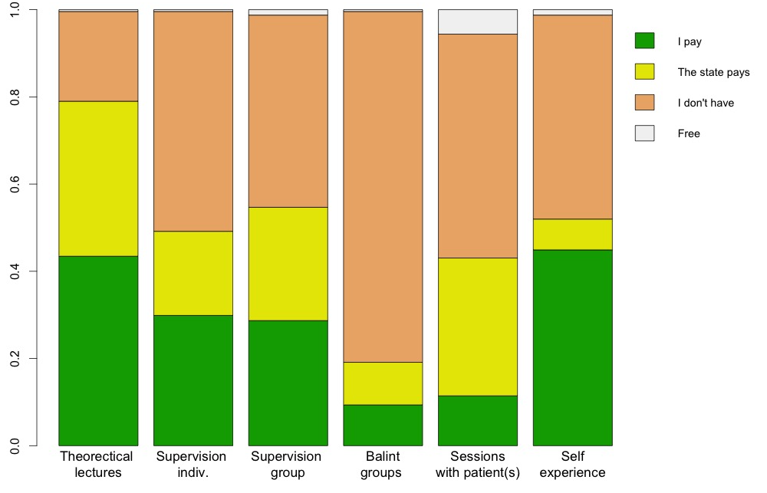
Thomas Gargot, France Ekin Sönmez, Turkey Clément Dondé, France Nikitas Arnaoutoglou, UK Milos Lazarevic, Serbia Petra Marinova, Bulgaria Rita Silva, Portugal David de Freitas Pereira, Belgium Tânia Abreu, Portugal. EFPT Psychotherapy Working Group, Brussels, Belgium Diego Quattrone, UK Roberts Klotins, UK
What is the actual status of psychotherapy training in Europe?
http://efpt.eu/wg/psychotherapy-wg/
psychotherapy-wg@efpt.eu
Motivations
The European Federation of Psychiatric Trainees (EFPT) aimed to evaluate the actual psychotherapy availabilities in Europe for psychiatry trainees and the implementation of the European Union of Medical Specialists (UEMS) guidelines in their training.
Demography
From 2013 to 2015, the EFPT collected 574 answers (Fig 1.) from trainees of 23 European countries with an on-line survey.
The mean age of respondents was 32 years (SD:5,3). 70 % were female. 84% of respondents were still trainees.
Fig 1. Number of answers by country
Psychiatry trainees are motivated to train in psychotherapy even if they need to invest time and money.
92 % of trainees considered psychotherapy as important for their professional identity.
90 % would like to practise psychotherapy after their training.
96 % would train for free. 50 % intend to spend up to 5 % of their salary for psychotherapy training.
Psychoanalysis, CBT and Systemic Therapy were the most popular schools of psychotherapy.
However, in practice the possibilities are quite low
For most trainees, only theoretical lectures are mandatory (Fig. 2).
Consequently, only 52 % of trainees were training (or trained) in psychotherapy.
41 % underwent personal psychotherapy.
33 % undertook psychotherapy training on their own initiative.
Whereas more than 1.7 hours of supervision per month are recommended by UEMS, 50 % don’t get any hour during the month.
Whereas training in psychotherapy is recommended by UEMS as a mandatory component of curriculum, most trainees don’t receive any or need to pay for it (Fig. 3.).
Fig 2. Mandatory training
Perspectives
EFPT strongly supports initiatives for better psychotherapy training and thinks that wider availability of good quality e-learning resources and international collaborations exemplified by EPA and ECNP could be a step to bridge this gap.
Fig 3. Who pays the training

