Slide 1
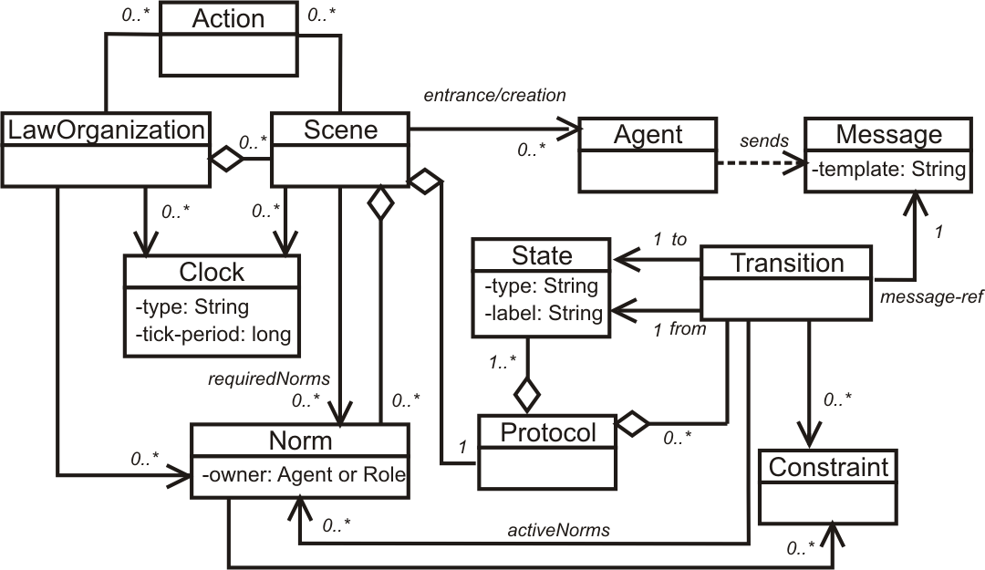
Monitoring laws on interactions
<Laws>
<LawOrganization id="…" name="…">
<Scene id="…" time-to-live="…">
<Creators>…</Creators>
<Entrance>
<Participant role="…" limit="…"/>
</Entrance>
<Messages>…</Messages>
<Protocol>
<States> … </States>
<Transitions>…</Transitions>
</Protocol>
<Norms>... </Norms>
<Clocks>...</Clocks>
<Actions>...</Actions>
</Scene>
</LawOrganization>
</Laws>
Agent A
Agent B
Law Governance
Mechanism

