Slide 1
Governance Frameworks for Open MAS
Gustavo Carvalho, Carlos Lucena
{guga,lucena}@inf.puc-rio.br

Slide 2
The technical problem
The greater the dependence of our society on open distributed applications, the greater will be the demand for dependable applications and also for new solutions that are variations of previously existing ones.
  Firstly, we should guarantee that errors in specific components will not be propagated to others.
  Secondly, one of the challenges of software development is to produce software that is designed to evolve, and so be extended, therefore reducing the maintenance efforts.
Notes:
Justification of importance

Slide 3
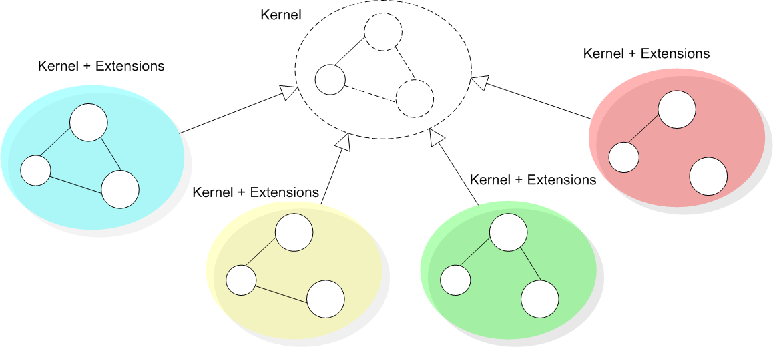
My proposal
We are addressing the problem of constructing a family of governance mechanisms that ensure that agents will conform to a well defined customizable specification.
  Governance for open systems means that specifications are enforced dynamically at application run-time.
  Our main goal is to contribute on the engineering on how we can productively define and reuse laws.

Slide 4
The research analogy
A framework is a set of abstract and concrete elements that embody a semi-complete solution.
  A framework instance is a set of concrete elements that specializes abstract elements to provide an executable system.
Governance frameworks may demonstrate in practice the ability to gauge enforcement (apply enforcement or, when needed, to relax enforcement) for both complex and changing specifications.
  Besides customizations, the compliance of the system to the specification must continue to be analyzed by a mechanism that governs the laws of interactions in open MAS.

Slide 5
The research hypothesis
Open MAS governance mechanism should be specified and developed to facilitate extensions.
  Since software systems need to be customized according to different purposes and peculiarities, it is possible to express evolution as:
    variations related to interactions of open systems and
    variations related to components that inhabit the environment.
  We propose to design open systems using extension points [8] to customize the definition of agents’ expected behavior.
    Extension points helps to specify elements that can be reused with predefined “hooks” that can be refined to develop a set of open MAS governance mechanisms according to variation regarding a specific domain.
  For component variation support, we propose to use specifications of agent roles [14][16][23].

Slide 6
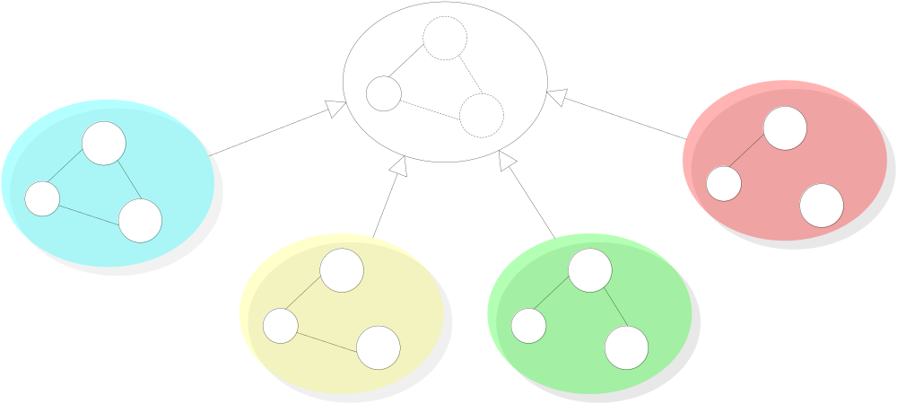
Governace Framework Overview
Evolution in time - Versioning support
version 4
version 1
version 2
version 3
Notes:
Suppose that you have the specification of the kernel of a general solution that can be customized to different purposes (Fig). In this kernel, you have the exact points that can be modified and enhanced. By this solution, it is possible to derive a family of governance mechanisms that share a core specification and implementation. This customization can be used for two purposes. You can have different governance mechanisms derived for different purposes or you can have different versions of a governance mechanism that are instanciated during its lifecycle.

Slide 7
Governace Framework Overview
Extensions according applications in a specific domain
app 4
app 1
app 2
app 3
Notes:
Suppose that you have the specification of the kernel of a general solution that can be customized to different purposes (Fig). In this kernel, you have the exact points that can be modified and enhanced. By this solution, it is possible to derive a family of governance mechanisms that share a core specification and implementation. This customization can be used for two purposes. You can have different governance mechanisms derived for different purposes or you can have different versions of a governance mechanism that are instanciated during its lifecycle.

Slide 8
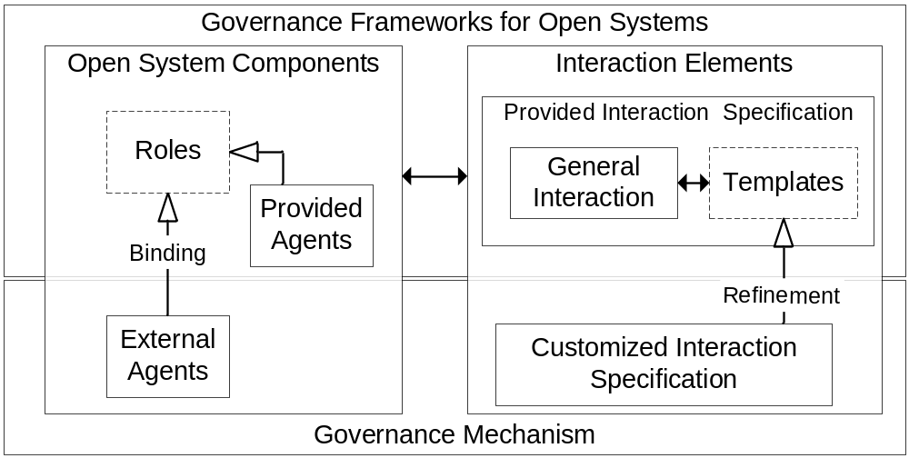
A sketch of the proposed solution

Slide 9
Extension Operators
type=“abstract” define when a law element is not completely implemented (have hooks) or must be better defined to be used.
completes – fill the “hooks” that were left unspecified
extends – reuses the description of law elements and includes or superposes modifications
<Permission id=“APRFQ2004” completes="AssemblerPermissionRFQ">
<Constraint id="checkCounter"
class="tacscm.norm.constraints.CounterLimit"/>
<Action id="orderID“
class="tacscm.norm.actions.RFQCounter“/>
</Permission>
<Permission id=“APRFQ2004” completes="AssemblerPermissionRFQ">
<Constraint id="checkCounter"
class="tacscm.norm.constraints.CounterLimit2005"/>
<Action id="orderID“
class="tacscm.norm.actions.RFQCounter2005“/>
</Permission>
<Permission id="AssemblerPermissionRFQ“ type=“abstract”>
<Owner>Assembler</Owner>
<Activations>
<Element ref="negotiation"
event-type="scene_creation"/>
</Activations>
<Deactivations>
<Element ref="orderTransition"
event-type="transition_activation"/>
</Deactivations>
<Constraints>
<Constraint id="checkCounter"/>
</Constraints>
<Actions>
<Action id="permissionRenew"
class="tacscm.norm.actions.ZeroCounter">
<Element ref="nextDay" event-type="clock_tick"/>
</Action>
<Action id="orderID">
<Element ref="rfqTransition"
event-type="transition_activation"/>
</Action>
</Actions>
</Permission>

Slide 10
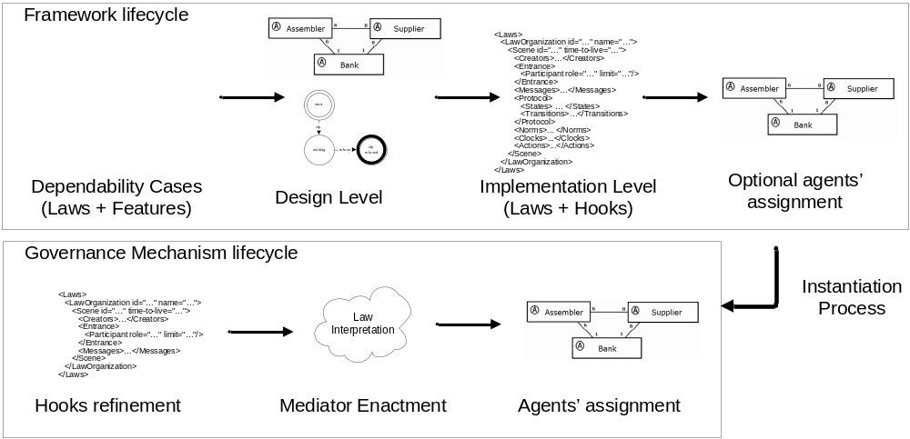
Method Overview

Slide 11
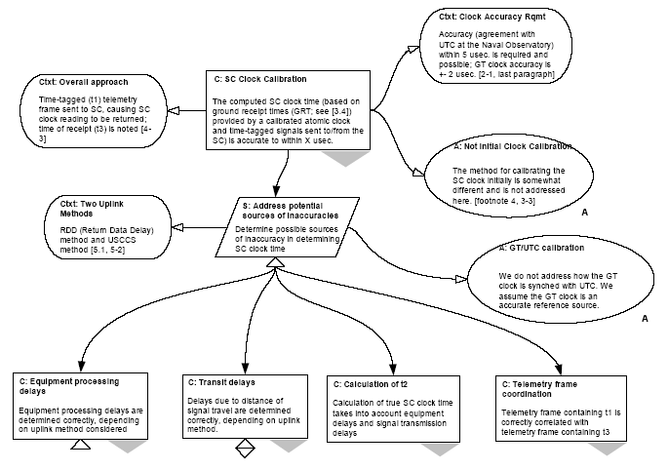
Dependability Cases

Slide 12
The expected contributions
Improve the quality of governance mechanisms of open systems
  Helping the customization of governance mechanisms
Methodological approach
  We are going to apply and extend dependability cases to document the decisions regarding law specification.
  We are going to study how object-oriented frameworks methodologies can help to develop governance mechanisms.

Slide 13
Ongoing work
Reengineering of XMLaw
Improvements and implementation of extension operators and the composition element
Documentation
  The study on how we can use dependability cases to document requirements and design decisions on law specifications
    Is it possible to specify framework's features using dependability cases?

Slide 14
Plan for evaluating the work
We will propose some metrics to evaluate when extensible points are useful.
  Compare the cost of extensions and the benefits of our proposal.
Case studies
  Replication strategies
  Integration tests
  Exception notification
  Virtual organizations - SELIC

Slide 15
Case Study
Exception Notification
  Monitor agents interactions, signaling exceptions to agents, i.e., interactions that were not specified in laws.
Wait for messages
Query Context
Apply Laws
Update Context
[not conform]
[ok]
Redirect Message
Inform Agent
(Signal exception)

Slide 16
Case Study
Integration Tests
  Monitor agents interactions, collecting information about the execution of agents to help understanding errors, for further analyses and diagnosis or to generate reports.
Wait for messages
Query Context
Apply Laws
Update Context
[not conform]
[ok]
Collect Information
Collect Information
Block Message
Redirect Message
Report error

Slide 17
Case Study
Replication strategy
  Monitor agents interactions, monitoring agents criticality to decide when new replicas are needed or are not needed anymore.
Wait for messages
Query Context
Apply Laws
Update Context
[not conform]
[ok]
Block Message
Add Replica ?
Report error
Remove Replica ?
Redirect Message

Slide 18
Case Study - SELIC
A motivação para este estudo é uma aplicação real do BC, o SELIC.
O SELIC desempenha importante papel no Sistema de Pagamentos Brasileiro (SPB)
  Sistema eletrônico que processa o registro e a liquidação financeira das operações realizadas com esses títulos.
  São efetuados os leilões de títulos emitidos pelo Tesouro Nacional ou pelo Bacen.
  Possui inúmeras restrições e regras de negócio que serão mapeadas para leis.
  Atualmente o sistema está em processo de migração de mainframe para java.
  No SPB, as instituições titulares da conta Reservas Bancárias, o Bacen e as câmaras e sistemas de liquidação comunicam-se por meio de mensagens.
    Em nosso estudo de caso, cada participante do SPB será um agente de software;
Sujeitas a alterações !

Slide 19
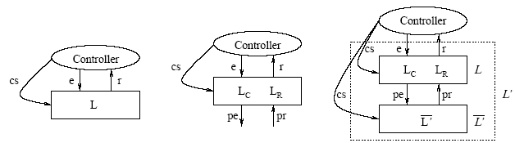
Related Work
Ao and Minsky [2] propose an approach that enhances LGI with the concept of policy-hierarchy to support that different internal policies are formulated independently of each other, achieving a flexibility support by this means.
  Different from our approach, Ao and Minsky consider confidentiality as a requirement for their solution.
  The goal of the extensions that we have presented until now is to support open system law maintenance, rather than flexibility for the purpose of confidentiality.

Slide 20
Related Work
All of these approaches are useful instruments to promote reuse, they can be seen as instruments for specifying extendable laws in governance frameworks.
  COSY [13] views a protocol as an aggregation of primitive protocols.
    Each primitive protocol can be represented by a tree where each node corresponds to a particular situation and transitions correspond to possible messages an agent can either receive or send, i.e., the various interaction alternatives.
  In AgenTalk [17], protocols inherit from one another.
    They are described as scripts containing the various steps of a possible sequence of interactions. Beliefs also are embedded into scripts.
  Koning and Huget [15] deal with the modeling of interaction protocols for multi-agent systems, outlining a component-based approach that improves flexibility, abstraction and protocol reuse.

Slide 21
Related Work
Singh [18] proposes a customizable governance service, based on skeletons.
  His approach formally introduces traditional scheduling ideas into an environment of autonomous agents without requiring unnecessary control over their actions, or detailed knowledge of their designs.
  Skeletons are equivalent to state based machines and we could try to reuse their formal model focusing on the implementation of a family of applications.
  But [18] has few implementation details and examples which could allow us to understand how his proposal was implemented.

Slide 22
Submitted Papers
CARVALHO, Gustavo; LUCENA, Carlos. A Governance Framework for Instantiating Supply Chain Management Applications as Open Systems. Submitted to AAMAS 2006.
CARVALHO, Gustavo; LUCENA, Carlos. Implementing Supply Chain Management Applications as Open Systems. Submitted to Journal AAMAS.
Accepted Papers
  CARVALHO, Gustavo; PAES, Rodrigo; LUCENA, Carlos; Extensions on Interaction Laws in Open Multi-Agent Systems. First Workshop on Software Engineering for Agent Oriented Systems, Brazilian Symposium on Software Engineering (SBES2005). Uberlândia, Brazil, Outubro 03, 2005.
  RODRIGUES, Luiz Fernando; CARVALHO, Gustavo; PAES, Rodrigo; LUCENA, Carlos; Towards an Integration Test Architecture for Open MAS. First Workshop on Software Engineering for Agent Oriented Systems, Brazilian Symposium on Software Engineering (SBES2005). Uberlândia, Brazil, Outubro 03, 2005.
  PAES, Rodrigo de Barros; CARVALHO, Gustavo Robichez de; LUCENA, Carlos José Pereira de; ALENCAR, Paulo S. C.; ALMEIDA, Hyggo Oliveira de; SILVA, Viviane Torres da. Specifying Laws in Open Multi-Agent Systems. In: Agents, Norms and Institutions for Regulated Multiagent Systems (ANIREM), 2005, Utrecht, The Netherlands.
  Gustavo Carvalho, Rodrigo Paes, Ricardo Choren, Paulo Alencar e Carlos Lucena. Increasing Software Infrastructure Dependability through a Law Enforcement Approach. 1st International Symposium on Normative Multiagent Systems (NorMAS2005).
  PAES, Rodrigo de Barros, CARVALHO, Gustavo Robichez, ALMEIDA, H.O., LUCENA, Carlos José Pereira, ALENCAR, Paulo C.S.; A conceptual architecture for law-governed open multi-agent systems. Anais do Simposio Argentino de Ingeniería de Software (ASSE 2004) - 33 Jornadas Argentinas de Informática e Investigación Operativa (33 JAIIO). Marcelo Campo, Jorge Boria. Sociedad Argentina de Informática e Investigación Operativa, SADIO. Cordoba, Argentina. 20 a 24 de setembro de 2004, Córdoba, Argentina. Proceedings em CD
  Gustavo Carvalho, Rodrigo Paes, Ricardo Choren, Carlos Lucena. Towards a Risk Driven Method for Developing Law Enforcement Middleware. Proceedings of the Third International Workshop on Agent-Oriented Methodologies - 19th Annual ACM Conference on Object-Oriented Programming, Systems, Languages, and Applications (OOPSLA 2004). Cesar Gonzalez-Perez, Centre for Object Technology Applications and Research, COTAR, Sydney, Austrália. 24 a 28 de outubro de 2004, Vancouver, Canadá, ISBN: 0-9581915-4-9, páginas: 75-86. Refereed Publications In Conference Proceedings

Slide 23
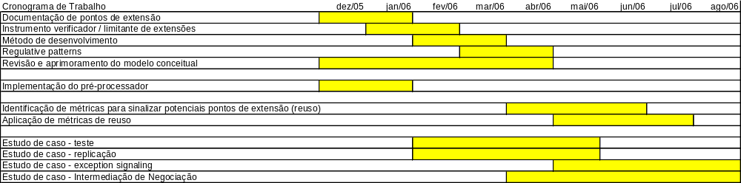
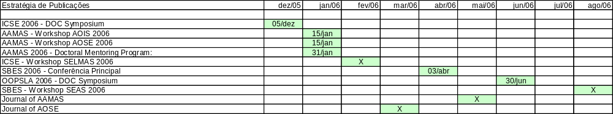
Cronograma de Estudos / Publicações

