Slide 1
Extending laws to consider criticality monitoring
Gustavo Carvalho
guga@les.inf.puc-rio.br
Maira Gatti
mgatti@les.inf.puc-rio.br

Slide 2
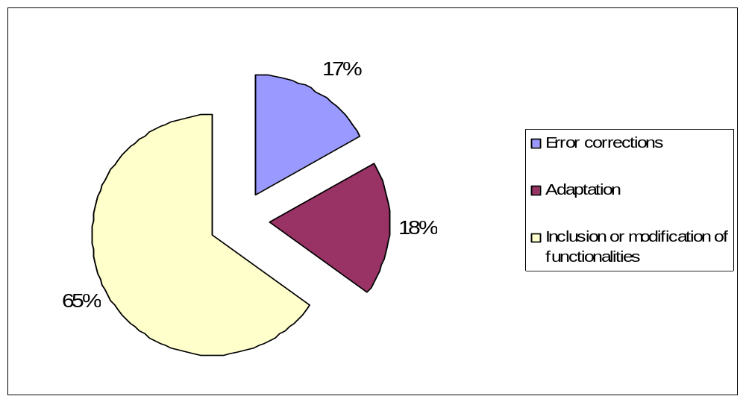

Development costs
Sommerville, Software Engineering, 7th edition.

Slide 3
Our Law Approach – Main Concerns
Requirements
  Requirement documentation
Analysis and Design
  Design of Open MAS focusing on reuse
Implementation
  XMLaw Code (with some mantainability support)
Test
  Unit / Integration Tests
Requirement
Design
Implementation
Test

Slide 4
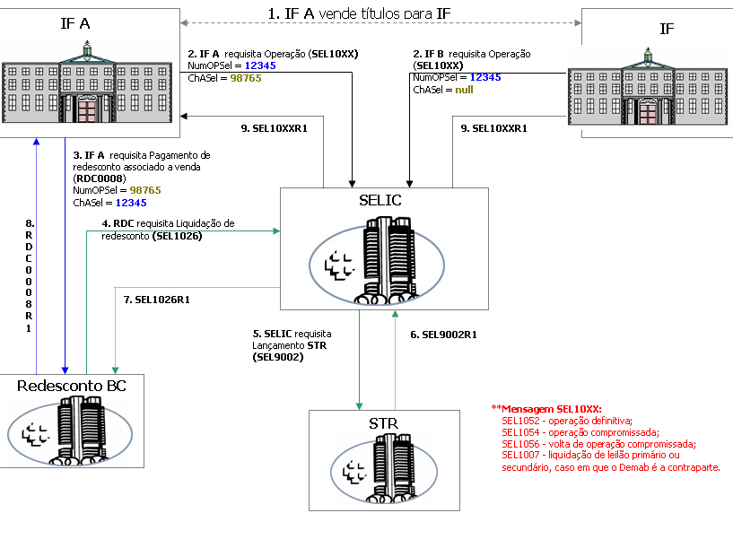
Example

Slide 5
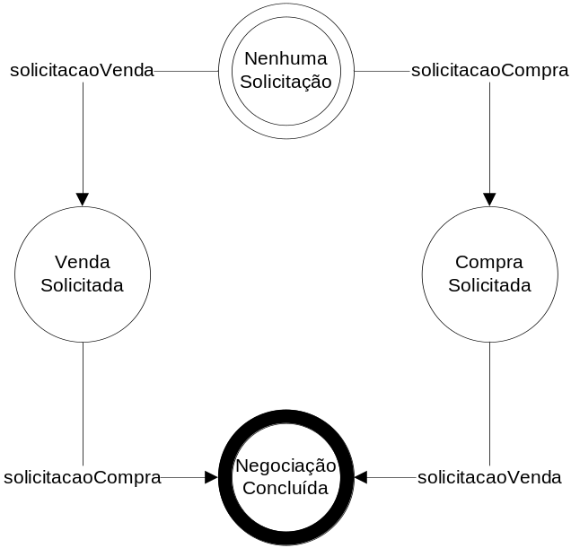
Designing & Implementing the example…
<LawOrganization id="bc" name="Banco Central">
<Role id="comprador" />
<Role id="vendedor" />
<Scene id="negociacao" time-to-live="infinity">
<xi:include href="./SELIC-Protocol.xml"/>
<Creators>
<Creator role_ref="comprador"/>
<Creator role_ref="vendedor"/>
</Creators>
<Entrance>
<Participant role_ref="comprador" limit="1">
<State ref="nenhumaSolicitacao"/>
<State ref="vendaSolicitada"/>
</Participant>
<Participant role_ref="vendedor" limit="1">
<State ref="nenhumaSolicitacao"/>
<State ref="compraSolicitada"/>
</Participant>
</Entrance>
</Scene>
</LawOrganization>

Slide 6
Designing & Implementing the example
<Protocol id="negotiation-protocol">
<Messages>
<Message id="solicitacaoCompraMsg" performative="inform">
<Content>
<Entry key="CodMsg" />
<Entry key="NumCtrlIF" /> <Entry key="ISPBIF" />
<Entry key="NumOpSEL" /> <Entry key="DtOp" />
<Entry key="CtCed" />
<Entry key="CtCes" />
<Entry key="TpDeb_Cred" /> <Entry key="IFLiqdantCed" /> <Entry key="IFLiqdantCes" /> <Entry key="IdentdTitSEL" /> <Entry key="DtVenc" />
<Entry key="PU" />
<Entry key="QtdTit" />
<Entry key="VlrFinanc" />
<Entry key="NivelPref" /> <Entry key="ChASEL" /> <Entry key="DtMovto" />
</Content>
<Sender role-ref="comprador" role-instance="$theSender" />
<Receivers>
<Receiver role-ref="vendedor" role-instance="$receiver" />
</Receivers>
</Message>
<Message id="solicitacaoVendaMsg" performative="inform">
<Content>…</Content>
<Sender role-ref="vendedor" role-instance="$receiver" />
<Receivers>
<Receiver role-ref="comprador" role-instance="$theSender" />
</Receivers>
</Message>
</Messages>
<States>
<State id="nenhumaSolicitacao" type="initial" label="Estado Inicial" />
<State id="compraSolicitada" type="execution"
label="Pedido de Compra Solicitado" />
<State id="vendaSolicitada" type="execution"
label="Pedido de Venda Solicitado" />
<State id="negociacaoFinalizada" type="success"
label="Negociacao Concluida" />
</States>
<Transitions>
<Transition id="solicitarCompra" from="nenhumaSolicitacao" to="compraSolicitada" ref="solicitacaoCompraMsg" event-type="message_arrival" />
<Transition id="solicitarVenda" from="nenhumaSolicitacao" to="vendaSolicitada" ref="solicitacaoVendaMsg" event-type="message_arrival" />
<Transition id="confirmarCompra" from="vendaSolicitada" to="negociacaoFinalizada" ref="solicitacaoCompraMsg" event-type="message_arrival" />
<Transition id="confirmarVenda" from="compraSolicitada" to="negociacaoFinalizada" ref="solicitacaoVendaMsg" event-type="message_arrival" />
</Transitions>
</Protocol>

Slide 7
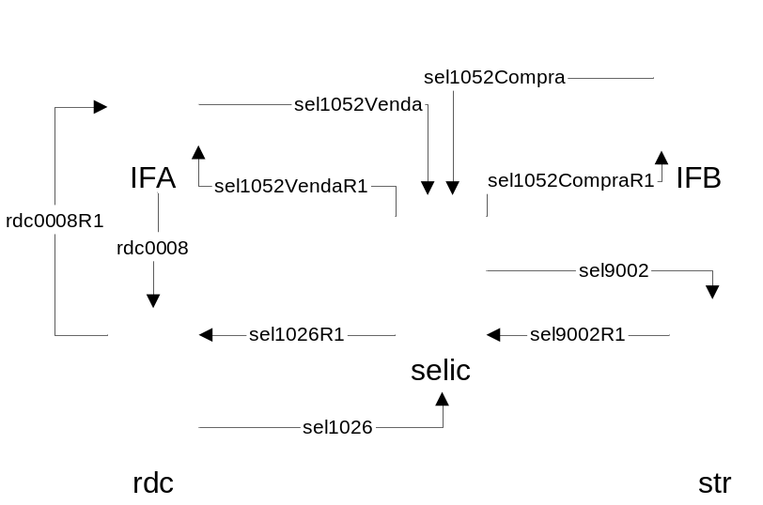
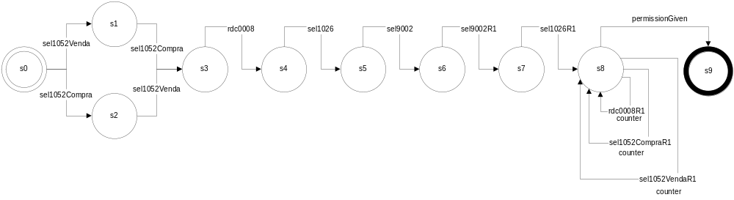
The whole picture

Slide 8
Now we have the basic design…
Why don’t we extend it to include criticality monitoring?

