Slide 1
Governance Frameworks for Open MAS
Gustavo Carvalho, Carlos Lucena
{guga,lucena}@inf.puc-rio.br

Slide 2
Outline
Technical problem to be solved
The research hypothesis
An overview and a sketch of the proposed solution
The expected contributions
Progress in solving the stated problem
Ongoing and future work
Plan for evaluating the work
Related work
Conclusion

Slide 3
The technical problem
Nowadays, software permeates every aspect of our society.
  It is increasingly becoming a distributed and open asset.
  Distribution means to integrate different software solutions that work cooperatively to achieve some users’ requirements.
  In many situations openness is a characteristic that is crucial for software.
    Open systems are software systems where autonomous distributed components interact and may enter and leave the environment at their will [12].
    Openness has led to software systems that can present an emergent or even unpredictable behavior [1].
    Auction systems and virtual enterprises are examples of such open and distributed applications [24].

Slide 4
The technical problem
The greater the dependence of our society on open distributed applications, the greater will be the demand for dependable applications and also for new solutions that are variations of previously existing ones.
  Firstly, we should guarantee that errors in specific components will not be propagated to others.
  Secondly, one of the challenges of software development is to produce software that is designed to evolve, and so be extended, therefore reducing the maintenance efforts.
Notes:
Justification of importance

Slide 5
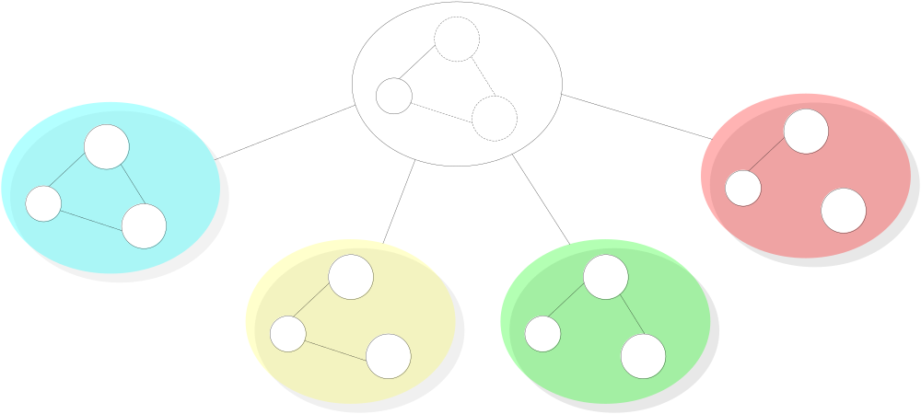
Motivation
Notes:
Suppose that you have the specification of the kernel of a general solution that can be customized to different purposes (Fig). In this kernel, you have the exact points that can be modified and enhanced. By this solution, it is possible to derive a family of governance mechanisms that share a core specification and implementation. This customization can be used for two purposes. You can have different governance mechanisms derived for different purposes or you can have different versions of a governance mechanism that are instanciated during its lifecycle.

Slide 6
The technical problem
Software agent technology is considered a promising approach for the development of open system applications [22].
Since software agents are often autonomous [24], sometimes they behave unpredictably and unforeseen situations arise.
Taming this uncertainty is a key issue for open software development. The specification of open multi-agent systems (open MAS) and the conformance verification mechanism help achieving more dependable systems. An specification includes the definition of agent roles and any other restrictions that the environment imposes on an agent to enter and participate in conversations. Agents are reused as they are required and as they conform to the specifications of the open MAS. The establishment of laws over interaction specification defines what and when something can happen in an open system. When enforced, laws create a boundary of tolerated autonomous behavior and are used to foster the development of trusted systems.
In this proposal, we will address the problem of constructing a family of governance mechanisms that ensure that agents will conform to a well defined customizable specification. Our main goal is to contribute on the engineering on how we can productively define and reuse laws.

Slide 7
The research hypothesis
Open MAS governance mechanism should be specified and developed to facilitate extensions.
  Since software systems need to be customized according to different purposes and peculiarities, the authors think that it is possible to express evolution as:
    variations related to interactions of open systems and
    variations related to components that inhabit the environment.
  Following this hypothesis, we propose to design open systems using extension points [8] to customize the definition of agents’ expected behavior. Extension points helps to specify elements that can be reused with predefined “hooks” that can be refined to develop a set of open MAS governance mechanisms according to variation regarding a specific domain.
  For component variation support, we propose to use specifications of agent roles [14][16][23].

Slide 8
The research hypothesis
We are proposing governance frameworks based on some object-oriented framework concepts.
A framework is a set of abstract and concrete elements that embody a semi-complete solution. A framework instance is a set of concrete elements that specializes abstract elements to provide an executable system.
  An object-oriented framework [11] metaphor provides the necessary modeling capabilities for constructing reusable implementations of governance mechanisms.
  The motivation for proposing the framework metaphor is to simplify the design and maintenance of a family of governance mechanisms and to address the needs for highly customizable applications in an economical manner [5].
Governance frameworks may demonstrate in practice the ability to apply enforcement (or, when needed, to relax enforcement) for both complex and changing specifications.
  Besides customizations, the compliance of the system to the specification must continue to be analyzed by a mechanism that governs the laws of interactions in open MAS.
  We use the XMLaw description language [19] to map the specification of interaction rules into a governance mechanism.

Slide 9
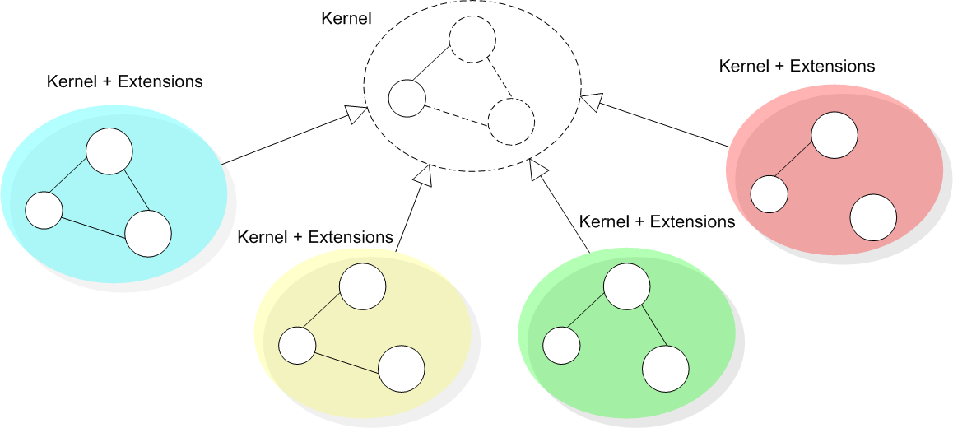
Governace Framework Overview
Notes:
Suppose that you have the specification of the kernel of a general solution that can be customized to different purposes (Fig). In this kernel, you have the exact points that can be modified and enhanced. By this solution, it is possible to derive a family of governance mechanisms that share a core specification and implementation. This customization can be used for two purposes. You can have different governance mechanisms derived for different purposes or you can have different versions of a governance mechanism that are instanciated during its lifecycle.

Slide 10
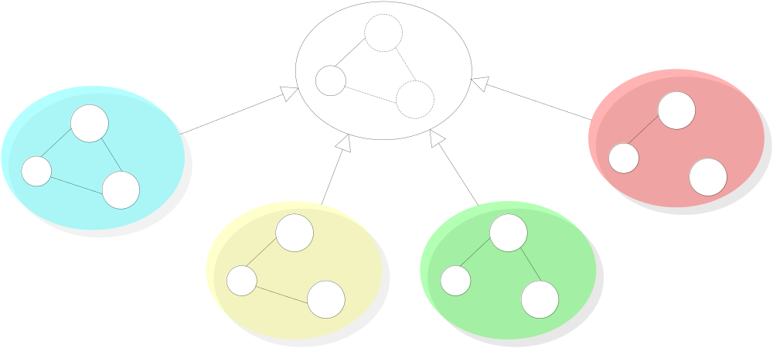
Governace Framework Overview
Evolution in time - Versioning support
version 4
version 1
version 2
version 3
Notes:
Suppose that you have the specification of the kernel of a general solution that can be customized to different purposes (Fig). In this kernel, you have the exact points that can be modified and enhanced. By this solution, it is possible to derive a family of governance mechanisms that share a core specification and implementation. This customization can be used for two purposes. You can have different governance mechanisms derived for different purposes or you can have different versions of a governance mechanism that are instanciated during its lifecycle.

Slide 11
Governace Framework Overview
Extension according application domain
app 4
app 1
app 2
app 3
Notes:
Suppose that you have the specification of the kernel of a general solution that can be customized to different purposes (Fig). In this kernel, you have the exact points that can be modified and enhanced. By this solution, it is possible to derive a family of governance mechanisms that share a core specification and implementation. This customization can be used for two purposes. You can have different governance mechanisms derived for different purposes or you can have different versions of a governance mechanism that are instanciated during its lifecycle.

Slide 12
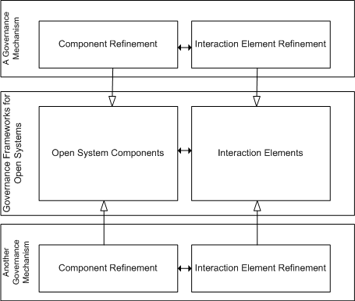
An overview of the proposed solution

Slide 13
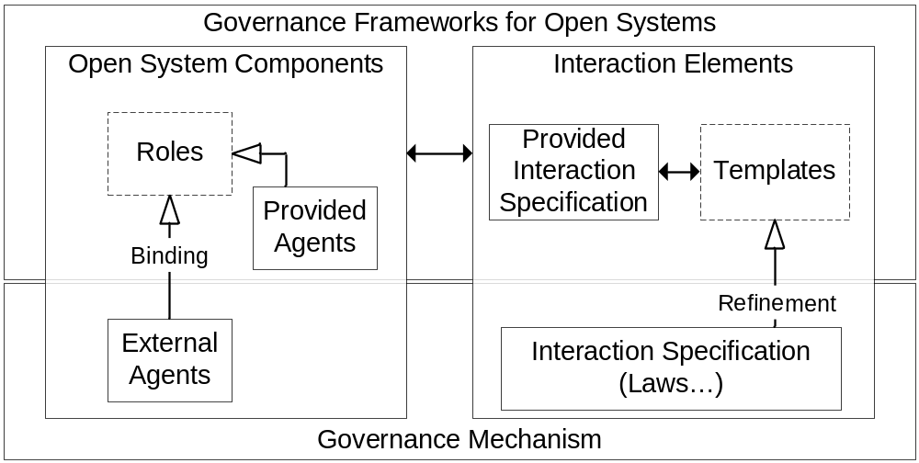
A sketch of the proposed solution

Slide 14
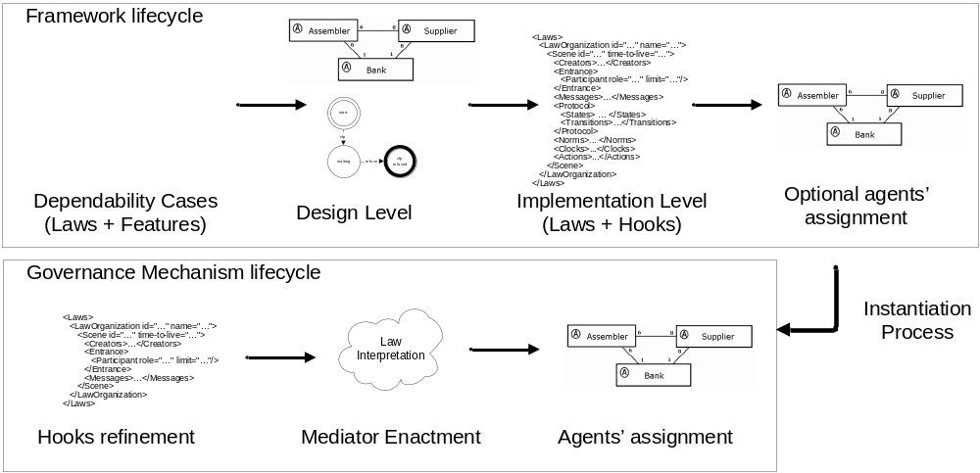
Method Overview

Slide 15
The expected contributions
Improve the quality of distributed systems in open systems
  Providing a customizable conformance verification mechanism
Improve the quality of governance mechanisms of open systems
  Helping the customization of governance mechanisms
  We propose to use variations and laws to specify, implement and maintain extension points in governance mechanisms for open systems.
  We support the implementation of these variations using a law-governed mechanism.
Methodological approach
  We are going to apply and extend dependability cases to document the decisions regarding law specification.
  We are going to study how object-oriented frameworks methodologies can help to develop governance mechanisms.
Study of the reuse perspectives of governance mechanisms
  Application domain variation - Reuse and customization of law specifications
    Worked on this
  Governance pattern - Reuse and customization of governance mechanism
    Some insigths

Slide 16
Progress in solving the stated problem
The implementation of a supply chain application using our law-governed approach.
  Submitted to Journal of Autonomous Agents
The proposal of extension points and how to apply extension points with XMLaw
  SEAS 2005
The proposal of using the governance mechanism for the integration tests of distributed agents
  SEAS 2005
The implementation of a governance framework for supply chain management
  Submitted to Autonomous Agents 2006
    A proof of concept prototype has been developed based on the specification of the Trading Agent Competition - Supply Chain Management (TAC SCM) [3][10][21].
      This example discussed how the changes to the laws of open MAS applications can be represented as templates that structurally “hook” the extension points into the interaction protocol.
      The goal of this study is to approach the TAC SCM structure by considering it an open system and, through the analysis of its specifications, we learned about how to extend the interaction specification and compliance verification in open system applications.
      The main purpose of that investigation was to specify, analyze and develop open software systems using extension points.
Modularizing XMLaw elements
  The proposal of extension operators in XMLaw, improvements on 3.
    Governance Seminar on Open MAS, to be submitted...
    abstract, completes and extends operators
  The proposal of a composition element in XMLaw
    Governance Seminar on Open MAS, to be submitted...
    Connectors

Slide 17
Ongoing work
Reengineering of XMLaw
Implementation of extension operators and the composition element
The study on how we can use dependability cases to document requirements and design decisions on law specifications
  Is it possible to specify framework's features using dependability cases?
The understanding on how we can use services as components of governance frameworks
  LawAwareness service

Slide 18
Future work
Work on improvements on the governance framework approach
Develop some metrics to help in the identification/decision/choice of extension points
Identify and develop more case studies

Slide 19
Plan for evaluating the work
We will propose some metrics to evaluate when extensible points are useful.
  Compare the cost of extensions and the benefits of our proposal.
Case studies
  Virtual organizations
  Replication strategies
  Integration tests
  Exception notification
Submission Plan
  Doc Simposium ICSE / AAMAS / OOPSLA / ECOOP

Slide 20
Related Work
Ao and Minsky [2] propose an approach that enhances LGI with the concept of policy-hierarchy to support that different internal policies are formulated independently of each other, achieving a flexibility support by this means.
  Different from our approach, Ao and Minsky consider confidentiality as a requirement for their solution.
  The goal of the extensions that we have presented until now is to support open system law maintenance, rather than flexibility for the purpose of confidentiality.

Slide 21
Related Work
All of these approaches are useful instruments to promote reuse, they can be seen as instruments for specifying extendable laws in governance frameworks.
  COSY [13] views a protocol as an aggregation of primitive protocols.
    Each primitive protocol can be represented by a tree where each node corresponds to a particular situation and transitions correspond to possible messages an agent can either receive or send, i.e., the various interaction alternatives.
  In AgenTalk [17], protocols inherit from one another.
    They are described as scripts containing the various steps of a possible sequence of interactions. Beliefs also are embedded into scripts.
  Koning and Huget [15] deal with the modeling of interaction protocols for multi-agent systems, outlining a component-based approach that improves flexibility, abstraction and protocol reuse.

Slide 22
Related Work
Singh [18] proposes a customizable governance service, based on skeletons.
  His approach formally introduces traditional scheduling ideas into an environment of autonomous agents without requiring unnecessary control over their actions, or detailed knowledge of their designs.
  Skeletons are equivalent to state based machines and we could try to reuse their formal model focusing on the implementation of a family of applications.
  But [18] has few implementation details and examples which could allow us to understand how his proposal was implemented.

Slide 23
Engineering Law-Governed Approaches
How to reuse, extend and compose interaction specifications
Gustavo Carvalho, Carlos Lucena
{guga,lucena}@inf.puc-rio.br
Seminar
Governance in Open MAS

Slide 24
Monitoring laws on interactions
Laws
defines
Organization
Agent B
Agent A
interaction

Slide 25
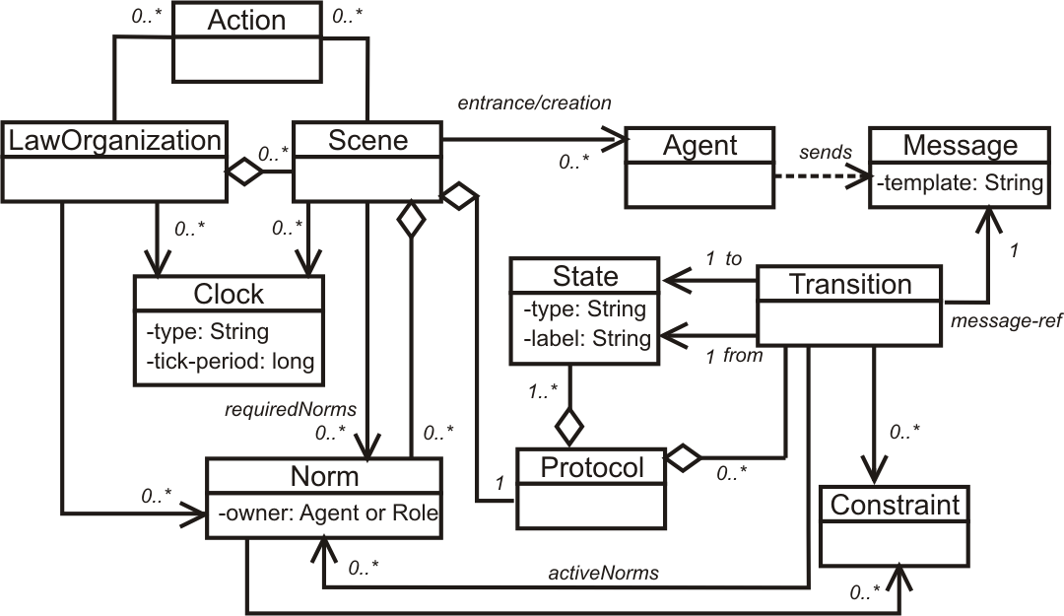
XMLaw
<Laws>
<LawOrganization id="…" name="…">
<Scene id="…" time-to-live="…">
<Creators>…</Creators>
<Entrance>
<Participant role="…" limit="…"/>
</Entrance>
<Messages>…</Messages>
<Protocol>
<States> … </States>
<Transitions>…</Transitions>
</Protocol>
<Norms>... </Norms>
<Clocks>...</Clocks>
<Actions>...</Actions>
</Scene>
</LawOrganization>
</Laws>

Slide 26
Problem statement
Nowadays, we do not have much support on the reuse of law specifications.
We can point to specifications but we can not extend or configure them.
<Organization id="exim1" name="Example Org 1">
<Scene id="ExchangeInfo" time-to-live="infinity">
<Creators>...</Creators>
<Entrance>... </Entrance>
<Messages>... </Messages>
<Protocol>
<States>... </States>
<Transitions>
<Transition id="normalCom" …/>
<Transition id="AnotherCom" …/>
<Transition id="externalCom" …>
<Constraints>
<Constraint id="checkForeigner“
class="checkForeigner1"/>
</Constraints>
</Transition>
<Transition id="AnotherExternalCom" …>
<Constraints>
<Constraint id="checkForeigner“
class="checkForeigner1"/>
</Constraints>
</Transition>
<Transition id="quitting" .../>
</Transitions>
</Protocol>
</Scene>
<Role id="agent"/>
<Role id="foreignAgent"/>
</Organization>
<Organization id="exim2" name="Example Org 2">
<Scene id="ExchangeInfo2" time-to-live="infinity">
<Creators>...</Creators>
<Entrance>... </Entrance>
<Messages>... </Messages>
<Protocol>
<States>... </States>
<Transitions>
<Transition id="normalCom" …/>
<Transition id="AnotherCom" …/>
<Transition id="externalCom" …>
<Constraints>
<Constraint id="checkForeigner“
class="checkForeigner2"/>
</Constraints>
</Transition>
<Transition id="AnotherExternalCom" …> <Constraints>
<Constraint id="checkForeigner“
class="checkForeigner2"/>
</Constraints>
</Transition>
<Transition id="quitting" …/>
</Transitions>
</Protocol>
</Scene>
<Role id="agent"/>
<Role id="foreignAgent"/>
</Organization>

Slide 27
Problem statement
Examples using LGI present similar characteristics…
  We do not have much support on the reuse of law specifications.
  We can point to specifications but we can not extend or configure them.
law(exim1,language(prolog)).
portal(exim2,lawURL(http://www.moses.rutgers.edu/examples/exim/exim2.law))
sent(X,foreign(M),Y) :- do(forward(X,M,[Y,exim2])).
sent(X,M,Y) :- do(forward).
arrived(X,M,Y) :- do(deliver).
arrived([X,exim2],M,Y) :- do(deliver(X,foreign(M,PeerHash),Y)).
disconnected :- do(quit). exception(E,Fc) :- do(deliver(Self,exc(E,Fc),Self)).
law(exim2,language(prolog)).
portal(exim1,lawURL(http://www.moses.rutgers.edu/examples/exim/exim1.law))
sent(X,foreign(M),Y) :- do(forward(X,M,[Y,exim1])).
sent(X,M,Y) :- do(forward).
arrived(X,M,Y) :- do(deliver).
arrived([X,exim1],M,Y) :- do(deliver(X,foreign(M,PeerHash),Y)).
disconnected :- do(quit). exception(E,Fc) :- do(deliver(Self,exc(E,Fc),Self)).

Slide 28
Defining a law element as abstract
Attribute type=“abstract” define when a law element is not completely implemented (have hooks) or must be better defined to be used.
<Permission id=“P“ type=“abstract”>
<Owner>…</Owner>
<Activations> … </Activations>
<Deactivations> … </Deactivations>
<Constraints>
<Constraint id=“constraintA"/>
</Constraints>
<Actions>
<Action id=“…“ class=“…"> … </Action>
<Action id=“actionA">…</Action>
</Actions>
</Permission>
<Permission id=“F“ type=“abstract”>
<Owner>…</Owner>
<Activations> … </Activations>
<Deactivations> … </Deactivations>
<Constraints> … </Constraints>
</Permission>

Slide 29
Extension operators
completes – fill the “hooks” that were left unspecified
<Permission id=“P“ type=“abstract”>
<Owner>…</Owner>
<Activations> … </Activations>
<Deactivations> … </Deactivations>
<Constraints>
<Constraint id=“constraintA"/>
</Constraints>
<Actions>
<Action id=“…“ class=“…"> … </Action>
<Action id=“actionA">…</Action>
</Actions>
</Permission>
<Permission id=“NewP” completes=“P">
<Constraint id=“constraintA“ class=“CA"/>
<Action id=“actionA“ class=“AA“/>
</Permission>
<Permission id=“AnotherP” completes=“P">
<Constraint id=“constraintA“ class=“CA"/>
<Action id=“actionA“ class=“AV“/>
</Permission>
<Permission id=“PCompleted” completes=“P">
<Constraint id=“constraintA“ class=“CC"/>
<Action id=“actionA“ class=“AB“/>
</Permission>

Slide 30
Extension operators
extends – reuses the description of law elements and includes or superposes modifications
<Permission id=“W“ type=“abstract”>
<Owner>…</Owner>
<Activations> … </Activations>
<Deactivations> … </Deactivations>
<Constraints>
<Constraint id=“constraintW"/>
</Constraints>
</Permission>
<Permission id=“NewP” extends=“W">
<Constraints>
<Constraint id=“constraintW“ class=“A"/>
</Constraints>
<Actions>
<Action id=“actionX“ class=“X">
<Element ref=“W“ event-type=“clock_activation"/>
</Action>
</Actions>
</Permission>
<Permission id=“AnotherP” extends=“W">
<Constraints>
<Constraint id=“constraintW“ class=“B"/>
</Constraints>
<Activations>
<Element ref=“X" event-type=“clock-tick"/>
</Activations>
</Permission>

Slide 31
Examples - Constraint over rfqTransition
<Transition id="rfqTransition" from="as1" to="as2"
message-ref="rfq“ type=“abstract”>
<Constraints>
<Constraint id="checkDueDate"/>
</Constraints>
<ActiveNorms>
<Norm ref="AssemblerPermissionRFQ"/>
</ActiveNorms>
</Transition>
<Transition id=“rfq2004” completes="rfqTransition">
<Constraint id="checkDueDate"
class="tacscm.constraints.ValiDate"/>
</Transition>
<Transition id=“rfq2005” completes="rfqTransition">
<Constraint id="checkDueDate"
class="tacscm.constraints.ValiDate2005"/>
</Transition>

Slide 32
Examples - Permission over Assembler’s RFQs
<Permission id="AssemblerPermissionRFQ“ type=“abstract”>
<Owner>Assembler</Owner>
<Activations>
<Element ref="negotiation"
event-type="scene_creation"/>
</Activations>
<Deactivations>
<Element ref="orderTransition"
event-type="transition_activation"/>
</Deactivations>
<Constraints>
<Constraint id="checkCounter"/>
</Constraints>
<Actions>
<Action id="permissionRenew"
class="tacscm.norm.actions.ZeroCounter">
<Element ref="nextDay" event-type="clock_tick"/>
</Action>
<Action id="orderID">
<Element ref="rfqTransition"
event-type="transition_activation"/>
</Action>
</Actions>
</Permission>
<Permission id=“APRFQ2004” completes="AssemblerPermissionRFQ">
<Constraint id="checkCounter"
class="tacscm.norm.constraints.CounterLimit"/>
<Action id="orderID“
class="tacscm.norm.actions.RFQCounter“/>
</Permission>
<Permission id=“APRFQ2004” completes="AssemblerPermissionRFQ">
<Constraint id="checkCounter"
class="tacscm.norm.constraints.CounterLimit2005"/>
<Action id="orderID“
class="tacscm.norm.actions.RFQCounter2005“/>
</Permission>

Slide 33
Examples - Payment process
<Obligation id="ObligationToPay“ type=“abstract”>
<Owner>Assembler</Owner>
<Activations>
<Element ref="orderTransition"
event-type="transition_activation"/>
</Activations>
<Deactivations>
<Element ref="payingTransition"
event-type="transition_activation"/>
</Deactivations>
</Obligation>
<Obligation id="ObligationToPay2004“ extends="ObligationToPay">
<Actions>
<Action id="supplierPayment“
class="tacscm.norm.actions.SupplierPayment100">
<Element ref="deliveryTransition"
event-type="transition_activation"/>
</Action>
</Actions>
</Obligation>
<Obligation id="ObligationToPay2005“ extends="ObligationToPay">
<Actions>
<Action id="supplierDownPayment“
class="law.tacscm.norm.actions.SupplierPayment10">
<Element ref="orderTransition"
event-type="transition_activation"/>
</Action>
<Action id="supplierPayment"
class="law.tacscm.norm.actions.SupplierPayment90">
<Element ref="deliveryTransition"
event-type="transition_activation"/>
</Action>
</Actions>
</Obligation>

Slide 34
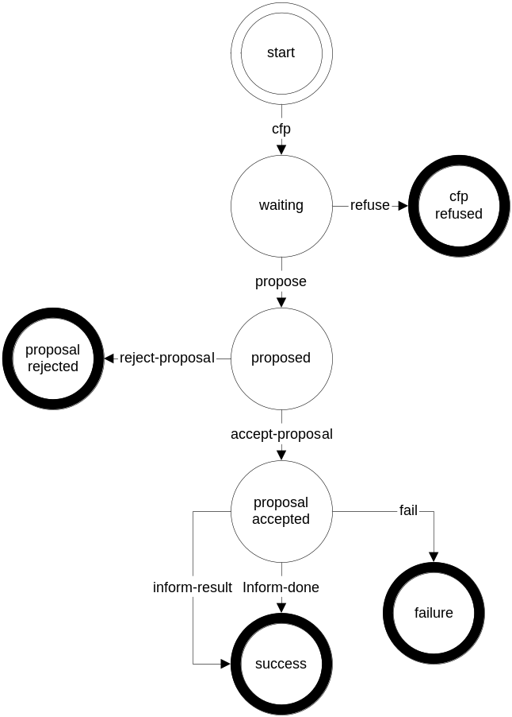
How to compose interaction laws / specifications?
Contract Net protocol
Contract Net is a pattern for a simple interaction type.
Elaboration on this pattern will almost certainly be necessary in order to specify all cases that might occur in an actual agent interaction.
Real world issues such as the effects of cancelling actions, asynchrony, abnormal or unexpected IP termination, and nested IPs are explicitly not addressed with CNP.

Slide 35
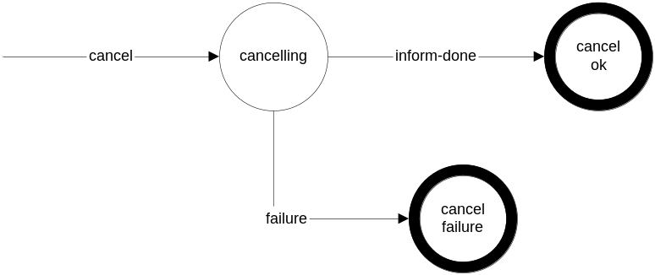
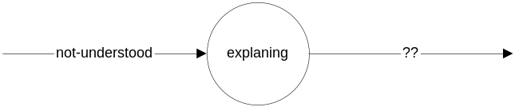
Contract Net protocol – Why don’t we modularize it?
Cancelling request...
Resolving doubts...
Basic CN Protocol

Slide 36
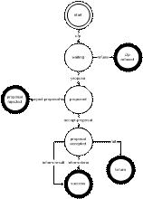
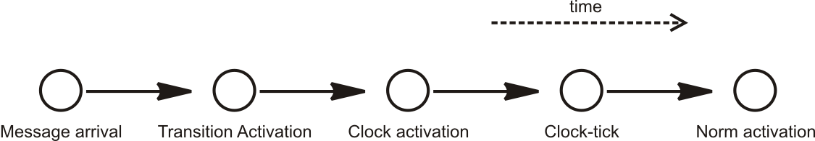
Modularizing Contract Net Protocol Specification
The contract net protocol laws are defined in 3 scenes, but they share some events while executing.
Relationship among the elements of the conceptual model is mostly based on events
Chain of causes and consequences
...
Law Specification
Law Specification
Element
generates
Event
perceives
Element
Law Specification

Slide 37
Connectors: Integrating Law Modules
Connector is a means to share event among different law modules.
  Law Module & Connector
  Input Link
  Output Link
  Input / Output Link
Module
generates
Event
perceives
Module
Law Module
Law Module
Law Module
Law Module
Law Module
Law Module
Law Module
Law Module

Slide 38
Connectors’ definition and usage
Connector :: Definition
<Organization ... >
<Connector id=“channel_name”>
  <EventRef type=“clock_activation"/>
  <EventRef type=“transition_activation"/>
  <EventRef type=“norm_deactivation"/>
</Connector>
...
</Organization>
Connector :: Usage
<Scene id=“scene_name">
<Connectors>
<ConnectorRef id =channel_name
type=“in”>
<EventRef type=“clock_activation"/>
</ConnectorRef>
</Connectors>
…
</Scene>
<Scene id=“other_scene_name">
<Connectors>
<ConnectorRef id =“channel_name”
type=“out”/>
</Connectors>
…
</Scene>

Slide 39
Connectors: Integrating Law Modules
Connector is a means to share event among different law modules.
<Scene id="ContractNet" time-to-live="infinity">
<Connectors>
<ConnectorRef id =“net” type=“inout”/>
</Connectors>
<Creators> … </Creators>
<Entrance> … </Entrance>
<Messages> … </Messages>
<Protocol>
<States> … </States>
<Transitions> … </Transitions>
</Protocol>
</Scene>
<Connector id=“net” >
  <EventRef type=“clock_activation"/>
  <EventRef type=“transition_activation"/>
  ...
</Connector>
<Scene id="NotUnderstood" time-to-live="infinity">
<Connectors>
<ConnectorRef id =“net” type=“in”/>
</Connectors>
…
</Scene>
<Scene id="CancelProccess" time-to-live="infinity">
<Connectors>
<ConnectorRef id =“net” type=“out”/>
</Connectors>
...
</Scene>

Slide 40
Conclusions
We are addressing the problem of constructing governance mechanisms that ensure that agents will conform to a well defined customizable specification.
  Our main goal is to contribute on the engineering on how we can productively define and reuse laws.
We are contributing with the study on how to engineer governance mechanisms development.
With the operators, we support the design of law elements for extension.
We begun to understand how to modularize law specifications (using connectors).

Slide 41
Future work
Implement extension operators and connectors in the new version of XMLaw
Propose some metrics to assess extension tendencies
Develop more case studies

Slide 42
Engineering Law-Governed Approaches
How to reuse, extend and compose interaction specifications
Gustavo Carvalho, Carlos Lucena
{guga,lucena}@inf.puc-rio.br

