Slide 1
Engineering Law-Governed Approaches
Governance Pattern: a Reuse Dimension in Open Multi-Agent Systems
Gustavo Carvalho
Rodrigo Paes
Luiz Fernando Rodrigues
Maira Gatti
Governance in Open MAS / Seminar

Slide 2
Monitoring laws on interactions
Laws
defines
Organization
Agent B
Agent A
interaction

Slide 3
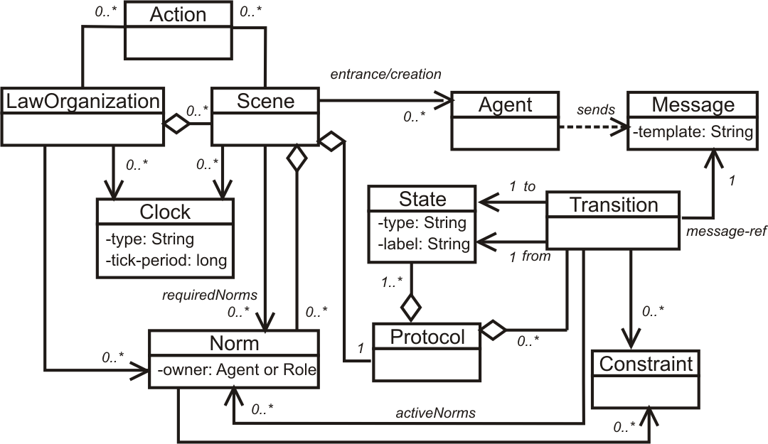
XMLaw
<Laws>
<LawOrganization id="…" name="…">
<Scene id="…" time-to-live="…">
<Creators>…</Creators>
<Entrance>
<Participant role="…" limit="…"/>
</Entrance>
<Messages>…</Messages>
<Protocol>
<States> … </States>
<Transitions>…</Transitions>
</Protocol>
<Norms>... </Norms>
<Clocks>...</Clocks>
<Actions>...</Actions>
</Scene>
</LawOrganization>
</Laws>

Slide 4
Laws establish a boundary on expected behaviors...
Laws

Slide 5
Reuse Dimensions in Open Multi-Agent Systems
Application domain
  Reuse and customization of law specifications
Technique domain
  Reuse and customization of governance mechanism

Slide 6
On the reuse of our governance mechanism
How to monitor and then handle not desired behaviors and states?
We are applying our law-governed approach in different contexts...
  Enforcement, tests, replication and exception handling.
What is really reused ?
  The specification language + conceptual model
  Part of the implementation...
Agent A
Agent B
Law Governance
Mechanism

Slide 7
Governance dynamics - General pattern
Wait for messages
Query Context
Apply Laws
Update Context
[not conform]
[ok]
Action
Action
[chain of actions]
Action
Redirect
Message
Inform
Agent
Collect
Information
Block
Message
Add
Replica
Remove
Replica

Slide 8
On the reuse of our governance mechanism
Monitor agents interactions,...
Enforcement
  blocking all messages that are not conform to the specification.
Exception handling
  signaling exceptions to agents, i.e., interactions that were not specified in laws.
Tests
  collecting information about the execution of agents to help understanding errors, for further analyses and diagnosis or to generate reports.
Replication strategy
  monitoring agents criticality to decide when new replicas are needed or are not needed anymore.

Slide 9
On the reuse of our governance mechanism
Enforcement
  Monitor agents interactions, blocking all messages that are not conform to the specification.
Wait for messages
Query Context
Apply Laws
Update Context
[not conform]
[ok]
Redirect Message
Block Message
Log Information

Slide 10
On the reuse of our governance mechanism
Exception handling
  Monitor agents interactions, signaling exceptions to agents, i.e., interactions that were not specified in laws.
Wait for messages
Query Context
Apply Laws
Update Context
[not conform]
[ok]
Redirect Message
Inform Agent
(Signal exception)

Slide 11
On the reuse of our governance mechanism
Tests
  Monitor agents interactions, collecting information about the execution of agents to help understanding errors, for further analyses and diagnosis or to generate reports.
Wait for messages
Query Context
Apply Laws
Update Context
[not conform]
[ok]
Collect Information
Collect Information
Block Message
Redirect Message
Report error

Slide 12
On the reuse of our governance mechanism
Replication strategy
  Monitor agents interactions, monitoring agents criticality to decide when new replicas are needed or are not needed anymore.
Wait for messages
Query Context
Apply Laws
Update Context
[not conform]
[ok]
Block Message
Add Replica ?
Report error
Remove Replica ?
Redirect Message

Slide 13
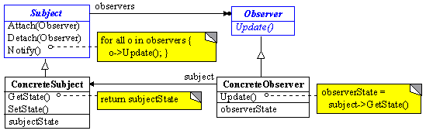
What about the “Apply Laws” step?
Some customizations will be required...
  But we will try it during experiments on the integration test approach and the replication strategy mechanism.
Wait for messages
Query Context
Apply Laws
Update Context
[not conform]
[ok]
Action
Action
[chain of actions]

