Slide 1
Engineering Law-Governed Approaches
A Governance Framework for Instantiating Supply Chain Management Applications as Open Systems
Gustavo Carvalho, Carlos Lucena
{guga,lucena}@inf.puc-rio.br
Submitted to AAMAS 2006

Slide 2
Monitoring laws on interactions
Laws
defines
Organization
Agent B
Agent A
interaction

Slide 3
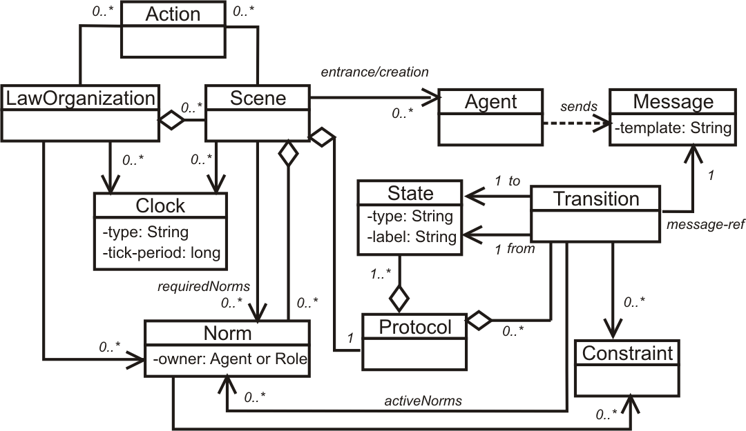
XMLaw
<Laws>
<LawOrganization id="…" name="…">
<Scene id="…" time-to-live="…">
<Creators>…</Creators>
<Entrance>
<Participant role="…" limit="…"/>
</Entrance>
<Messages>…</Messages>
<Protocol>
<States> … </States>
<Transitions>…</Transitions>
</Protocol>
<Norms>... </Norms>
<Clocks>...</Clocks>
<Actions>...</Actions>
</Scene>
</LawOrganization>
</Laws>

Slide 4
Context
Open MAS should be specified and developed to facilitate extensions.
  Last talk was about extension points[8].
Since software systems need to be customized according to different purposes and peculiarities, we propose to express evolution as variations related to interactions of open systems and to components that inhabit the environment.

Slide 5
Context
Following this hypothesis, we propose to design open systems using extension points [8] to annotate interaction specification and using laws to customize the agents’ expected behavior.
Agent roles
  For component variation support, we propose to use specifications of agent roles [14][16][23].
Templates
  Some specification elements can be reused and that some predefined “hooks” can be refined to develop a set of open MAS applications in a specific domain.

Slide 6
OO Framework Metaphor
An object-oriented framework [11] metaphor provides the necessary modeling capabilities for constructing reusable implementations of open systems.
  Framework
    A framework is a set of abstract and concrete elements that embody a semi-complete solution.
  Instances
    An instance is a set of concrete elements that specializes abstract elements to provide an executable system.
  The motivation for proposing the framework metaphor is to simplify the design and maintenance of a family of applications and to address the needs for highly customizable applications in an economical manner [5].

Slide 7
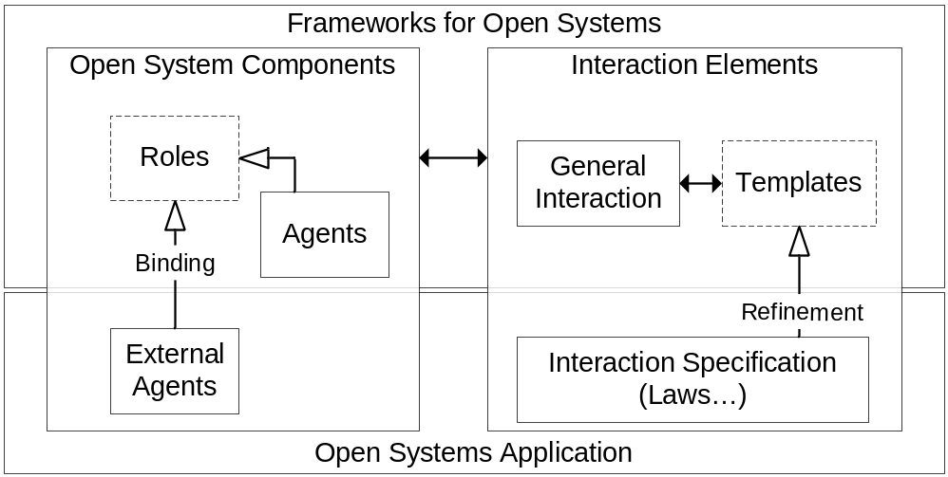
Governance Framework
Governance frameworks may demonstrate in practice the ability to apply enforcement (or, when needed, to relax enforcement) for both complex and changing specifications.
    Besides customizations, the compliance of the system to the specification must continue to be analyzed by a mechanism that governs the laws of interactions in open MAS.
    We use the XMLaw description language [19] to map the specification of interaction rules into a governance mechanism.

Slide 8
Extension points in XMLaw
Law customization is done by a step-wise refinement
  Interaction specification is extensible via law addition, law replacement, or law removal.
How to plug actions and constraints components in the law specification?
  Hooks are a means of representing knowledge about the place in a specification that can be changed by application developers.
  Two phases:
    Other elements definition + specification of hooks
    Hook instantiation → component assignment

Slide 9
Hooks
No class reference
<Actions>
<Action id="anyID">
<Element ref="transition"
event-type="transition_activation"/>
</Action>
</Actions>
<Constraints>
<Constraint id="anyID"/>
</Constraints>
No class reference

Slide 10
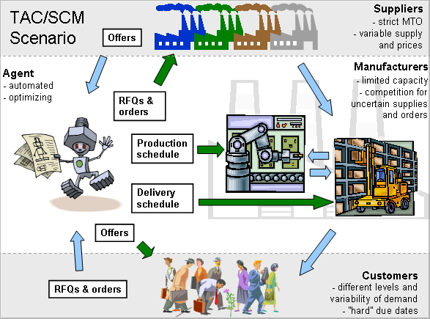
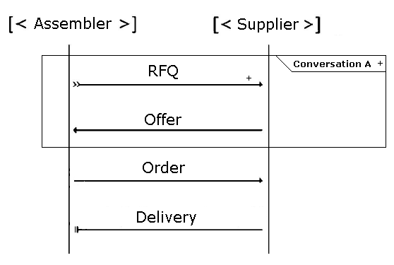
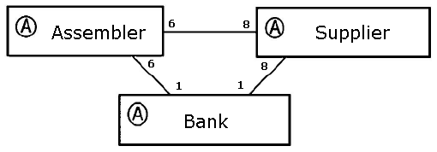
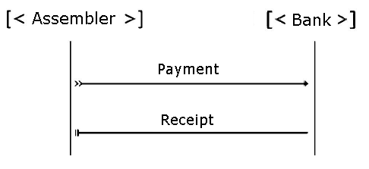
Case Study - TAC SCM Variability

Slide 11
TAC SCM Governance Framework
Core
  Common law definition + extension points
Extension points
  Constraint over rfqTransition
  Permission over Assembler’s RFQs
  Payment process

Slide 12
Core
<Messages>
<Message id="payment" template="..."/>
<Message id="receipt" template="..."/>
</Messages>
<Protocol>
<States>
<State id="p1" type="initial"/>
<State id="p2" type="execution"/>
<State id="p3" type="success"/>
</States>
<Transitions>
<Transition id="payingTransition"
from="p1" to="p2" message-ref="payment"/>
<Transition id="paymentConcludedTransition"
from="p2" to="p3" message-ref="receipt"/>
</Transitions>
</Protocol>
<Scene id="negotiation" time-to-live="3300000">
<Creators>
<Creator role="assembler"/>
</Creators>
<Entrance>
<Participant role="assembler" limit="6"/>
<Participant role="supplier" limit="8"/>
</Entrance>
</Scene>
...
<Messages>
<Message id="rfq" template="..."/>
<Message id="offer" template="..."/>
<Message id="order" template="..."/>
<Message id="delivery" template="..."/>
</Messages>
<Norms>
<Permission id="RestrictOfferValues">
<Owner>Supplier</Owner>
<Activations>
<Element ref="rfqTransition"
event-type="transition_activation"/>
</Activations>
<Deactivations>
<Element ref="offerTransition"
event-type="transition_activation"/>
</Deactivations>
<Actions>
<Action id="keepRFQInfo"
class="tacscm.norm.actions.KeepRFQAction">
<Element ref="rfqTransition"
event-type="transition_activation"/>
</Action>
</Actions>
<Constraints>
<Constraint id="checkDates"
class="tacscm.norm.constraints.CheckValidDay"/>
<Constraint id="checkAttributes"
class="tacscm.norm.constraints.CheckValidMessage"/>
</Constraints>
</Permission>
<Norms>
<States>
<State id="as1" type="initial"/>
<State id="as2" type="execution"/>
<State id="as3" type="execution"/>
<State id="as4" type="execution">
<State id="as5" type="success"/>
</States>
<Scene id="payment" time-to-live="infinity">
<Creators>
<Creator role="any"/>
</Creators>
<Entrance>
<Participant role="assembler" limit="1"/>
<Participant role="bank" limit="1"/>
</Entrance>
</Scene>
<Transitions>
<Transition id="rfqTransition" from="as1" to="as2"
message-ref="rfq">...</Transition>
<Transition id="newRFQTransition" from="as2" to="as2"
message-ref="rfq">...</Transition>
<Transition id="otherRFQTransition" from="as3" to="as2"
message-ref="rfq">...</Transition>
<Transition id="offerTransition" from="as2" to="as3"
message-ref="offer">...</Transition>
<Transition id="orderTransition" from="as3" to="as4"
message-ref="order"/>
<Transition id="deliveryTransition" from="as4" to="as5"
message-ref="delivery">...</Transition>
</Transitions>

Slide 13
Constraint over rfqTransition
<Transition id="rfqTransition" from="as1" to="as2"
message-ref="rfq">
<Constraints>
<Constraint id="checkDueDate"/>
</Constraints>
<ActiveNorms>
<Norm ref="AssemblerPermissionRFQ"/>
</ActiveNorms>
</Transition>
<Transition id="rfqTransition" from="as1" to="as2"
message-ref="rfq">
<Constraints>
<Constraint id="checkDueDate"
class="tacscm.constraints.ValiDate"/>
</Constraints>
...
</Transition>
<Transition id="rfqTransition" from="as1" to="as2"
message-ref="rfq">
<Constraints>
<Constraint id="checkDueDate"
class="tacscm.constraints.ValiDate2005"/>
</Constraints>
...
</Transition>

Slide 14
Permission over Assembler’s RFQs
<Permission id="AssemblerPermissionRFQ">
<Owner>Assembler</Owner>
<Activations>
<Element ref="negotiation"
event-type="scene_creation"/>
</Activations>
<Deactivations>
<Element ref="orderTransition"
event-type="transition_activation"/>
</Deactivations>
<Constraints>
<Constraint id="checkCounter"/>
</Constraints>
<Actions>
<Action id="permissionRenew"
class="tacscm.norm.actions.ZeroCounter">
<Element ref="nextDay" event-type="clock_tick"/>
</Action>
<Action id="orderID">
<Element ref="rfqTransition"
event-type="transition_activation"/>
</Action>
</Actions>
</Permission>
<Permission id="AssemblerPermissionRFQ">
<Constraints>
<Constraint id="checkCounter"
class="tacscm.norm.constraints.CounterLimit"/>
</Constraints>
<Actions>
...
<Action id="orderID“
class="tacscm.norm.actions.RFQCounter">...</Action>
</Actions>
</Permission>
<Permission id="AssemblerPermissionRFQ">
<Constraints>
<Constraint id="checkCounter"
class="tacscm.norm.constraints.CounterLimit2005"/>
</Constraints>
<Actions>
<Action id="orderID“
class="tacscm.norm.actions.RFQCounter2005">...</Action>
</Actions>
</Permission>

Slide 15
Payment process
<Obligation id="ObligationToPay">
<Owner>Assembler</Owner>
<Activations>
<Element ref="orderTransition"
event-type="transition_activation"/>
</Activations>
<Deactivations>
<Element ref="payingTransition"
event-type="transition_activation"/>
</Deactivations>
</Obligation>
<Obligation id="ObligationToPay">
...
<Actions>
<Action id="supplierPayment“
class="tacscm.norm.actions.SupplierPayment100">
<Element ref="deliveryTransition"
event-type="transition_activation"/>
</Action>
</Actions>
</Obligation>
<Obligation id="ObligationToPay">
...
<Actions>
<Action id="supplierDownPayment“
class="law.tacscm.norm.actions.SupplierPayment10">
<Element ref="orderTransition"
event-type="transition_activation"/>
</Action>
<Action id="supplierPayment"
class="law.tacscm.norm.actions.SupplierPayment90">
<Element ref="deliveryTransition"
event-type="transition_activation"/>
</Action>
</Actions>
</Obligation>

Slide 16
Related Work
Singh [18] proposes a customizable governance service, based on skeletons.
  His approach formally introduces traditional scheduling ideas into an environment of autonomous agents without requiring unnecessary control over their actions, or detailed knowledge of their designs.
  Skeletons are equivalent to state based machines and we could try to reuse their formal model focusing on the implementation of a family of applications.
  But [18] has few implementation details and examples where allowing us to understand how his proposal was implemented.

Slide 17
Related Work
All of these approaches are useful instruments to promote reuse, they can be seen as instruments for specifying laws in governance frameworks, and their effectiveness will be evaluated in future experiments.
  COSY [13] views a protocol as an aggregation of primitive protocols. Each primitive protocol can be represented by a tree where each node corresponds to a particular situation and transitions correspond to possible messages an agent can either receive or send, i.e., the various interaction alternatives.
  In AgenTalk’s [17], protocols inherit from one another. They are described as scripts containing the various steps of a possible sequence of interactions. Beliefs also are embedded into scripts.
  Koning and Huget [15] deal with the modeling of interaction protocols for multi-agent systems, outlining a component-based approach that improves flexibility, abstraction and protocol reuse.

Slide 18
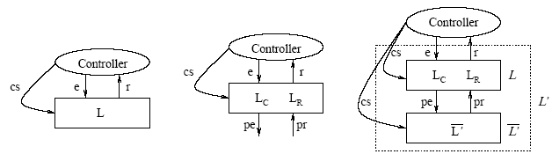
Related Work
Ao and Minksy (2003) propose an approach to enhance LGI with the concept of policy-hierarchy to support that different internal policies are formulated independently of each other, achieving by this means a flexibility support.
Differently from our approach, Ao and Minsky consider confidentiality as a requirement for their solution. The extensions that we have presented until now has the goal of supporting open system law maintenance, instead of flexibility for confidentiality purpose.

Slide 19
Conclusions
The purpose of this talk was to present an approach that could be useful to facilitate extensions on governance mechanisms for open systems.
  Interaction and roles are first order abstractions in open system specification reuse.
We address the problem of constructing a family of governance mechanisms that ensure that agents will conform to a well defined customizable specification.
  Our main goal was to contribute on the engineering on how we can productively use and reuse laws.

Slide 20
Conclusions
The law-governed approach is a non-intrusive method, which allows the independent development of the agents of the open system – they are only required to follow the protocols specified for the system.
While analyzing the open software system domain, it is possible to distinguish two kinds of interaction specification: fixed (stable) and flexible (extensible).
  The challenge to developers is to deliver a specification that identifies the aspects of the open MAS that will not change and cater the software to those areas.
  Stability is characterized by the interaction protocol and some general rules that are common to all open MAS instances.

Slide 21
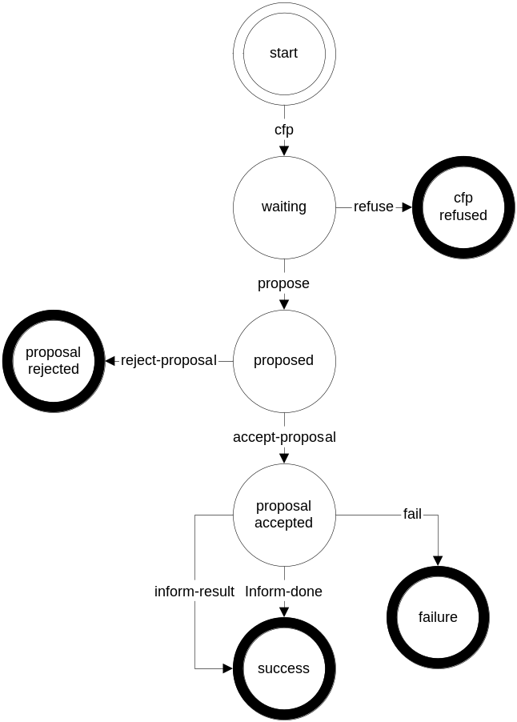
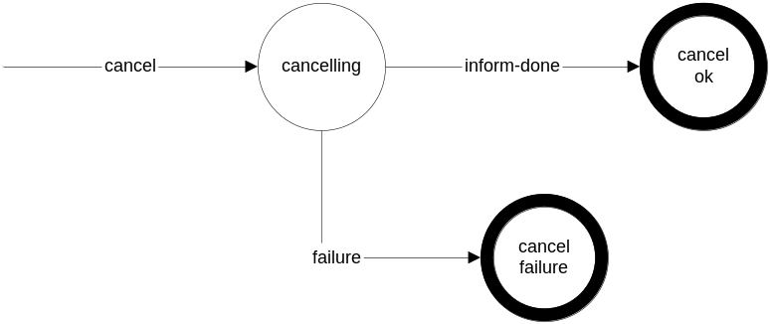

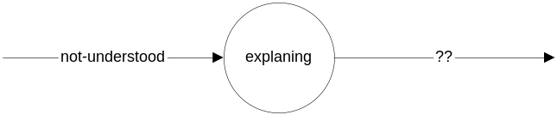
Ongoing work – Contract Net protocol
<Laws>
<Organization id="contractNet" name="Contract Net Protocol">
<Scene id="ContractNet" time-to-live="infinity">
<Creators>
<Creator role="initiator"/>
</Creators>
<Entrance>
<Participant role="initiator" limit="1">
<State ref="start"/>
</Participant>
<Participant role="participant" limit="m">
<State ref="waiting"/>
</Participant>
</Entrance>
<Messages>
<Message id="cfp" template="message(cfp,
sender(Requester,initiator),
receiver(Participant,participant),
content( conversation-id(ID), reply-by(deadline)))."/>
<Message id="propose" template="message(propose,
sender(Participant,participant),
receiver(Requester,initiator),
content( conversation-id(ID) ))."/>
<Message id="refuse" template="message(refuse,
sender(Participant,participant),
receiver(Requester,initiator),
content( conversation-id(ID) ))."/>
<Message id="rejectProposal" template="message(reject-proposal,
sender(Requester,initiator),
receiver(Participant,participant),
content( conversation-id(ID) ))."/>
<Message id="acceptProposal" template="message(accept-proposal,
sender(Requester,initiator),
receiver(Participant,participant),
content( conversation-id(ID) ))."/>
<Message id="failure" template="message(failure,
sender(Participant,participant),
receiver(Requester,initiator),
content( conversation-id(ID) ))."/>
<Message id="informDone" template="message(inform,
sender(Participant,participant),
receiver(Requester,initiator),
content( conversation-id(ID) ))."/>
<Message id="informResult" template="message(inform,
sender(Participant,participant),
receiver(Requester,initiator),
content( conversation-id(ID),result(info) ))."/>
</Messages>
<Protocol>
<States>
<State id="start" type="initial" label="Initial state"/>
<State id="waiting" type="execution" label="Waiting"/>
<State id="proposed" type="execution" label="proposed"/>
<State id="proposalAccepted" type="execution" label="proposal accepted"/>
<State id="success" type="success" label="Success"/>
<State id="proposalRejected" type="failure" label="proposal rejected"/>
<State id="failure" type="failure" label="failure"/>
<State id="cfpRefused" type="failure" label="cfp Refused"/>
</States>
<Transitions>
<Transition id="cfpTransition" from="start" to="waiting"
message-ref="cfp"/>
<Transition id="proposeTransition" from="waiting" to="proposed"
message-ref="propose"/>
<Transition id="acceptTransition" from="proposed" to="proposalAccepted"
message-ref="acceptProposal"/>
<Transition id="endDoneTransition" from="proposalAccepted" to="success"
message-ref="informDone"/>
<Transition id="endResultTransition" from="proposalAccepted" to="success"
message-ref="informResult"/>
<Transition id="endFailureTransition" from="failure" to="failure"
message-ref="failure"/>
<Transition id="rejectTransition" from="proposed" to="proposalRejected"
message-ref="rejectProposal"/>
<Transition id="refuseTransition" from="Waiting" to="cfpRefused"
message-ref="refuse"/>
</Transitions>
</Protocol>
</Scene>
<Scene id="NotUnderstood" time-to-live="infinity">
<Creators>
<Creator role="any"/>
</Creators>
<Entrance>
<Participant role="initiator" limit="1">
<State ref="start"/>
<State ref="explaining"/>
</Participant>
<Participant role="participant" limit="1">
<State ref="start"/>
<State ref="explaining"/>
</Participant>
</Entrance>
<Messages>
<Message id="notUnderstood" template="message(not-understood,
sender(any,any),
receiver(any,any),
content( conversation-id(ID) ))."/>
<Message id="inform" template="message(inform,
sender(any,any),
receiver(any,any),
content( conversation-id(ID) ))."/>
</Messages>
<Protocol>
<States>
<State id="start" type="initial" label="Initial state"/>
<State id="explaining" type="execution" label="Explaining"/>
<State id="end" type="success" label="End"/>
</States>
<Transitions>
<Transition id="notUnderstoodTransition" from="start" to="explaining"
message-ref="notUnderstood"/>
<Transition id="gotoEndTransition" from="explaining" to="end"
message-ref="inform"/>
</Transitions>
</Protocol>
</Scene>
<Scene id="CancelProccess" time-to-live="infinity">
<Creators>
<Creator role="any"/>
</Creators>
<Entrance>
<Participant role="initiator" limit="1">
<State ref="start"/>
</Participant>
<Participant role="participant" limit="1">
<State ref="cancelling"/>
</Participant>
</Entrance>
<Messages>
<Message id="cancel" template="message(canceled-communicative-act,
sender(any,initiator),
receiver(any,participant),
content( conversation-id(ID) ))."/>
<Message id="informDoneCanceling" template="message(inform-done,
sender(any,participant),
receiver(any,initiator),
content( conversation-id(ID) ))."/>
<Message id="informFailureCanceling" template="message(failure,
sender(any,participant),
receiver(any,initiator),
content( conversation-id(ID) ))."/>
</Messages>
<Protocol>
<States>
<State id="start" type="initial" label="Initial state"/>
<State id="cancelling" type="execution" label="Cancelling"/>
<State id="cancelOk" type="success" label="Cancel ok"/>
<State id="cancelFailure" type="failure" label="Cancel failure"/>
</States>
<Transitions>
<Transition id="cancelTransition" from="start" to="cancelling"
message-ref="cancel"/>
<Transition id="cancelOkTransition" from="cancelling" to="cancelOk"
message-ref="informDoneCanceling"/>
<Transition id="cancelFailureTransition" from="cancelling" to="cancelFailure"
message-ref="informDoneCanceling"/>
</Transitions>
</Protocol>
</Scene>
</Organization>
</Laws>
</Laws>
Contract Net is a pattern for a simple interaction type. Elaboration on this pattern will almost certainly be necessary in order to specify all cases that might occur in an actual agent interaction.
Real world issues such as the effects of cancelling actions, asynchrony, abnormal or unexpected IP termination, nested IPs, and the like, are explicitly not addressed here.

Slide 22

Ongoing work - Law Awareness Service
Law Awareness service is a publish/subscribe architecture
  In runtime, this service notifies the catalogued agents of any law modification
The subscriber (agent) sends a message containing a subscription to the publisher (law awareness service)
  This subscription specifies the conditions under which the publisher will send a message to the subscriber
Subscription
Law
Awareness
Service
Notification
Subscriber

Slide 23
Future work
Basically, we can say that laws can be used to support several features related to fault tolerance [ Romanovsky ]:
  error detection
  system structuring for FT (nested scopes, error confinement)
  exception propagation
  cooperative exception handling
  sophisticated exception propagation policies
How do we engineer LGIs?
  How to start from requirements?
  How do we use system spec to build LGIs or XMLaw descriptions?
  Can we develop/introduce LGIs at the architectural level as a special type of connectors?
  Protocol part of XMLaws: look into existing work on path-expressions

Slide 24
References
Agha, G. A. Abstracting Interaction Patterns: A Programming Paradigm for Open Distributed Systems, In (Eds) E. Najm and J.-B. Stefani, Formal Methods for Open Object-based Distributed Systems IFIP Transactions, Chapman & Hall, 1997.
Ao, X. and Minsky, N. Flexible Regulation of Distributed Coalitions. In Proc. of the 8th European Symposium on Research in Computer Security (ESORICS). Gjøvik Norway, October, 2003.
Arunachalam, R; Sadeh, N; Eriksson, J; Finne, N; Janson, S. The Supply Chain Management Game for the Trading Agent Competition 2004. CMU-CS-04-107, July 2004
Bachmann, F and Bass, L. "Managing variability in software architectures," presented at Proceedings of the 2001 symposium on Software reusability: putting software reuse in context, Toronto, Canada.
Batory, D; Cardone, R. and Smaragdakis, Y. “Object-Oriented Frameworks and ProductLines”, 1st Software Product-Line Conference, Denver, Colorado, August 2000.
Bellifemine, F; Poggi, A; Rimassa, G. (2001) Jade: a fipa2000 compliant agent development environment, in: Proceedings of the fifth international conference on Autonomous agents, ACM Press, 2001, pp. 216–217
Carvalho, Gustavo; Paes, Rodrigo; Lucena, Carlos. Governing the Interactions of an Agent-based Open Supply Chain Management System. MCC nº 29/05, Dpto de Informática, PUC-Rio, 27 p., 2005.
Carvalho, Gustavo; Paes, Rodrigo; Lucena, Carlos. Extensions on Interaction Laws in Open Multi-Agent Systems. In: First Workshop on Software Engineering for Agent-oriented Systems (SEAS 05), 19th Brazilian Symposium on Software Engineering. Uberlândia, Brasil
Choren, R. and Lucena, C.J.P. Modeling Multi-agent systems with ANote. Software and Systems Modeling 4(2), 2005, p. 199 - 208.
Collins, J; Arunachala,R; Sadeh,N; Eriksson,J; Finne,N; Janson,S. (2005) The Supply Chain Management Game for the 2005 Trading Agent Competition. CMU-ISRI-04-139. http://www.sics.se/tac/tac05scmspec_v157.pdf
Fayad, M; Schmidt, D.C.; Johnson, R.E. Building application frameworks : object-oriented foundations of framework design. ISBN 0471248754, New York: Wiley, 1999.
Fredriksson M. et al. First international workshop on theory and practice of open computational systems. In Proceedings of twelfth international workshop on Enabling technologies: Infrastructure for collaborative enterprises (WETICE), Workshop on Theory and practice of open computational systems (TAPOCS), pp. 355 - 358, IEEE Press, 2003.

Slide 25
References
Haddadi, A. Communication and Cooperation in Agent Systems: A Pragmatic Theory, volume 1056 of Lecture Notes in Computer Science. Springer Verlag, 1996.
Kendall, E. “Role Modelling for Agent Systems Analysis, Design and Implementation”, IEEE Concurrency, 8(2):34-41, April-June 2000.
Koning, J.L. and Huget, M.P.. A component-based approach for modeling interaction protocols. In H. Kangassalo and E. Kawaguchi, editors, 10th European-Japanese Conference on Information Modelling and Knowledge Bases, Frontiers in Artificial Intelligence and Applications.IOS Press, 2000
Kristensen, B. B., Østerbye, K. “Roles: Conceptual Abstraction Theory & Practical Language Issues”, Special Issue of Theory and Practice of Object Systems on Subjectivity in Object-Oriented Systems, Vol. 2, No. 3, pp. 143-160, 1996.
Kuwabara, K; Ishida, T; and Osato, N. AgenTalk: Coordination protocol description for multiagent systems. In First International Conference on MultiAgent Systems (ICMAS-95), San Francisco, June 1995. AAAI Press. Poster.
Singh, M. P., "A Customizable Coordination Service for Autonomous Agents," Intelligent Agents IV: Agent Theories, Architectures, and Languages, Munindar P. Singh et al. ed., Springer, Berlin, 1998, pp. 93-106.
Paes, R. B.; Carvalho G. R.; Lucena, C.J.P.; Alencar, P. S. C.; Almeida H.O.; Silva, V. T. Specifying Laws in Open Multi-Agent Systems. In: Agents, Norms and Institutions for Regulated Multi-agent Systems (ANIREM), AAMAS2005, 2005.
Paes, R.B; Lucena, C.J.P; Alencar, P.S.C. A Mechanism for Governing Agent Interaction in Open Multi-Agent Systems MCC nº 30/05, Depto de Informática, PUC-Rio, 31 p., 2005
Sadeh, N; Arunachalam, R; Eriksson, J; Finne, N; Janson, S. TAC-03: a supply-chain trading competition, AI Mag. 24 (1) 92–94, 2003.
Wooldridge, M; Weiss, G; Ciancarini, P. (Eds.) Agent-Oriented Software Engineering II, Second International Workshop, AOSE 2001, Montreal, Canada, May 29, 2001, Revised Papers and Invited Contributions, Vol. 2222 of Lecture Notes in Computer Science, Springer, 2002.
Yu, L; Schmid, B.F. “A conceptual framework for agent-oriented and role-based workflow modelling”, the 1st International Workshop on Agent-Oriented Information Systems, Heidelberg, June 1999.
Zambonelli, F, Jennings, N; Wooldridge, M. Developing multiagent systems: The gaia methodology, ACM Trans. Softw. Eng. Methodol. 12 (3) 317–370, 2003.

