Slide 1
Extensions on Interaction Laws in Open Multi-Agent Systems
Gustavo Carvalho
guga@les.inf.puc-rio.br
Software Engineering for Agent-oriented Systems
SEAS 2005 - Uberlândia - Brasil

Slide 2
Outline
Difficulties with Open MASs
XMLaw in a Nutshell
  Laws acting on interactions
  Conceptual Model
  Example
How to design open systems for extensions?
  Motivation
  Extension points in XMLaw
  Constraints
  Actions
  Examples
  Related work
Conclusions and Future work

Slide 3
Difficulties with Open MASs
How to interact with agents that:
  we know little, if anything, about them
  whom we do not trust?
How does one reason about such a system?
How does one protect the system from buggy agents?
Etc.

Slide 4
Laws acting on interactions
Laws
defines
Organization
Agent B
Agent A
interaction

Slide 5
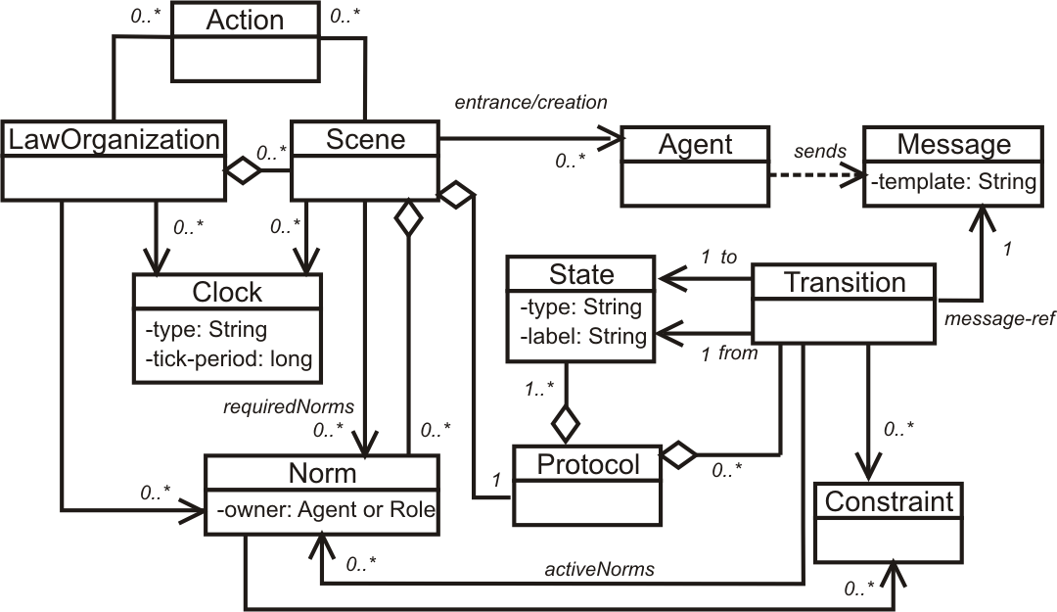
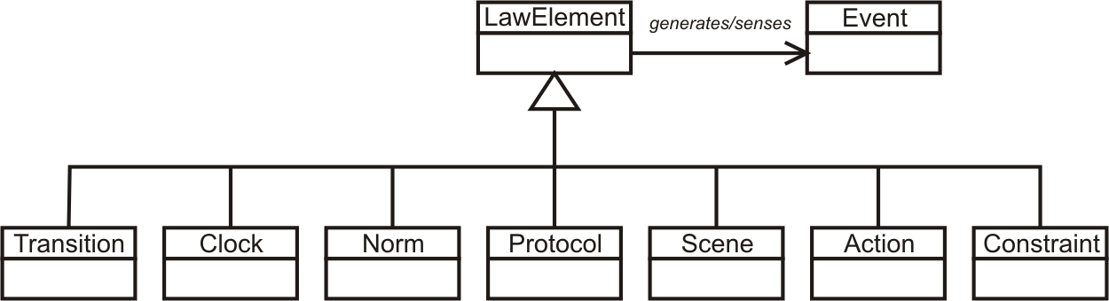
The Computational Conceptual Model
Set of concepts to represent interactions

Slide 6
Ping Pong Example – XMLaw
<LawOrganization id="org-ping-pong" name="International Ping Pong Organization">
<Scene id="game" time-to-live="infinity">
<Creators>
<Creator agent="any" role="ping" />
</Creators>
<Entrance>
<Participant agent="any" role="ping" limit="1">
<State ref="s0" />
</Participant>
<Participant agent="any" role="pong" limit="1">
<State ref="s1" />
</Participant>
</Entrance>
<Messages>
<Message id="m1" template="message(request,sender(_,ping),receiver(_,pong),content(ping))." />
<Message id="m2" template="message(inform,sender(_,pong),receiver(_,ping),content(ping-pong))." />
</Messages>
<Protocol>
<States>
<State id="s0" type="initial" label="Initial State" />
<State id="s1" type="execution" label="Ping sent" />
<State id="s2" type="success" label="Pong sent" />
</States>
<Transitions>
<Transition id="t1" from="s0" to="s1" message-ref="m1" />
<Transition id="t2" from="s1" to="s2" message-ref="m2" />
</Transitions>
</Protocol>
</Scene>
</LawOrganization>

Slide 7
How to design open systems for extensions?
As software systems need to be customized according to different purposes and peculiarities, it should be possible to express extensions over interactions of software agents.
  We annotated the interaction specification using extension points and that the expected behavior of the agents be specified using laws.
  Independently of extension points, the compliance of the system to the specification must continue to be analyzed by a mechanism that governs the laws of interactions in open MAS.
  For this purpose, we extended the XMLaw description language [Paes et al., 2005a] to map the specification of interaction rules into a governance mechanism and we enhanced it with support for extension points.

Slide 8
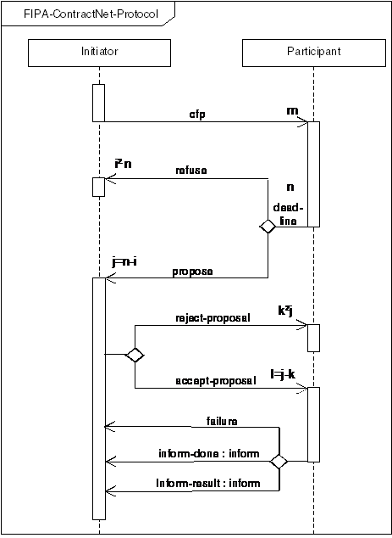
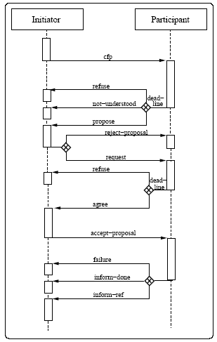
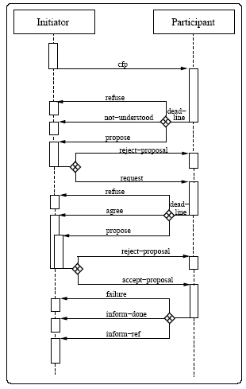
Motivation
Time outs?
Norms?
Filters?
Contract Net with Confirmation Protocol
Holonic Contract Net with Confirmation Protocol

Slide 9
Extension points in XMLaw
The extension points allow the modification of the interaction laws with services (action element) that could be activated by a law and with filters (constraint element) that could validate or not a law.
  This is a first step towards using variations and laws to specify extensions points in open system interactions.
Further, we intend to evaluate how we can use extensions to protocols, norms, scenes, and any other element.

Slide 10
Constraint
Constraints are restrictions over norms or transitions and generally specify filters for events, constraining the allowed values for a specific attribute of an event.
  For instance, a constraint can describe what the allowed values for specific attributes are. It can filter the event that is not conform to this rule.
    DueDate < 10/10/2005
    Value > 1000
Constraints are implemented using Java code.
  The class is called when a transition or a norm is supposed to fire, and basically the constraint analyzes if the message values or any other events’ attributes are valid.
    public class CheckValidDay extends AbstractConstraint {
    public boolean constrain(InfoCarrier info) {
    /* manipulate data */
    if ( /*check conditions*/ )
    return true;
    else
    return false;
    }
    }

Slide 11
Constraints in Transitions and Norms
<Transition id=”ab”
from=”a”
to=”b”
message-ref=”m”>
<Constraint id="anId" class="aClass"/>
</Transition>
<Permission id="a-Permission-Id">
<Owner>...</Owner>
<Activations>...</Activations>
<DeActivations>...</DeActivations>
<Constraints>
<Constraint id="anId" class="aClass"/>
</Constraints>
<Actions>...</Actions>
</Permission>
anId = true
a
b
m
anId = false
a
b
m
anId = true
anId = false
Norm
Norm
Activated
Deactivated

Slide 12
Actions
Environment actions are domain-specific Java code that runs integrated with XMLaw specifications.
  Actions can be used to plug services in an environment.
  For instance, an environment can call a debit service from a bank agent to automatically charge the purchase of a good in a negotiation.
Actions can be activated by any XMLaw event such as transition, norm, and even action activation.
  The class attribute of an Action specifies the java class in charge of the functionality implementation.
  The Element tag references the events that activate this action, and as many Element tags as needed can be defined to trigger an action.
<Actions>
<Action id="anActionId“
class="apackage.ActionClass">
<Element ref=“…“ event-type=“.."/>
<Element ref=“…“ event-type=“…"/>
</Action>
</Actions>
public class KeepRFQAction extends ActionExecution {
public void execute(InfoCarrier infoCarrier) throws LawException {
/* action implementation */
}
}

Slide 13
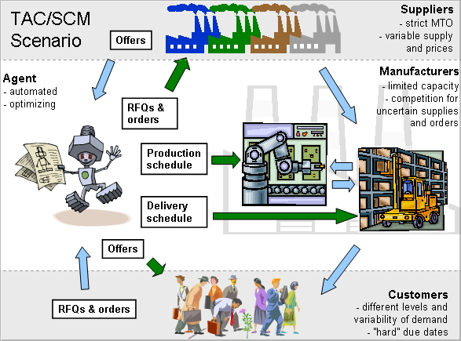
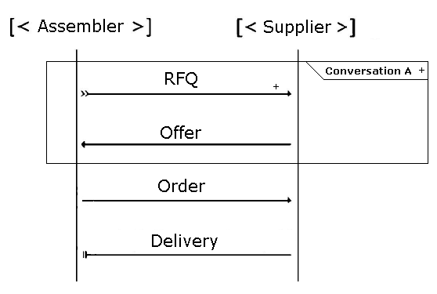
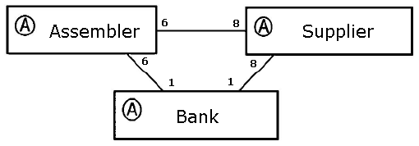
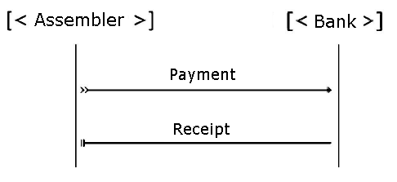
TAC SCM Variability

Slide 14
Governance Variations in XMLaw
Law customization is done by a step-wise refinement
  Interaction specification is extensible via law addition, law replacement, or law removal.
How to plug actions and constraints components in the law specification?
  Hooks are a means of representing knowledge about the place in a specification that can be changed by application developers.
  Two phases:
    Other elements definition + specification of hooks
    Hook instantiation → component assignment

Slide 15
Hooks
No class reference
<Actions>
<Action id="anyID">
<Element ref="transition"
event-type="transition_activation"/>
</Action>
</Actions>
<Constraints>
<Constraint id="anyID"/>
</Constraints>
No class reference

Slide 16
Transition with hook
<Transition id="rfqTransition" from="as1" to="as2“ message-ref="rfq">
<Constraints>
<Constraint id="checkDueDate"/>
</Constraints>
<ActiveNorms>
<Norm ref="AssemblerPermissionRFQ"/>
</ActiveNorms>
</Transition>
<Transition id="rfqTransition" from="as1" to="as2“ message-ref="rfq">
<Constraints>
<Constraint id="checkDueDate“ class="tacscm.constraints.ValiDate2005“ />
</Constraints>
...
</Transition>
No class reference

Slide 17
Permission with hooks
<Permission id="AssemblerPermissionRFQ">
<Owner>Assembler</Owner>
<Activations>
<Element ref="negotiation" event-type="scene_creation"/>
</Activations>
<Deactivations>
<Element ref="orderTransition" event-type="transition_activation"/>
</Deactivations>
<Constraints>
<Constraint id="checkCounter"/>
</Constraints>
<Actions>
<Action id="permissionRenew“ class="tacscm.norm.actions.ZeroCounter">
<Element ref="nextDay" event-type="clock_tick"/>
</Action>
<Action id="orderID">
<Element ref="rfqTransition" event-type="transition_activation"/>
</Action>
</Actions>
</Permission>
<Permission id="AssemblerPermissionRFQ">
…
<Constraints>
<Constraint id="checkCounter“ class="tacscm.norm.constraints.CounterLimit2005"/>
</Constraints>
<Actions>
<Action id="orderID“ class="tacscm.norm.actions.RFQCounter2005">...
</Action>
</Actions>
</Permission>
No class reference
No class reference

Slide 18
Obligation
<Obligation id="ObligationToPay">
<Owner>Assembler</Owner>
<Activations>
<Element ref="orderTransition“
event-type="transition_activation"/>
</Activations>
<Deactivations>
<Element ref="payingTransition“
event-type="transition_activation"/>
</Deactivations>
</Obligation>
<Obligation id="ObligationToPay">
<Owner>Assembler</Owner>
<Activations>
<Element ref="orderTransition“
event-type="transition_activation"/>
</Activations>
<Deactivations>
<Element ref="payingTransition“
event-type="transition_activation"/>
</Deactivations>
<Actions>
<Action id="supplierPayment“
class="tacscm.norm.actions.SupplierPayment">
<Element ref="orderTransition“
event-type="transition_activation"/>
</Action>
</Actions>
</Obligation>
Element inclusion

Slide 19
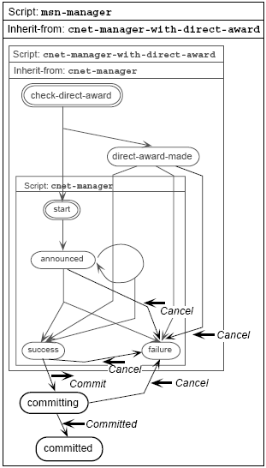
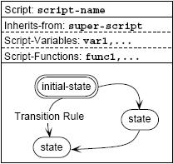
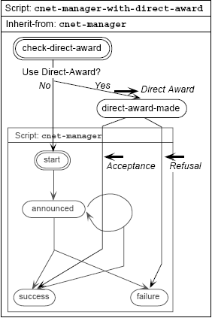
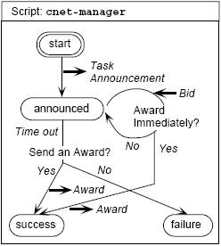
Inheritance - Extension Mechanism
Kuwabara, K., Ishida, T., and Osato, N.: "AgenTalk: Describing Multiagent Coordination Protocols with Inheritance", Proc. 7th IEEE International Conference on Tools with Artificial Intelligence (ICTAI '95) p.460-p.465 (1995)

Slide 20
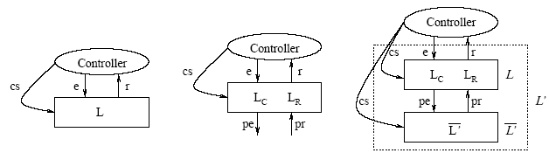
Hierarchy – Extension Mechanism
Minsky proposes a coordination and control mechanism called law governed interaction (LGI). This mechanism is based in two basic principles: the local nature of the LGI laws and a decentralization of law enforcement. It provides a language to specify laws and it is concerned with architectural decisions to achieve a high degree of robustness.
Ao and Minksy (2003) propose an approach to enhance LGI with the concept of policy-hierarchy to support that different internal policies are formulated independently of each other, achieving by this means a flexibility support.
Differently from our approach, Ao and Minsky consider confidentiality as a requirement for their solution. The extensions that we have presented until now has the goal of supporting open system law maintenance, instead of flexibility for confidentiality purpose.
Xuhui Ao and Naftaly Minsky. Flexible Regulation of Distributed Coalitions. In Proc. of the 8th European Symposium on Research in Computer Security (ESORICS). Gjøvik Norway, October 2003.

Slide 21
Conclusions
Extensions points can be defined in interaction specifications
  They can be used to customize the laws of open systems
It is quite easy to change the constraints and actions in XMLaw.
Next steps
  “Small Experiment”
    Contract net protocol and its variations
  How to design and implement a family of open systems?
    Continue to identify and evaluate extension mechanisms
      Skeletons [Singh, 1997]
      Abstract Laws [Dignum, 1998]
      Hierarchical levels of specification [Dignum, 2002]
      AgentTalk [Kuwabara et al., 1995]
      A component-based approach for modeling interaction protocols [Huget, 2000]

Slide 22
References
Ao, X. and N. Minsky. Flexible Regulation of Distributed Coalitions. In Proc. of the 8th European Symposium on Research in Computer Security (ESORICS). Gjøvik Norway, October 2003.
PAES, Rodrigo; LUCENA, Carlos; ALENCAR, Paulo S. C. Governing Agent Interaction in Open Multi-Agent Systems. Monografias em Ciência da Computação nº 30/05, Departamento de Informática, PUC-Rio, 39 p., 2005.
Singh, M. P., "A Customizable Coordination Service for Autonomous Agents," Intelligent Agents IV: Agent Theories, Architectures, and Languages, Munindar P. Singh et al. ed., Springer, Berlin, 1998, pp. 93-106.
Kuwabara, K; Ishida, T; and Osato, N. AgenTalk: Coordination protocol description for multiagent systems. In First International Conference on MultiAgent Systems (ICMAS-95), San Francisco, June 1995. AAAI Press. Poster.
Koning, J.L. and Huget, M.P. A component-based approach for modeling interaction protocols. In H. Kangassalo and E. Kawaguchi, editors, 10th European-Japanese Conference on Information Modelling and Knowledge Bases, Frontiers in Artificial Intelligence and Applications.IOS Press, 2000

Slide 23
Questions??
Gustavo Carvalho
guga@les.inf.puc-rio.br
Software Engineering for Agent-oriented Systems
SEAS 2005 - Uberlândia - Brasil

